Slide 1
Active learning for efficiently constructing surrogate models
AA 222 | Engineering Design Optimization | Spring 2020
Ross Alexander

Slide 2
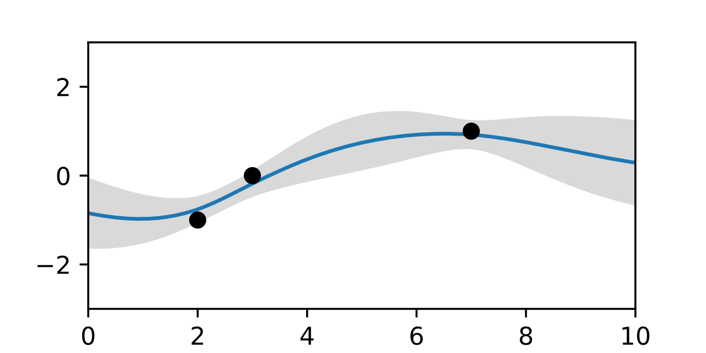

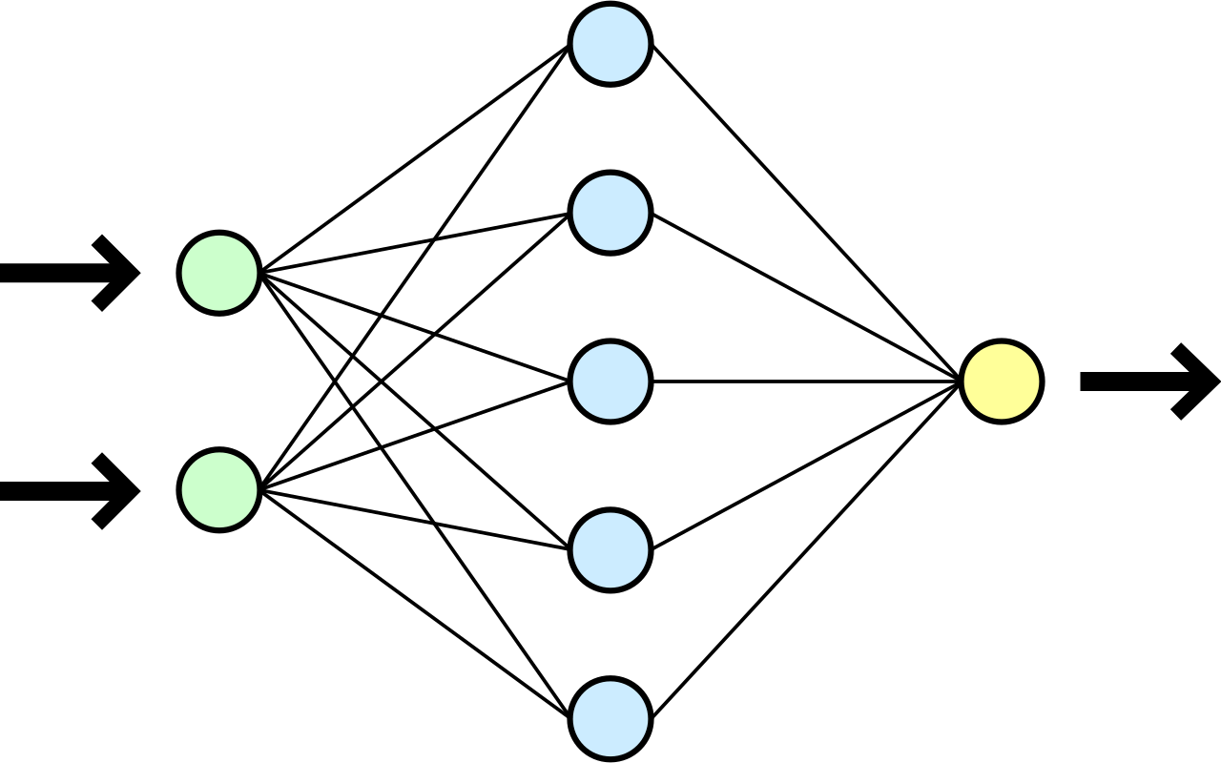

Efficiently learning a surrogate model using adaptive sampling
Goal
Given an arbitrary objective function, efficiently construct a surrogate model
Approach
Utilize active learning (adaptive sampling) to improve sample efficiency
Consider only Gaussian process and neural network surrogates
Construct and fit GPs using scikit-learn
Construct and fit NNs using tensorflow.keras
Select next sample based on:
Maximum variance estimator (GP only)
Maximum k-fold cross-validation variance estimator
Maximum linear approximation error using surrounding samples
Random sampling and space-filling sequences

Slide 3
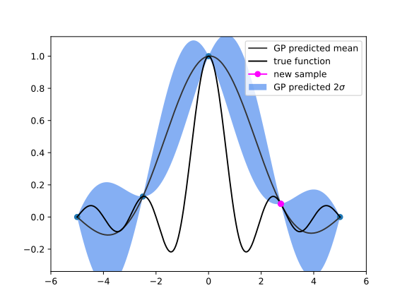
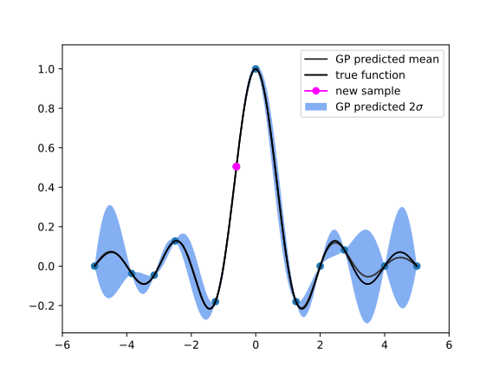
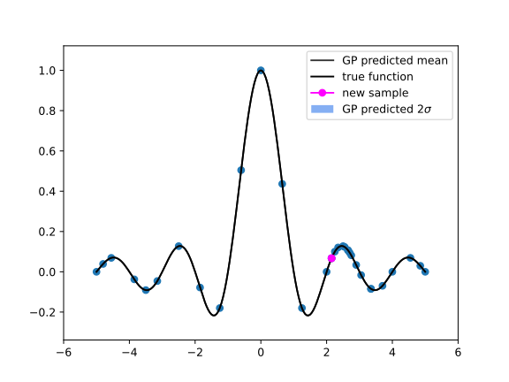
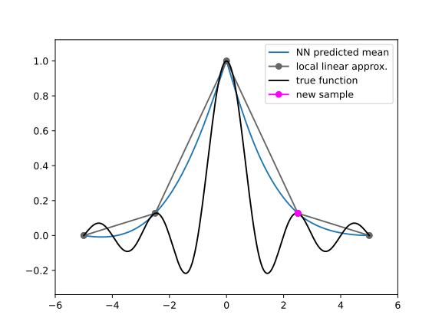
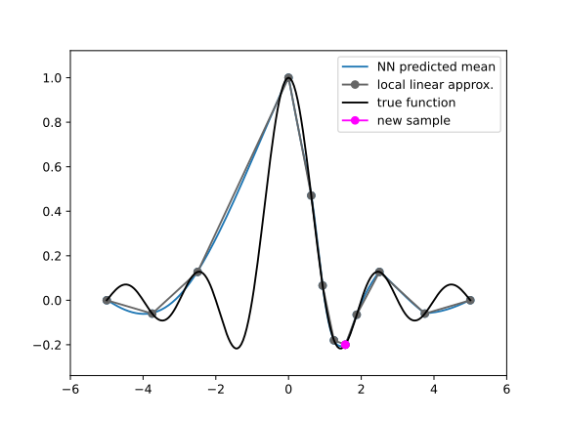
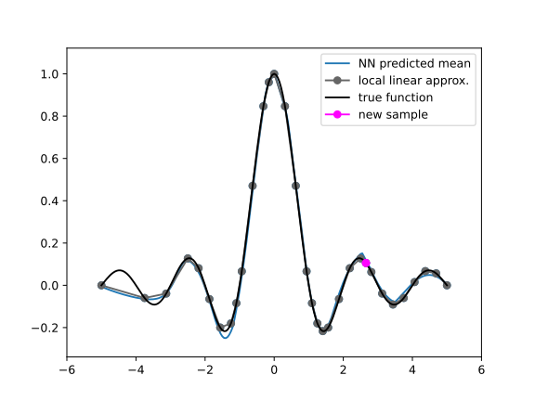
GP
Variance-based sampling
NN
Local approximation error-based sampling

Slide 4
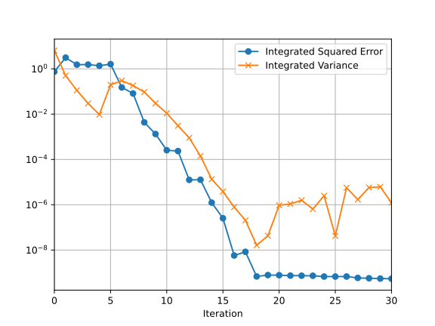
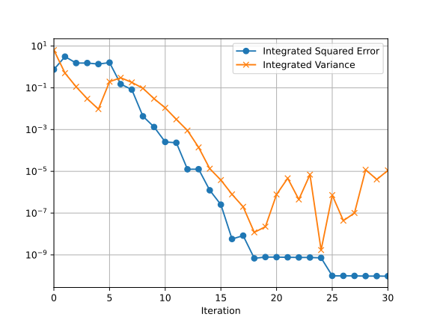
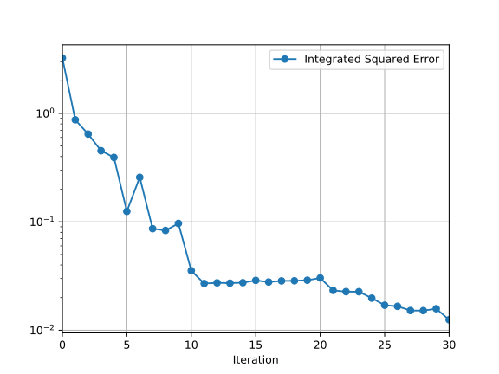
Compare model errors to examine sample efficiency
GP
Variance-based sampling
GP
Local approximation error-based sampling
NN
Local approximation error-based sampling

