Slide 1
Planning under uncertainty with sensor occlusions in urban driving scenarios
Offline and online planning approaches for solving the occluded crosswalk problem
Ross B. Alexander
2.24.2020

Slide 2
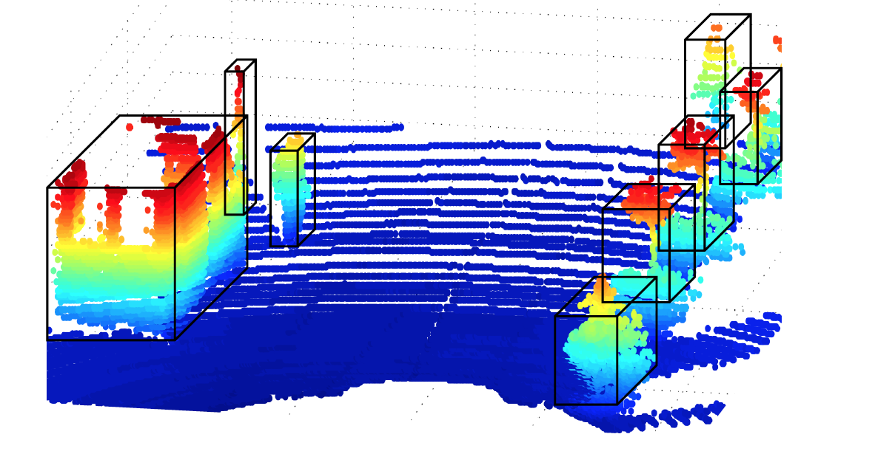
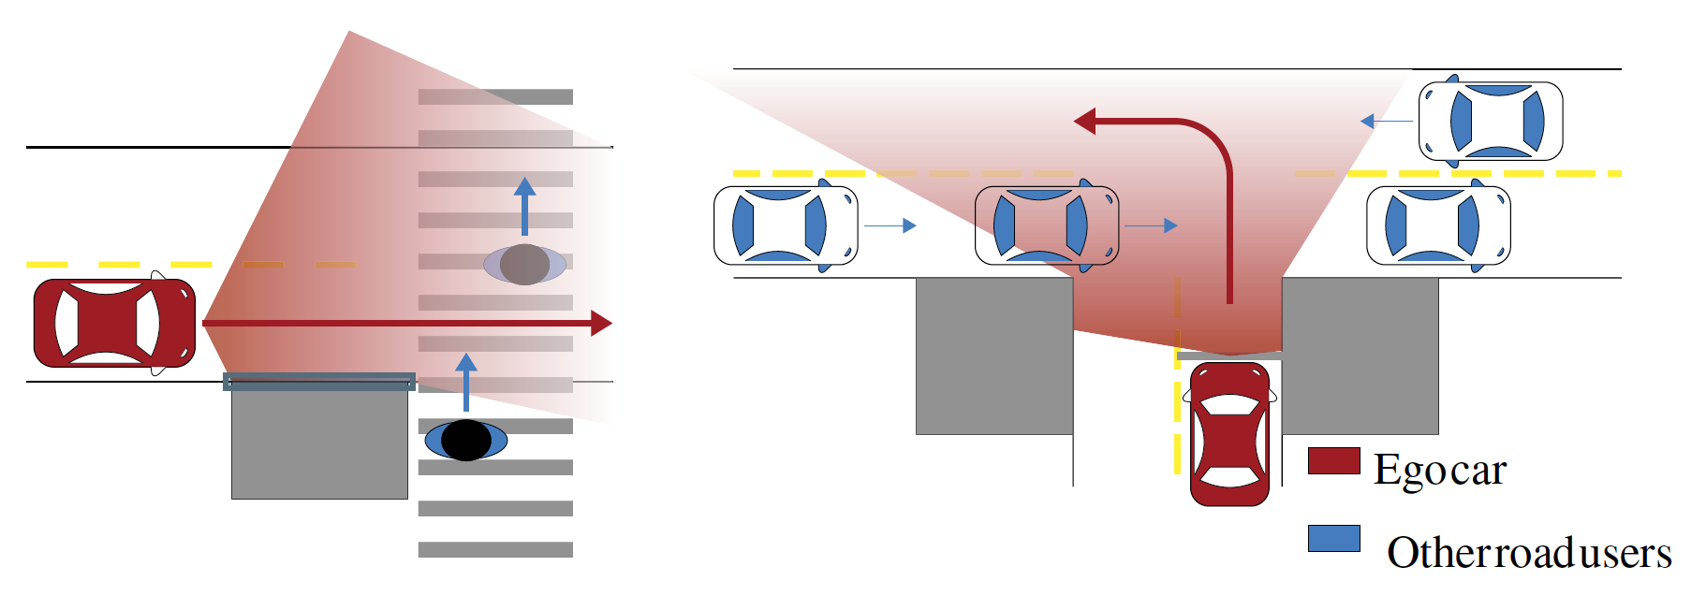
Motivation
Need safe and efficient planning for autonomous vehicles in urban scenarios
Even with perfect sensors, sensor occlusions lead to planning uncertainty
Static occlusions (buildings, signs, trees)
Dynamic occlusions (other traffic participants)
Common occlusion scenarios
Occluded crosswalk
Occluded unsignalized T-intersection
Occluded overtaking (rural!)
Ideal detection result from LIDAR
S. D. Pendleton et al., “Perception, planning, control, and coordination for autonomous vehicles,” Machines, vol. 5, no. 1, pp. 1–54, 2017.
Common occlusion scenarios
M. Bouton, A. Nakhaei, K. Fujimura, and M. J. Kochenderfer, “Scalable Decision Making with Sensor Occlusions for Autonomous Driving,” 2018 IEEE Int. Conf. Robot. Autom., pp. 2076–2081, 2018.
Notes:
Achieve level ⅘ autonomous driving
Urban scenarios, even common ones that can be handled easily by human drivers, are tough for AVs to navigate

Slide 3
Motivation
To achieve safe and efficient planning, other traffic participants need to be reasoned about and sensor uncertainty and sensor occlusions need to be accounted for
Occluded crosswalk is a good initial problem
Ideal detection result from LIDAR
S. D. Pendleton et al., “Perception, planning, control, and coordination for autonomous vehicles,” Machines, vol. 5, no. 1, pp. 1–54, 2017.
Common occlusion scenarios
M. Bouton, A. Nakhaei, K. Fujimura, and M. J. Kochenderfer, “Scalable Decision Making with Sensor Occlusions for Autonomous Driving,” 2018 IEEE Int. Conf. Robot. Autom., pp. 2076–2081, 2018.
Notes:
Must have belief that expresses/captures the non-zero probability of a traffic participant behind an occlusion
This is one of the critical steps in achieving level 4 & level 5 autonomous driving

Slide 4
Related Work
Pedestrian avoidance (Kapania, 2019); (Pusse, 2019)
Sensor occlusions
Crosswalk, static & dynamic occlusion (Bouton, 2018); (Schratter, 2019)
Crosswalk, dynamic occlusion (Thornton, 2018)
Risk quantification (Yu, 2018)
Field-of-view propagation (Hubmann, 2019)
Intention-aware planning
Pedestrians (Bai, 2015); (Luo, 2018); (Cai, 2019)
Drivers (Sunberg, 2017)
Notes:
Project to gain familiarity with POMDPs.jl, get some experience in the AV domain, and get a chance to better understand some of the solver techniques discussed in class
Lots of work on occlusions in autonomous driving
Pusse 2019 using DRL
Cai 2019 as the let’s drive paper
Intention aware planning is a sister to sensor occlusion modeling since we’re essentially partially observing some cooperation parameter

Slide 5
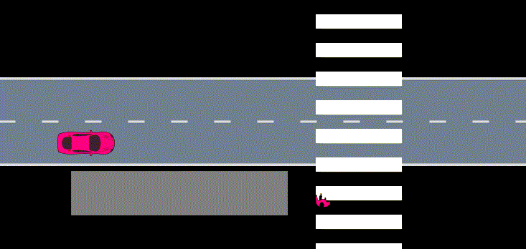
Problem Setting
Occluded crosswalk POMDP
Ego vehicle (·_{ego}) and pedestrian (·_{ped})
s: position
v: velocity
a: acceleration
2D continuous reduced spaces
S: (s_{ego}, v_{ego}) ✕ (s_{ped}, v_{ped}) … ✕_{i} (s_{ped}, v_{ped})_{i}
A: a_{ego}
O: (s_{ego}, v_{ego}) ✕ (s_{ped}, v_{ped}) … ✕_{i} (s_{ped}, v_{ped})_{i}
Options to discretize spaces, extend number of traffic participants
Occluded crosswalk scenario with ego vehicle and one pedestrian
Notes:
Simplified, but good choice for demonstration of this is the occluded crosswalk problem
Vehicles never reverse course is an assumption, but no vehicles really ever back up to avoid hitting a ped; pruning/clamping as well
Can see how this problem could be easily extended to multiple pedestrians or to the k-nearest traffic participants, big urban intersection

Slide 6
Problem Setting
Occluded crosswalk POMDP
Transition, reward, and observation models
T: linearized vehicle dynamics w/noise
linearized pedestrian dynamics w/noise
R: -1 for collision with pedestrian,
+1 for reaching roadway end
O: fully-observable ego vehicle
partially-observable pedestrian
Reach end of roadway without collision as quickly as possible using finite-horizon discounting
Occluded crosswalk scenario with ego vehicle and one pedestrian
Obstacle prevents even partial observability of pedestrian
Notes:
Markov property holds when state description is sufficiently rich and time step is small
As fast as possible due to discounting, also have to select a delta-t though (Gamma = 0.9)

Slide 7
Progress & Future Work
POMDPs.jl & AutomotivePOMDPs.jl
SingleOCPOMDP crosswalk ego, one pedestrian
OCPOMDP crosswalk ego, multiple pedestrians
UrbanPOMDP urban intersection ego, multiple pedestrians, multiple cars
Examine performance of offline solvers
Random policy simulation
QMDP policy simulation
SARSOP policy simulation
Notes:
Would like to add DESPOT

Slide 8
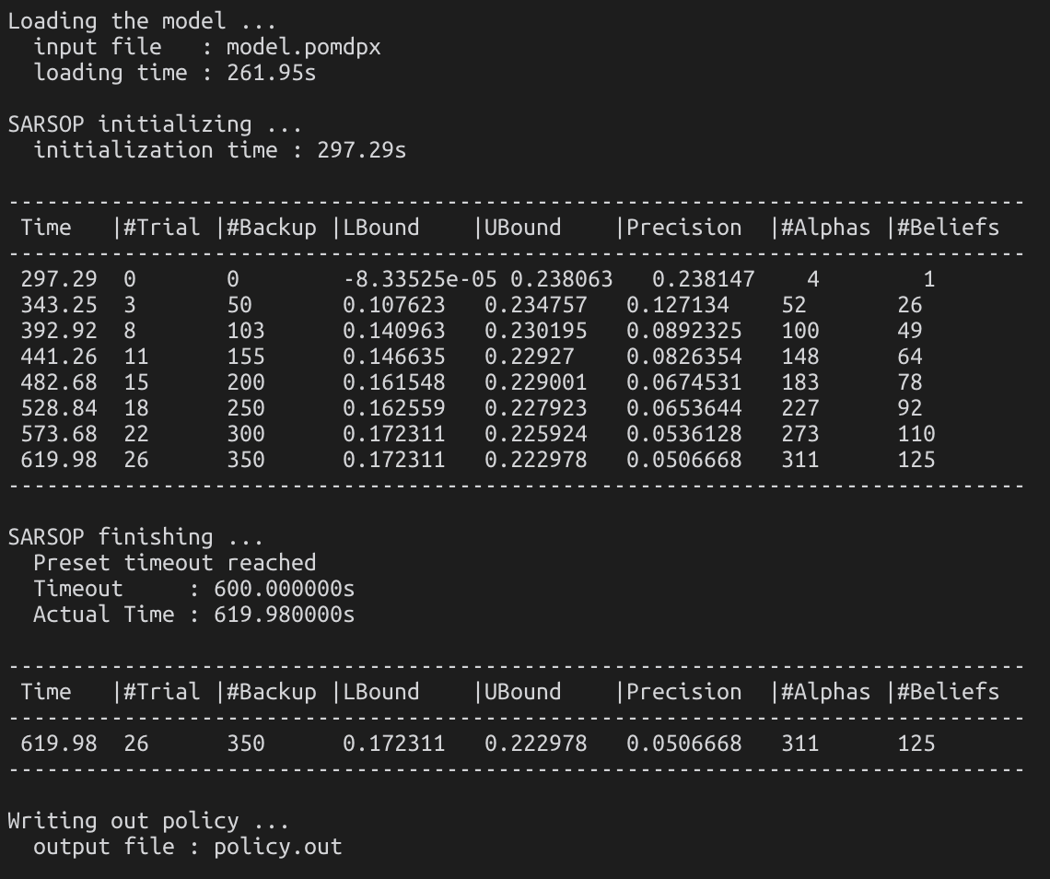
Progress & Future Work
Examine effects of:
discretization (continuous v. discrete, discrete resolution)
sensor types (Gaussian sensor, LIDAR sensor)
Metrics & results
Success rate
Crossing time (≈ reward)
Computation time & bound convergence
Policy & history visualizations
Offline approaches will likely become intractable in more complex scenarios, so explore online approaches in the OCPOMDP scenario
Notes:
as the discretization grows finer or as the number of peds grows offline approaches may become intractable
examine the OCPOMDP case

