Slide 1
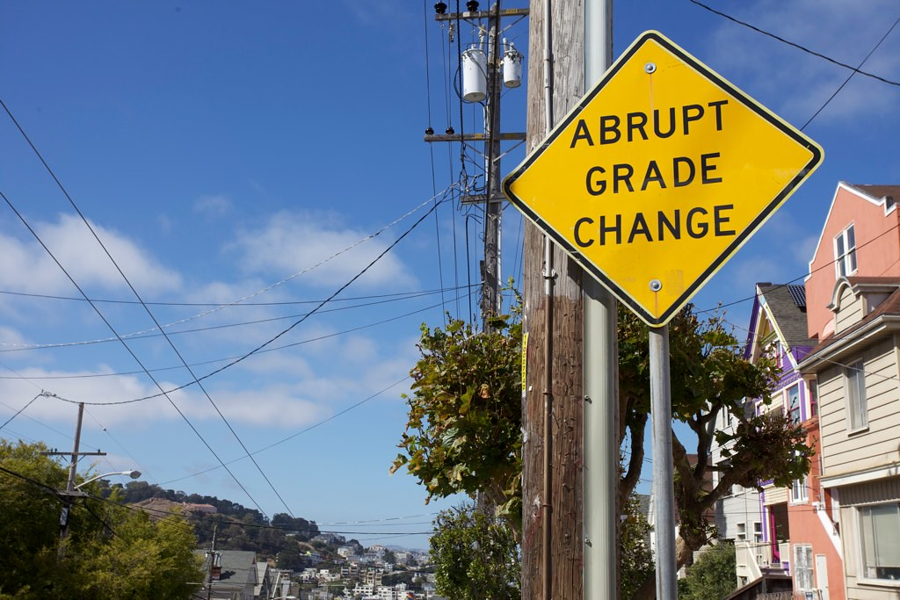

Abrupt Grade Change
Team 9
Ross Alexander
Matthew Hunter
Adyasha Mohanty
Roshan Nair

