Slide 1
ME 227 PROJECT

Slide 2
Longitudinal Controller

Slide 3
Tracking on a straight road- best version
Xla = 20
Kla = 3500
Klong = 2.5;
K long was determined by canceling out the drag, rolling resistance, Ux_des_dot term in the full controller; this gives
K_long = Fx / (m*(Ux_des - Ux)) = m*axDes / m*(Uxdes - Ux) = axDes / (Uxdes - Ux)
For spec of 0.25*g/(1 m/s or velocity error) is K_long = 0.25*g/1 = 2.5 (approx.)
Notes:
2.5 is exactly what we were looking for
Trey says that it is an upper bound, so nothing above 2.5; trey says good values are 1.5-2.5
Figure 4 is the acceleration plot we need to use

Slide 4
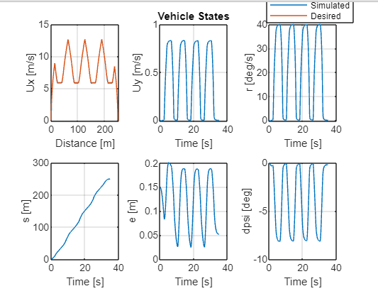
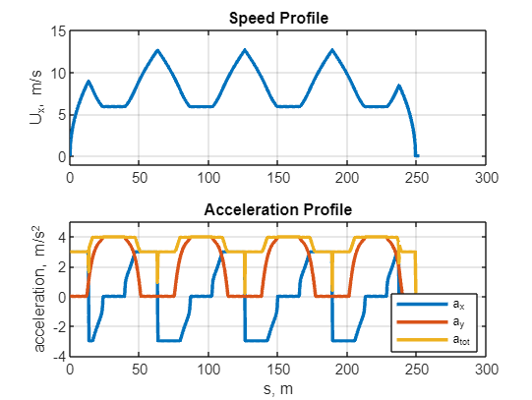
Kla = 3500, xla = 20; Klong = 2.5

Slide 5
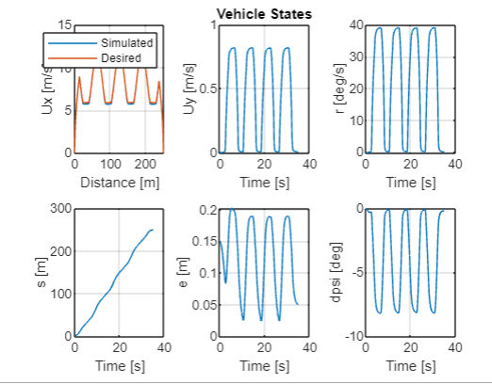
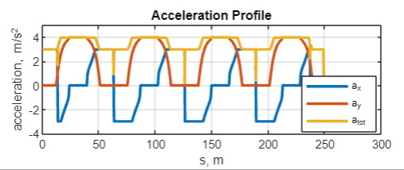
Kla = 3500, xla = 20; Klong = 0.625
Notes:
Write analysis tmrw morning, do formatting tmrw morning

Slide 6
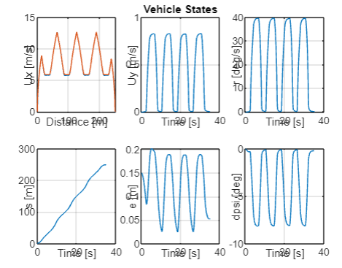
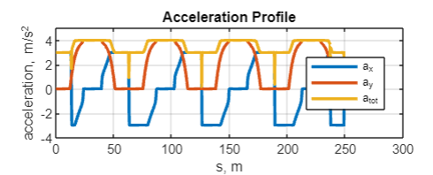
Kla = 3500, xla = 20; Klong = 1.25

Slide 7
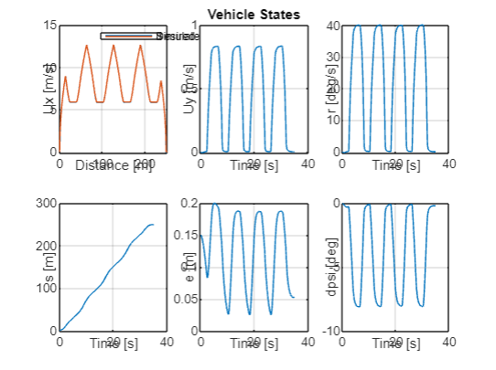
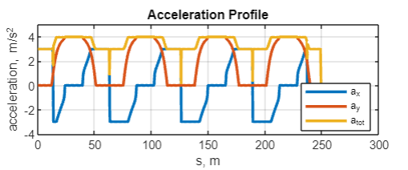
Kla = 3500, xla = 20; Klong = 5

Slide 8
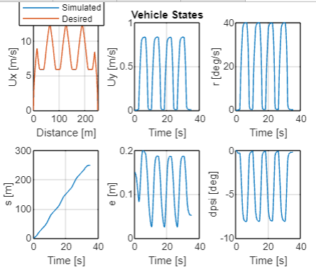
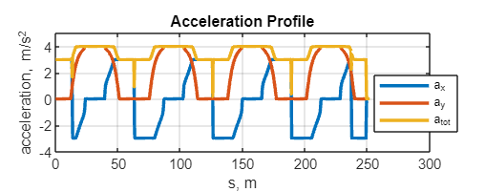
Kla = 3500, xla = 20; Klong = 10

Slide 9
Lateral Lookahead Controller

Slide 10
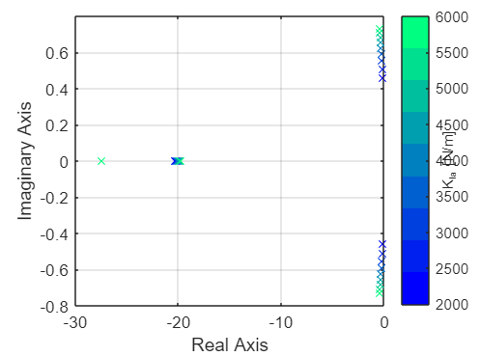
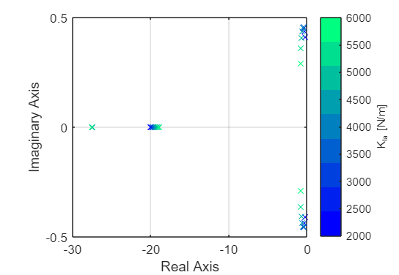
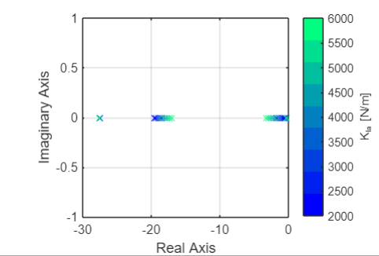
Ux = 5 m/s, xla = 5,10,20 m, Kla = 2600: 6000
Notes:
Trey says for the final report it could be cool to do a root locus on Ux with fixed xla and Kla

Slide 11
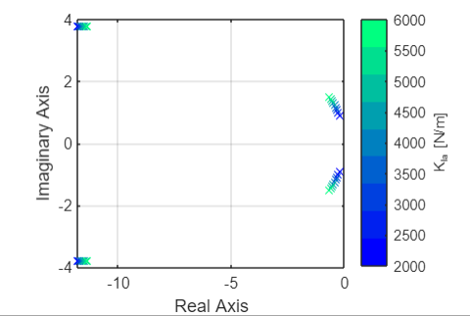
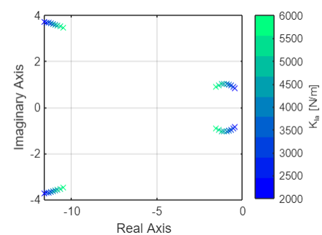
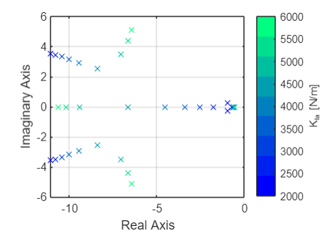
Ux = 10 m/s, xla = 5,10,20 m, Kla = 2600: 6000
Notes:
X_la = 20 m gives good performance at Ux = 5, and 10 m/s when K_la is on the upper end of the range (near 6500)

Slide 12
Kla = 3500, xla = 20; Klong = 2.5

Slide 13
Lookahead Distance Sensitivity
Lookahead Distance x_{la}(m) | Maximum Lateral Error e_{max}(m)
10 | .2653
15 | .2186
20 | .2006
25 | .2055
30 | .2199
Performed sensitivity analysis around original ideal case for lookahead distance
Upon further exploring around 20 meters, a new optimal lookahead distance was set at 22 that specifically met lateral error bound requirements
18 | .2061
19 | .2031
20 | .2006
21 | .1990
22 | .1988
23 | .2031

Slide 14
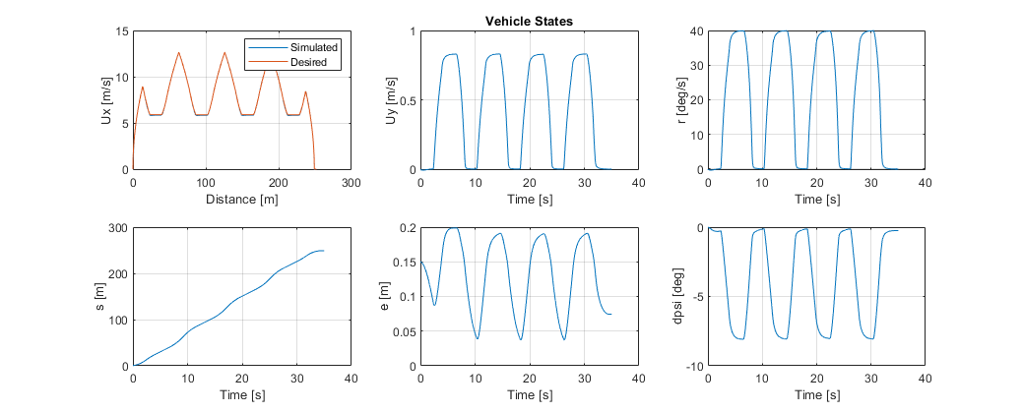
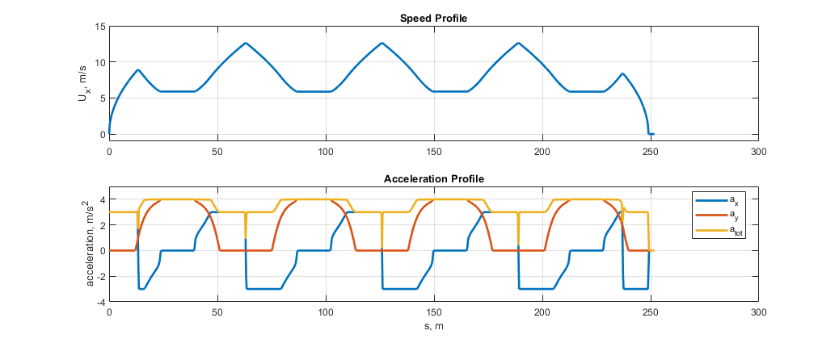
Simulation 0 (x_la = 22, K_la = 3500, K_long = 2.5)
e_max = 0.1988 m

Slide 15
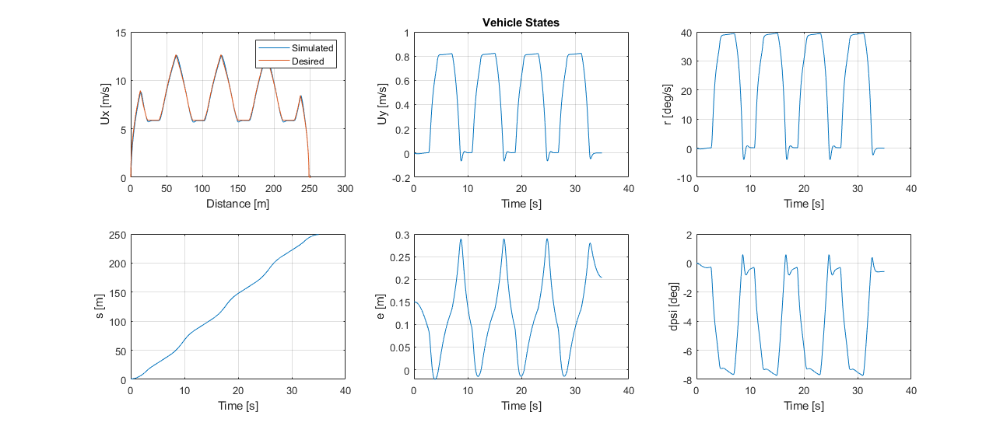
Simulation 1 (x_la = 22, K_la = 3500, K_long = 2.5)
e_max = 0.2897 m

Slide 16
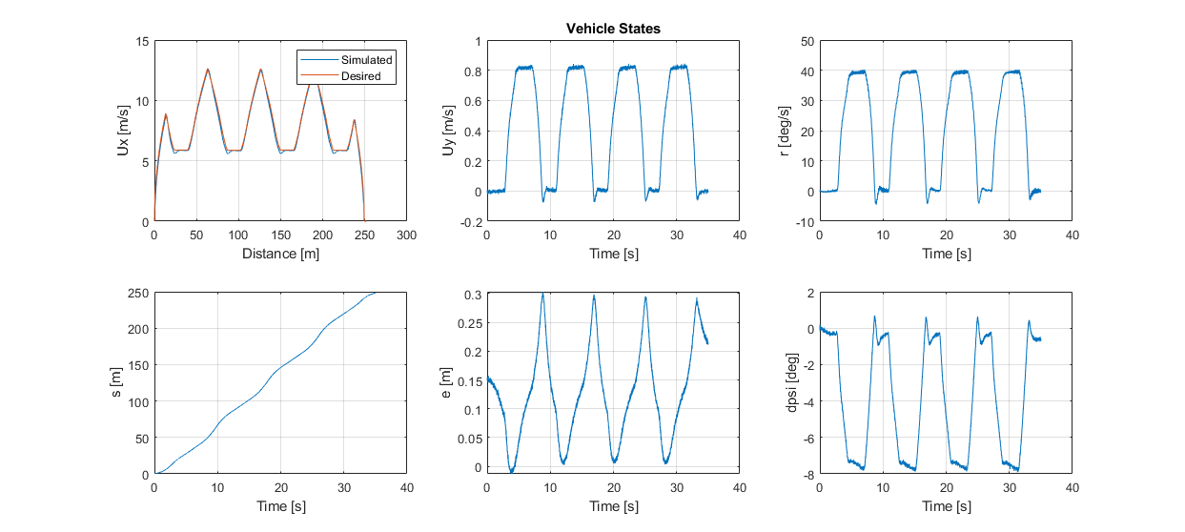
Simulation 2 (x_la = 22, K_la = 3500, K_long = 2.5)
e_max = 0.3030 m
Notes:
Looks like they added noise

Slide 17
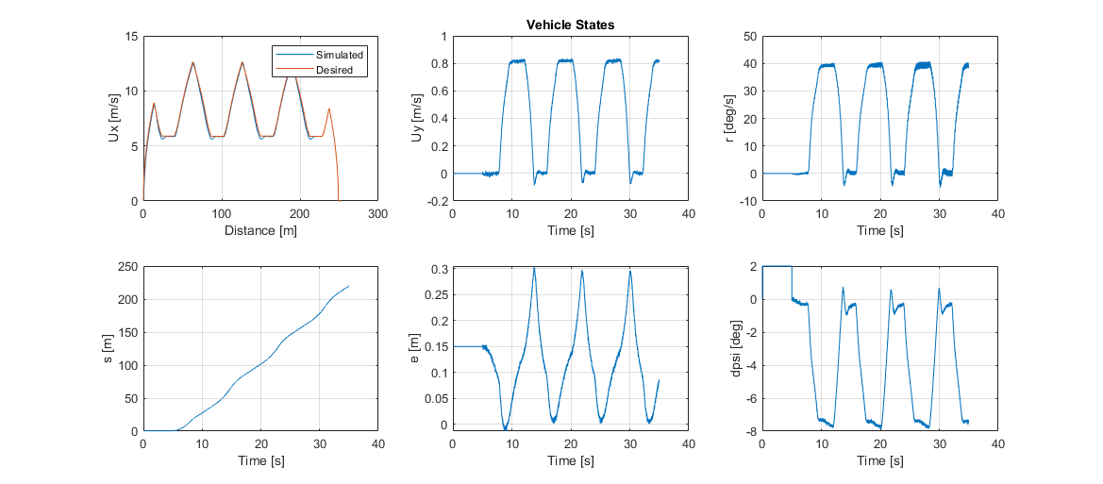
Simulation 3 (x_la = 22, K_la = 3500, K_long = 2.5)
e_max = 0.3049 m

Slide 18
Simulation 3 Experiments
x_la | K_la | K_long | e_max | Ux tracking
22 | 3500 | 2.5 | .3013 | -
22 | 3500 | .5 | .2840 | -
22 | 6500 | .5 | .2664 | -
20 | 6500 | .5 | .2549 | -
15 | 6500 | .5 | .2289 | -
10 | 6500 | .5 | .1896 (yay!) | Bad! (adjust K_long)
8 | 6500 | 5 | .1948 (also yay!) | Good!
Notes:
Decreasing x_la improves e
Decreasing K_long
Higher sim modes have delay in steering
K_long should be 1.5-2.5
X_la trends are weirder in higher sims since there is a steering delay
Start at xla = 20, Kla=3500, K_lon=2.5; tune K_lon down a bit
Tune a little around this region after that (K_la = 3000)

Slide 19
PID Controller

