Slide 1

Vecathon Subject: Light Toy
Realized by: Raul
Anna
Rostom
Lety

Slide 2
<number>
Plan
1. Introduction 2. Global Architecture 3. Demonstration 4.Conclusion and perspectives

Slide 3
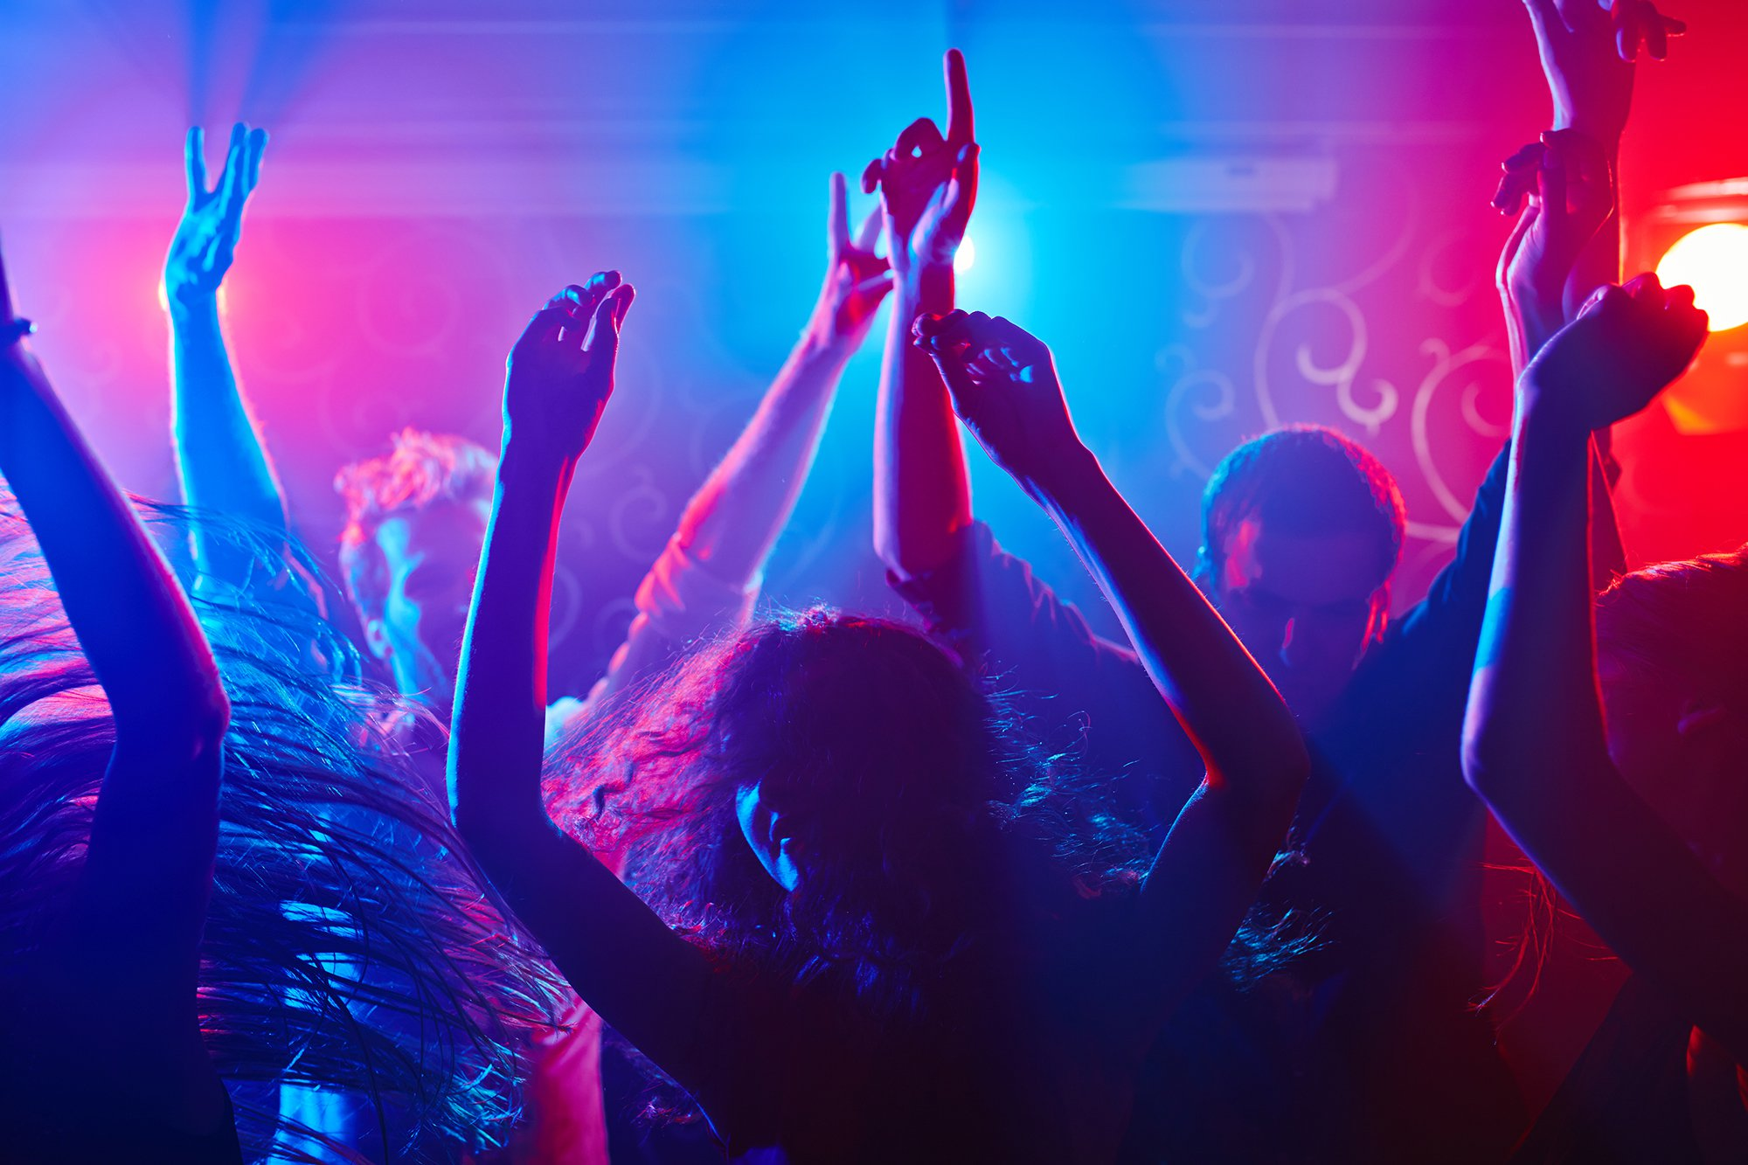

General Context
<number>

Slide 4
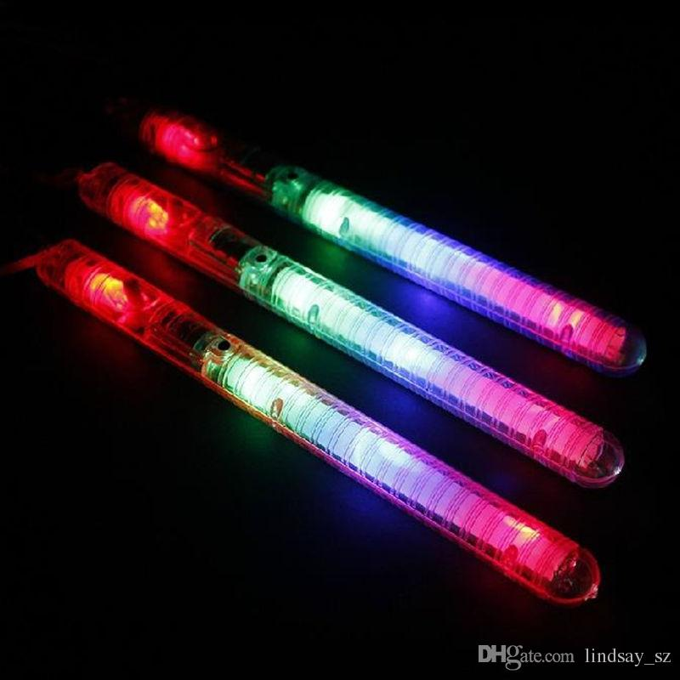
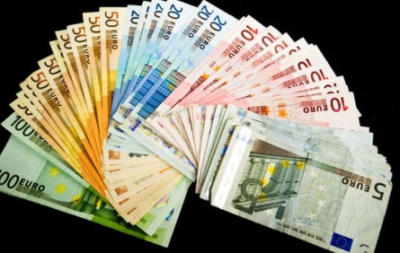

General Context
<number>
<number>
High costs: 2000 Euros
Non satisfaction of the costumer

Slide 5
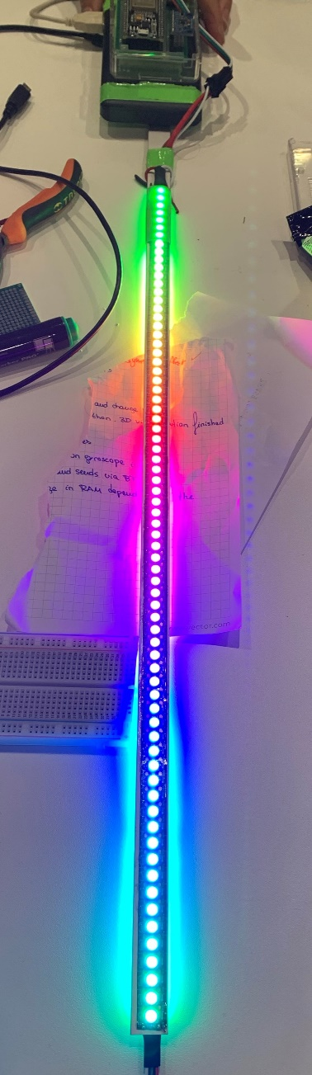
General Context
<number>
Build our own Light Toy!

Slide 6
<number>
The Plan
1. Introduction 2. Global Architecture 3. Demonstration 4. Conclusion and perspectives

Slide 7
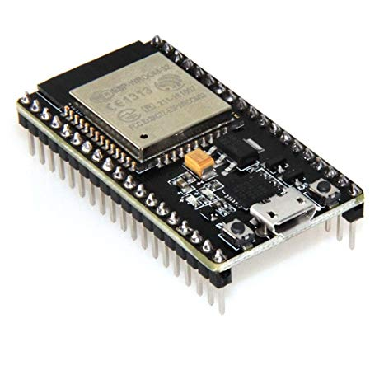
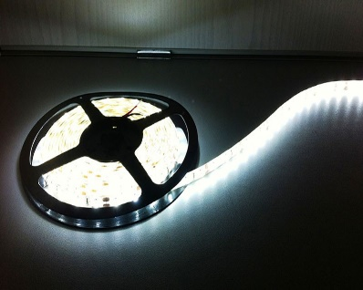
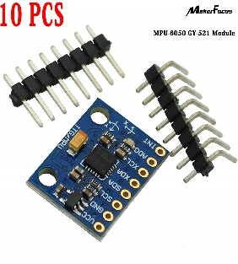
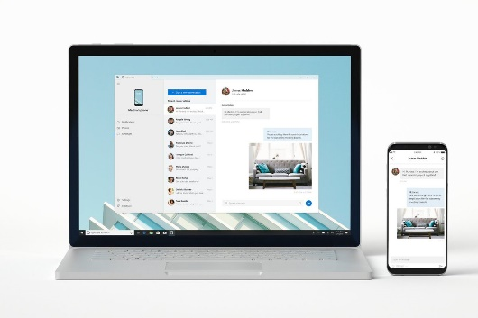
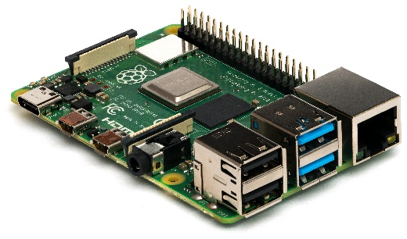
Hardware
<number>
ESP32 Microcontroller
Led strip
Gyroscope module
Pc and phone
Raspberry Pi

Slide 8
System architecture
<number>

Slide 9
Technology
<number>
Hardware | Software
Microcontroller: ESP32 | Embedded IDE: Arduino
LED stripe: WS2812B | 3D visualization: Python, Pygame, OpenGL
Gyroscope: MPU9250 | GUI: NodeRed
Back end: RaspberryPi 3B+ | Comm ESP32 – Visualization: UDP
 | Comm GUI – Visualization: MQTT

Slide 10
<number>
The Plan
1. Introduction 2. Global Architecture 3. Demonstration 4. Conclusion and perspectives

Slide 11
Demonstration
<number>

Slide 12
<number>
The Plan
1. Introduction 2. Global Architecture 3. Demonstration 4. Conclusion and perspectives

Slide 13
General conclusion and perspectives
<number>
Conclusion:
A big part of the innovative Light toy already accomlished during the Vecathon such as the modes of lightings and measurement of the position and see the real time simulation on the PC…
Perspectives:
Improvements in the modes and the ability to display images when moving the stick

Slide 14
<number>
Thanks for your attention

