Slide 1

Vecathon Raver Sword
Members by: Raul
Anna
Rostom
Lety

Slide 2
2
Plan
1. Introduction 2. Global Architecture 3. Demonstration 4.Conclusion and perspectives

Slide 3
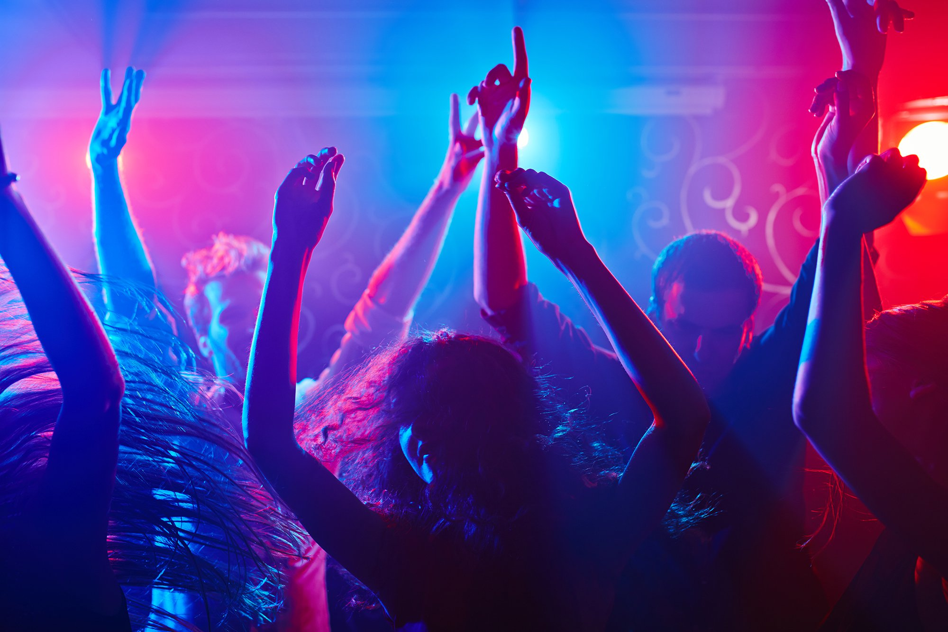

General Context
3

Slide 4
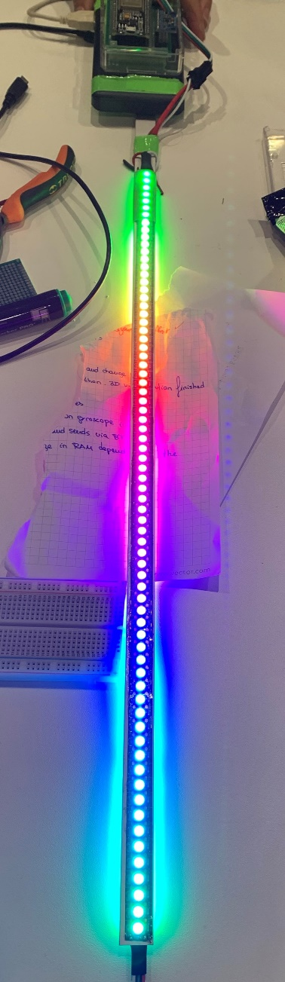
Build our own toy: the Raver Sword!
4

Slide 5
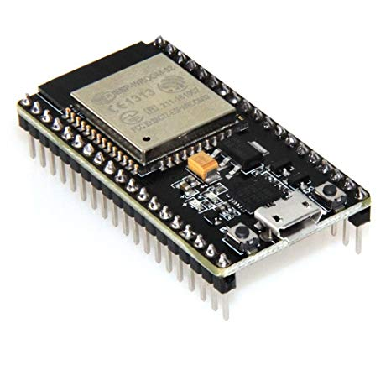
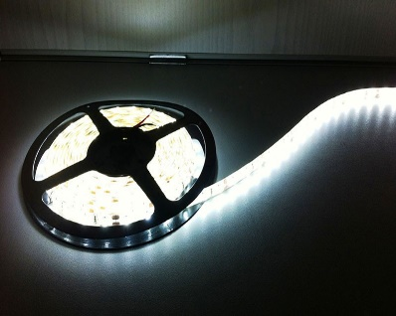
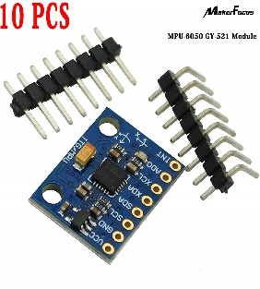
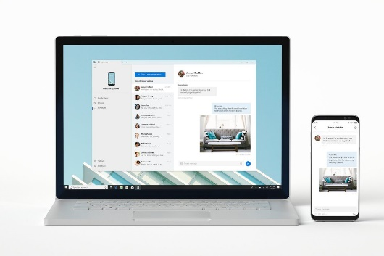
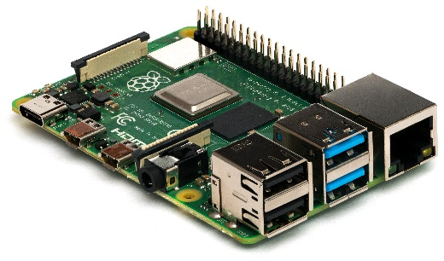
Hardware
5
ESP32 Microcontroller
Led strip
Gyroscope module
Pc and phone
Raspberry Pi

Slide 6
Technology
6
Hardware | Software
Microcontroller: ESP32 | Embedded IDE: Arduino
LED stripe: WS2812B | 3D visualization: Python, Pygame, OpenGL
Gyroscope: MPU9250 | GUI: NodeRed
Back end: RaspberryPi 3B+ | Comm ESP32 – Visualization: UDP
 | Comm GUI – Visualization: MQTT

Slide 7
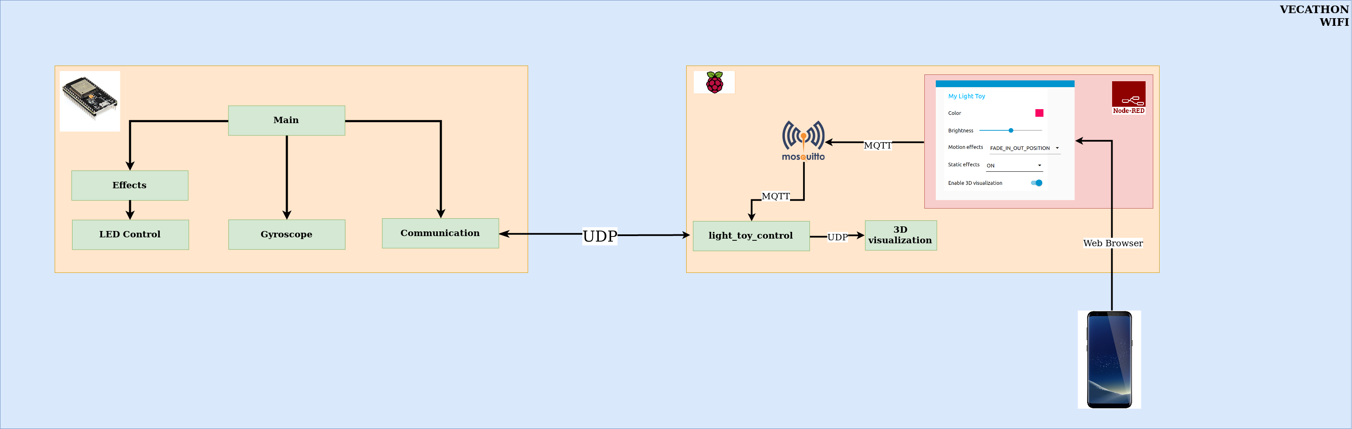
System architecture
7

Slide 8
Demonstration

Slide 9
General conclusion and perspectives
9
Conclusion:
Raver Sword Framework has been accomplished!
During the Vecathon, the features achieved were : uploading the modes or effects of lights, measurement of the position and the 3D imaging of the real time telemetry on the PC…
Perspectives:
Even more super cool light effects and the ability to display images when the stick is moving.

Slide 10
10
Thanks for your attention

