Slide 1

Vecathon Subject: Light Toy
Realized by: Raul
Anna
Rostom
Lety

Slide 2
1. Introduction 2. Global Architecture 3. Demonstration 4.Conclusion and perspectives
Plan

Slide 3
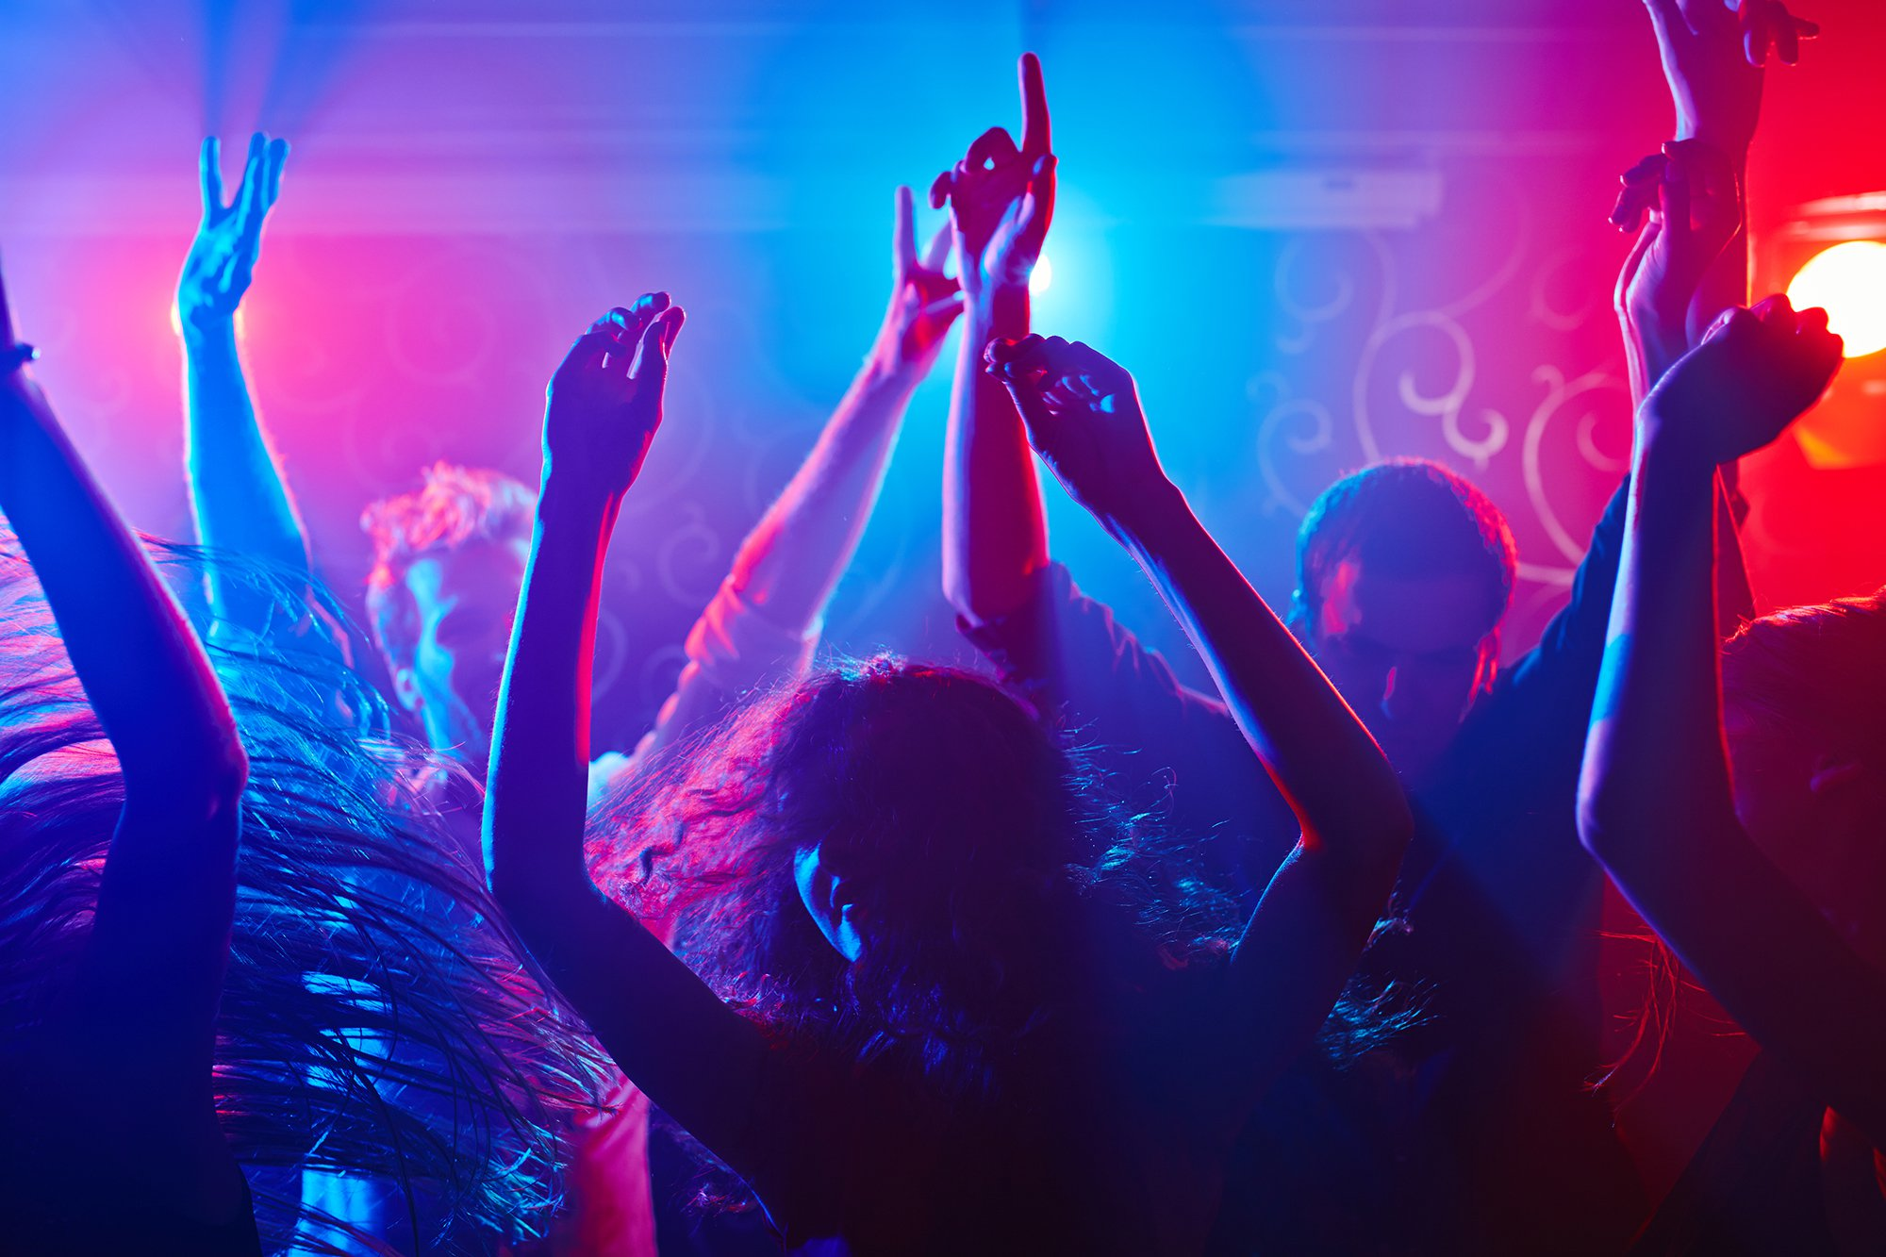

General Context

Slide 4
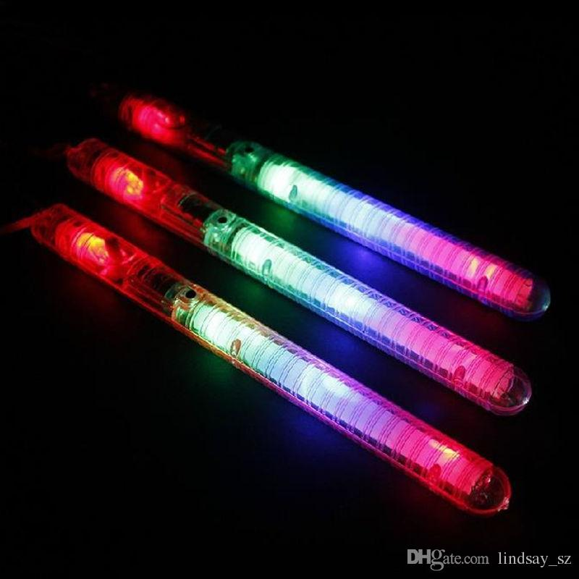
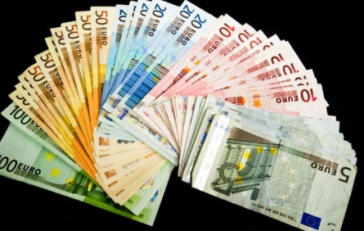

General Context
4
High costs: 2000 Euros
Non satisfaction of the costumer

Slide 5
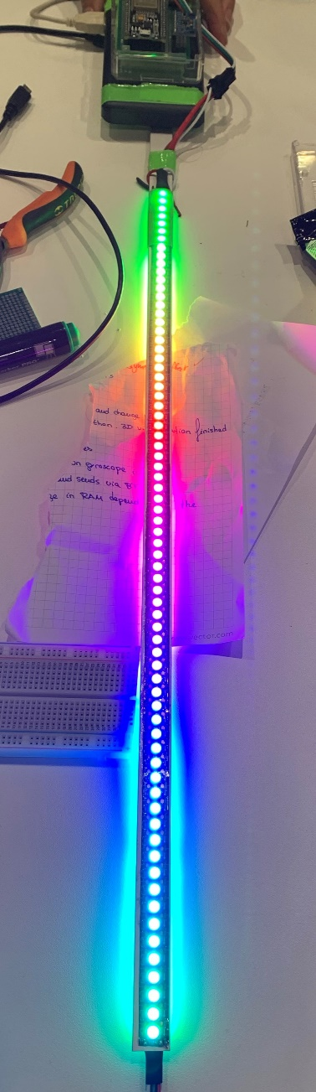
General Context
Build our own Light Toy!

Slide 6
1. Introduction 2. Global Architecture 3. Demonstration 4. Conclusion and perspectives
The Plan

Slide 7
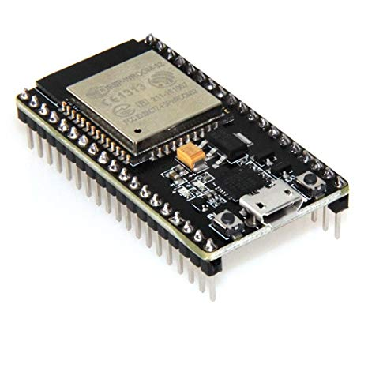
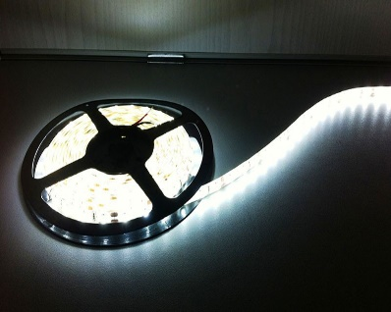
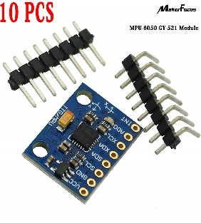
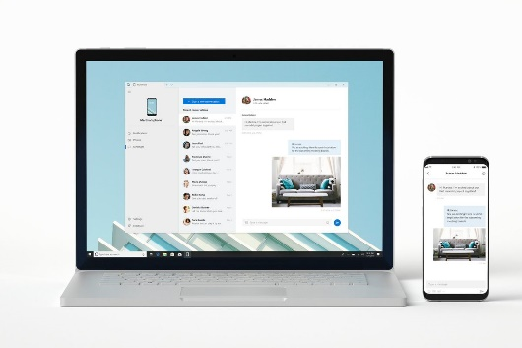
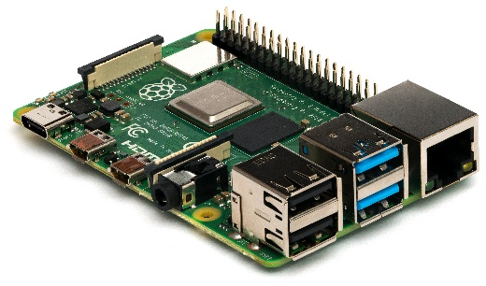
Hardware
ESP32 Microcontroller
Led strip
Gyroscope module
Pc and phone
Raspberry Pi

Slide 8
System architecture

Slide 9
1. Introduction 2. Global Architecture 3. Demonstration 4. Conclusion and perspectives
The Plan

Slide 10
Demonstration

Slide 11
1. Introduction 2. Global Architecture 3. Demonstration 4. Conclusion and perspectives
The Plan

Slide 12
General conclusion and perspectives
Conclusion:
A big part of the innovative Light toy already accomlished during the Vecathon such as the modes of lightings and measurement of the position and see the real time simulation on the PC…
Perspectives:
Improvements in the modes and the ability to display images when moving the stick

Slide 13
Thanks for your attention

