Slide 1

A Combined Neural Price-Aware Collaborative Filtering and Clustering Approach for User Segmentation Based on Willingness to Pay
Paper ID - LT617
By: Aakash Swami and Tirumala V
TCS Research
May 25, 2024

Slide 2

Objective
User segmentation can benefit in increasing business revenue by providing users with the right offers, improving user satisfaction by making marketing efforts segment-oriented, etc.
While user segmentation considers a wide range of factors such as geographic, demographic, psychological, and behavioral, user segmentation based on willingness to pay (WTP) focuses exclusively on the price sensitivity aspect of user behavior.
User segmentation based on WTP is crucial in developing a successful pricing and revenue strategy for a product or service.
The paper aims to propose a novel approach for user segmentation based on their WTP using user purchase data.
https://emglobalgroup.com/marketing-segmentation/

Slide 3
Introduction
 | User segmentation based on WTP
Method | Stated preference | Revealed preference
 | Involve directly asking individuals about their preferences through surveys, interviews, or hypothetical scenarios. Data is self-reported and hypothetical, based on what individuals say they would do or prefer. | Infer preferences based on observed choices made by individuals in real-world situations. Data is based on actual choices made by individuals in real situations, providing more concrete and observable information.
Limitations | Does not necessarily require respondents to purchase the product, and thus can deviate from the user’s actual WTP Do not consider user’s joint purchase decision on multiple item | Need well-defined item and user attributes, which might sometimes be difficult to gather due to security and privacy issues. Do not consider user’s joint purchase decision on multiple item
Proposed approach addresses the limitations:
Uses user purchase data that correspond to revealed preference data
Consider joint purchasing decisions/behavior on multiple items when segmenting.
Uses the collaborative filtering technique that does not require well-defined item and user attributes.

Slide 4
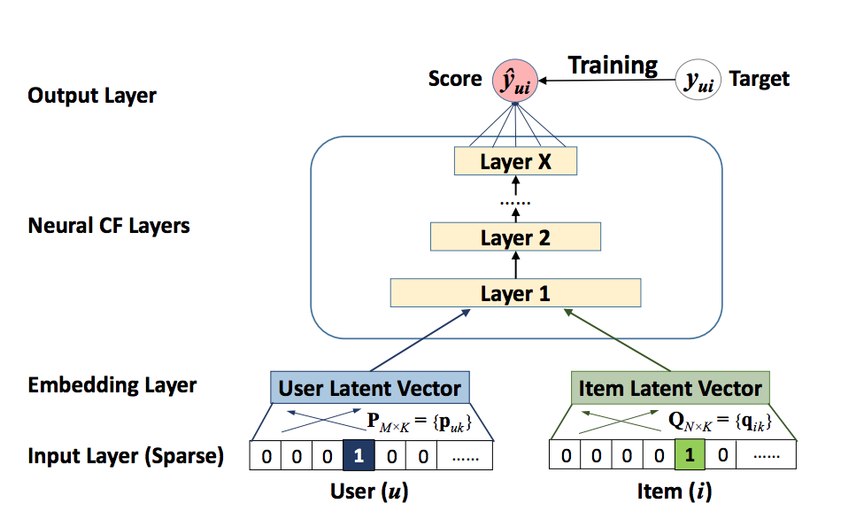
Neural collaborative filtering(2017)
Neural Collaborative Filtering (NCF) uses neural networks to model complex interactions between users and items for recommendation systems.
NCF is generic and can express and generalize matrix factorization under its framework.
NCF is scalable, making it suitable for large-scale recommendation systems with millions of users and items
He, Xiangnan, Lizi Liao, Hanwang Zhang, Liqiang Nie, Xia Hu, and Tat-Seng Chua. "Neural collaborative filtering." In Proceedings of the 26th international conference on world wide web, pp. 173-182. 2017.

Slide 5
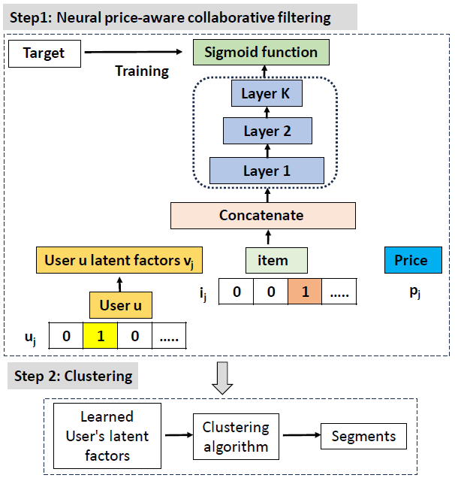
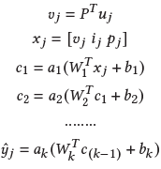
Proposed approach
Step1: Neural price-aware collaborative filtering
Extension to Neural collaborative filtering to consider price
𝑦_{𝑗} represents the predicted purchase probability of item i at a particular price p by a user u for the j-th sample.
When training, the model learns the latent factors for the users to best explain their purchase behavior. Consequently, latent factors of users with similar purchase behavior will be close together.
ˆ
Step 2: Clustering
Users are clustered using the learned latent factors. These clusters refer to the segments formed comprising users having similar WTP

Slide 6
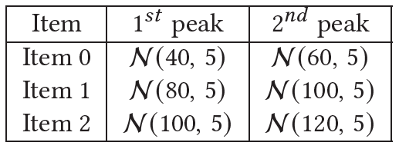
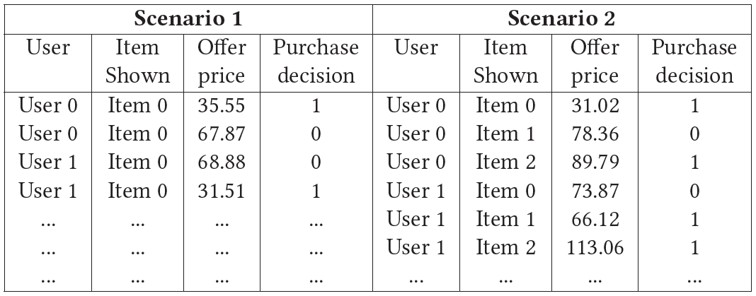
Data generation
We consider two scenario and 3 items i.e., item 0, item 1, and item 2.
In scenario 1, we consider item 0 and around 1000 users
In scenario 2 we consider three items i.e., item 0, item 1, and item 2, and around 1000 users.
To generate data :
A given user is shown an item/items (as per scenario) at a given offer price,
Each user WTP for an item/items is sampled from the Figure 1. distributions for items
Based on the user’s WTP, the user decides to purchase it or not.
Figure 1. Distribution of the price of an item
Figure 2. Sample data

Slide 7
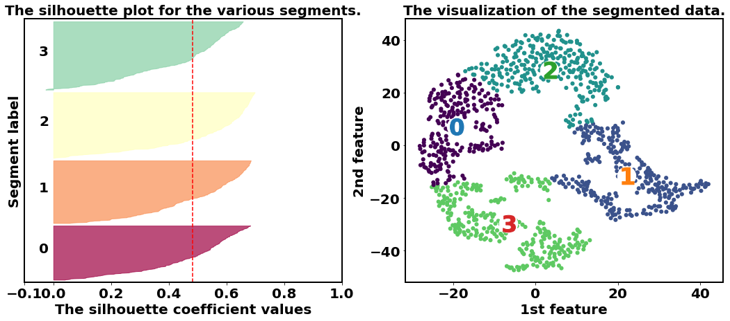
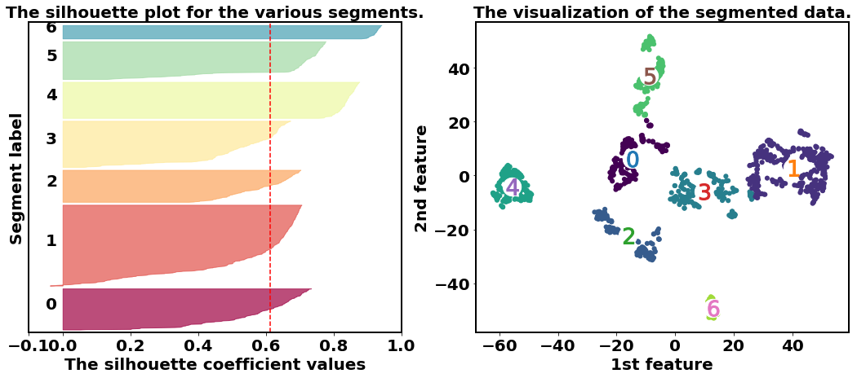
Result: Quality of the segments formed
Scenario 1: Silhouette score is 0.48 with 4 segments
Scenario 2 : Silhouette score is 0.61 with 7 segments

Slide 8
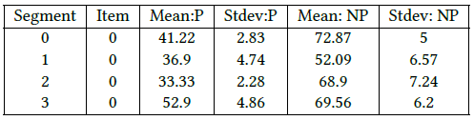
Result: Comparing segment-specific WTP (Scenario 1)
Segments formed have users with different WTPs.
WTP for item 0 is different between segments for example in segment 0 the "Mean:P" is 41.22 and in segment 2 the "Mean:P" is 33.33.
Segmentation is not only based on the price at which the item is purchased by a user but also based on the price at which the item is not purchased by a user.
"Mean:P" is nearly the same between segments 1 and 2 i.e. 36.9 and 33.33 respectively, the "Mean: NP" is 52.09 in segment 1 and 68.9 in segment 2.
"Mean:P“ : Mean of the prices at which a particular item is purchased within a segment
"Stdev:P“ : Standard deviation(Stdev) of the prices at which a particular item is purchased within a segment
"Mean:NP“ : Mean of the prices at which a particular item is not purchased within a segment
"Stdev:NP“ : Stdev of the prices at which a particular item is not purchased within a segment

Slide 9
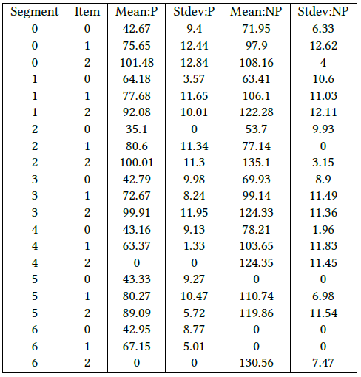
Result: Comparing segment-specific WTP(Scenario 2)
Similar to scenario 1, segmentation in scenario 2 is also not only based on the price at which the item is purchased by a user but also based on the price at which the item is not purchased by a user.
Segmentation is based on the user’s joint purchasing decisions on all items.
"Mean:P" for item 0 is nearly the same between segments 0 and 4 i.e. 42.67 and 43.16 respectively, the mean is different for item 1 and item 2.

Slide 10
Result: User’s purchase behavior for a given item at a given price within a segment
Scenario 1
Scenario 2
 | User | Item shown | Offer price | Purchase decision
 | 150 | 0 | 65.35 | 1
 |  | 0 | 78.99 | 0
Similar/ Nearby clustered users | 427 | 0 | 66.36 | 1
 |  | 0 | 77.98 | 0
 | 269 | 0 | 73.43 | 0
 |  | 0 | 58.28 | 1
 | 312 | 0 | 60.81 | 1
 |  | 0 | 72.42 | 0
 | 141 | 0 | 61.31 | 1
 |  | 0 | 74.95 | 0
 | ... | ... | ... | ...
 | User | Item shown | Offer price | Purchase decision
 | 92 | 0 | 77.96 | 0
 |  | 2 | 97.14 | 1
 |  | 1 | 63.67 | 1
Similar/ Nearby clustered users | 253 | 1 | 62.45 | 1
 |  | 0 | 75.92 | 0
 |  | 2 | 94.69 | 1
 | 383 | 2 | 92.24 | 1
 |  | 1 | 64.9 | 1
 |  | 0 | 78.98 | 0
 | ... | ... | ... | ...
Nearby clustered users are the ones having similar purchase decisions for a given item at a given offer price.

Slide 11
Conclusion
Demonstrated a novel approach for user segmentation based on WTP, using a combination of neural price-aware collaborative filtering and clustering techniques.
Segments are not only formed based on the price at which the item is purchased by a user but the price at which the item is not purchased by a user is also considered.
In case the user purchase data contains user interaction with multiple items, the user’s joint purchasing decisions on all items are considered while segmenting.
The proposed approach can be used to create user segments based on WTP in various business domains, enabling them to create more personalized pricing and marketing strategies, leading to increased revenue and user satisfaction.

Slide 12
Reference
Masiero, Lorenzo, and Juan L. Nicolau. "Tourism market segmentation based on price sensitivity: Finding similar price preferences on tourism activities." Journal of Travel Research 51, no. 4 (2012): 426-435.
Zhang, Lei, and YangWu. "Market segmentation and willingness to pay for green electricity among urban residents in China: The case of Jiangsu Province." Energy Policy 51 (2012): 514-523.
Arevalillo, Jorge M. "A machine learning approach to assess price sensitivity with application to automobile loan segmentation." Applied Soft Computing 76 (2019): 390-399.
He, Xiangnan, Lizi Liao, Hanwang Zhang, Liqiang Nie, Xia Hu, and Tat-Seng Chua. "Neural collaborative filtering." In Proceedings of the 26th international conference on world wide web, pp. 173-182. 2017.

Slide 13
Thank you, Any questions ?

