Slide 1
House Prices
Anu Kannan, Rani Banjarian, Andrew Marra, John Lakwijk

Slide 2
Problem Statement
We will use the Ames dataset from the Kaggle House Prices competition to accurately predict house prices in Ames, Iowa

Slide 3
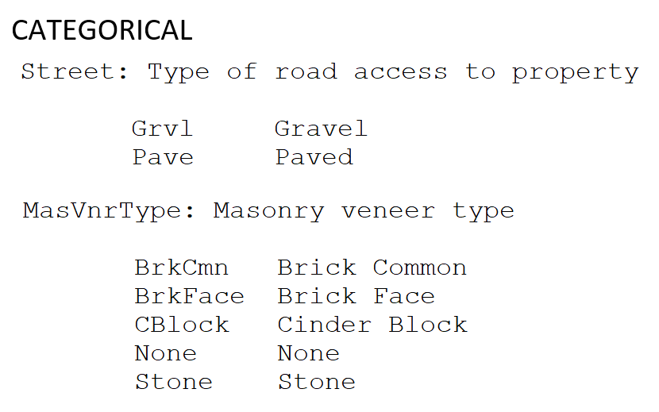
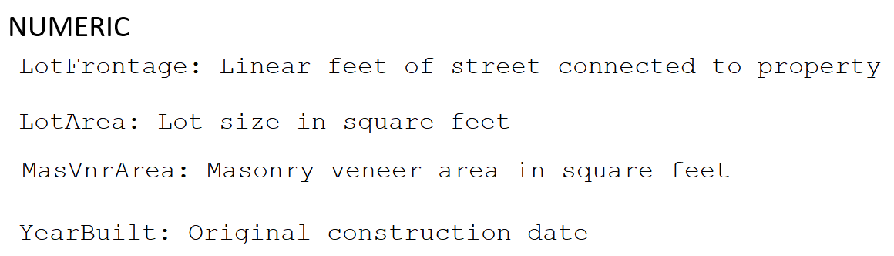
The Data
The dataset contains 79 predictive features and one response, sale price
Features are either Categorical or Numeric (types of masonry, areas, etc)
Two files: train and test, each with around 1460 different house details

Slide 4
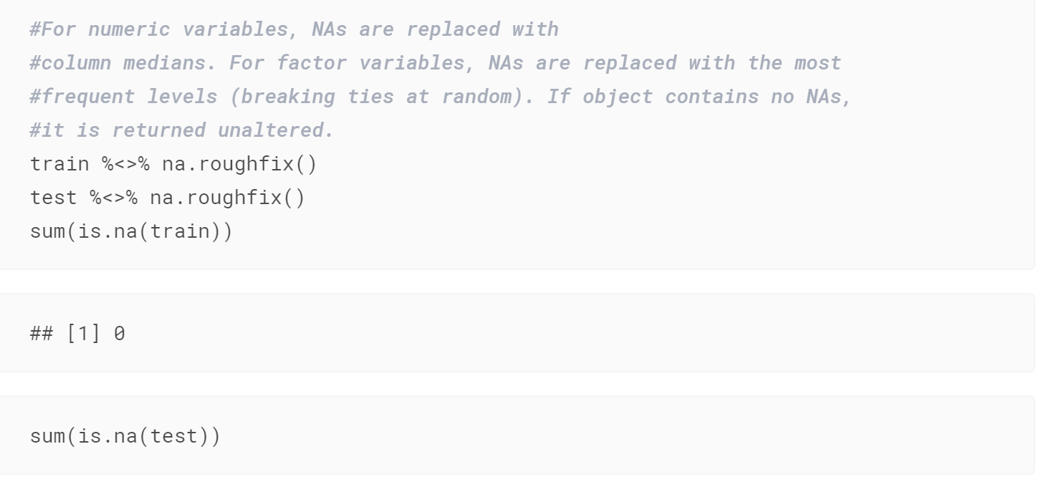
Other Approaches
Notebook 1

Slide 5
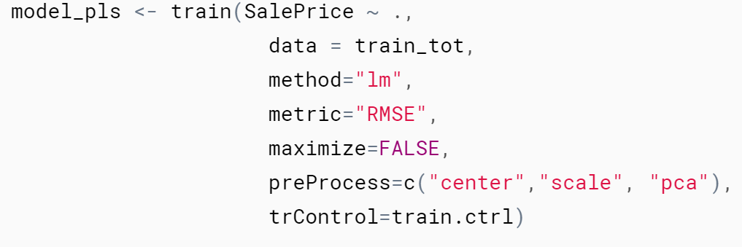
Other Approaches
Notebook 2 uses….

