Slide 1
Customer shopping
behavior
What 3,900 purchases reveal about revenue concentration, loyalty, subscriptions, products, and next actions.
Customer behavior analysis

Slide 2
THE READOUT
Four signals stand out
1
2
Loyalty is strong
Subscriptions lag
3,116 customers are classified as loyal.
27% of customers subscribe, while 73% do not.
3
4
Discounts can still drive spend
The clearest growth levers
839 customers used discounts and spent above the average purchase amount.
Convert repeat buyers, sharpen product positioning, and protect margin.

Slide 3
FIELD DATA
The dataset is broad enough to guide action
3,900
25
4
50
transactions
products
categories
locations
Four seasons are represented. Customer ages span 18–70.
Average purchase: $59.76
Average review rating: 3.75
37 review ratings were missing and imputed by product-category median.

Slide 4
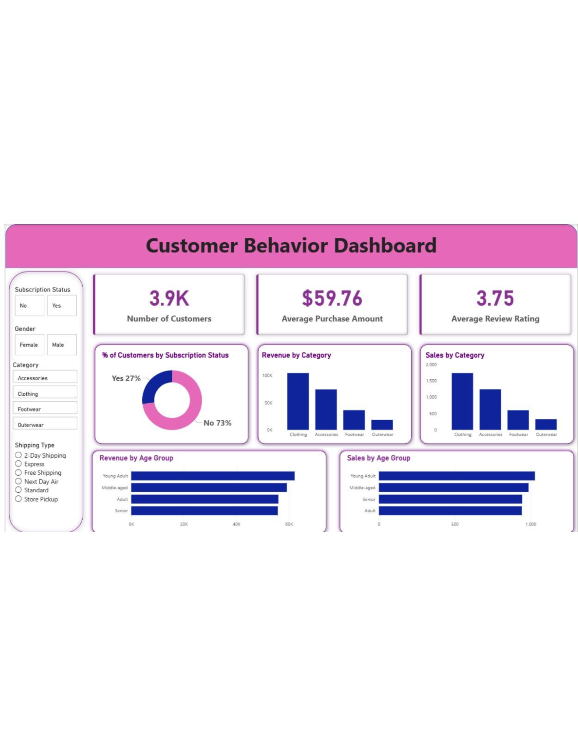
REVENUE SHAPE
Revenue is concentrated in a few customer and category pockets
Male customers generated $157,890 versus $75,191 from female customers.
Clothing is the largest category by revenue and sales, followed by Accessories.

Slide 5
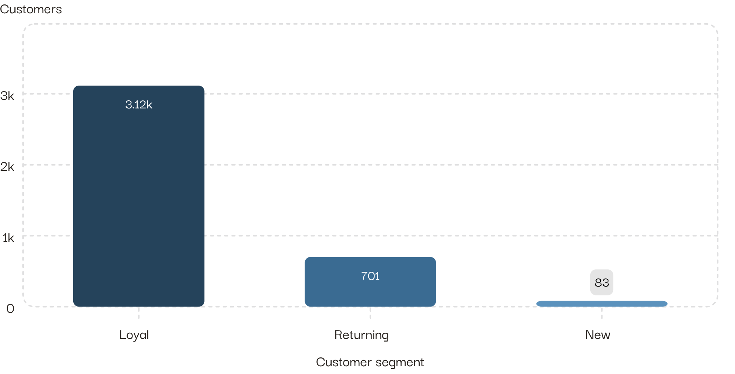
LOYALTY
Repeat behavior is the business engine
3,116
customers are loyal.
Among repeat buyers, 958 subscribe and 2,518 do not.

Slide 6
SUBSCRIPTIONS
Subscriptions have a conversion problem, not a spend problem
AVERAGE PURCHASE
AVERAGE PURCHASE
$59.49
$59.87
Subscribers
Non-subscribers
REVENUE FROM SUBSCRIBERS
REVENUE FROM NON-SUBSCRIBERS
$62,645
$170,436
Spend per purchase is nearly level. The gap is conversion: 27% subscribe, while 73% do not.

Slide 7
PRODUCT SIGNALS
Product winners are visible in ratings and category demand
Top-rated products | Rating
Gloves | 3.86
Sandals | 3.84
Boots | 3.82
Hat | 3.80
Skirt | 3.78
Category leaders | Category
Jewelry | Accessories
Blouse | Clothing
Sandals | Footwear
Jacket | Outerwear

Slide 8
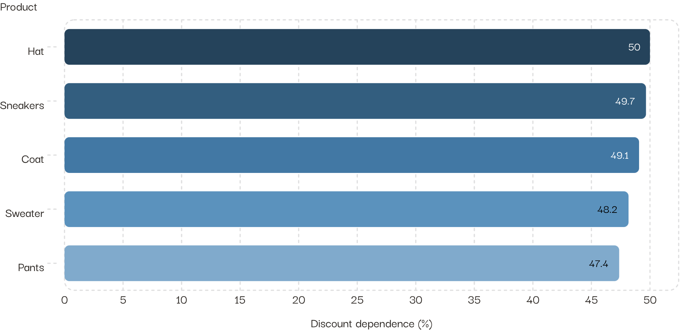
PROMOTION
Discounts unlock demand — and expose margin risk
839
customers used discounts while spending above the average purchase amount.
The most discount-dependent products are Hat, Sneakers, Coat, Sweater, and Pants.

Slide 9
TARGETING
Fulfillment and age point to sharper targeting
AVERAGE PURCHASE
HIGHEST-REVENUE AGE GROUP
$60.48
$62,143
Express shipping
Young Adults
Standard: $58.46
Middle-aged: $59,197
Target high-revenue age groups and test express-shipping messages.

Slide 10

NEXT ACTIONS
Five actions to turn insight into growth
01
02
Promote subscriber-only benefits
Build loyalty rewards
Start with repeat buyers.
Move returning customers into the loyal segment.
03
04
Review discount depth
Feature product winners
Focus on products with the highest discount dependence.
Use top-rated products and category leaders in campaigns.
05
Sharpen targeting
Reach high-revenue age groups and test express-shipping messages.

