Slide 1
DS310 Project Group 19
Matt Frysinger, Ze Song, Roamah Baray, Sanjeev Pal

Slide 2
Table of contents
01
02
03
04
Introduction
Data Flow, Schema
Analytical Justification
Findings

Slide 3
Introduction
01
Context
Question
Objective
Softwares
COVID-19 virus is forecasted to hit the fictional country Caladan. The government officials desire help to create a policy plan to mitigate the next wave in order to minimize casualties.
What are the most unrestrictive, yet effective they can implement to keep the growth rate of death below 1% and new cases below 3% on a 30-day rolling average?
Use Data Engineering techniques to build pipelines for solving the posted question, utilize PowerBI visualizations and analytical tools to reach conclusions
Microsoft Azure, PowerBI, Github

Slide 4
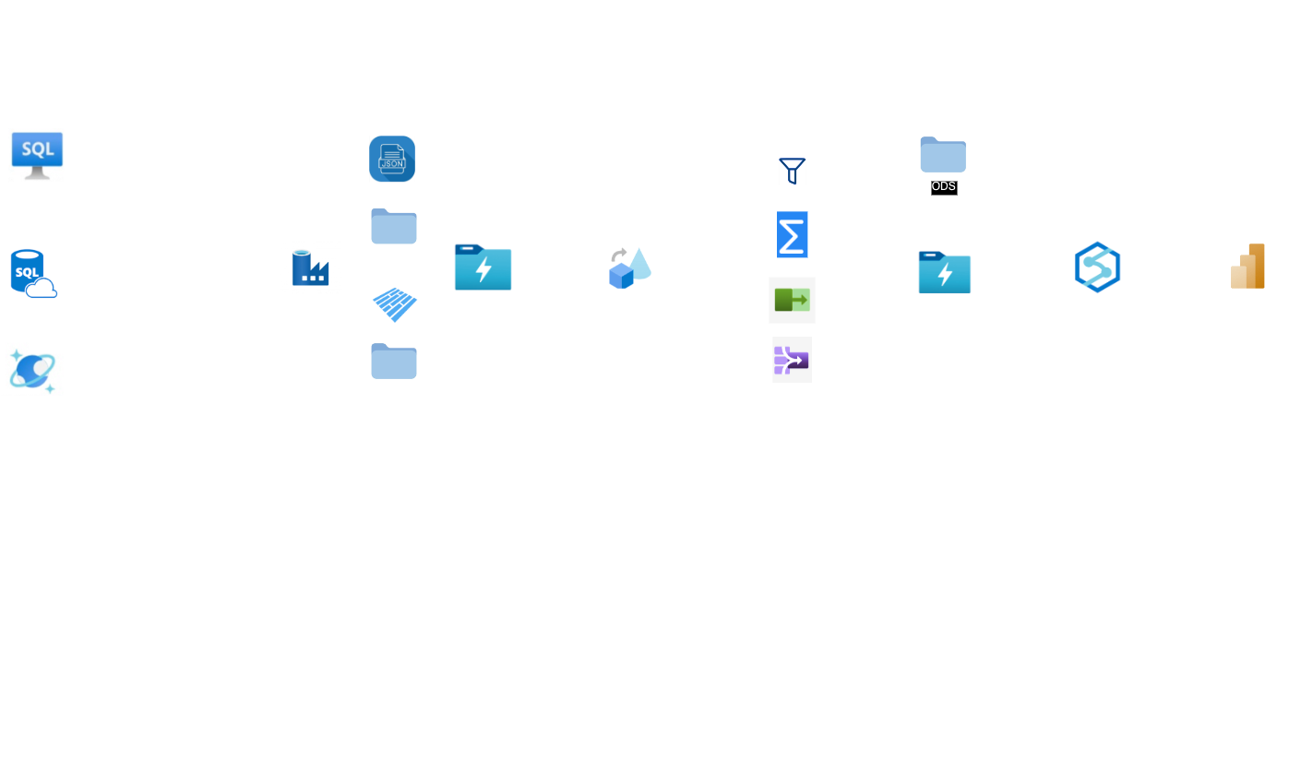
02
Data Flow

Slide 5
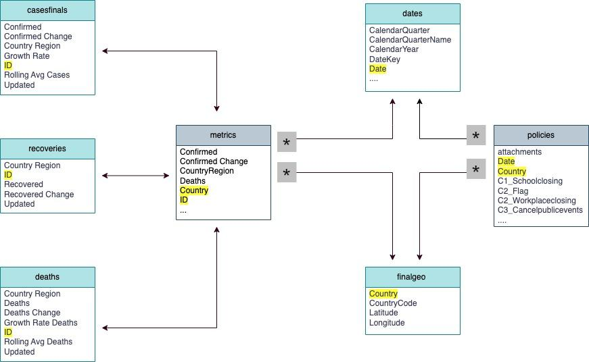
Galaxy Schema

Slide 6
03
Analytical Justification

Slide 7
Normalizing Each Policy
Summing the Normalized Policies
Results
Normalized C1 =
DIVIDE(policies[C1_Schoolclosing] - MIN(policies[C1_Schoolclosing]),
MAX(policies[C1_Schoolclosing]) - MIN(policies[C1_Schoolclosing]))
Normalized Policy_Sums = (
policies[Normalized C1] + policies[Normalized C2] + policies[Normalized C3] + policies[Normalized C4] +
policies[Normalized C5] + policies[Normalized C6] + policies[Normalized C7] + policies[Normalized C8] + policies[Normalized H6])
New columns
Standardizes the policy-scales, makes for better analysis (PowerBI)

Slide 8
04
Findings

Slide 9
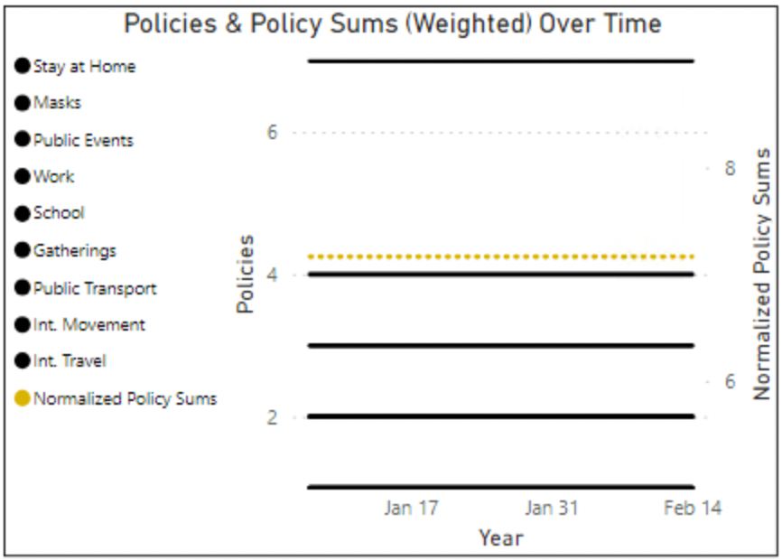
Policy Recommendations
Stay at Home
Large Groups of People
The most effective and least restrictive policies that meet our thresholds.
Restrictions on staying at home, from school and work
Restrictions on public events and gatherings
Masks
Transportation
Mask requirement in public spaces
Restrictions on public transportation, international movement, and international travel.

