Slide 1
MTS Testing Data Summary
Updated 2026-08-31 | Axes flipped: Angle on X, Moment on Y

Slide 2
Method Snapshot
Input: MTS 6DOF Book*.xlsx grouped as FE, LB, AR per intervention
Cycle basis: third cycle, centered avg(load/unload)
Model: M(theta) = C1*theta + C2*theta^2 + C3*theta^3
Plot orientation: angle on x-axis, moment on y-axis
Flexion branch display: native negative theta and negative moment
Flexion stiffness window: 0 to -5 Nm secant

Slide 3
MTS Flexion Stiffness Ranking
MTS Flexion Ranking (native negative axes, 0 to -5 Nm secant)
Rank Intervention k [Nm/deg] R2 n_points
----------------------------------------------------------
1 Posterior Release 0.466 nan 2
2 Intact 0.449 nan 2
3 SPO 0.446 nan 2
4 PUF Left 0.429 nan 2
5 FBF 0.414 nan 2
6 FUF Left 0.409 nan 2

Slide 4
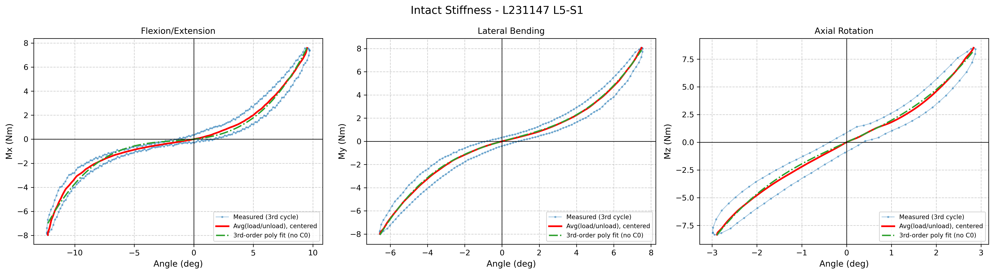
Intervention: Intact

Slide 5
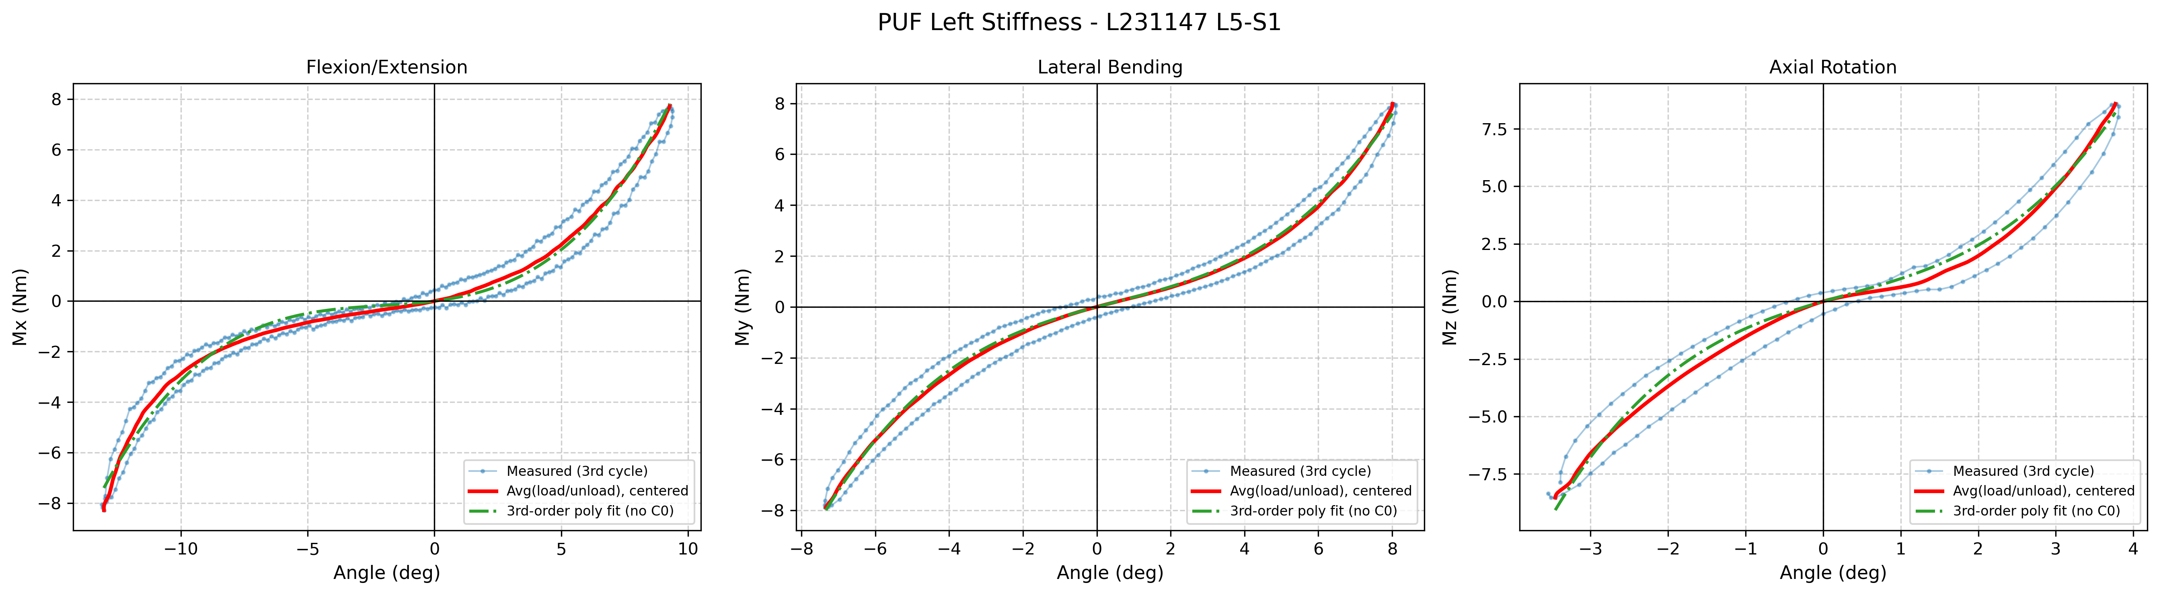
Intervention: PUF Left

Slide 6
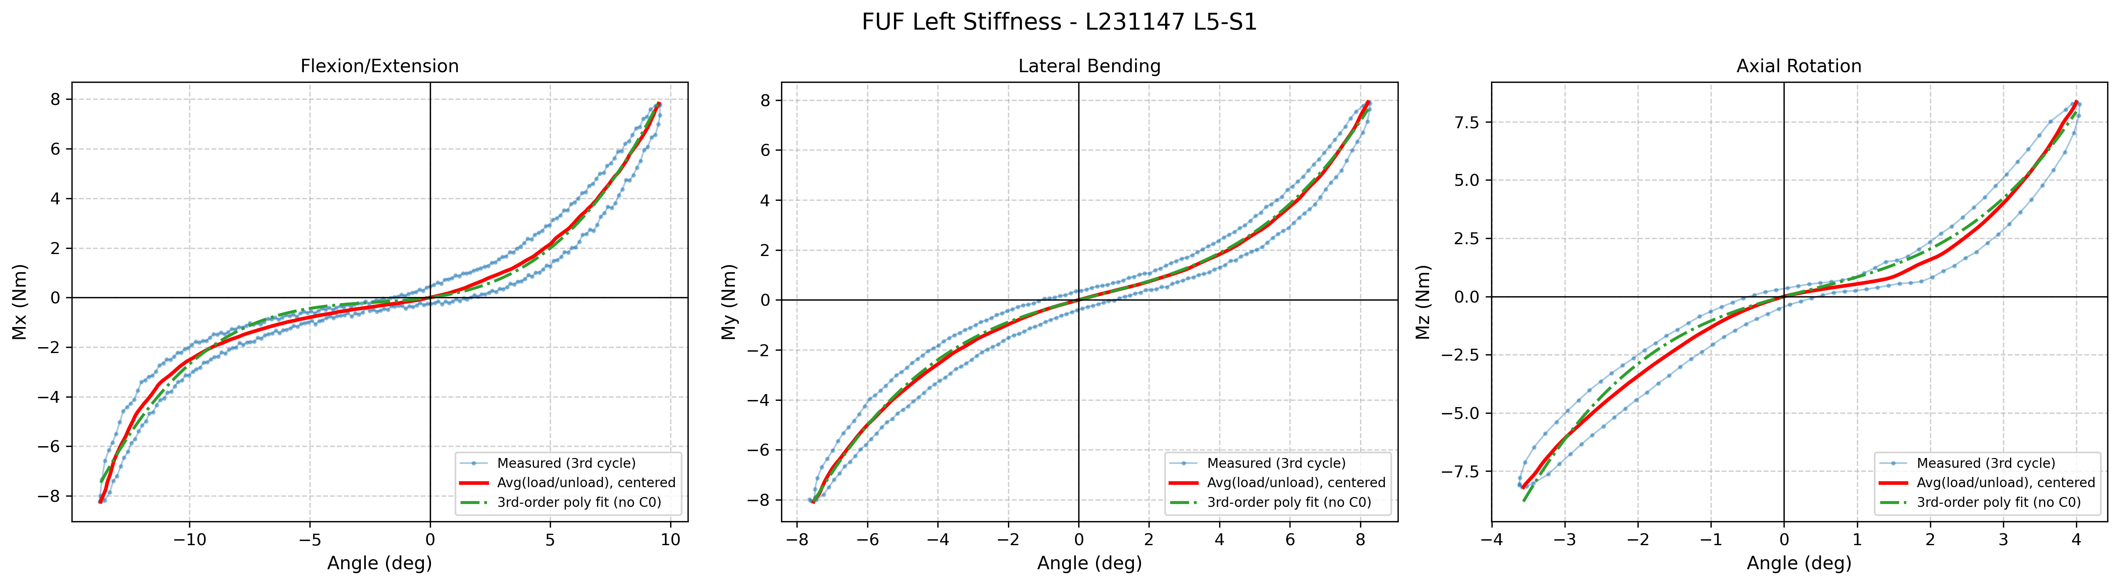
Intervention: FUF Left

Slide 7
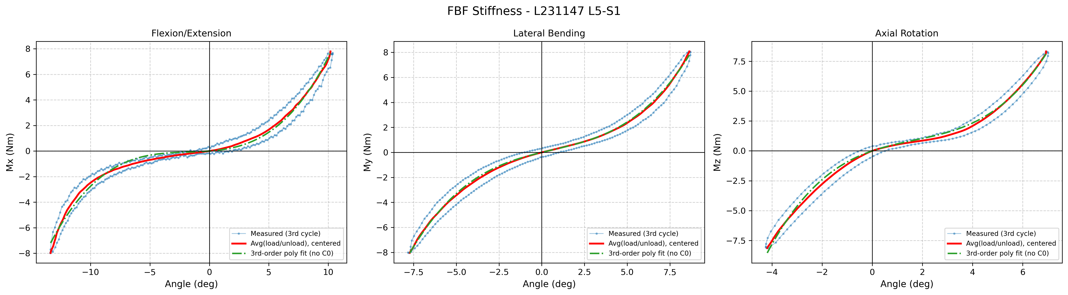
Intervention: FBF

Slide 8
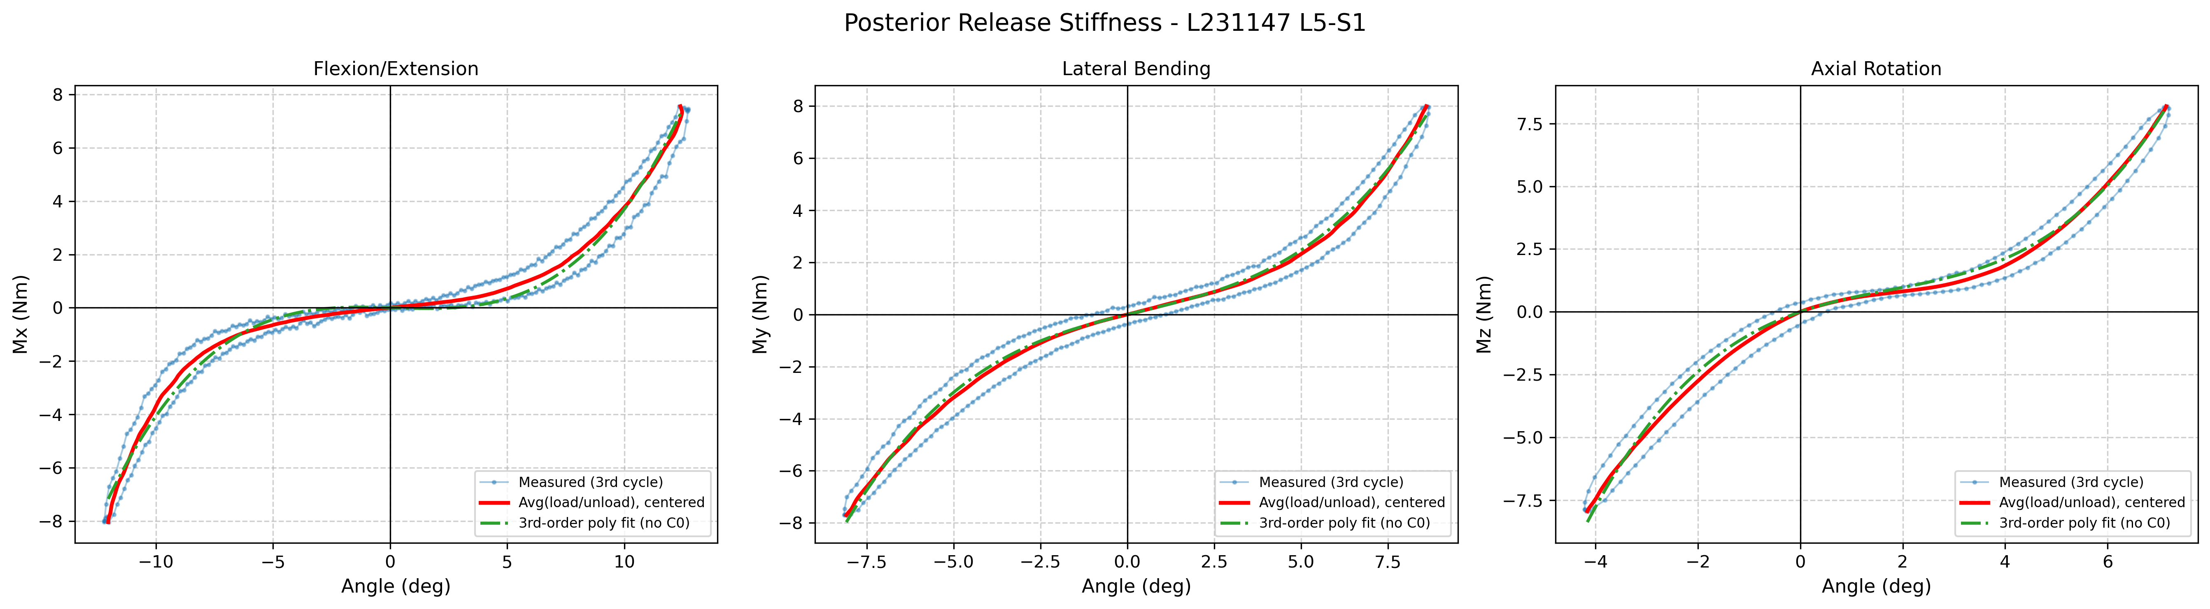
Intervention: Posterior Release

Slide 9
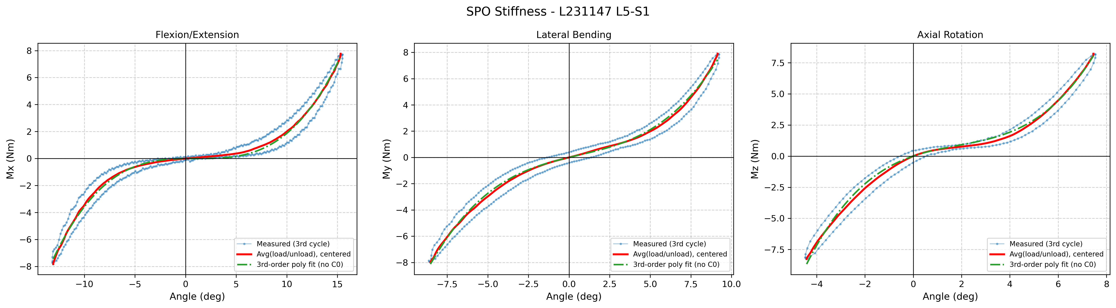
Intervention: SPO

Slide 10
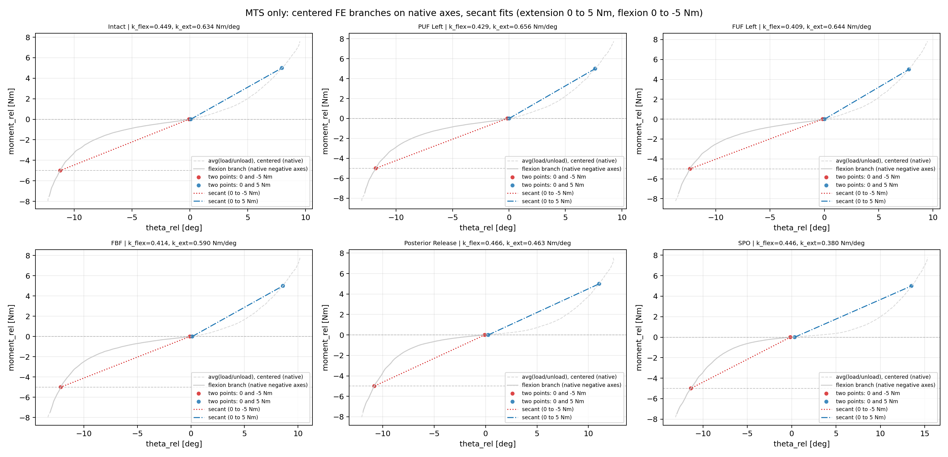
MTS FE (Native Axes): Extension 0-5 and Flexion 0 to -5 Nm Secant Fit Panels

Slide 11
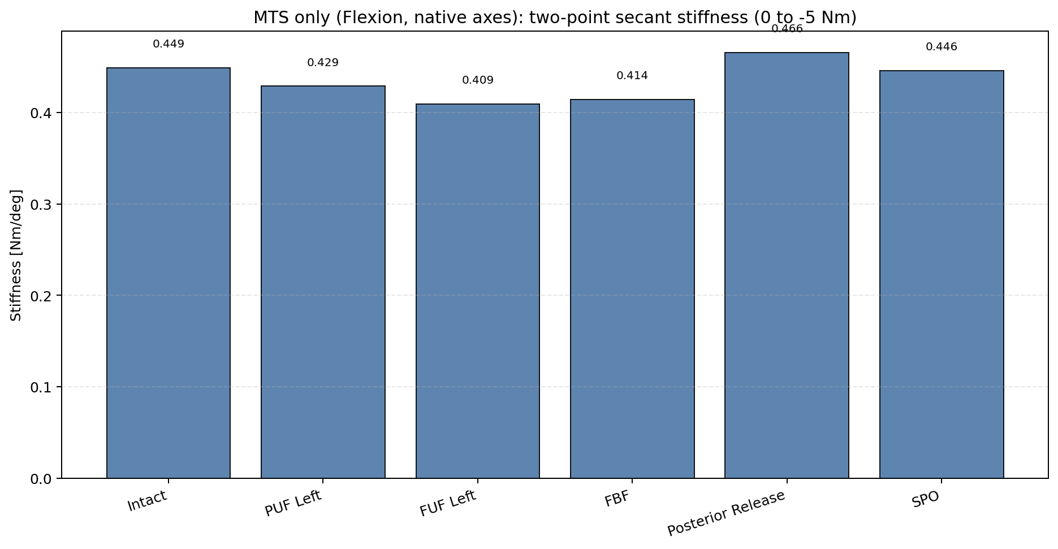
MTS Flexion (Native Negative Axes): 0 to -5 Nm Secant Stiffness Bar

Slide 12
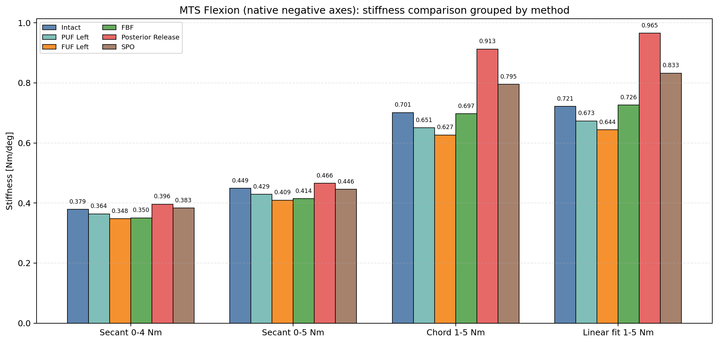
MTS Flexion (Native Negative Axes): Four-Method Stiffness Comparison

Slide 13
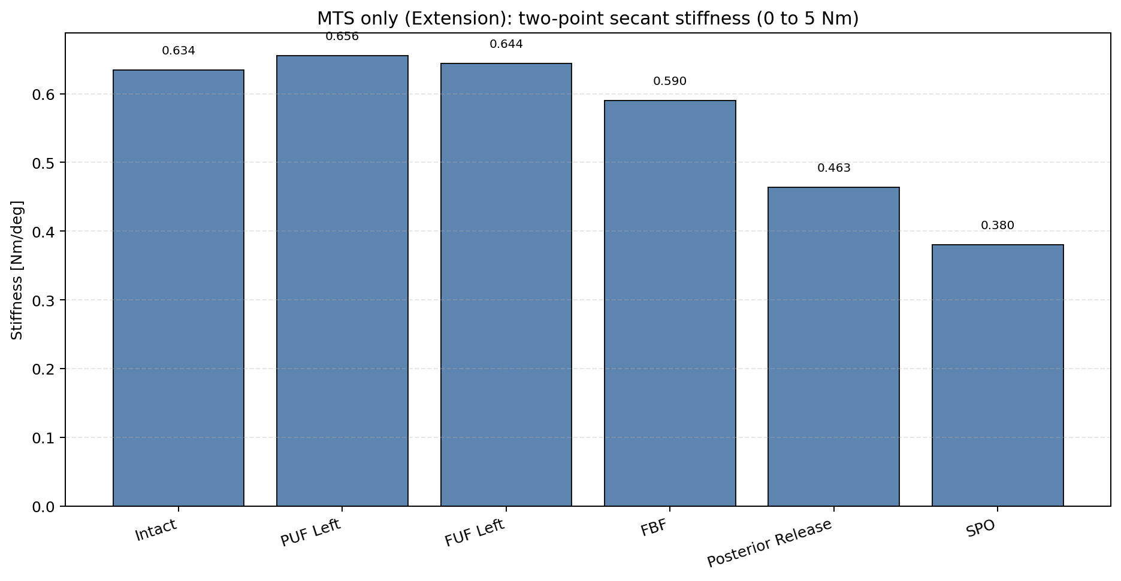
MTS Extension (Native Positive Axes): 0 to 5 Nm Secant Stiffness Bar

Slide 14
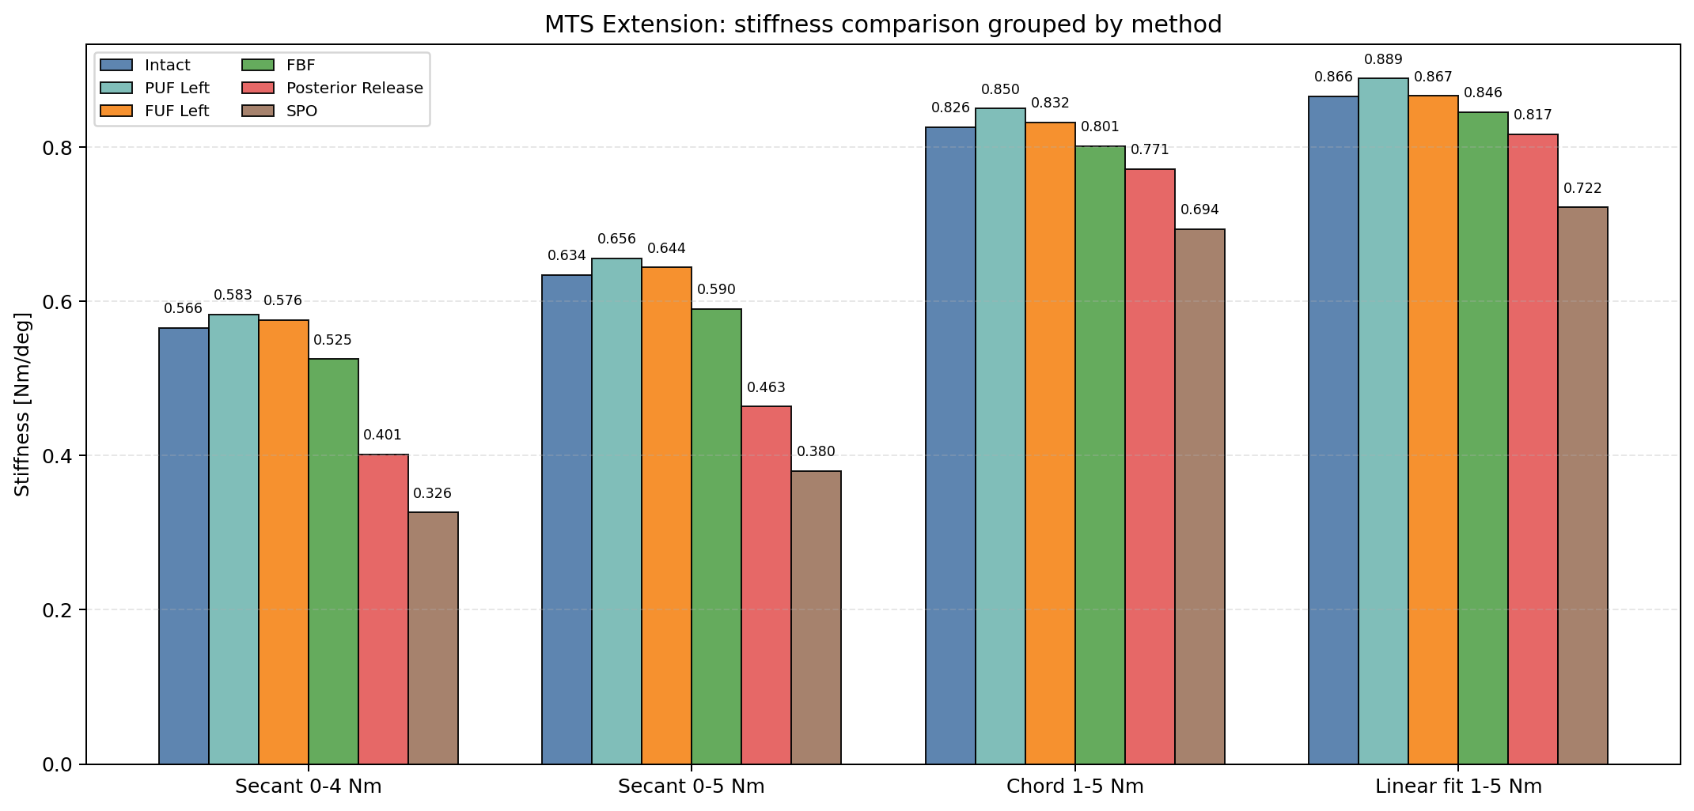
MTS Extension (Native Positive Axes): Four-Method Stiffness Comparison

