Slide 1
MTS Testing Data Summary
Updated 2026-08-19

Slide 2
Method Snapshot
Input: MTS 6DOF Book*.xlsx grouped as FE, LB, AR per intervention
Cycle basis: third cycle, centered avg(load/unload)
Model: M(theta) = C1*theta + C2*theta^2 + C3*theta^3
Plot orientation: angle on x-axis, moment on y-axis

Slide 3
Intact

Slide 4
Intervention: PUF Left

Slide 5
Intervention: FUF Left

Slide 6
Intervention: FBF

Slide 7
Intervention: Posterior Release

Slide 8
Intervention: SPO

Slide 9
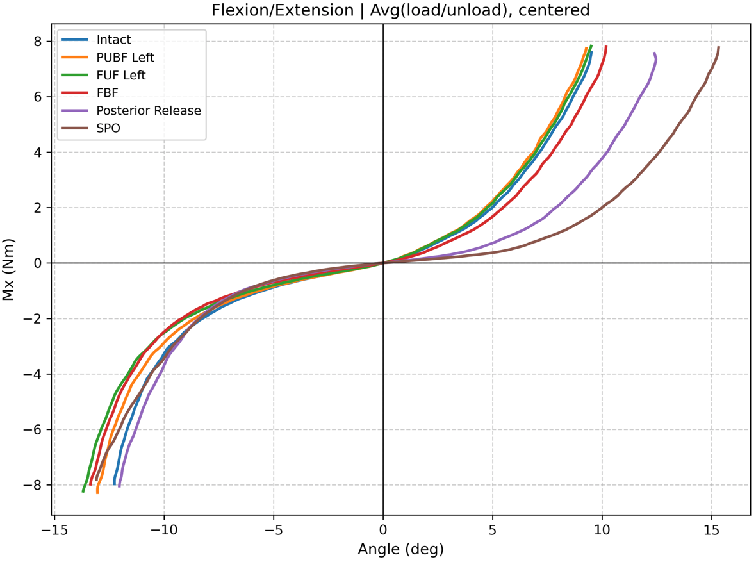
Flexion/Extension – All Interventions
Extension
PLL release and SPO significantly decreased extension stiffness
Facetectomy decreased it as well but to a lesser extent
Continuous loss of stability with increasing bony/tissue resections
Extension
Flexion
For all interventions, stiffness is unchanged until around 8 deg
Facetectomy lowers stiffness afterwards
Flexion
similar stiffness up to ~8 deg

Slide 10
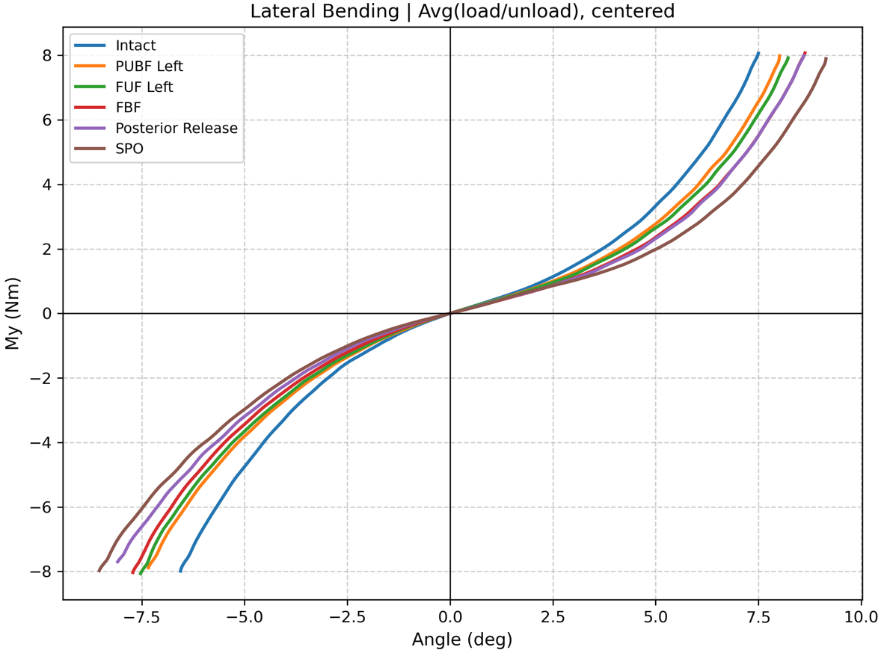
Lateral Bending – All Interventions
Left
Right

Slide 11
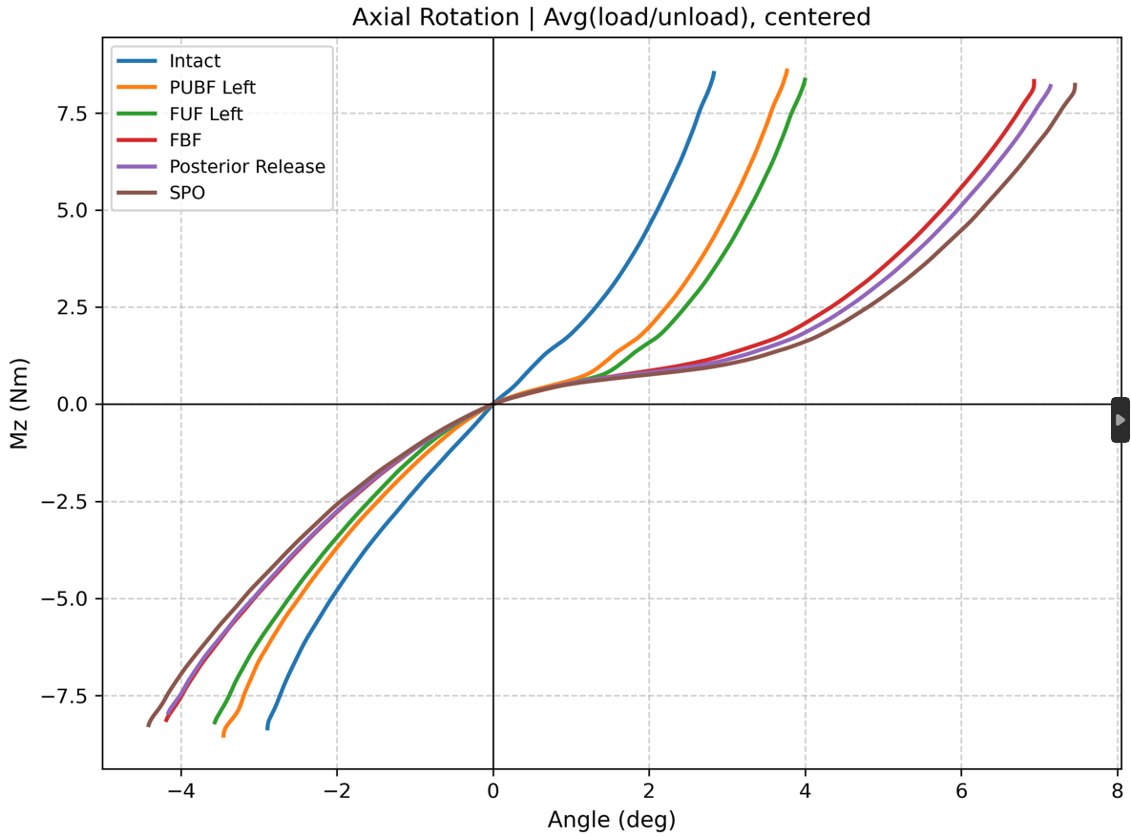
Axial Rotation – All Interventions
Left
Right

Slide 12
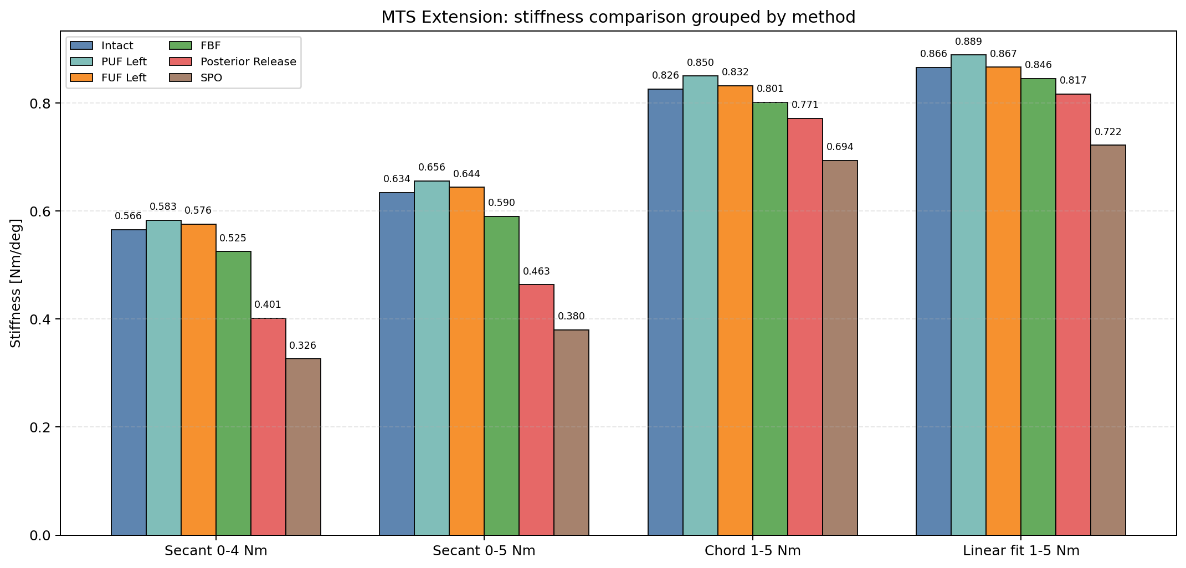
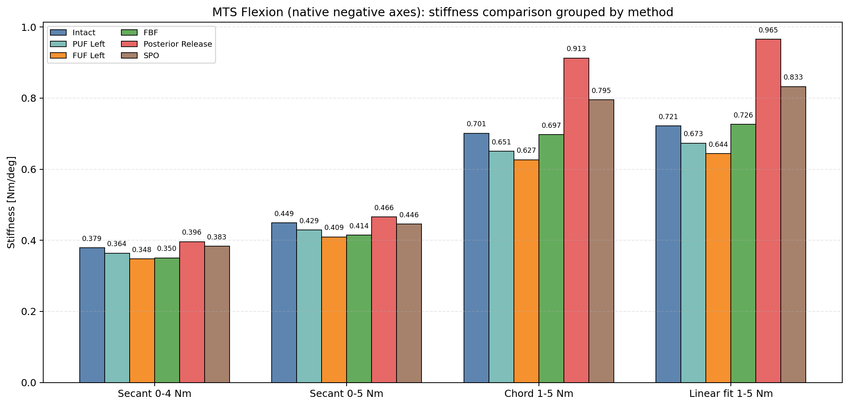
MTS Flexion: Comparison of Different Stiffness Metrics
Extension
Flexion

Slide 13
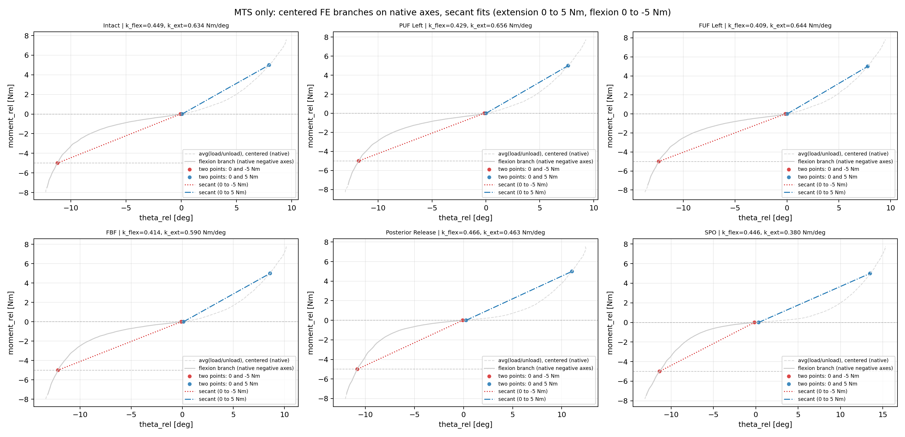
MTS FE (Native Axes): Extension 0-5 and Flexion 0 to -5 Nm Secant Fit Panels

Slide 14
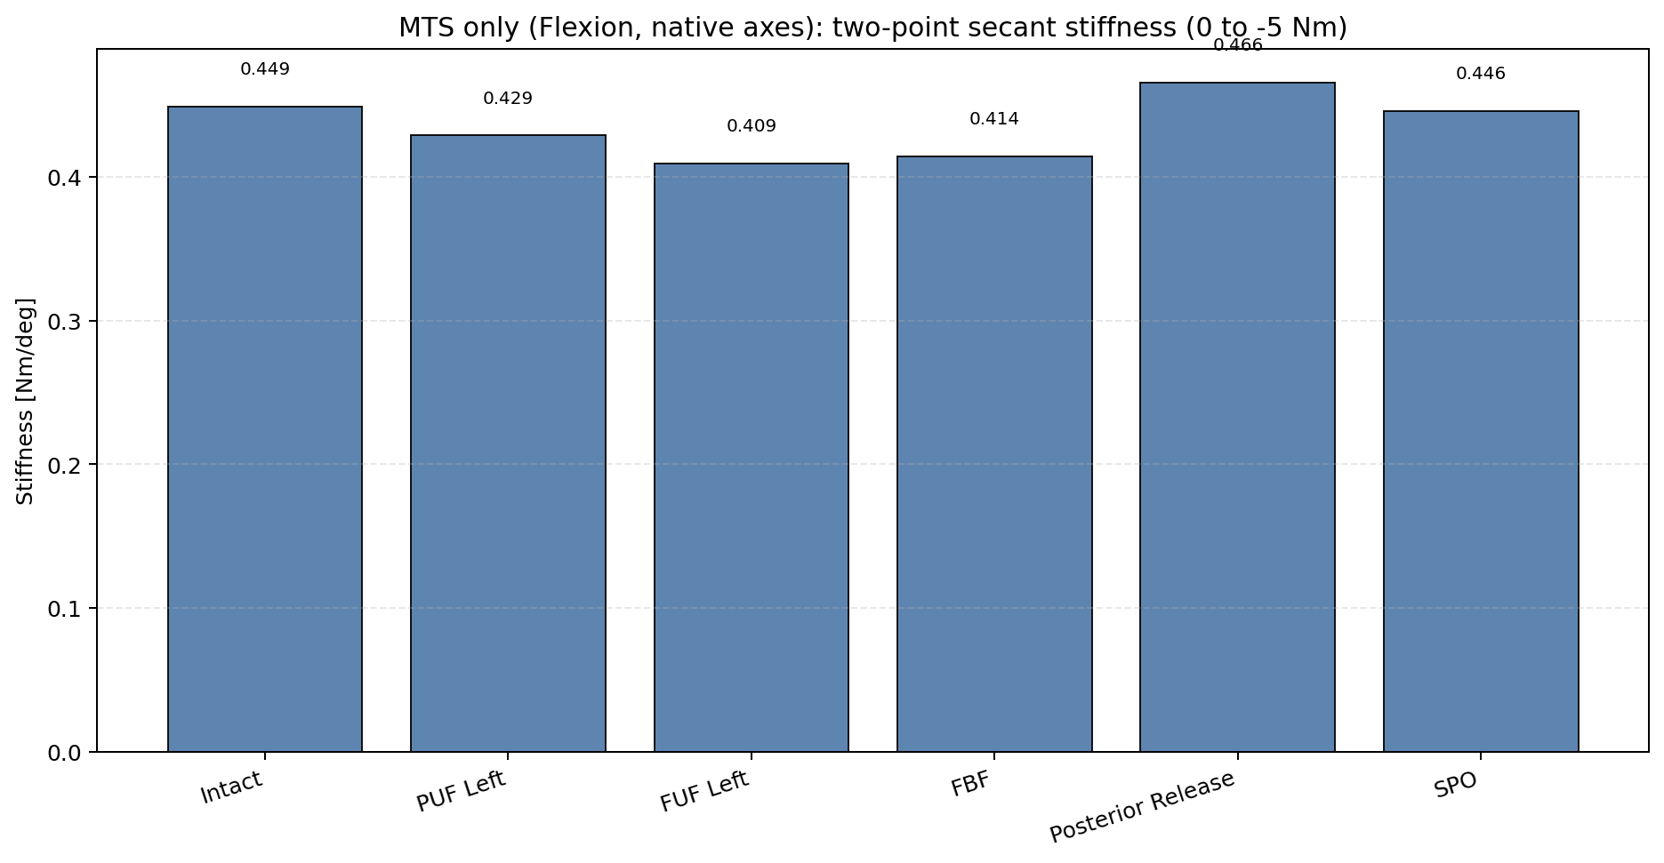
MTS Flexion (Native Negative Axes): 0 to -5 Nm Secant Stiffness Bar

Slide 15
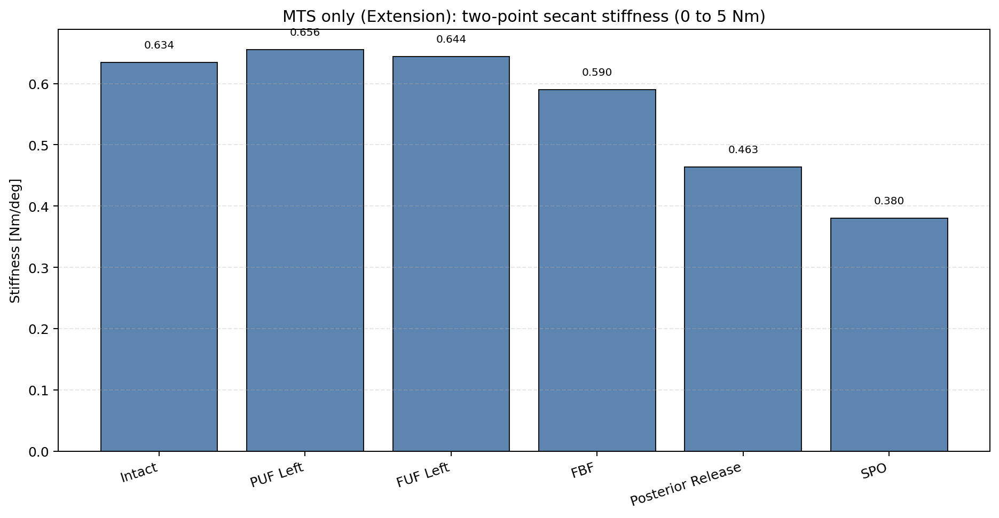
MTS Extension (Native Positive Axes): 0 to 5 Nm Secant Stiffness Bar

Slide 16
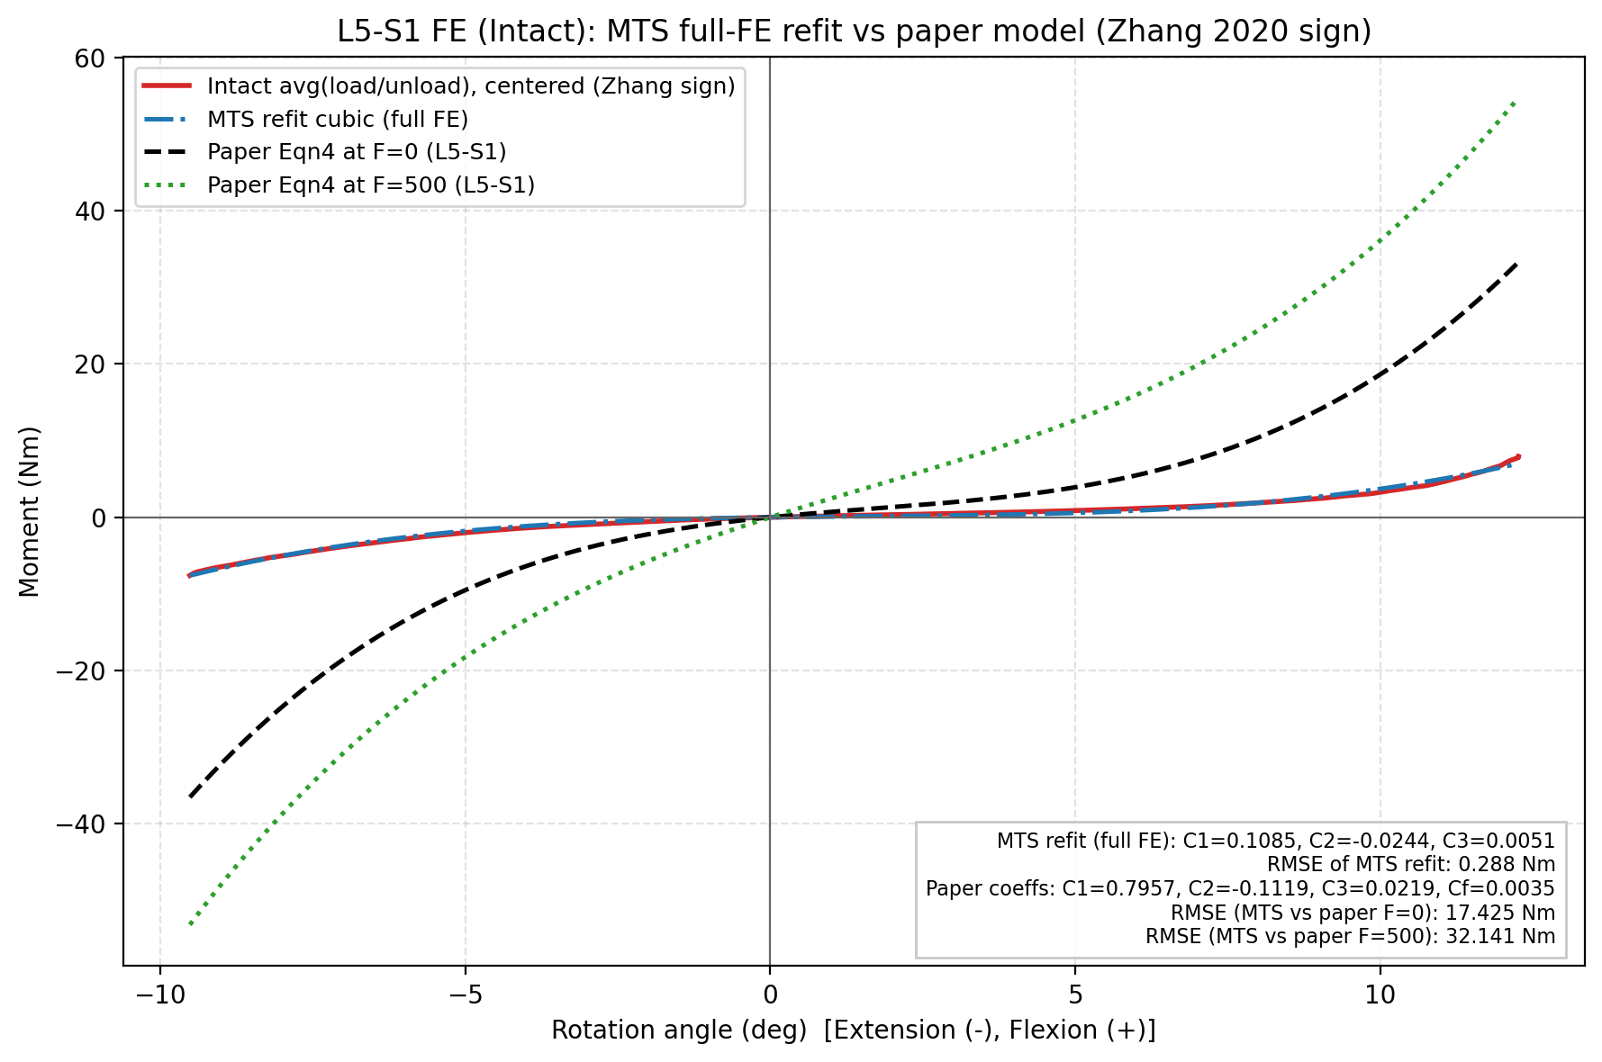
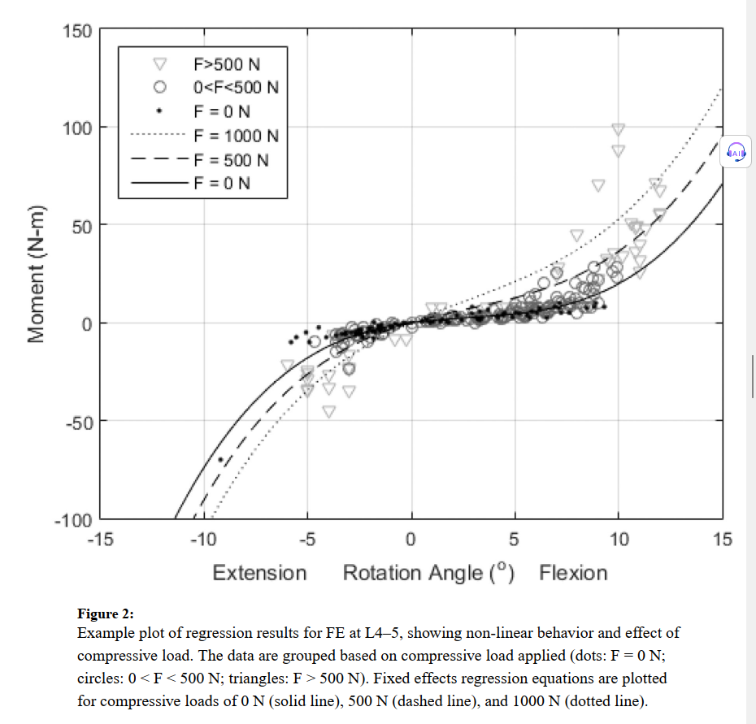
Comparison with Literature (Zhang 2020)

Slide 17
Lamina Spreader Testing Data Summary

Slide 18
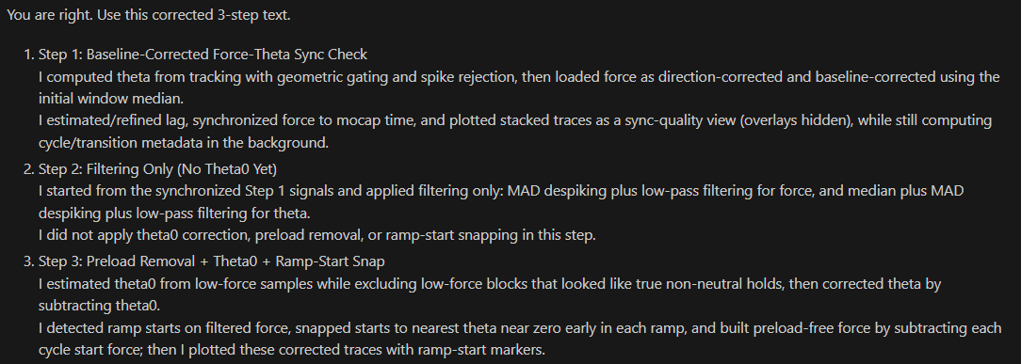
Workflow Overview
1. Sync-check raw force and raw theta traces across interventions.
2. Apply force/theta filters only (no theta0 extraction yet).
3. Apply preload removal + theta0 baseline extraction + ramp-start detection with theta snap.
4. Mark transition-flagged cycles as ineligible.
5. Fit force-tip linear region using displacement >= 0 mm points (some cycles can fail fit criteria).
6. Fit moment-theta linear region using theta >= 0 deg points (some cycles can fail fit criteria).

Slide 19
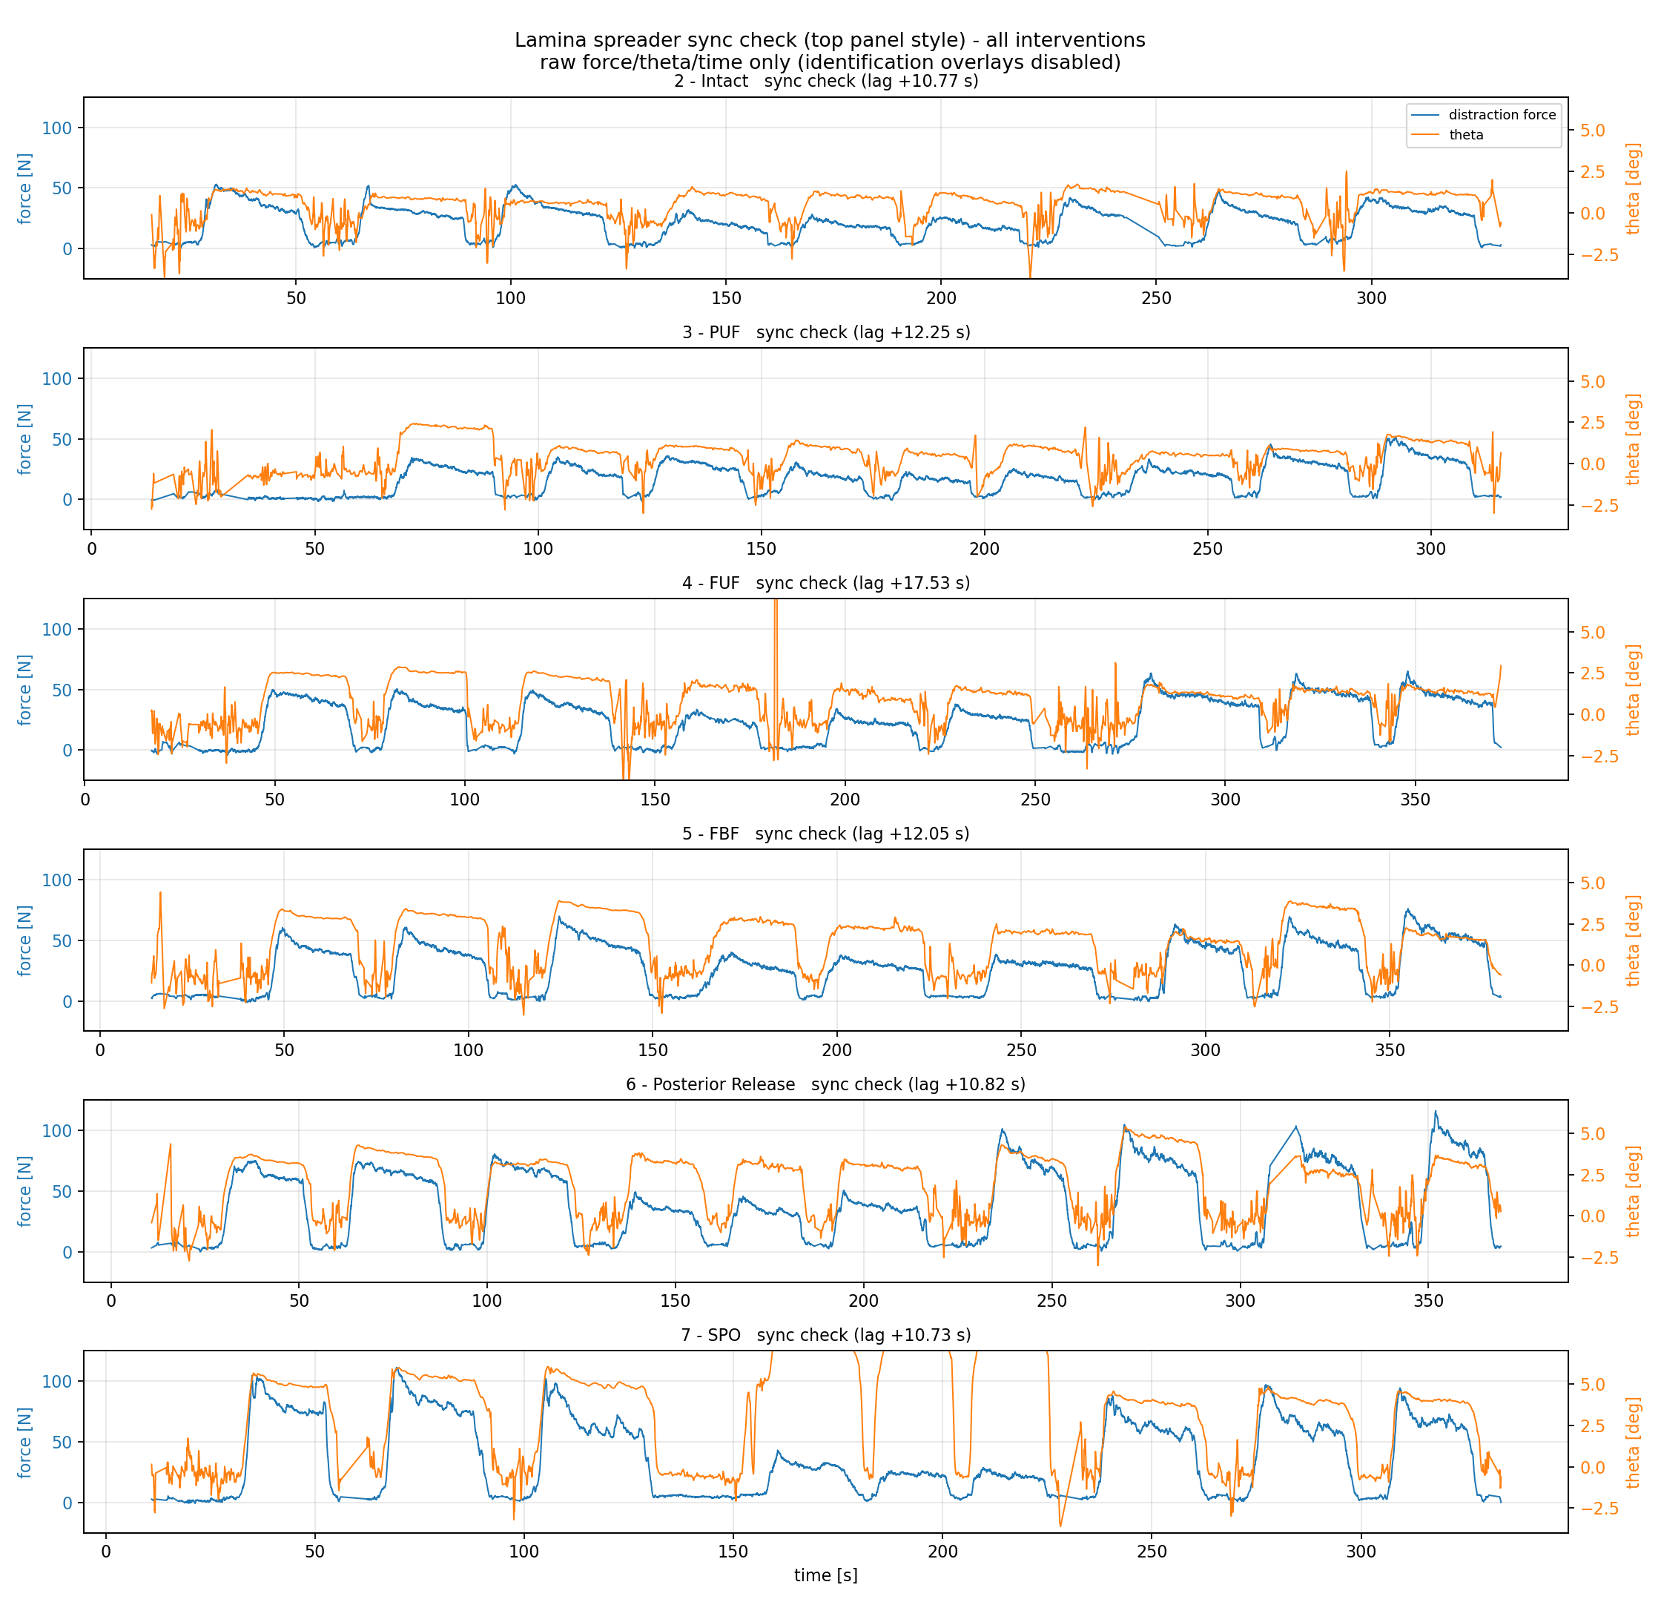
Step 1: Raw Force-Theta Sync Check
All interventions stacked before filtering/corrections.

Slide 20
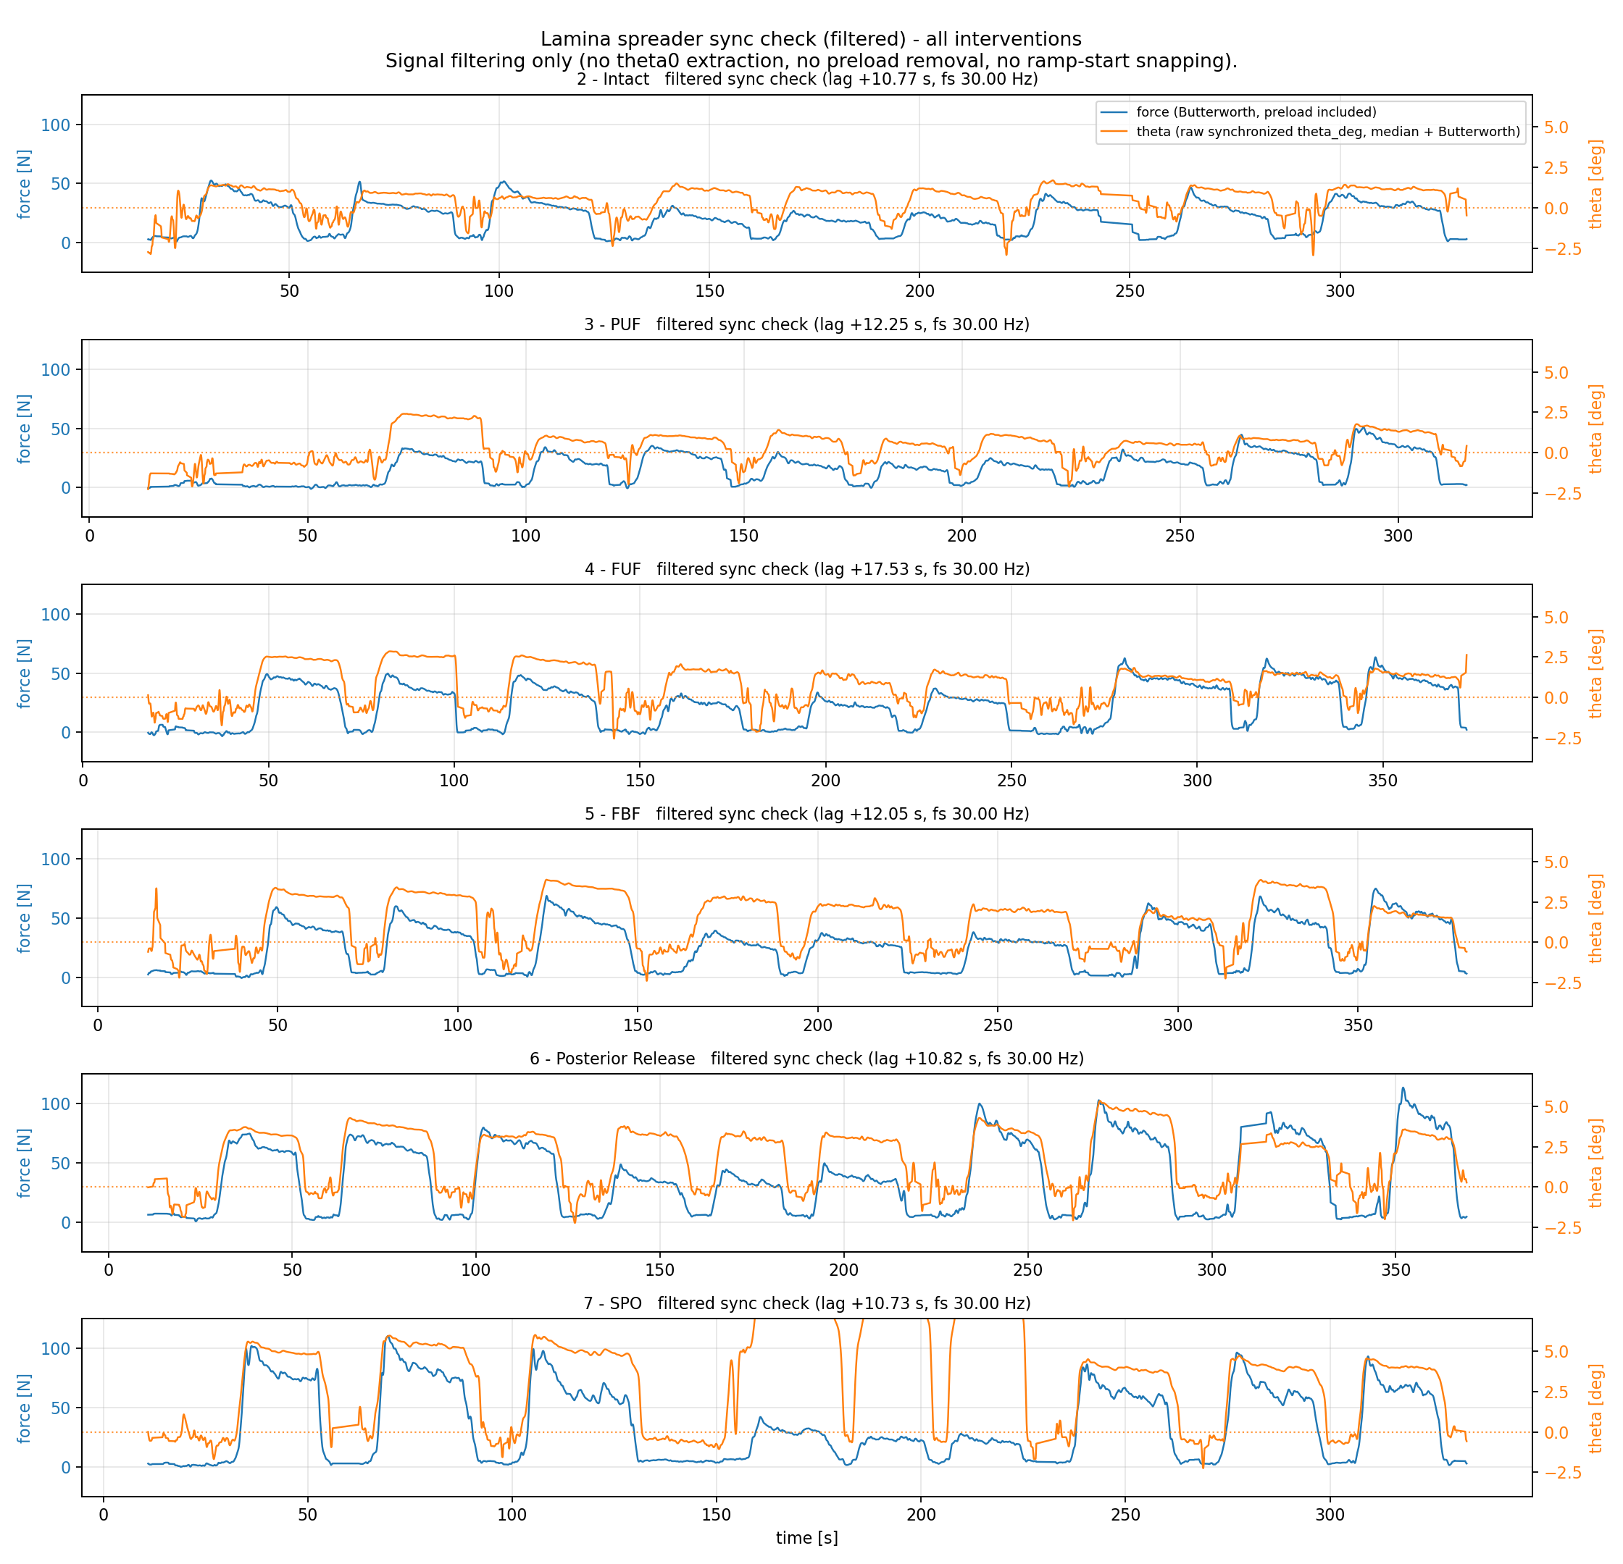
Step 2: Filtering Only (No Theta0 Yet)
Filtered force/theta signals only; no theta0 extraction or preload removal in this step.

Slide 21
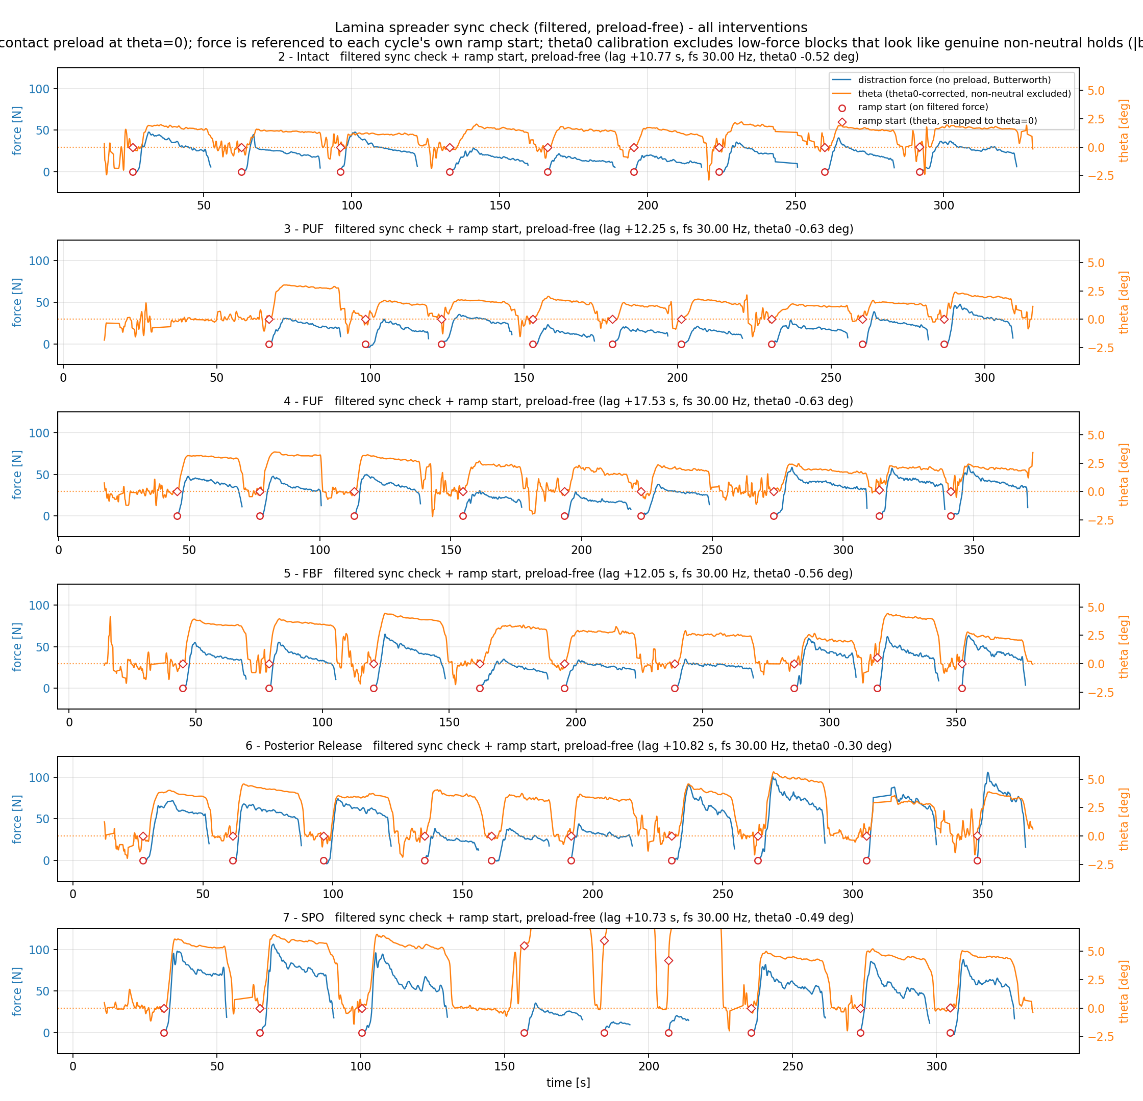
Step 3: Preload Removal + Theta0 + Ramp-Start Snap
Signals after preload removal, theta0 baseline extraction, and ramp-start detection with theta snap.

Slide 22
Step 4: Mark And Exclude Ineligible Cycles
Step 4: Cycle Eligibility (Transition-Flag Filtering)
Intervention n_cycles eligible ineligible
---------------------------------------------------------
FBF 9 9 0
FUF 9 9 0
Intact 9 9 0
PUF 9 9 0
Posterior Release 10 10 0
SPO 9 6 3
Rule: transition-flagged cycles are excluded from stiffness fitting.
Note: ineligible here only counts transition_flag=True cycles.
Additional exclusions can occur later at fit stage (separate from transition flags):
Intervention force-fit excluded moment-fit excluded
--------------------------------------------------------------
FBF 0 0
FUF 0 0
Intact 1 1
PUF 0 0
Posterior Release 0 0
SPO 3 3

Slide 23
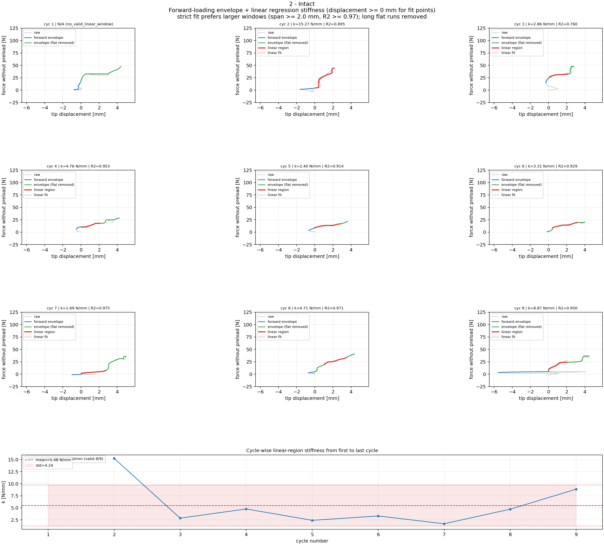
Step 5A: Force-Tip Linear Region Fitting: Intact
Cycle-wise linear windows and per-cycle stiffness (fit uses displacement >= 0 mm; shared force y-limits) for Intact.

Slide 24
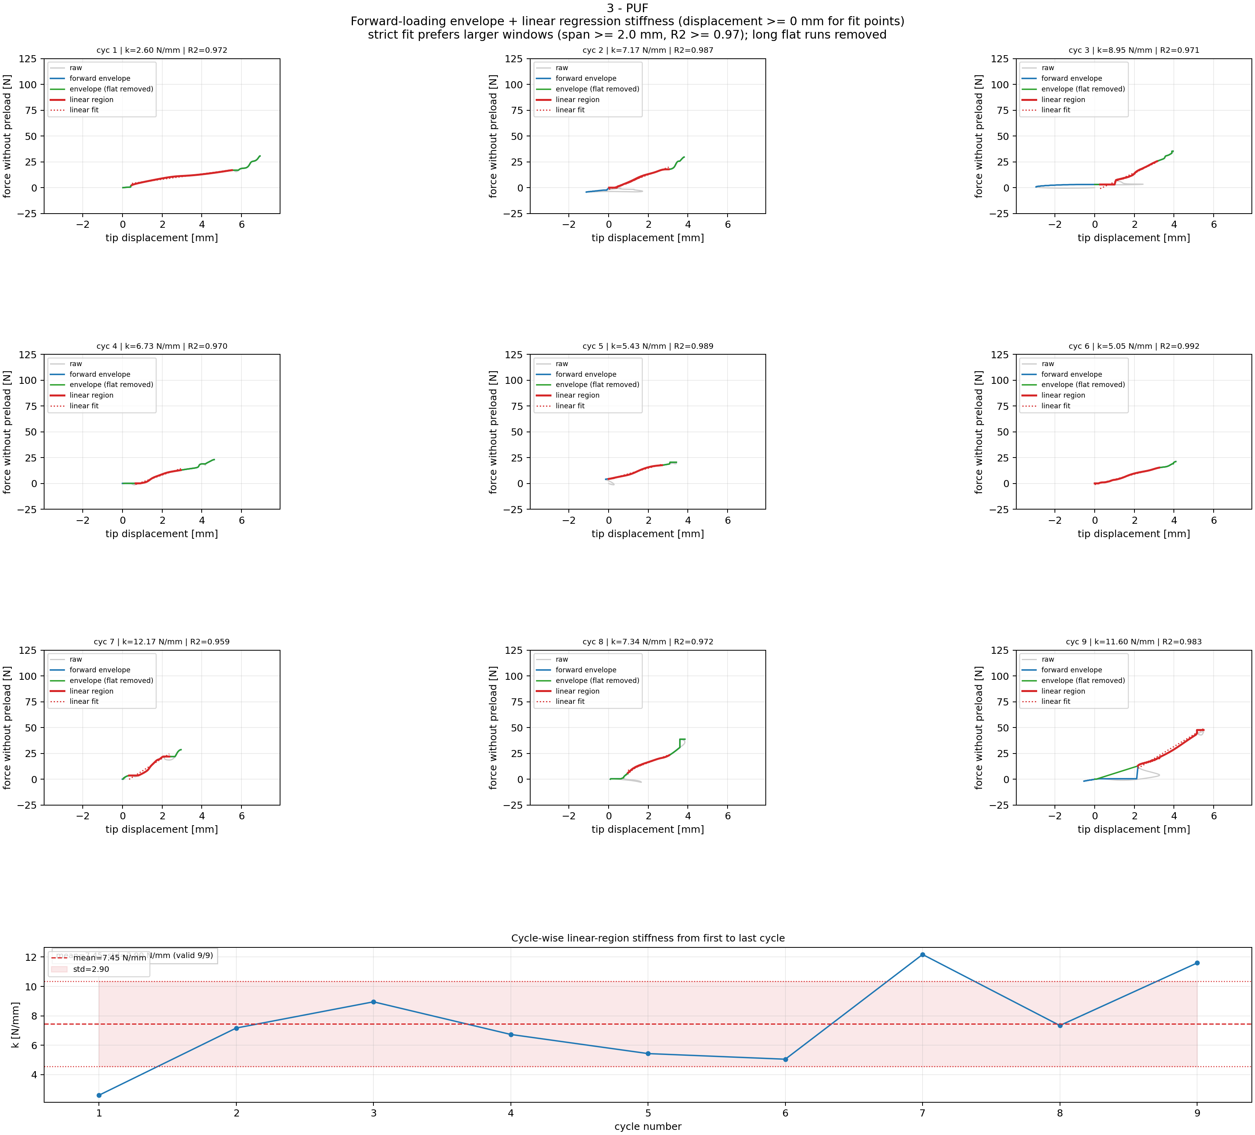
Step 5A: Force-Tip Linear Region Fitting: PUF
Cycle-wise linear windows and per-cycle stiffness (fit uses displacement >= 0 mm; shared force y-limits) for PUF.

Slide 25
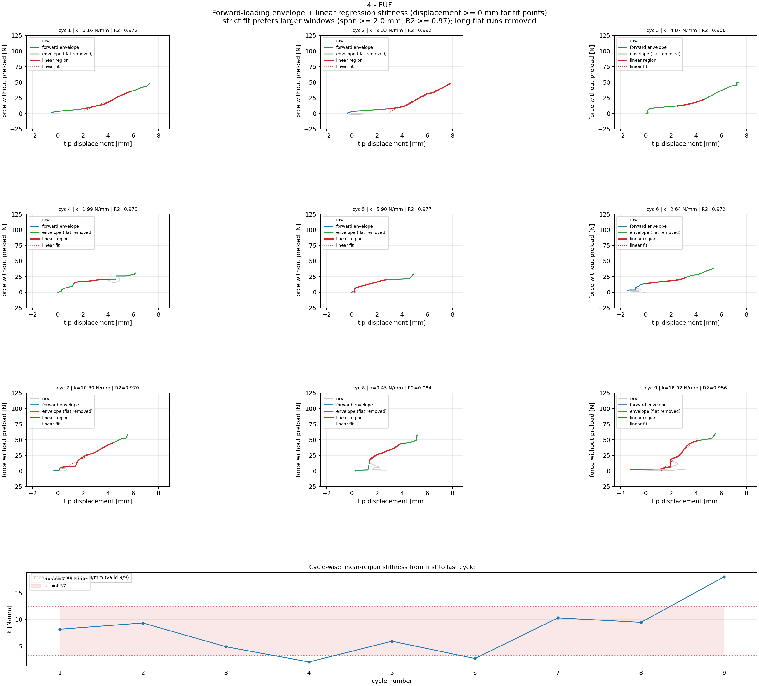
Step 5A: Force-Tip Linear Region Fitting: FUF
Cycle-wise linear windows and per-cycle stiffness (fit uses displacement >= 0 mm; shared force y-limits) for FUF.

Slide 26
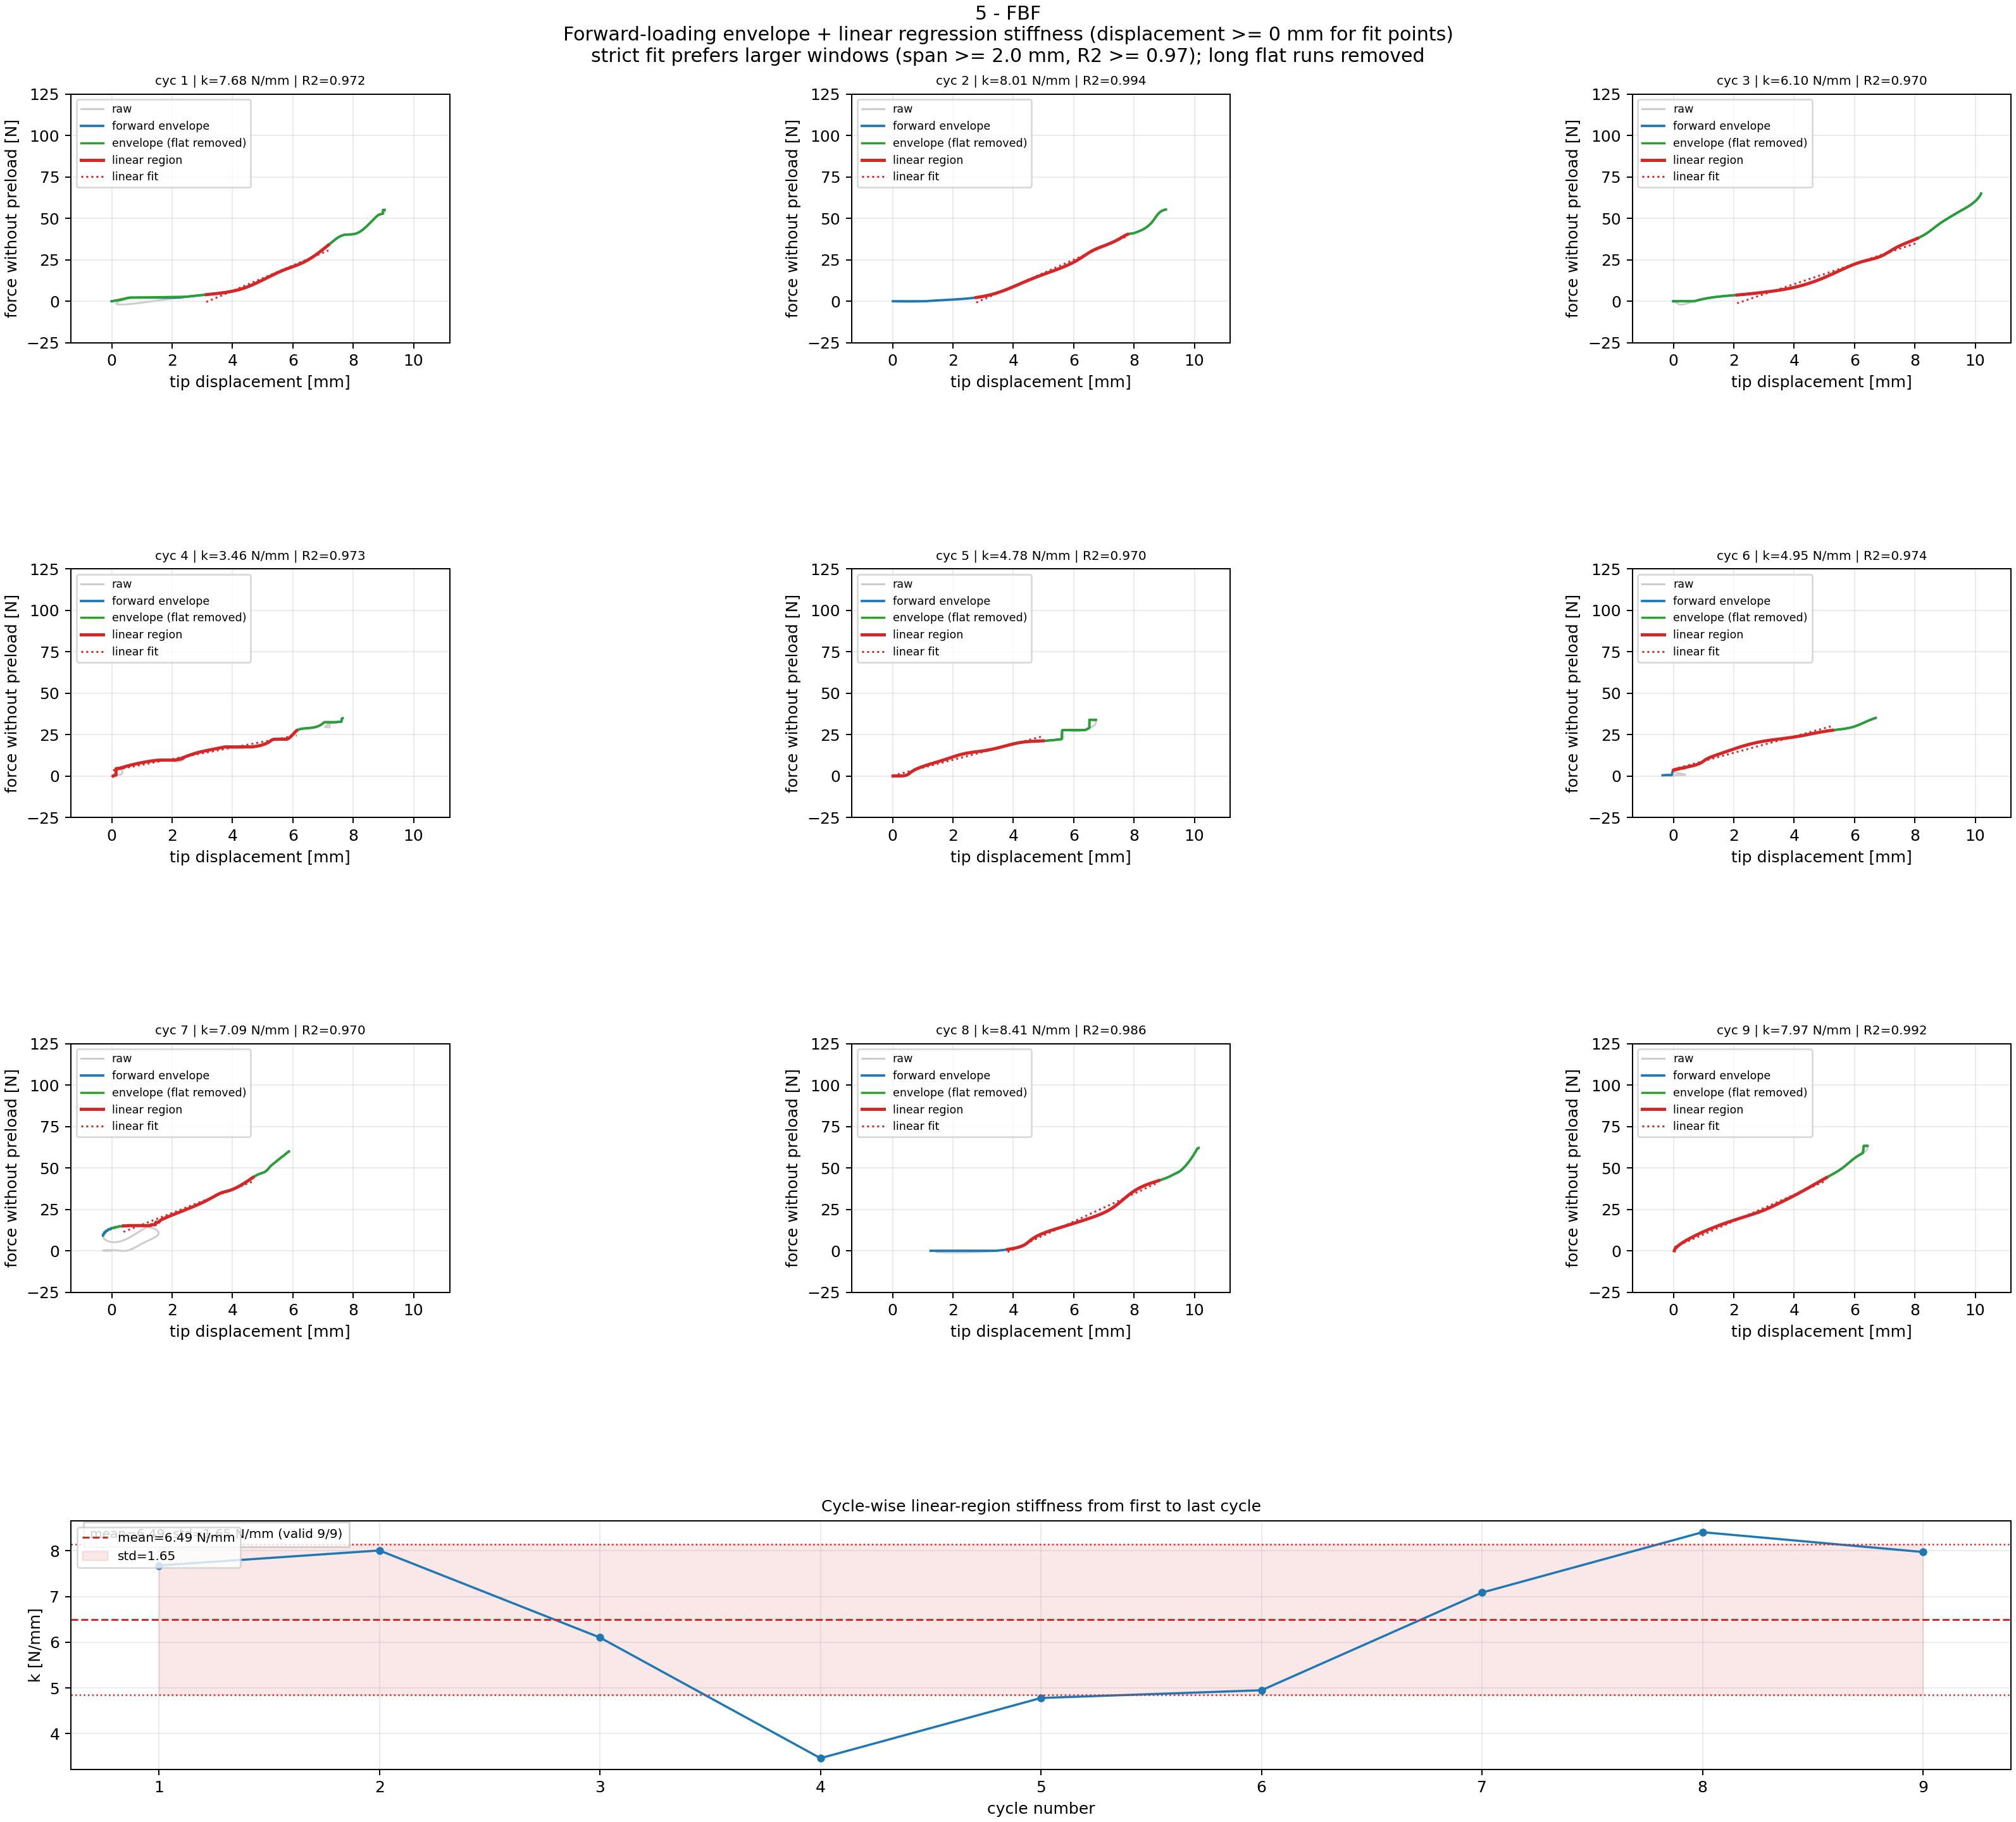
Step 5A: Force-Tip Linear Region Fitting: FBF
Cycle-wise linear windows and per-cycle stiffness (fit uses displacement >= 0 mm; shared force y-limits) for FBF.

Slide 27
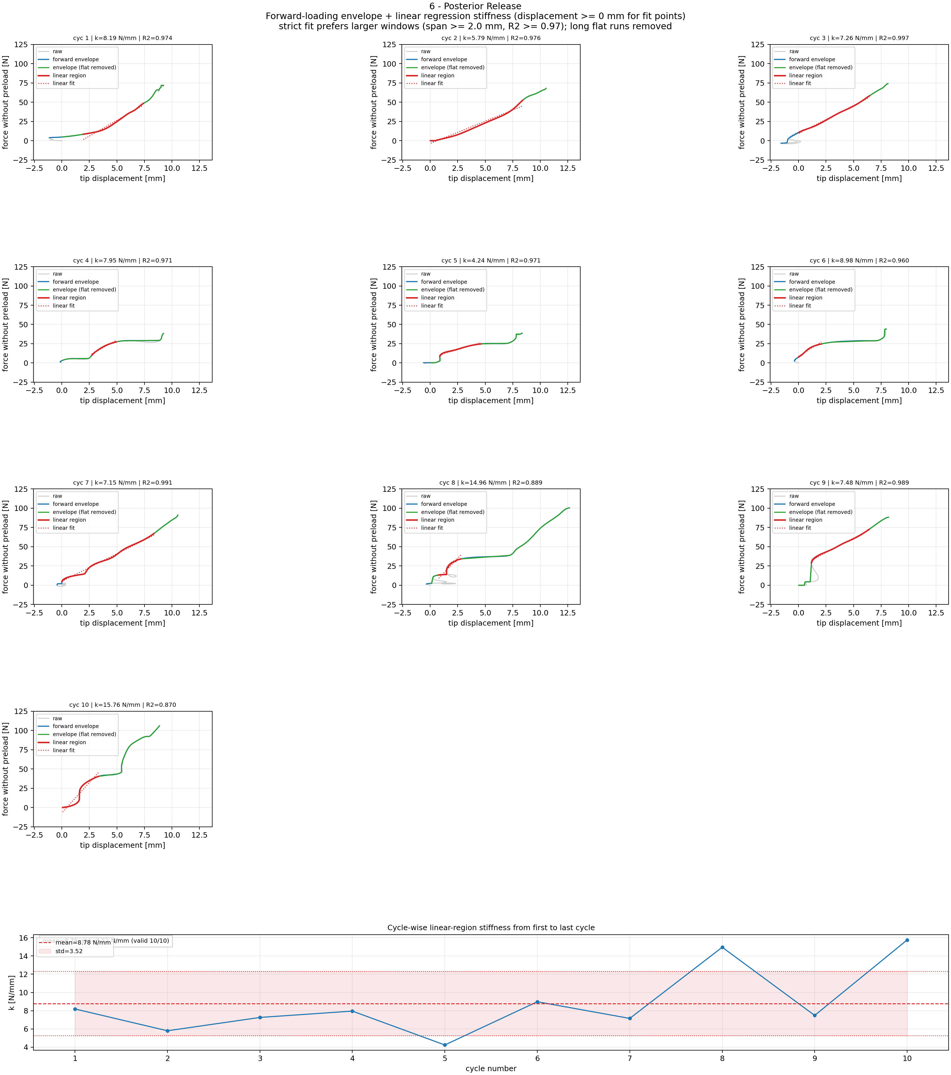
Step 5A: Force-Tip Linear Region Fitting: Posterior Release
Cycle-wise linear windows and per-cycle stiffness (fit uses displacement >= 0 mm; shared force y-limits) for Posterior Release.

Slide 28
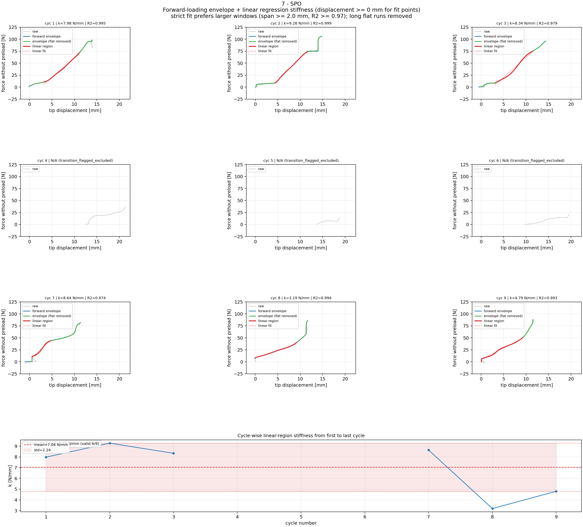
Step 5A: Force-Tip Linear Region Fitting: SPO
Cycle-wise linear windows and per-cycle stiffness (fit uses displacement >= 0 mm; shared force y-limits) for SPO.

Slide 29
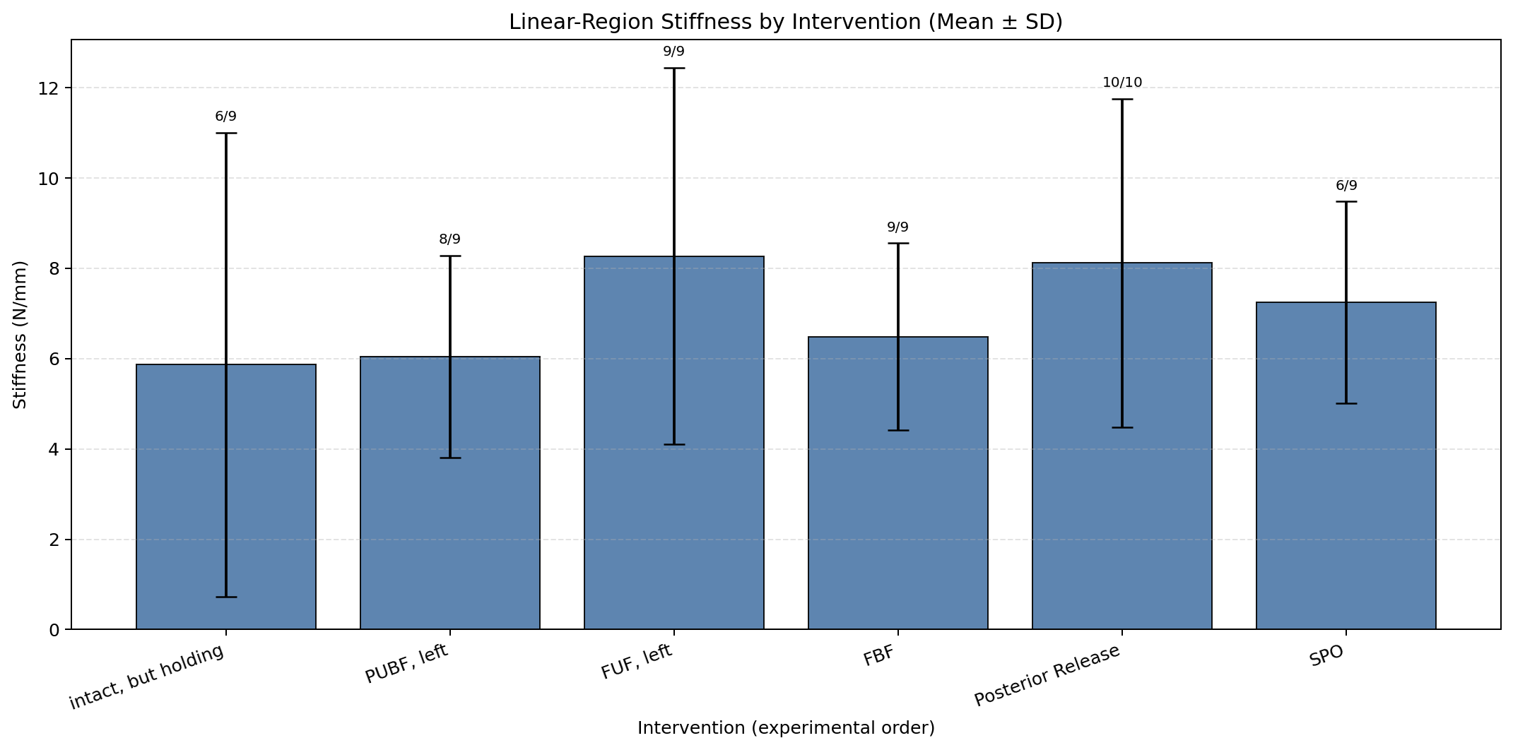
Step 5B: Linear Stiffness Results Across Interventions
Mean ± SD from valid cycles (force-tip linear-region stiffness).

Slide 30
Linear Stiffness Ranking
Step 6A Results: Linear-Region Force-Tip Stiffness
Rank Intervention median [N/mm] mean [N/mm] n_valid/n_cycles
--------------------------------------------------------------------------
1 SPO 8.158 7.037 6/9
2 FUF 8.158 7.851 9/9
3 Posterior Release 7.716 8.775 10/10
4 PUF 7.170 7.450 9/9
5 FBF 7.086 6.495 9/9
6 Intact 4.011 5.483 8/9

Slide 31
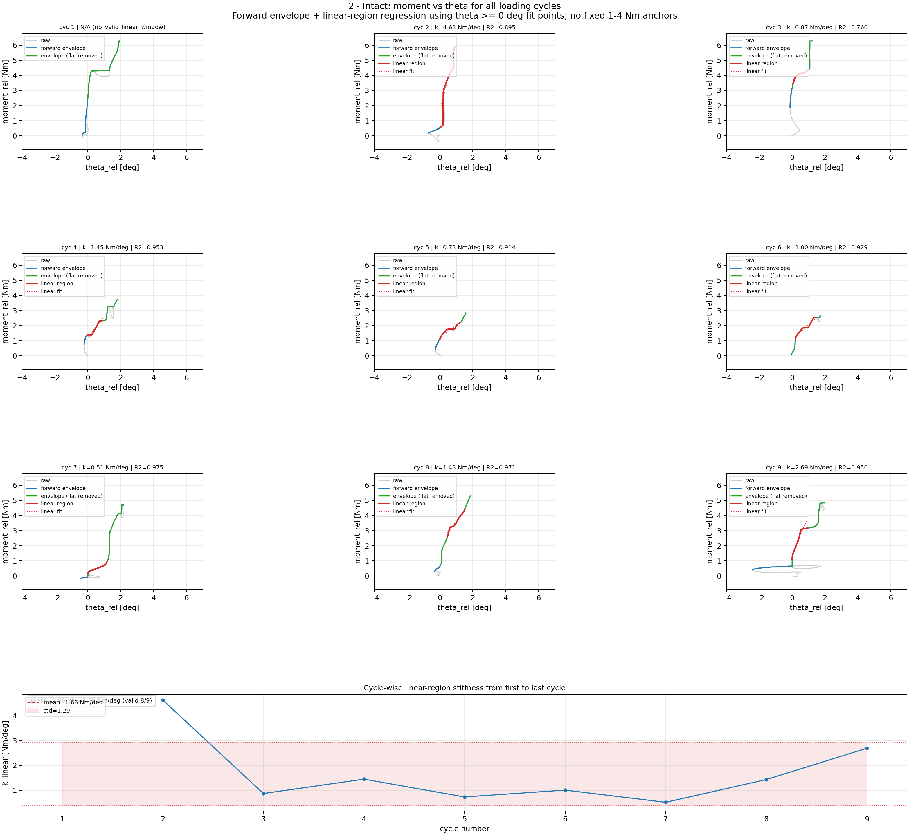
Step 6A: Moment-Theta Processing: Intact
Cycle-wise rotational stiffness processing (fit uses theta >= 0 deg; shared theta limits) for Intact.

Slide 32
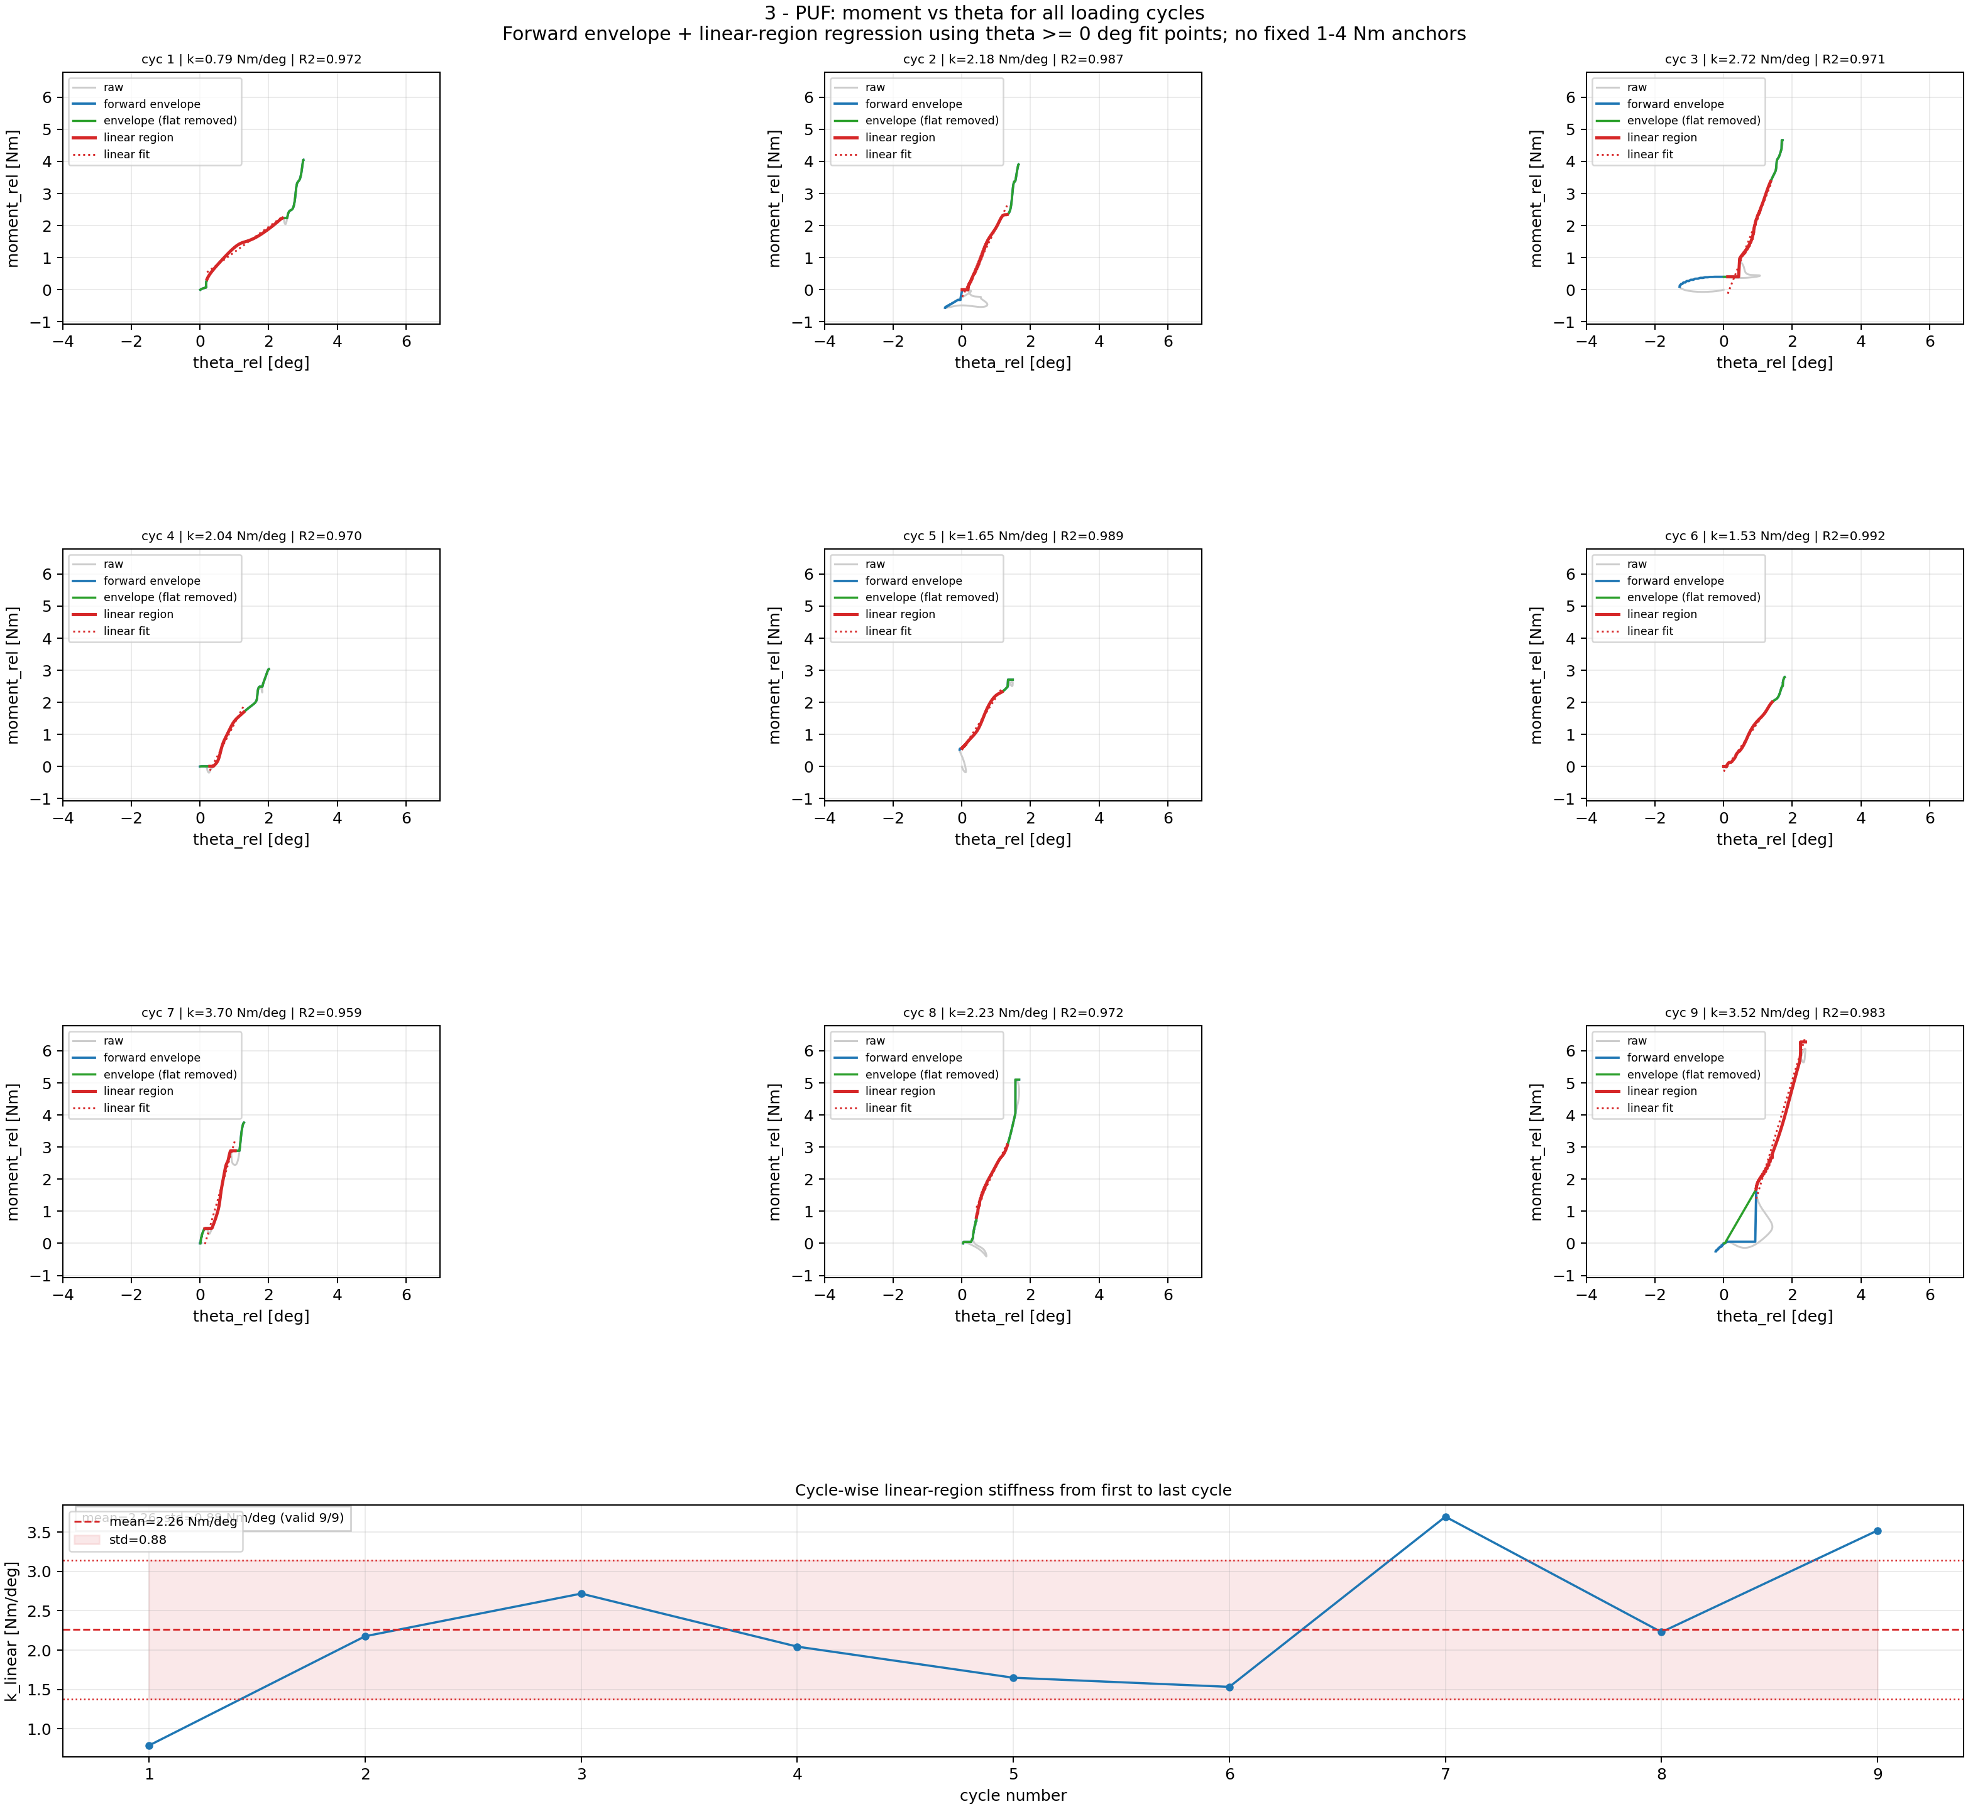
Step 6A: Moment-Theta Processing: PUF
Cycle-wise rotational stiffness processing (fit uses theta >= 0 deg; shared theta limits) for PUF.

Slide 33
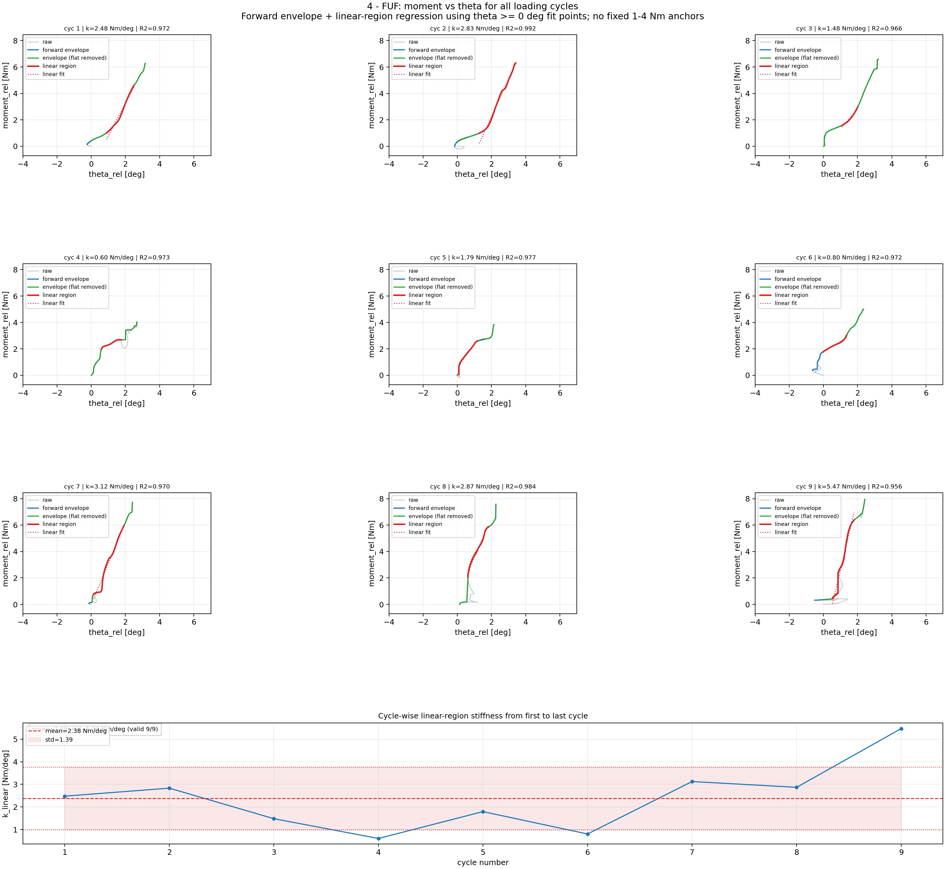
Step 6A: Moment-Theta Processing: FUF
Cycle-wise rotational stiffness processing (fit uses theta >= 0 deg; shared theta limits) for FUF.

Slide 34
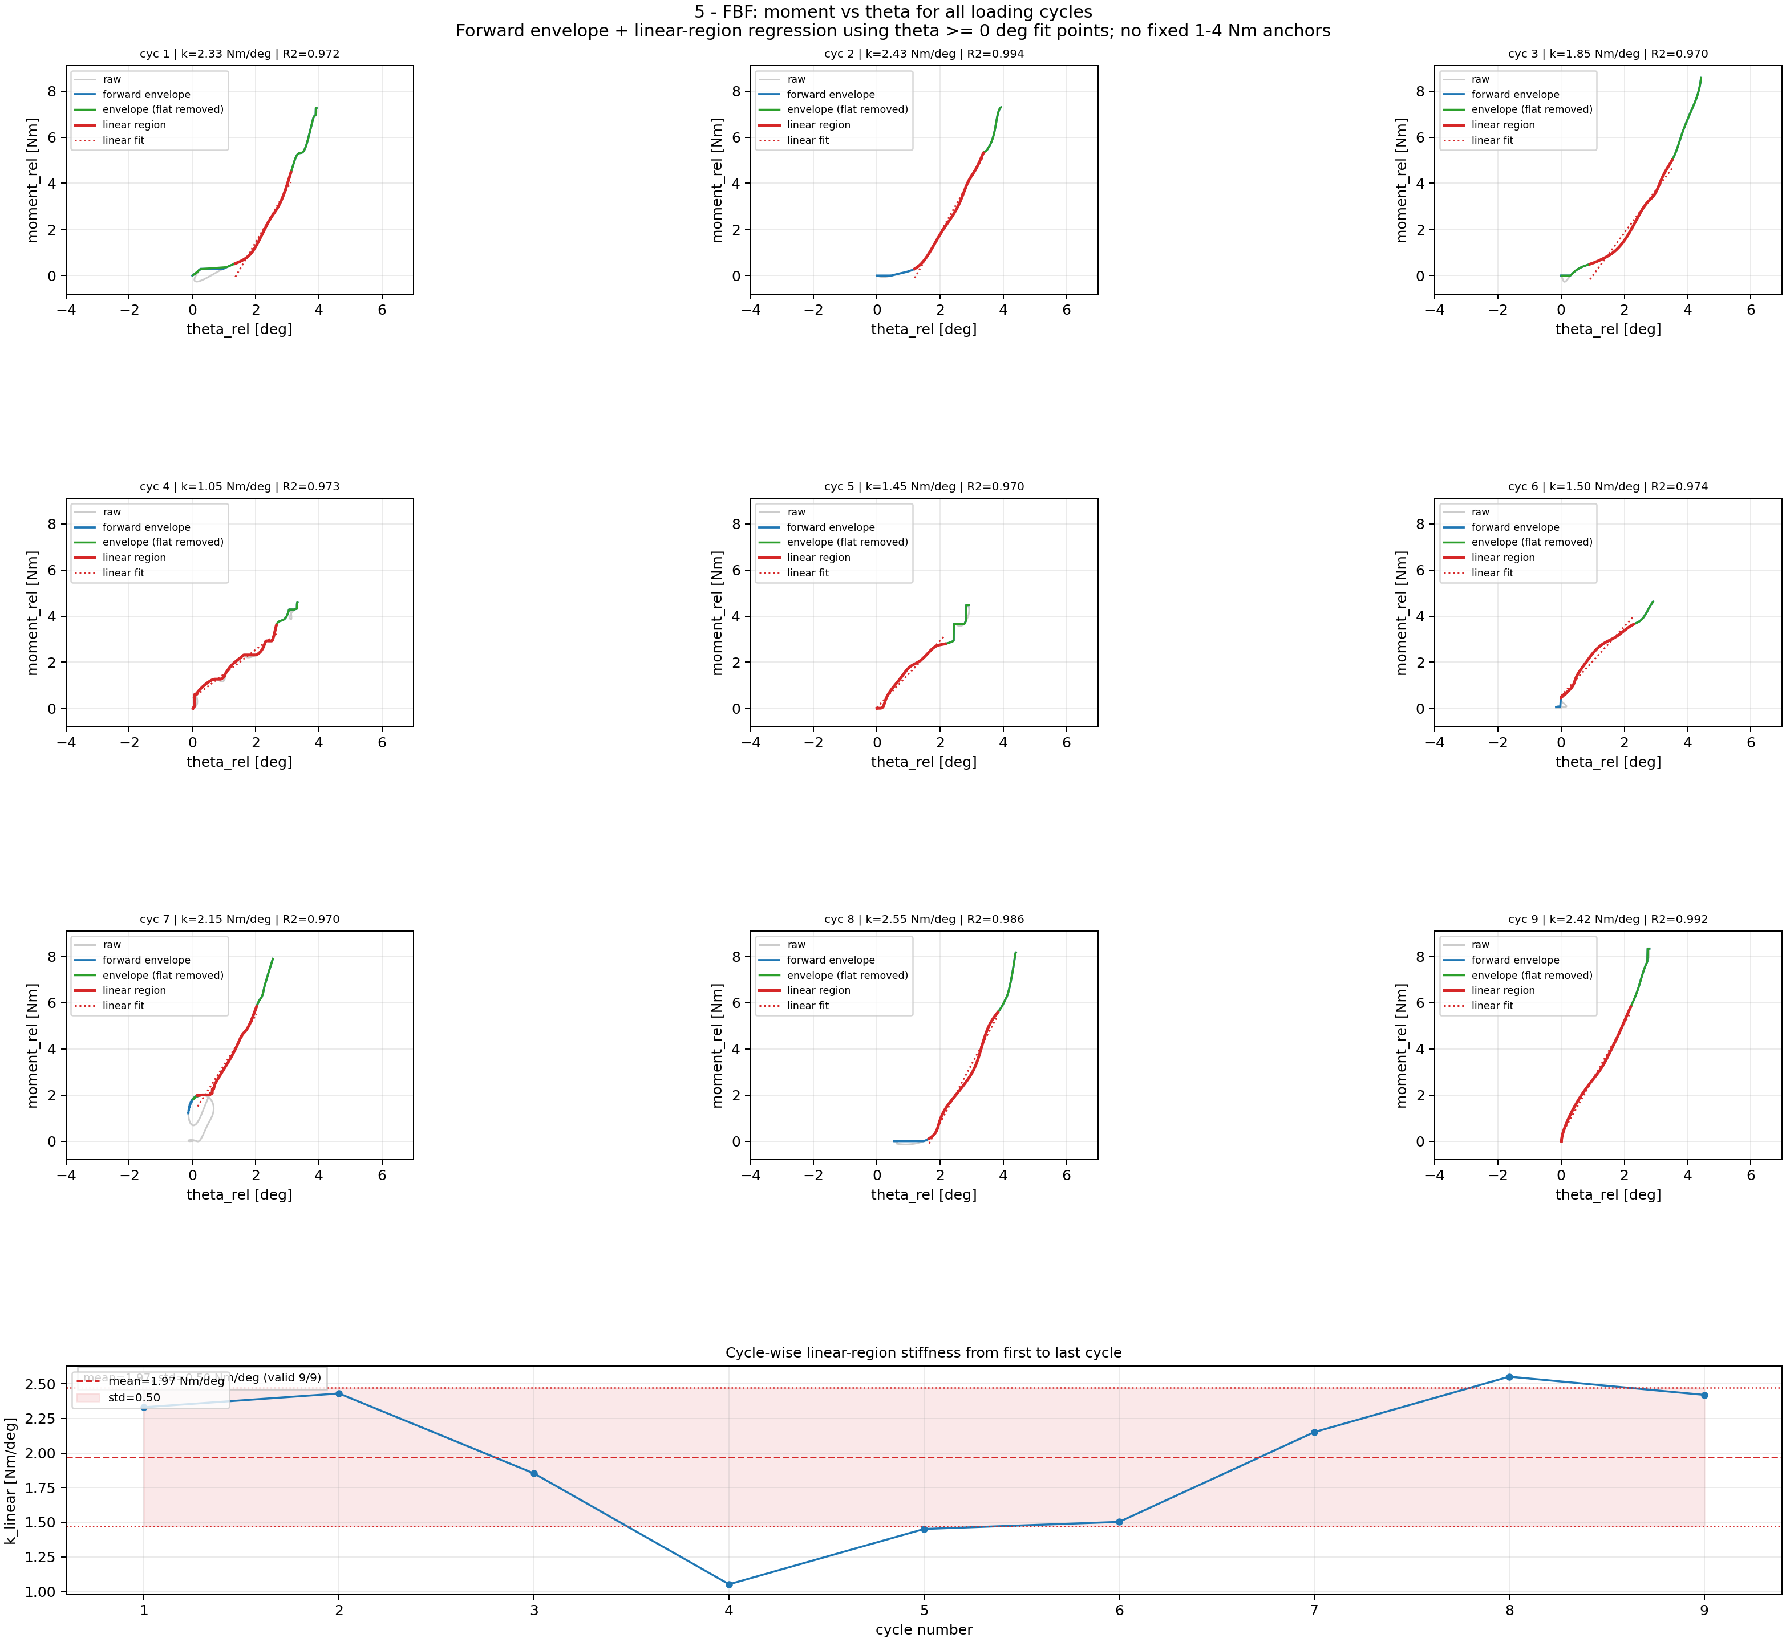
Step 6A: Moment-Theta Processing: FBF
Cycle-wise rotational stiffness processing (fit uses theta >= 0 deg; shared theta limits) for FBF.

Slide 35
Step 6A: Moment-Theta Processing: Posterior Release
Cycle-wise rotational stiffness processing (fit uses theta >= 0 deg; shared theta limits) for Posterior Release.

Slide 36
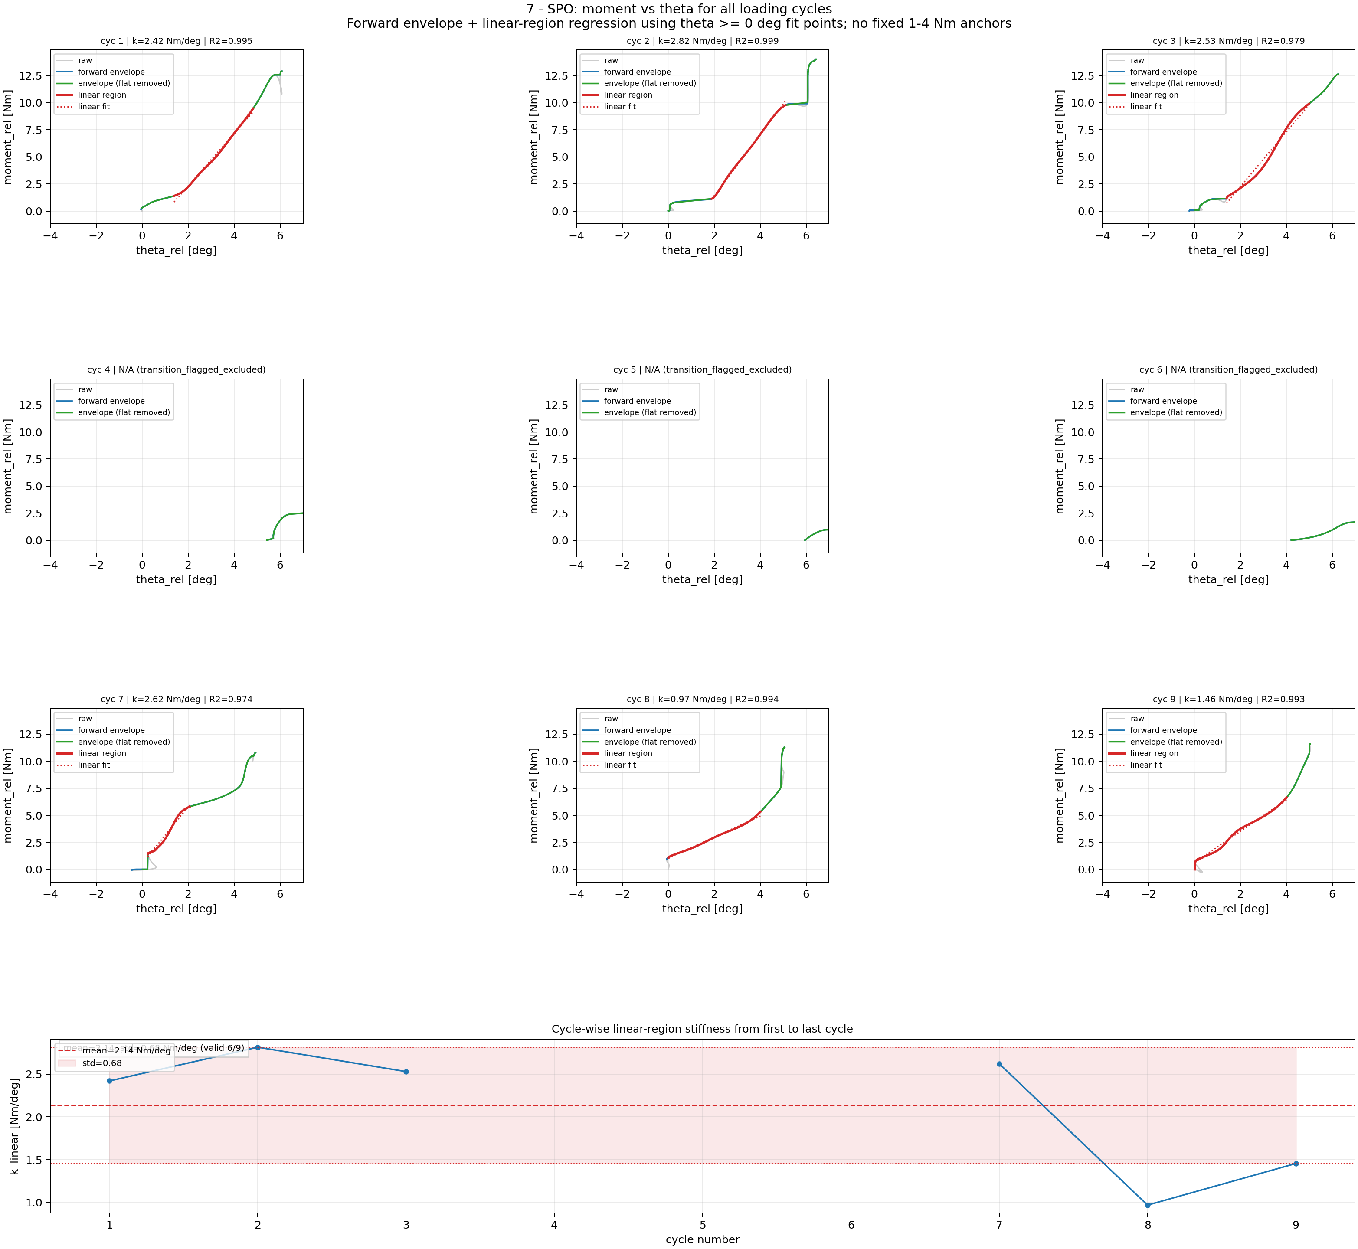
Step 6A: Moment-Theta Processing: SPO
Cycle-wise rotational stiffness processing (fit uses theta >= 0 deg; shared theta limits) for SPO.

Slide 37
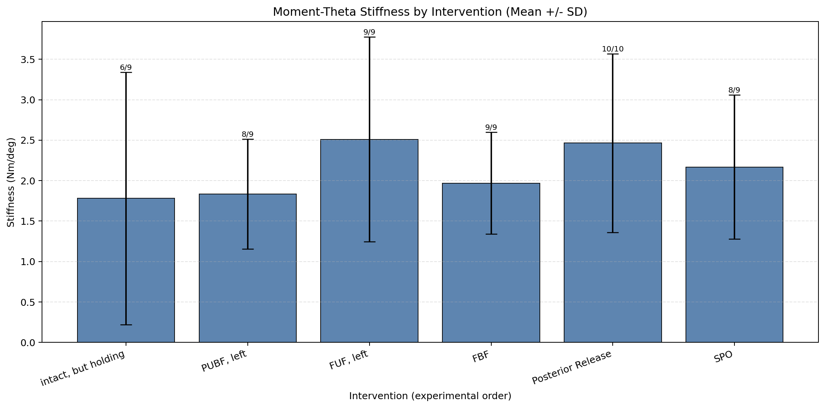
Step 6B: Rotational Stiffness Results Across Interventions
Mean ± SD from valid cycles (moment-theta stiffness).

Slide 38
Rotational Stiffness Ranking
Step 6B Results: Moment-Theta Rotational Stiffness
Rank Intervention median [Nm/deg] mean [Nm/deg] n_valid/n_cycles
---------------------------------------------------------------------------
1 SPO 2.476 2.136 6/9
2 FUF 2.476 2.383 9/9
3 Posterior Release 2.342 2.663 10/10
4 PUF 2.176 2.261 9/9
5 FBF 2.151 1.971 9/9
6 Intact 1.217 1.664 8/9

Slide 39
Appended Update: Fit-Point Rules
This version appends re-analysis results with explicit fit-point thresholds.
Displacement stiffness fitting: use only displacement >= 0 mm points.
Rotational stiffness fitting: use only theta >= 0 deg points.
All rankings/tables in this deck reflect these updated fit-selection rules.

Slide 40
Appendix: Filters Used
Median filter (theta, kernel=5): replaces each sample with local median; removes isolated spikes while preserving step/ramp edges better than mean smoothing.
Butterworth low-pass (order=2): force cutoff=1.5 Hz, theta cutoff=1.2 Hz; attenuates high-frequency noise while preserving low-frequency cycle shape and phase reasonably well.
MAD despiking before low-pass: force window=11, z=3.5; theta window=15, z=3.5; robust outlier suppression using rolling median absolute deviation.
Pseudo-ramp rejection: keep cycles only if run_samples>=30, rise_time>=1.2 s, and theta_rise>=0.2 deg.
Duplicate-peak merge: close peaks are clustered and only strongest candidate retained (time-gap bounds 2.5 to 10.0 s).
Theta0 calibration filter: estimate zero-angle from low-force samples (<5% Fmax) but exclude low-force blocks with |median theta|>1.0 deg.
Ramp-start theta snap: move force-based ramp start to nearest theta~0 in early ramp window (1.5 s), unless start is already non-neutral (|theta|>1.5 deg).
Linear-fit point constraints: displacement fits use x>=0 mm; moment-theta fits use theta>=0 deg; flat low-slope segments removed before regression.

Slide 41
Key Takeaways
Step-wise processing narrows from raw traces to quality-controlled cycles.
Results are reported in two complementary stiffness spaces:
force-tip (N/mm) and moment-theta (Nm/deg).
Rankings are based on median stiffness across valid cycles.
Fit-point constraints are displacement >= 0 mm and theta >= 0 deg.

Slide 42
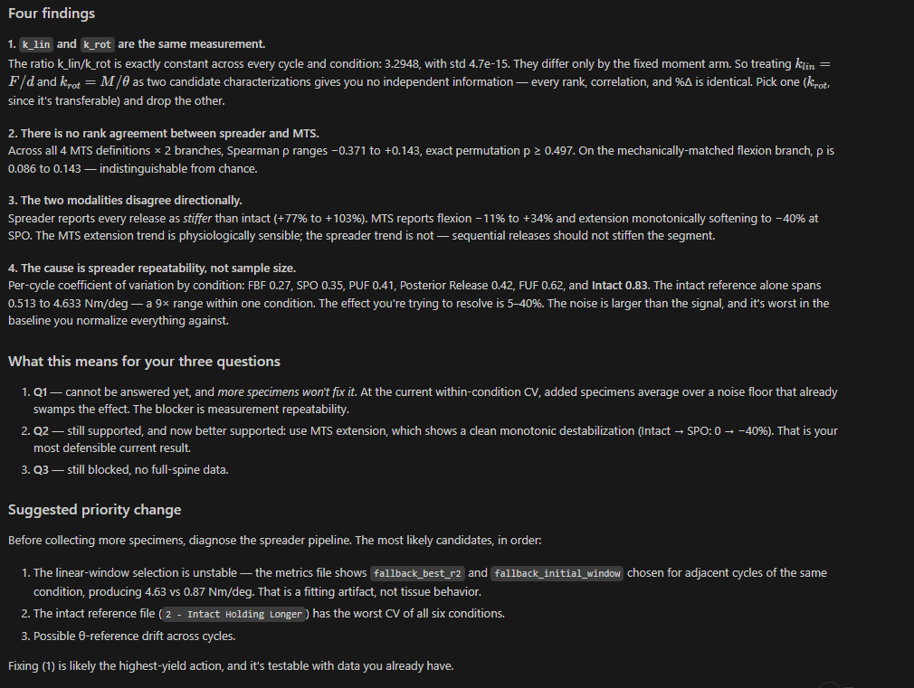

Slide 43
MTS Flexion/Extension – All Interventions
Extension
PLL release and SPO significantly decreased extension stiffness
Surprising to see PLL release had a large impact
Facetectomy decreased it as well but to a lesser extent
Continuous loss of stability with increasing bony/tissue resections
Extension
Flexion
For all interventions, stiffness is unchanged until around 8 deg
Facetectomy lowers stiffness afterwards
Surprising to see PLL removal did not decrease stiffness
Flexion
similar stiffness up to ~8 deg

Slide 44
MTS FE (Native Axes): Extension 0-5 and Flexion 0 to -5 Nm Secant Fit Panels

Slide 45
MTS Flexion: Comparison of Different Stiffness Metrics
Extension
Flexion

Slide 46
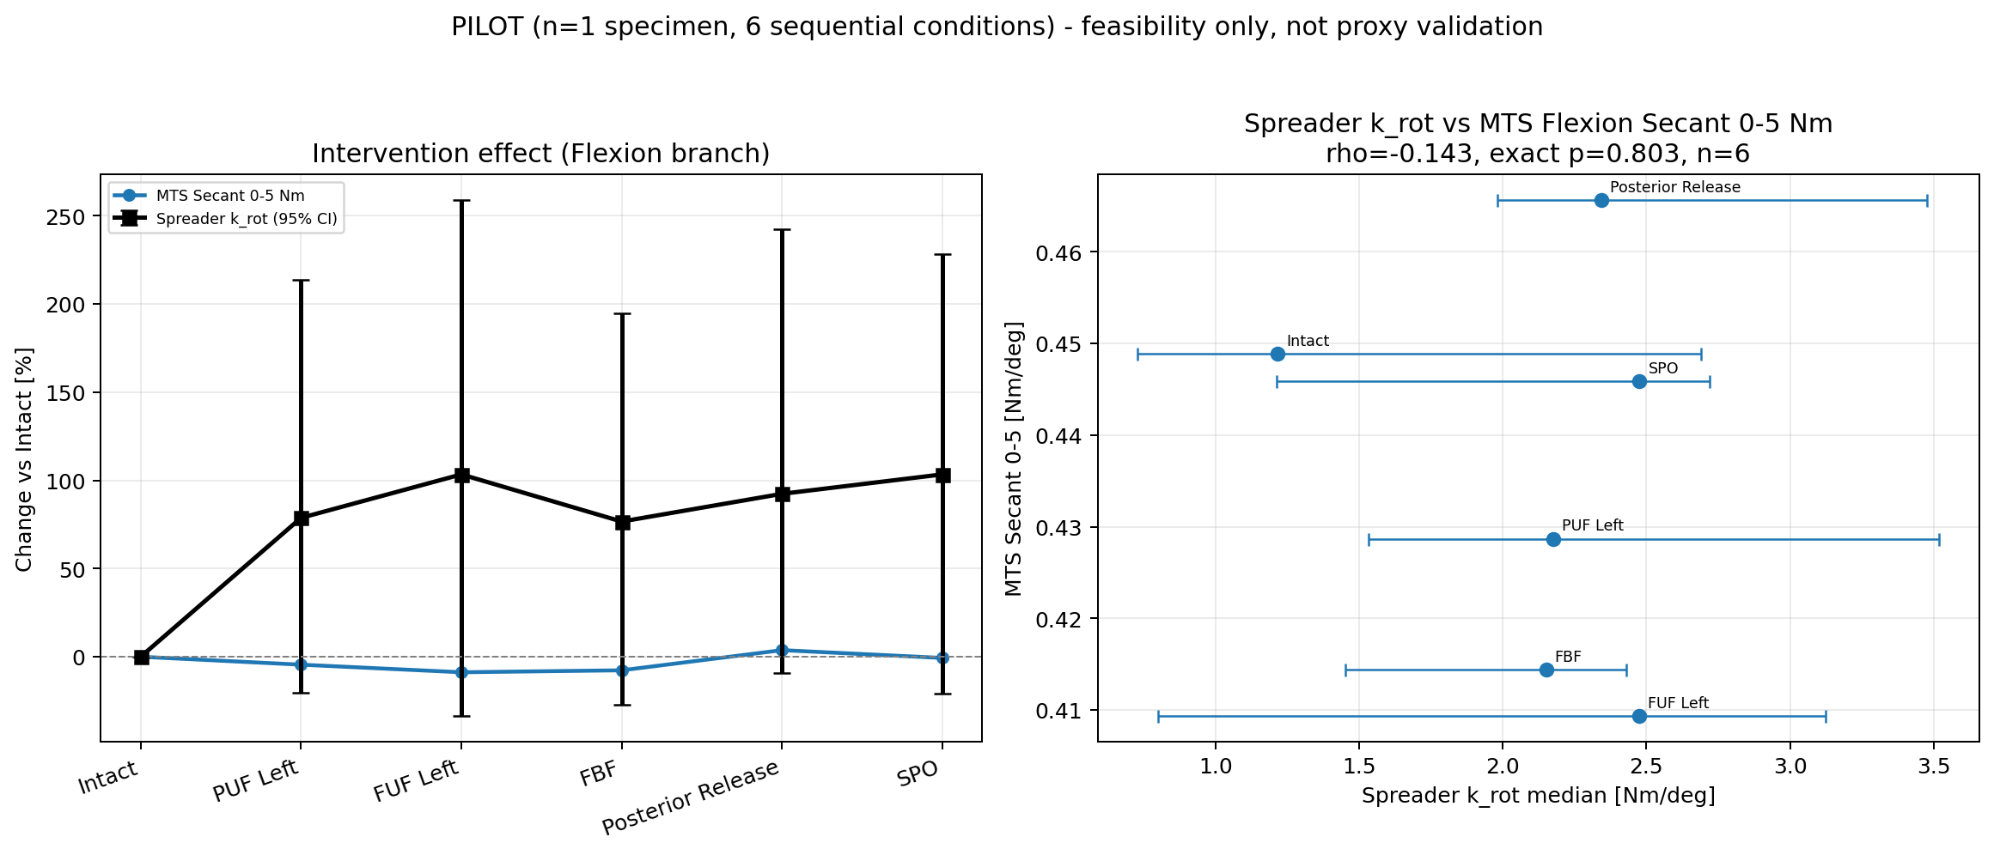
Intervention Effect For Flexion

Slide 47
Brainstorming – Model Scaling
Question 1: Does lamina spreader reliably characterize segment stiffness?
We’ll compare motion segment testing data for flexion between lamina spreader and traditional testing. If they are highly correlated, we can use spreader measurements as a proxy to joint stiffness. For example, we can then estimate motion segment stiffness using spreader.
Question 2: How do we quantify the impact of interventions on intact motion segments?
We’ll use traditional testing data to quantify the impact of interventions on intact motion segments. We’ll only use spreader if patient-specific assessment of the impact of interventions on stability is required. It’s technically not feasible to measure lateral bending and axial rotation using spreader.
Question 3: How do we estimate intact isolated motion segment stiffness from intact full spine patient stiffness?
We’ll measure/establish the relationship between these two features using lamina spreader. If successful, we can use intraoperative spreader measurements to estimate motion segment stiffness using either our cadaver measurements or the literature data.

Slide 48
Cadaver Lab Goals
Goal 1: Establish usage guidelines:
  - Establish where to apply lamina spreader (left/right lamina, spinous process)
  - Establish how to perform consistent measurements (gradual force application, pause at the end, etc.)
  - Establish how many cycles are needed?
  - What makes a measurement cycle qualify?
Goal 2: Figure out whether to update stiffness on the go, or at the end of data collection
Goal 3: Collect data for multiple levels
- Figure out if there is a path to extrapolate multiple levels from one level measurement

Slide 49
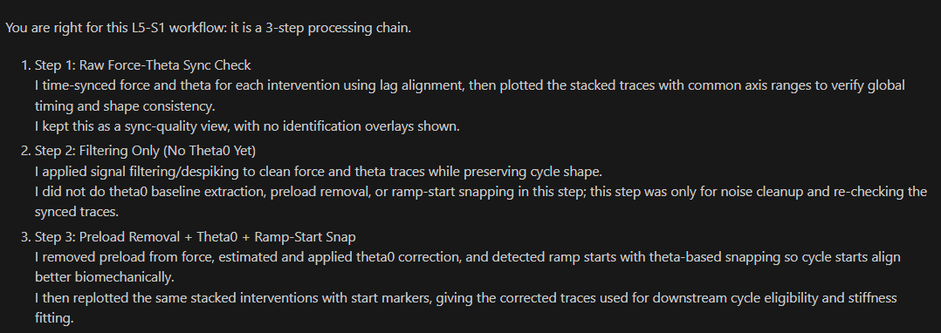

Slide 50
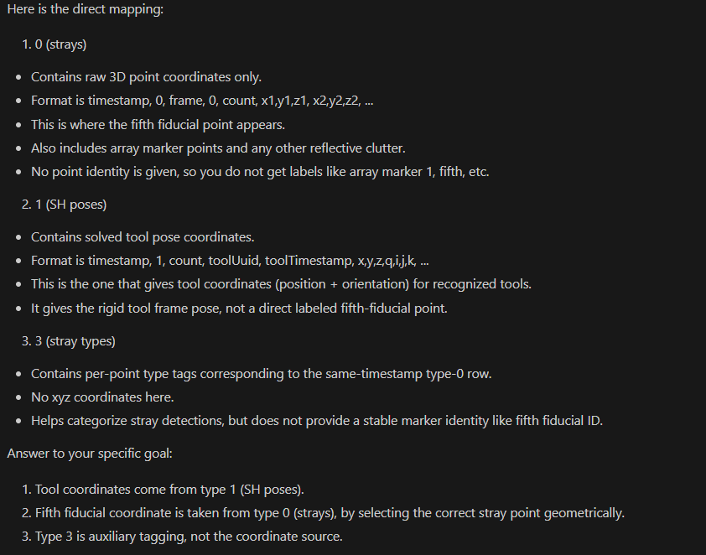

Slide 51
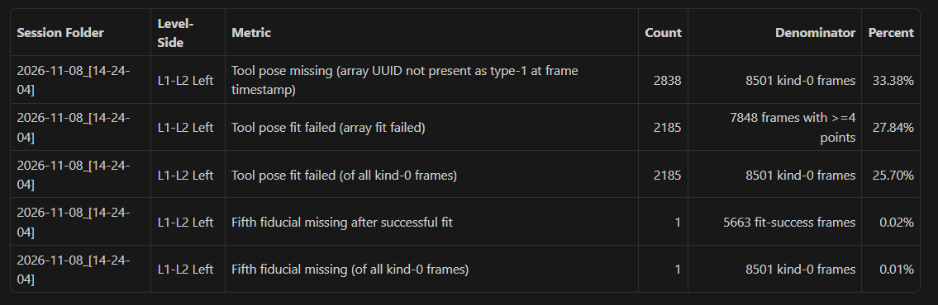

Slide 52
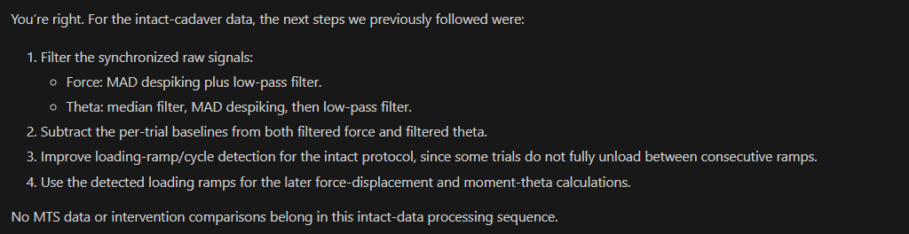

Slide 53
Summary for Intraoperative Stiffness Measurements Using Lamina Spreader

Slide 54
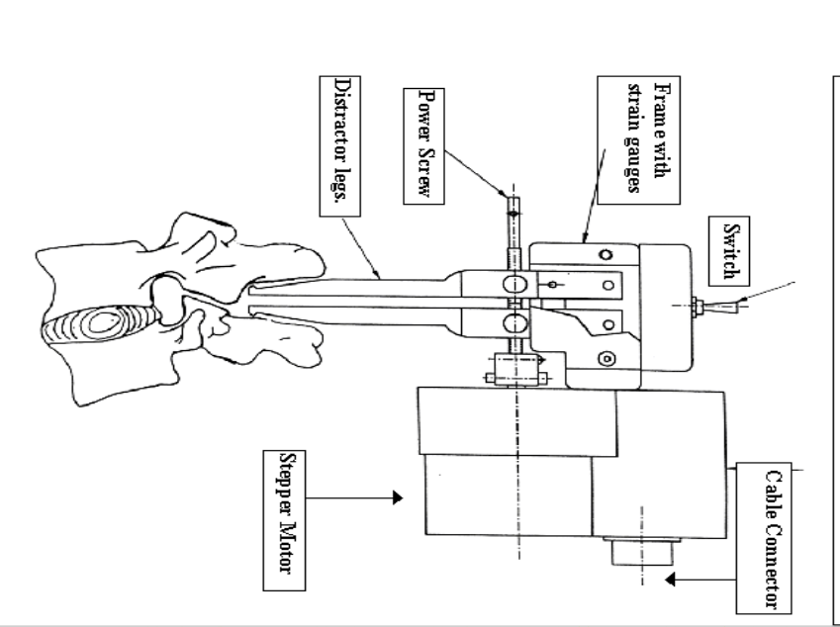
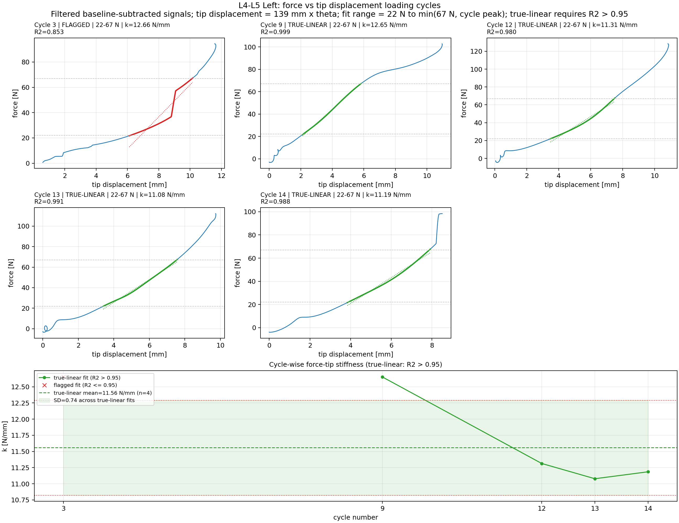
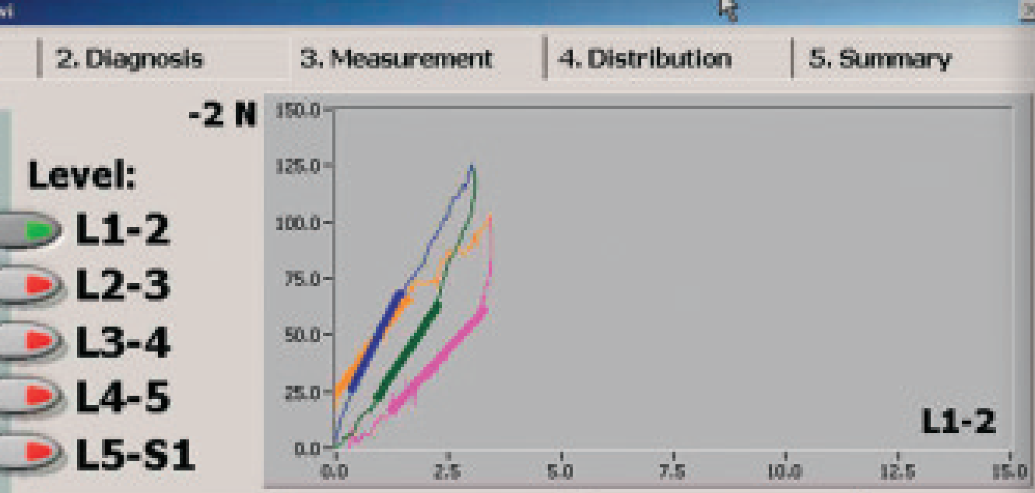
Brown 2002 et al.

Slide 55
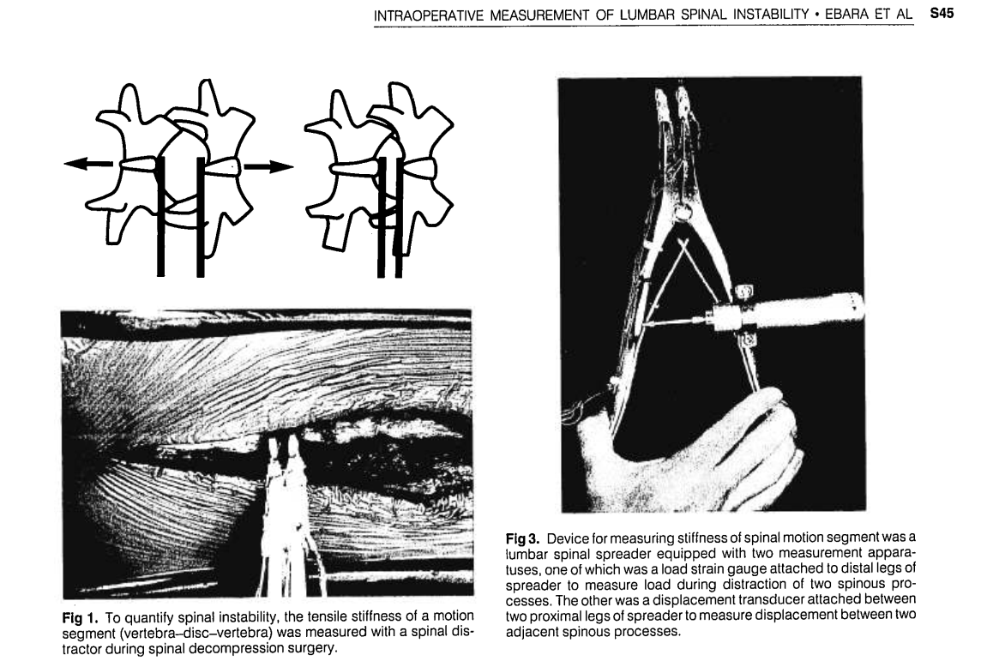
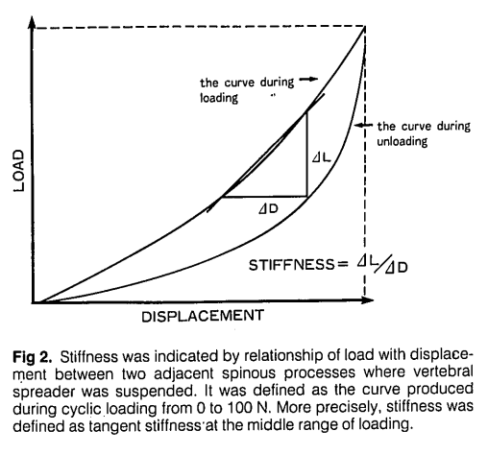
Ebara 1992 et al.

Slide 56
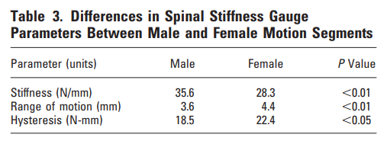
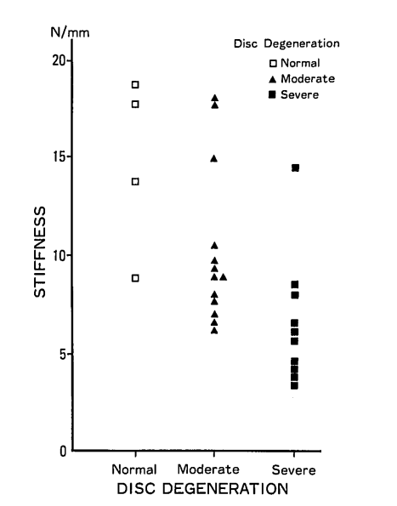
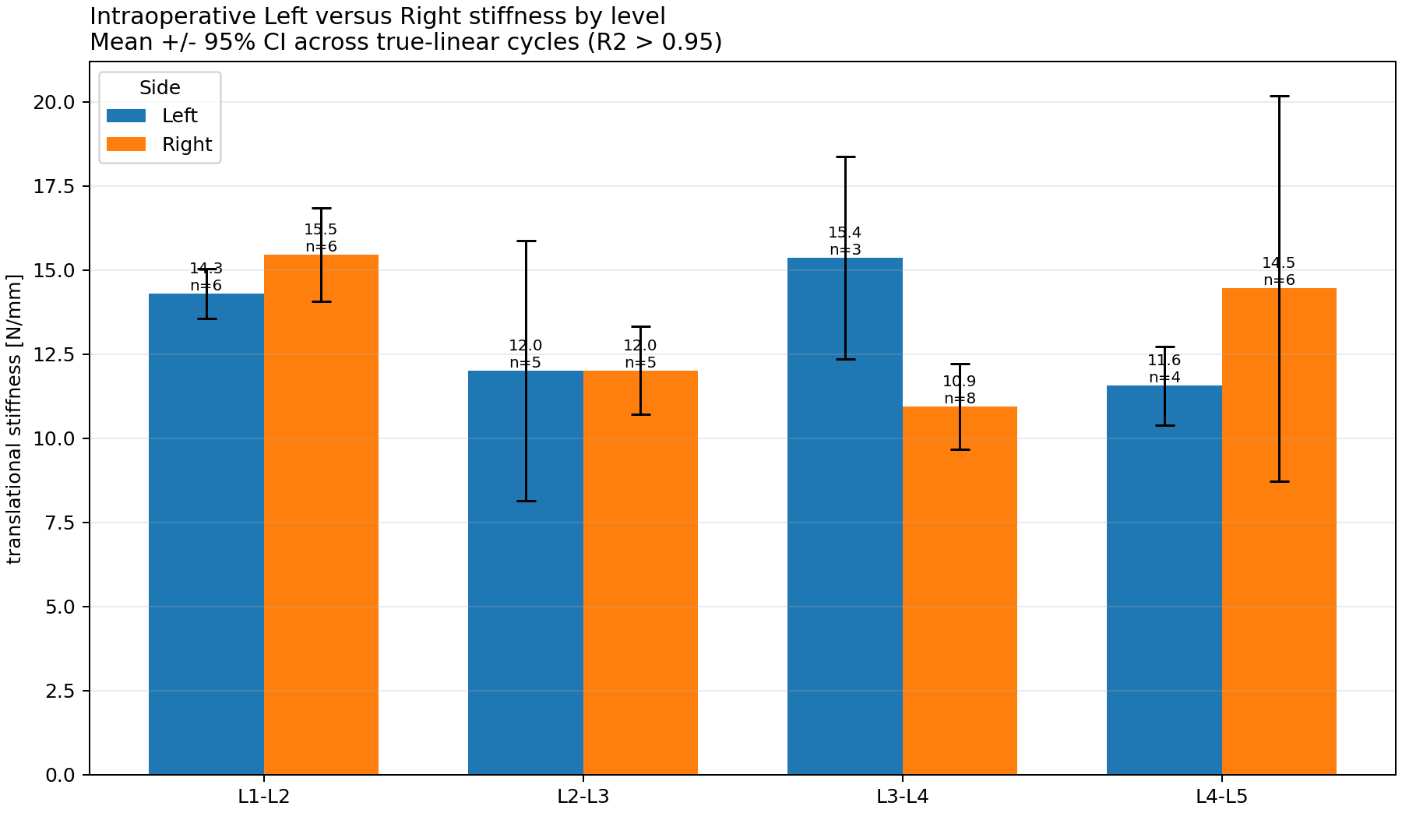
Comparison of Intraoperative Stiffness with Literature

Slide 57
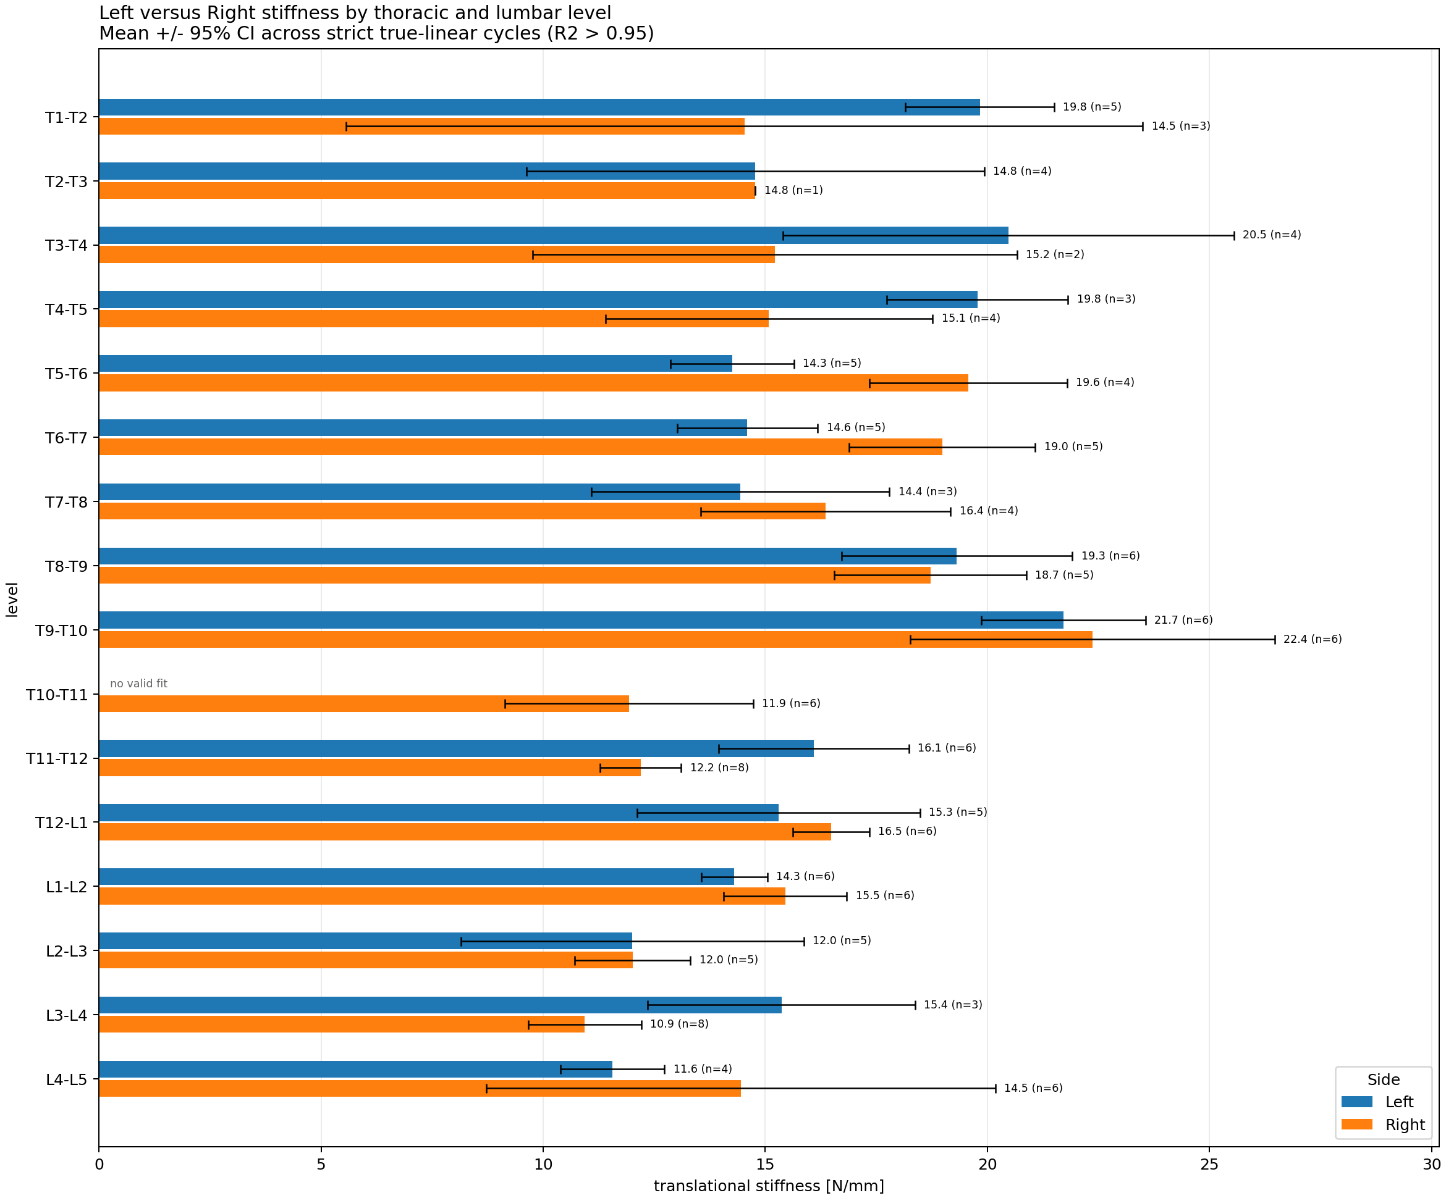
Comparison of Measurement Side

Slide 58
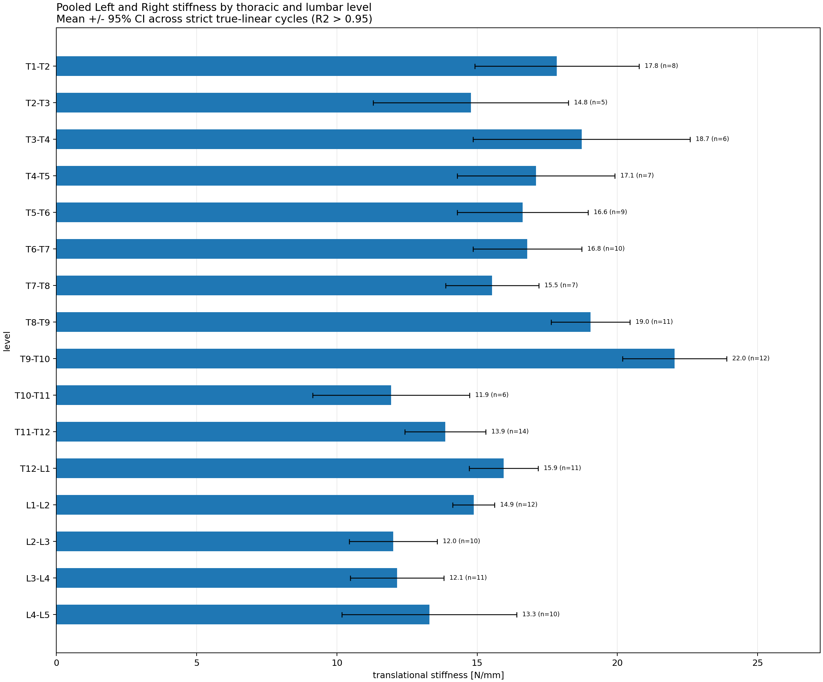
Comparison of Spine Levels

Slide 59
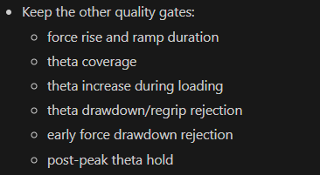
Standardized force band stiffness

Slide 61
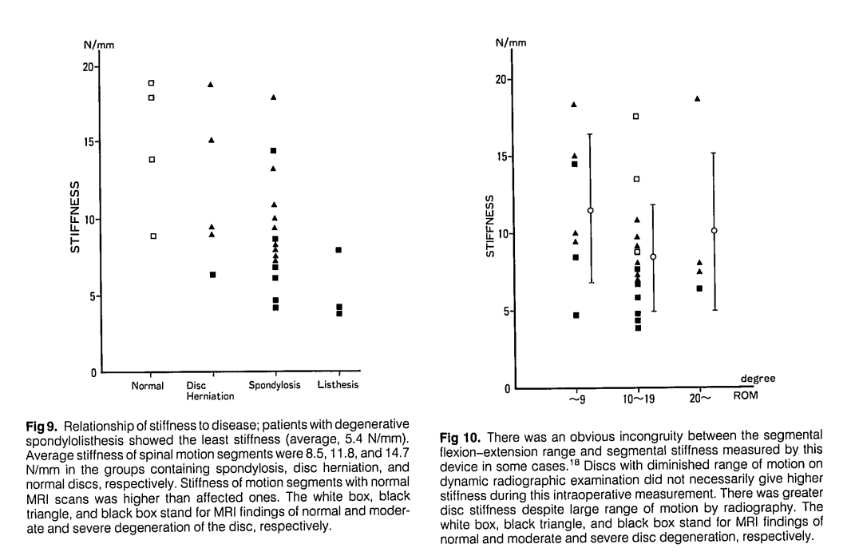

Slide 62
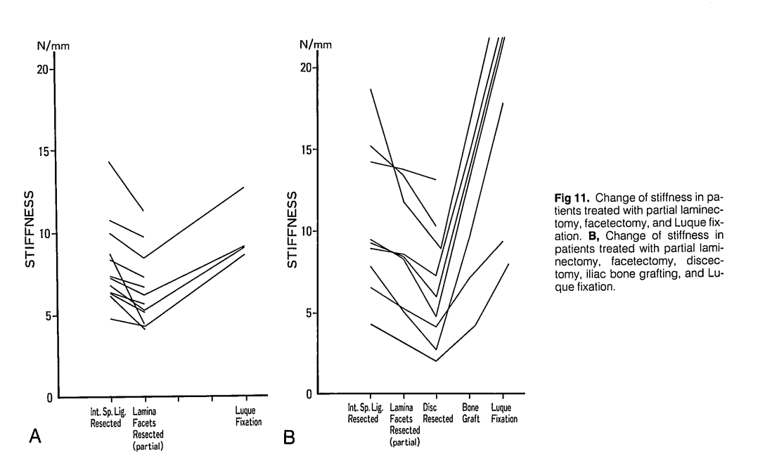

Slide 63
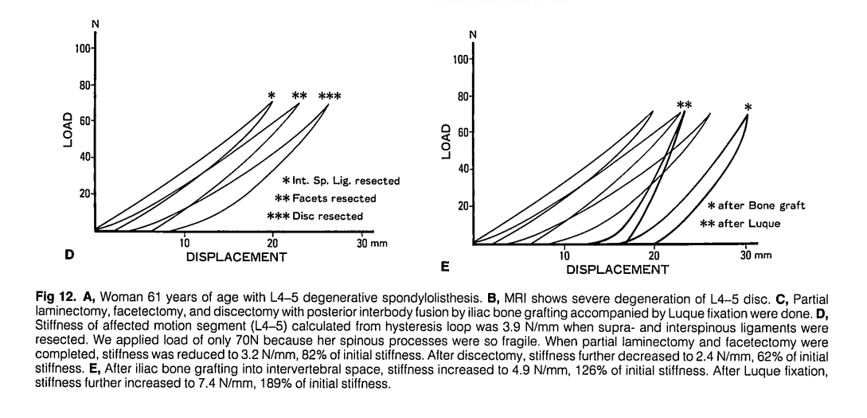

Slide 64
