Slide 1
Spreader Data Processing And Results
Updated 2026-08-24

Slide 2
Workflow Overview
1. Sync-check raw force and angle traces across interventions.
2. Detect ramp starts and define analysis windows per cycle.
3. Remove preload and apply theta-zero correction.
4. Mark and exclude transition/ineligible cycles.
5. Fit force-tip linear region using displacement >= 0 mm points.
6. Fit moment-theta linear region using theta >= 0 deg points.

Slide 3
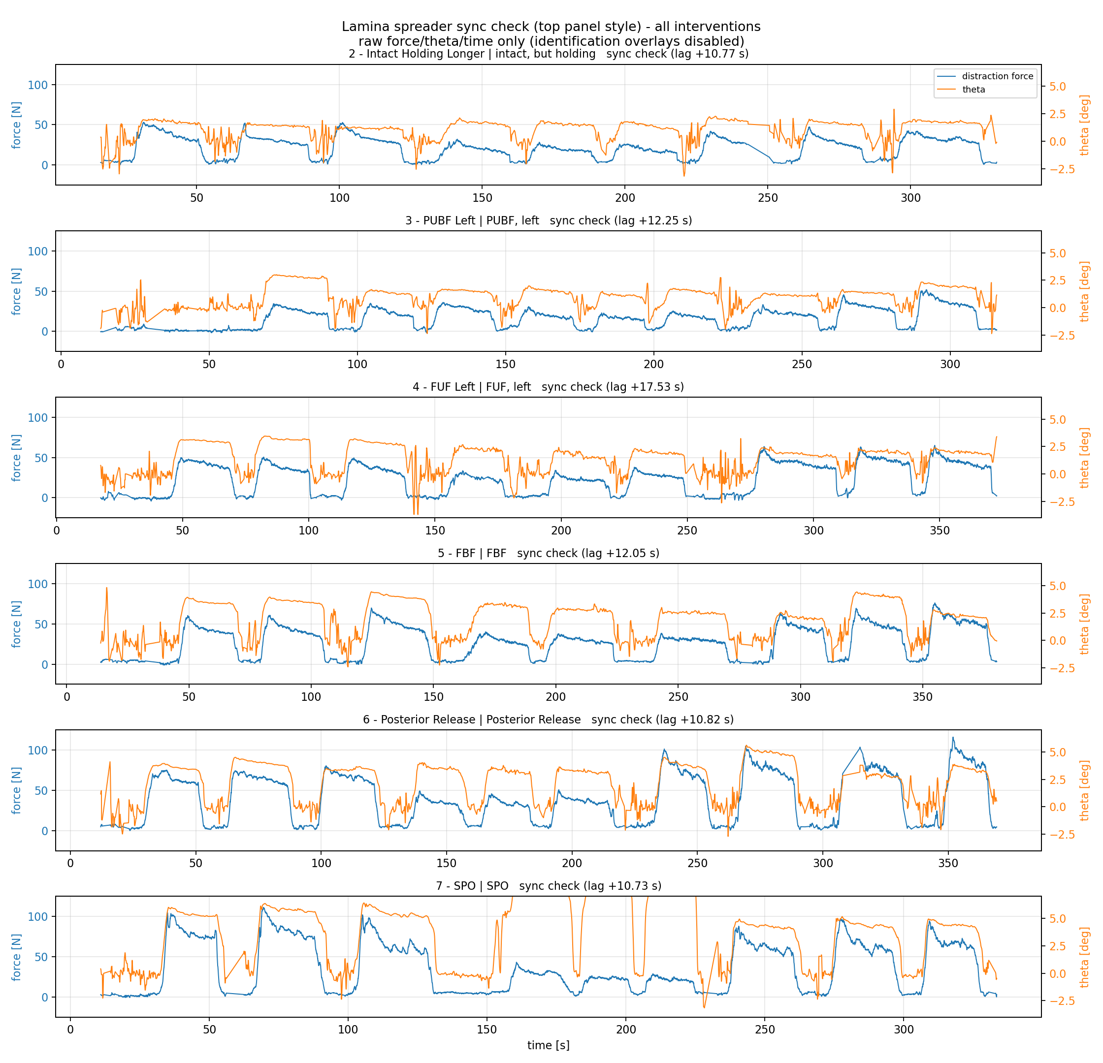
Step 1: Raw Force-Time Sync Check
All interventions stacked before filtering/corrections.

Slide 4
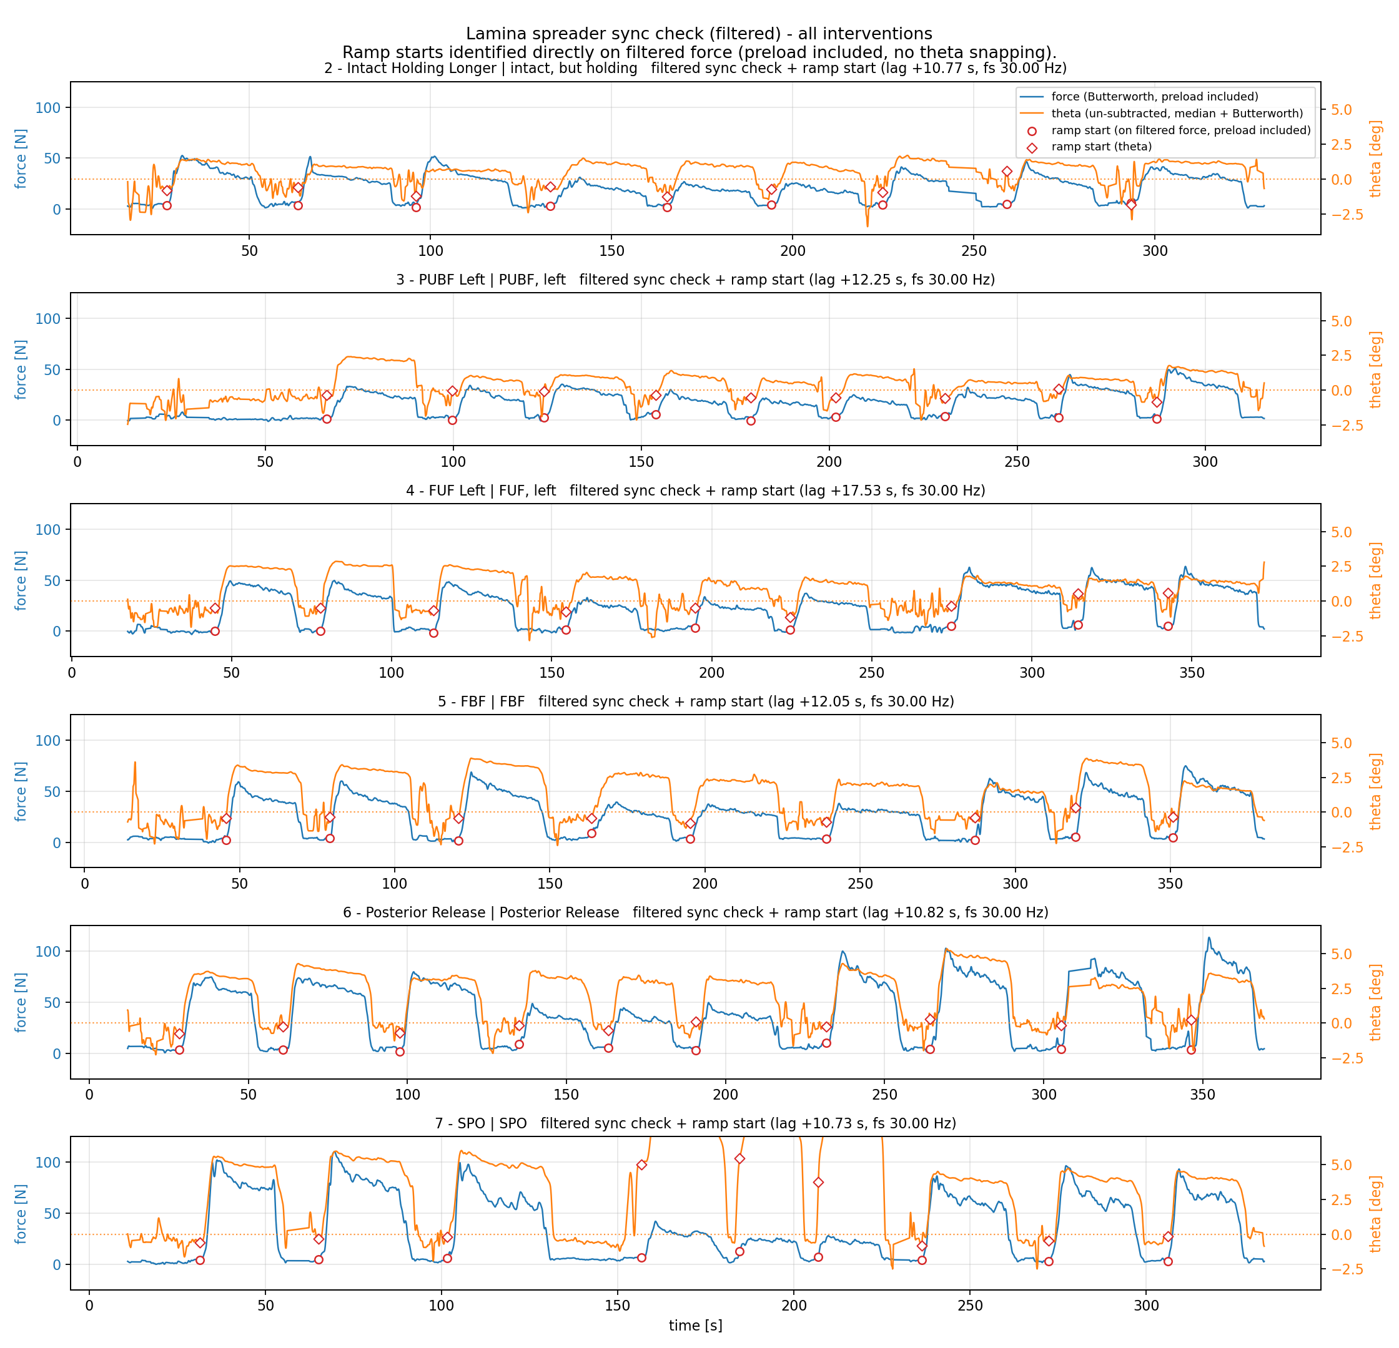
Step 2: Ramp-Start Detection
Filtered traces with ramp-start windows for cycle-level analysis.

Slide 5
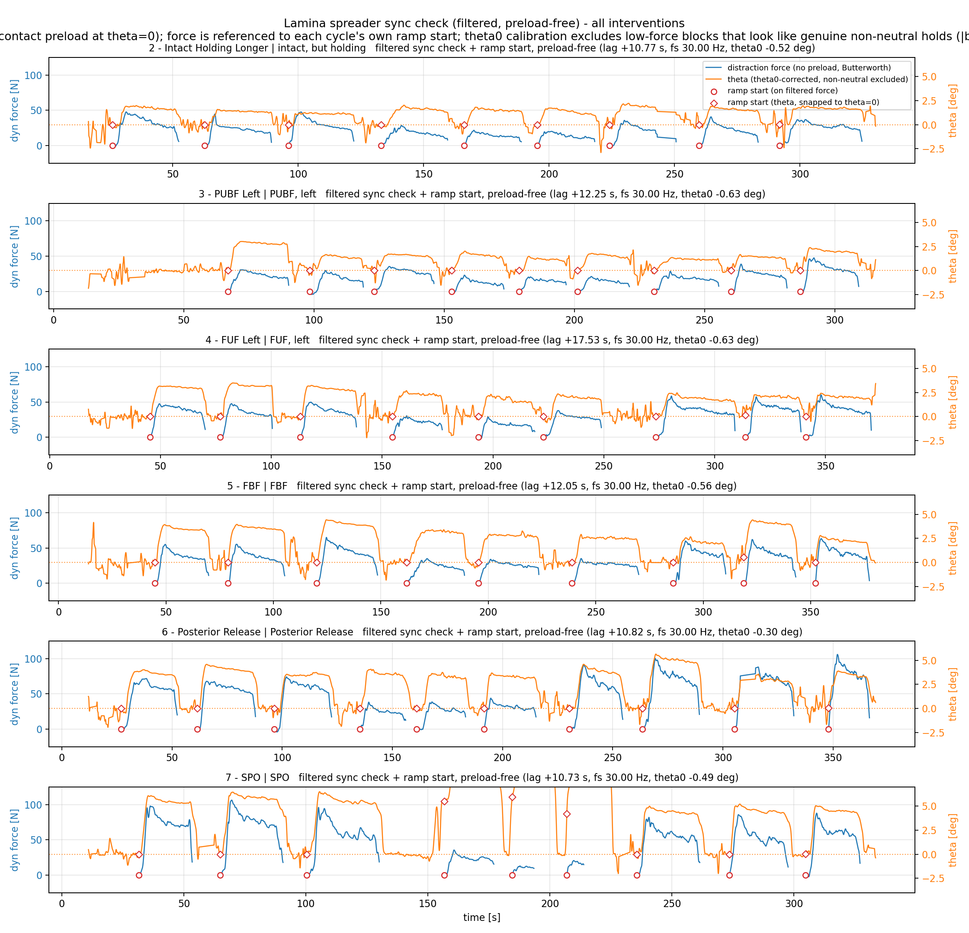
Step 3: Preload-Free + Theta-Zero Corrected
Signals after preload removal and angle reference correction.

Slide 6
Step 4: Mark And Exclude Ineligible Cycles
Step 4: Cycle Eligibility (Transition-Flag Filtering)
Intervention n_cycles eligible ineligible
---------------------------------------------------------
FBF 9 9 0
FUF Left 9 9 0
Intact Holding 9 9 0
PUF Left 9 9 0
Posterior Release 10 10 0
SPO 8 8 0
Rule: transition-flagged cycles are excluded from stiffness fitting.

Slide 7
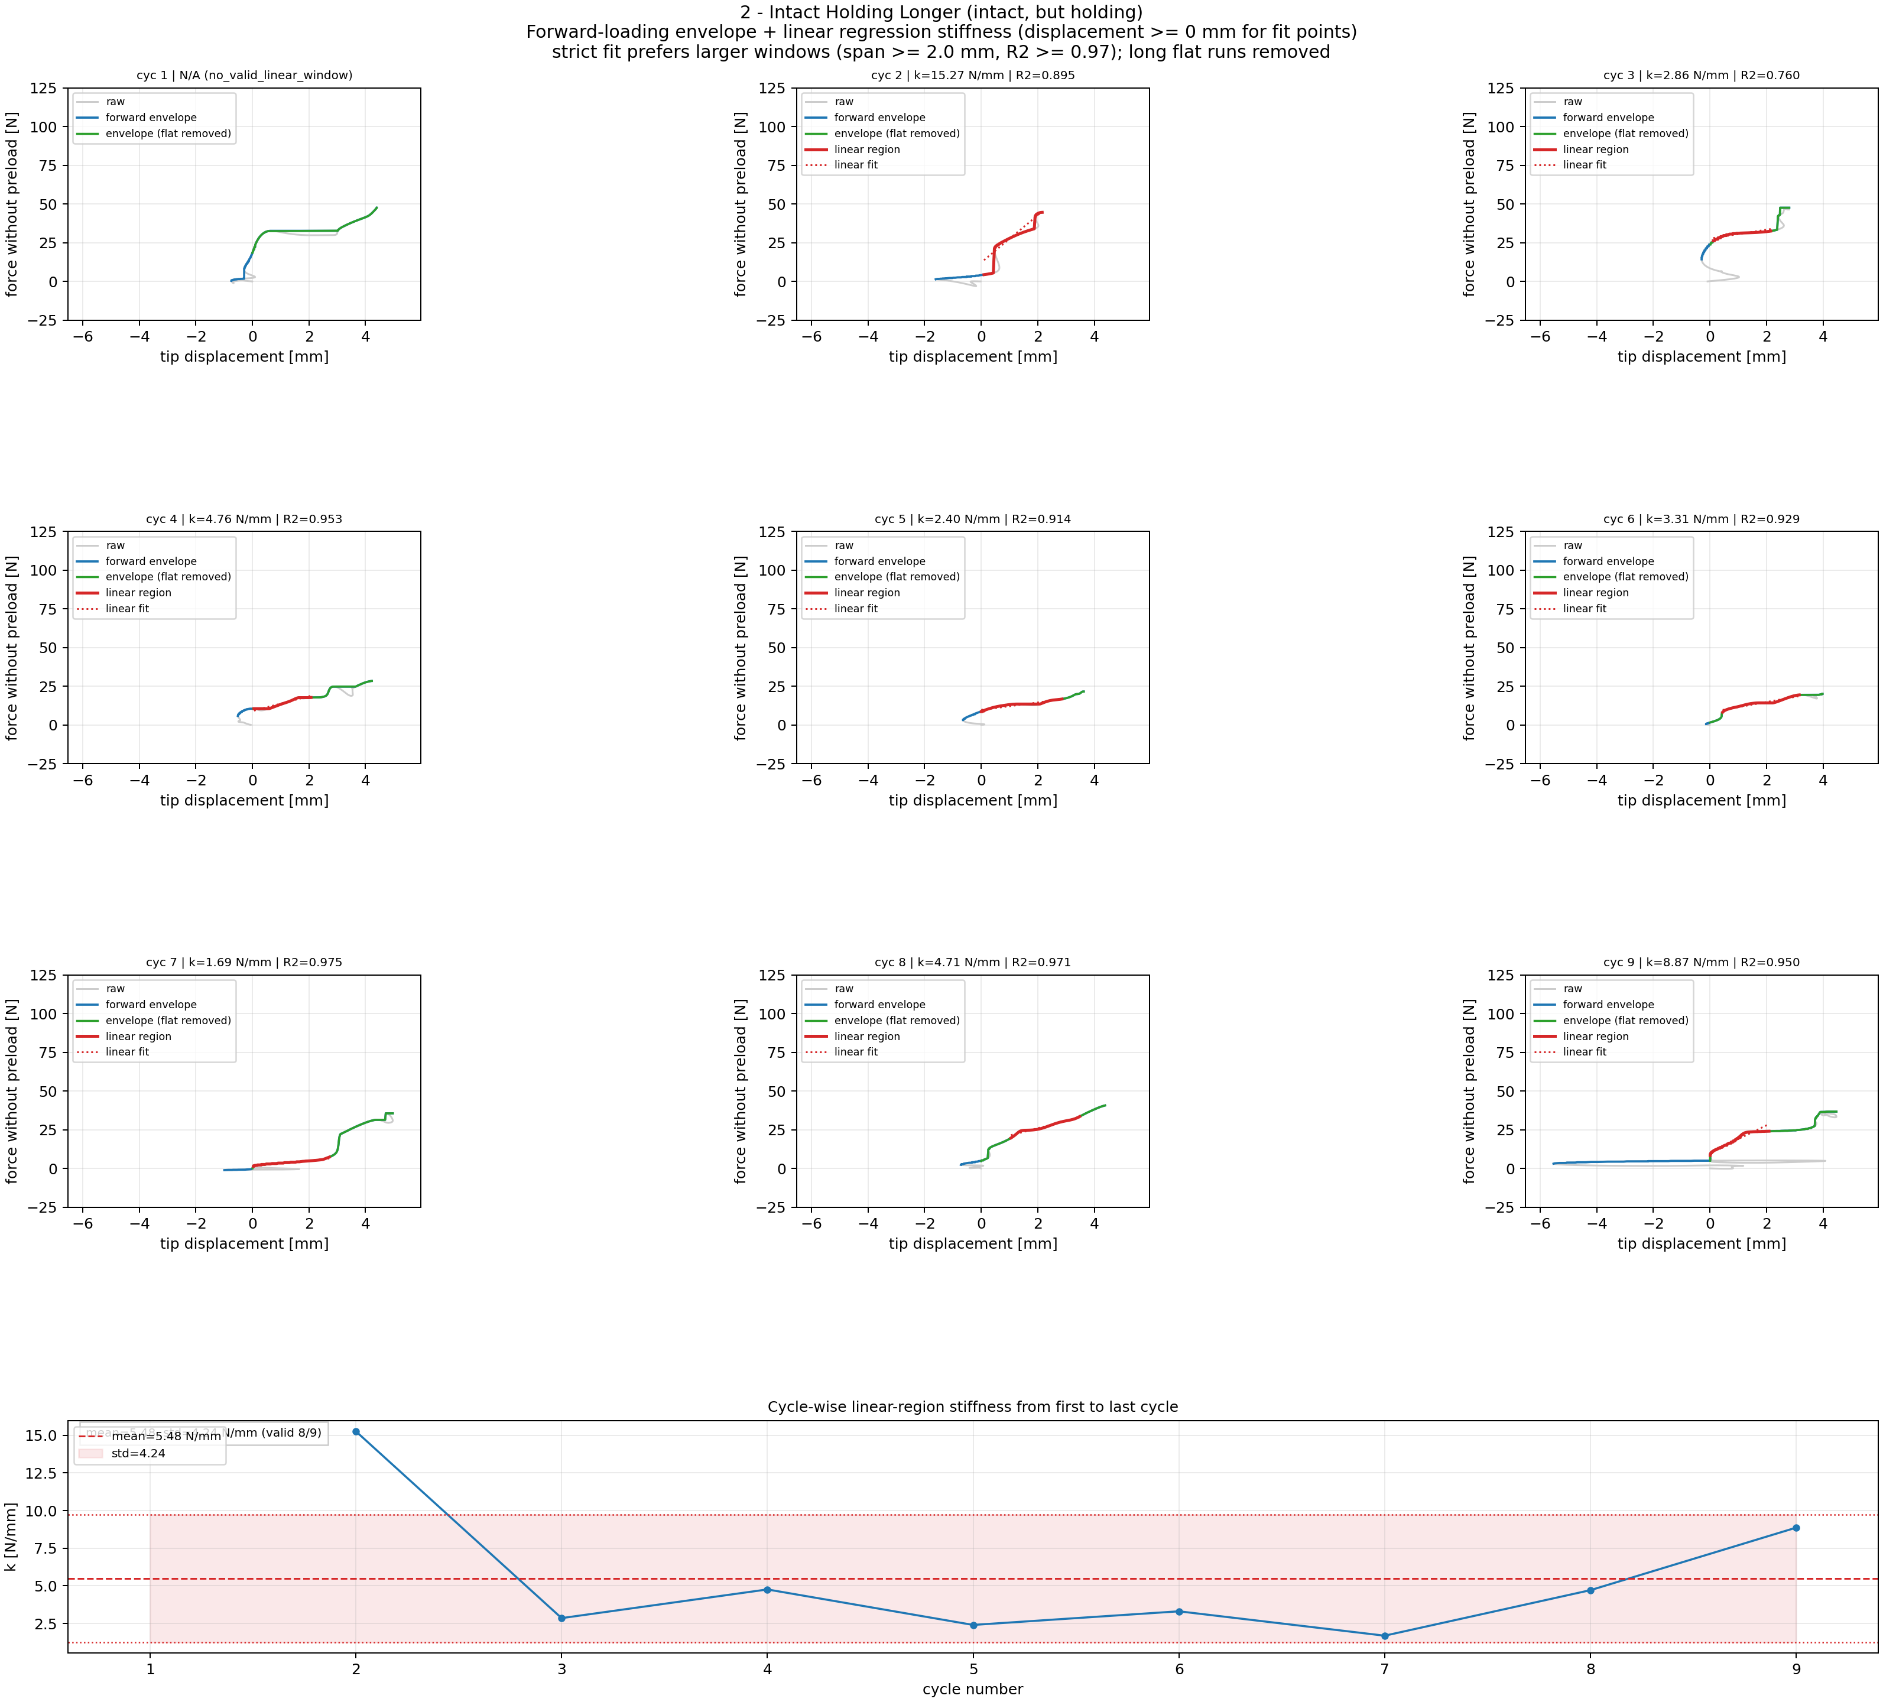
Step 5A: Force-Tip Linear Region Fitting: 2 - Intact Holding Longer
Cycle-wise linear windows and per-cycle stiffness (fit uses displacement >= 0 mm; shared force y-limits) for 2 - Intact Holding Longer.

Slide 8
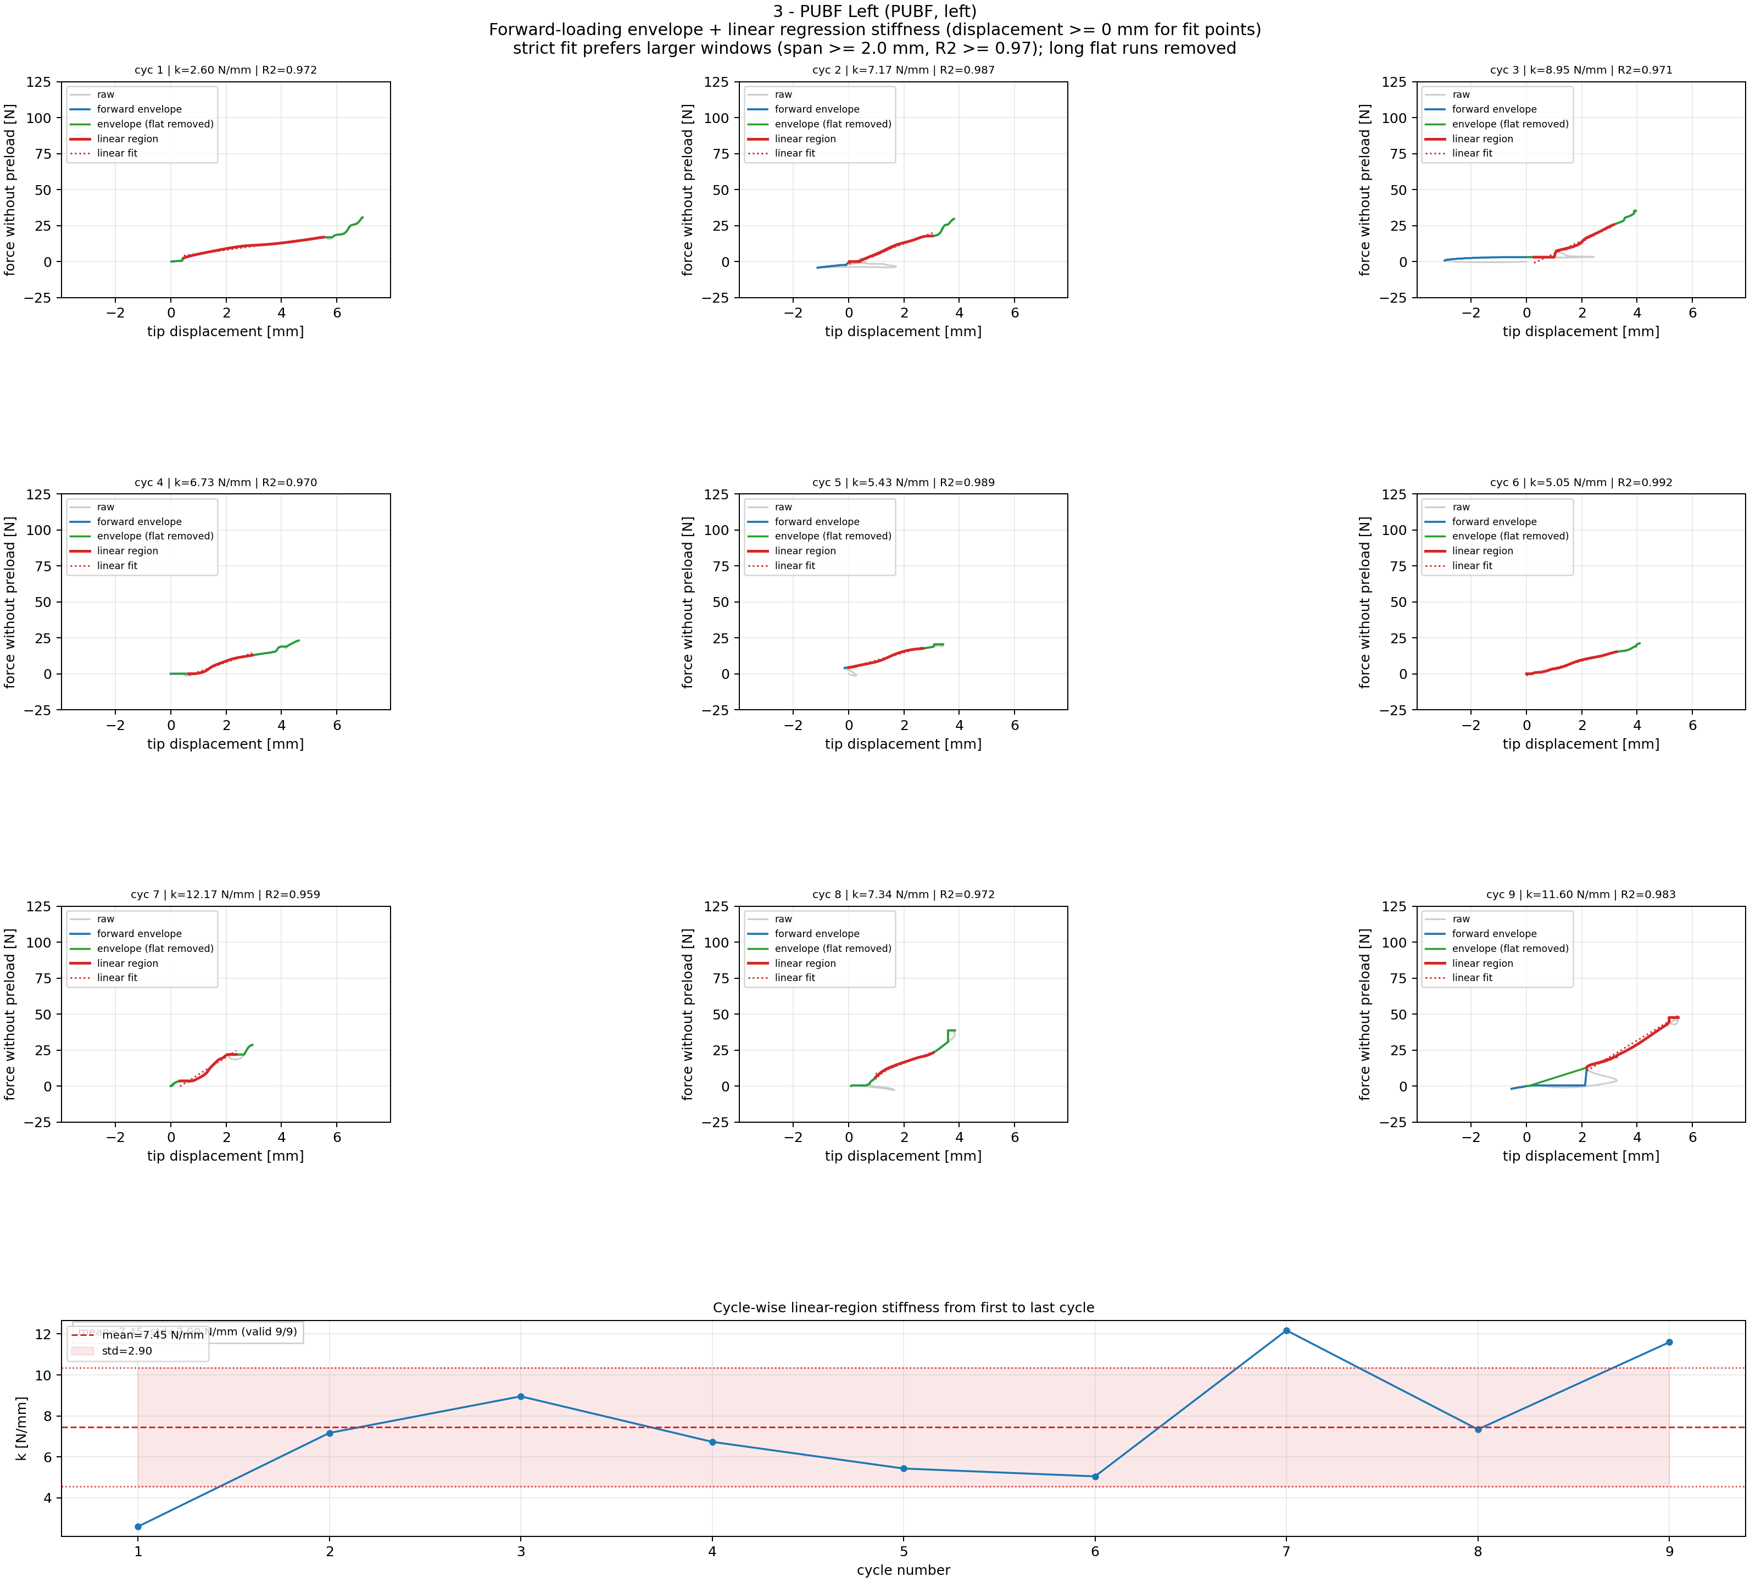
Step 5A: Force-Tip Linear Region Fitting: 3 - PUBF Left
Cycle-wise linear windows and per-cycle stiffness (fit uses displacement >= 0 mm; shared force y-limits) for 3 - PUBF Left.

Slide 9
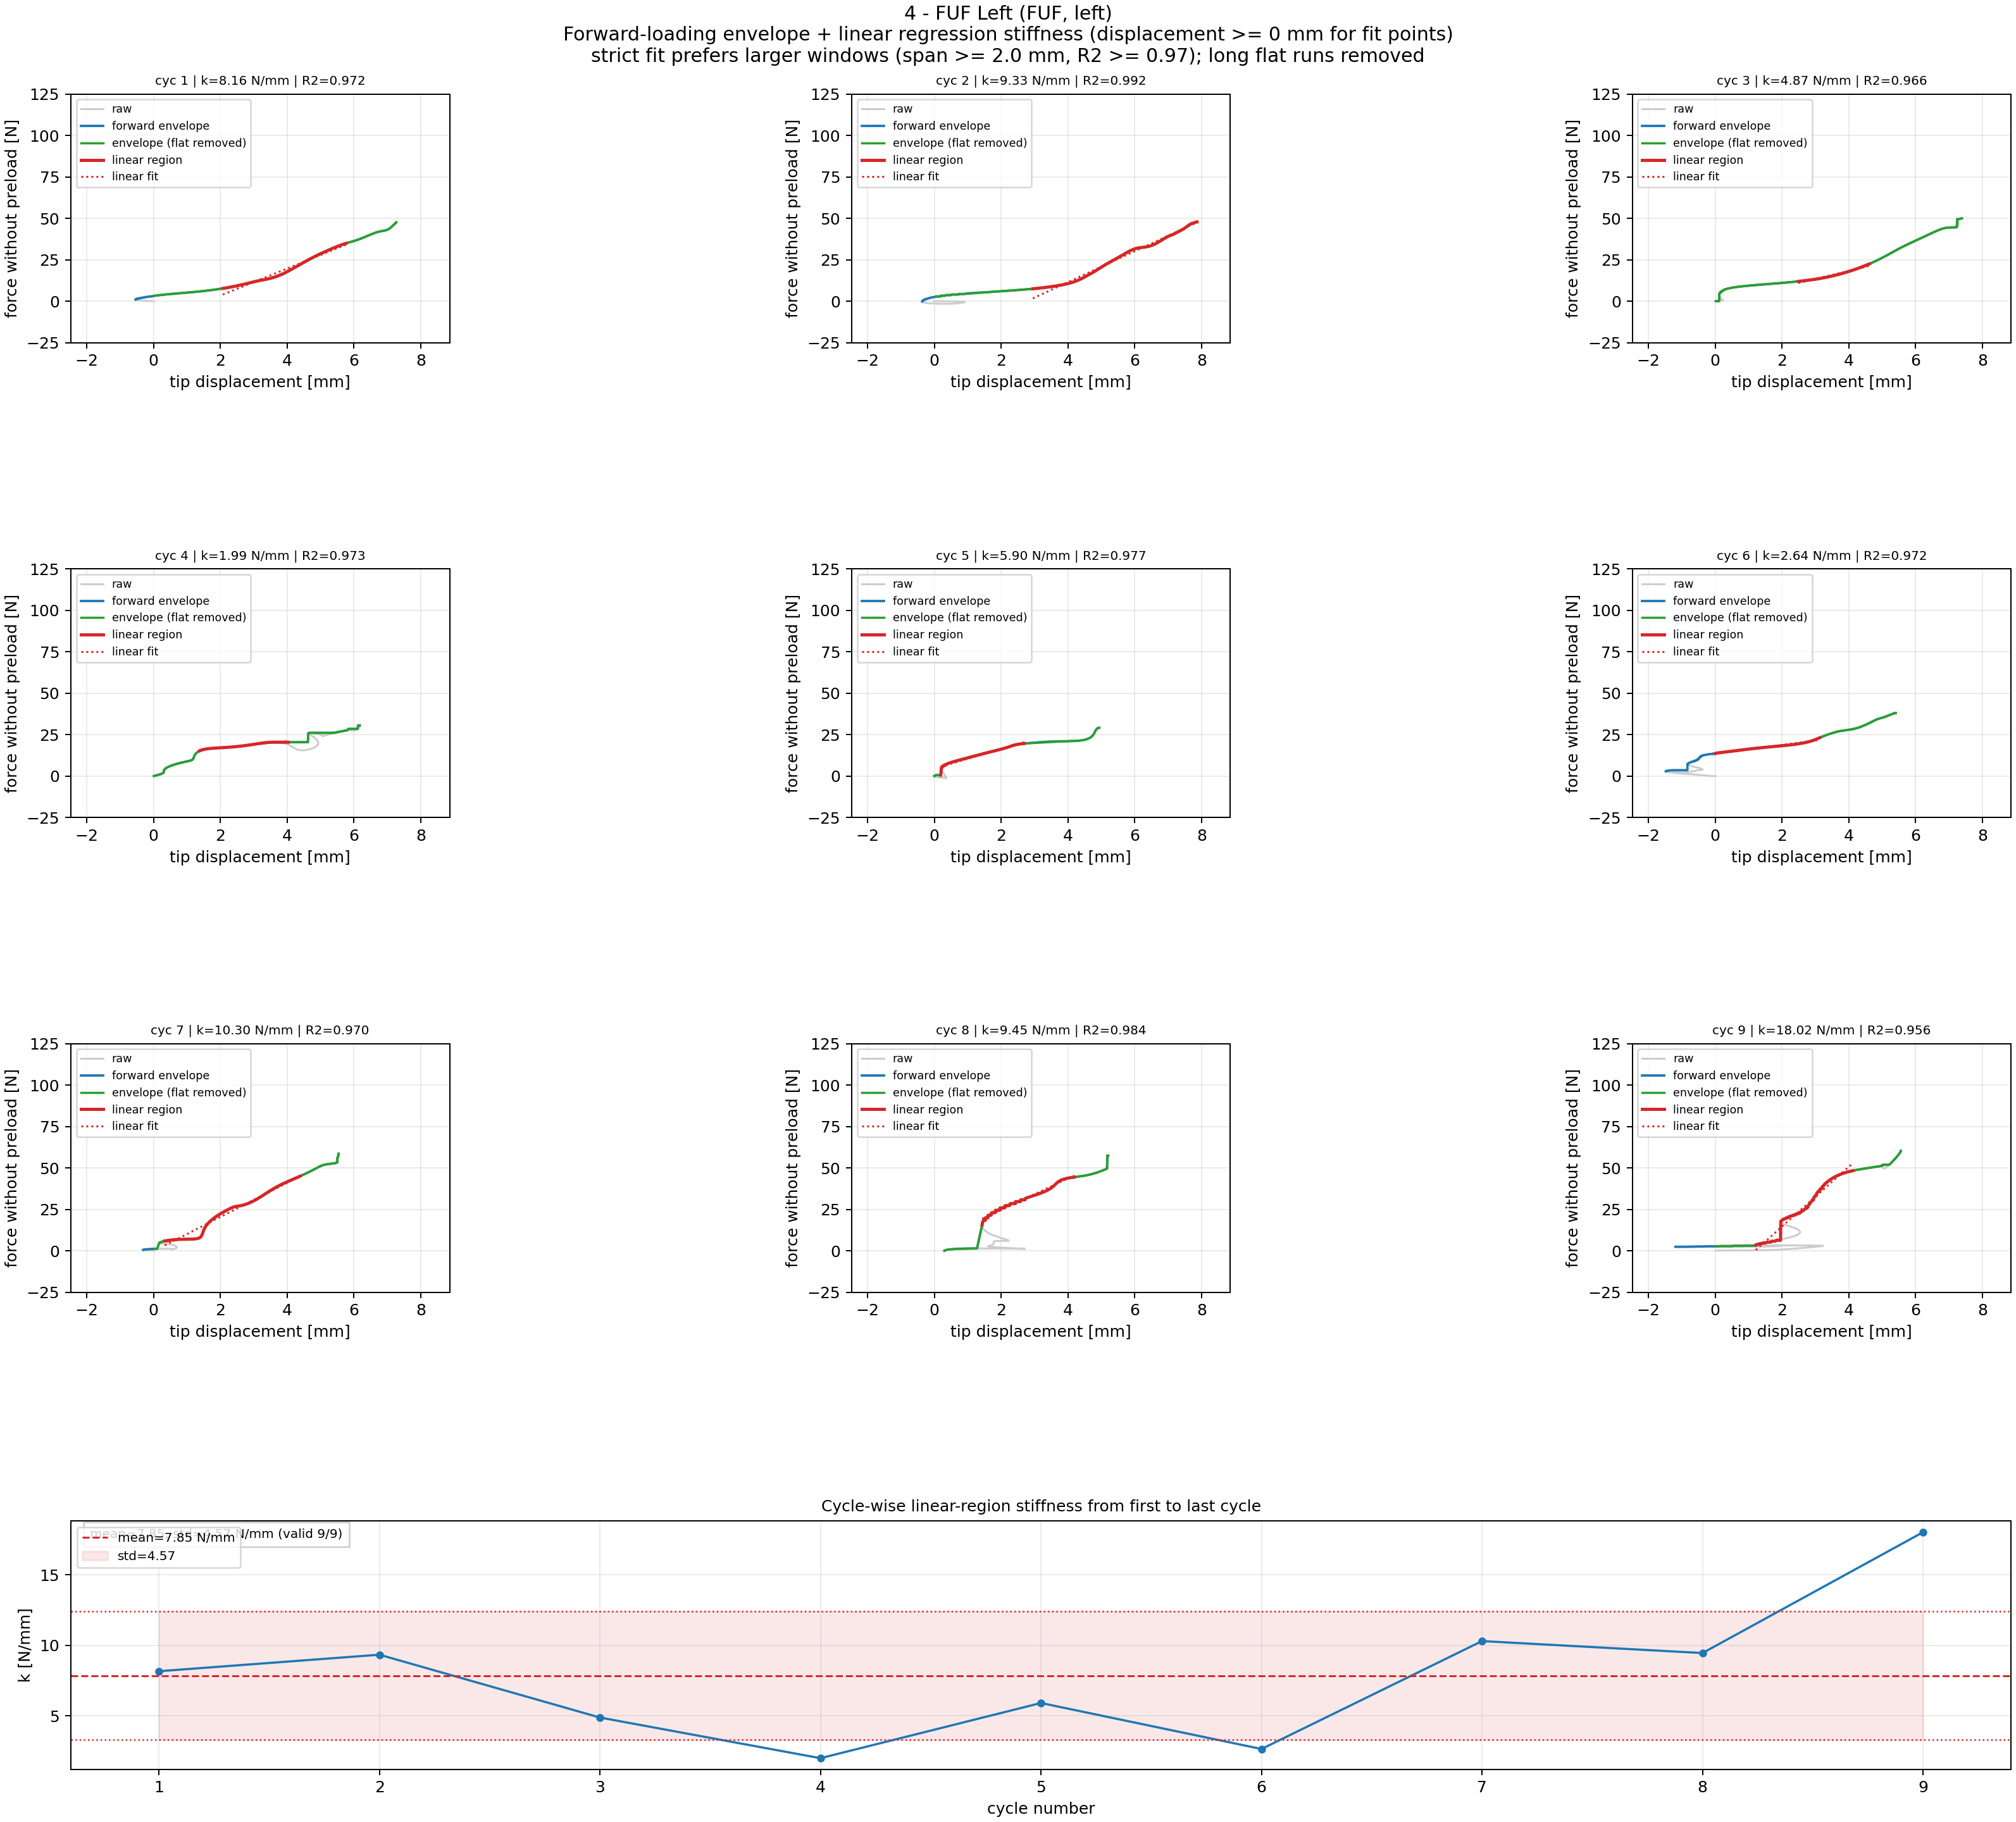
Step 5A: Force-Tip Linear Region Fitting: 4 - FUF Left
Cycle-wise linear windows and per-cycle stiffness (fit uses displacement >= 0 mm; shared force y-limits) for 4 - FUF Left.

Slide 10
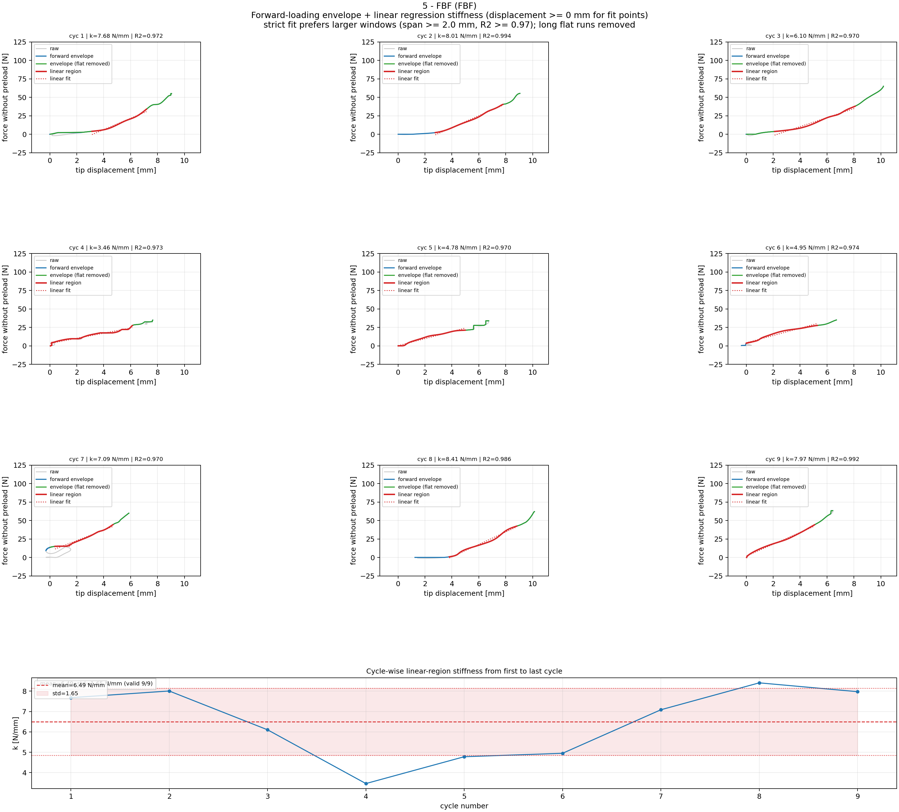
Step 5A: Force-Tip Linear Region Fitting: 5 - FBF
Cycle-wise linear windows and per-cycle stiffness (fit uses displacement >= 0 mm; shared force y-limits) for 5 - FBF.

Slide 11
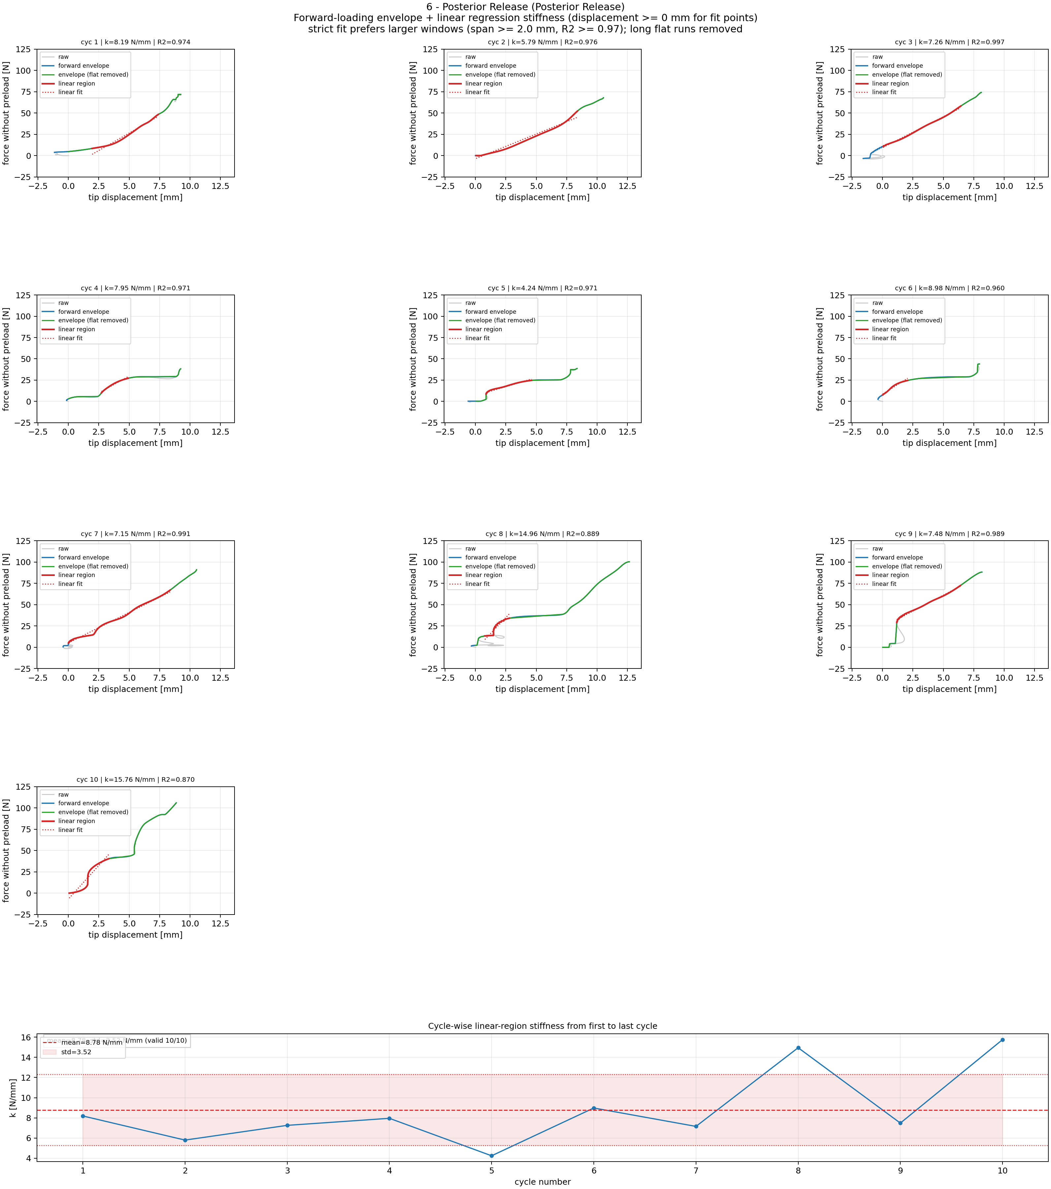
Step 5A: Force-Tip Linear Region Fitting: 6 - Posterior Release
Cycle-wise linear windows and per-cycle stiffness (fit uses displacement >= 0 mm; shared force y-limits) for 6 - Posterior Release.

Slide 12
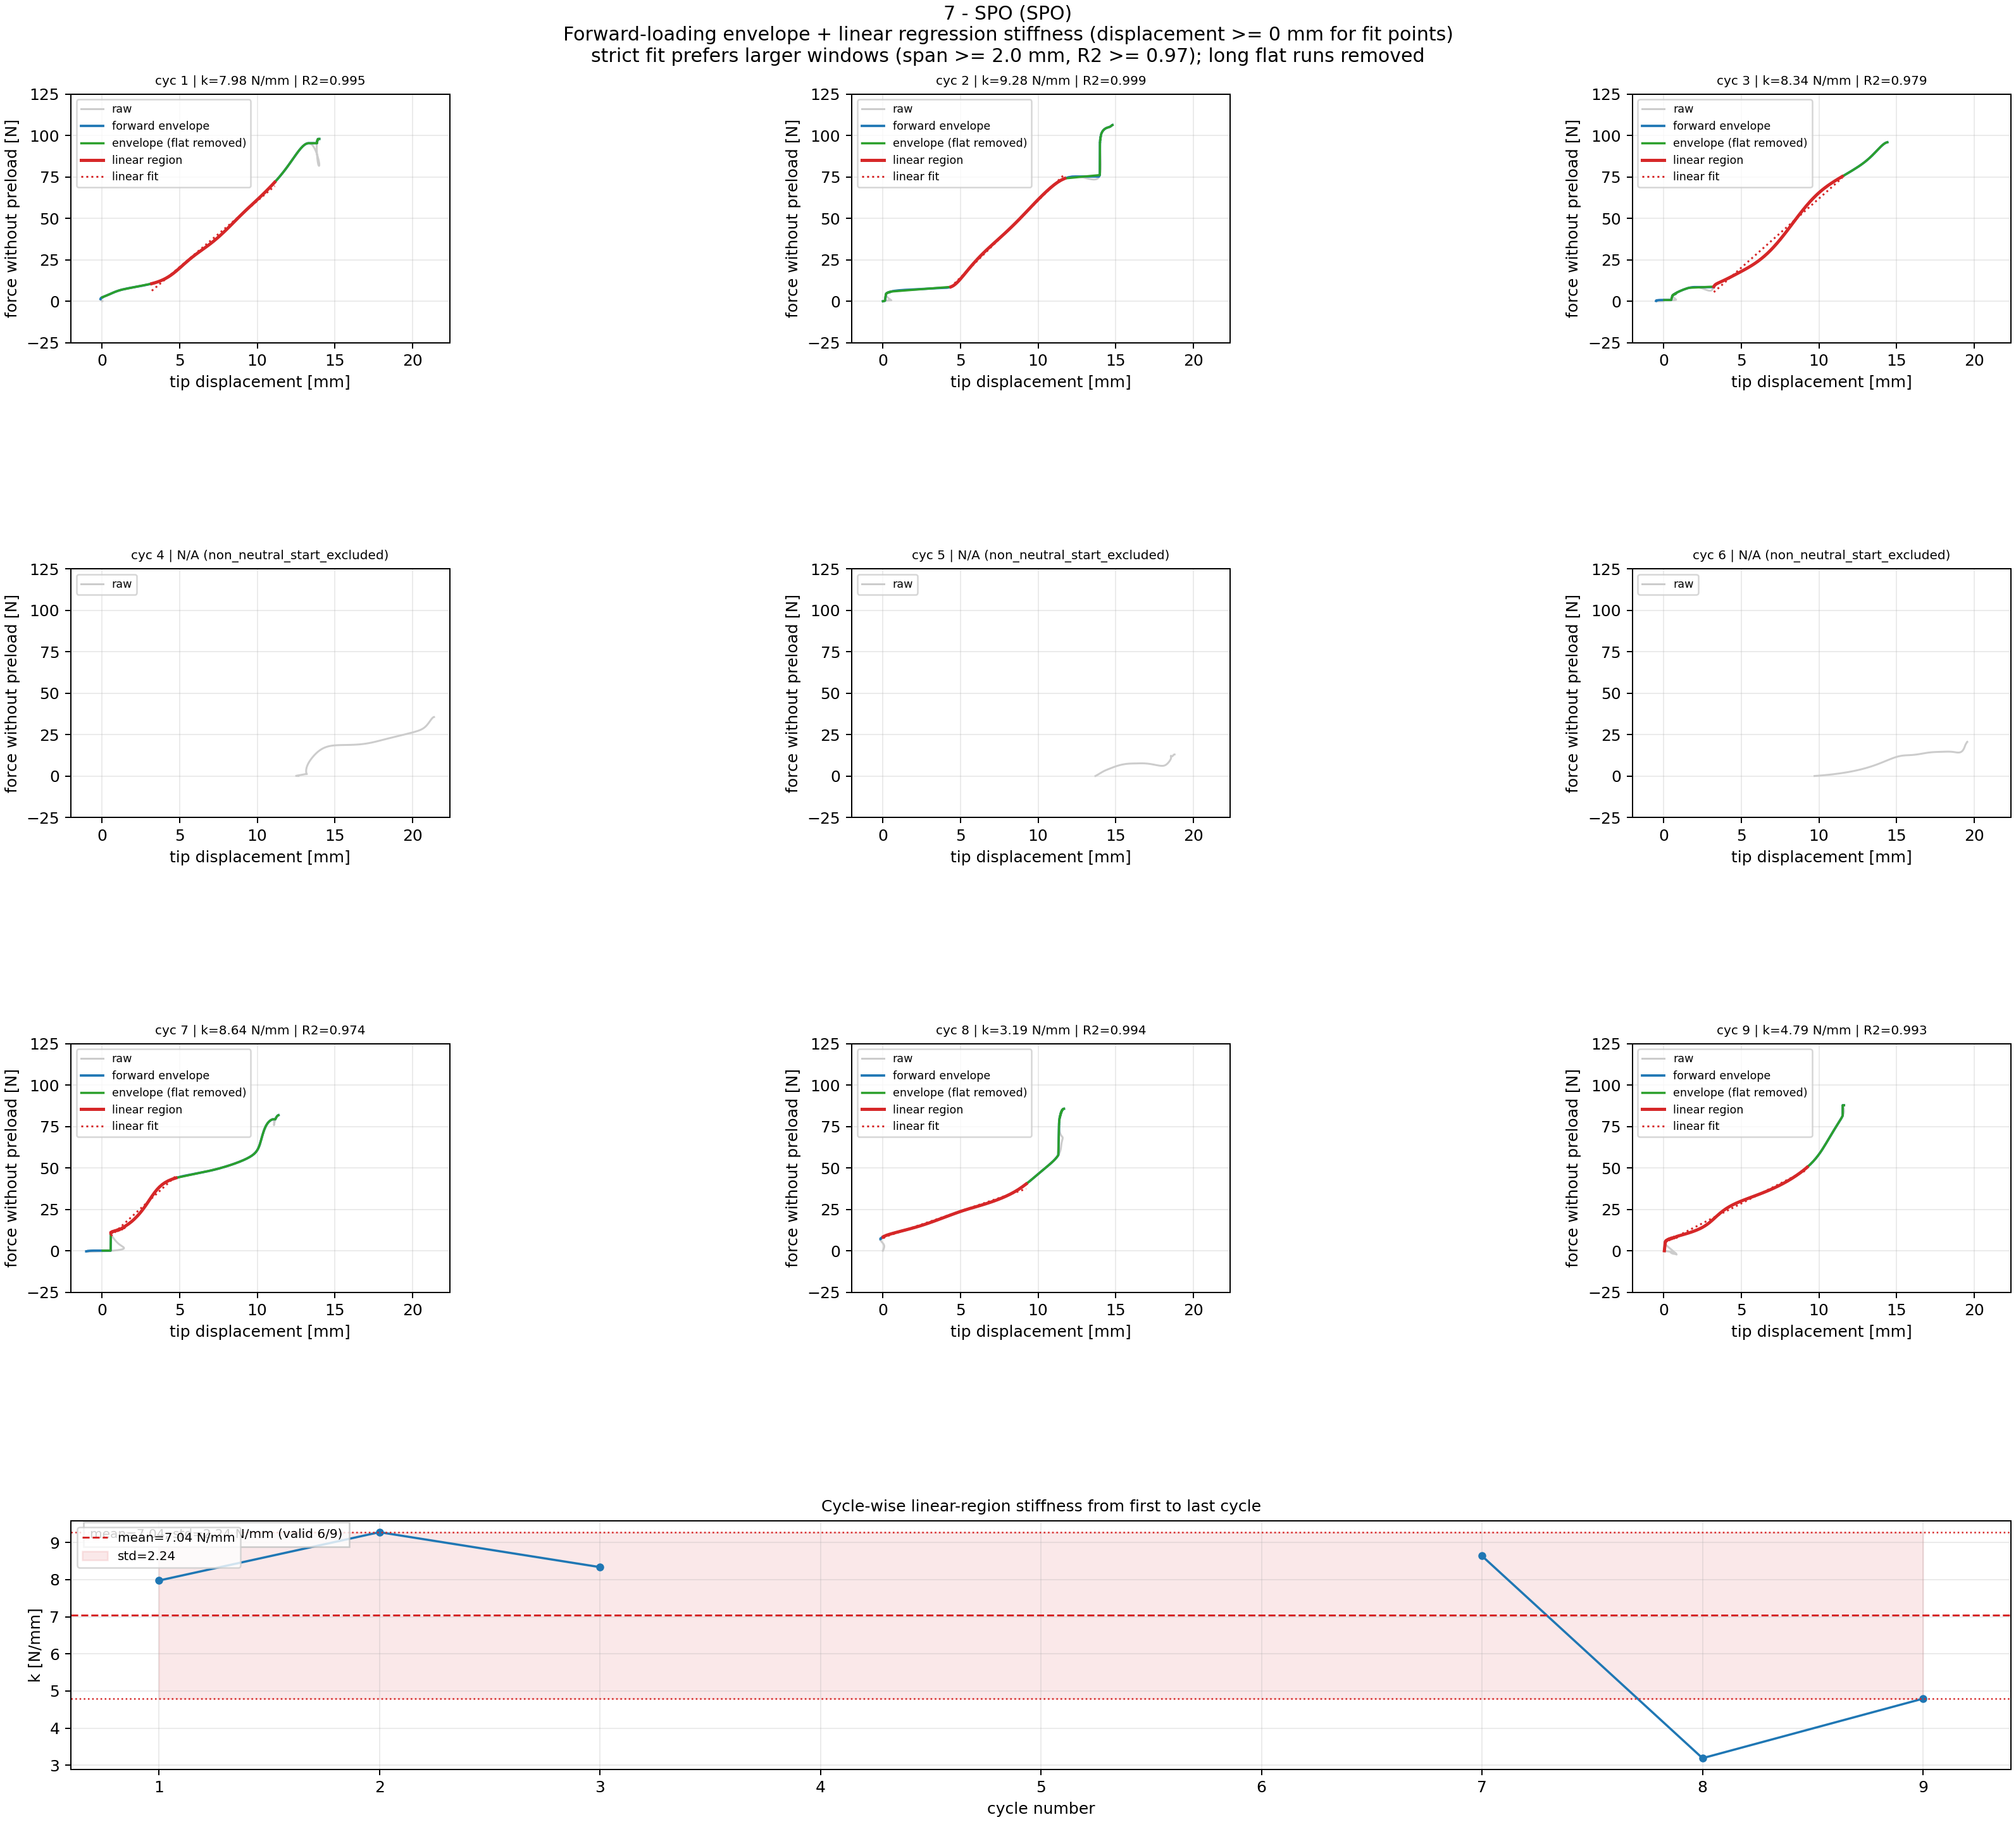
Step 5A: Force-Tip Linear Region Fitting: 7 - SPO
Cycle-wise linear windows and per-cycle stiffness (fit uses displacement >= 0 mm; shared force y-limits) for 7 - SPO.

Slide 13
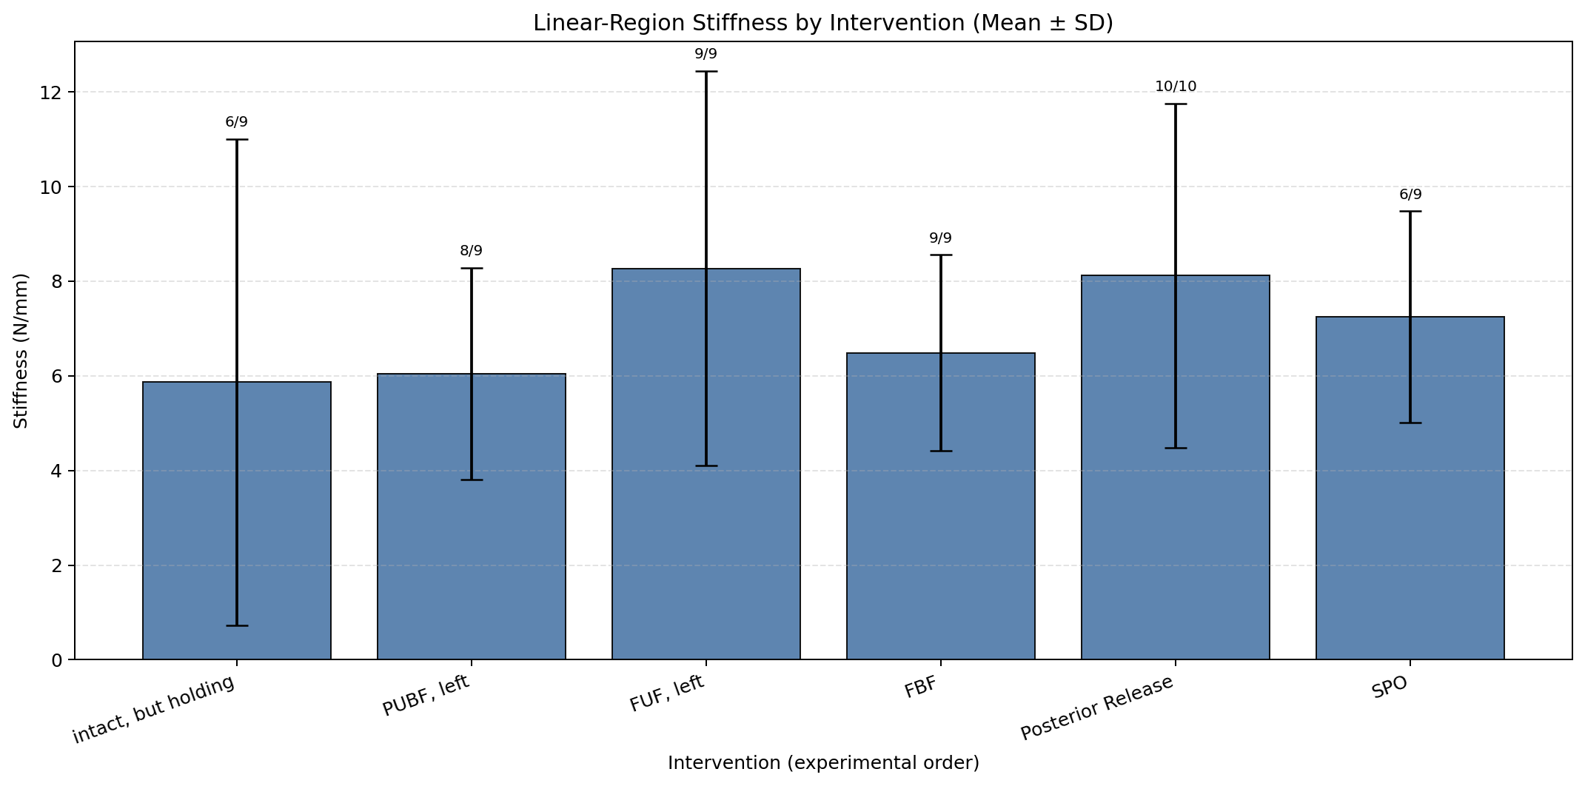
Step 5B: Linear Stiffness Results Across Interventions
Mean ± SD from valid cycles (force-tip linear-region stiffness).

Slide 14
Linear Stiffness Ranking
Step 6A Results: Linear-Region Force-Tip Stiffness
Rank Intervention median [N/mm] mean [N/mm] n_valid/n_cycles
--------------------------------------------------------------------------
1 SPO 8.158 7.037 6/9
2 FUF Left 8.158 7.851 9/9
3 Posterior Release 7.716 8.775 10/10
4 PUF Left 7.170 7.450 9/9
5 FBF 7.086 6.495 9/9
6 Intact Holding 4.011 5.483 8/9

Slide 15
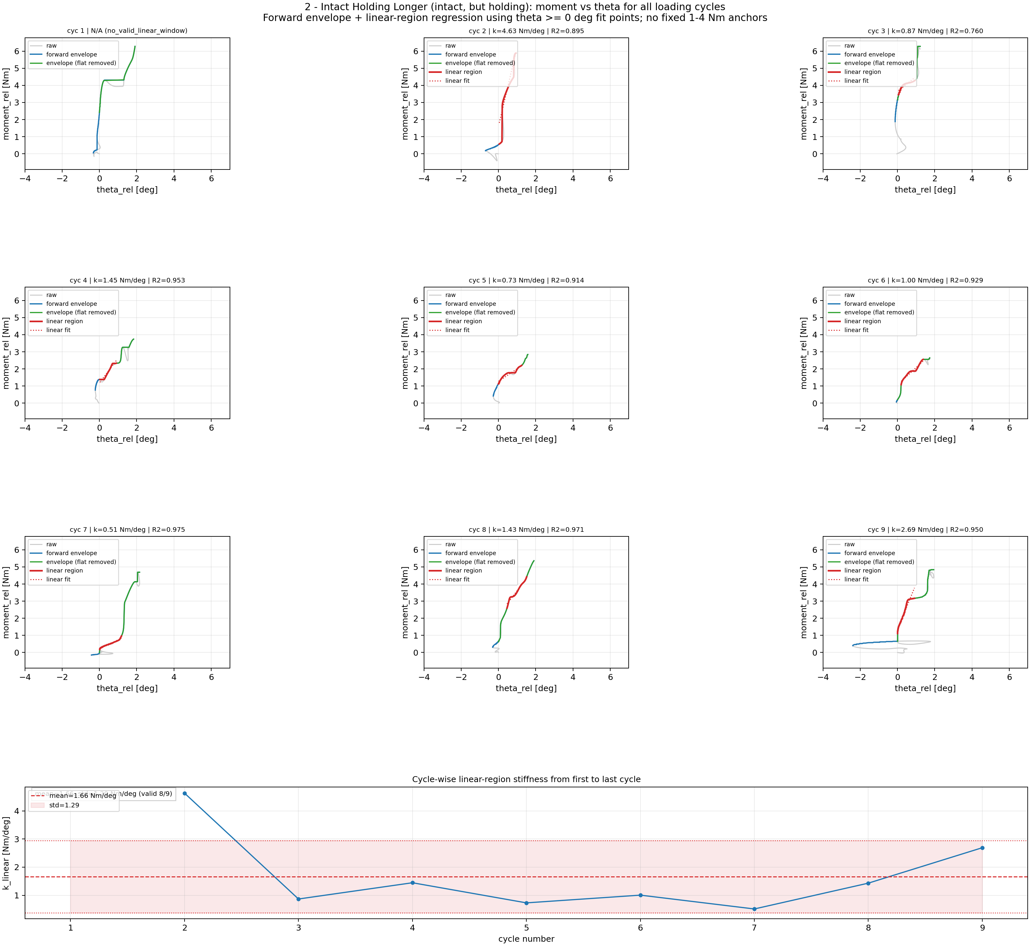
Step 6A: Moment-Theta Processing: 2 - Intact Holding Longer
Cycle-wise rotational stiffness processing (fit uses theta >= 0 deg; shared theta limits) for 2 - Intact Holding Longer.

Slide 16
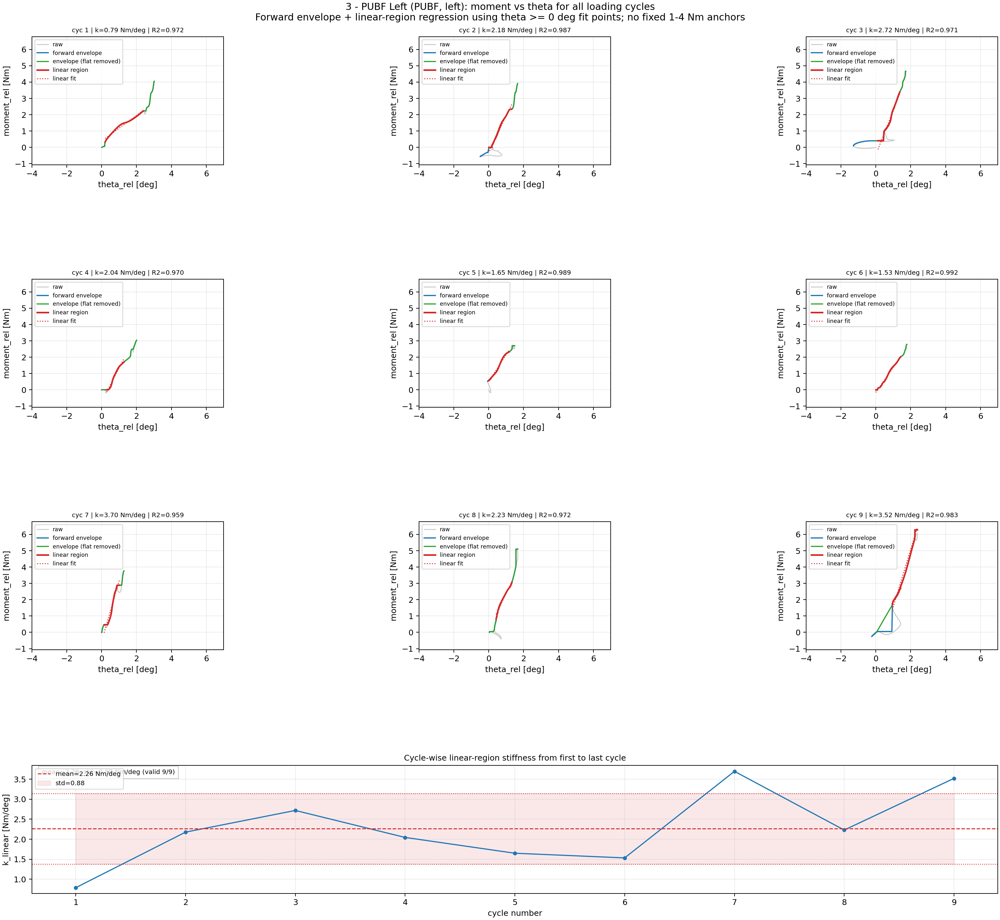
Step 6A: Moment-Theta Processing: 3 - PUBF Left
Cycle-wise rotational stiffness processing (fit uses theta >= 0 deg; shared theta limits) for 3 - PUBF Left.

Slide 17
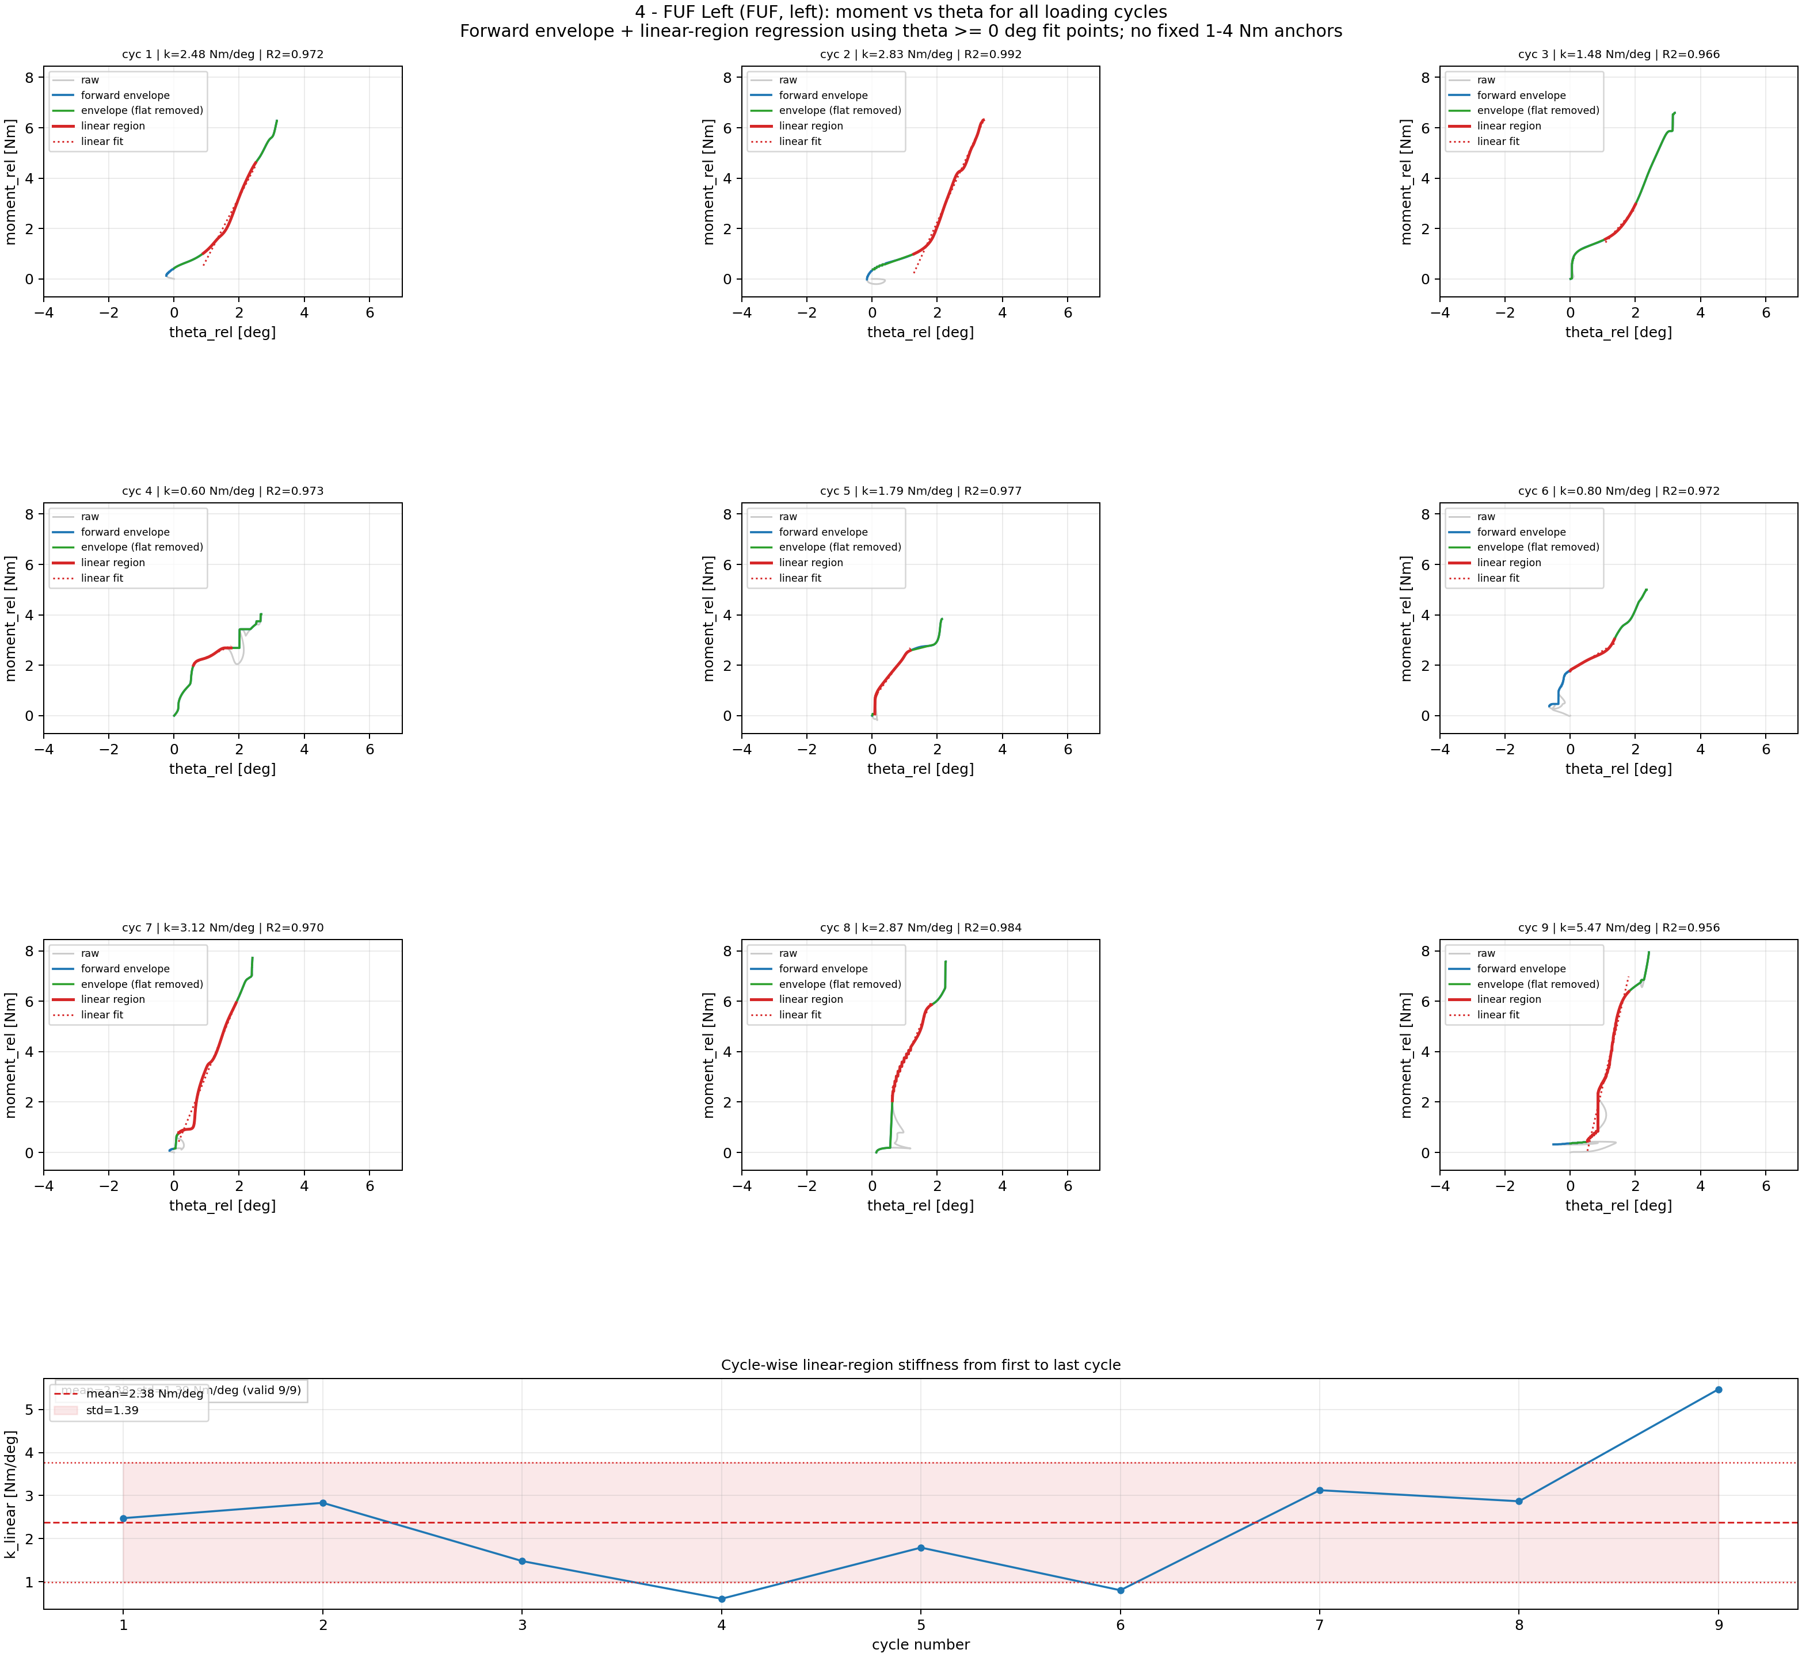
Step 6A: Moment-Theta Processing: 4 - FUF Left
Cycle-wise rotational stiffness processing (fit uses theta >= 0 deg; shared theta limits) for 4 - FUF Left.

Slide 18
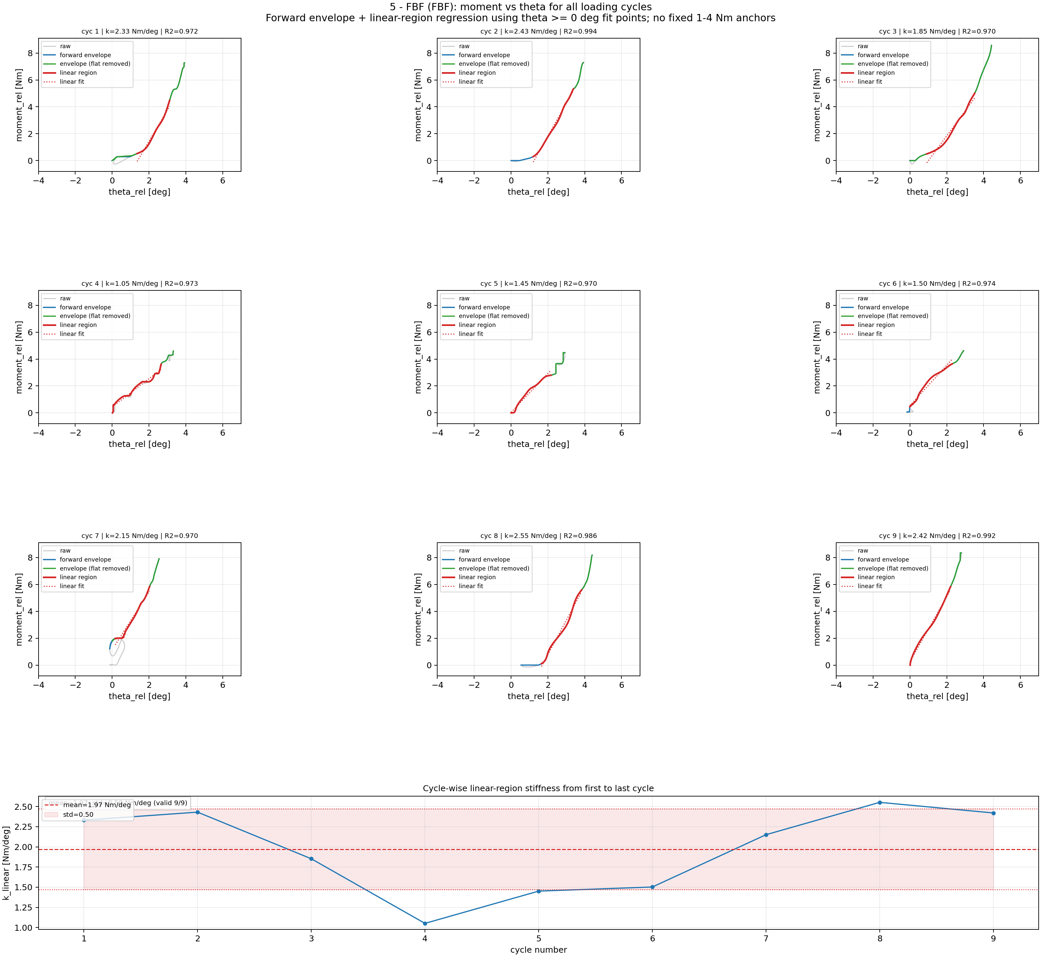
Step 6A: Moment-Theta Processing: 5 - FBF
Cycle-wise rotational stiffness processing (fit uses theta >= 0 deg; shared theta limits) for 5 - FBF.

Slide 19
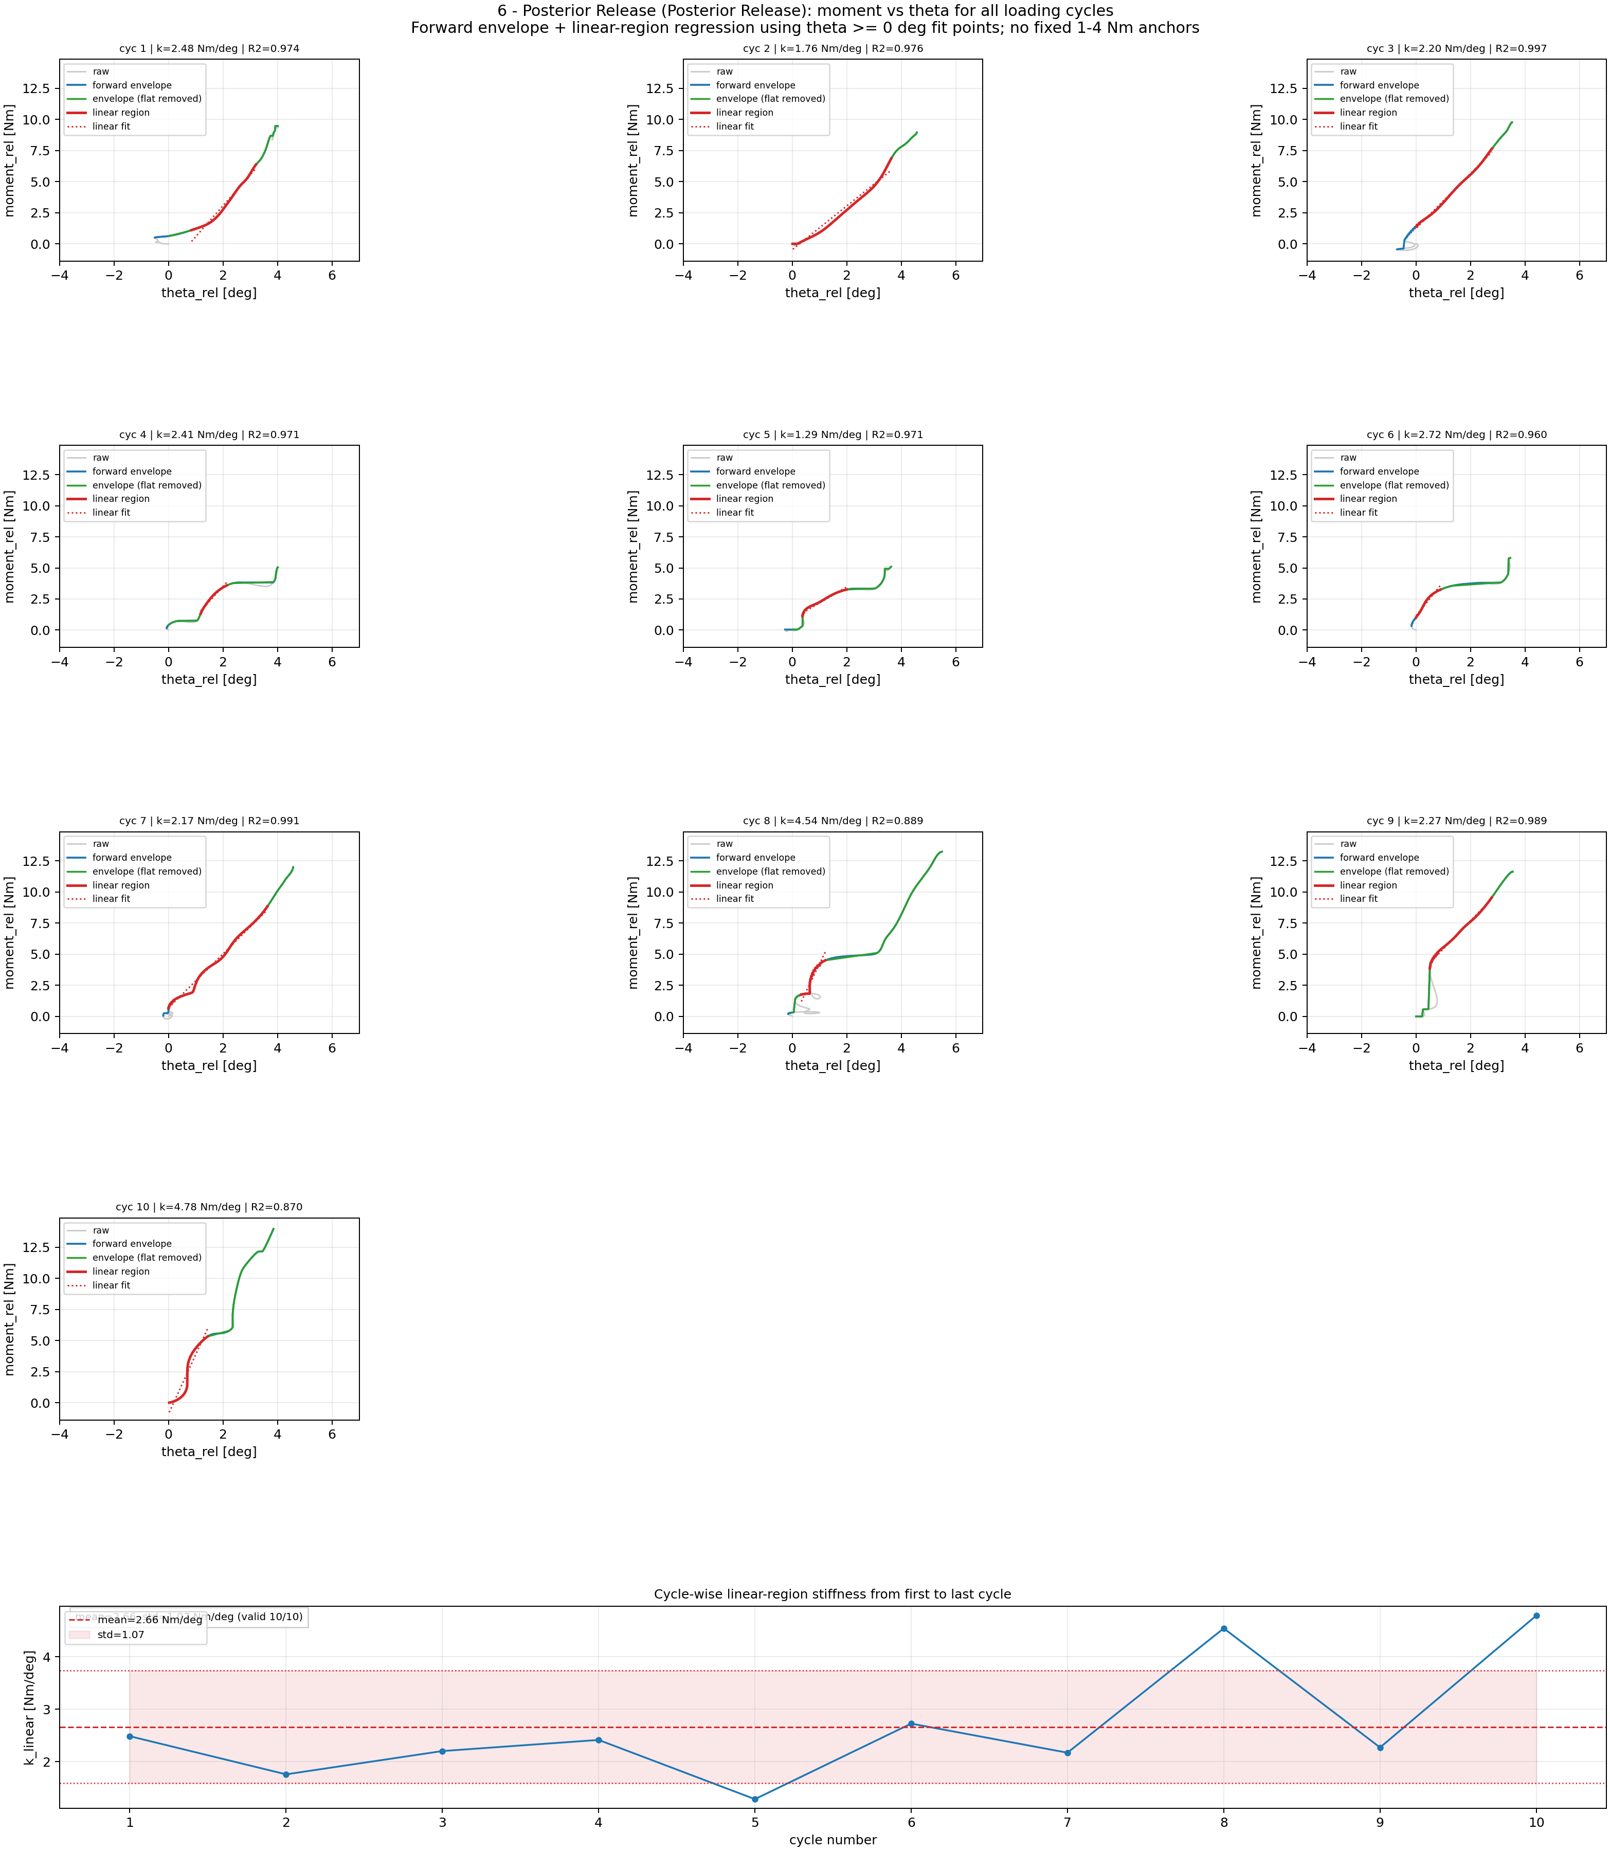
Step 6A: Moment-Theta Processing: 6 - Posterior Release
Cycle-wise rotational stiffness processing (fit uses theta >= 0 deg; shared theta limits) for 6 - Posterior Release.

Slide 20
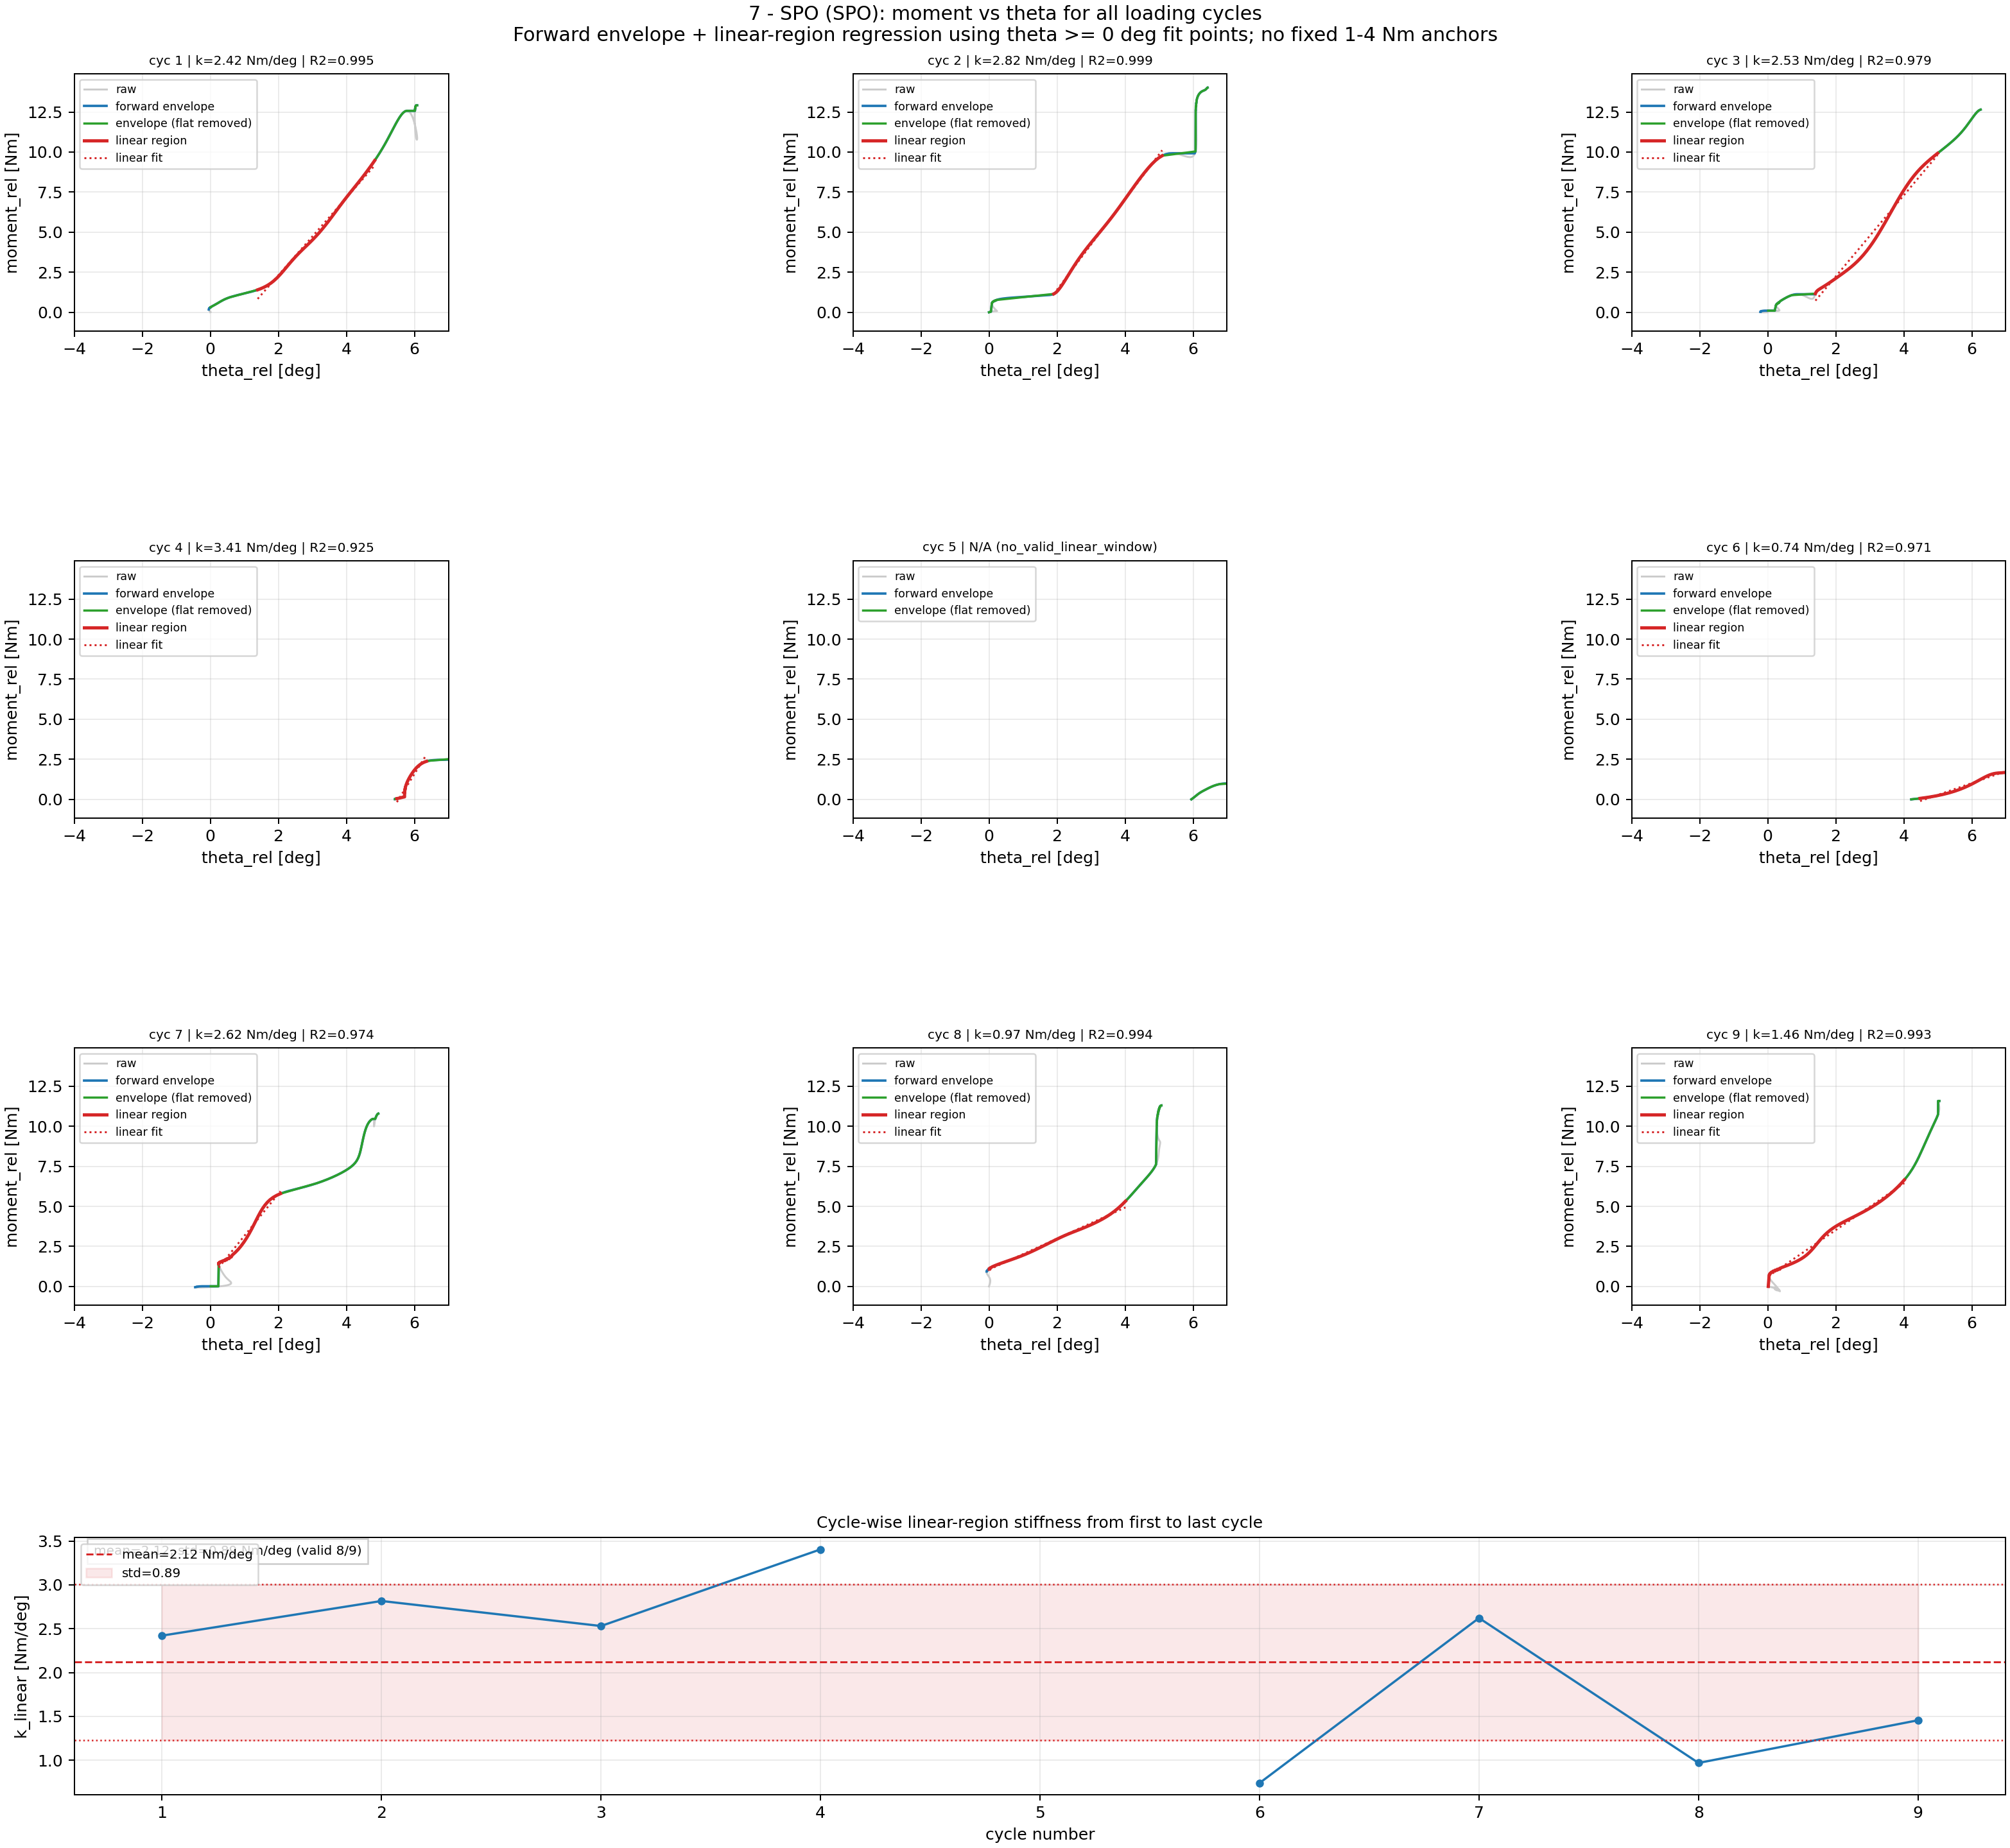
Step 6A: Moment-Theta Processing: 7 - SPO
Cycle-wise rotational stiffness processing (fit uses theta >= 0 deg; shared theta limits) for 7 - SPO.

Slide 21
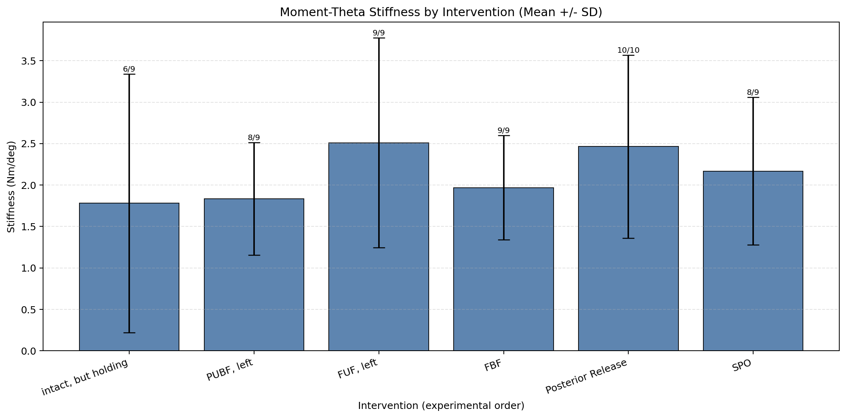
Step 6B: Rotational Stiffness Results Across Interventions
Mean ± SD from valid cycles (moment-theta stiffness).

Slide 22
Rotational Stiffness Ranking
Step 6B Results: Moment-Theta Rotational Stiffness
Rank Intervention median [Nm/deg] mean [Nm/deg] n_valid/n_cycles
---------------------------------------------------------------------------
1 SPO 2.476 2.120 8/9
2 FUF Left 2.476 2.383 9/9
3 Posterior Release 2.342 2.663 10/10
4 PUF Left 2.176 2.261 9/9
5 FBF 2.151 1.971 9/9
6 Intact Holding 1.217 1.664 8/9

Slide 23
Appended Update: Fit-Point Rules
This version appends re-analysis results with explicit fit-point thresholds.
Displacement stiffness fitting: use only displacement >= 0 mm points.
Rotational stiffness fitting: use only theta >= 0 deg points.
All rankings/tables in this deck reflect these updated fit-selection rules.

Slide 24
Appendix: Filters Used
Median filter (theta, kernel=5): replaces each sample with local median; removes isolated spikes while preserving step/ramp edges better than mean smoothing.
Butterworth low-pass (order=2): force cutoff=1.5 Hz, theta cutoff=1.2 Hz; attenuates high-frequency noise while preserving low-frequency cycle shape and phase reasonably well.
MAD despiking before low-pass: force window=11, z=3.5; theta window=15, z=3.5; robust outlier suppression using rolling median absolute deviation.
Pseudo-ramp rejection: keep cycles only if run_samples>=30, rise_time>=1.2 s, and theta_rise>=0.2 deg.
Duplicate-peak merge: close peaks are clustered and only strongest candidate retained (time-gap bounds 2.5 to 10.0 s).
Theta0 calibration filter: estimate zero-angle from low-force samples (<5% Fmax) but exclude low-force blocks with |median theta|>1.0 deg.
Ramp-start theta snap: move force-based ramp start to nearest theta~0 in early ramp window (1.5 s), unless start is already non-neutral (|theta|>1.5 deg).
Linear-fit point constraints: displacement fits use x>=0 mm; moment-theta fits use theta>=0 deg; flat low-slope segments removed before regression.

Slide 25
Key Takeaways
Step-wise processing narrows from raw traces to quality-controlled cycles.
Results are reported in two complementary stiffness spaces:
force-tip (N/mm) and moment-theta (Nm/deg).
Rankings are based on median stiffness across valid cycles.
Fit-point constraints are displacement >= 0 mm and theta >= 0 deg.

