Slide 1
Spreader Stiffness: Step-by-Step Workflow
Updated 2026-08-28

Slide 2
Workflow Overview
1. Plot raw force/theta sync traces across interventions.
2. Apply filtering and preload/theta0 corrections.
3. Detect and mark ramp starts.
4. Mark transition-flagged cycles as ineligible.
5. Fit force-tip and moment-theta stiffness (some cycles can fail fit criteria).
6. Report rankings from valid fitted cycles.

Slide 3
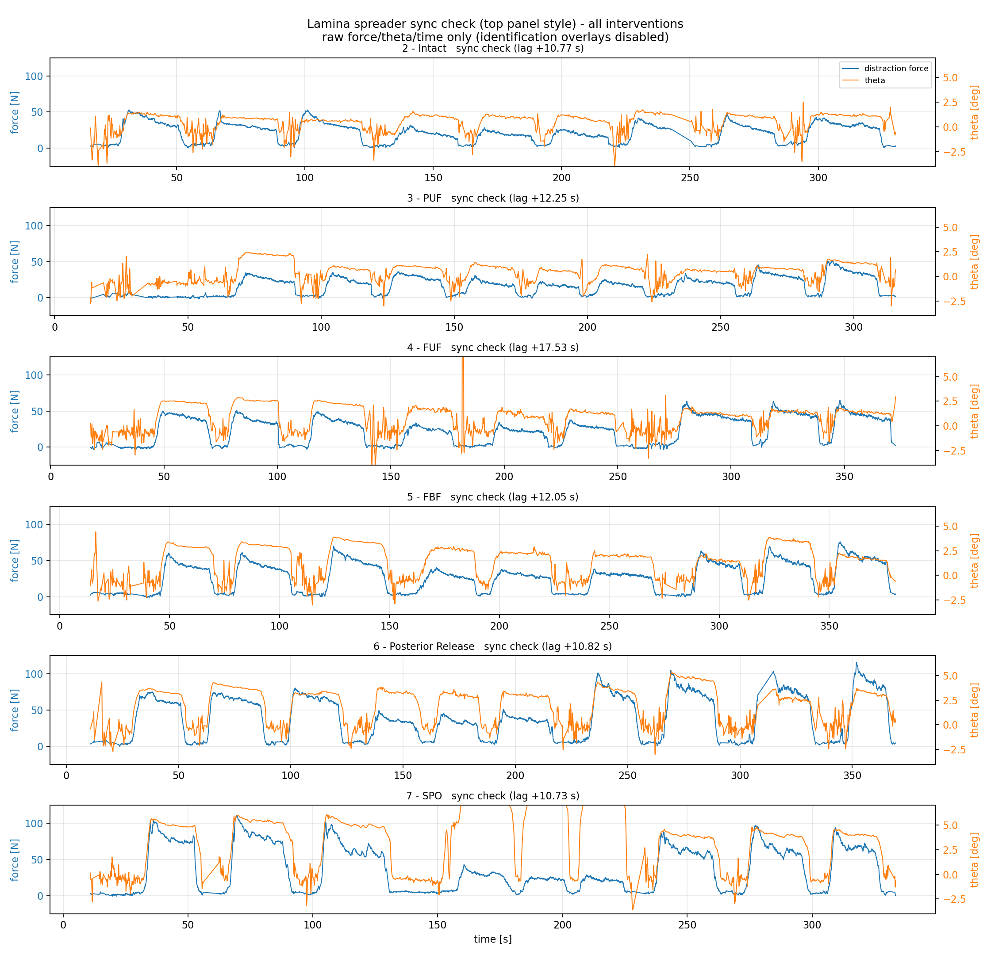
Step 1: Raw Force vs Time
Raw distraction force trace with synchronized angle per intervention.

Slide 4
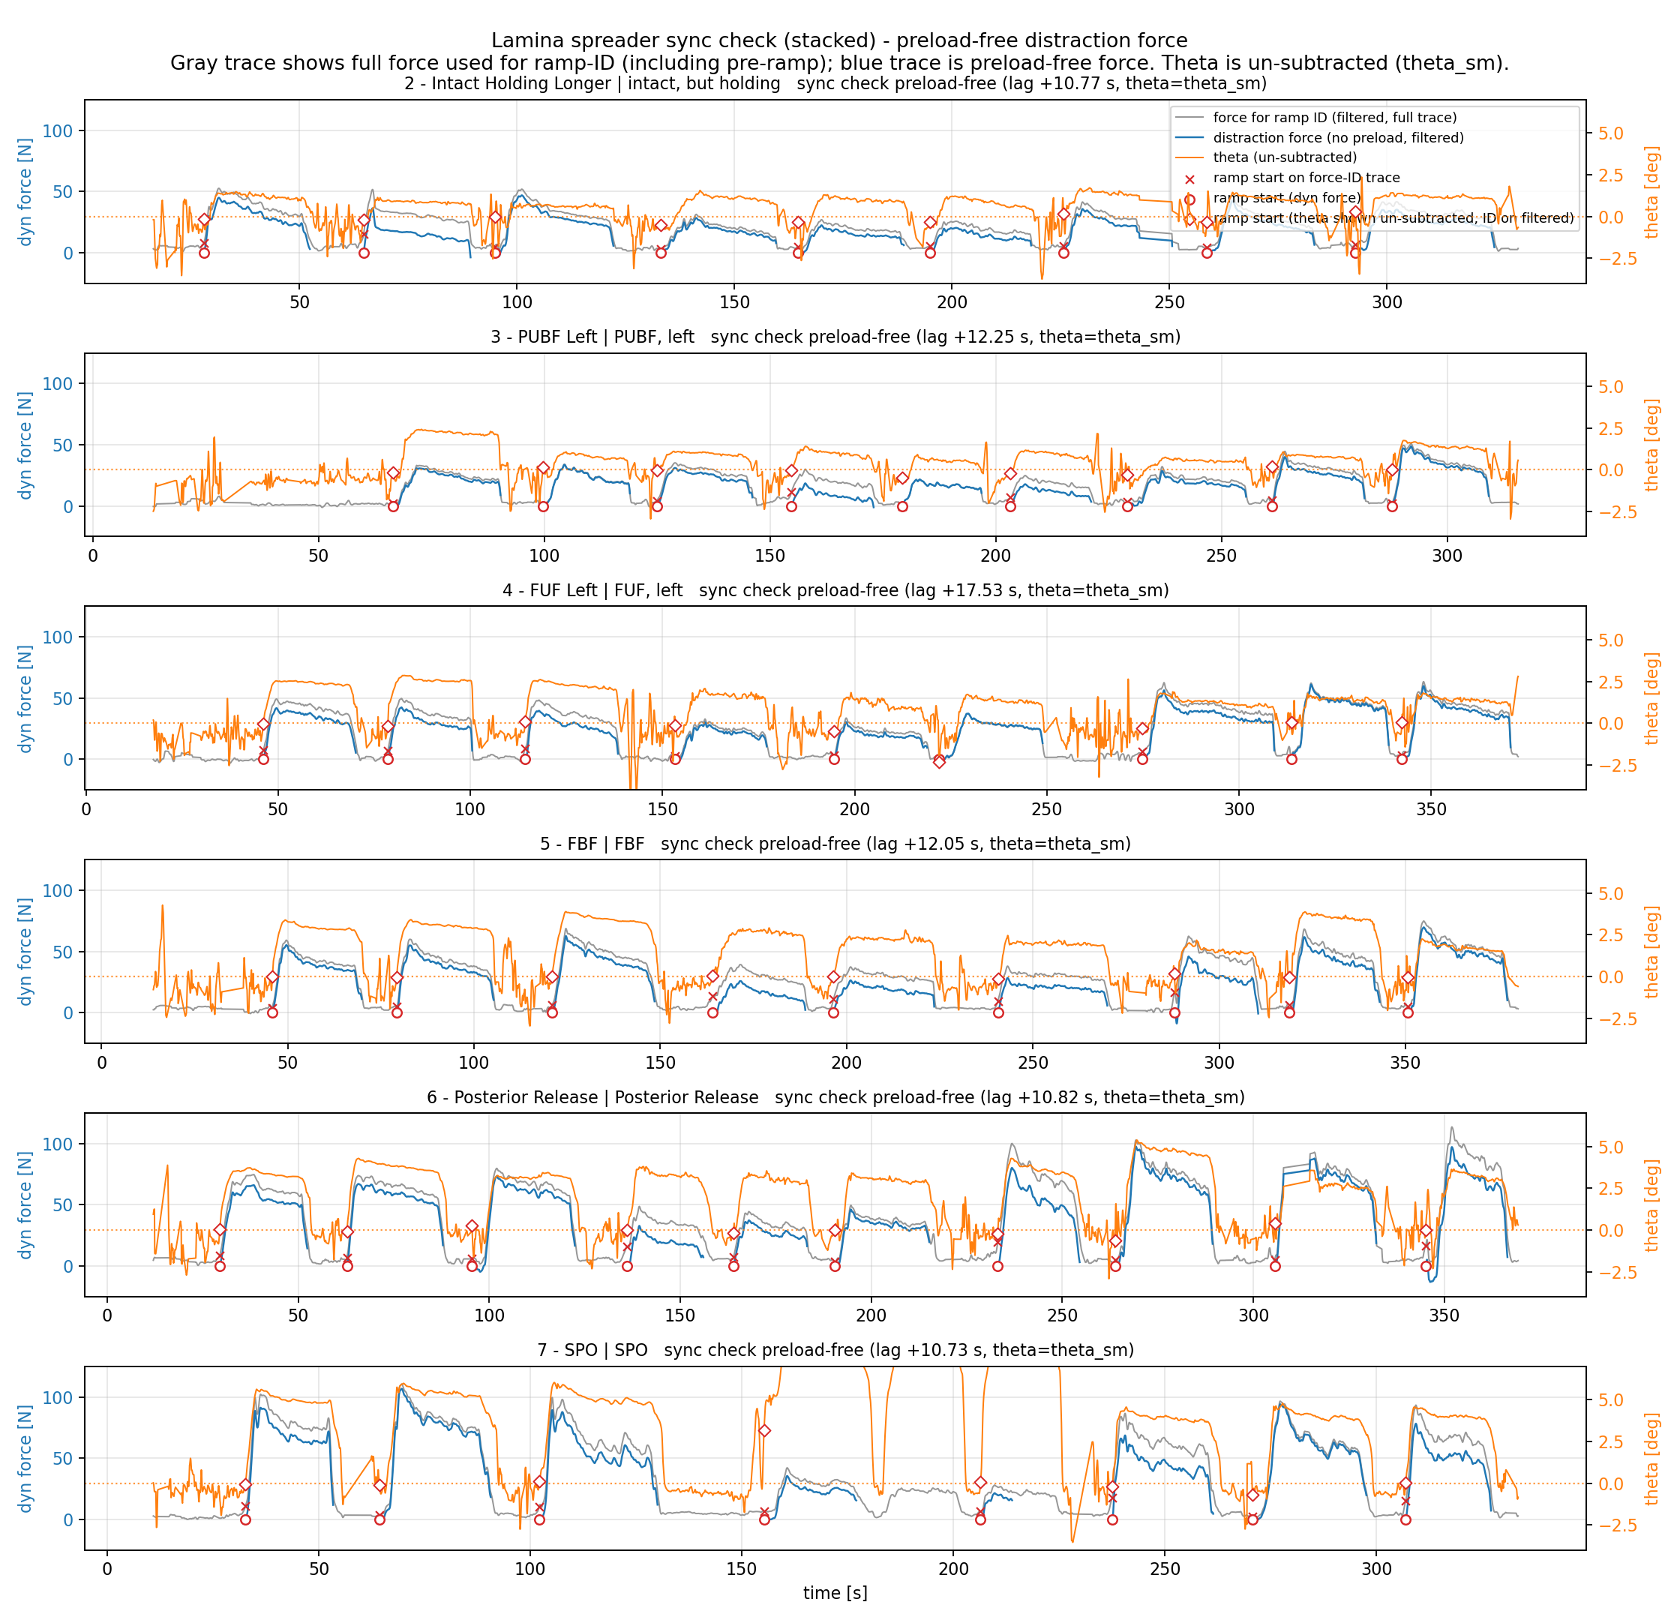
Step 2: Force Without Preload vs Time
Preload-corrected force; dashed lines show secant force references.

Slide 5
Step 4: Mark Ineligible Cycles
Cycle eligibility summary (preload-free transition flags)
Intervention n_cycles eligible ineligible
------------------------------------------------------------
FBF 9 9 0
FUF 9 9 0
Intact 9 9 0
PUF 9 9 0
Posterior Release 10 10 0
SPO 9 6 3
Rule: ineligible here only means transition_flag=True.

