Slide 1
MTS Testing Data Summary
Updated 2026-08-19

Slide 2
Method Snapshot
Input: MTS 6DOF Book*.xlsx grouped as FE, LB, AR per intervention
Cycle basis: third cycle, centered avg(load/unload)
Model: M(theta) = C1*theta + C2*theta^2 + C3*theta^3
Plot orientation: angle on x-axis, moment on y-axis
Flexion ranking window: 1-5 Nm

Slide 3
MTS 1-5 Nm Stiffness Ranking
MTS Flexion Ranking (1-5 Nm, centered branch)
Rank Intervention k [Nm/deg] R2 n_points
----------------------------------------------------------
1 PUBF Left 0.889 0.983 124
2 FUF Left 0.867 0.983 125
3 Intact 0.866 0.981 128
4 FBF 0.846 0.983 126
5 Posterior Release 0.817 0.978 128
6 SPO 0.722 0.977 128

Slide 4
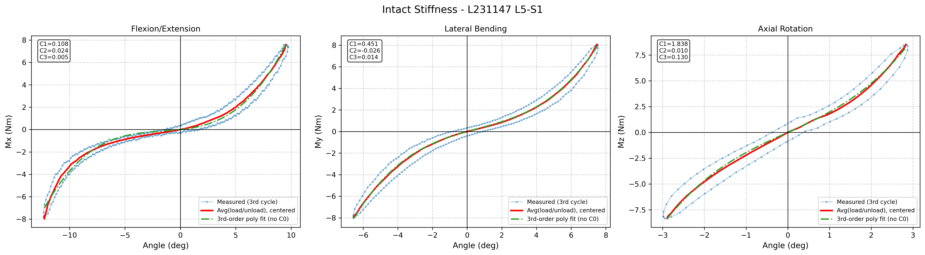
Intervention: Intact

Slide 5
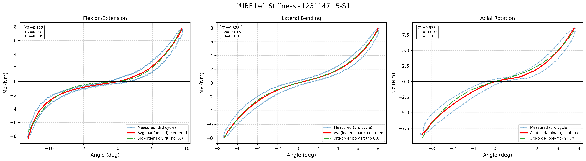
Intervention: PUBF Left

Slide 6
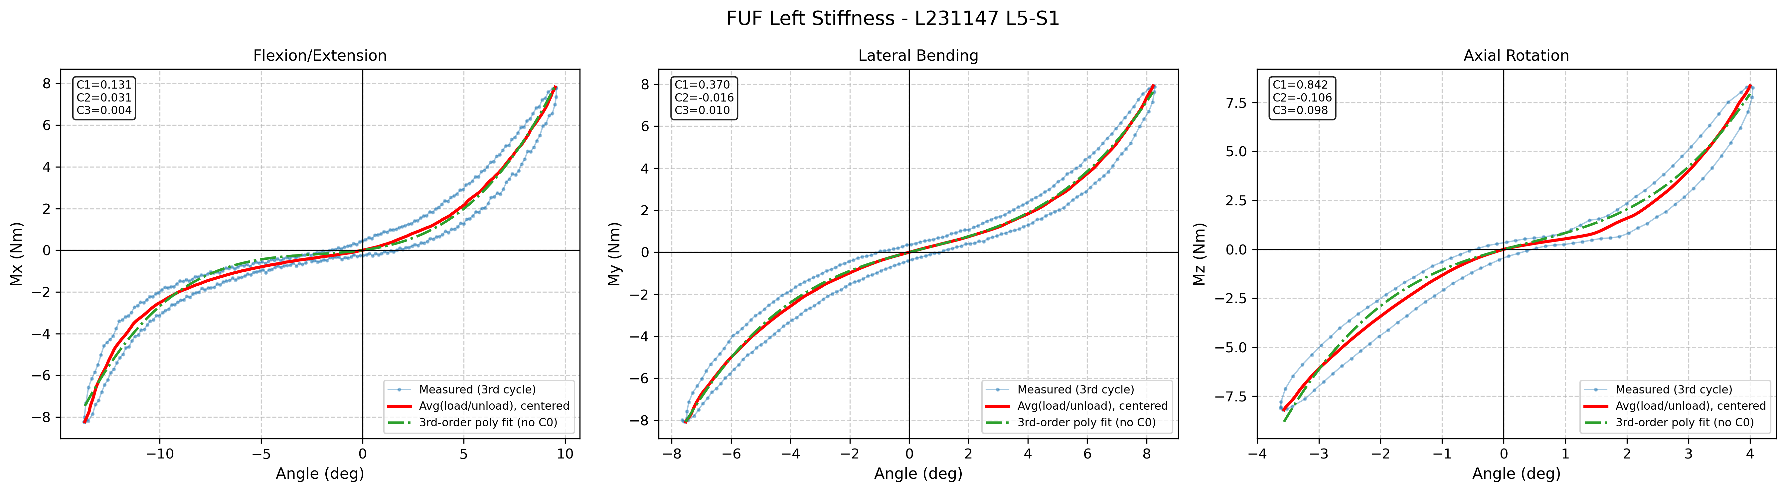
Intervention: FUF Left

Slide 7
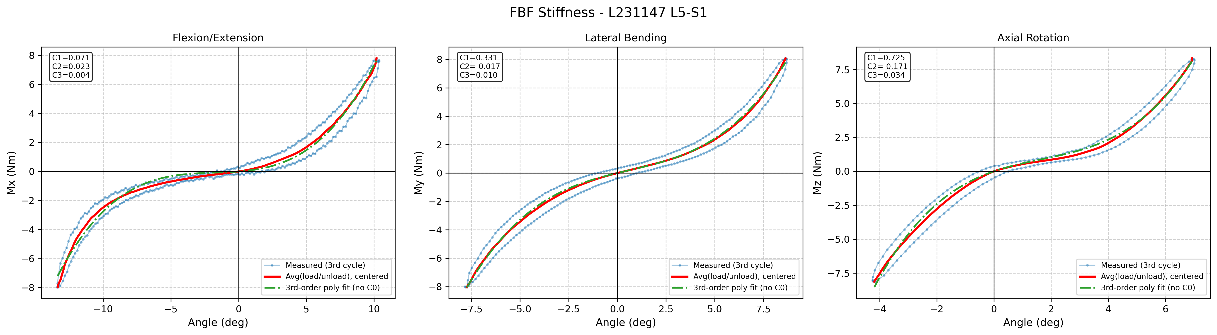
Intervention: FBF

Slide 8
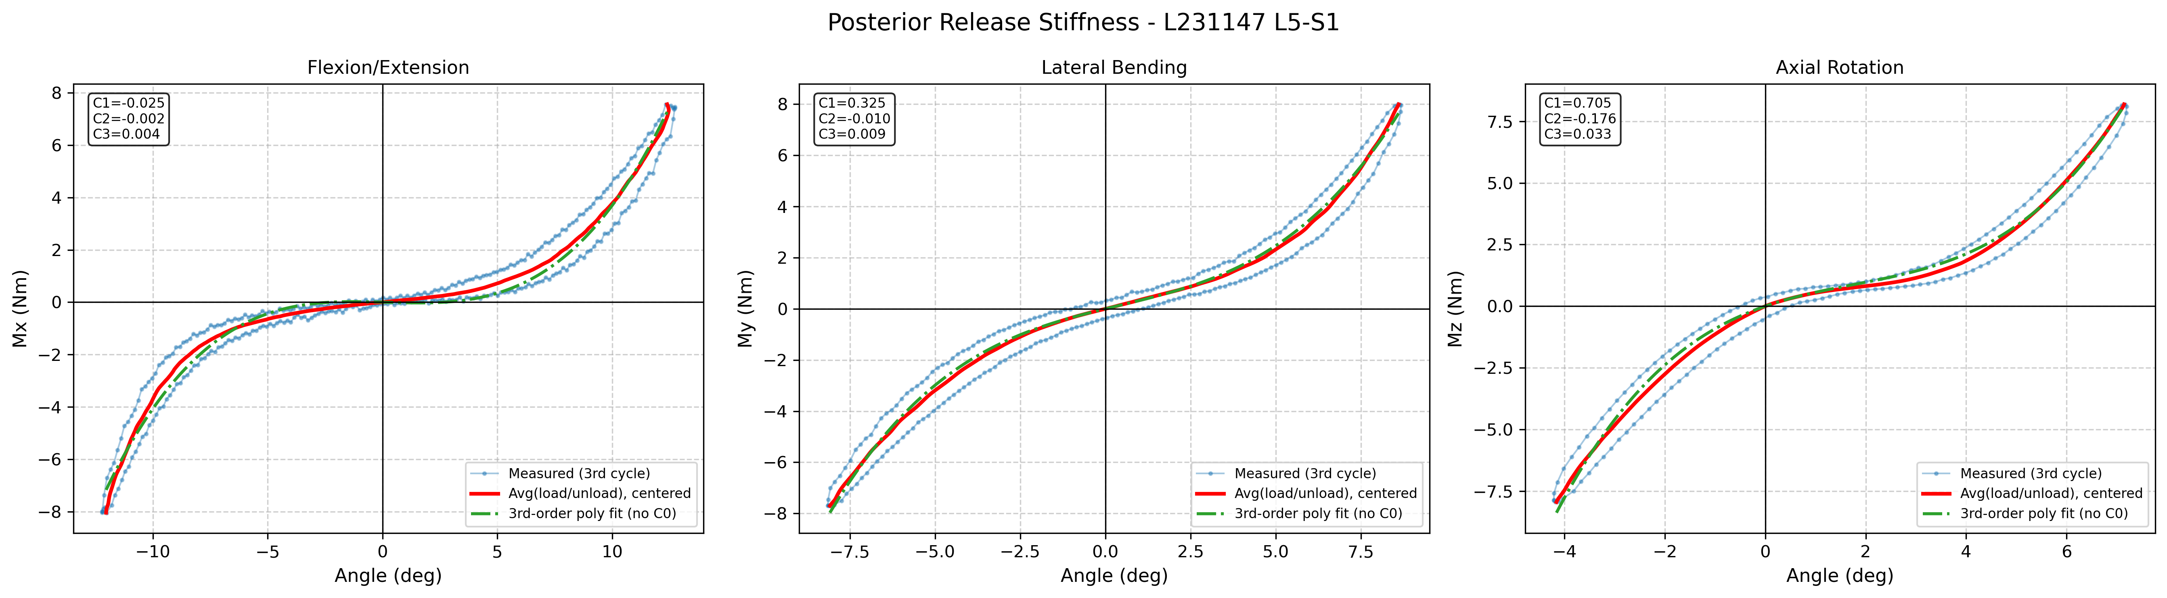
Intervention: Posterior Release

Slide 9
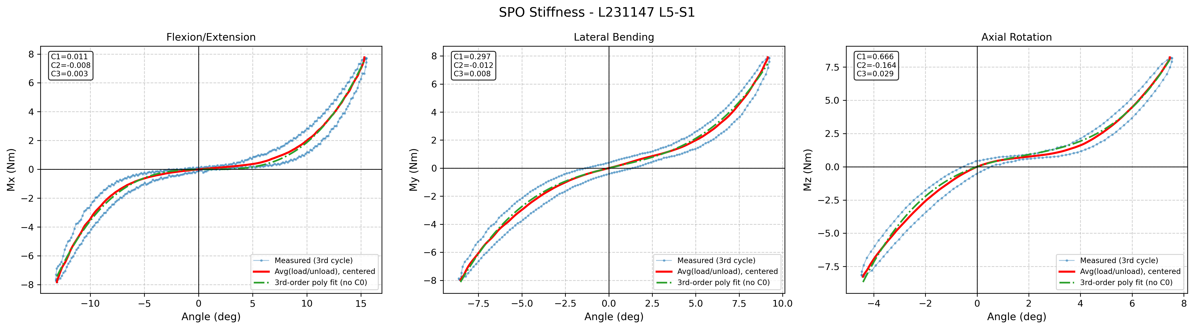
Intervention: SPO

Slide 10
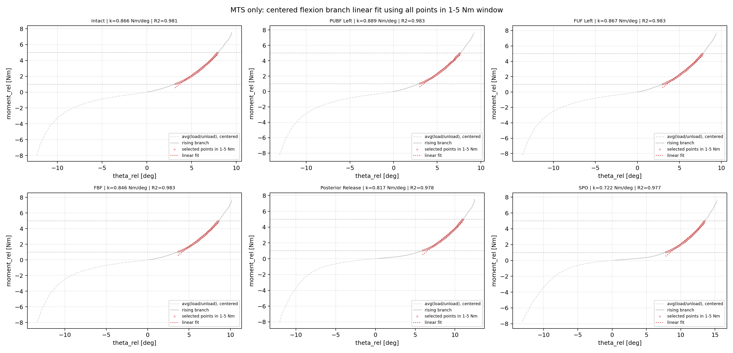
MTS Flexion: 1-5 Nm Fit Panels

Slide 11
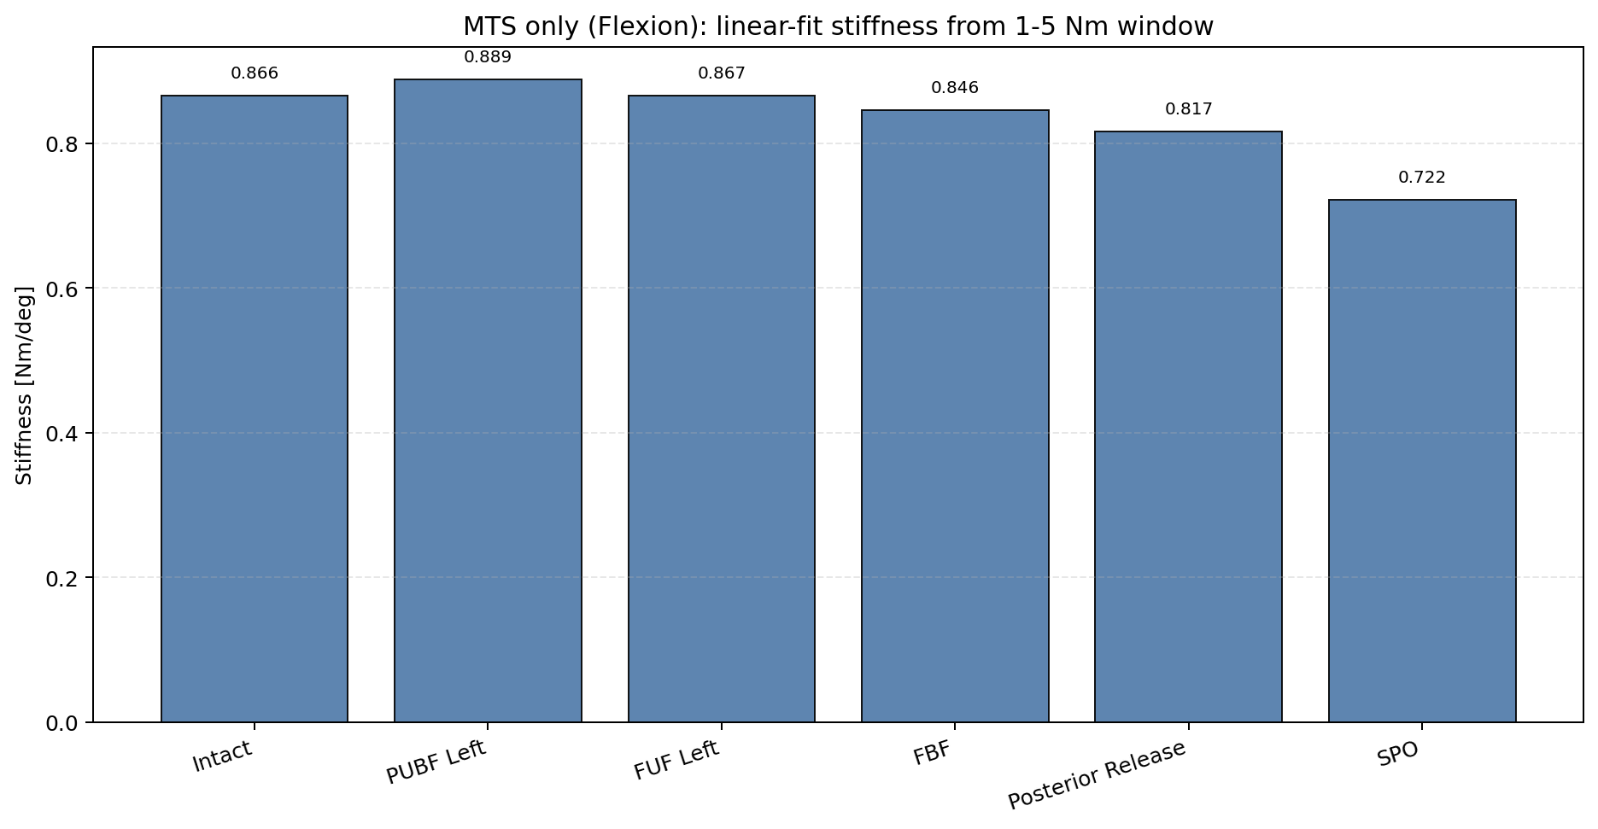
MTS Flexion: 1-5 Nm Stiffness Bar

