Slide 1
Spreader Stiffness: Step-by-Step Workflow
Updated 2026-08-19

Slide 2
Workflow Overview
1. Plot raw force vs time (all cycles)
2. Remove preload and re-plot force vs time
3. Detect and mark ramp starts
4. Mark ineligible cycles (transition-flag rules)
5. Compute stiffness on force vs displacement windows
6. Convert to moment vs theta and report stiffness ranking

Slide 3

Step 1: Raw Force vs Time
Raw distraction force trace with synchronized angle per intervention.

Slide 4
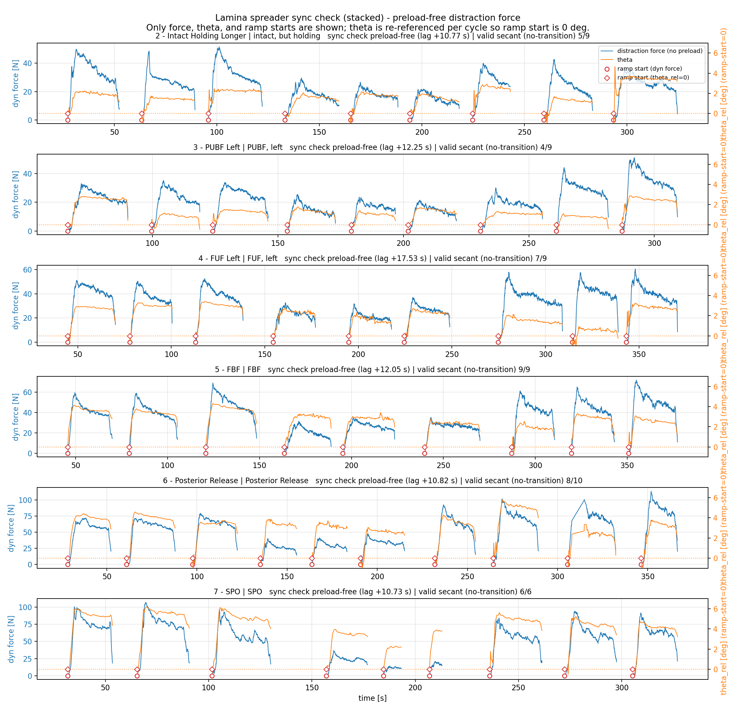
Step 2: Force Without Preload vs Time
Preload-corrected force; dashed lines show secant force references.

Slide 5

Step 3: Ramp Start Detection
Ramp-start preload force tracked across cycles/interventions.

Slide 6
Step 4: Mark Ineligible Cycles
Cycle eligibility summary (preload-free transition flags)
Intervention n_cycles eligible ineligible
------------------------------------------------------------
FBF 9 9 0
FUF, left 9 9 0
PUBF, left 9 9 0
Posterior Release 10 10 0
SPO 9 6 3
intact, but holding 9 9 0
In plots, transition/ineligible cycles are marked in red.

Slide 7

Step 5: Force vs Tip Displacement
Blue segment is the selected linear region used for stiffness fit.

Slide 8

Step 6: Moment vs Theta
Final rotational stiffness k_rot computed from the selected linear region.

Slide 9
Final Spreader Stiffness Ranking
Spreader stiffness ranking (after excluding ineligible cycles)
Rank Intervention median k_sec [Nm/deg] n_valid/n_cycles
--------------------------------------------------------------------------
1 intact, but holding 3.210 6/9
2 PUBF, left 2.808 2/9
3 FUF, left 2.770 7/9
4 FBF 2.529 6/10
5 SPO 2.236 6/13
6 Posterior Release 1.906 8/11

