Slide 1
Distributed Matrix Computation (DMaC)
A Distributed System for Matrix Multiplication
Ryan Bazzell & Jiwoon Yim
March 17, 2025
Notes:
Hello, my name is 2d Lt Jay Yim. And I am Ryan Bazzell. This is the presentation of our CSCE689 final project: Distributed Matrix Computation

Slide 2
Introduction
Distributed matrix multiplication
Strassen’s Algorithm
Heterogeneous nodes
Coordinator-worker architecture
Client for User-Interface
Scalable and transparent
Notes:
As a brief introduction, the system we built is a distributed matrix multiplication using Strassen’s Algorithm, which we will talk about in the later slide. The system utilizes heterogeneous nodes with coordinator-worker architecture. For user-interface, we came up with a client module that communicates with the coordinator to start matrix multiplication. This system is designed to be scalable and transparent as you will realized throughout the presentation

Slide 3
Motivation
Single-threaded shortcomings
Time consuming large-scale matrix multiplications
Improve performance
Provide scalability
Notes:
So why did we come up with this project? We realized doing a matrix multiplication on a single-threaded machine has a lot of shortcomings, which can be slowness and lack of memories. That leads to my next point of how time-consuming large-scale matrix multiplications are. So, our distributed sytem of matrix multiplication aims to improve performance and provide scalability, which addresses the single-threaded shortcomings.

Slide 4
System Architecture
Client: Submits jobs and verifies results
Coordinator: Distributes tasks, collects results
Workers: Compute using Strassen’s Algorithm
Worker 1
Worker 2
Client
Coordinator
…..
Worker n
Notes:
As for our system architecture, we have a client module which communicates with the user to submit jobs and verifies the result that coordinator provides. The coordinator node receives the jobs and distributes tasks among the available worker nodes in a round-robin style and then collect results from each of the workers. Workers, upon receiving the tasks, computes matrix multiplication using Strassen’s algorithm.

Slide 5
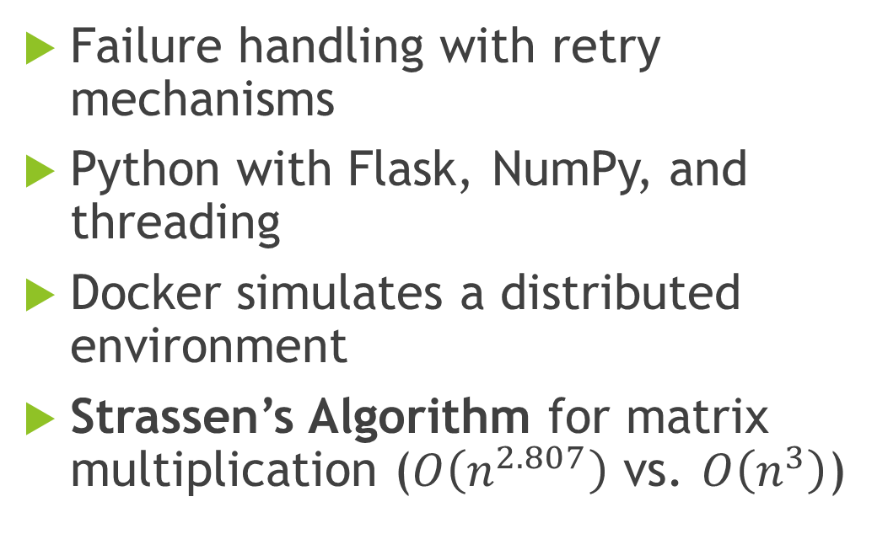
Implementation Details
Failure handling with retry mechanisms
Python with Flask, NumPy, and threading
Docker simulates a distributed environment
Strassen’s Algorithm for matrix multiplication ($O\left(n^{2.807}\right)$ vs. $O\left(n^{3}\right)$)
Notes:
To talk about our implementation details further, we implemented failure handling with retry mechanisms, which means if a network message timesout, the sender attempt to resend up to 3 times to allow the receiver to respond accordingly. We are also using Python for our choice of programming language with dependencies like Flask, numpy, and threading. The simulations of our system is running on docker with variable number of docker containers. As promised, we are using Strassen’s algorithm for matrix multiplication instead of a naïve matrix multiplication approach to improve performance and time complexities.

Slide 6
Demo

Slide 7
Simulation & Testing
Performance benchmarks and test cases
Simulated heterogeneous setup with Docker (Alpine, Debian, Fedora)
Three scales: Small (4 workers), Medium (10 workers), Large (20 workers)
Compared local vs. distributed performance
Metrics
Accuracy
Performance
Scalability
Transparency

Slide 8
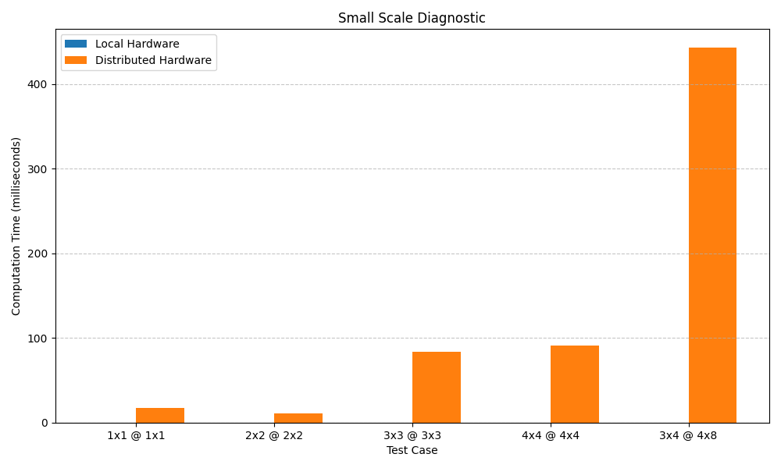
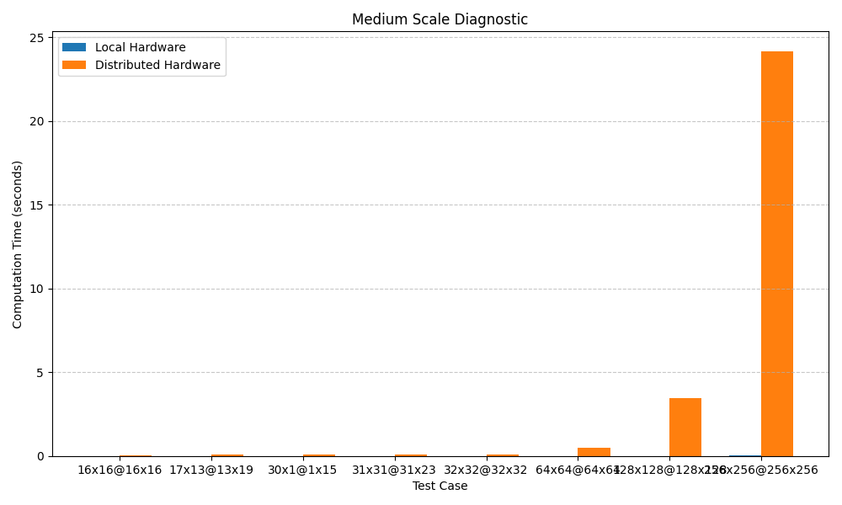
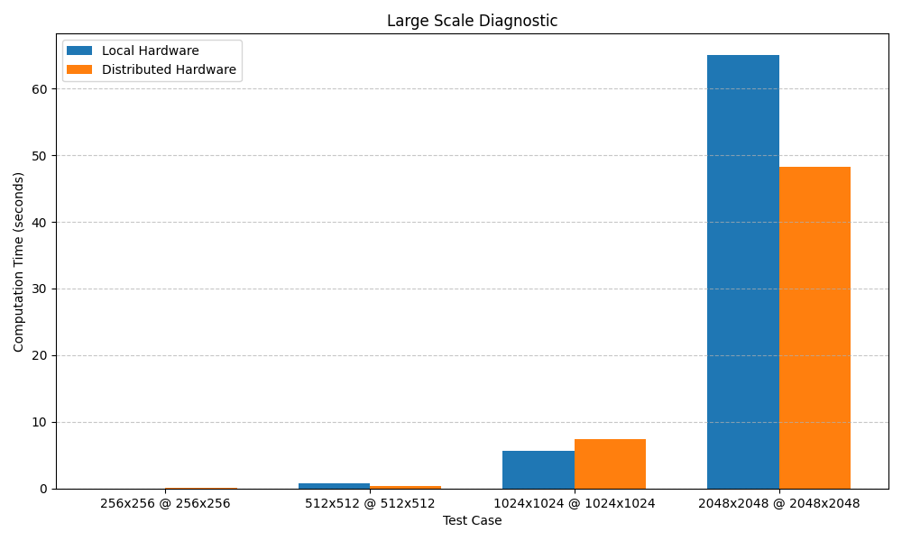
Results - Diagnostics

Slide 9
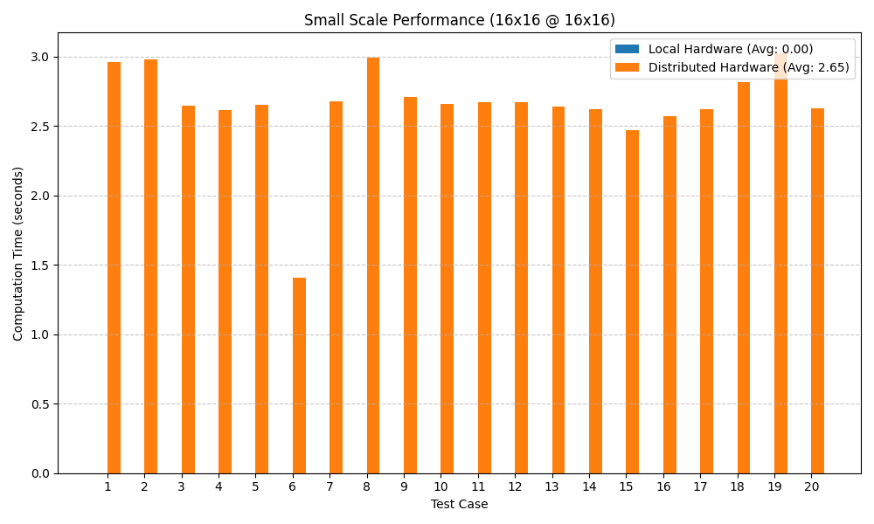
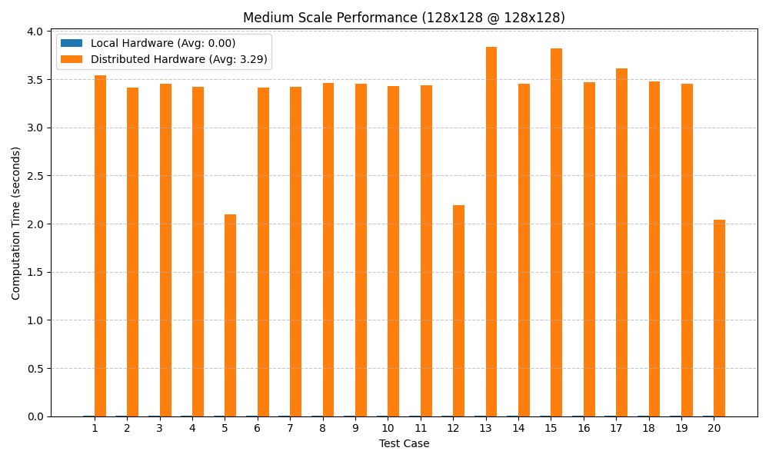
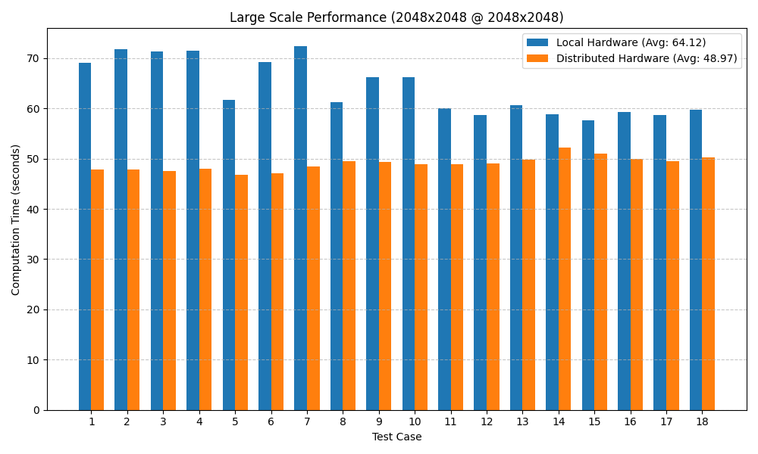
Results - Performance

Slide 10
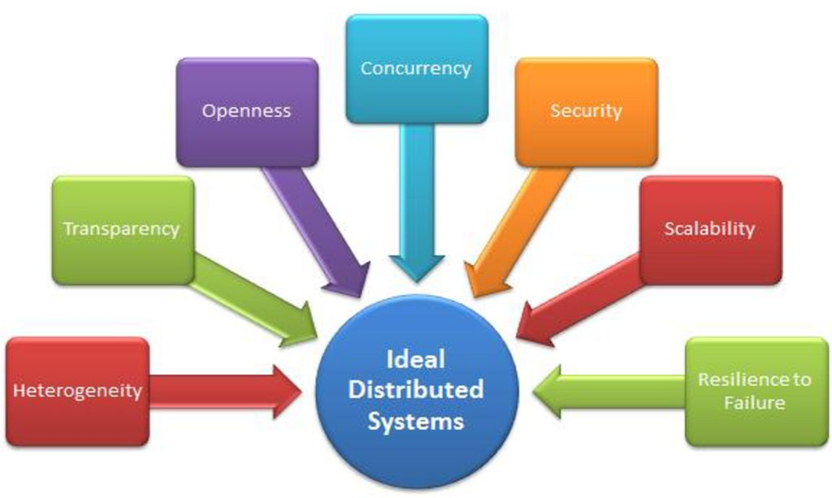
Distributed System Principles
Scalability: Works across different worker counts
Transparency: Hides distribution from user
Resource Sharing: Tasks split across nodes

Slide 11
Lessons Learned
Communication Overhead
Single Point of Failure
Effectiveness of Programming Tools
Efficient Distributed Algorithms
Fault Tolerance
Notes:
Distributed Computing Trade-offs: Communication overhead impacts performance at small scales.
Single Point of Failure Challenge: Coordinator node needs redundancy.
Effectiveness of Docker for Simulation: Useful but requires real multi-node deployment for validation.
Algorithm Efficiency: Strassen’s Algorithm worked but required optimization for distributed execution.
Load Balancing Issues: Coordination overhead limited linear scalability with more worker nodes.

Slide 12
Future Work
Addressing the Single Point of Failure
Improving Communication Efficiency
Implement Worker Fault Tolerance
Notes:
Our single coordinator setup severely bottlenecks the system in the case of a local failure. To address the reliability concerns of a coordinator failing, a pool of coordinators could be used, with systems such as Paxos,
Raft, or ZooKeeper or another way to achieve is use hierarchical architecture to address the performance bottleneck of a single coordinator system.
To improve communication efficiency, we could Optimize data serialization and use asynchronous communication.
Our current sytem is not fault tolerant, as in the event of a failure in a worker node, the coordinator remains unaware and the worker doesn’t compute the task as expected. Future work includes researching a way to implement fault tolerance of a worker node.

Slide 13
Conclusion
Distributed computing for matrix multiplications
Offers scalability, though overhead remains a challenge
Future improvements can enhance real-world applicability

Slide 14
References
API — Flask Documentation (3.0.x). 2024. url: https://flask.palletsprojects.com/en/stable/api/.
Ankur Mallick, Malhar Chaudhari, and Gauri Joshi. “Fast and Efficient Distributed Matrix-vector Multiplication UsingRateless Fountain Codes”. In: ICASSP 2019 - 2019 IEEE International Conference on Acoustics, Speech and SignalProcessing (ICASSP). 2019, pp. 8192–8196. doi: 10.1109/ICASSP.2019.8682347.
Oded Schwartz and Noa Vaknin. “Pebbling Game and Alternative Basis for High Performance Matrix Multiplication”.In: SIAM Journal on Scientific Computing 45.6 (2023), pp. C277–C303. doi: 10.1137/22M1502719. eprint: https://doi.org/10.1137/22M1502719. url: https://doi.org/10.1137/22M1502719.
Volker Strassen. “Gaussian elimination is not optimal”. In: Numerische Mathematik 13.4 (Aug. 1969), pp. 354–356. doi:10.1007/bf02165411. url: https://doi.org/10.1007/bf02165411.
Serhii Zybin, Vladimir Khoroshko, Volodymyr Maksymovych, and Ivan Opirskyy. “Effective Distribution of Tasks inMultiprocessor and Multi-Computers Distributed Homogeneous Systems”. In: International Journal of Computing (June2021), pp. 211–220. doi: 10.47839/ijc.20.2.2168.

