Slide 1


Distributed Matrix Computation (DMaC)
A Distributed System for Matrix Multiplication
Ryan Bazzell & Jiwoon Yim
March 17, 2025

Slide 2
Introduction
DMaC enables distributed matrix operations across heterogeneous nodes
Uses a client-coordinator-worker architecture to distribute tasks efficiently
Scalable and transparent computation for users

Slide 3
Motivation
Large-scale matrix computations require efficiency.
Single-threaded processing is slow and limited.
Distributed systems improve scalability and fault tolerance.

Slide 4
System Architecture
Client: Submits jobs and verifies results
Coordinator: Distributes tasks, collects results
Workers: Compute using Strassen’s Algorithm
Docker simulates a distributed environment
Client
Coordinator
Workers

Slide 5
Implementation Details
Worker nodes communicate with the coordinator.
Client module handles user interaction.
Failure handling with redundancy mechanisms.
Python with Flask, NumPy, and threading
Strassen’s Algorithm for matrix multiplication (O(n^2.807) vs. O(n^3))

Slide 6
Demo

Slide 7
Simulation & Testing
Docker-based environment for distributed simulation
Simulated heterogeneous computing setup
Performance benchmarks and test cases
Simulated heterogeneous setup with Docker (Alpine, Debian, Fedora)
Three scales: Small (4 workers), Medium (10 workers), Large (20 workers)
Compared local vs. distributed performance

Slide 8
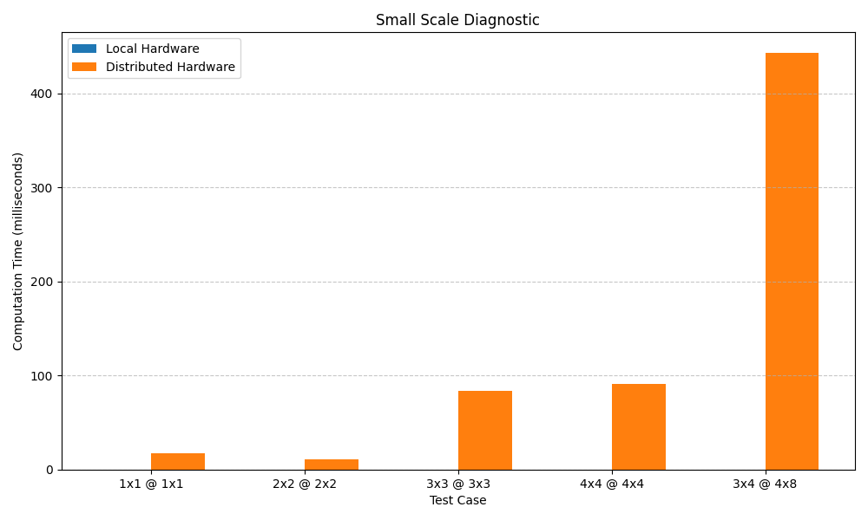
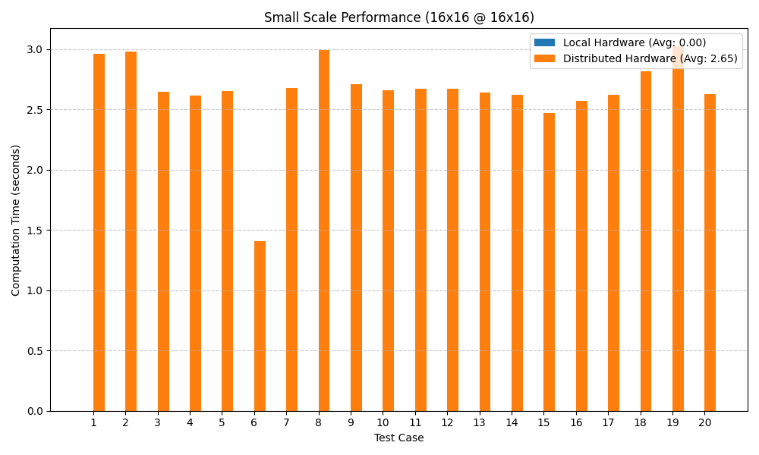
Results

Slide 9
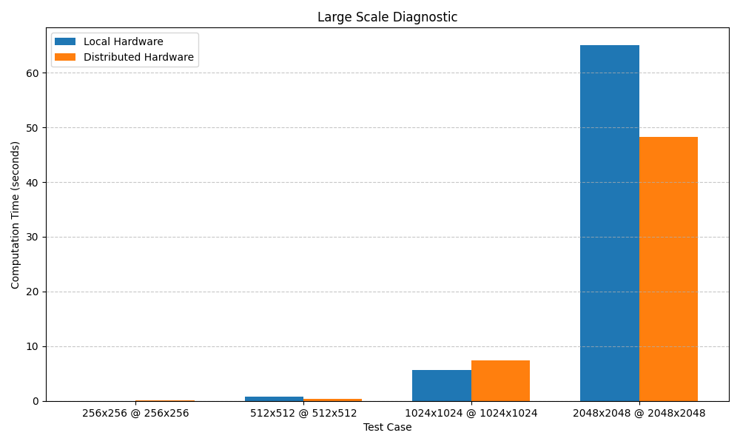
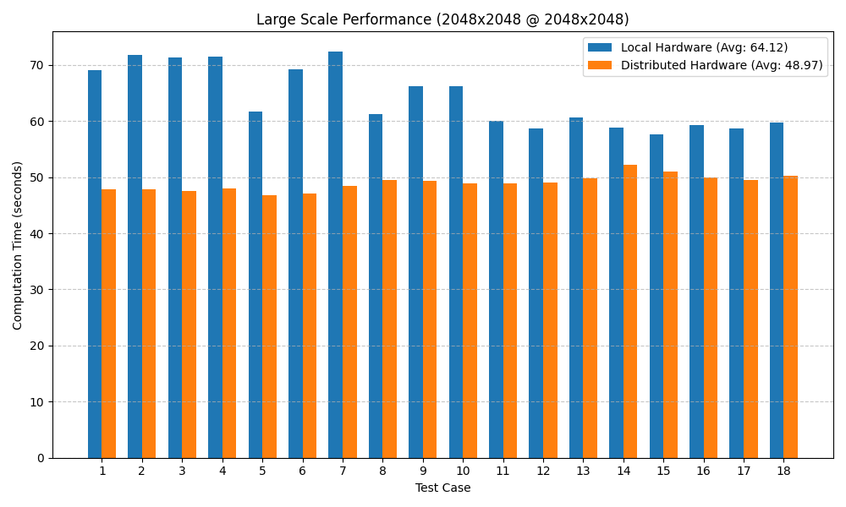
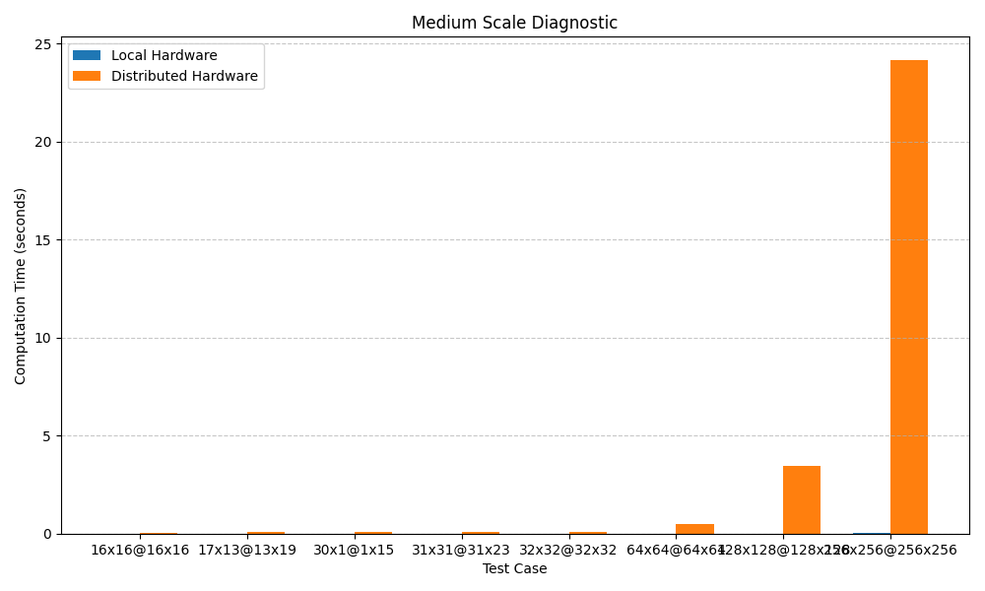
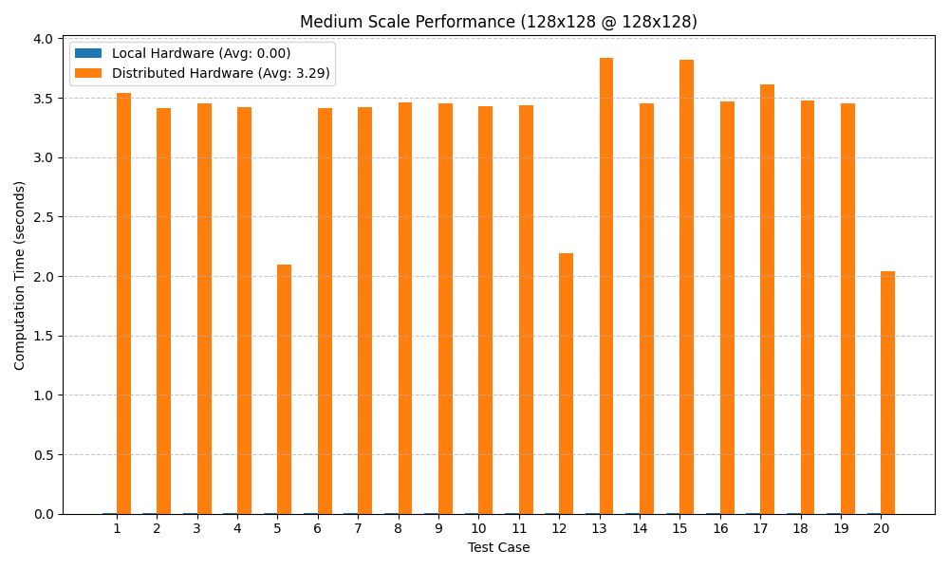
Results

Slide 10
Results

Slide 11
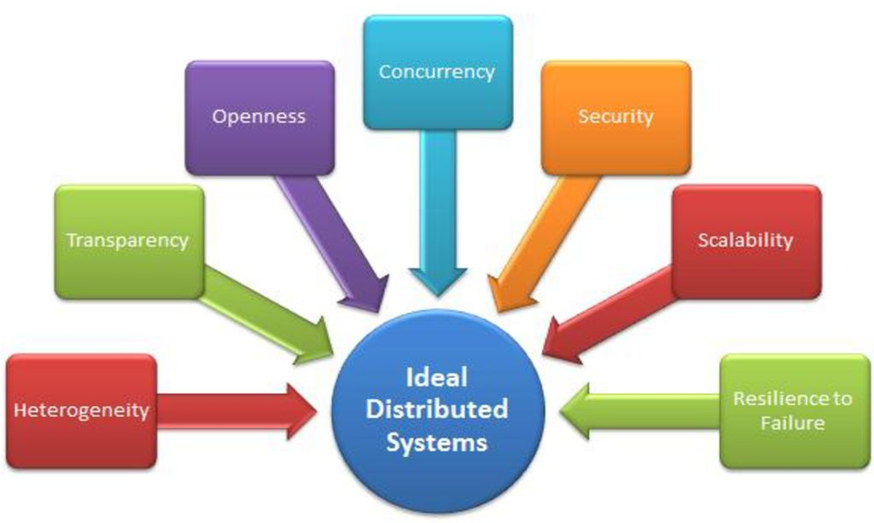
Distributed System Principles
Scalability: Works across different worker counts
Transparency: Hides distribution from user
Resource Sharing: Tasks split across nodes

Slide 12
Lessons Learned
Communication overhead hurts small-scale performance
Single coordinator is a weak point
Docker is great for simulation, but real nodes differ
Load balancing needs optimization
Notes:
Distributed Computing Trade-offs: Communication overhead impacts performance at small scales.
Single Point of Failure Challenge: Coordinator node needs redundancy.
Effectiveness of Docker for Simulation: Useful but requires real multi-node deployment for validation.
Algorithm Efficiency: Strassen’s Algorithm worked but required optimization for distributed execution.
Load Balancing Issues: Coordination overhead limited linear scalability with more worker nodes.

Slide 13
Future Work
Addressing the Single Point of Failure
Optimized Load Balancing Strategies
Alternative Matrix Computation Methods
Improving Communication Efficiency Real Multi-Node Deployment
Notes:
Implement a redundant coordinator or leader election algorithm.
Implement dynamic task allocation and explore adaptive scheduling.
Optimize data serialization and use asynchronous communication.
Move beyond Docker and test in a cloud-based distributed cluster.

Slide 14
Conclusion
DMaC demonstrates the potential of distributed computing for matrix operations
Offers scalability, though overhead remains a challenge
Future improvements can enhance real-world applicability

Slide 15
References
Mallick et al. (2019). Fast and Efficient Distributed Matrix-vector Multiplication.
Schwartz & Vaknin (2023). High Performance Matrix Multiplication.
Zybin et al. (2021). Effective Task Distribution in Distributed Systems.

