Slide 1
Distributed Matrix Computation (DMaC)
A Distributed System for Matrix Multiplication
Ryan Bazzell & Jiwoon Yim
March 17, 2025

Slide 2
Introduction
Distributed matrix multiplication
Strassen’s Algorithm
Heterogeneous nodes
Coordinator-worker architecture
Client for User-Interface
Scalable and transparent

Slide 3
Motivation
Single-threaded shortcomings
Time consuming large-scale matrix multiplications
Improve performance
Provide scalability

Slide 4
System Architecture
Client: Submits jobs and verifies results
Coordinator: Distributes tasks, collects results
Workers: Compute using Strassen’s Algorithm
Worker 1
Worker 2
Client
Coordinator
…..
Worker n

Slide 5
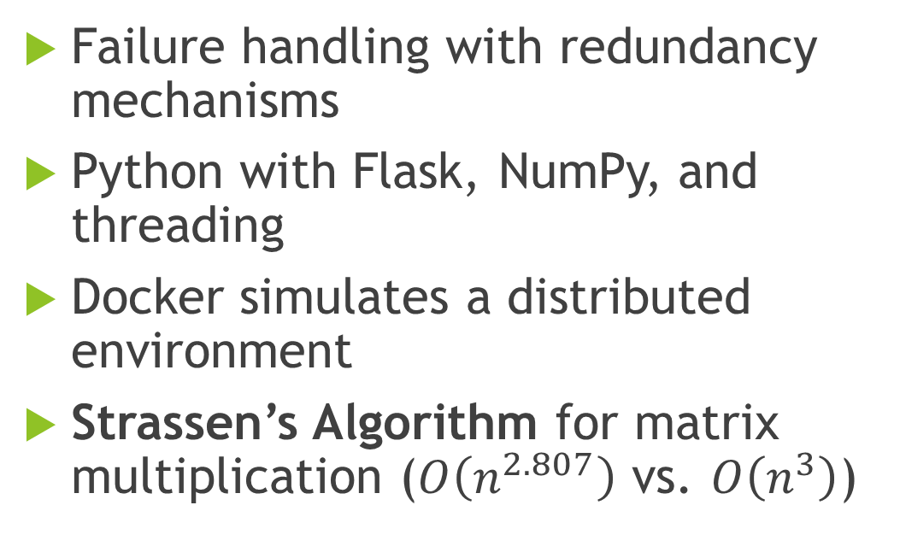
Implementation Details
Failure handling with redundancy mechanisms
Python with Flask, NumPy, and threading
Docker simulates a distributed environment
Strassen’s Algorithm for matrix multiplication ($O\left(n^{2.807}\right)$ vs. $O\left(n^{3}\right)$)

Slide 6
Demo

Slide 7
Simulation & Testing
Performance benchmarks and test cases
Simulated heterogeneous setup with Docker (Alpine, Debian, Fedora)
Three scales: Small (4 workers), Medium (10 workers), Large (20 workers)
Compared local vs. distributed performance
Metrics
Accuracy
Performance
Scalability
Transparency

Slide 8
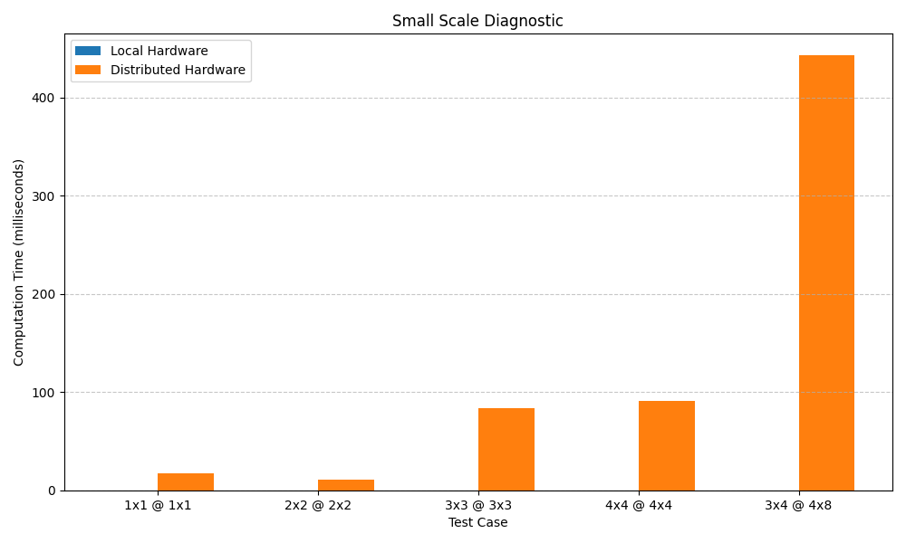
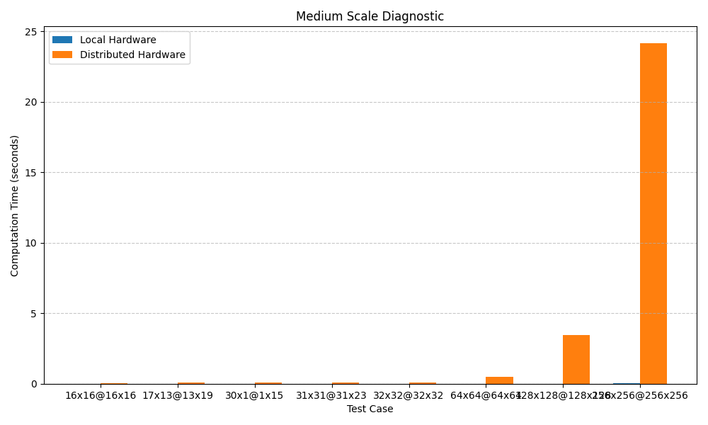
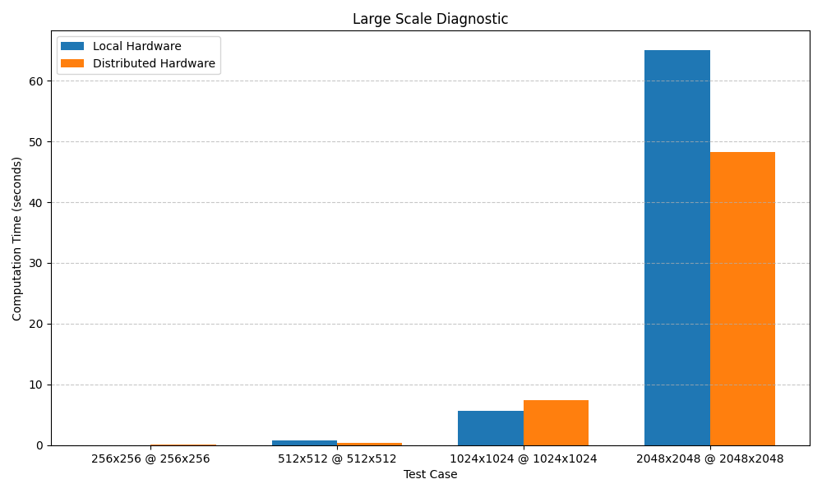
Results - Diagnostics

Slide 9
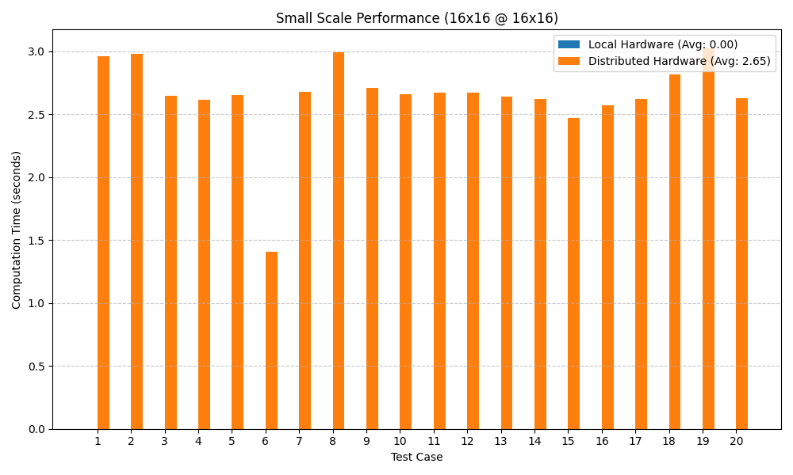
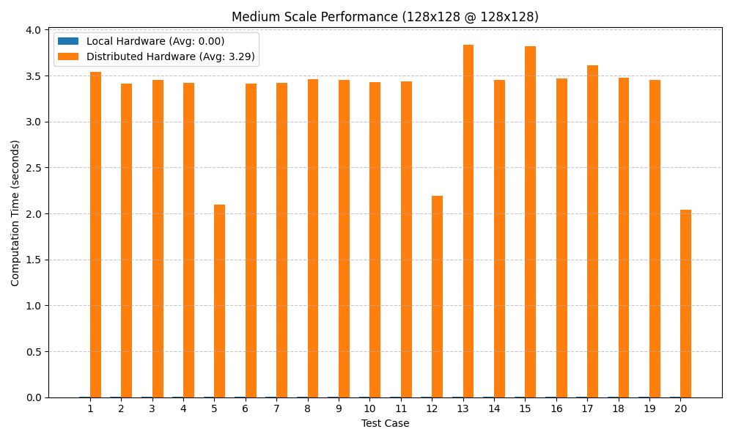
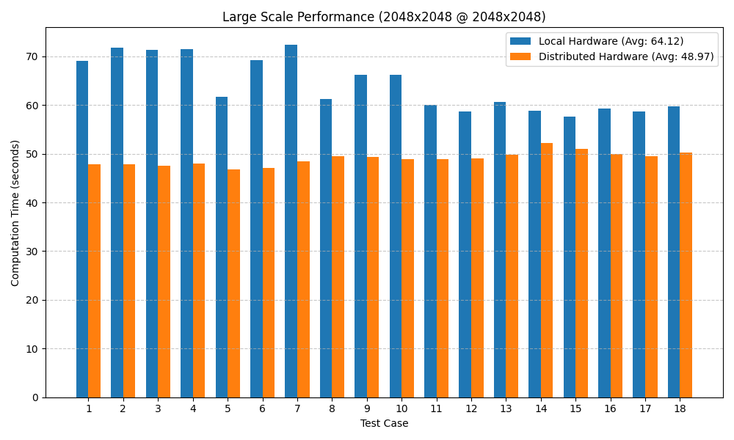
Results - Performance

Slide 10
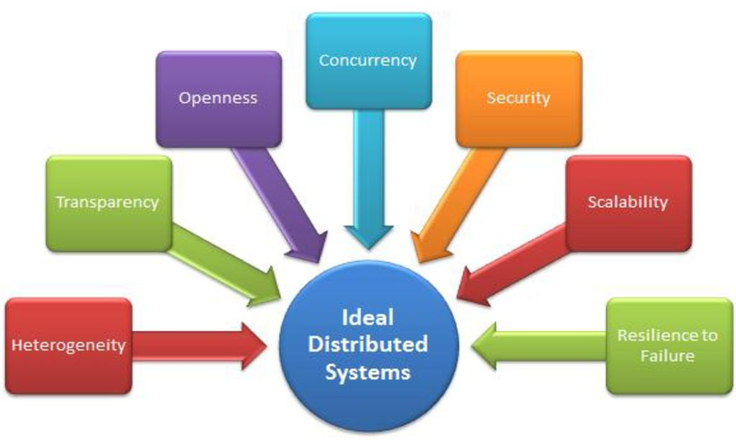
Distributed System Principles
Scalability: Works across different worker counts
Transparency: Hides distribution from user
Resource Sharing: Tasks split across nodes

Slide 11
Lessons Learned
Communication Overhead
Single Point of Failure
Effectiveness of Programming Tools
Efficient Distributed Algorithms
Fault Tolerance
Notes:
Distributed Computing Trade-offs: Communication overhead impacts performance at small scales.
Single Point of Failure Challenge: Coordinator node needs redundancy.
Effectiveness of Docker for Simulation: Useful but requires real multi-node deployment for validation.
Algorithm Efficiency: Strassen’s Algorithm worked but required optimization for distributed execution.
Load Balancing Issues: Coordination overhead limited linear scalability with more worker nodes.

Slide 12
Future Work
Addressing the Single Point of Failure
Optimized Load Balancing Strategies
Alternative Matrix Computation Methods
Improving Communication Efficiency
Implement Worker Fault Tolerance
Notes:
Implement a redundant coordinator or leader election algorithm.
Implement dynamic task allocation and explore adaptive scheduling.
Optimize data serialization and use asynchronous communication.
Move beyond Docker and test in a cloud-based distributed cluster.

Slide 13
Conclusion
Distributed computing for matrix multiplications
Offers scalability, though overhead remains a challenge
Future improvements can enhance real-world applicability

Slide 14
References
API — Flask Documentation (3.0.x). 2024. url: https://flask.palletsprojects.com/en/stable/api/.
Ankur Mallick, Malhar Chaudhari, and Gauri Joshi. “Fast and Efficient Distributed Matrix-vector Multiplication UsingRateless Fountain Codes”. In: ICASSP 2019 - 2019 IEEE International Conference on Acoustics, Speech and SignalProcessing (ICASSP). 2019, pp. 8192–8196. doi: 10.1109/ICASSP.2019.8682347.
Oded Schwartz and Noa Vaknin. “Pebbling Game and Alternative Basis for High Performance Matrix Multiplication”.In: SIAM Journal on Scientific Computing 45.6 (2023), pp. C277–C303. doi: 10.1137/22M1502719. eprint: https://doi.org/10.1137/22M1502719. url: https://doi.org/10.1137/22M1502719.
Volker Strassen. “Gaussian elimination is not optimal”. In: Numerische Mathematik 13.4 (Aug. 1969), pp. 354–356. doi:10.1007/bf02165411. url: https://doi.org/10.1007/bf02165411.
Serhii Zybin, Vladimir Khoroshko, Volodymyr Maksymovych, and Ivan Opirskyy. “Effective Distribution of Tasks inMultiprocessor and Multi-Computers Distributed Homogeneous Systems”. In: International Journal of Computing (June2021), pp. 211–220. doi: 10.47839/ijc.20.2.2168.

