Slide 1


Pitt CSD R Workshop (This is a practice run)
Rob Cavanaugh
Emily Goldberg
Alex Swiderski

Slide 2
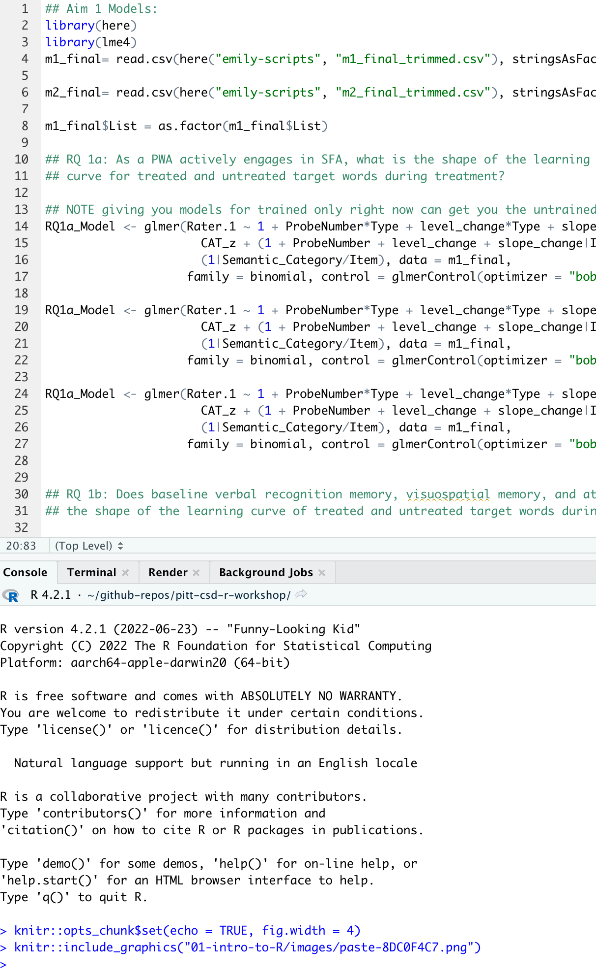
What is R, and why use it?
R is a free (open source) programming environment for data processing and statistical analysis.
R allows you to write scripts and computational markdown documents that organize, process, analyze, and visualize data.

Slide 3
R is useful for…
conducting reproducible research
automating data processing pipelines
creating high-quality visualizations
conducting statistical analyses

Slide 4

Ask questions anytime
If you’re unsure about something, someone else is too.

Slide 5
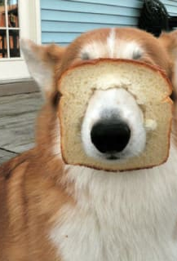
Accept that you will get stuck
Trial and error is a great way to learn

Slide 6

Give and Receive help from peers
Giving help clarifies your own understanding
Other novice R users might be better at explaining things than we are

Slide 7
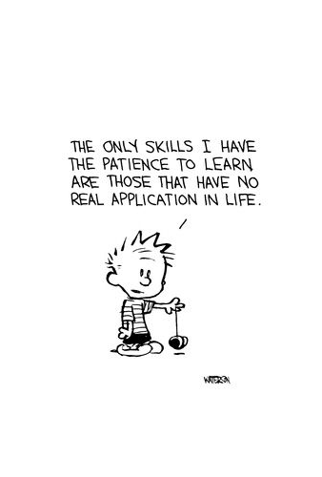
Be patient with yourself and others

Slide 8
Questions?

