Slide 1
Supervised Learning
AI4All 2021 Robotics

Slide 2
What is supervised learning?

Slide 3
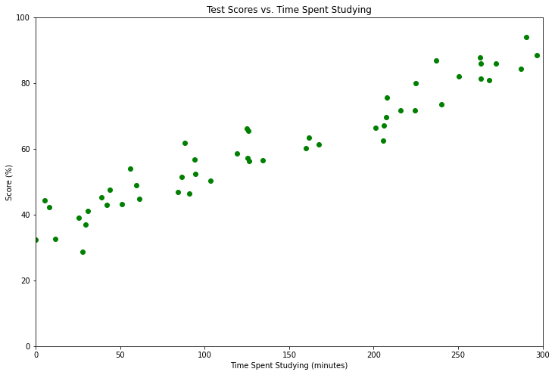
Let’s start with an example!
We have some data on student test scores based on how long they studied for the test.
You know you have spent 200 minutes studying for the test.
Can you predict your score?
Let’s fit a line!

Slide 4
What is a line?
y
y = ax + b
a
Slope
Intercept
b
x
We call a and b the parameters of our model.

Slide 5
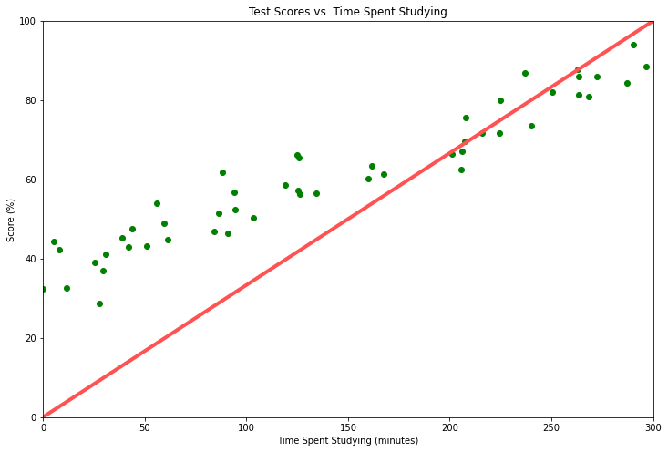
How do we choose the parameters?
a = 0.33
b = 0.0

Slide 6
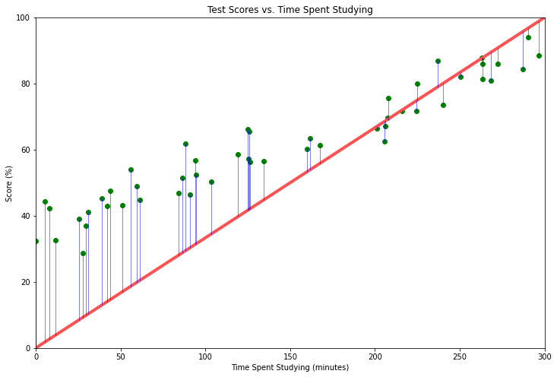
How do we choose our parameters?
a = 0.33
b = 0.0
Calculate errors:
33.8, 41.1, ... , -13.7
Square them:
1142.44, 1689.21, ... , 187.69
Average them to get the mean squared error:
418.9

Slide 7
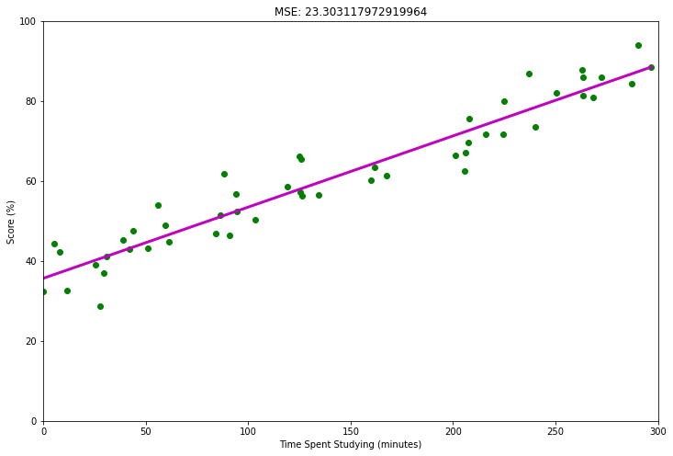
Try it out! (Exercise 1)
How did you do?
MSE: 23.3
a: 0.178
b: 36.656
Final model:
score = 0.178 * time + 36.656

Slide 8
Let’s make our prediction
We wanted to guess what our grade would be if we studied for 200 minutes.
Final model:
score = 0.178 * time + 36.656
Plugging in:
score = 0.178 * 200 + 36.656 = 72.256

Slide 9
You just made a machine learning model!

Slide 10
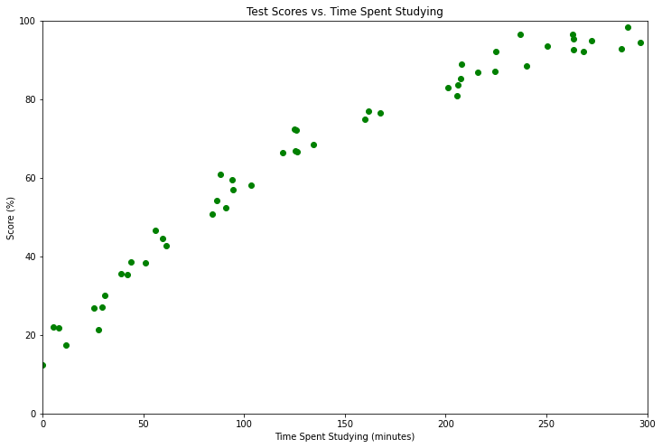
What if our data looks different?
Try it out! (Exercise 2)

Slide 11
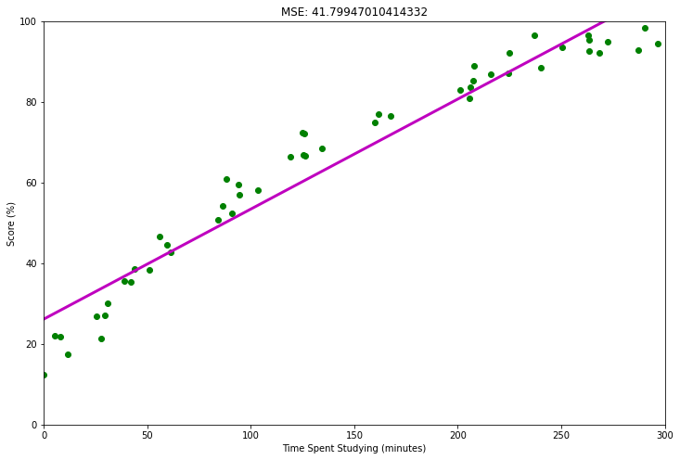
How did you do?
MSE: 41.8
a: 0.273
b: 26.138
Maybe a line is not the best function to fit our data. Let’s try something else!

Slide 12
Let’s try a parabola!
y
y = ax² + bx + c
Parameters: a, b, c
Try it out! (Exercise 3)
x

Slide 13
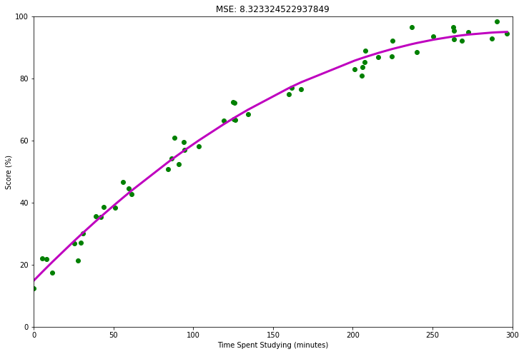
Did it work better?
MSE: 8.32
a: -0.00086
b: 0.526
c: 14.8
Final model:
score = -0.00086 * time² + 36.656 * time + 14.8

Slide 14
Let’s summarize!

Slide 15
Creating a supervised learning model
This is sometimes called the loss or loss function!
1
2
Choose a model class and define the parameters.
3
Determine a “score” to evaluate your model.
Gather your data.
Example: mean squared error
f(x) = ax + b
f(x) = ax² + bx + c
f(x) = asin(x) + bx² + c
...
f(x) = neural network
4
Optimize your parameters.
Optimizer
5
Evaluate.
Final Model

Slide 16
How do we choose a model class?

Slide 17
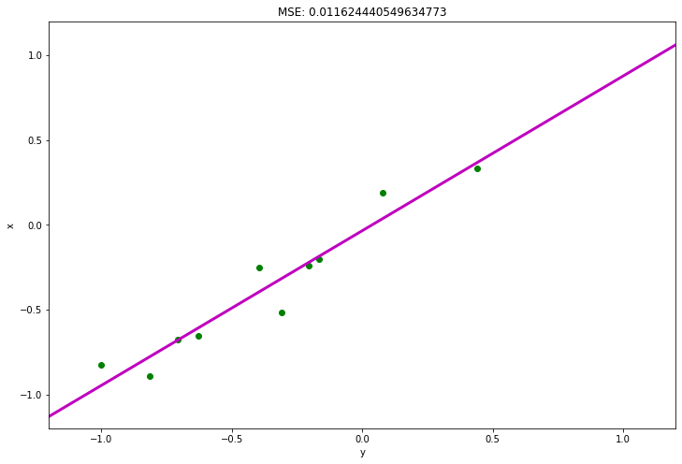
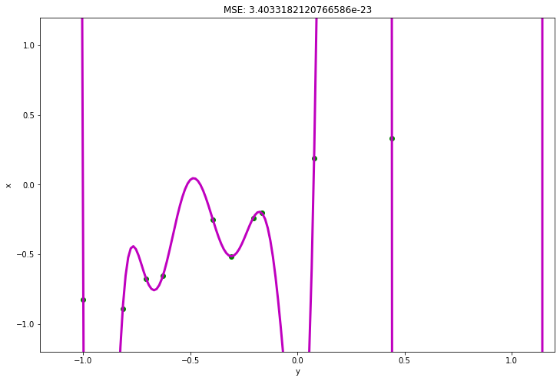
Evaluate using MSE
Try it out! (Exercise 4)
Model class: polynomial with degree n
Plan: vary n and pick the one with the lowest MSE
Degree: 1 MSE: 0.0116
Degree: 10 MSE: 0.0
Overfitting!!
Maybe that wasn’t the best plan...

Slide 18
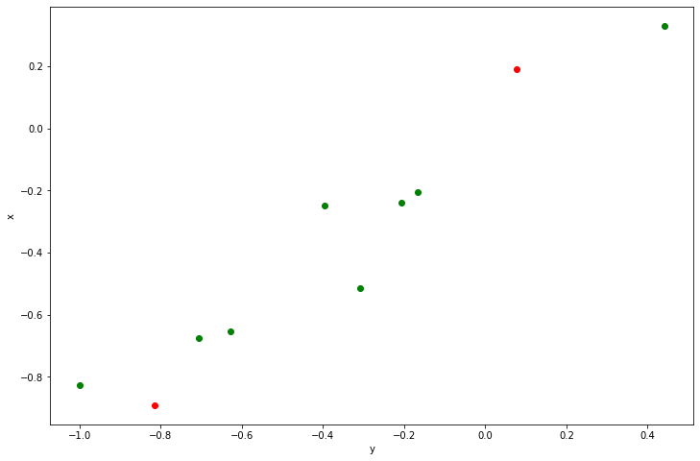
How do we detect overfitting?
Let’s try leaving some points out of our training:
Train on these points
Test on these points

Slide 19
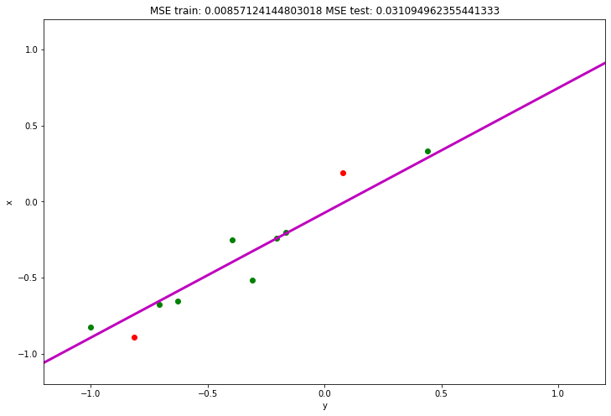
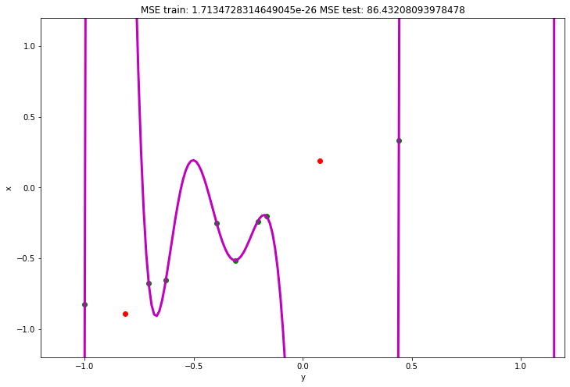
How does this help detect overfitting?
Try it out! (Exercise 5)
Degree: 1
MSE Train: 0.00857
MSE Test: 0.03109
Degree: 10
MSE Train: 0.0
MSE Test: 86.43

Slide 20


Train vs. Test Set
It is common in machine learning to set aside a small portion of your data to use as a test set.
Train Set
Test Set

Slide 21
Questions?

Slide 22
Next Week
How does this mysterious “optimizer” work?
Neural networks
Train a neural network to take and image of the runway and predict where the aircraft is

Slide 23
Rest of today
Work on notebook for generating data to train our network next week
We have some image processing to do!
Supervised learning notebook from last year’s AI4All robotics sessions

Slide 24
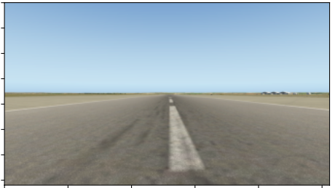
Image data
Matrix of numbers
RGB
How to decrease amount of data
Compression
Image segmentation
Convert to grayscale
Crop the sky out
What are labels
Crosstrack error
Heading error

