Slide 1

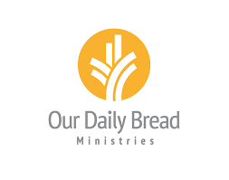
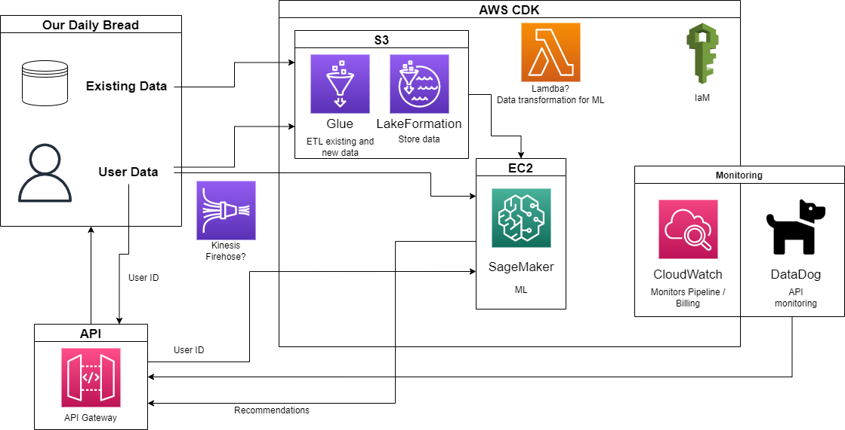
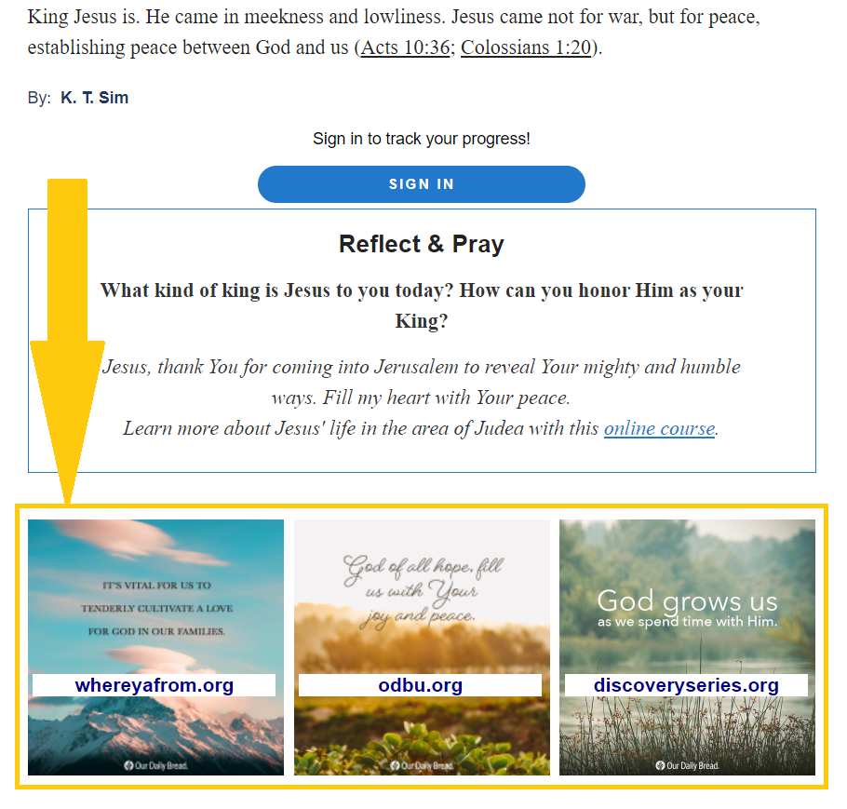
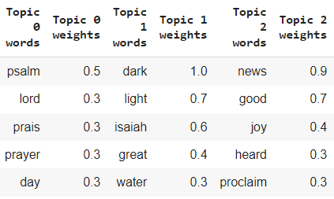
Team Our Daily Bread (ODB): Content Recommendation Engine
Client: Our Daily Bread Ministries (Joe Fahnestock)
Jacob Johnson, Thomas Lobbestael, Michael Dykema, Emily Linderman
Overview
Recommendation Engine
Technical Details
Goal:
Build a recommendation engine using Amazon Web Services (AWS) that will provide content recommendations to users who visit their daily devotional. Current user and site data will be collected, transformed, and processed into a machine learning model, with results accessible from an API, and monitoring for costs and errors.
Problem:
When a user visits ODB’s daily devotional, links to other content should appear at the bottom of the page. These recommendations should be based on content popularity, other user behaviors, and content similarity
Solution:
Use collaborative filtering to find users with similar profiles and behavior to find new content for a user
When not enough user data is present, find similar content using topic analysis
Topic Analysis is performed by processing website page text and creating topics by finding similar words
Pages are grouped by topic and stored for retrieval on site visit
Recommendations are calculated when user visits page and an API is called
Figure 3: System Architecture
Data
AWS LakeFormation for data lake creation
AWS AppFlow streams real-time Google Analytics data into data lake
Recommendation Engine
AWS SageMaker hosts Docker image of Tensor Flow model and non-negative matrix factorization (NMF) model
API
AWS ApiGateway hosts a REST API that uses AWS Lambda functions to pull recommended content
Monitoring
AWS CloudWatch monitors all other AWS services for surpassing billing thresholds and error counting
Web Scraping
AWS EC2 for hosting and running Python script
AWS RDS hosts MySQL database for results
Figure 1: Mock of content cards for recommended content
User Data
Figure 2: Sample topics from NMF modelling
Problem:
ODB currently utilizes Google Analytics to track site and page statistics for their different websites. The past and future data needs to be stored and processed for machine learning. Additionally, page content scraped from websites will need to be stored.
Solution:
A data lake stores the data of various formats and schemas
Google Analytics data is streamed into the data lake on a regular basis
Different metrics such as user information and page hits are aggregated for machine learning
Scraped site content is stored in database and moved into data lake for later use
Future Work
Monitoring
The web page UI of this project was not the team’s responsibility and still needs to added to ODB’s devotional page. With more data on specific user behavior the collaborative filtering model’s performance would improve substantially.
Problem:
AWS services are billed on a usage basis, so alarms need to set to warn when costs are higher than expected. Additionally, services such as the API need to be monitored for high numbers of errors to ensure the pipeline is working correctly.
Solution:
Each service has alarms registered for different metrics such as run time, endpoint calls, storage used, etc.
Emails are sent to individuals at ODB in case alarm is tripped
A dashboard displays the most important metrics so the health of the system can be monitored at a glance
Reports are exportable in a JSON format for later analysis
Acknowledgements
We would like to thank Our Daily Bread Ministries for providing us with this project and their assistance during development. In particular, we would like to thank Joe Fahnestock for his patience, hard work, and help throughout the whole project.

