Slide 1
REST API
Presented by
Hayan Reyaz (17048112040)
Department Of CSE University of Kashmir,
North Campus
(2021)

Slide 2
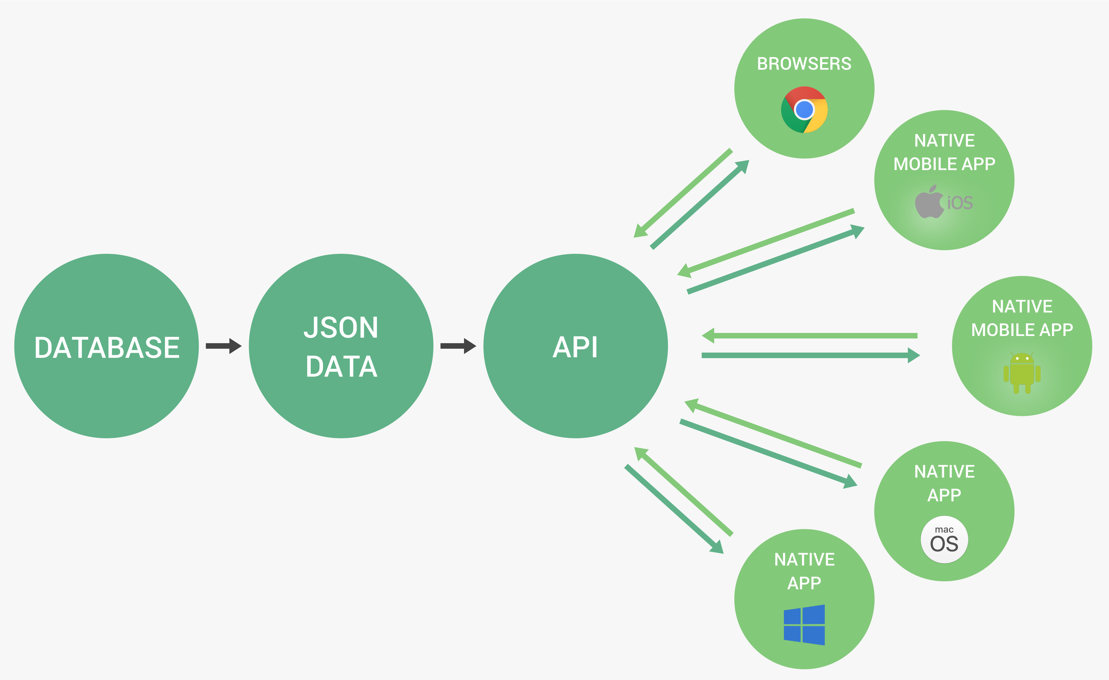
API
Application Programming Interface: a piece of software that can be used by another piece of software, in order to allow applications to talk to each other.
Web APIs
But, “Application” can be other things:
Node.js’fsorhttpAPIs(“nodeAPIs”);
Browser’sDOMJavaScriptAPI;
Withobject-orientedprogramming,whenexposing methods to the public, we’re creating an API;

Slide 3
THE REST ARCHITECTURE
Separate API into logical resources
Expose structured, resource-based URLs
Use HTTP methods (verbs)
Send data as JSON (usually)
Be stateless

Slide 4
Resource: Object or representation of something, which has data associated to it. Any information that can be named can be a resource.
Routes
Users
Review
URL
https://www.vtrack.com/addNewUser
Endpoints should contain only resources (nouns), and use HTTP methods for actions!
ENDPOINT

Slide 5
Use HTTP methods:
User Id
/addNewUser
POST
/user
Create
Read
Update
Delete
/getUser
GET
/user/2
/udateUser
PUT
/user/2
/deleteUser
PATCH
/user/2
DELETE
/user/2
CRUD
OPERATIONS
HTTP METHODS
/getRoutesByUser
GET
/user/3/routes
/deleteRoutesByUser
DELETE
/users/3/routes/9

Slide 6
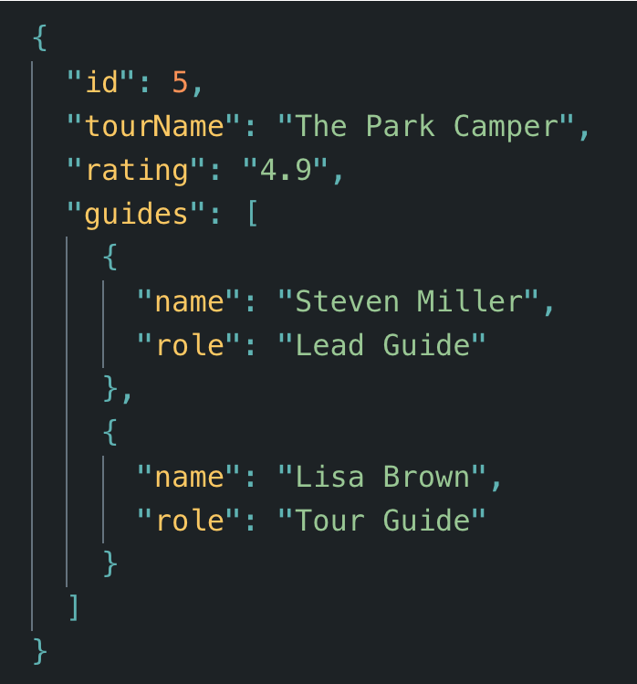
Send data as JSON (usually)
String
Value
Key-Value-Pair
Object
Array

Slide 7
STATELESS:
Stateless RESTful API: All state is handled on the client. This means that each request must contain all the information necessary to process a certain request. The server should not have to remember previous requests.
Examples of state:
loggedIn
currentPage
BAD WAY
currentPage = 5
STATE ON SERVER
Web
server
nextPage = currentPage + 1
send(nextPage)
GET
/tours/nextPage
Web
server
GET
/tours/page/6
Send (6)
STATE COMING FROM CLIENT

