Slide 1

Onflo
FILTER EXPERIENCE
ENGINEERING HANDOFF · DASHBOARD TEAM
Service Overview & Comparison
Dashboards
Mostly a UI update to dashboards already in production — the new filter modal is the core of this work.
Onflo Filter Experience prototype · May 2026 · Integration overview

Slide 2
ORIENTATION
What this deck covers
1
The two dashboards Service Overview (canonical) and the three Comparison pages.
READ THIS FIRST
The dashboards already work — this is a UI update.
The filter modal is the one genuinely new system, and the core of this work.
This deck summarizes the specs and handoff so the team can review it together — it doesn't replace them.
2
Page anatomy & toolbar The shared dashboard shell every page is built from.
3
Filters The vanilla-JS filter engine and the Angular filter-shell wrapper.
4
Saved views Saving, routing to, and restoring a named filter state.
5
What's left to wire The backend endpoints this experience depends on.
Onflo · Dashboard team handoff
02

Slide 3
SCOPE
What you own — and what you don't
✓ YOU OWN
✕ NOT IN SCOPE
▪ The filter modal — the one genuinely NEW system, and the core of this work
▪ Updated page header (title, stats, last-updated, learn-more)
▪ Updated dashboard toolbar (date, filter, Save/Edit View, download, share)
▪ Applied-filters bar (driven by the filter modal)
▪ Saved-view save / route / load / edit / delete flow
▪ Three shared modals: Save View, Share Dashboard, Notify Users
— The chart data & chart logic — already in production, unchanged
— The app shell (top nav, sidebar, agent status)
— Tickets, Assets, Settings features
— Call Center, Chatbot, Fees (other teams)
— Migrating to the DS <ds-filter> component — see slide 7
A UI update over analytics already in production — the filter modal is the one new build. Cross-boundary bug? File it, don't fix it.
Onflo · Dashboard team handoff
03

Slide 4
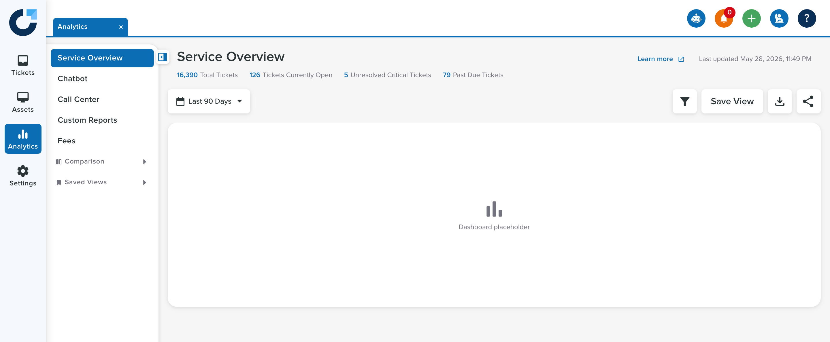
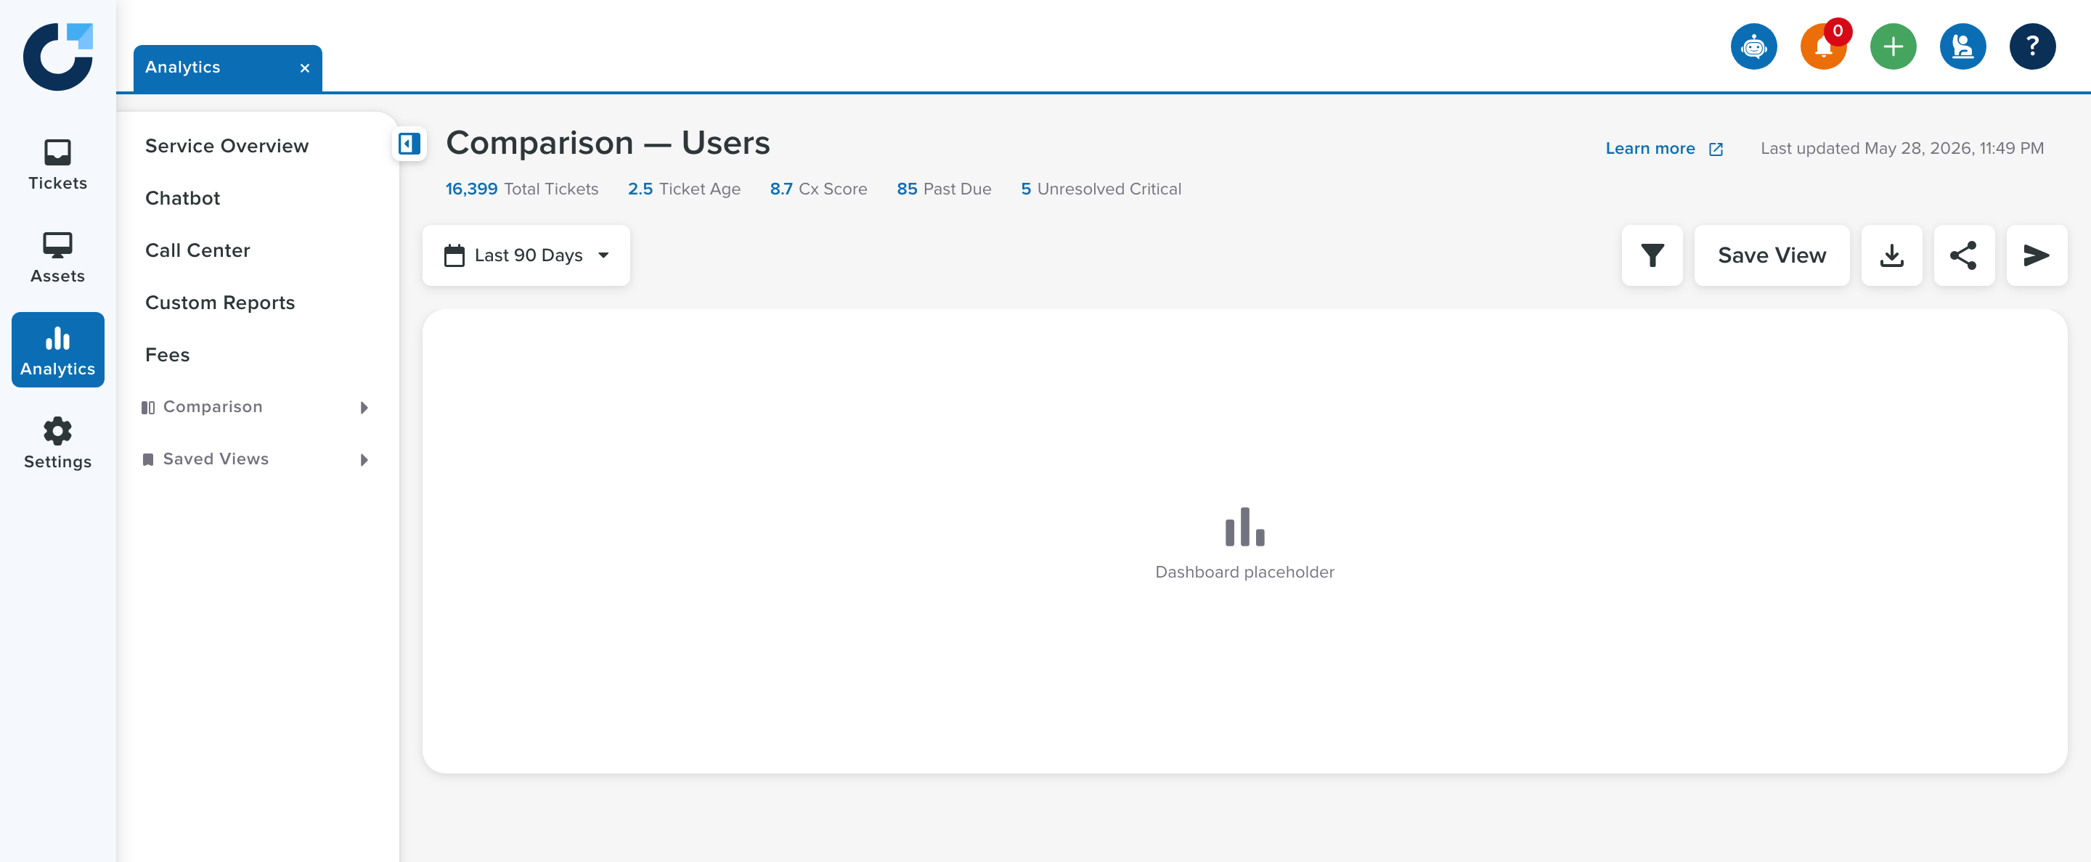
THE PAGES
Two dashboards, one pattern
Service Overview is the canonical reference. The three Comparison pages follow the same shell with page-specific extras.
Service Overview
Comparison · Users / Categories / Topics
The grey “Dashboard placeholder” is where production charts already render — outside this team's scope.
Onflo · Dashboard team handoff
04

Slide 5
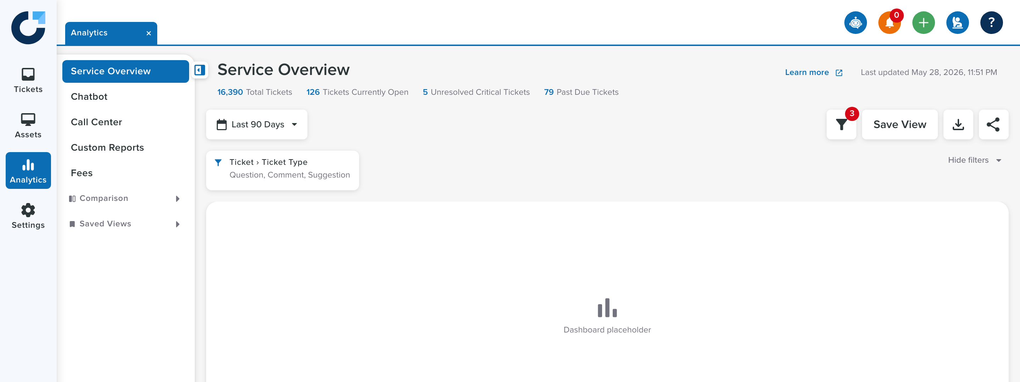
PAGE ANATOMY
Every dashboard is two stacked zones
ds-page-content__
dashboard-header
▪ Heading row title, stats bar, last-updated, learn-more
▪ Toolbar row date select + filter / Save View / download / share
▪ Applied-filters bar appears only when filters are active
1
ds-page-content__
main--dashboard
2
▪ Scrolling canvas the only zone that scrolls; header stays pinned
Onflo · Dashboard team handoff
05

Slide 6
THE TOOLBAR
One toolbar drives the whole experience
Date select
Filter
Save / Edit View
Download
Share
Left-aligned, always first. A filter-modal date overrides it.
Opens the modal. Shows a badge with the active filter count.
Captures the current state as a named, routable saved view.
Exports the dashboard (stubbed in the prototype).
Opens the Share Dashboard modal.
Comparison pages add one more button — Notify Users (the paper-plane icon). See slide 14.
Onflo · Dashboard team handoff
06

Slide 7
FILTERS · ARCHITECTURE
NEW · CORE AREA
The filter modal is a vanilla-JS engine
angular.json scripts[ ]
loads the engine globally, once
⚠ DO NOT MIGRATE
This is not the design system <ds-filter>.
The custom engine is intentional. <ds-filter> does not support:
• tiered groups
• per-field types
• excluded buckets
• saved filter sets
Porting to Angular is an optional v2 — not required for launch.
filter-modal-engine.js
vanilla JS · owns ALL filter state, rendering & saved sets
Angular filter-shell component
renders the modal HTML · calls the window API · re-emits events
Parent page component
binds [(open)] + @Outputs; never touches the engine directly
Onflo · Dashboard team handoff
07

Slide 8
FILTERS · WIRING
How the shell talks to the page
filter-shell
ngAfterViewInit → filterModalInit(context)
JS engine
switches context, loads filter groups
context keys the groups +
saved-sets storage. Tabbed
pages swap context reactively.
The engine fires window events — the shell re-emits them as Angular @Outputs:
filterApplied
filterModalClose
dateRangeSelected
{ count, hasDateFilter }
(dismissed, no apply)
{ label }
→ @Output
filterCountChange · filterDateActiveChange
→ @Output
openChange → false
→ @Output
parent updates date label
Saved views reach in via @ViewChild: parent calls getState() / setState() / applySilent(). Place the shell at the end of the template.
Onflo · Dashboard team handoff
08

Slide 9
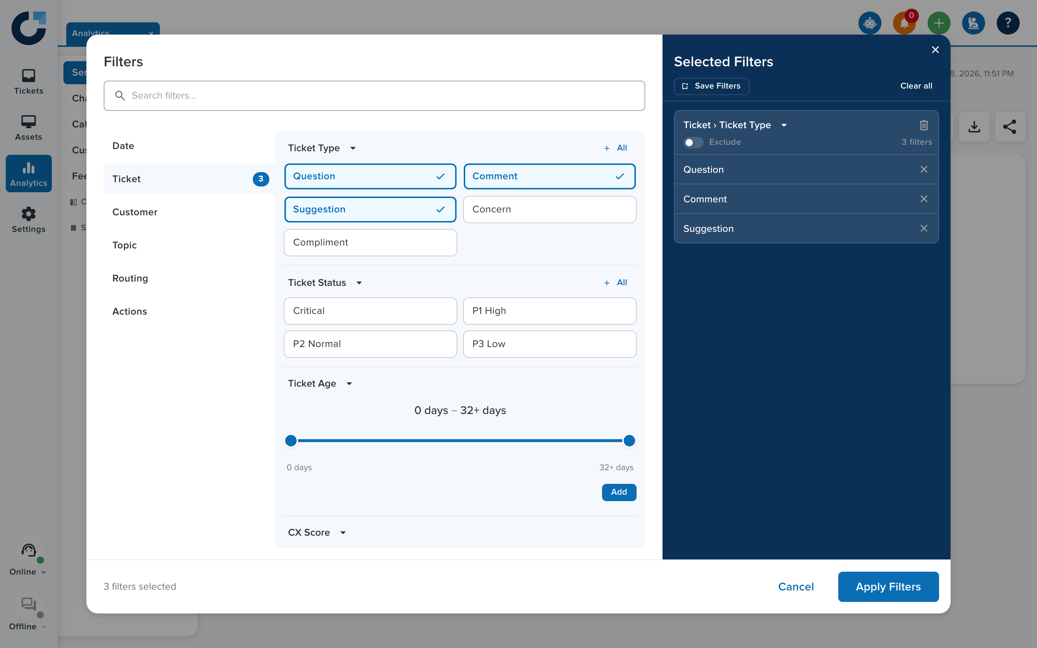
FILTERS · THE MODAL
What the user actually sees
▪ Groups left nav — Date, Ticket, Customer… each with an icon
▪ Tiers sub-sections inside a group (Type, Status, Age…)
▪ Field types date / cost / numeric / time ranges + text-match
▪ Selected panel the navy column; Exclude flips a bucket to NOT
▪ Save Filters saved filter sets — see slide 11
▪ Draft vs committed edits are a draft; Apply commits, X / Esc discards
Onflo · Dashboard team handoff
09

Slide 10
FILTERS · APPLIED BAR
The applied-filters bar
▪ Hidden until active no chrome when there are zero filters
▪ Grouped cards one card per tier/bucket, not one per option
▪ Count badge the toolbar filter button mirrors the active count
▪ Collapsible “Hide filters” collapses it to a single count chip
▪ Excluded buckets render as NOT and don't add to the count
Onflo · Dashboard team handoff
10

Slide 11
DON'T CONFUSE THESE
Saved filter sets ≠ saved views
Saved filter sets
Saved views
Where
inside the filter modal (“Save Filters”)
Where
app-level (“Save View” in the toolbar)
Stores
only the filter selection
Stores
filter state + tab, date label, count
Persistence
localStorage, per context, browser-bound
Persistence
localStorage now → backend API
Key
onflo-filter-sets-{context}
Key
onflo-saved-views · routed by :id
Owned by
the filter engine
Owned by
SavedViewsService
They share no storage. A saved view round-trips the filter portion through the engine's getState() / setState().
Onflo · Dashboard team handoff
11

Slide 12
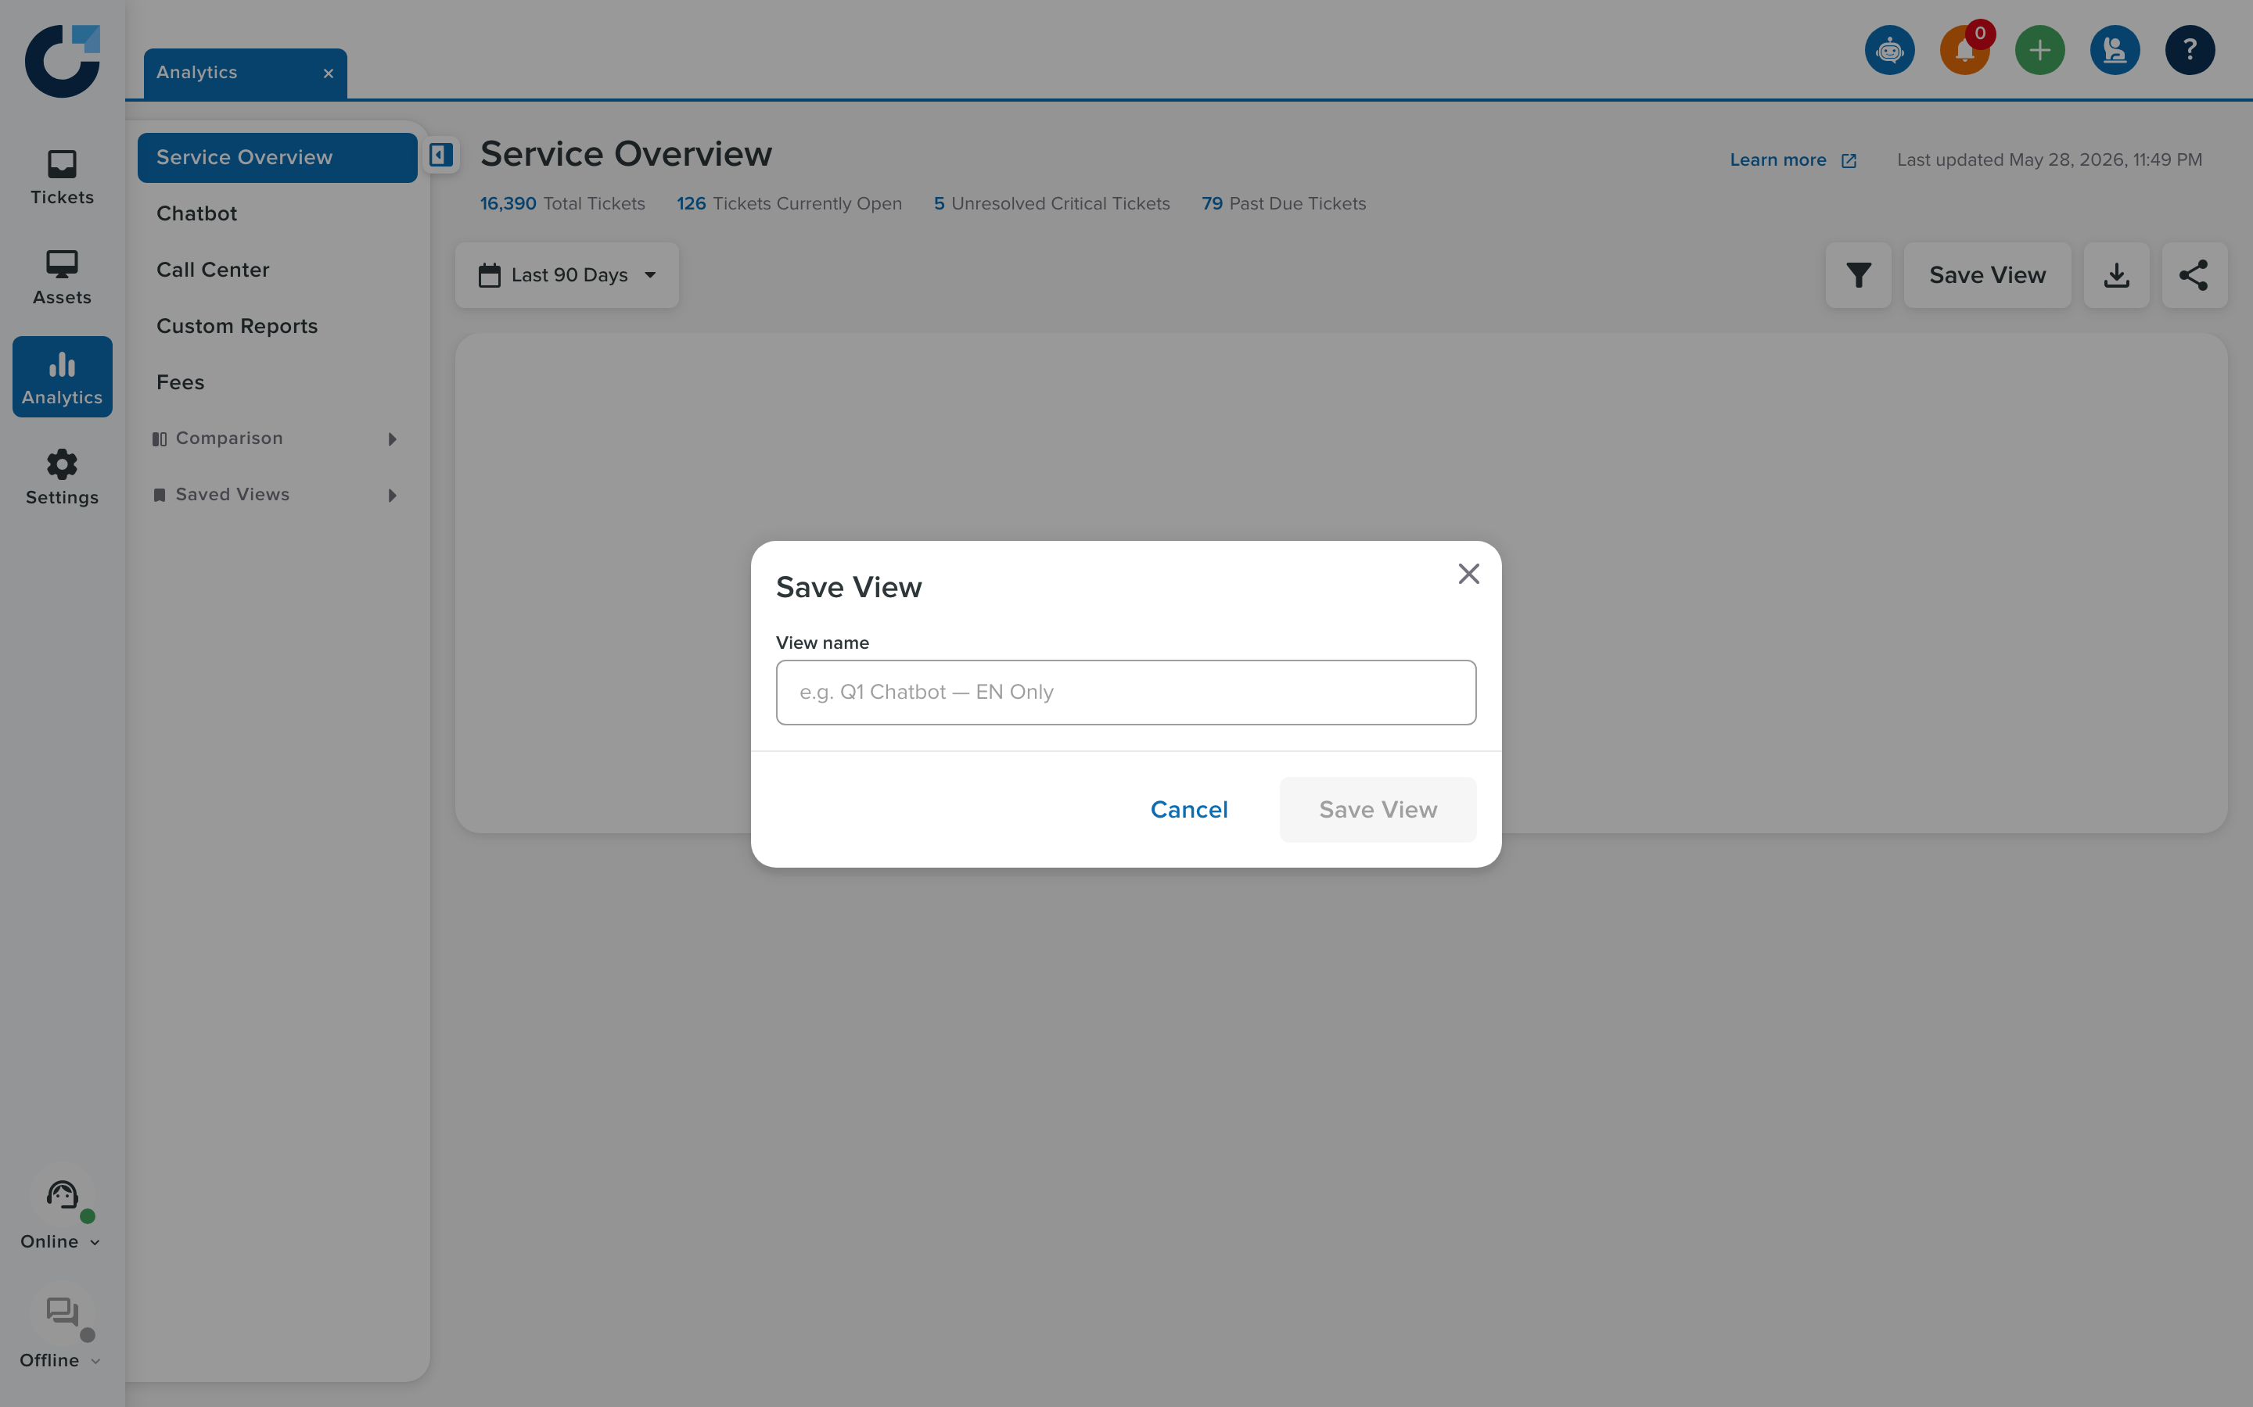
SAVED VIEWS · FLOW
Save → route → restore
Apply filters
engine commits the selection
Save View
name it in the modal
service.save()
captures getState() + meta
Route
/analytics/.../saved-views/:id
Restore
setState() + applySilent()
Restore happens without opening the modal.
applySilent() applies the state and still emits filterApplied, so the count and date label update correctly.
Edit updates in place (URL unchanged). Delete returns to the base route and resets.
Onflo · Dashboard team handoff
12

Slide 13
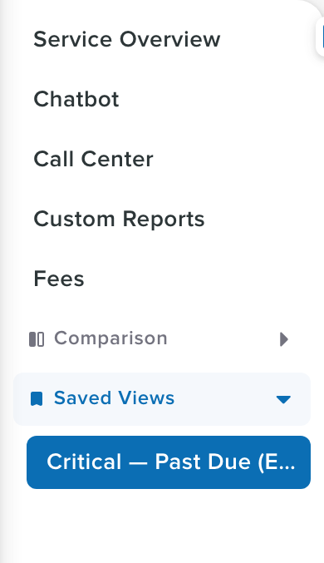
SAVED VIEWS · PLUMBING
Storage, routing & the subnav
▪ SavedViewsService core/services/saved-views.service.ts — a readonly savedViews signal
▪ Storage localStorage key onflo-saved-views (per the migration plan, a backend API in production)
▪ Per-page child route saved-views/:id resolves to the same page component, which reads :id in ngOnInit
▪ SavedViewLoaderComponent the /analytics/saved-views/:id shortcut maps sourcePage → the right page route
▪ Subnav every saved view appears under “Saved Views” in the Analytics subnav →
Onflo · Dashboard team handoff
13

Slide 14
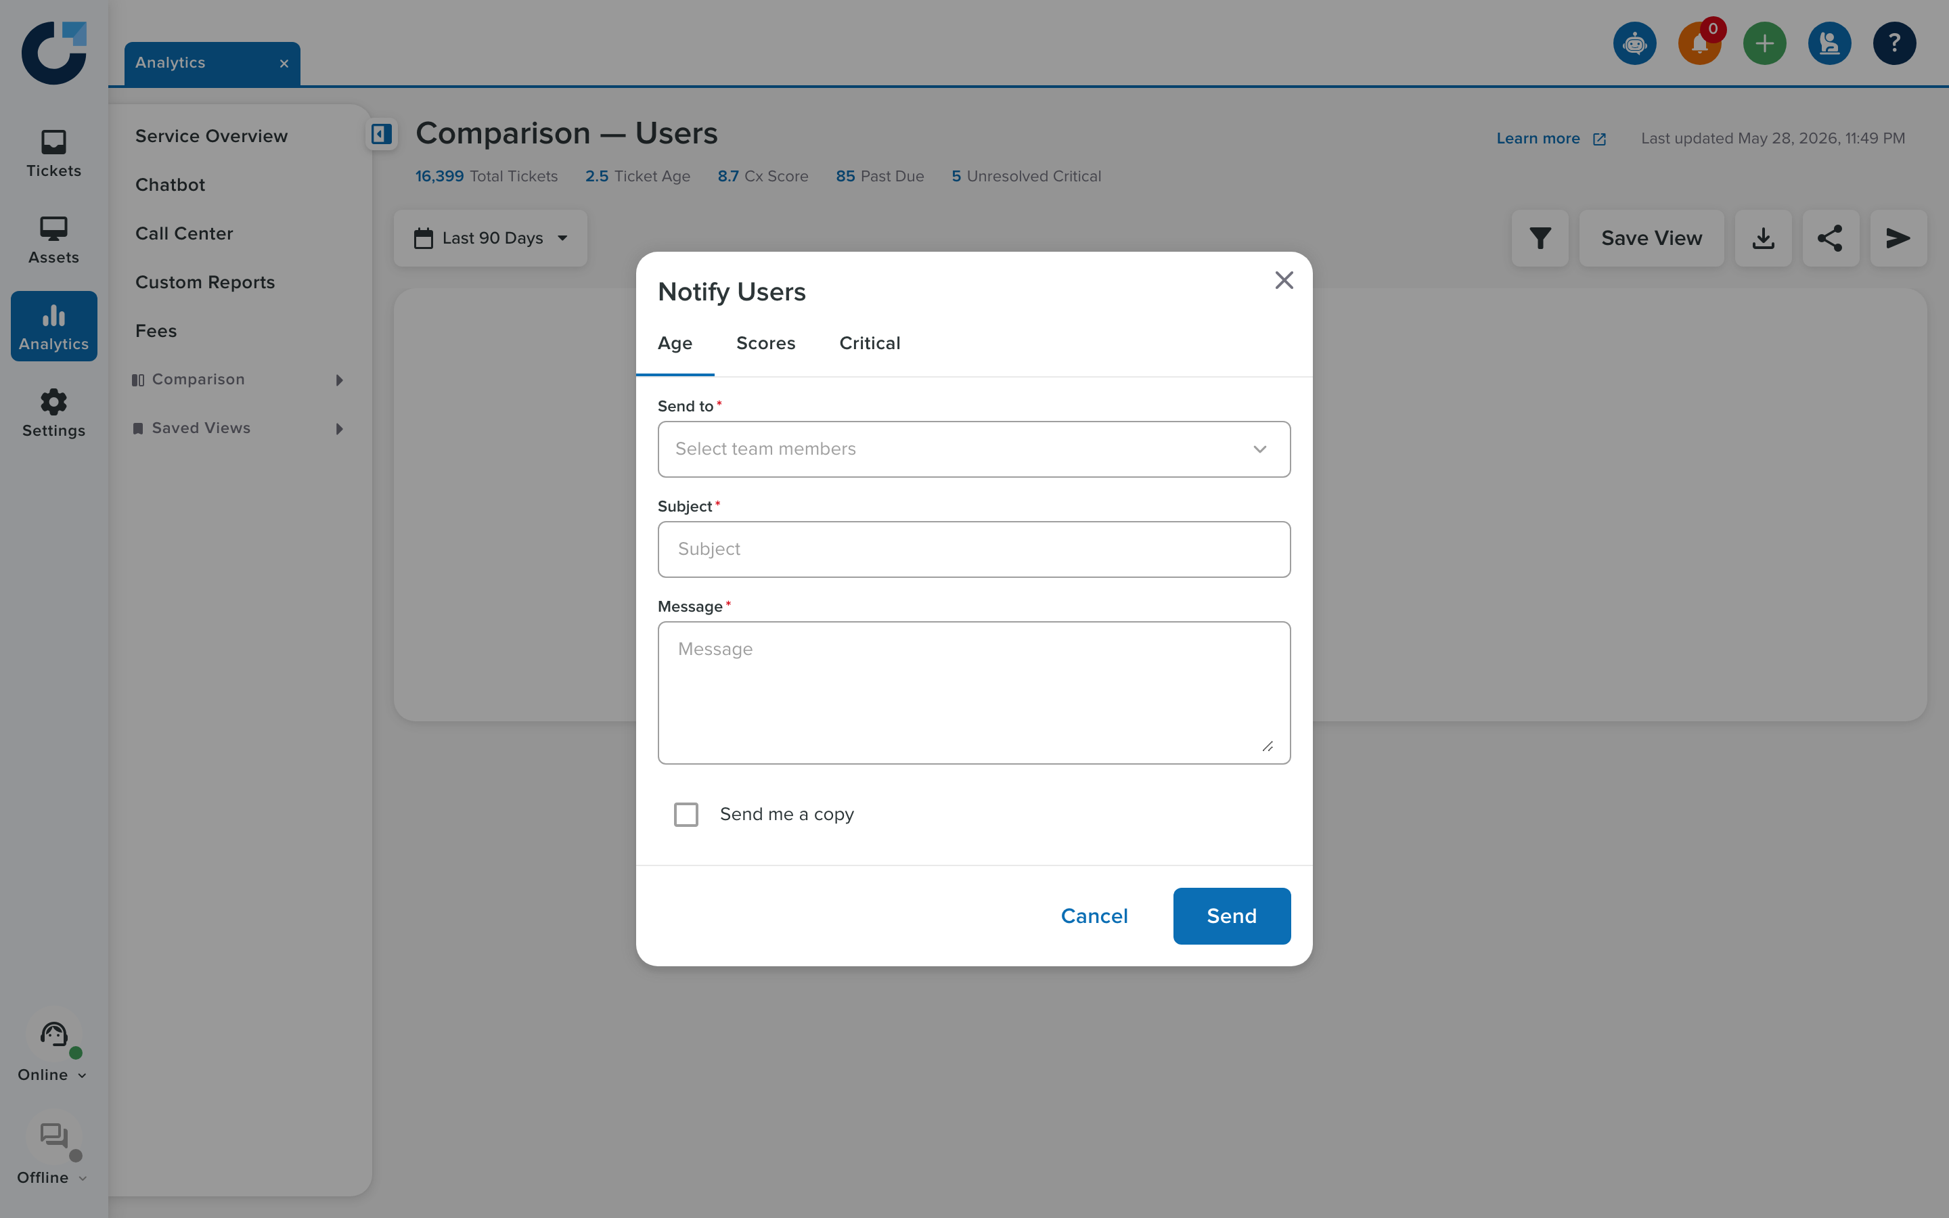
COMPARISON PAGES
Same shell, plus cohort messaging
Users, Categories and Topics each reuse the full dashboard pattern — and add one toolbar button: Notify Users.
Note the extra ✈ toolbar button
Notify Users modal
▪ Each page has its own filter-shell + context; the cohort modal sends a message to a selected user set.
Onflo · Dashboard team handoff
14

Slide 15
BEFORE PRODUCTION
Backend dependencies
Saved-views API
/api/analytics/saved-views
CRUD per user; replaces the localStorage store.
Saved-filter-sets API
per user, per context
Migrate the engine's localStorage sets; copy existing on first login.
Stats-bar endpoints
Service Overview + Comparison
Populate the header KPI counts.
Cohort-message endpoint
Notify Users
Send the message to the selected cohort.
Filter persistence
URL query param
Applied filters survive refresh in-session; clear on logout.
Coordinate with backend early — these are blocking for the integration work.
Onflo · Dashboard team handoff
15

Slide 16
GO DEEPER
The authoritative docs
Shared specs
.claude/specs/shared/
specs-dashboard.md · specs-filter-engine.md · specs-saved-views.md
Per-page specs
.claude/specs/dashboard/
specs-service-overview.md · comparison-{users,categories,topics}.md
Team handoff
docs/handoff/
dashboard-team.md — required reading order + backend notes
Live preview
GitHub Pages
rbenedict-debug.github.io/Filter-Experience/analytics/service-overview
Onflo Filter Experience · Dashboard team handoff · May 2026

