Slide 1
Developing in containerized environments using Linux and Docker
Ryan Berger
10-18-23

Slide 2

Story time: how did we get here?
Timeline:
Mar 2020 – Decision to build Covid dashboard. Bob Lonigro will build the dashboard, Ryan and Lindsey will provide the daily data to feed it.
Jun 2020 – Bob finishes dashboard using Linux server, R Shiny, Docker, Azure
Sep 2020 – Bob transitions dashboard process/ownership to Ryan + Lindsey
Nov 2020 – Ryan + Lindsey create new development tools using Docker containers on the Linux server
Jan 2021 – Digital Health dissolves, Bob leaves company
Mar 2022 – Covid dashboard is retired
Dec 2022 – Linux servers go offline (and I get very grouchy)
Mar 2023 – New Linux server is planned and gets green light
Jun 2023 – New Linux server is online and working
Bob Lonigro

Slide 3

The Covid dashboard process was overly technical
Dashboard process (daily):
Connect to Linux server via ssh
Run R scripts to generate new dashboard data for that day
Package new data and dashboard code into a docker image
Push new docker image to Azure container registry
Update Azure website to point to new docker image

Slide 4



Dependency Hell and “It works on my computer” problem
User 1
File1.py
File2.py
File3.py
File4.py
File1.py
File2.py
File3.py
File4.py
FIle5.py
File1.py
File2.py
File3.py
File4.py
FIle5.py
Package 1.0
Package 1.0
Package 1.1
“Weird that code won’t run on my computer. Guess I need to update that package to 1.1”
“Great my entire process is now broken! Time to have a mini panic attack then spend the entire day fixing this. Fun!!”
User 2
File5.py
Package 1.1

Slide 5

Part II: How we used Linux and Docker to solve our problems

Slide 6


What is a Linux server?
Computer stored in a data center that you connect to remotely
Linux is an open-source operating system commonly used on servers
Why do people use them?
Very stable
High computing power
Flexible/Scalable
Always on
Faster than a PC

Slide 7
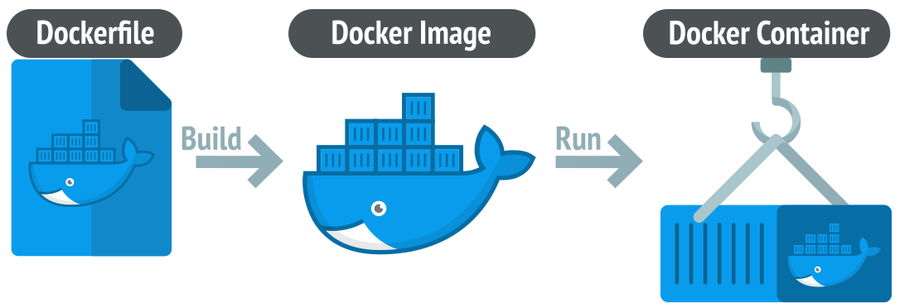
What is Docker and containers?
Containers are like mini-computers running within a computer
Docker is open-source software for building/running containers
Benefits to using containers:
Can run code/apps anywhere (your PC, server, cloud, etc.)
Can be customized with whatever dependencies or software you need
Lightweight on computer resources
Isolated from host environment
Disposable and easy to create/destroy

Slide 8
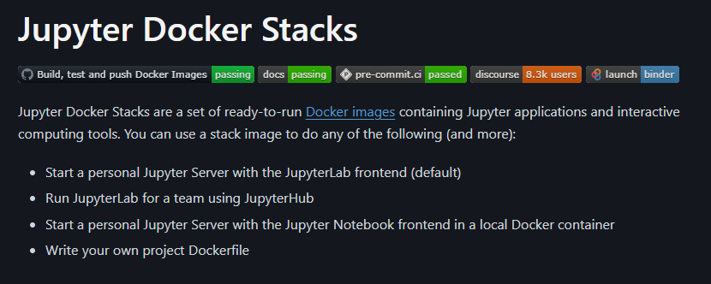
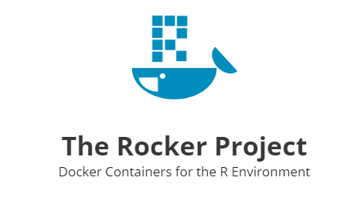
Pre-built Docker images can be used for code development
Docker hub is a website where you can download pre-made Docker images made by others
R and python images are available (Rocker and Jupyter)
Makes it possible to run Rstudio or Jupyter Lab IDEs from a container

Slide 9
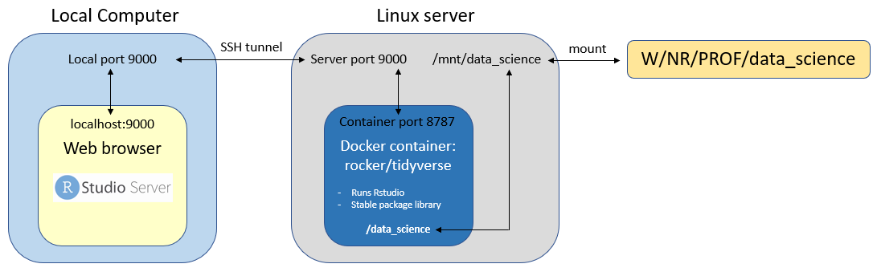
We built the architecture to run RStudio inside Docker containers on the Linux server
Steps to use:
Connect to the linux server via SSH
Run an RStudio docker container on the server on port 9000
Go to localthost:9000 on a browser on your computer
Work in an RStudio session with access to W-drive folder

Slide 10
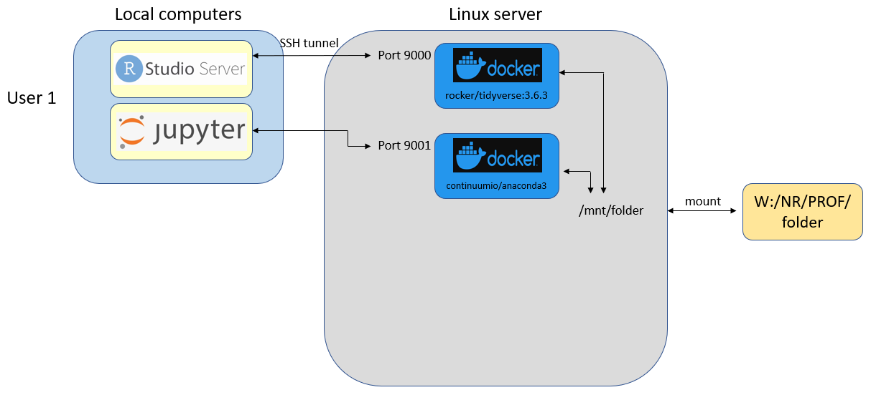
Working with Docker containers on the Linux server

Slide 11
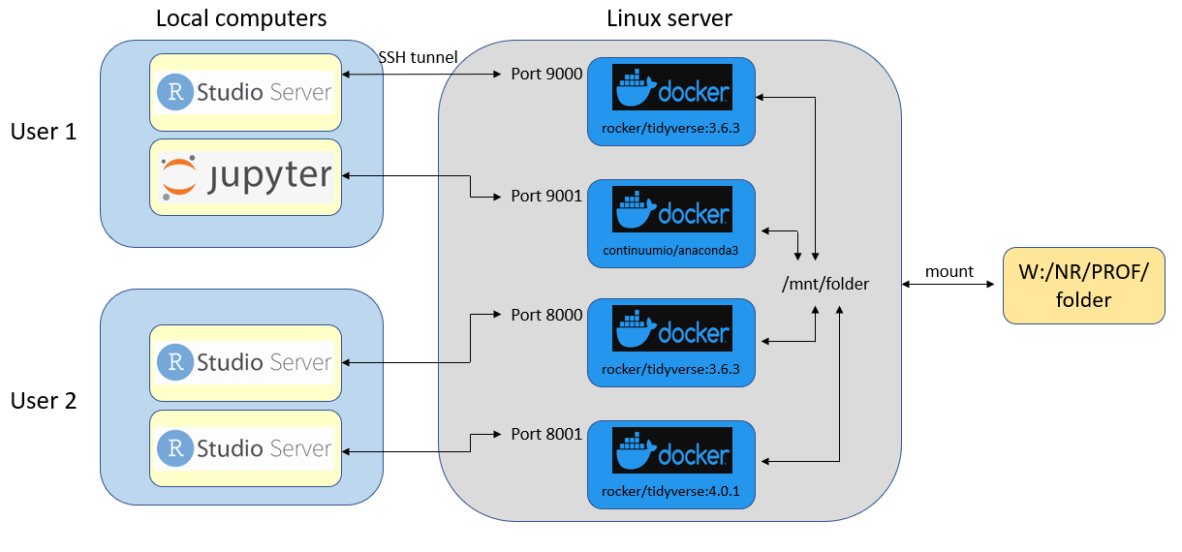
Working with Docker containers on the Linux server

Slide 12
Takeaway points: who should or shouldn’t use this?
Could be useful for you:
You code in R or python regularly
You have complex data pipelines that run frequently
Not useful for you:
You use SAS or Excel as your tools
Your processes aren’t too complicated (don’t need tech overkill)

Slide 13
Interactive Exercise
Log into your account on github.com
Open codespaces tab (click top left button, codespaces)
Start new codespace using blank template
Clone the exercise repo from the command line:
git clone https://github.com/rberger997/linux_docker_exercise.git

