Slide 1
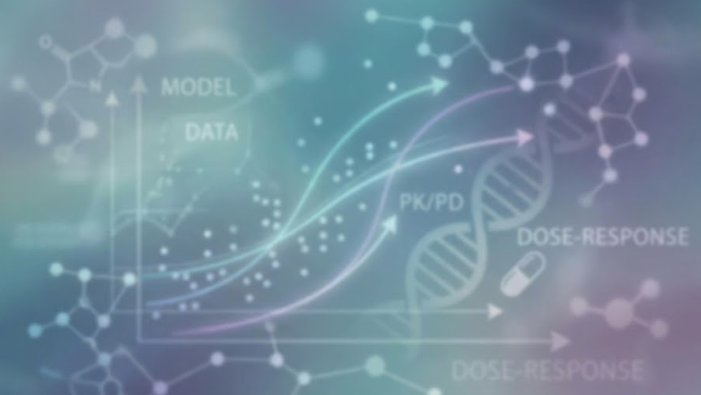



Introduction to pharmacometrics
Dr Racym BERRAH, Dr Moreno URSINO

Slide 2
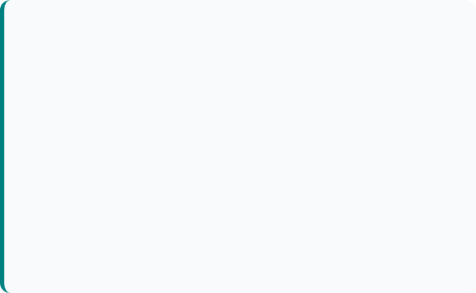

The problem :
« One size fits all » does not work
Pharmacokinetics (PK)
Pharmacodynamics (PD)
“What the body does to the drug”
“What the drug does to the body”
Variability in :
Absorption
Distribution
Metabolism (Liver )
Élimination (Kidney)
Receptors sensibility
Homeostasis
Disease progression
etc…
➔ Exposition variability
➔ Response variability

Slide 3

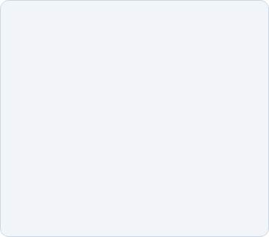




3 main approaches in Pharmacometrics
NCA
PopPK
PBPK
"Non-Compartimental"
"Population PK"
"Physiologically Based"
Let the data speak. Robust (AUC, Cmax, T1/2). Does not predict
Top-Down. Variability estimation. Allow simulation. Our standard
Bottom-Up. Organ per organ. Complex, good for interactions

Slide 4
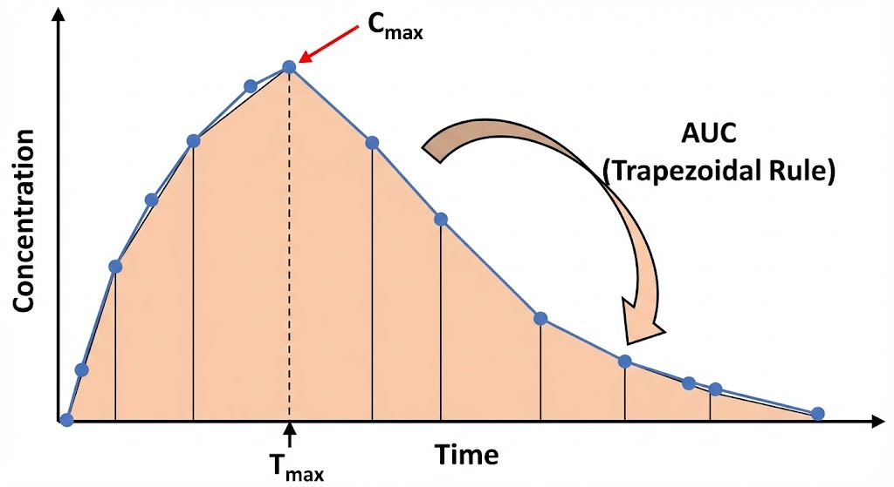
Non-Compartimental Analysis (NCA)
The "Model-Independent" Approach : NCA is a descriptive method that calculates PK parameters based purely on algebra and geometry, without assuming a specific compartment model.
Methodology: It relies on the Trapezoidal Rule to calculate the area under the curve (AUC), which represents total drug exposure.
Key Metrics:
Cmax: Maximum observed concentration.
Tmax: Time of maximum concentration.
AUC: Total exposure (Area Under the Curve).

Slide 5
Non-Compartimental Analysis (NCA)
Limitations of NCA
The PopPK Solution
While NCA is the "Gold Standard" for description, it has significant limits:
Requires Rich Data: Needs many samples per patient to accurately calculate the Area Under the Curve.
Descriptive Only: It tells you what happened, but cannot predict what will happen if you change the dose or regimen.
Ignores Variability: Treats each individual separately without quantifying why they differ (e.g., weight, age).
Population PK modeling addresses these gaps:
Handles Sparse Data: Can estimate parameters even with few samples per patient (e.g., pediatrics).
Predictive Power: Can simulate new dosing regimens and clinical trial scenarios.
Quantifies Variability: Separates "Between-Subject Variability" (BSV) from "Residual Error," allowing for covariate analysis.

Slide 6
3 main approaches in Pharmacometrics
NCA
PopPK
PBPK
"Non-Compartimental"
"Population PK"
"Physiologically Based"
Let the data speak. Robust (AUC, Cmax, T1/2). Does not predict
Top-Down. Variability estimation. Allow simulation. Our standard
Bottom-Up. Organ per organ. Complex, good for interactions

Slide 7
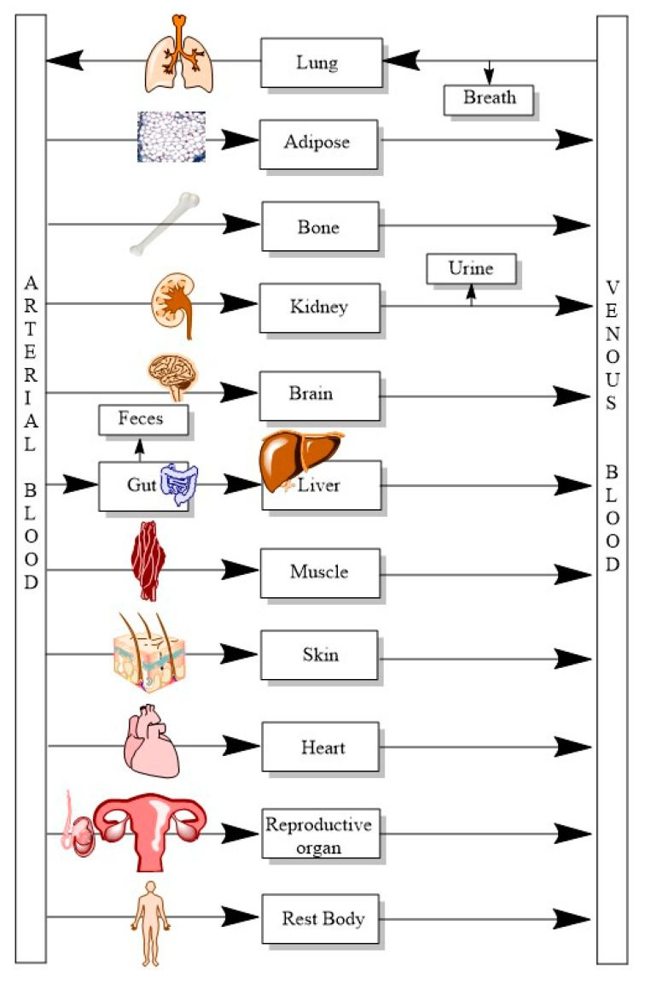
What is a PK model
What the body does to the drug ?
A Pharmacokinetic (PK) model is a mathematical representation of how a drug moves through the body over time.
It uses mathematical equations to describe the process.
What is it used for ?
Dose Optimization: Finding the "Goldilocks" zone—a dose high enough to be effective but low enough to avoid toxicity.
Prediction: Forecasting drug concentrations for complex scenarios, such as missed doses or different infusion rates.
Special Populations: Adjusting treatments for vulnerable groups like pediatrics, the elderly, or patients with renal impairment

Slide 8

Population models
Mechanistic population models are a simplification of PBPK mechanistic models
BLOOD
Depot
Kidneys
Urine
Adipose
Rest Body
Ka
Central Compartment
V1
Peripherical compartment
V2
Q
Central compartment
CL
Elimination
Adipose
Other

Slide 9




Why do we call our models “Mechanistic”
Empirical model
Mechanistic model
Simple statistical correlation
Parameters without biological meaning
Extrapolation out of the data
Describe a physiological flow
Real parameters as Volume or Clearance
Adaptable (ex: Kideny failure)
Bonus : It’s the same as Fick's laws of diffusion

Slide 10
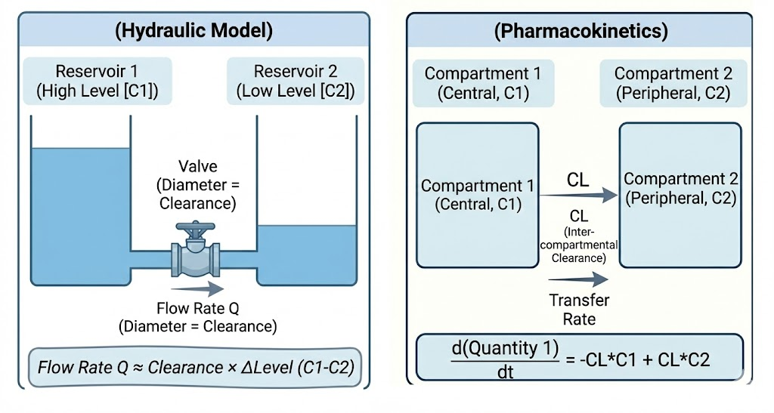

Ordinary Differential Equation (ODE)
The concept of "Flow"
An Ordinary Differential Equation (ODE) simply describes the rate of transfer between tanks.
Imagine two buckets connected by a pipe. The flow rate depends on the diameter of the pipe (clearance) and the water level (concentration).
The decrease is exponential: the more medication there is, the faster the elimination.

Slide 11
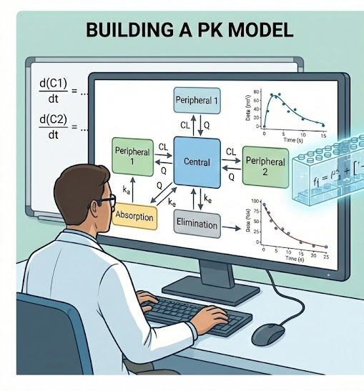

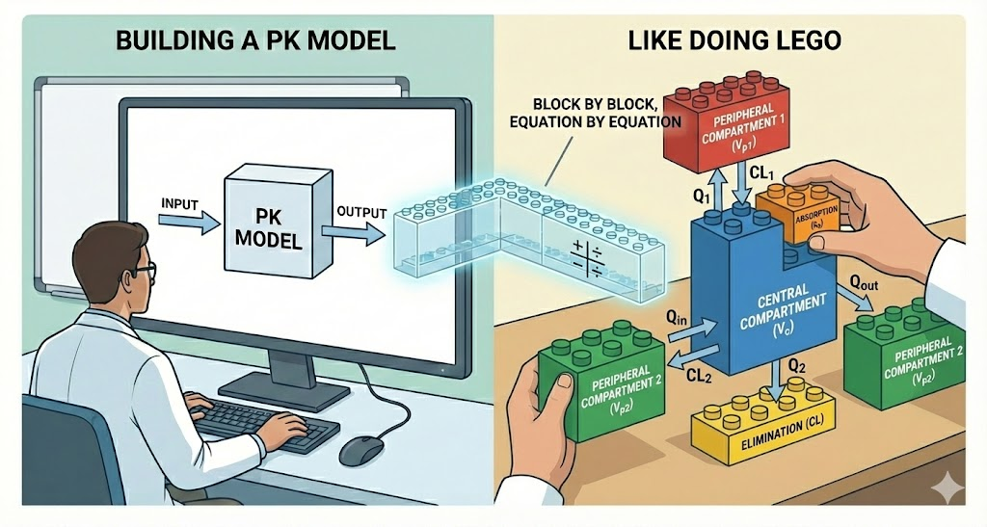
How to build a model

Slide 12
How to build a model
Structural Model
Final Model
Monocompartimental
Bicompartimental
Transit, Tlag, Michaelis-Menten…

Slide 13


Structural Model: A.D.E. Approach (or ADME)
Absorption
Distribution
Elimination
How does the drug enter the body? (and how fast)
Where does the drug go
How does it exit the body
Lag Time: A delay between drug administration and its first appearance in the bloodstream. Transit: A series of compartments (progressive absorption).
Order 0/1: Infusion or passive entry.
1 Compartment: Homogeneous (Central).
2 Compartments: Exchanges with peripheral tissues.
3 Compartments: Deep tissues for example
Linear : Constant clearance
Michaelis-Menten : Saturable elimination

Slide 14
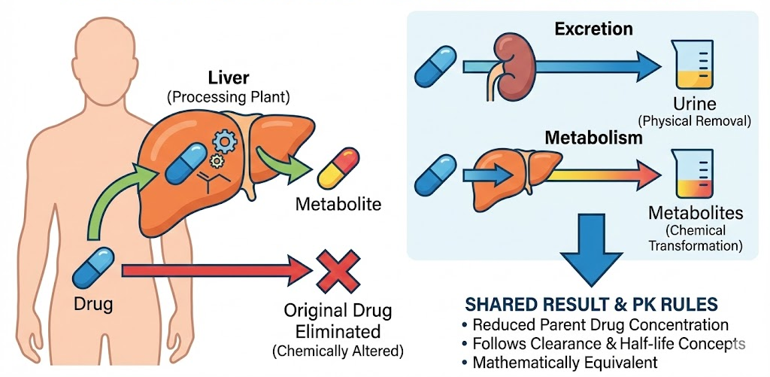
Metabolization : The "Chemical" Elimination
Metabolization
The body (primarily the liver) acts as a chemical processing plant, altering the drug molecule into a new compound called a metabolite
Why is it considered Elimination? Even though the new molecule is still inside the body, the original drug molecule is gone. Because the parent drug is no longer present, it has effectively been "eliminated."

Slide 15
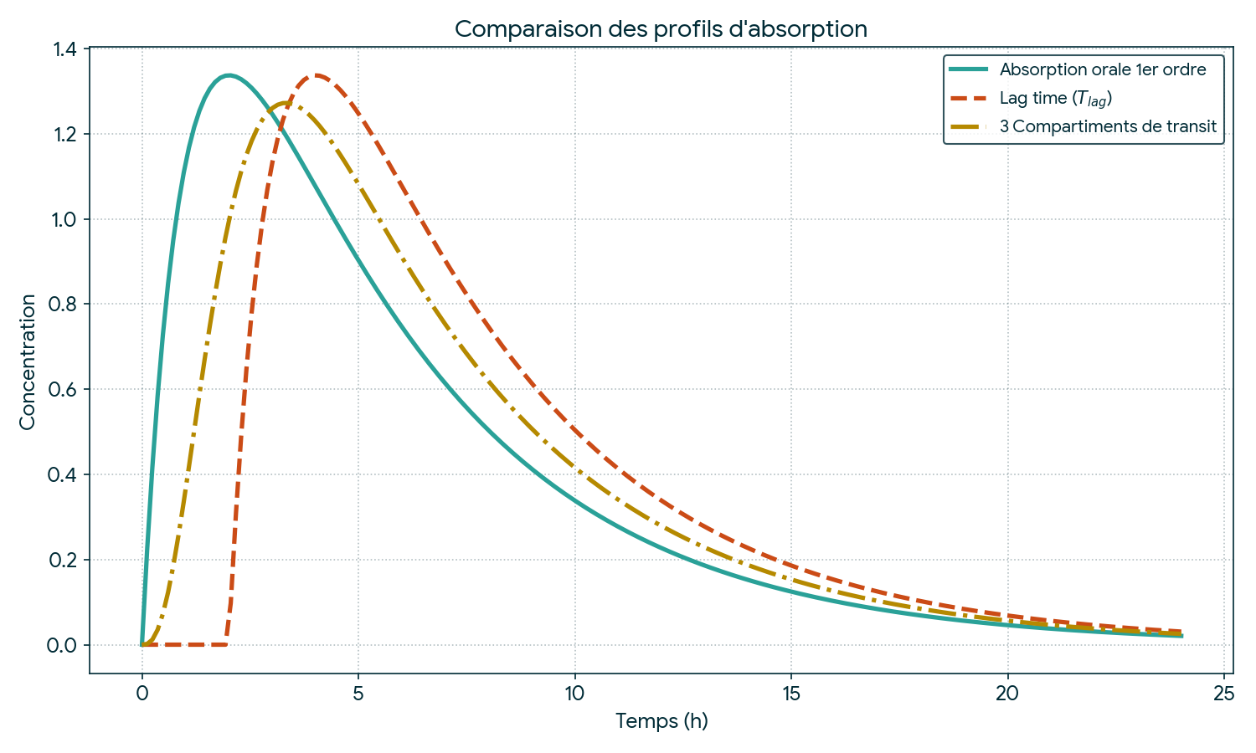
Structural Model: A.D.E. Approach (or ADME)
Absorption
Distribution
Elimination

Slide 16
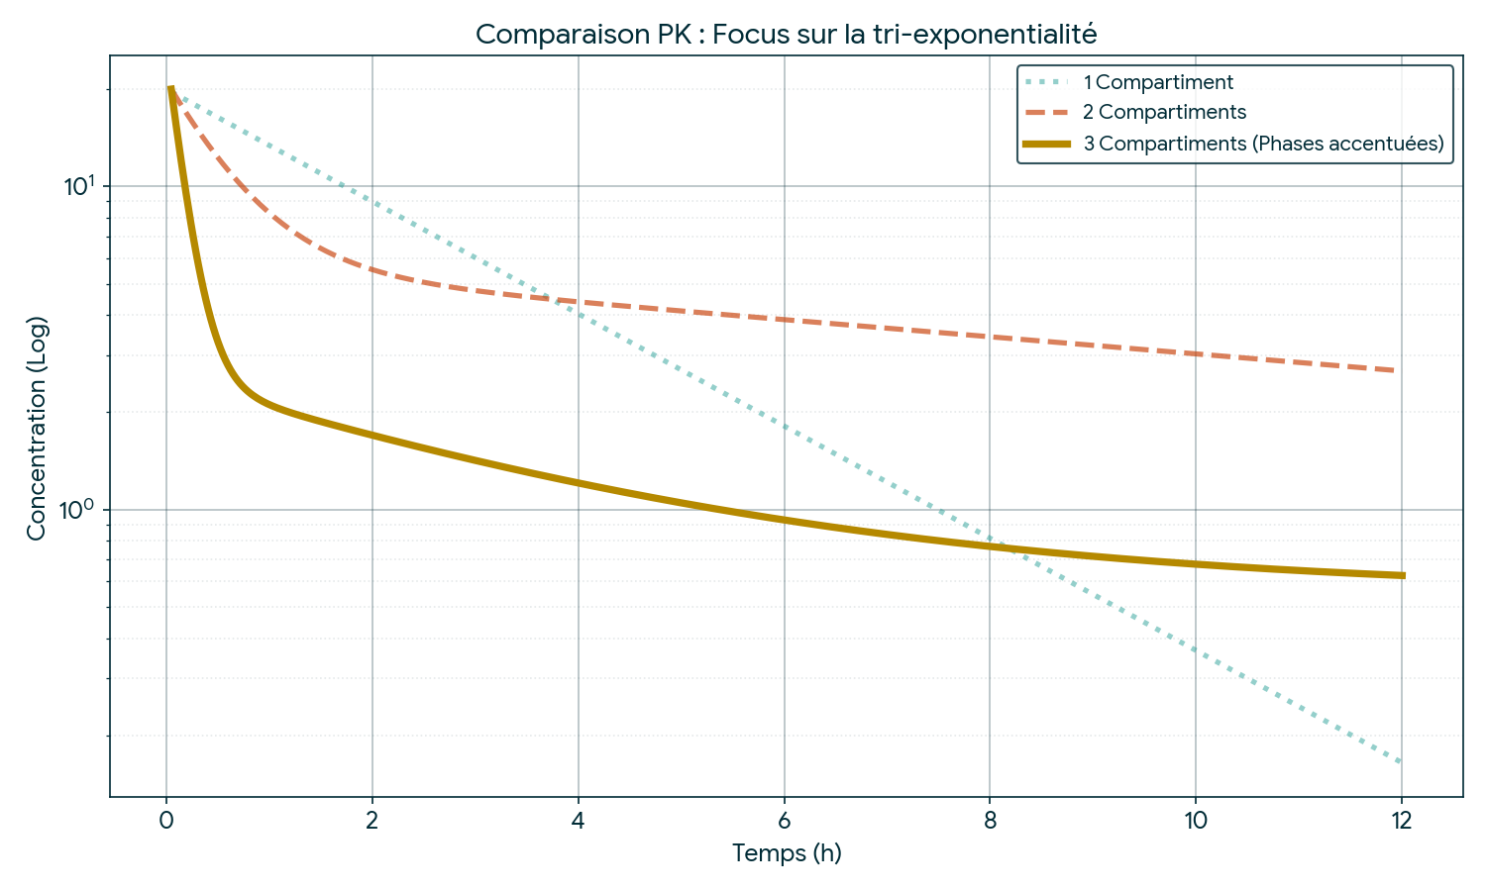
Structural Model: A.D.E. Approach (or ADME)
Absorption
Distribution
Elimination

Slide 17
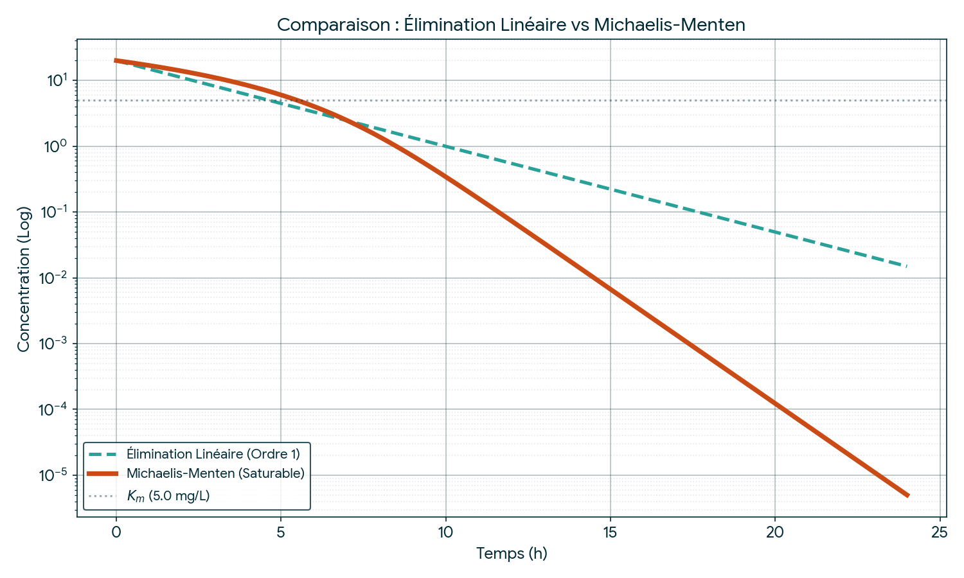
Structural Model: A.D.E. Approach (or ADME)
Absorption
Distribution
Elimination

Slide 18
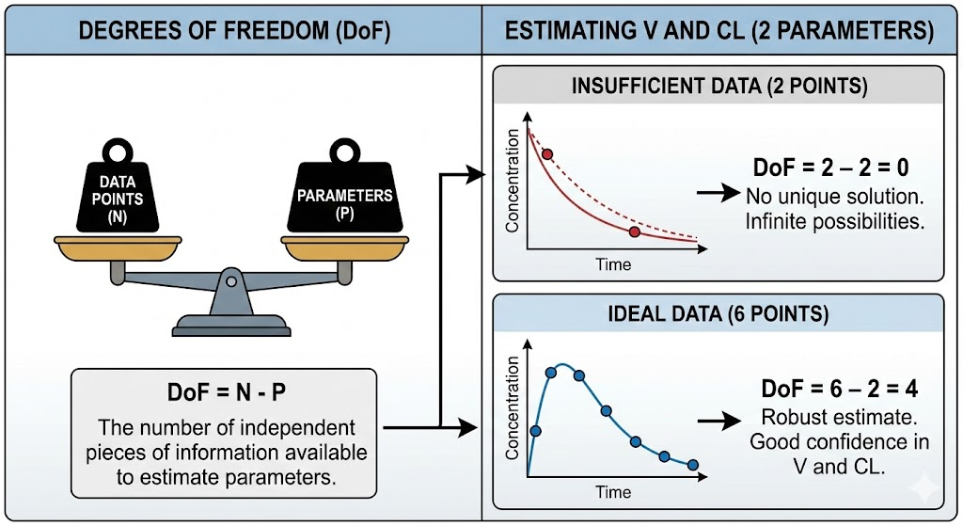
Be careful with the available data!

Slide 19
How to build a model
Inter Individual Variability (IIV),
Inter Occasion Variability (IOV)
Structural Model
Variability
Final Model
Monocompartimental
Bicompartimental
Transit, Tlag, Michaelis-Menten…

Slide 20



Variability in PKpop : Mixed Effect Models
Fixed Effects (θ)
Random Effects (ƞ)
Represents the typical patient.
This is the average trend in the population.
Example: CLpop
Represents Individual variability. (Inter or Intra)
The unique difference for each patient.
Fundamental Equation :
(The exponential function ensures that the clearance always remains positive)

Slide 21
The Hierarchy of Variability
IIV : Inter-Individual
IOV : Inter-Occasion
Between patients
In the same patient
Sex, weight, phenotype
Stress, Food effect, …
Constant for a given patient. (Approximately)
Clinical danger: If IOV > IIV, therapeutic monitoring is very difficult because the patient is constantly changing.

Slide 22
How to build a model
Inter Individual Variability (IIV),
Inter Occasion Variability (IOV)
Structural Model
Variability
Residual Error Model
Final Model
Monocompartimental
Bicompartimental
Transit, Tlag, Michaelis-Menten…
Proportional
Additive
Combined

Slide 23


Residual error (Ɛ)
The unexplained error
Error Models
This is the difference between the model's prediction and the reality observed in the laboratory.
Additive Ɛadd : Constant background noise (e.g., 0.1 mg/L, limit of quantification).
Administration error
Analytic error
Structural model error
Proportionnal Ɛprop: The error increases with concentration (e.g., 10% of the value).
➔ Combined error :

Slide 24
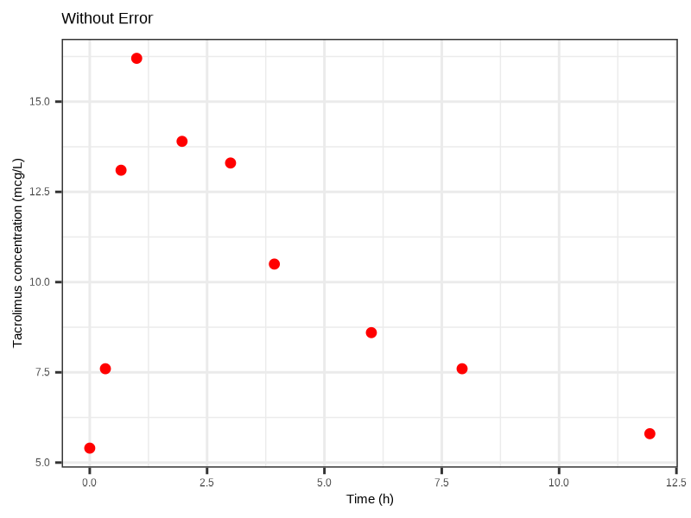
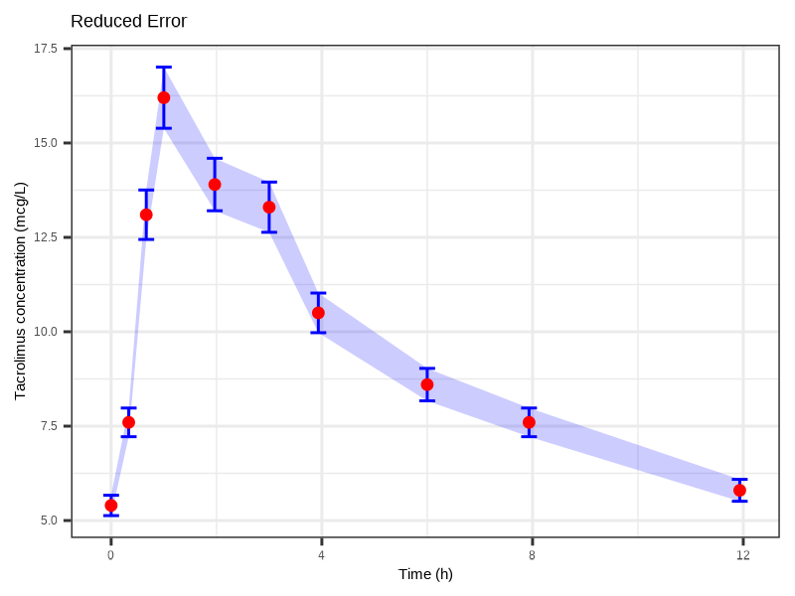
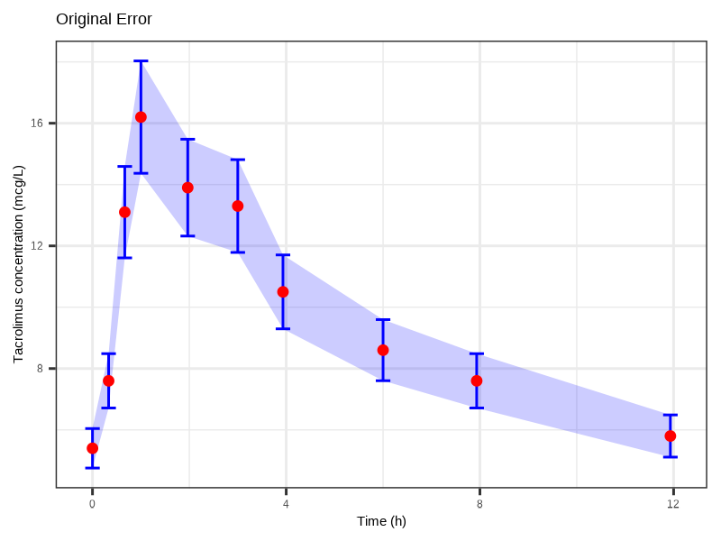
Residual error (Ɛ)
Tacrolimus concentration (mcg/L)
Tacrolimus concentration (mcg/L)
Tacrolimus concentration (mcg/L)
17.5
15.0
Tacrolimus concentration (mcg/L)
15.0
16
12.5
12.5
12
10.0
10.0
7.5
7.5
8
5.0
5.0
0.0
2.5
5.0
7.5
10.0
12.5
0
4
8
12
0
4
8
12
Time (h)
Time (h)
Time (h)
Without residual error
Low residual error
Prop : 5%
More residual error
Prop : 12%, Add: 0,05
The greater the residual error, the more room the curve has to pass through the points.
➔ The estimated residual error is therefore the variability of each point.
➔ Intra-individual (or inter-occasion) variability represents the variability of the curve at each occasion.
➔ Inter-individual variability represents the variability of each curve.

Slide 25
How to build a model
Inter Individual Variability (IIV),
Inter Occasion Variability (IOV)
Age, Sex, Weight
Structural Model
Variability
Residual Error Model
Covariates effect
Final Model
Monocompartimental
Bicompartimental
Transit, Tlag, Michaelis-Menten…
Proportional
Additive
Combined

Slide 26
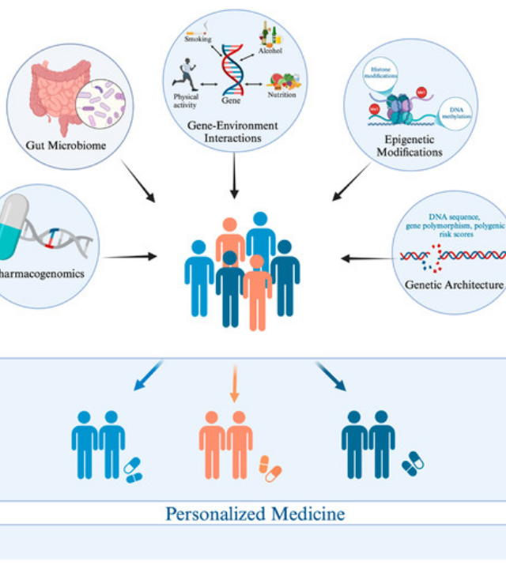
Covariates :
The investigation
Why is this patient different ?
Once the structure (ADE) and random variability (IIV) are defined, we seek to explain this variability by physiological factors.
Morphology: Weight, Height, Body Surface Area.
Organs: Creatinine (Kidney), Bilirubin (Liver).
Demographics: Age, Sex, Race.

Slide 27



Allometry : The law of size
Example of weight in pediatrics:
A child is not a "small adult"
Standard Allometric Equation
For clearance (CL), the exponent is 0.75:
Physiology does not change linearly with weight. The relationships follow power laws.
This is crucial for pediatrics and obese patients.
For volume (V), the exponent is often 1.0 (linear).

Slide 28
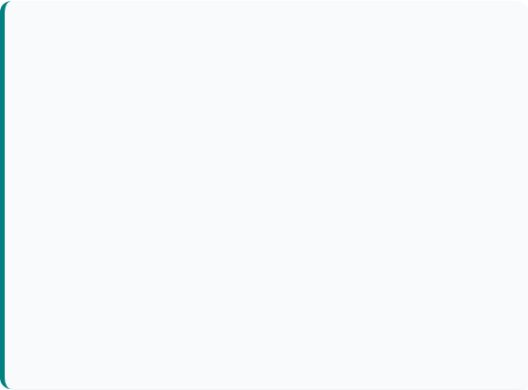
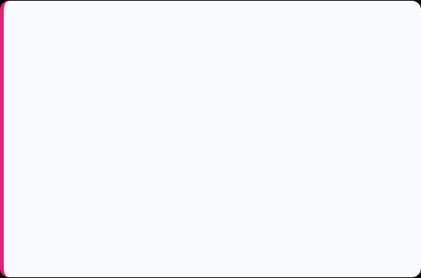




Coding of covariates
How do we integrate Weight or Sex into the parameter equation?
Quantitative (Continuous)
Qualitative (Categorical)
Ex: Weight, Age, Créatinine.
Ex: Sex, Genetics (CYP2D6), Tabaco.
We center on the median to give meaning to the typical value.
We use a multiplicative factor (Switch).
CAT = 0 (Reference)
CAT = 1 (Test group)
Si : ß > 0 then the parameter increases with the covariate. If COV = COVmed then P = Ppop.
A continuous covariate can be transformed into a categorical one.
Example: Patient's BMI ➔ Weight categories (Normal / Overweight / Moderately obese / Severely obese)

Slide 29


Covariates & Traps Workflow
Methodology
Shrinkage Trap
1. Forward Selection: Covariates are added one by one. They are retained if the OFV decreases significantly (p < 0.05).
Decrease of 3.84 (95% chi-square distribution)
2. Backward Elimination: Covariates are removed one by one. Only those with a significant increase in OFV are retained (p < 0.01).
➔ Increase of 6.63 (99% chi-square distribution)
If the "narrowing" is high (>30%), it means that the model lacks information about the individual or the model is over-parameterized.
Rule: Never use EBEs* for graphical correlations if shrinkage is strong.
*Empirical Bayesian Estimates = Estimated Individual Parameters
Also pay attention to the plausibility and covariance of the covariates.
For example, you wouldn't use weight and BMI at the same time.

Slide 30
How to build a model
Inter Individual Variability (IIV),
Inter Occasion Variability (IOV)
Age, Sex, Weight
Structural Model
Variability
Residual Error Model
Covariates effect
Final Model
Monocompartimental
Bicompartimental
Transit, Tlag, Michaelis-Menten…
Proportionnal
Additif
Combined
Check one last time using the forward/backward method
Do bootstrap for stability (x500 in general)

Slide 31

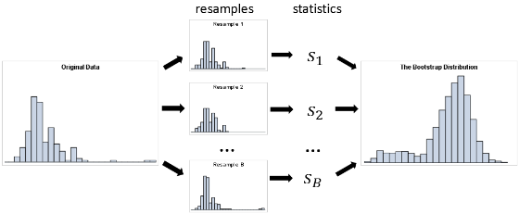
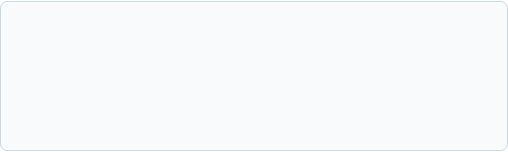

The Bootstrap: Testing the durability of the model
"Virtual Cloning" (Re-sampling)
How can we know if our model is robust or if it was just lucky with our 50 patients?
We take the original study.
We create 1000 new virtual studies by randomly selecting patients (with replacement).
We run the model 1000 times.
Expected results :
Clinical Translation: This allows us to calculate the Confidence Interval (CI) of our parameters. We don't just want an average value; we want to know the margin of error.
CL = 5 L/h [IC 95% : 4.8 – 5.2]
Narrow interval = Robust model

Slide 32
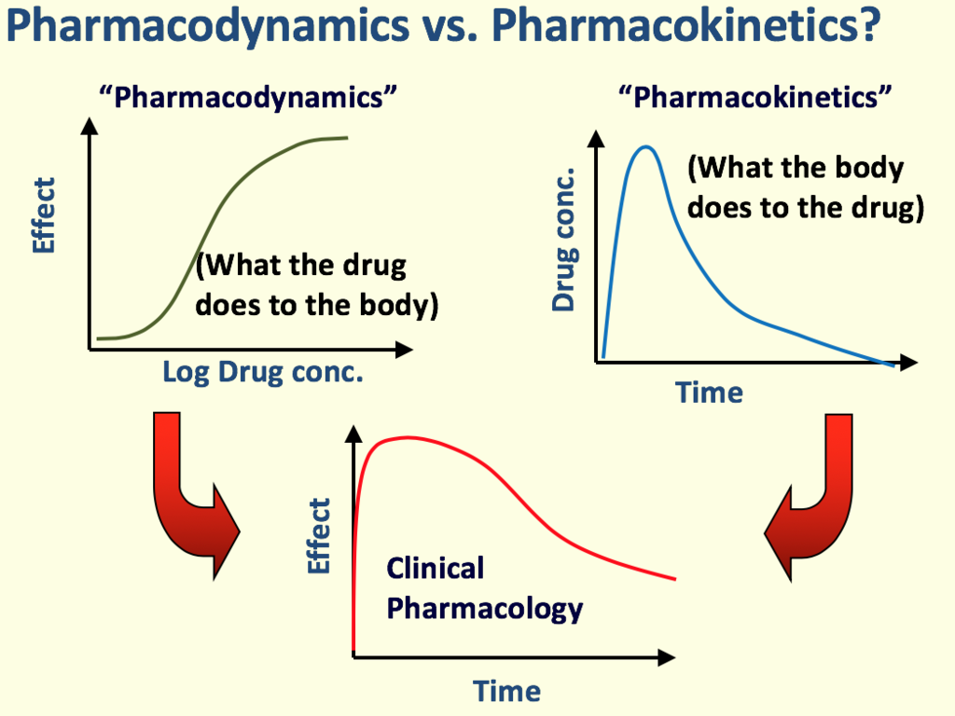
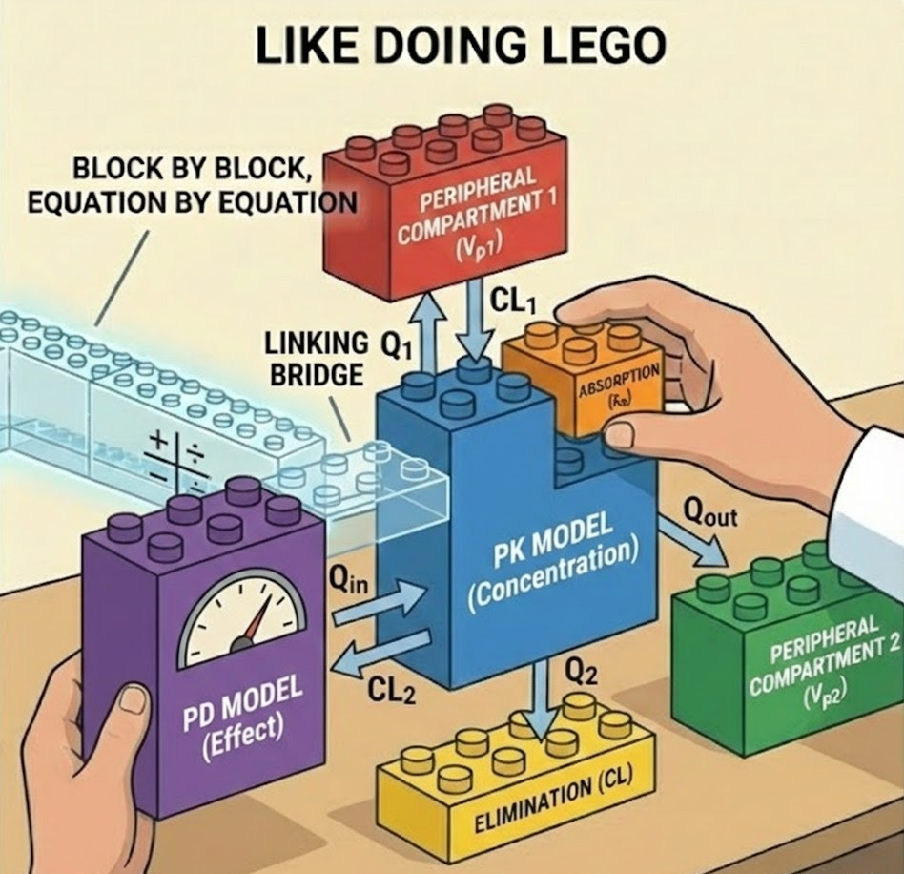
Pharmacodynamics
Same workflow but the observed data are effects (it can be Creatinine, CRP, tumor growth etc…
(the equations are a bit different)
And the abscise is not time but drug concentration
You can just link the models and do a joint modeling

Slide 33
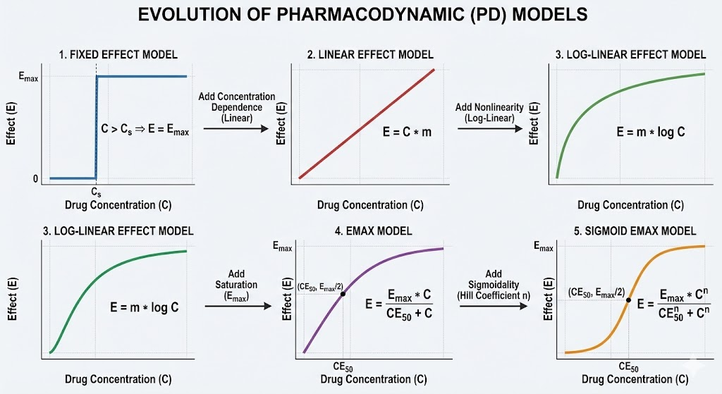
Different types of effect :
Different functions exist to link concentration to effect. They become increasingly complex and comprehensive over time.

Slide 34
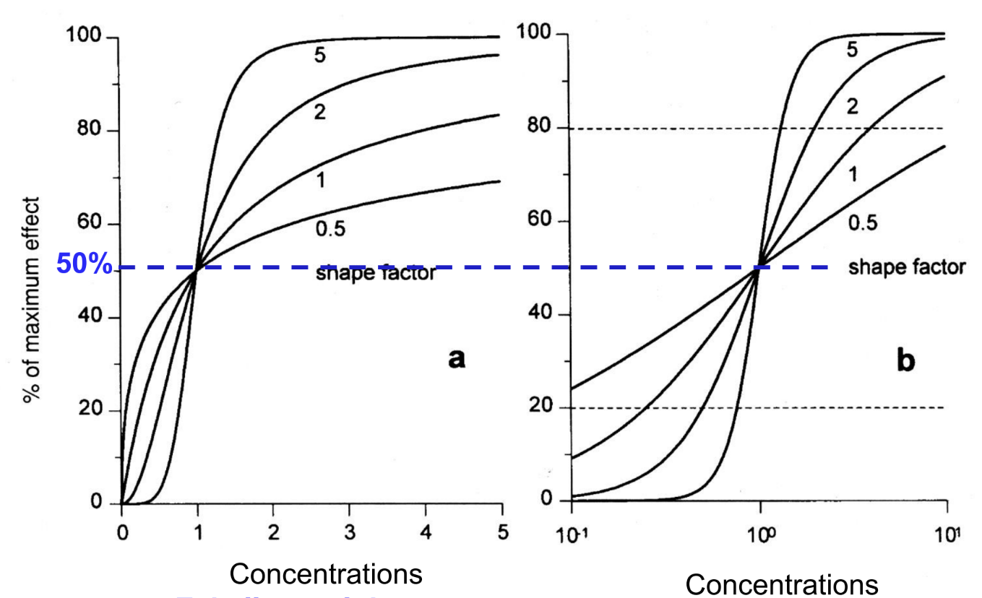
Different types of effect :
Changing the value of a parameter can modify the entire curve, allowing it to adapt. However, the more complex the model, the more data is needed.

Slide 35
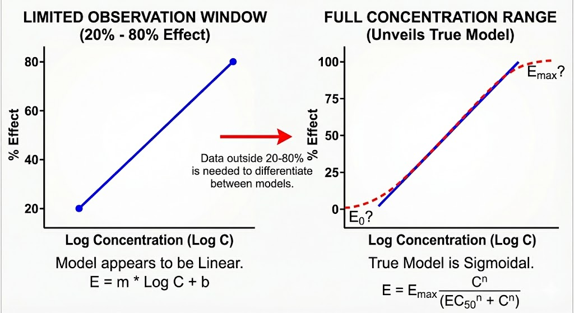
Easy Trap :
If you only have data between 20 and 80% of Emax, the effect can seem linear or loglinear.

Slide 36
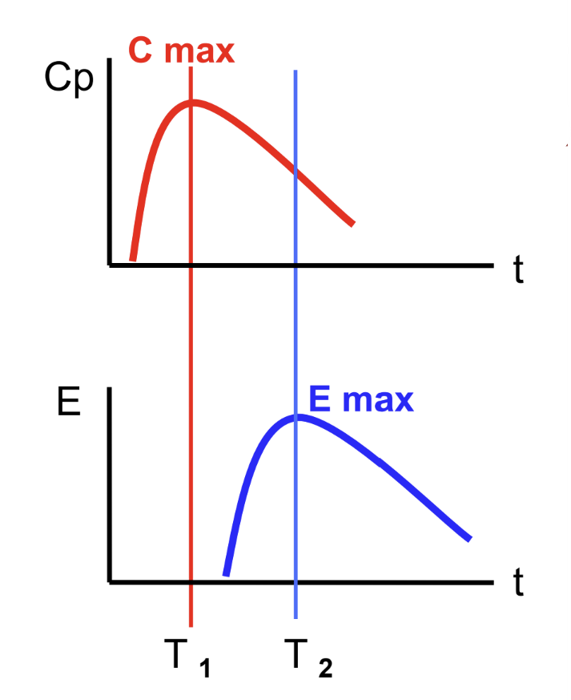
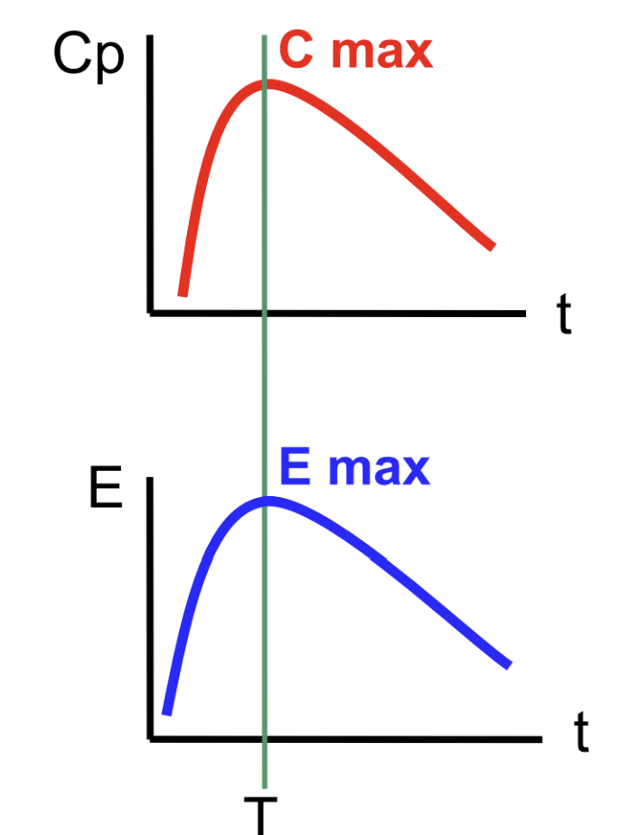
PK-PD modeling : Direct and Indirect Effects
The easiest case :
Same Tmax for PK and PD
Both in the same compartment.
Easy just use a model from before directly
More common:
Different Tmax for PK and PD
PK and PD are in different compartment.

Slide 37
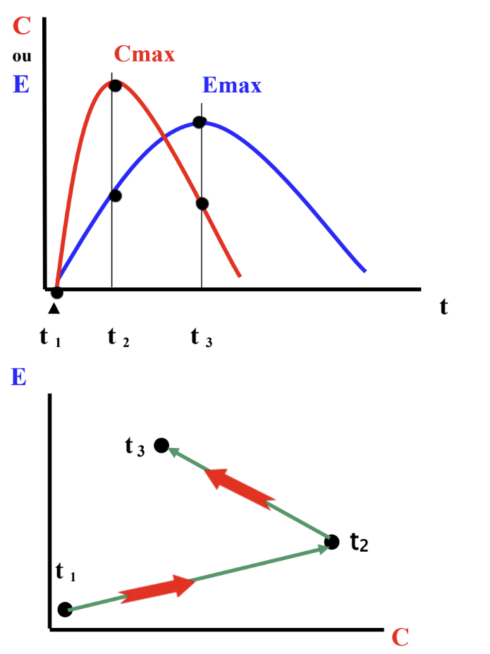
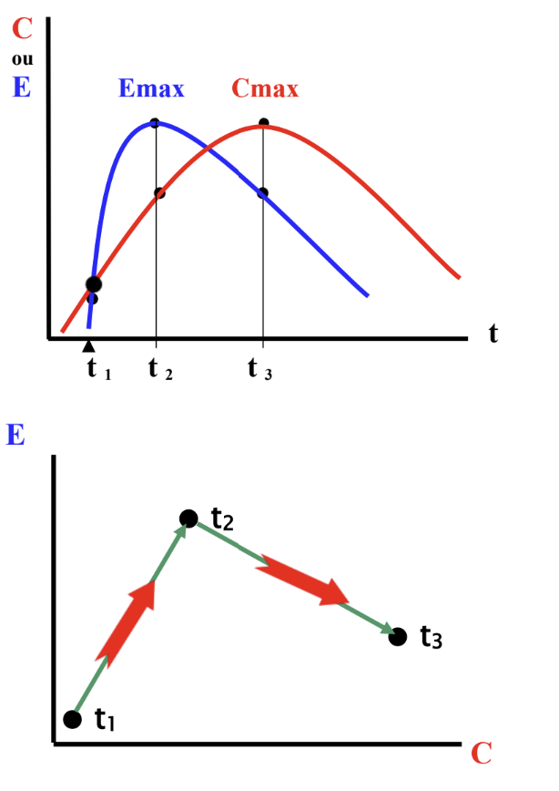
Indirect Effect: 2 cases
1. Delayed formation of active agonist metabolites (maximum effect delayed).
2. Role of efflux proteins?
3. Sensitization: with repeated administration, an increase in the number of receptors ("upregulation").
4. Intermediate biochemical mechanisms: cascade reactions (protein synthesis) leading to the pharmacological effect.
1. Formation of antagonistic active metabolites (the effect decreases, while concentrations increase).
2. Decrease in the number of receptors ("downregulation"), saturation of ligand-receptor binding.
3. Physiological systems of negative feedback regulation (hormones).
4. Role of influx proteins?

Slide 38
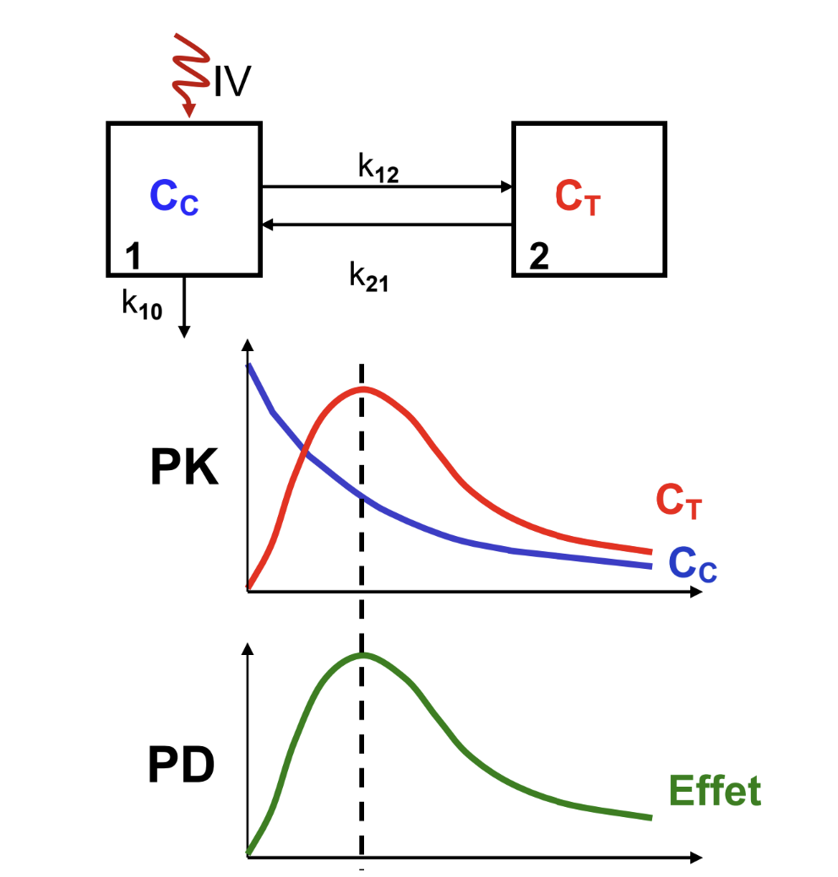
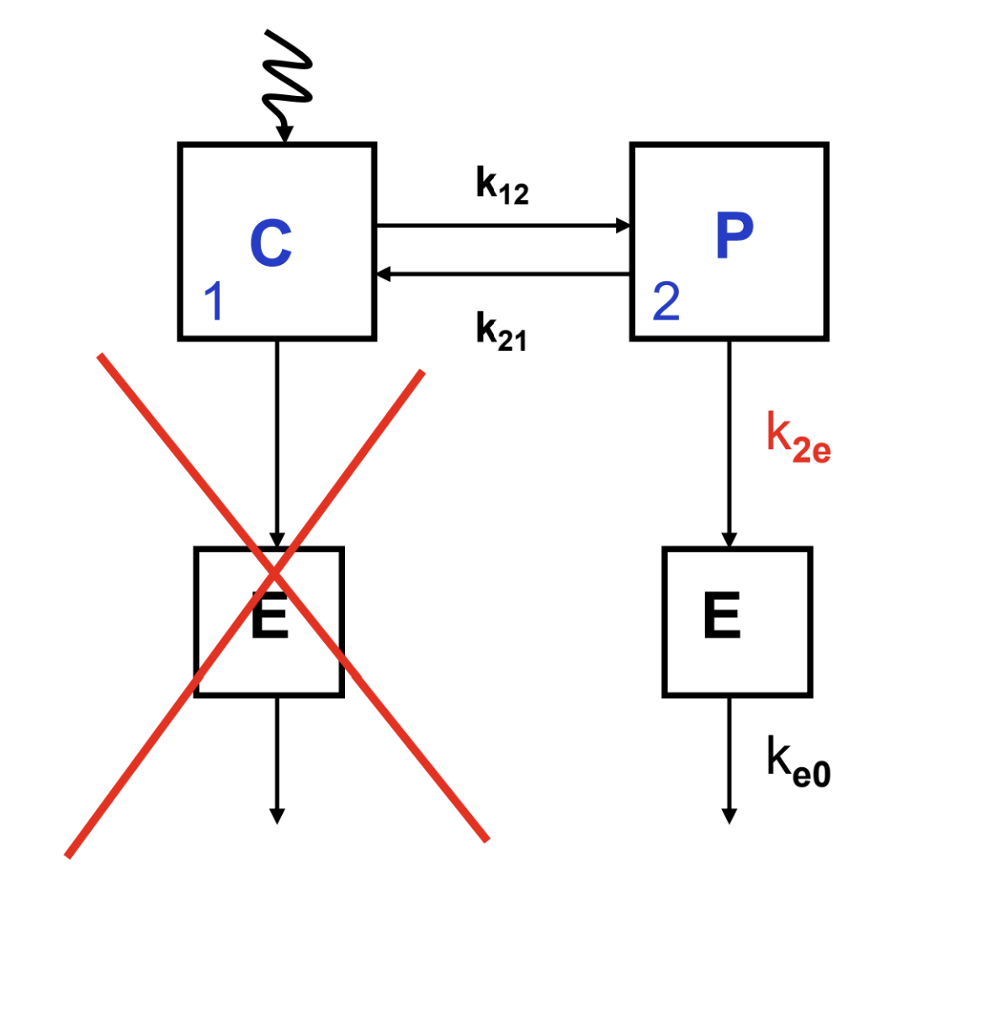

Indirect Effect : Schneider Model
Easiest case : The « effect » compartment is the peripherical compartment
Other cases : The « effect » compartment is different from the PK compartments
$$k_{1e}$$

Slide 39
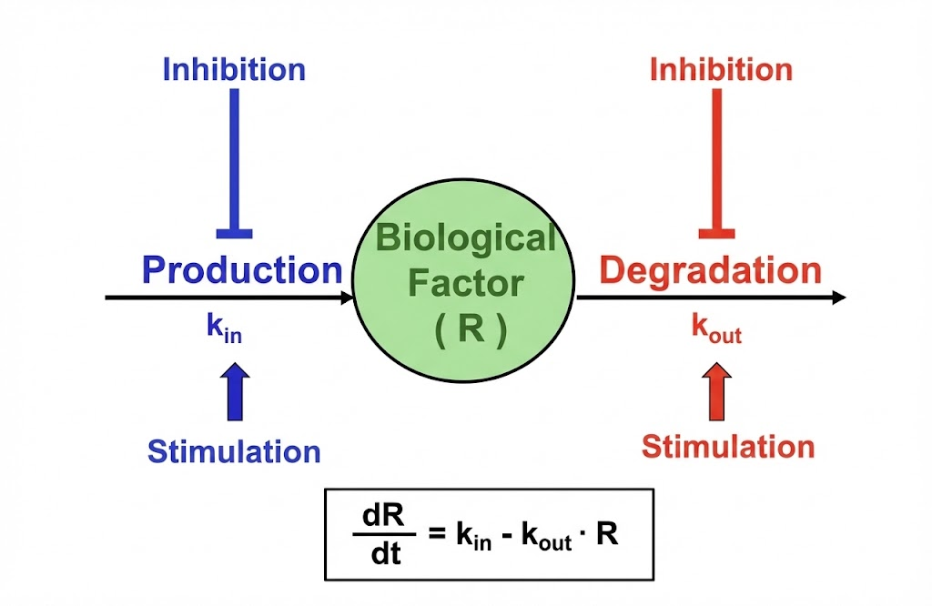
Indirect Effect : The Turnover
In this model, we view the biological response R as a dynamic system in constant 'turnover.’
Instead of the drug acting directly on the response, it acts on the processes that control it.

Slide 40
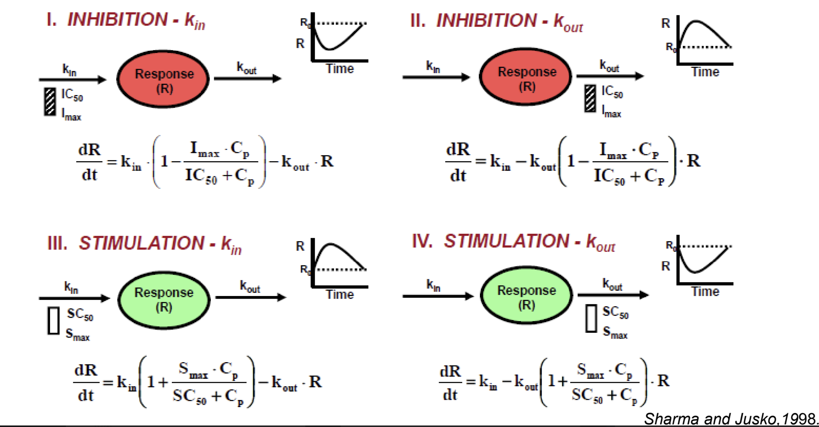
Turnover Effect

Slide 41
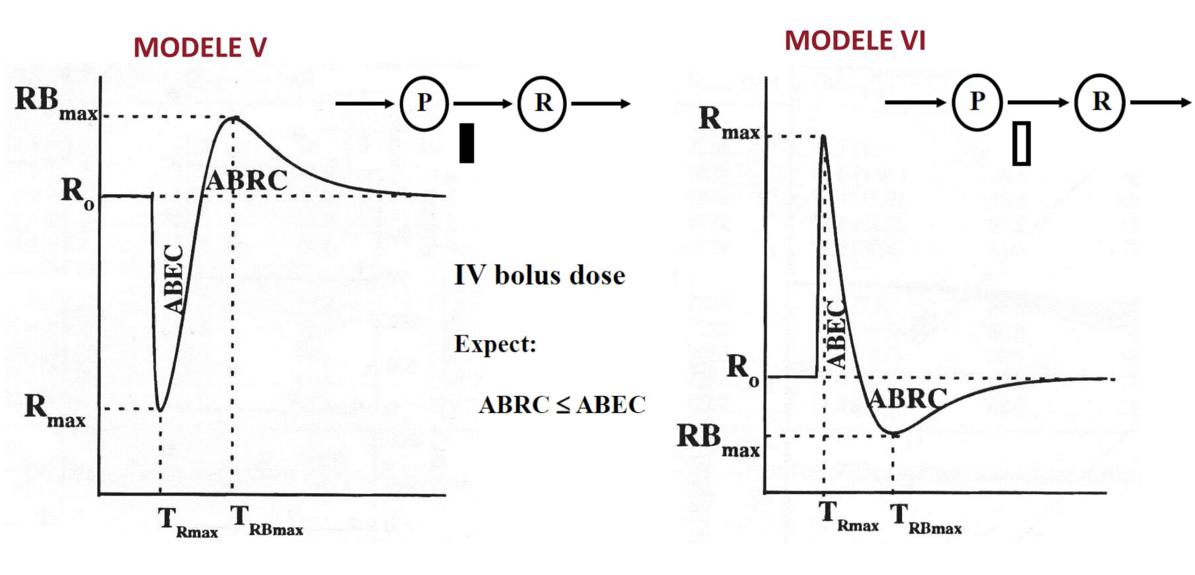
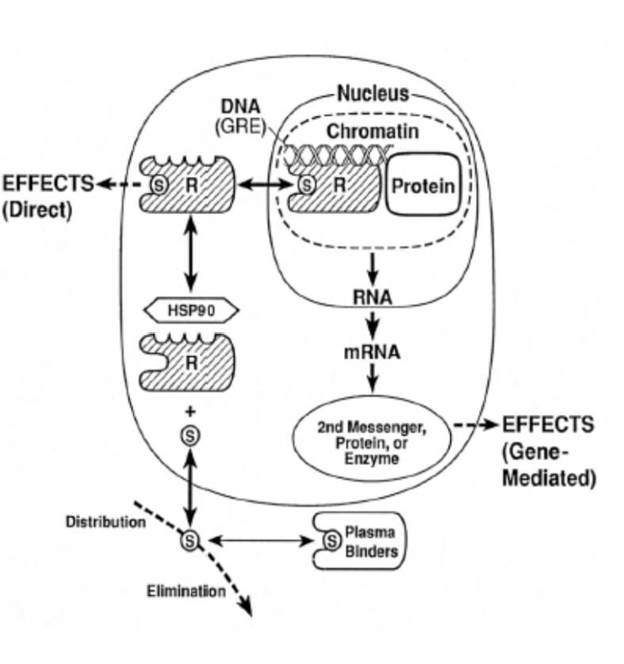
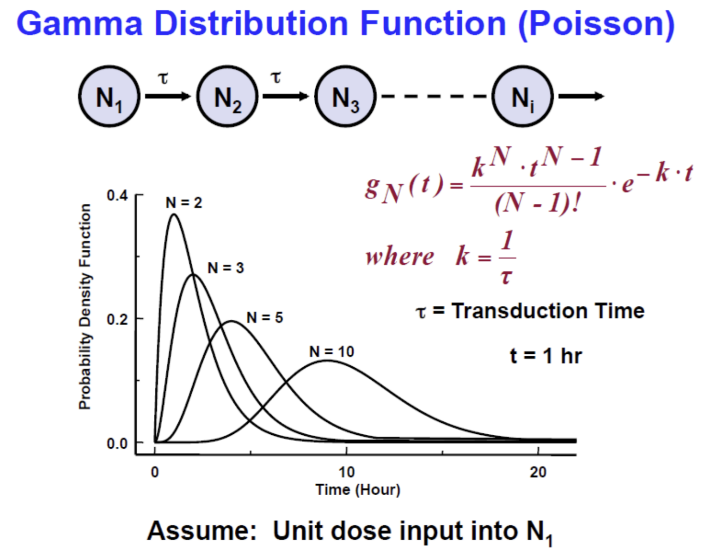
And more..
Indirect Effet with precursor
Gamma distribution
And more…

Slide 42
Pause ?
After that it’s gonna be more practical with an example dataset ?

Slide 43
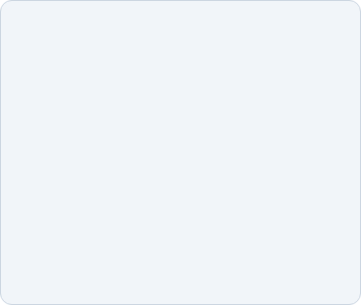





The Software Landscape
We do, of course, have software to help us.
NONMEM
Monolix
R (nlmixr2)
The historical reference. Regulatory "Gold Standard". Complex (Pure Code).
Graphical interface. Powerful SAEM algorithm. Ideal for beginners and visualization.
Open-source & Free. Total flexibility. nlmixr2 for estimation, Mrgsolve for simulation.

Slide 44
Estimation: How does the software "learn"?
Now that the model is built, how do we find the parameters?
We provide the raw data, but in a highly codified format.
ID | time | CYP | HT | DV | SEX | AMT | SS | EVID
1 | 0 | 0 | 29.7581 | -0.51189 | 0 | 10 | 1 | 1
1 | 0 | 0 | 29.7581 | 18.01827 | 0 | 10 | 1 | 1
1 | 0 | 0 | 29.7581 | -0.51189 | 0 | 0 | 1 | 0
1 | 0 | 0 | 29.7581 | 18.01827 | 0 | 0 | 1 | 0
1 | 0.333333 | 0 | 29.7581 | 30.15817 | 0 | 0 | 1 | 0
1 | 0.666667 | 0 | 29.7581 | 44.24434 | 0 | 0 | 1 | 0
1 | 1 | 0 | 29.7581 | 64.65023 | 0 | 0 | 1 | 0
1 | 1.5 | 0 | 29.7581 | 68.04197 | 0 | 0 | 1 | 0
1 | 2 | 0 | 29.7581 | 43.33467 | 0 | 0 | 1 | 0
1 | 3 | 0 | 29.7581 | 44.46657 | 0 | 0 | 1 | 0
1 | 4 | 0 | 29.7581 | 32.27944 | 0 | 0 | 1 | 0
1 | 6 | 0 | 29.7581 | 27.94903 | 0 | 0 | 1 | 0
1 | 9 | 0 | 29.7581 | 24.33938 | 0 | 0 | 1 | 0
2 | 0 | 1 | 31.07929 | 0.440721 | 1 | 10 | 1 | 1
2 | 0 | 1 | 31.07929 | 7.093868 | 1 | 10 | 1 | 1
2 | 0 | 1 | 31.07929 | 0.440721 | 1 | 0 | 1 | 0
2 | 0 | 1 | 31.07929 | 7.093868 | 1 | 0 | 1 | 0
2 | 0.333333 | 1 | 31.07929 | 12.07626 | 1 | 0 | 1 | 0
2 | 0.666667 | 1 | 31.07929 | 26.77159 | 1 | 0 | 1 | 0
2 | 1 | 1 | 31.07929 | 42.91382 | 1 | 0 | 1 | 0
2 | 1.5 | 1 | 31.07929 | 41.36653 | 1 | 0 | 1 | 0
2 | 2 | 1 | 31.07929 | 39.45124 | 1 | 0 | 1 | 0
2 | 3 | 1 | 31.07929 | 18.26694 | 1 | 0 | 1 | 0
2 | 4 | 1 | 31.07929 | 18.03305 | 1 | 0 | 1 | 0
2 | 6 | 1 | 31.07929 | 12.51075 | 1 | 0 | 1 | 0
2 | 9 | 1 | 31.07929 | 9.503914 | 1 | 0 | 1 | 0
ID : Patients’ ID
Time : time
CYP : a categorical covariate
HT : a continuous covariate
DV : Dependent Variable (Observed data)
SEX : an other categorical covariate
AMT : AMounT (dose)
SS : Steady State
EVID : Observation or Administration line (0 or 1)

Slide 45
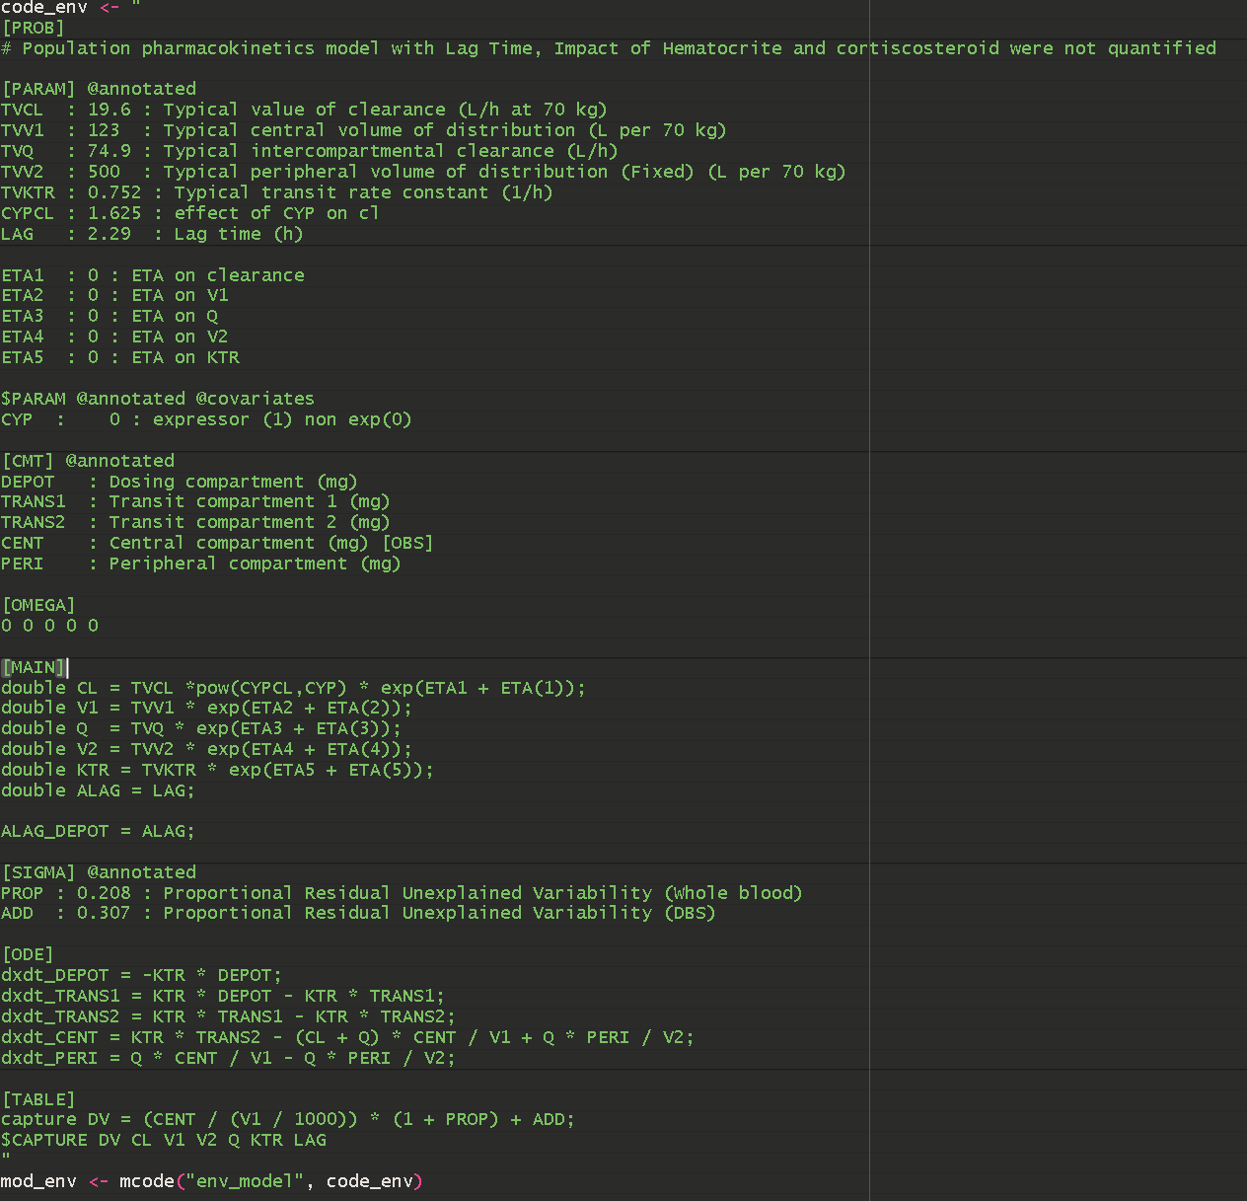
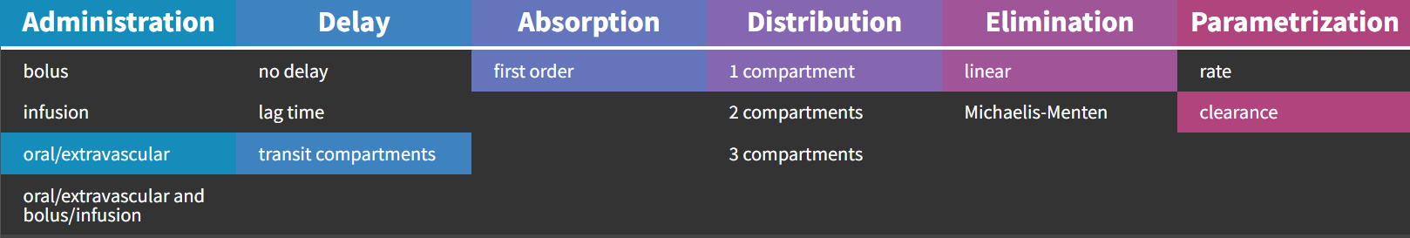
Estimation: How does the software "learn"?
Coding ourselves : mrgsolve example
Now that the model is built, how do we find the parameters?
We are provided with a structural model that we want to test:
Using a library (here it’s Monolix’s) :
[LONGITUDINAL]
input = {Vstd, Clstd, POIDS, gCL}
POIDS = {use=regressor}
PK:
; PK model definition
V = Vstd * (POIDS/1384)
Cl = Clstd * (POIDS/1384)^gCL
Cc = pkmodel(V, Cl)
OUTPUT:
output = {Cc}

Slide 46
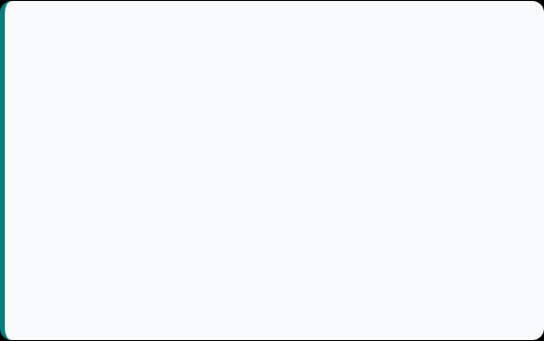

Estimation: How does the software "learn"?
Now that the model is built, how do we find the parameters? We will try to decrease the value of a function that serves as a criterion (distance between the curve and the points), called the likelihood.
Two main algorithms are:
FOCE-I
SAEM
First Order Conditional Estimation
Stochastic Approximation EM
The old school (NONMEM). Deterministic.
The modern method (Monolix, nlmixr2).
Fast for simple models
Can get stuck in a "local minimum"
Sensitive to initial data
Explore the space randomly
Find the global optimum
Much more robust for complex models

Slide 47
Estimation : What’s the SAEM?
Step A1:
Behavior: The system has "no memory." It completely forgets the previous iteration to fully accept the new simulation.
Objective: To allow parameters to jump abruptly from one value to another to escape local minima
Step S: Exploration
Action: The system randomly selects plausible individual parameters based on current observations and population parameters estimated in the previous step.
Goal: To reconstruct the missing information (latent variables) through stochastic sampling.
Step A2: Smoothing
Behavior: The system becomes increasingly conservative. It calculates a weighted average between all accumulated historical data and the new simulation.
Objective: To progressively reduce stochastic variance (noise) to finely stabilize the estimates of the inter-individual variance Omega and the residual error sigma.
c
First prior
No convergence ➔ new prior
Step M: Maximization
Action: The system updates the population parameters theta using Maximum Likelihood Estimation.
Result: The new "average" population parameters are obtained (e.g., the mean clearance of all patients), which will serve as the basis for the next iteration.
Initialization
Convergence

Slide 48

Numerical validation
The Likelihood
Other numerical criteria
The basis: Distance of observed points relative to the drawn curve ➔ RMSE / MSE / R²
The “objective” function criteria $Criteria =−2(\sum_{i=1}^{n}{\frac{{\left(y_{i}−{\hat{y}}_{i}\right)}^{2}}{σ_{i}^{2}}}+\sum_{j=1}^{m}{\frac{η_{j}}{ω_{j}^{2}}}$
Its derivatives: BIC / AIC…
Penalize the number of parameters. Indeed, if we have 1000 parameters, we can create a curve that passes through all the points.
➔ Overfitting + poor parameter estimation
Accurate estimation of parameters: RSE < 30% – 50%
Scientific plausibility: No, hair color does not influence kidney function.
Shrinkage < 30%: Over-parameterized model
Lowest possible variability: The lower the variability, the more explanatory the model.

Slide 49




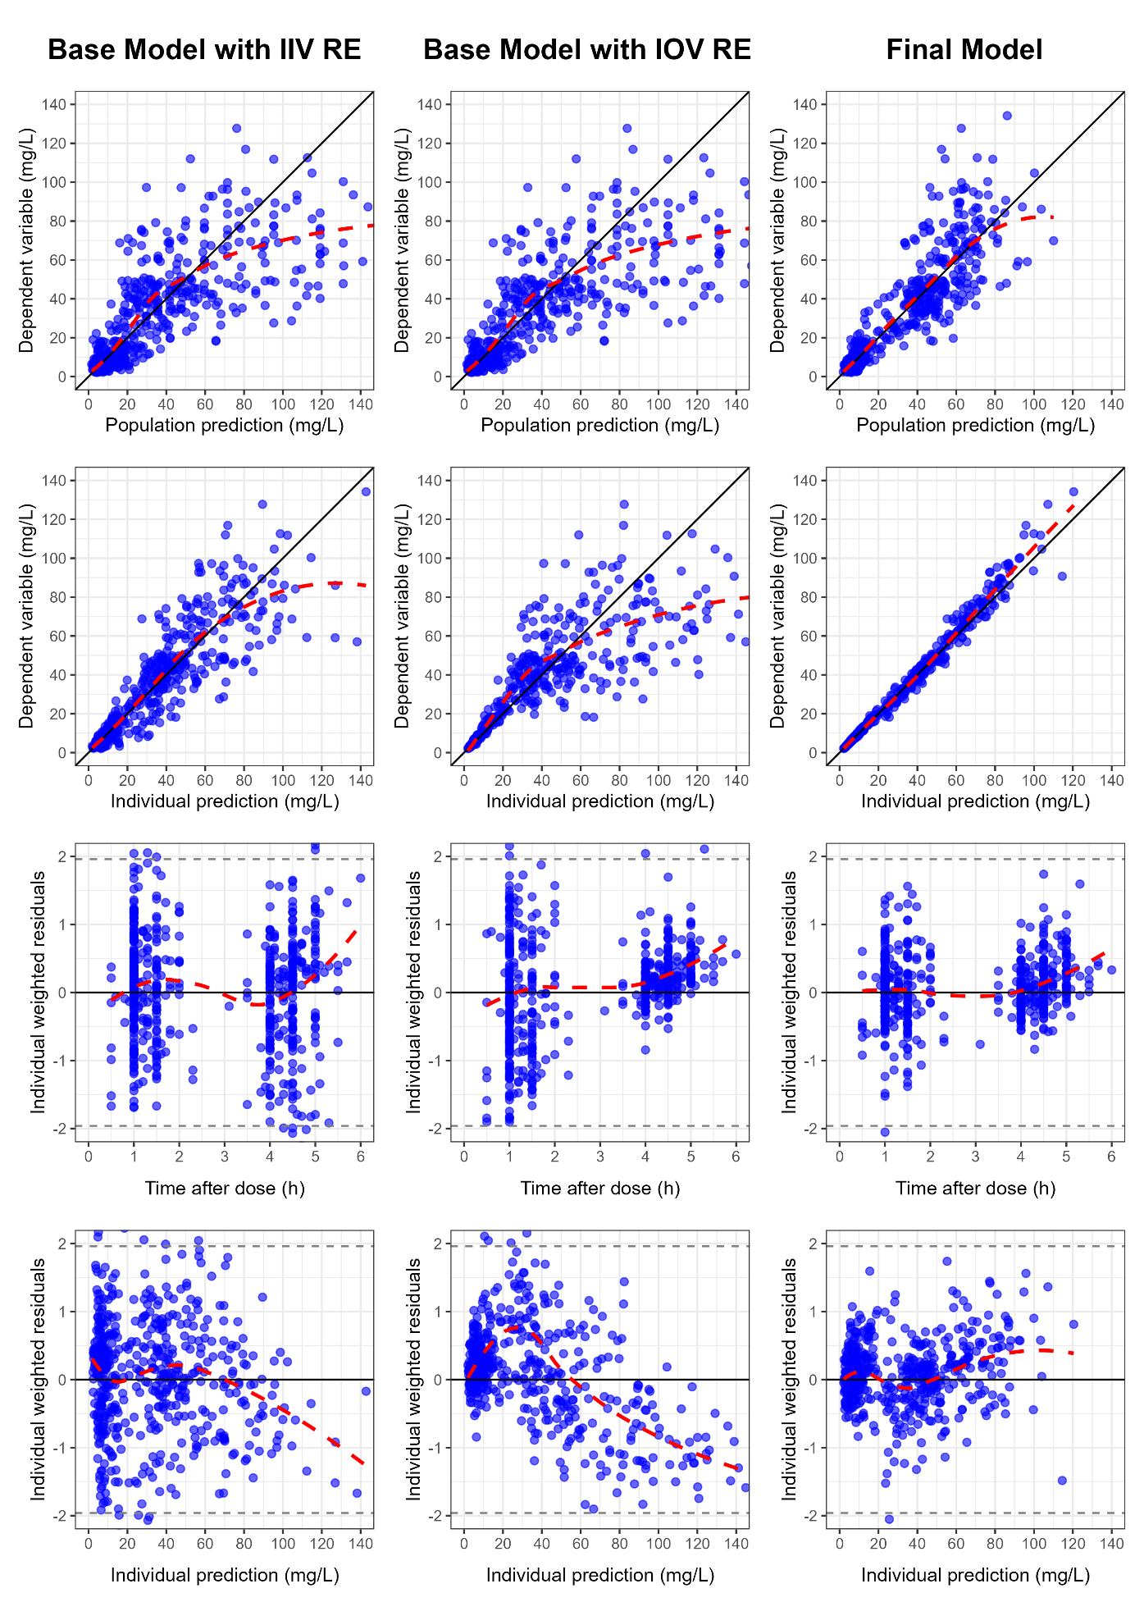

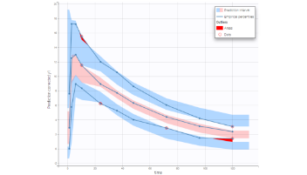
Graphical Validation
Obs vs Pred
Residues
VPC
The more points follow the first bisector, the better.
Cloud centered on 0. homogeneous = No bias.
The final judge. The simulations reflect reality.

Slide 50


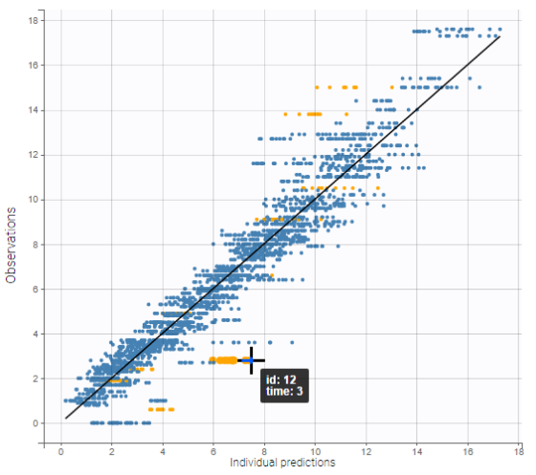

Observed vs. Predicted: The Reality Test
Population Pred (PRED)
"Does the average work?"
Compare the actual data with the prediction of the typical patient. Often scattered (this is normal, because IIV exists).
Individual Pred (IPRED)
"Does the model fit?"
Compare after Bayesian adaptation (EBEs). The points MUST be on the diagonal.

Slide 51

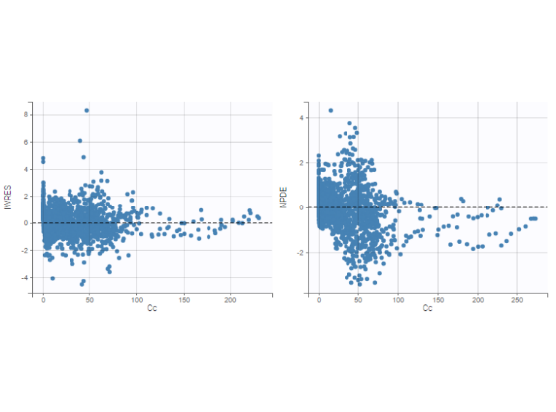
Residues (IWRES): Bias Hunting
What we want to see: White Noise (Random)
The individual weighted residuals (IWRES) should be a random cloud centered on 0, mostly between -2 and +2.
What should be worrying: The trends
Banana shape (U-shape):
The linear model is incorrect. Try Michaelis-Menten or Emax.
Fan-shaped error:
The proportional error is poorly modeled. Switch to logarithmic mode or change the error model.

Slide 52
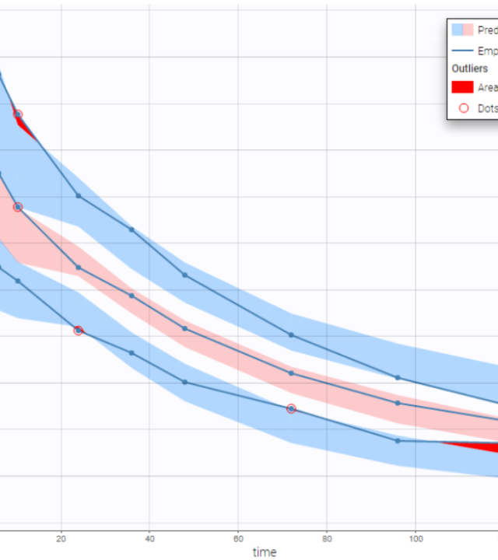
VPC : The "Crash Test"
Visual Predictive Check
We simulate 1000 virtual studies with the model and compare them with the real study. (Monte Carlo Simulations
Blue/red lines: Actual data (Median, 5th, 95th percentiles).
Shaded areas: The confidence interval of the simulation.
Clinical Interpretation:
If the actual lines "exceed" the shaded tubes, the model CANNOT be used to simulate clinical trials.
Pay attention to bins and other display settings

Slide 53




Technical Diagnostics: Stability & Covariates
Convergence (SAEM)
Shrinkage
Correlations (EBEs vs Cov)
Question: "Is the calculation finished?"
Question: "Rich or poor data?"
Question: "Have we forgotten a factor?"
We look at the iteration history. The line should resemble a stable horizontal "caterpillar" at the end. If it still oscillates, more iterations are needed.
If shrinkage > 30%, individual diagnoses (scatter plots EBEs) become misleading. Rely only on VPC and population residuals.
If we see a slope between the parameter and a covariate (e.g., Weight), we must add it to the model!

Slide 54
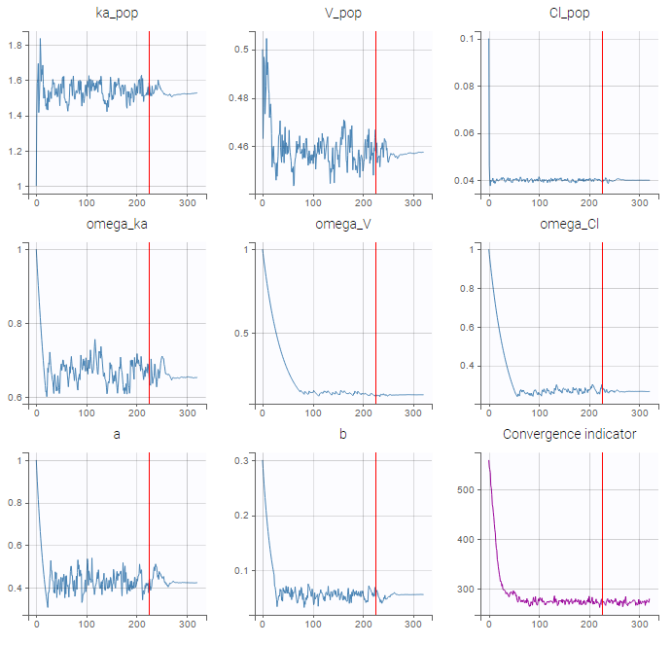
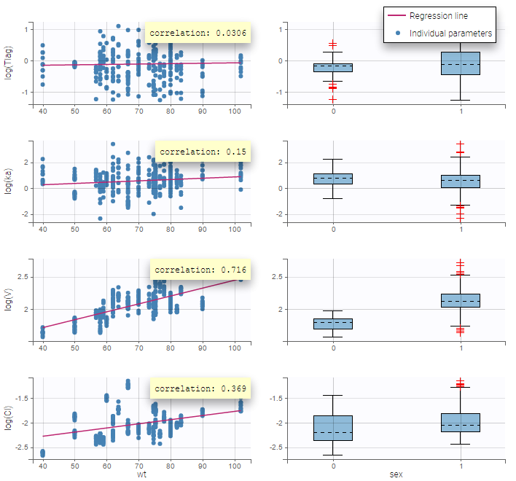
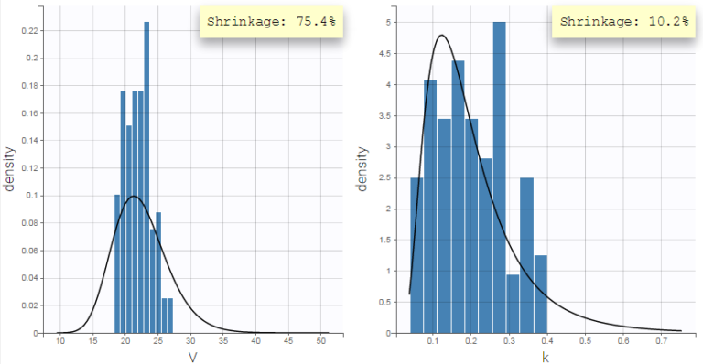
Technical Diagnostics: Stability & Covariates
Convergence (SAEM)
Shrinkage
Correlations (EBEs vs Cov)
➔ The Fisher Information Matrix (FIM)
➔ Bayesian Estimation

Slide 55

The Fisher Information Matrix (FIM)
What is it? The FIM quantifies how much "information" the observed data carries about the unknown parameters. It measures the curvature of the likelihood function. Sharp Peak: High information, high precision, small standard errors. Flat Peak: Low information, high uncertainty, large standard errors.
In practice :
the FIM measures the curvature (information);
we invert this matrix to obtain the Variance-Covariance matrix (uncertainty),
we normalize those results to get the RSE

Slide 56



Computing FIM in Monolix
Linearization
Stochastic Approximation
Diagnostic Use
Fast & Approximate
Robust & Precise
Identifiability Check
Approximates the model as linear around the individual predictions. Very fast, but less accurate for highly non-linear models.
Uses Monte Carlo Markov Chains (MCMC) to compute the matrix. Slower, but provides the "Gold Standard" for complex models.
If the condition number of the FIM is very high, it indicates that the model is over-parameterized (parameters are correlated). ➔ Shrinkage

Slide 57


What’s Bayesian Estimation (such as EBEs)
How can the dose be adjusted with a single blood test?
We leverage the power of the population to fill the gaps in individual information.
The Posterior provides the individual parameters (EBEs) unique to this patient, allowing for the simulation of their next perfect dose.
Prior: Knowledge (PopPK).
Likelihood: Patient measurement .

Slide 58




Bayesian estimation and variability
Changing the residual error or the variability changes the weights
$$Criteria =−2(\sum_{i=1}^{n}{\frac{{\left(y_{i}−{\hat{y}}_{i}\right)}^{2}}{σ_{i}^{2}}}+\sum_{j=1}^{m}{\frac{η_{j}}{ω_{j}^{2}}}$$
$$ω$$
Reduction of residual error or increase of variability

Slide 59




Exemple : Head ou Tails ?

Slide 60




The Bayesian estimator: Who to trust?
Bayesian estimation (EBEs) is a permanent compromise between what the Population says (Prior) and what the Patient Data says (Likelihood).
Being close to the observed point
➔ We have confidence in our observation
LIKELIHOOD
PRIOR
Being close to the model
➔ We have confidence in our model
Patient Observed data
Model Population
Depends on the error
Depends on IIV ( )
Give weight to the observation:
Strong IIV, Low Error
Give weight to the model:
Low IIV, High Error
"Everyone is different, but my measurement is precise."
"Everyone looks the same, and my measurement is noisy."
➔ The model believes the patient. The estimate deviates from the average to better match the data.
➔ The model believes the population. The estimate remains stuck to the mean (Shrinkage).

Slide 61
Use of Empirical Bayes Estimates (EBEs)
Building a popPK model
Goal: Understand individual variability within a population.
Method: Calculates individual post-hoc parameters by combining population typical values with the individual's specific data.
Outcome: Essential for model diagnostics and identifying new covariate relationships (e.g., clearance vs. renal function).

Slide 62

Use of Empirical Bayes Estimates (EBEs)
Precision Dosing & TDM
Goal: Individualize therapy to maximize efficacy and minimize toxicity.
Method: Combines a prior population model with sparse patient samples to predict specific concentration-time profiles.
Outcome: Guides real-time, personalized dose adjustments in the clinic.
Tools : package mapbayR

Slide 63
Use of Empirical Bayes Estimates (EBEs)
Full Bayesian Population Modeling
Adaptive Clinical Trial Design
Goal: Estimate complex models when standard MLE approaches struggle.
Method: Uses MCMC (e.g., Stan, WinBUGS) to estimate fixed and random effects by combining priors with current data.
Key Use Case: Highly valuable for sparse datasets, such as pediatric pharmacology or rare diseases, leveraging prior knowledge to stabilize the model.
Goal: Make clinical trials more efficient and ethical.
Method: Continuously updates the probability of success or toxicity as new patient data flows in during the trial.
Outcome: Allows for early stopping (efficacy/futility) or dynamic dose-escalation (e.g., CRM in oncology).

Slide 64
Maximum A posteriori and Maximum Likelihood
Feature | Maximum Likelihood (MLE) | Maximum A Posteriori (MAP)
Philosophy | "Let the data speak." Focuses purely on the current observations to drive the parameter estimation. | "Combine observation with prior knowledge." Balances what is seen now with what was known before.
Mechanism | Calculates parameters that make the observed data most likely to have occurred. Default method in Monolix (SAEM). | Bayesian approach (penalized maximum likelihood). Maximizes the posterior distribution by weighing likelihood against a Prior.
Prior Knowledge | None. Initial estimates are used only to start the algorithm; the final result is driven entirely by the input dataset. | Explicitly Defined. Requires a "Prior" value and Standard Deviation (SD). Small SD implies high confidence; Large SD implies low confidence.
When to use | Rich, informative datasets. When an unbiased, population-specific view is required. | Sparse or noisy datasets. Poorly identifiable parameters (e.g., bridging adult data to pediatric models).

Slide 65


Clustering with EBEs
Concept: "Let the data speak"
Instead of grouping patients by known factors (male vs. female), we group patients based purely on the mathematical similarity of their individual parameters.
Method: Apply clustering algorithms to EBEs.
Warning: Be aware of the "shrinkage trap" which can distort cluster boundaries.

Slide 66





Why Cluster EBEs?
Phenotype Discovery
Hypothesis Generation
Precision Medicine
Identify hidden "fast" vs. "slow" metabolizers or distinct disease progression trajectories.
Look back at clinical data to see why they clustered. Do patients in Cluster 1 share a specific biomarker?
Design specific dosing regimens tailored for distinct patient phenotypes discovered through clustering.

Slide 67
Why Cluster EBEs?
Phenotype Discovery
Hypothesis Generation
Precision Medicine
Identify hidden "fast" vs. "slow" metabolizers or distinct disease progression trajectories.
Look back at clinical data to see why they clustered. Do patients in Cluster 1 share a specific biomarker?
Design specific dosing regimens tailored for distinct patient phenotypes discovered through clustering.

Slide 68


The Challenge: The Data Explosion
The limitation of the classical model
Traditional pharmacometry (PopPK) excels with 3 or 4 covariates (Weight, Creat, Age).
But today, the patient file contains:
Genimics (SNPs)
Proteomics
Data from connected sensors
➔ Testing 50 variables manually (forward/backward) is statistically inaccurate and humanly impossible.

Slide 69







State of the art
1. Selection
2. Prediction
3. Hybridation
Algorithms : Random Forest…
Algorithms : XGBoost…
Algorithms : Neural ODEs...
Predicting AUC or dose directly without using a differential equation (Non-Parametric).
Using AI to fill the gaps in known physiology.
Sort through the "noise" to find the truly influential biomarkers before modeling.

Slide 70

1. Selection the VSURF algorithm
Variable Selection Using Random Forests
Rather than testing variables one by one, we launch a "forest" of decision trees.
Principle: If a variable (e.g., a gene) is important, it will often be used by the trees to "cut" the population.
Result: An importance score ("Variable Importance") is obtained.
Advantage: Handles complex interactions that humans cannot see.
https://mlu-explain.github.io/random-forest/

Slide 71




2. Therapeutic Drug Monitoring (TDM)
The “Tree-Based” alternative (XGBoost)
In Therapeutic Drug Monitoring (e.g., Tacrolimus), we want to predict exposure (AUC) from a few points.
Classical approach (Bayesian) :
Requires a robust PK model, sensitive to model errors.
ML approach :
The algorithm directly learns the Concentration ➔ AUC relationship on a giant database.

Slide 72
3. Hybrids models
Neural ODEs (Physiologie + IA)
The merge of two worlds for the future.
White Box (Pharmacometry): We keep the compartments (V, CL) because we know the physiology and we want to adapt the dose.
Grey Box: AI is used to establish PK models with possible optimization via neural networks.
Black Box (Neural Network): AI replaces the unknown parts (tumor progression, complex absorption).
https://mlu-explain.github.io/neural-networks/
Towards the patient's Digital Twin.
(Consortium DIGPHAT)

Slide 73


Clinical conclusion
AI is not magic, it is useful
For the clinician, these algorithms are "silent assistants".
They sift through thousands of patient data points.
They detect risk profiles invisible to the naked eye.
They offer a dose of precision.
The doctor retains the decision; the algorithm reduces uncertainty.

Slide 74
The End
Ajouter Faire des simulations ? Mrgsolve / Simulx

