Slide 1



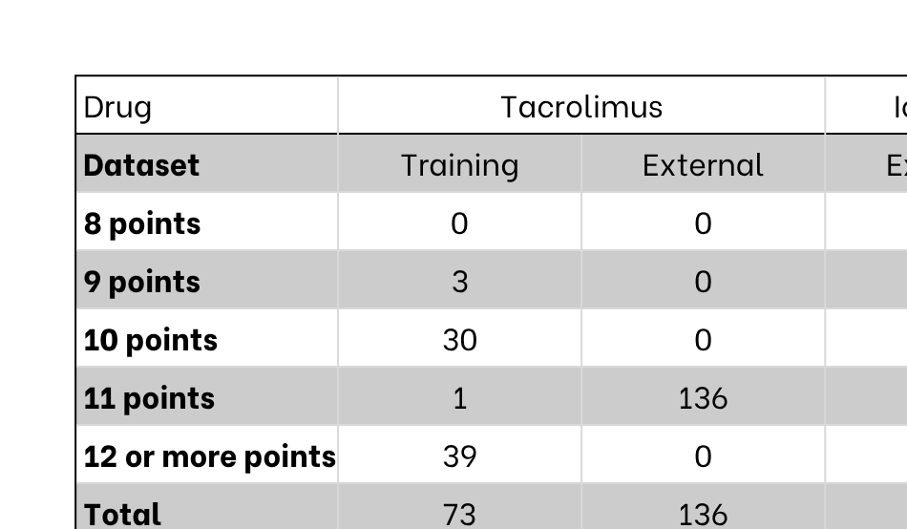
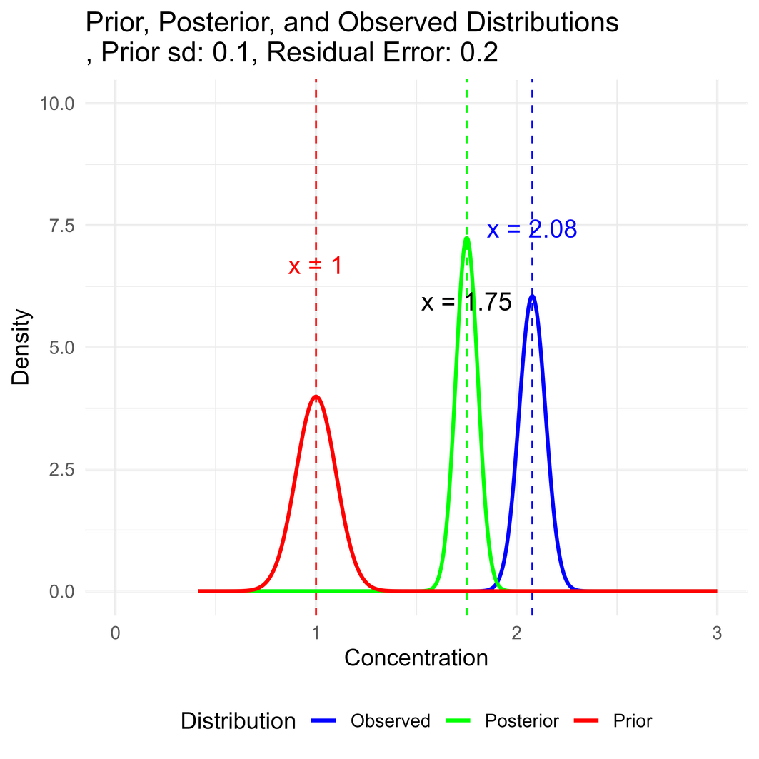
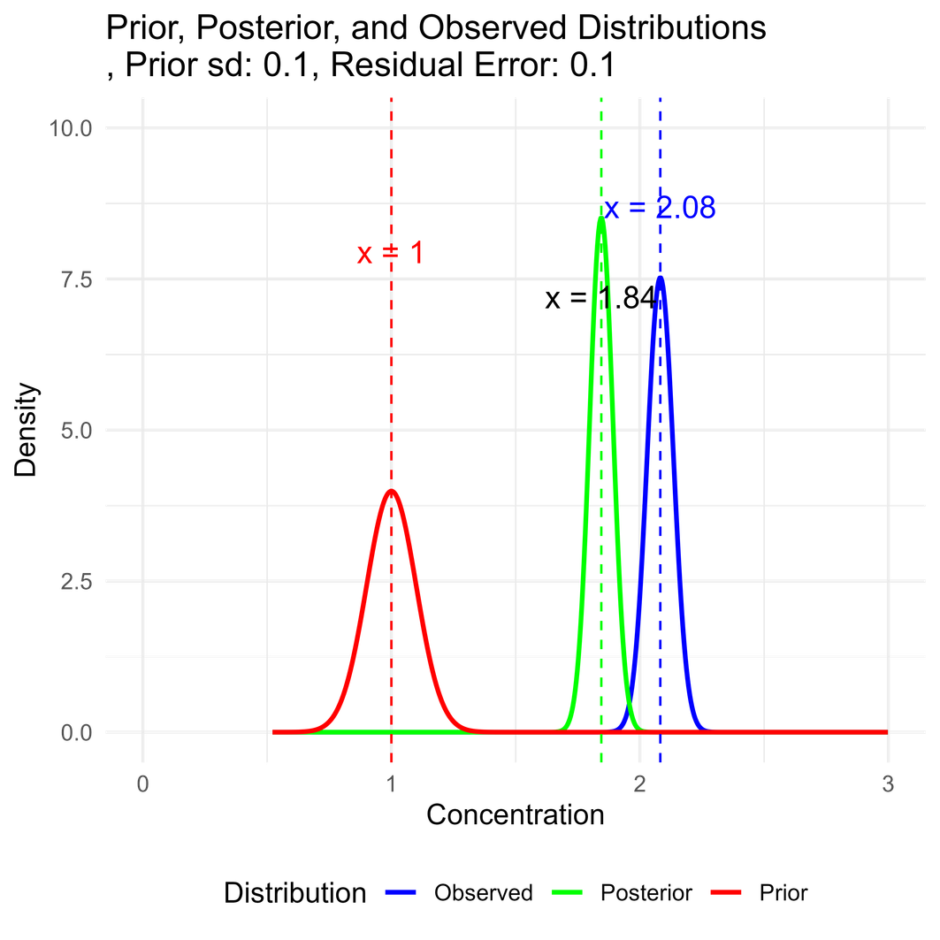
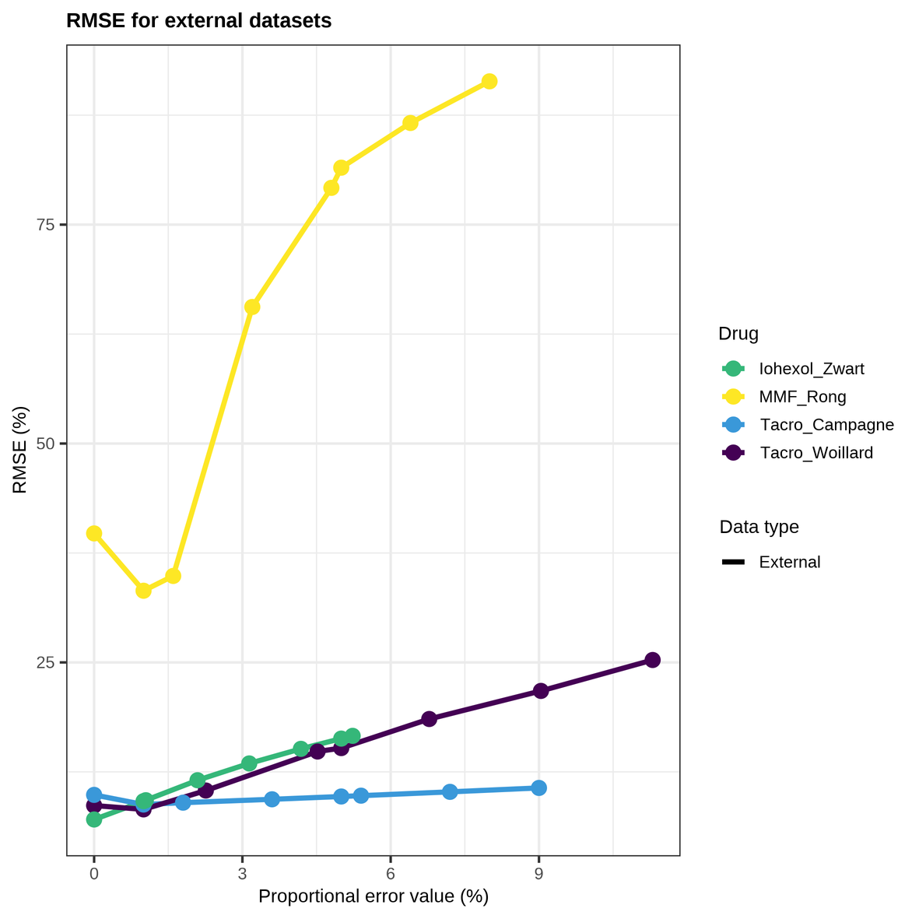
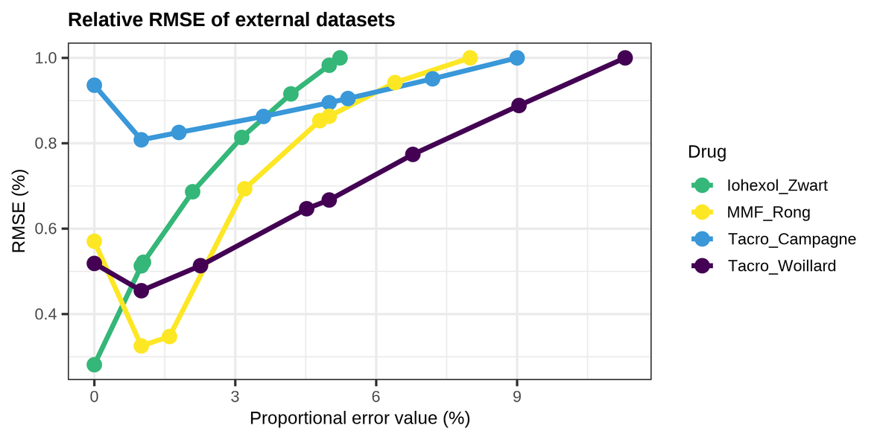
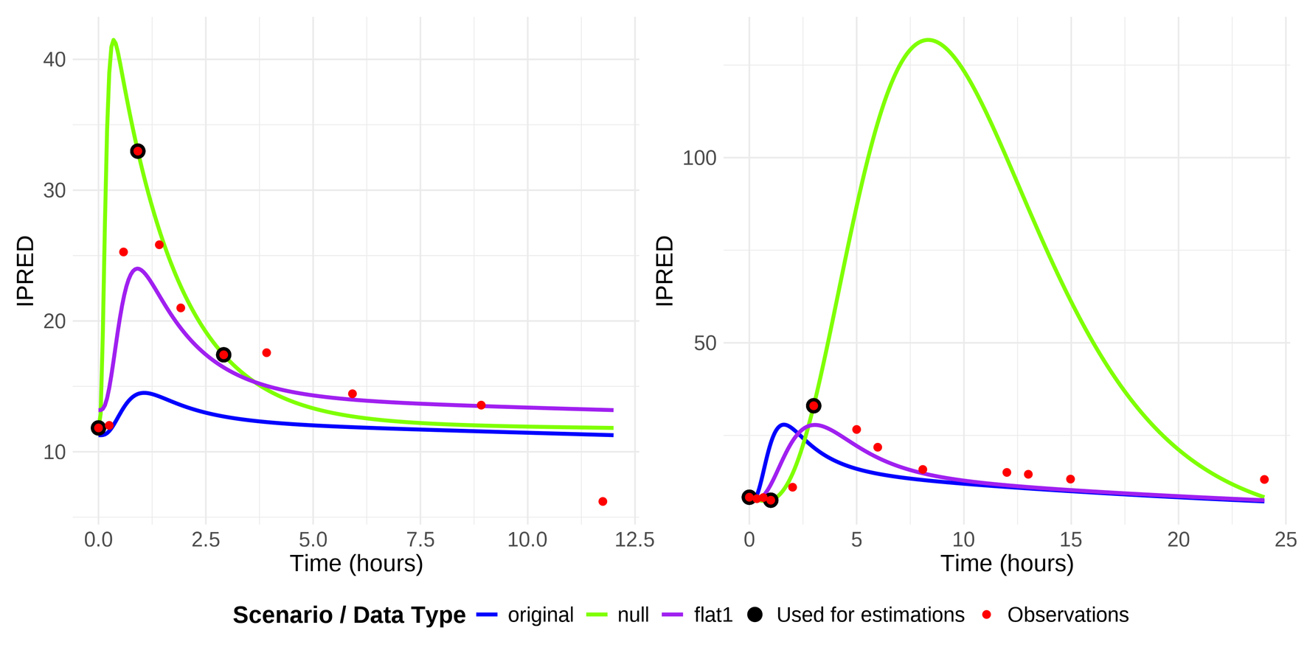
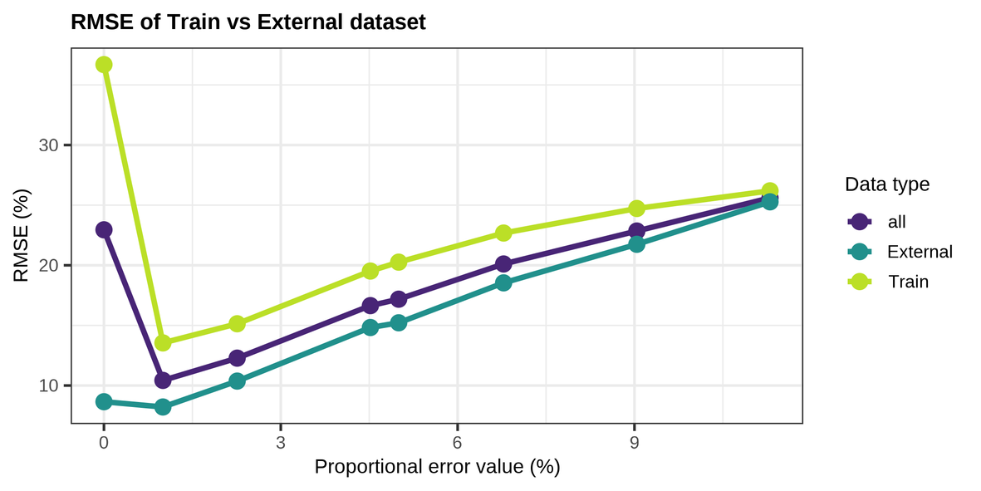
Impact of Residual Error Handling
on Model Informed Precision Dosing
and AUC Calculation
Berrah R 1 , Labriffe M 1,2,3 , Marquet P 1,2,3 , Monchaud C 1,2,3 , Woillard JB 1,2,3
On behalf of the pharmacometrics committee of IATDMCT
1 Pharmacology & Transplantation, INSERM U1248, Limoges University, Limoges, FRANCE
2 Department of Pharmacology, Toxicology and Pharmacovigilance, CHU Limoges, Limoges, FRANCE
3 Fédération Hospitalo-Universitaire Survival Optimization in Organ Transplantation (FHU SUPORT), Limoges, FRANCE
Introduction
Material & Methods
Maximum A Posteriori Bayesian Estimation (MAPBE) is widely used in Therapeutic drug monitoring (TDM) to determine drug exposure (AUC). However, pharmacokinectics (PK) models are often derived from populations that may not represent current clinical settings.
Recent approaches, such as hybrid models, reduce prior influence to improve individualization (Hughes et al.).
We investigated the impact of residual error on the estimation of pharmacokinetic (PK) parameters for three drugs:
  Tacrolimus
  Iohexol
  Mycophenolate Mofetil (MMF).
Depending on availability, data used for PK model development (Train dataset) or external validation (Test dataset) were utilized.
Data Selection
Only rich PK profiles, defined as those with at least eight observed concentrations per patient, were included in the analysis. A summary of the dataset characteristics is provided in the accompanying table.
Objective
To explore an alternative strategy: reducing residual error to increase the weight of individual data (likelihood) in Maximum A Posteriori Bayesian Estimation (MAPBE).
Bayesian Estimation: A Quick Refresher
Bayesian Estimation Approach
Maximum A Posteriori (MAP) Bayesian estimation was performed under different residual error scenarios, to assess its influence on PK parameter estimation:
  Negligible residual error (10-10 proportionnal error)
  Proportional error models: 1% and 5% proportional error
  Scaled error models: 0.2×, 0.4×, 0.6×, 0.8× original error
  Original residual error (as defined in the PK model)
Bayesian estimation was done using mapbayr package on R.4.4.2
Error Evaluation and Comparison
To quantify the impact of residual error on the accuracy of AUC estimation, we calculated the Root Mean Square Error (RMSE), defined as the square root of the mean squared bias across scenarios. The RMSE values were compared to assess the influence of different error magnitudes on Bayesian estimates.
Results
Population level
Individual Level
Reducing the residual error reduces the RMSE and therefore improves the accuracy of the AUC estimates.The higher the basal RMSEs, the greater the improvement seems to be.
By using a reduced residual error approach, the PK parameter estimates are allowed to drift further from the population estimates, and the concentration‐time curve passes closer to the measured value.
However some rare times overfitting data are observed when the residual error is negligeable (only 2 out of the 394 patients)
Scenarios with a 1% proportional error and those assuming negligible error provided the most accurate AUC estimates, with no meaningful difference observed between these two approaches.
Conclusion
Limits
Perspective
  Reducing residual error to emphasise the likelihood allows to be closer to observed data.
  Giving more weight to the observed data improves the estimation of exposure.
  Particularly effective for patients with observed data that deviate from the model population
  A residual error of 1% seems to be the best way to do it.
  The null residual error assumption is that all the observed variability arises from the structural model parameters, rather than from measurement noise.
  RMSE is a population-level metric and does not necessarily reflect individual-level performance.
There may be a common minimum that can be used to estimate the parameters most accurately.
This could involve flattening the prior, emphasising the likelihood, or a combination of both.
Related Literature
Iohexol Model : Zwart TC et al. Clin Pharmacokinet. 2021;60(9):1201–15.
MMF Model : Rong Y et al. CClin Pharmacokinet. 2019;58(11):1483-95.
MAPBE Prior Flattening: Hughes JH, Keizer RJ. CPT Pharmacometrics Syst Pharmacol. 2021;10(10):1150–60.
Tacrolimus Model (1): Woillard JB et al. Br J Clin Pharmacol. 2011;71(3):391–402.
Tacrolimus Model(2): Campagne O et al. J Clin Pharmacol. 2018;58(9):1184–95.I

