Slide 1
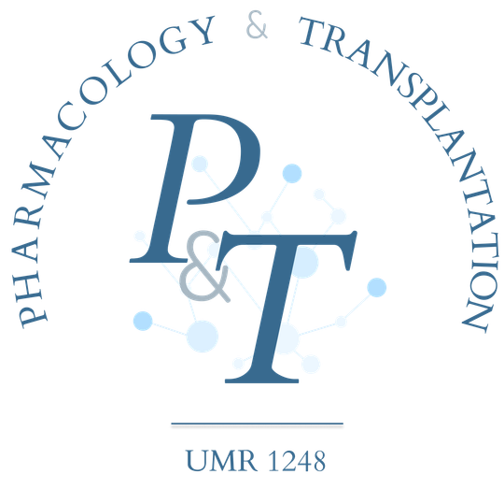
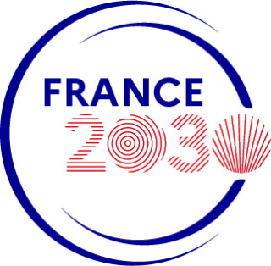

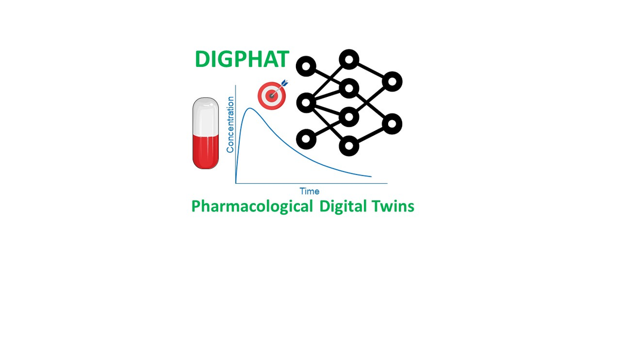

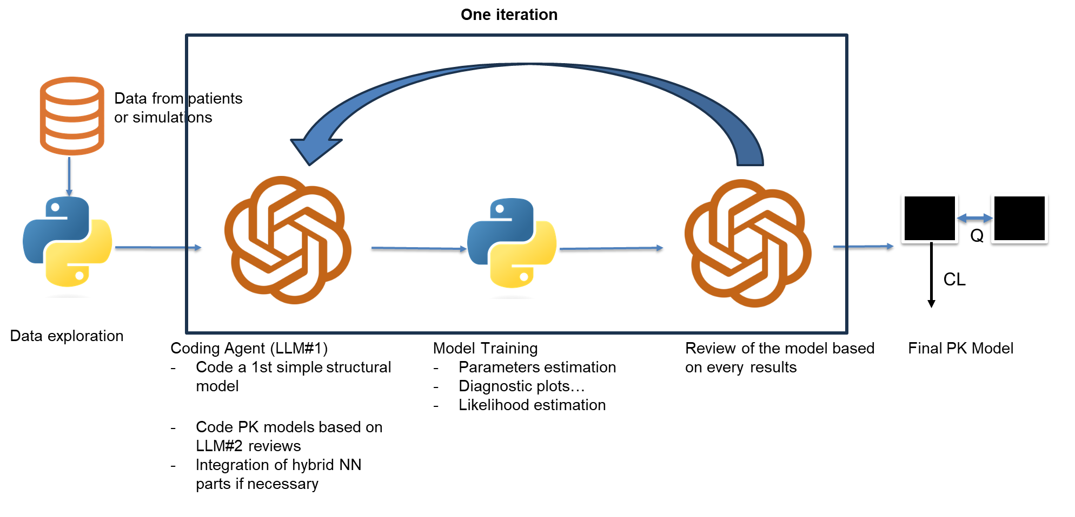
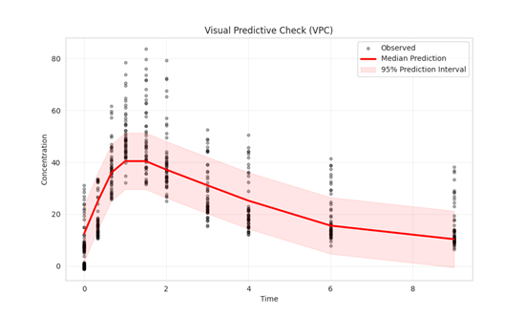
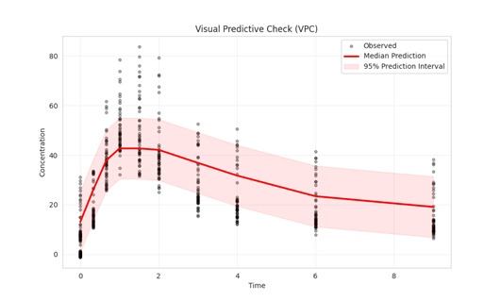
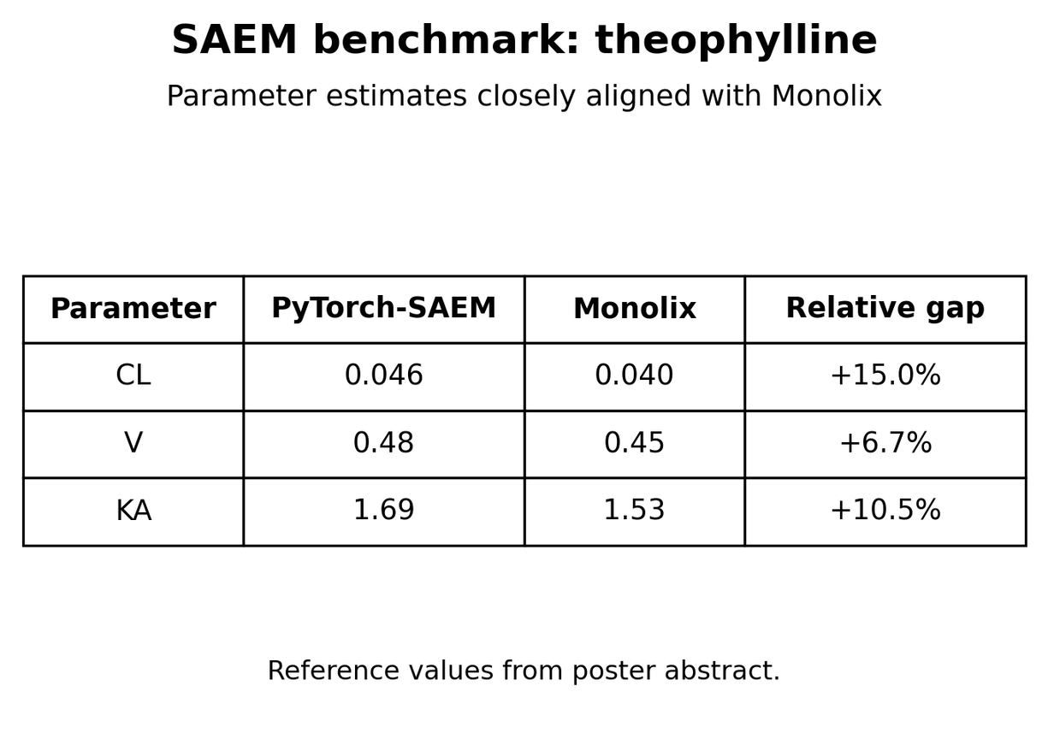
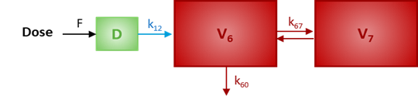

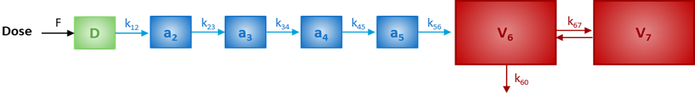
TOWARD AUTONOMOUS PHARMACOMETRICS:
A MULTI AGENT FRAMEWORK
FOR STRUCTURE DISCOVERY,
COVARIATE SELECTION AND GRAY-BOX MODELING
Berrah R 1 , Woillard JB 1,2,3
1 Pharmacology & Transplantation, INSERM U1248, Limoges University, Limoges, FRANCE
2 Department of Pharmacology, Toxicology and Pharmacovigilance, CHU Limoges, Limoges, FRANCE
3 Fédération Hospitalo-Universitaire Survival Optimization in Organ Transplantation (FHU SUPORT), Limoges, FRANCE
Background
Objective :
Turn the PopPK loop into an autonomous pipeline
PopPK modeling is central to model-informed precision dosing, but model development remains iterative and expert-dependent.
Classical compartmental models are interpretable but rigid, whereas pure ML is flexible but less mechanistic.
We propose an autonomous multi-agent framework built around a custom SAEM engine.
  Build a multi-agent LLM framework executing the full PopPK cycle: EDA structure code SAEM diagnostics.
  Develop a JAX-accelerated SAEM engine
  Validate the framework on simulated and real-world tacrolimus data
  Enable future bounded gray-box extensions while preserving interpretability.
Architectural Pipeline
Pipeline example
LLM Proposal based on EDA
LLM Review : “Add a second compartment to have a slower elimination at the end“
SAEM Validation : Theophyline Dataset
Pipeline Validation : Simulated Dataset & Real Dataset
  On simulated tacrolimus data, the multi-agent loop generally recovered the ground-truth structure and rejected a random dummy SEX covariate.
  When convergence was achieved, the correct PopPK structure was typically recovered within 5–8 refinement iterations.
These results support the numerical validity of the in-house estimation backend as a basis for autonomous model exploration.
  The workflow was also transferable to 73 real-world tacrolimus profiles with 10–12 observations per patient.
Gray-box Modeling
Limitations
  The PyTorch-based engine enables bounded Neural-ODE extensions in which a mechanistic PK backbone is preserved, while a neural residual captures unexplained dynamics under pharmacological constraints.
  More broadly, the custom SAEM engine provides an extensible backbone allowing neural components to propose missing covariate effects or structural refinements within a formal population-estimation framework.
  Transfer to real-world tacrolimus data was feasible, but robustness remains limited by LLM-generated code instability.
  Frequent syntax or runtime failures still require stronger execution guardrails.
  JAX + L40 reduced runtime to ~7 min/iteration, but the system remains slower than optimized software.
Conclusion
Perspective
  This proof of concept shows that LLM agents can act as effective junior pharmacometricians for iterative PopPK structure exploration, candidate coding, and model revision.
  The framework combines automated hypothesis generation, custom SAEM estimation, and model refinement.
  Full autonomy is not yet achieved: strict numerical safeguards, validation layers, and pharmacometric supervision remain essential.
  Full JAX port: accelerate SAEM and autonomous structure search on GPU/HPC infrastructures.
  Robust orchestration: add an Aviary-inspired safety layer for code, ODE, and execution validation.
  Hybrid discovery: use the SAEM backbone to test neural proposals for missing covariate effects or structural refinements.
Related Literature
FundingThis work is part of the DIGPHAT project, which was sup-ported by a grant from the French government, managedby the National Research Agency (ANR), under the France2030 program, with reference ANR-22-PESN-0017.
Tacrolimus Model (1): Woillard JB et al. Br J Clin Pharmacol. 2011;71(3):391–402.
Sam Holt et al. Automatically Learning Hybrid Digital Twins of Dynamical Systems

