Slide 1
Missed dose management : Beyond “Skip or Take”
A universal population half-life rule for missed and delayed oral doses
Racym Berrah, Caroline Monchaud, Antoine Humeau, Jean-Baptiste Woillard, Pierre Marquet
INSERM U1248 Pharmacology & Transplantation, University of Limoges · Dept of Pharmacology, Toxicology & Pharmacovigilance, CHU Limoges · FHU SUPORT, Limoges, France
Oral communication · IATDMCT & SFPT 2026, Rennes · Manuscript submitted to Clinical Pharmacology & Therapeutics
Notes:
[0:00-0:15]
Good morning. I am Racym Berrah, from the pharmacology team in Limoges. I will present a simple pharmacokinetic rule that answers a question every clinician and pharmacist hears: "I forgot my dose - what should I do now?"

Slide 2
A daily question, binary answers
Empirical cutoffs, different between FDA and EMA
≈ 50 %
One molecule — tacrolimus — three answers
of patients with chronic conditions take fewer than half of their doses correctly
Prograf
take ≤ 6 h
skip
“Skip or take”
Advagraf
skip
take ≤ 14 h
labels reduce a continuous PK problem to an all-or-nothing cutoff
Envarsus
take ≤ 15 h
skip
Delay after the scheduled dose
0 h
12 h
24 h
No framework
no universal, PK-grounded catch-up rule
Amiodarone: “unless it is nearly time” — no number
2 / 9
Notes:
[0:15-1:00]
Missed and delayed doses are the most common form of non-adherence: about half of patients with chronic conditions take fewer than half of their doses correctly. In transplantation, irregular tacrolimus intake drives intra-patient variability, rejection and graft loss.
What do we tell patients? Labels reduce a continuous pharmacokinetic problem to an all-or-nothing cutoff. Look at tacrolimus: 6 hours for Prograf, 14 for Advagraf, 15 for Envarsus - same molecule, three different answers. Amiodarone has no number at all; abemaciclib says never catch up.
These cutoffs are empirical, differ between agencies, and there is no universal framework for catch-up dosing. That is what we tried to build.
(Refs: Cutler BMJ Open 2018; Albassam & Hughes EJCP 2021; Saint-Marcoux 2015; full label instructions in Backup 1.)

Slide 3
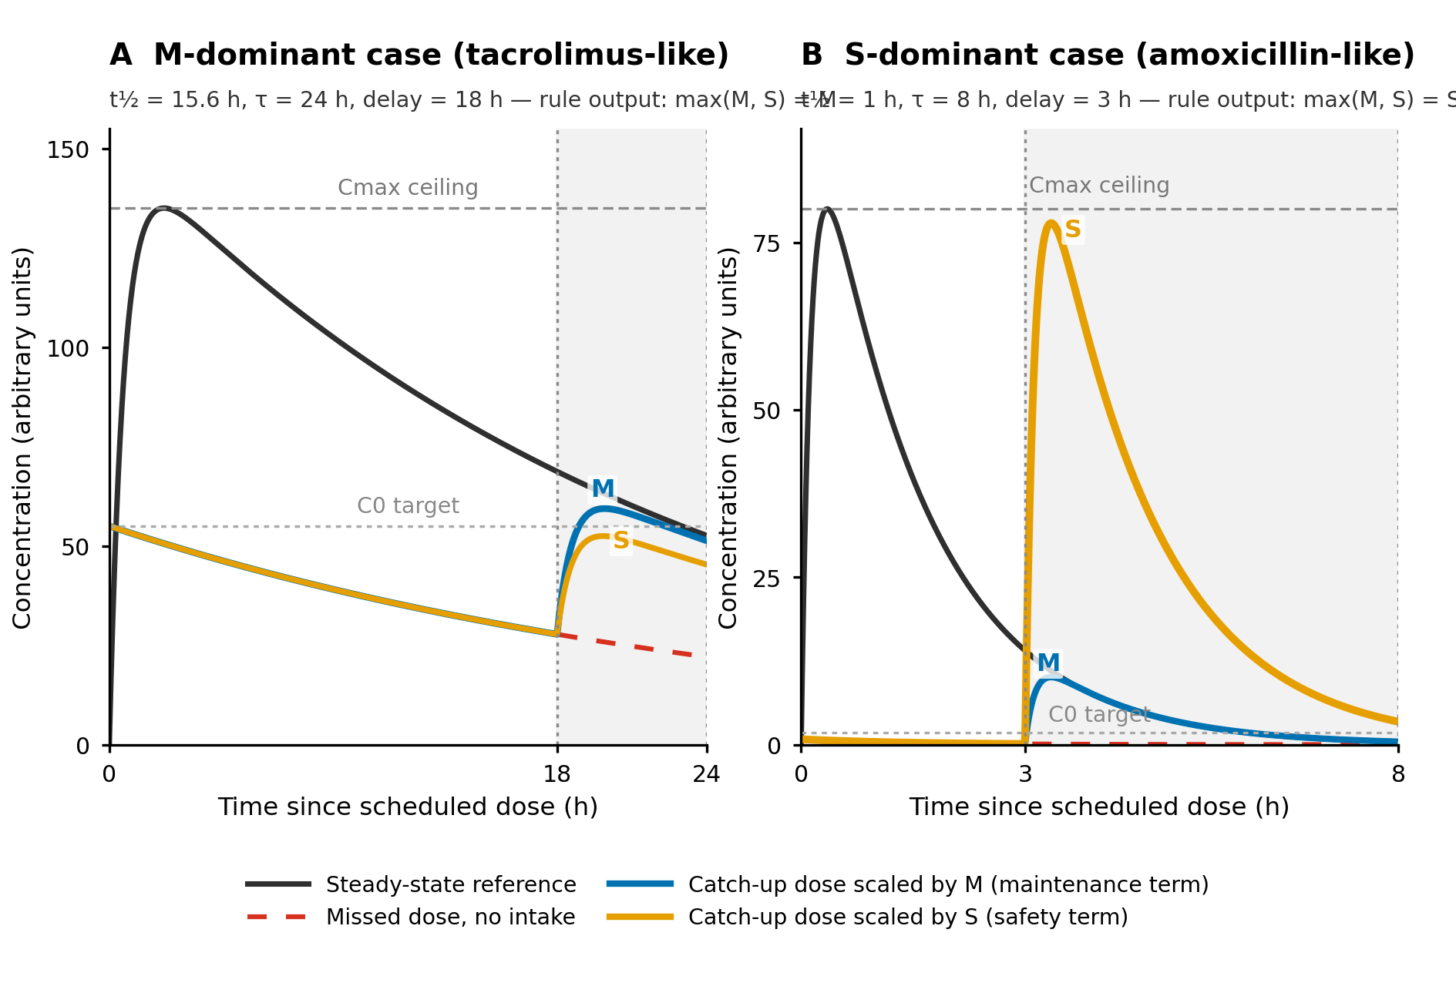
One equation, three variables, a graded dose
τ
dosing interval
t½
population half-life
d
Concentration time curves in different scenarios
delay
Catch-up dose = usual dose × max(M, S)
M = 2^{−d / t½}
Dose fraction remaining at the time of the delay
S = (1 − 2^{−(τ−d) / t½}) / (1 − 2^{−τ / t½})
Dose fraction adjusted for the remaining interval to limit accumulation
Then rounded down to the available strength
3 / 9
Notes:
[1:00-2:15]
The rule needs three numbers that are always available: the delay, the dosing interval, and the population half-life. It returns a fraction of the usual dose - the larger of two terms.
M is the maintenance term: two to the power of minus delay over half-life - simply the fraction of the dose already eliminated. Hence the rule of thumb: one half-life late, half a dose.
S is the safety term: for short-half-life drugs, when the next dose is close, it caps the catch-up so the next peak stays below the steady-state peak.
We keep the larger of the two and round DOWN to the available strength - deliberately conservative.
On the chart: the blue step is the label - all or nothing. The orange curves are the rule - a graded dose that self-adjusts to the drug through the half-life / interval ratio.
Bedside example (if asked): Prograf 5 mg BID taken 6 h late: M = 0.77, so 3.5 mg with the 0.5-mg capsules, then back to the usual schedule. The free web calculator does this for you.

Slide 4
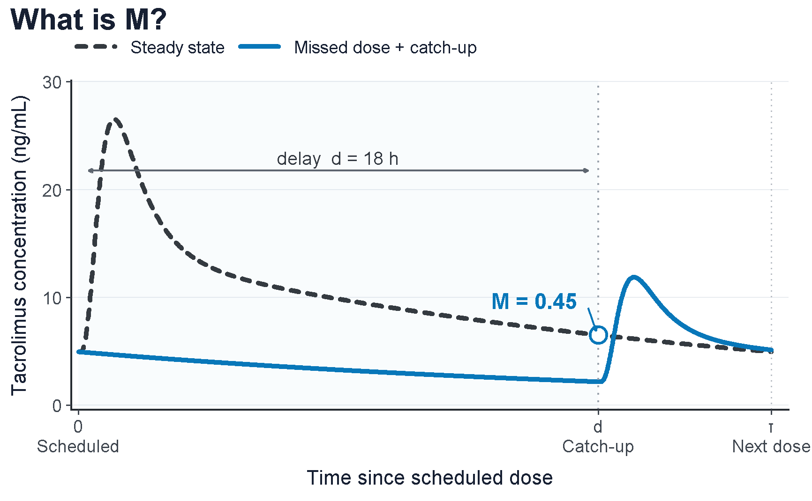
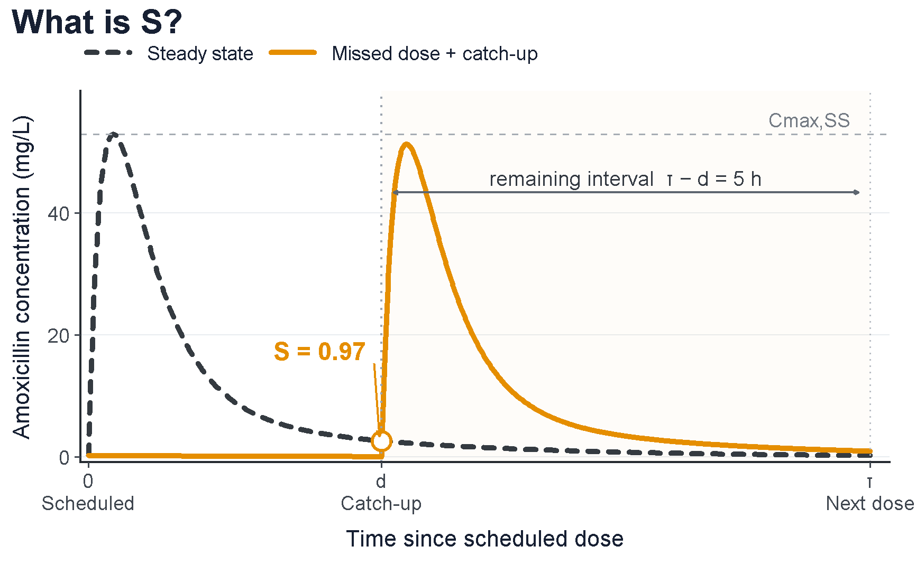
One equation, three variables, a graded dose
What is M : Tacrolimus example
What is S : Amoxicillin example
M is the fraction of the dose that would still be on board at delay d, had it been taken on schedule
S is the largest fraction you can still give now without pushing the next scheduled dose above its steady-state peak.
4 / 9
Notes:
[1:00-2:15]
The rule needs three numbers that are always available: the delay, the dosing interval, and the population half-life. It returns a fraction of the usual dose - the larger of two terms.
M is the maintenance term: two to the power of minus delay over half-life - simply the fraction of the dose already eliminated. Hence the rule of thumb: one half-life late, half a dose.
S is the safety term: for short-half-life drugs, when the next dose is close, it caps the catch-up so the next peak stays below the steady-state peak.
We keep the larger of the two and round DOWN to the available strength - deliberately conservative.
On the chart: the blue step is the label - all or nothing. The orange curves are the rule - a graded dose that self-adjusts to the drug through the half-life / interval ratio.
Bedside example (if asked): Prograf 5 mg BID taken 6 h late: M = 0.77, so 3.5 mg with the 0.5-mg capsules, then back to the usual schedule. The free web calculator does this for you.

Slide 5
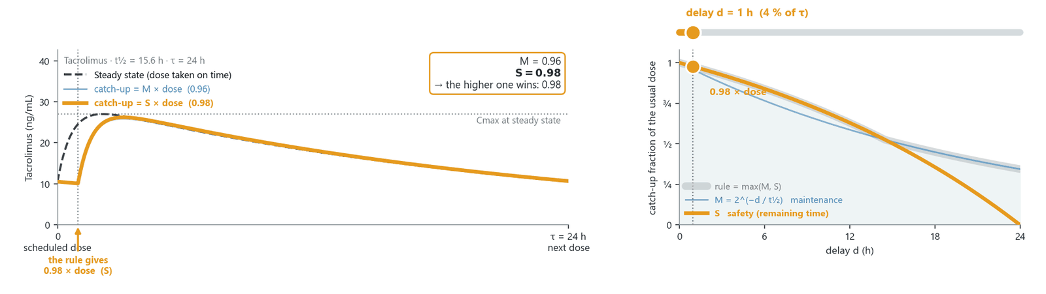
One equation, three variables, a graded dose
Tacrolimus — two candidate catch-up doses: M × dose and S × dose
The rule follows the higher one: max(M, S)
M is the fraction of the dose that would still be on board at delay d, had it been taken on schedule
S is the largest fraction you can still give now without pushing the next scheduled dose above its steady-state peak.
4 — auto-play GIF (delay sweeps 4 → 96 % of τ and back, ~11 s loop)
4 / 9
Notes:
[1:00-2:15]
The rule needs three numbers that are always available: the delay, the dosing interval, and the population half-life. It returns a fraction of the usual dose - the larger of two terms.
M is the maintenance term: two to the power of minus delay over half-life - simply the fraction of the dose already eliminated. Hence the rule of thumb: one half-life late, half a dose.
S is the safety term: for short-half-life drugs, when the next dose is close, it caps the catch-up so the next peak stays below the steady-state peak.
We keep the larger of the two and round DOWN to the available strength - deliberately conservative.
On the chart: the blue step is the label - all or nothing. The orange curves are the rule - a graded dose that self-adjusts to the drug through the half-life / interval ratio.
Bedside example (if asked): Prograf 5 mg BID taken 6 h late: M = 0.77, so 3.5 mg with the 0.5-mg capsules, then back to the usual schedule. The free web calculator does this for you.
[4 - GIF version] The delay slider sweeps automatically while you talk. Left (tacrolimus, long half-life): M dominates and slides down gently - one half-life late, half a dose. Right (amoxicillin, short half-life): M collapses within hours but S keeps the catch-up near a full dose until the next dose is too close - and the next peak never exceeds the steady-state Cmax.

Slide 6
Stress-tested across 11 oral drugs
1,000 virtual patients
per drug, from published popPK models
Exposure vs steady state
AUC (primary)
peak
trough
One event
the dose is delayed, from slightly to fully missed
3 strategies
half-life rule
label cutoff
skip
1
2
3
4
5 / 9
Notes:
[2:15-3:00]
We stress-tested the rule on 11 published population PK models of oral drugs: a thousand-fold range of half-lives, from 1 hour for amoxicillin to 58 days for amiodarone, across five therapeutic classes.
For each drug: 1,000 virtual patients at steady state; then one event - the dose delayed by 10, 20, 33, 50, 75 or 100 % of the interval, 100 % being a fully missed dose caught up at the next scheduled time; and three strategies: our rule, the label with its FDA or EMA cutoff, and skipping.
The primary outcome: the proportion of patients whose AUC, in the interval after the event, stays within 0.80 to 1.25 of their own steady state - the bioequivalence window. We also looked at peaks and troughs, and at whether anything persisted into the following interval.
(Details: 6 delay levels; label cutoffs 4-16 h, eTable 1; Table 1 in Backup 1.)

Slide 7
The rule stays on target where labels fall off the cliff
% in target
averaged over all drugs and delays
Patients with AUC in target after the event (%)
Half-life rule
97.7 %
Label
81.7 %
Skip
61.6 %
100 % on target through half an interval
The gain is where labels say “skip”
6 / 9
Notes:
[3:00-4:15]
The primary result: AUC on target by delay, averaged over the 11 drugs.
Skipping, in grey: about 4 patients in 10 under-exposed, whatever the delay.
The label, in blue, does well for short delays - it sits at 92 %, not 100 %, only because abemaciclib's label says never catch up. Then it falls off a cliff once the cutoffs are crossed: about 61 %, identical to skipping.
The rule, in orange: 100 % of patients on target through half a dosing interval, and still 95 % and 92 % at 75 % and at a fully missed dose.
Averaged over everything: 97.7 %, versus 81.7 % for the label and 61.6 % for skipping. The advantage is largest exactly where labels tell the patient to skip.
(Per-drug detail in Backup 2: from 0 % gain for amiodarone/carvedilol to +100 points for Envarsus at 75 %.)

Slide 8
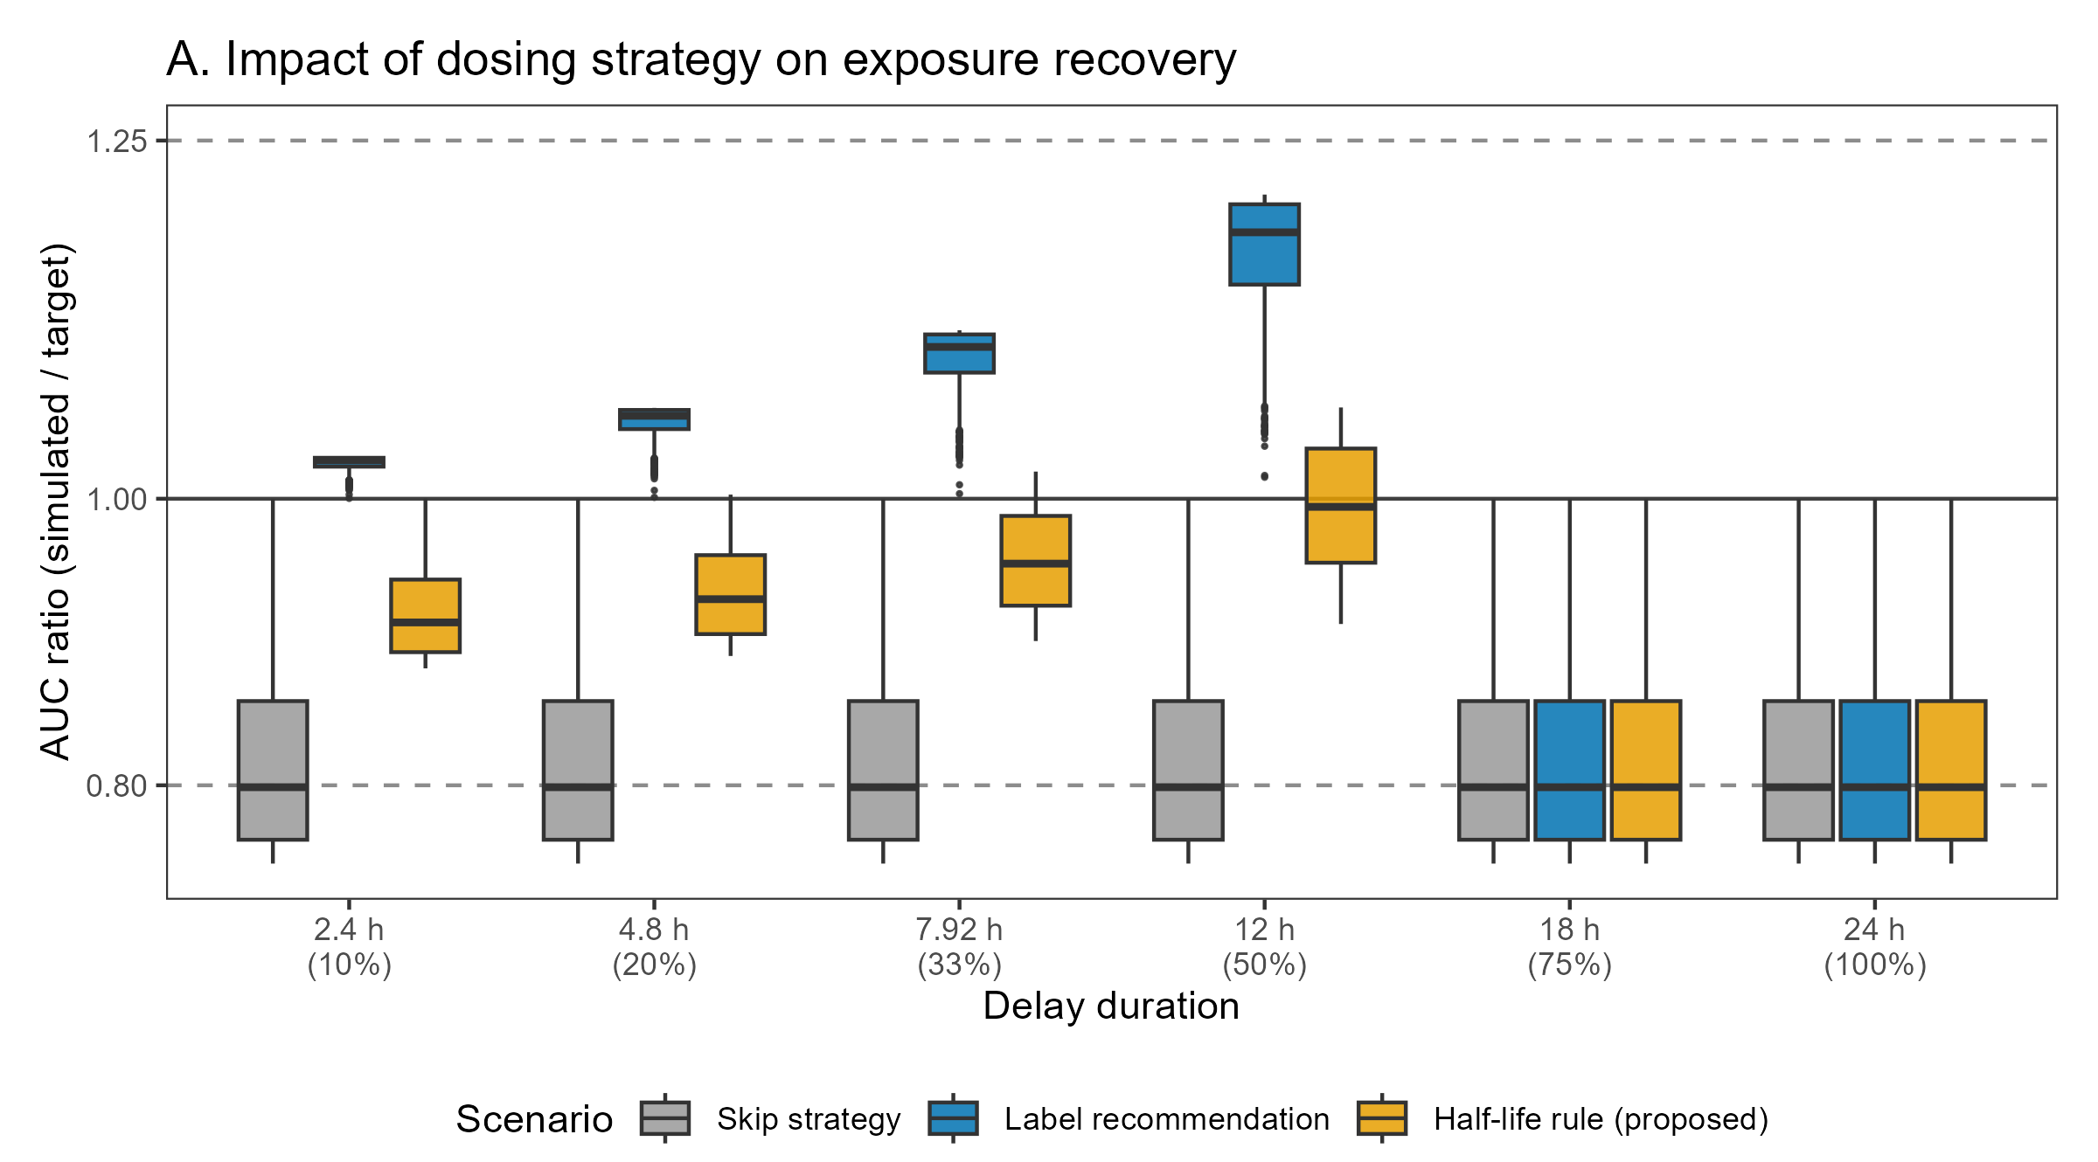
A practical example: levofloxacin once daily
Impact of dosing strategy on exposure recovery
The Skip
Always skip → underexposure
The Label
Full dose just before the cutoff → overexposure
Skip just after → underexposure
The Rule
Half a tablet, whatever the delay up to half a day → stays inside the window
Dose rounded down.
7 / 9
Notes:
[5:15-6:00]
One concrete example: levofloxacin, once daily, half-life 7 hours, label cutoff 16 hours.
With the label, a full dose taken 12 hours late overshoots - AUC ratio around 1.18, just before the cutoff. Six hours later the patient skips, and drops to 0.80. Overexposure on one side of an arbitrary line, underexposure on the other.
With the rule: half a tablet, whatever the delay up to half a day - and the AUC stays inside the window. Beyond that, the calculated dose falls below the smallest tablet, so the rule omits, like the label: that is the price of coarse strengths.
With tacrolimus and its 0.5-mg capsules, the rule tracks the exact dose almost continuously - the table is in backup.
Sensitivity analyses: floor rounding avoids overshoot; an individualized elimination rate adds almost nothing over the population half-life - the simple form is enough.

Slide 9
A practical example: tacrolimus twice daily
Impact of dosing strategy on exposure recovery
The Skip
Always skip → underexposure
The Label
Full dose just before the cutoff → overexposure
Skip just after → underexposure
The Rule
Half a tablet, whatever the delay up to half a day → stays inside the window
Dose rounded down.
Dose granularity matters
Coarse dose increments may force omission
Smaller strengths, such as tacrolimus, allow the rule to track the calculated dose more closely
8 / 9
Notes:
[5:15-6:00]
One concrete example: levofloxacin, once daily, half-life 7 hours, label cutoff 16 hours.
With the label, a full dose taken 12 hours late overshoots - AUC ratio around 1.18, just before the cutoff. Six hours later the patient skips, and drops to 0.80. Overexposure on one side of an arbitrary line, underexposure on the other.
With the rule: half a tablet, whatever the delay up to half a day - and the AUC stays inside the window. Beyond that, the calculated dose falls below the smallest tablet, so the rule omits, like the label: that is the price of coarse strengths.
With tacrolimus and its 0.5-mg capsules, the rule tracks the exact dose almost continuously - the table is in backup.
Sensitivity analyses: floor rounding avoids overshoot; an individualized elimination rate adds almost nothing over the population half-life - the simple form is enough.

Slide 10

Thank you
Funding DIGPHAT — France 2030 (ANR-22-PESN-0017)
Take-home
1
Three variables always avalaible
replaces “skip or take” across oral drugs
Try the calculator
2
Recovers exposure where labels give up
in a safe manner
3
A decision aid, with safeguards
not a substitute for TDM; not yet validated in patients
4
Towards harmonized PK-grounded labels
and decision-support tools
tdmhub.shinyapps.io/MissedDoseApp
free · includes a Safety-First mode
9 / 9
Notes:
[6:00-6:45]
To take home.
One: three numbers give a graded catch-up dose that replaces "skip or take", across drugs as different as amoxicillin and amiodarone.
Two: it recovers exposure exactly where labels give up - 97.7 % on target overall versus 81.7 % for labels and 61.6 % for skipping - without peak overexposure up to three quarters of the interval.
Three: it is a decision aid with safeguards - cap or skip fully missed doses of rapid-absorption or peak-toxicity drugs (the Safety-First mode of the calculator); it is not a substitute for TDM, and it has not yet been validated in patients.
And four: missed-dose scenarios should be simulated during drug development, so that labels become harmonized and PK-grounded.
The calculator is free - scan the QR code.

Slide 11
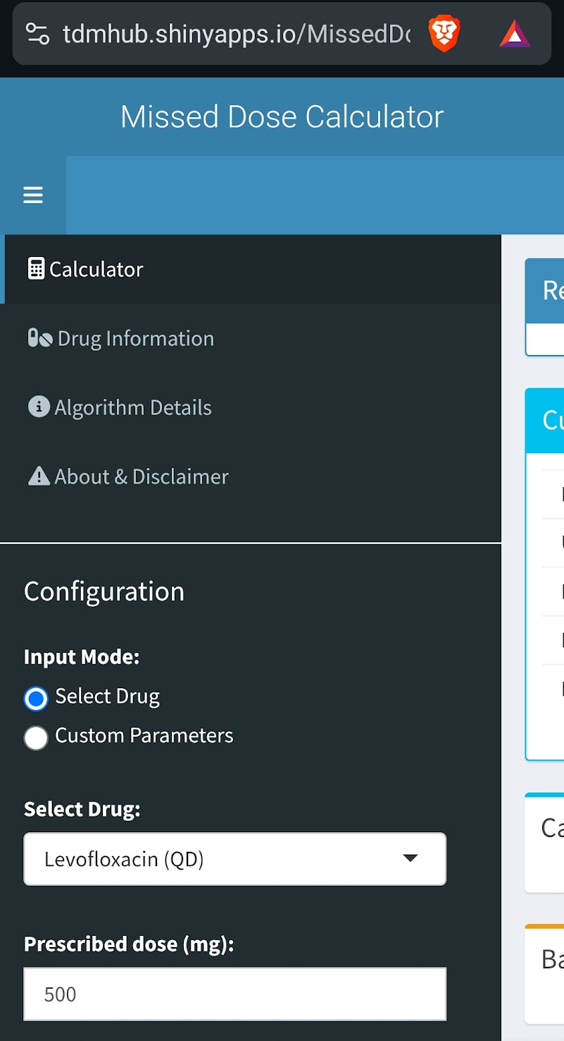
Thank you
Funding DIGPHAT — France 2030 (ANR-22-PESN-0017)
Take-home
1
Try the calculator
Three variables always avalaible
replaces “skip or take” across oral drugs
2
Recovers exposure where labels give up
in a safe manner
3
A decision aid, with safeguards
not a substitute for TDM; not yet validated in patients
4
Towards harmonized PK-grounded labels
and decision-support tools
tdmhub.shinyapps.io/MissedDoseApp
free · includes a Safety-First mode
9 / 9
Notes:
[6:00-6:45]
To take home.
One: three numbers give a graded catch-up dose that replaces "skip or take", across drugs as different as amoxicillin and amiodarone.
Two: it recovers exposure exactly where labels give up - 97.7 % on target overall versus 81.7 % for labels and 61.6 % for skipping - without peak overexposure up to three quarters of the interval.
Three: it is a decision aid with safeguards - cap or skip fully missed doses of rapid-absorption or peak-toxicity drugs (the Safety-First mode of the calculator); it is not a substitute for TDM, and it has not yet been validated in patients.
And four: missed-dose scenarios should be simulated during drug development, so that labels become harmonized and PK-grounded.
The calculator is free - scan the QR code.

Slide 12
8 / 9

Slide 13
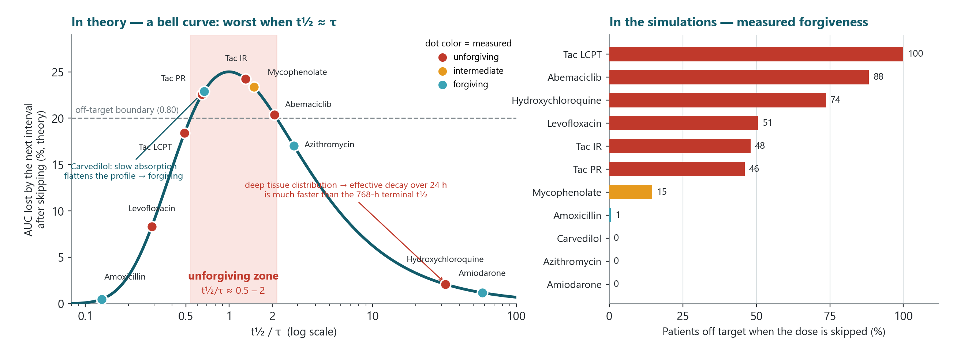
Backup — Drug forgiveness: where does a missed dose actually hurt?
Worst when the effective t½ ≈ τ — forgiveness must be measured by simulation, not read off the terminal half-life.
Backup 7
Notes:
Backup, if asked about forgiveness.
Forgiveness is a regimen's tolerance to an occasional missed dose (Urquhart; Osterberg & Blaschke NEJM 2005). The manuscript does not define a forgiveness index, but eTable 2 measures it directly: the fraction of patients off the AUC target when a dose is simply skipped (right panel).
LEFT PANEL - the theory is a bell curve, not a straight line. The AUC lost by the post-event interval is x(1-x), where x = 2^(-tau/t1/2) is the fraction of the missed dose that would have carried over into that interval. Both extremes forgive: t1/2 << tau (amoxicillin) - the missed dose would not have contributed to the next interval anyway; t1/2 >> tau (amiodarone) - the accumulated stock buffers the loss. The maximum (~25 % of the interval AUC) occurs when t1/2 is close to tau: the unforgiving zone is t1/2/tau ~ 0.5-2, where Envarsus, Advagraf, Prograf and abemaciclib sit.
DOT COLORS = measured forgiveness. The two annotated outliers carry the second message:
- Hydroxychloroquine (terminal t1/2/tau = 32) is measured UNFORGIVING: plasma decay over one 24-h interval is governed by the fast distribution phases, not the 768-h terminal half-life - its effective t1/2 puts it back in the danger zone. Table 1 lists terminal half-lives, hence the apparent paradox.
- Carvedilol sits in the theoretical danger zone but is measured FORGIVING: slow absorption flattens the profile and buffers the missed dose.
- Levofloxacin lies below the theoretical boundary but half the patients still fall off target: inter-individual variability around the binary 0.80 threshold decides which side each patient lands on (same reason Envarsus is 100 % off vs Prograf 48 %).
One-sentence answer if challenged: forgiveness depends on the drug's effective concentration decay over one dosing interval relative to tau - worst when they are similar - modulated by absorption/distribution shape and inter-individual variability around the 0.80 boundary; that is why it must be measured by population simulation, not read off the terminal half-life.
Useful distinction: the rule USES t1/2/tau to size the catch-up; the NEED for a catch-up (forgiveness) comes out of the full simulation - one more argument for simulating missed-dose scenarios during drug development. The rule concentrates its benefit exactly on the unforgiving drugs and leaves the forgiving ones untouched.

Slide 14
Backup — Table 1. Drug models and simulation settings
Drug / model | Standard regimen | Pop. t½ (h) | τ (h) | t½/τ | Label cutoff | Label instruction (operationalized, eTable 1)
Amoxicillin | 1000 mg TID | 1.0 | 8 | 0.13 | 4 h | as soon as remembered, ≈ 4 h before the next dose
Levofloxacin | 500 mg QD | 7.0 | 24 | 0.29 | 16 h | only if ≥ 8 h remain before the next dose
Tacrolimus LCPT (Envarsus) | 5 mg QD | 11.7 | 24 | 0.49 | 15 h | as soon as possible within 15 h
Tacrolimus PR (Advagraf) | 5 mg QD | 15.6 | 24 | 0.65 | 14 h | up to 14 h after the scheduled time
Carvedilol | 6.25 mg BID | 8.0 | 12 | 0.67 | 6 h | no two doses within 6 h
Tacrolimus IR (Prograf) | 5 mg BID | 15.6 | 12 | 1.30 | 6 h | if ≤ 6 h late; never double
Mycophenolate mofetil | 1000 mg BID | 17.9 | 12 | 1.49 | 10 h | unless the next dose is < 2 h away
Abemaciclib | 150 mg BID | 24.8 | 12 | 2.07 | omit | never take an additional dose
Azithromycin | 500 mg QD | 68 | 24 | 2.83 | 12 h | if ≤ 12 h have elapsed
Hydroxychloroquine | 400 mg QD | 768 | 24 | 32.0 | 12 h | omit if the next dose is within 12 h
Amiodarone | 400 mg QD | 1392 | 24 | 58.0 | none | “unless nearly time for the next dose” → omit
Sorted by t½/τ. Cutoffs operationalized from the most recent FDA / EMA product information. Simulations: R 4.4.2, mrgsolve 1.5.2, 1,000 virtual patients per model, ≥ 7 dosing intervals to steady state; delays 10/20/33/50/75/100 % of τ.
Backup 1
Notes:
Backup: Table 1 of the manuscript with the operationalized label instructions (eTable 1).

Slide 15
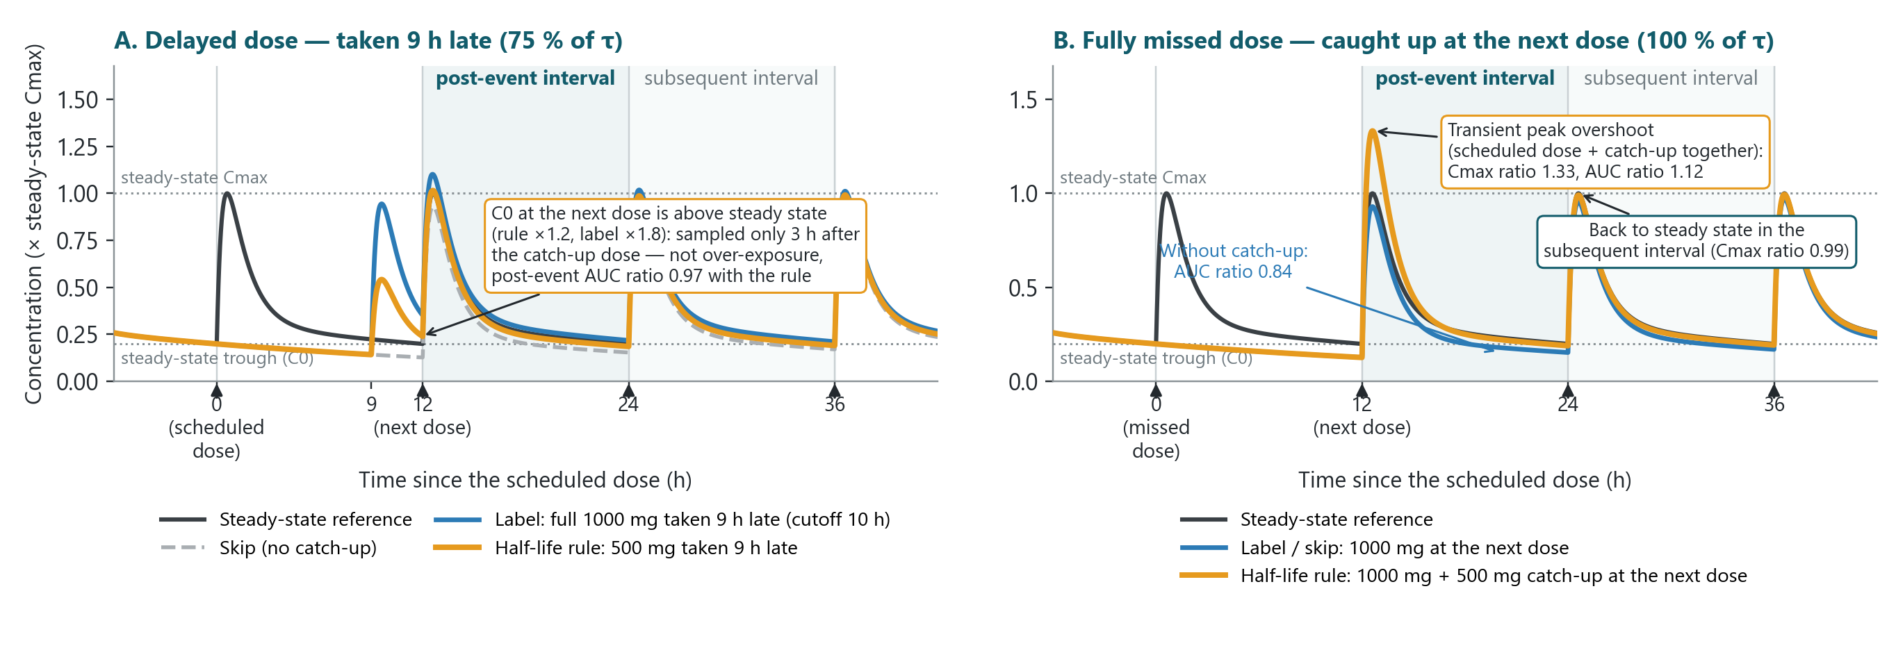
A higher trough or peak after a catch-up is expected — and transient
Trough sampled a few hours after the catch-up → higher, with AUC on target. Peak overshoot → only after a fully missed dose of rapid-absorption drugs, gone by the next interval.
Illustrative 2-compartment simulation (mycophenolate-like); ratios vs steady state.
6 / 9
Notes:
[4:15-5:15]
Two things you will see in TDM after a catch-up, on simulated curves of a rapid-absorption drug like mycophenolate.
Panel A, a dose taken 9 hours late: the trough measured at the next scheduled time is higher than steady state - about 1.2 times with the rule, 1.8 with a full label dose - simply because the sample is drawn 3 hours after the intake. This is not over-exposure: the AUC is on target. Overall the rule roughly doubles trough target attainment versus the label at moderate-to-severe delays (88 vs 56 % at a third of the interval, 78 vs 38 % at half, 49 vs 15 % at three quarters).
Panel B, a fully missed dose caught up at the next scheduled time: the scheduled dose and the catch-up are taken together, so the peak transiently exceeds the steady-state peak - Cmax ratio 1.3 here - while skipping leaves the patient under-exposed. By the following interval everything is back to steady state.
In the simulations: no peak overexposure with the rule through 50 % delay; at a fully missed dose it was concentrated in four rapid-absorption models (MMF 74 %, azithromycin 58 %, tacrolimus PR 17 %, IR 7 %) and never persisted. Figures 2-3 in Backups 3-4.

Slide 16
Backup — AUC target attainment by drug model and delay (% of patients)
Drug model | Rule 10 % | Rule 20 % | Rule 33 % | Rule 50 % | Rule 75 % | Rule 100 % | Label 10 % | Label 20 % | Label 33 % | Label 50 % | Label 75 % | Label 100 % | Skip
Amoxicillin | 100 | 100 | 100 | 100 | 92 | 99 | 100 | 100 | 100 | 100 | 99 | 99 | 99
Levofloxacin | 100 | 100 | 100 | 100 | 49 | 49 | 100 | 100 | 100 | 100 | 49 | 49 | 49
Tacrolimus LCPT | 100 | 100 | 100 | 100 | 100 | 100 | 100 | 100 | 100 | 100 | 0 | 0 | 0
Tacrolimus PR | 100 | 100 | 100 | 100 | 100 | 95 | 100 | 100 | 100 | 100 | 54 | 54 | 54
Carvedilol | 100 | 100 | 100 | 100 | 100 | 100 | 100 | 100 | 100 | 100 | 100 | 100 | 100
Tacrolimus IR | 100 | 100 | 100 | 100 | 100 | 98 | 100 | 100 | 100 | 100 | 52 | 52 | 52
Mycophenolate mofetil | 100 | 100 | 100 | 100 | 100 | 77 | 100 | 100 | 100 | 99 | 76 | 85 | 85
Abemaciclib | 100 | 100 | 100 | 100 | 100 | 100 | 12 | 12 | 12 | 12 | 12 | 12 | 12
Azithromycin | 100 | 100 | 100 | 100 | 100 | 91 | 100 | 100 | 100 | 100 | 100 | 100 | 100
Hydroxychloroquine | 100 | 100 | 100 | 100 | 100 | 100 | 100 | 100 | 100 | 100 | 26 | 26 | 26
Amiodarone | 100 | 100 | 100 | 100 | 100 | 100 | 100 | 100 | 100 | 100 | 100 | 100 | 100
Mean (11 models) | 100.0 | 100.0 | 100.0 | 100.0 | 94.6 | 91.8 | 92.0 | 92.0 | 92.0 | 91.9 | 60.8 | 61.6 | 61.6
Green ≥ 95 %, yellow 80–94 %, red < 80 % within 0.80–1.25 of steady-state AUC in the post-event interval (eTable 2). Skip is independent of the delay. Abemaciclib and amiodarone labels operationalize as omission at every delay.
Backup 2
Notes:
Backup: per-drug AUC target attainment (eTable 2). The pooled label value of 92 % at short delays is driven solely by abemaciclib.

Slide 17
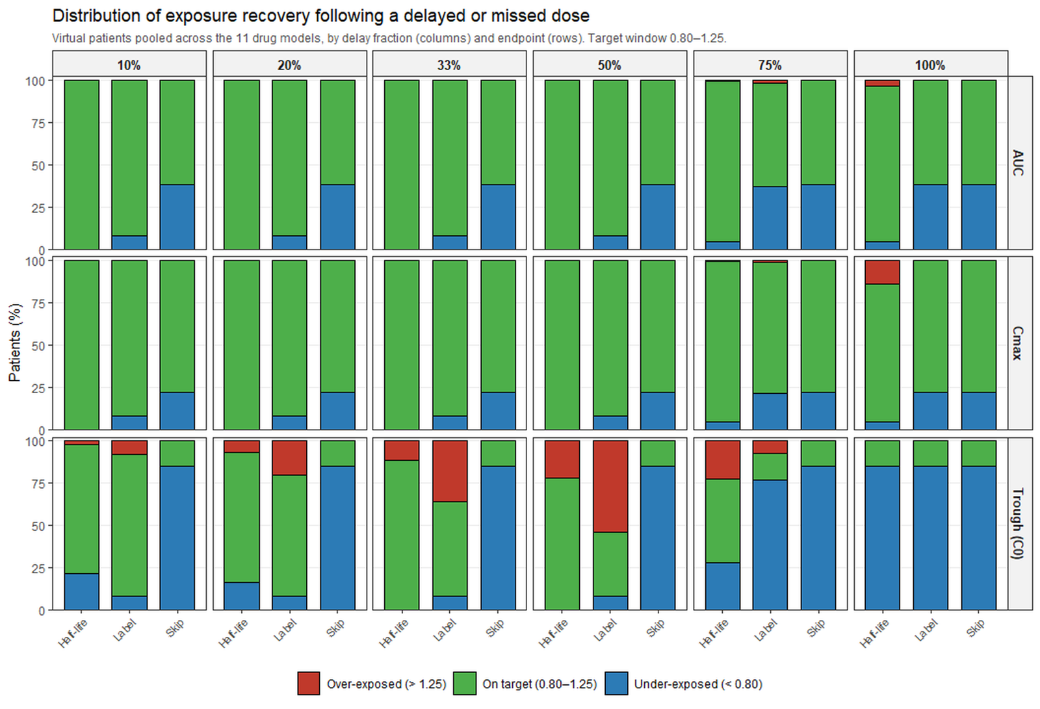
Backup — Figure 2. AUC, Cₘₐₓ and C₀ ratio distributions (pooled)
Backup 3
Notes:
Backup: Figure 2 of the manuscript (proportions below / within / above the 0.80-1.25 window, pooled across the 11 drug models).

Slide 18
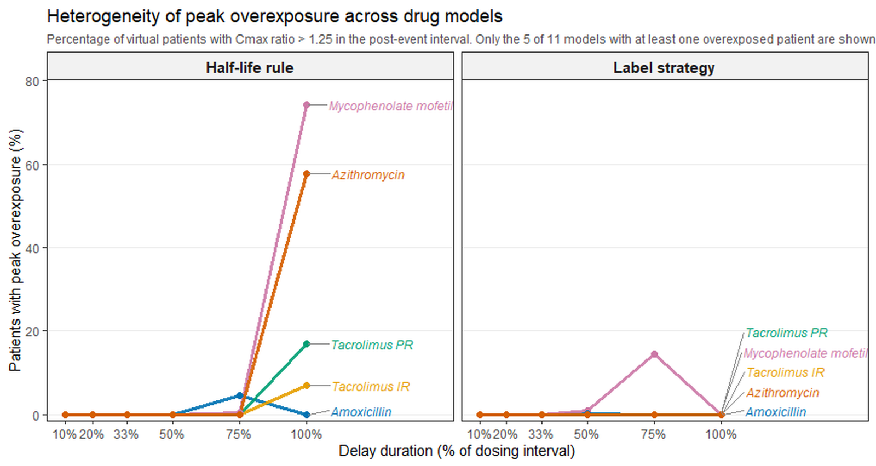
Backup — Figure 3. Heterogeneity of peak overexposure
Backup 4
Notes:
Backup: Figure 3 of the manuscript (% of virtual patients with Cmax ratio > 1.25 by delay; only the 5 of 11 models with at least one overexposed patient are shown).

Slide 19
Backup — levofloxacin 500 mg QD: rule output by delay
t½ 7 h · τ 24 h · label cutoff 16 h · strengths 250 and 500 mg (250-mg steps)
Delay | max(M, S) | Exact dose | Rule gives | Label gives
2.4 h (10 %) | 0.97 | 486 mg | 250 mg | 500 mg
4.8 h (20 %) | 0.94 | 469 mg | 250 mg | 500 mg
7.9 h (33 %) | 0.88 | 439 mg | 250 mg | 500 mg
12 h (50 %) | 0.77 | 383 mg | 250 mg | 500 mg
18 h (75 %) | 0.49 | 247 mg | omit | omit
24 h (100 %) | 0.09 | 46 mg | omit | omit
At 18 h the exact dose (247 mg) rounds down below the 250-mg tablet → omission, like the label; median AUC ratio 0.80.
Floor rounding avoids the overshoot of round-to-nearest; individual kₑ adds little over the population t½ (Fig. 4B).
Backup 5
Notes:
Backup: levofloxacin worked example with exact rule outputs (250-mg increments).

Slide 20
Backup — tacrolimus IR: finer strengths, finer catch-up
5 mg BID · t½ 15.6 h · label cutoff 6 h · capsules 0.5 / 1 / 5 mg
Tacrolimus IR — patients on target (%)
Delay | max(M, S) | Exact dose | 0.5-mg steps | Full / half / none | Label gives
1.2 h (10 %) | 0.95 | 4.74 mg | 4.5 mg | 2.5 mg | 5 mg
2.4 h (20 %) | 0.90 | 4.49 mg | 4.0 mg | 2.5 mg | 5 mg
4 h (33 %) | 0.84 | 4.19 mg | 4.0 mg | 2.5 mg | 5 mg
6 h (50 %) | 0.77 | 3.83 mg | 3.5 mg | 2.5 mg | 5 mg
9 h (75 %) | 0.67 | 3.35 mg | 3.0 mg | 2.5 mg | omit
12 h (100 %) | 0.59 | 2.93 mg | 2.5 mg | 2.5 mg | omit
With 0.5-mg capsules the catch-up tracks the exact dose within 0.5 mg; “full / half / none” floors to 2.5 mg at every delay → systematic under-compensation.
Fully missed dose: 2.5 mg added to the scheduled 5 mg → AUC on target in 98 %, Cₘₐₓ ratio > 1.25 in 7 %, nothing persisting.
Beyond the 6-h cutoff the label skips → 52 % on target only.
Backup 6
Notes:
Backup: tacrolimus IR worked example - the finer the strengths, the closer the rule tracks the exact catch-up dose; results per delay from eTables 2 and 4.

