Slide 1




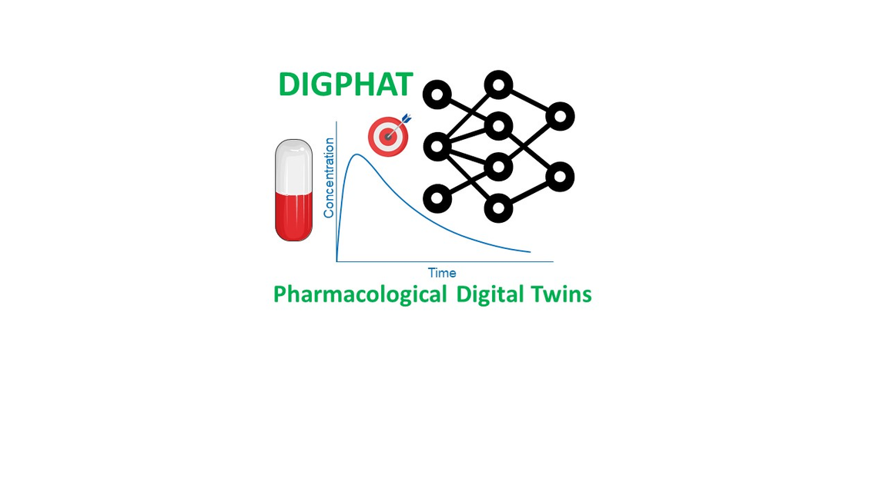
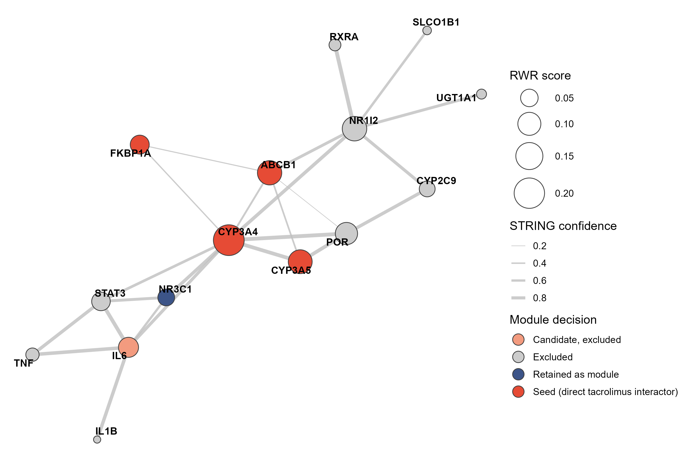
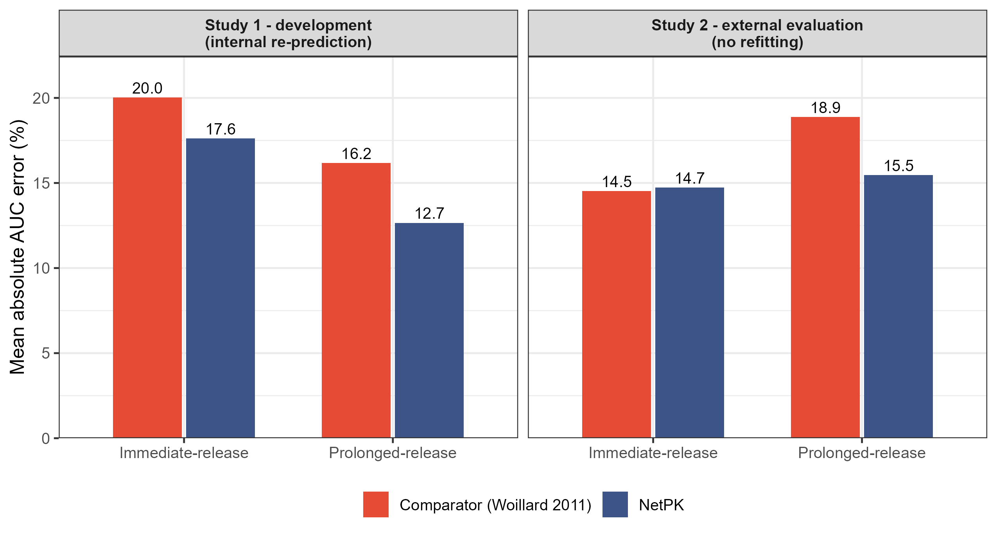

NETWORK-INFORMED PHARMACOKINETICS
NetPK: fusing published biological knowledge into pharmacokinetic models through network diffusion
A literature-augmented population PK framework — tacrolimus as proof of concept, built to generalize
Racym Berrah¹, Pierre Marquet^{1,2}, Jean-Baptiste Woillard^{1,2}
¹ Pharmacology & Transplantation, INSERM U1248, University of Limoges ² Department of Pharmacology, Toxicology and Pharmacovigilance, CHU Limoges
1
Background & aim
4
What the network retains
6
External results (study 2)
Decades of independent studies have quantified tacrolimus pharmacology: in-vitro drug–drug interactions, CYP3A fractional contributions, pharmacogenetics, hematocrit partitioning, corticosteroid induction, inflammation, food effects…
Yet population PK (PopPK) models encode only 2–4 empirically estimated covariates: identifying more would require very large, covariate-complete cohorts that rarely exist.
Three questions.
Can published knowledge be fused into a PopPK model via network diffusion?
Does the model estimate AUC better from sparse monitoring?
Does it generate better virtual patients for machine-learning training?
Prolonged release, trough only — absolute AUC error
(% within ±20%: 64.3 → 83.3)
Systematic bias corrected (mean relative error)
Tacrolimus-centered network: node size = RWR score, edge width = STRING confidence, color = module decision.
18.9% → 15.5%
+9.6% → −2.5%
NetPK is not a neural network. It is an ordinary nonlinear mixed-effects model — its novelty is that the covariate structure is selected and quantified by the literature, not estimated from the data.
Three pre-specified selection criteria
% within ±20% of observed AUC (n = 73) | C0 | C0+C1 | C0+C1+C3
MAP-BE / comparator | 71.2 | 76.7 | 87.7
MAP-BE / NetPK | 78.1 | 74.0 | 90.4
XGB / comparator-gen. | 71.2 | 75.3 | 89.0
XGB / NetPK-gen. | 74.0 | 82.2 | 90.4
(i) a quantitative, literature-supported effect size exists; (ii) a routinely measurable clinical covariate carries the mechanism; (iii) that covariate is available and non-redundant in the target datasets.
2
The NetPK workflow
Topology alone decides nothing: NR1I2 ranks #2 but has no targeted routine covariate (excluded); IL-6 is credible but unharmonized here (future module via CRP); ABCB1 is redundant with CYP3A in vivo (excluded); NR3C1 enters through the corticosteroid dose (encoded).
① Formalize the literature as a network
STRING
Same 73 daytime external profiles, same metrics; the reference AUC only scores predictions. Simulation-trained XGBoost matches or beats Bayesian estimation at every strategy; the NetPK generator adds most under sparse two-sample monitoring.
Drug-centered interaction graph; published confidence scores as edge weights.
② Prioritize mechanisms by diffusion
5
Six literature-fixed modules
7
NetPK as a foundation
RWR
Mechanism | Literature-fixed encoding
CYP3A5 genotype | CL × (0.95 + 0.275·CYP) — fractional metabolism
Hematocrit | exp(±1.5·(HCT − 0.33)) on CL and V1 — partitioning
Corticosteroids | CL × 1.575 above 25 mg/day prednisone
Age | CL × (age/50)^−0.10
Formulation | Separate transit constants; F = 0.825 (prolonged release)
Body composition | V2 = V2,lean + fat mass × 16.5 (Janmahasatian)
Next drugs, same recipe. Mycophenolate, everolimus, voriconazole — any drug with a documented ADME network.
New modules. Inflammation (CRP), assay-error layer, chronopharmacology of night dosing.
Calibrated uncertainty. Propagating literature coefficient uncertainty into individual AUC intervals.
Stronger evidence. Module ablation, weaker baseline models, prospective validation of dose adjustment.
AI-ready virtual populations. Biologically constrained synthetic cohorts for digital-health and ML pipelines.
Random Walk with Restart from the proteins in physical contact with the drug ranks every candidate mechanism.
③ Encode literature-fixed modules
nlmixr2
Retained mechanisms become fixed covariate modules; only baseline PK parameters are estimated (study 1, n = 169), then locked.
④ Evaluate under sparse sampling
mapbayr
Bayesian AUC estimation from C0, C0+C1, C0+C1+C3 in an independent trial (study 2, n = 76 profiles), no refitting.
None of these coefficients is estimated from the study data. Magnitudes converge with the comparator for hematocrit but diverge for CYP3A5 (×1.29 literature vs ×2.0 estimated) — quantifying how much of an empirical covariate effect is mechanism vs absorbed correlation.
⑤ Reuse as a virtual-patient generator
XGBoost
Funding & reproducibility
5,000 biologically constrained virtual patients train ML AUC estimators, evaluated on the real external profiles.
Supported by the French government through the France 2030 program (PEPR Santé Numérique, DIGPHAT project), managed by the Agence Nationale de la Recherche, grant ANR-22-PESN-0017.
The full annotated R pipeline — network construction and RWR, executable model codes, Bayesian evaluation, virtual-patient generation, machine learning, SHAP — reproduces every number on this poster.
Design point: study 1 (PCCP) is the development dataset of both NetPK and the reference Woillard 2011 estimator — study 1 comparisons are internal for both models; all conclusions rest on the external study 2 (AADAPT).
Key messages
Published knowledge can be transferred into standard, fully interpretable PopPK models through a reproducible network recipe.
External gains are modest but real: better prolonged-release trough-only estimation, corrected bias, stronger sparse-sampling ML training.
May be applicable for the extrapolation to special populations
3
At the bedside
Used exactly like any Bayesian estimator: enter the dosing history, the available concentrations (a single trough suffices) and routine covariates; the model returns the interdose AUC and the dose reaching the target.
No extra sampling, no covariates beyond routine transplant care — and a lower risk of overestimating exposure in prolonged-release patients monitored by trough only.
Contact
Mail : racym.berrah@inserm.fr
Linkedin : Racym BERRAH
Website : rberrah.github.io
References. Woillard et al. Br J Clin Pharmacol 2011 · Woillard et al. Clin Pharmacol Ther 2021 · Köhler et al. Am J Hum Genet 2008 · Szklarczyk et al. Nucleic Acids Res 2019 · Marquet et al. Pharmacol Res 2018.
PEPR Santé Numérique — Journées annuelles 2026

