Slide 1
How to test your code on GitHub
From testable Python functions to automated checks with GitHub Actions

Slide 2
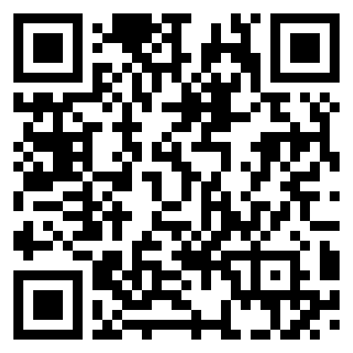
Before you start making photos
Tutorial, code and this presentation
https://github.com/rbesenczi/my_ols
Also shown at the end of the presentation

Slide 3
What we will cover
01
02
03
04
Design your code for testing
Test locally
Handle awkward code
Automate
Separate logic from I/O
Unit + integration + regression
Dependency injection + mocking
CI/CD with GitHub Actions
HOW TO TEST YOUR CODE ON GITHUB

Slide 4
What we will cover
01
02
03
04
Design your code for testing
Test locally
Handle awkward code
Automate
Separate logic from I/O
Unit + integration + regression
Dependency injection + mocking
CI/CD with GitHub Actions
+1
GitHub Issues
Towards more robustness
HOW TO TEST YOUR CODE ON GITHUB

Slide 5

Why testing matters?

Slide 6
Testing is a feedback system, not a final exam
WRITE
CHECK
LEARN
Make behaviour explicit
Catch failures close to the change
Turn failures into durable knowledge
Small, deterministic functions are easier to test.
Fast tests reduce the amount of code you have to reason about.
A regression test preserves the bug fix.
Core principle: the cheaper it is to run a check, the more often you can use it.
HOW TO TEST YOUR CODE ON GITHUB

Slide 7
CI/CD turns local confidence into shared confidence
1
Change
2
Trigger
3
Verify
4
Report
Push a change to the repository
CI starts on the repository event
Build, tests and other checks run
Results appear where you can act
Best practice: keep the CI path predictable, fast enough to use routinely, and visible to the team.
HOW TO TEST YOUR CODE ON GITHUB

Slide 8

Always check if the resulting app makes sense!

Slide 9
Why this script is awkward to test
data = np.loadtxt('data.txt')
model = np.loadtxt('design.txt')
fit = np.linalg.inv(model.T @ model) @ model.T @ data
error = data - (model @ fit)
np.savetxt('pes.txt', fit)
np.savetxt('residuals.txt', error)
I/O + maths are coupled
Every test must run the whole script
What each test needs
1 create input files
2 run a process
3 inspect output files
Problem: the structure makes programmatic testing complicated.
HOW TO TEST YOUR CODE ON GITHUB

Slide 10
Refactor the core logic into a function
CORE LOGIC
I/O BOUNDARY
def ols(data, model):
fit = np.linalg.inv(model.T @ model) @ model.T @ data
error = data - (model @ fit)
return fit, error
CALL
def main(args=None):
data = np.loadtxt(datafile)
model = np.loadtxt(designfile)
fit, error = ols(data, model)
np.savetxt(fitfile, fit)
np.savetxt(errfile, error)
Now both layers can be invoked directly in tests.
HOW TO TEST YOUR CODE ON GITHUB

Slide 11
Refactor the core logic into a function
Complete working code in tutorial
CORE LOGIC
I/O BOUNDARY
def ols(data, model):
fit = np.linalg.inv(model.T @ model) @ model.T @ data
error = data - (model @ fit)
return fit, error
CALL
def main(args=None):
data = np.loadtxt(datafile)
model = np.loadtxt(designfile)
fit, error = ols(data, model)
np.savetxt(fitfile, fit)
np.savetxt(errfile, error)
Now both layers can be invoked directly in tests.
HOW TO TEST YOUR CODE ON GITHUB

Slide 12
Design principles that pay off in testing
Small
Simple
Self-contained
No side-effects
One clear job
Few moving parts
Inputs are explicit
Predictable behaviour
Separate procedural work (loading/saving) from numerical operations.
In general, separate as much as possible.
HOW TO TEST YOUR CODE ON GITHUB

Slide 13
Write code to test your code
test_model = np.array([...]).T
test_data =
(test_model[:,0]*5) + (test_model[:,1]*20)
def test_ols():
fit, err = ols(test_data, test_model)
assert np.isclose(fit, [5, 20]).all()
assert np.isclose(err, 0).all()
Test the contract
✓ Known inputs
✓ Expected fit = [5, 20]
✓ Expected residuals = 0
Fast + deterministic + local
HOW TO TEST YOUR CODE ON GITHUB

Slide 14
Write code to test your code
Complete working code in tutorial
test_model = np.array([...]).T
test_data =
(test_model[:,0]*5) + (test_model[:,1]*20)
def test_ols():
fit, err = ols(test_data, test_model)
assert np.isclose(fit, [5, 20]).all()
assert np.isclose(err, 0).all()
Test the contract
✓ Known inputs
✓ Expected fit = [5, 20]
✓ Expected residuals = 0
Fast + deterministic + local
HOW TO TEST YOUR CODE ON GITHUB

Slide 15
Unit vs integration testing
UNIT TEST
INTEGRATION TEST
test_ols()
test_main()
Checks the isolated regression
function with toy data.
Checks file I/O + orchestration
through the public entry point.
Together: confidence in the building block and the assembled flow.
HOW TO TEST YOUR CODE ON GITHUB

Slide 16
Let pytest run the suite
TERMINAL
Why this matters
$ pytest
============== test session starts =====+=========
my_ols/tests/test_ols.py::test_ols PASSED
[ 50%]
my_ols/tests/test_ols.py::test_main PASSED [100%]
================ 2 passed in 0.06s ===============
• Discovers test_* functions
• Runs the suite consistently
• Supports focused runs: pytest -k test_ols
Convention reduces test-runner boilerplate.
HOW TO TEST YOUR CODE ON GITHUB

Slide 17
Coverage shows if you are missing something
EXAMPLE REPORT
USE IT TO FIND GAPS
Name Stmts Miss Cover
----------------------------------------
my_ols/main.py 20 2 90%
----------------------------------------
TOTAL 20 2 90%
90% covered
Coverage shows tested code, not whether behaviour is correct.
pytest --cov-report=html
Pair test assertions with coverage to see both correctness checks and untested paths.
HOW TO TEST YOUR CODE ON GITHUB

Slide 18
THREE WORKABLE LAYOUTS
Where should tests live?
Separate directory
Same directory
Sub-package
my_ols/
main.py
tests/
test_ols.py
my_ols/
main.py
test_ols.py
my_ols/
main.py
tests/
test_ols.py
The tutorial favours the sub-directory / sub-package approach, but this is largely preference.
HOW TO TEST YOUR CODE ON GITHUB

Slide 19
Test continuously as the code evolves
01
Write tests alongside code
02
Keep tests fast
small units
03
Test individual functions
04
Add a test for every bug fix
regression test; bugs cannot return
05
Keep smoke tests for releases
protects against silly mistakes
HOW TO TEST YOUR CODE ON GITHUB

Slide 20
When code is awkward to test
def load_parameters():
resp = requests.get('https://www.config.org/parameters.txt')
config = resp.text.split('\n')
return int(config[0]), int(config[1]), int(config[2])
def run_preprocessing(data):
p1, p2, p3 = load_parameters()
return data * p1 * p2 / p3
Problem: external state
The response is outside the test’s control.
Better boundary
Pass p1, p2, p3
into the function.
Dependency injection turns “unknown external state” into explicit inputs.
HOW TO TEST YOUR CODE ON GITHUB

Slide 21
Mock the dependency when refactoring is not practical
with mock.patch(
'my_ols.preprocess.load_parameters',
return_value=(10, 10, 10)
):
assert preproc.run_preprocessing(10) == 100
with mock.patch(
'my_ols.preprocess.load_parameters',
return_value=(1, 2, 5)
):
assert preproc.run_preprocessing(10) == 4
MOCK
Replace
load_parameters()
with known values.
Now the test controls the input.
HOW TO TEST YOUR CODE ON GITHUB

Slide 22
Make tests data-driven
tests = [
(10, (10, 10, 10), 100),
(10, (1, 2, 4), 5),
(20, (1, 2, 5), 8)
]
for data, params, result in tests:
with mock.patch(..., return_value=params):
assert preproc.run_preprocessing(data) == result
One test shape
input
+ parameters
+ expected result
Easy to extend
Add rows, not repeated code.
Data-driven tests make dozens or hundreds of cases easier to maintain.
HOW TO TEST YOUR CODE ON GITHUB

Slide 23
CI/CD turns “remember to test” into automation
1
2
3
4
Push changes
Trigger CI
Run in cloud
Execute tests
Repository
GitHub notifies CI
Container / VM
Script runs pytest
GitHub Actions is GitHub’s built-in CI infrastructure for this workflow.
HOW TO TEST YOUR CODE ON GITHUB

Slide 24
Set up a local development environment
Complete working example in tutorial
01
Install Python environment + pytest + coverage
02
Fork the my_ols repository
03
Clone your fork
04
Install dependencies with uv sync --all-extras
05
Run uv run my_ols and uv run pytest
uv run pytest
HOW TO TEST YOUR CODE ON GITHUB

Slide 25
Create a GitHub Actions workflow
on:
push:
branches: main
WORKFLOW RULE
Run when commits
are pushed to main.
HOW TO TEST YOUR CODE ON GITHUB

Slide 26
Create a GitHub Actions workflow
on:
push:
branches: main
jobs:
test:
runs-on: ubuntu-latest
steps:
- uses: actions/checkout@v4
- name: Set up Python 3.14
uses: actions/setup-python@v6
with:
python-version: "3.14"
- name: Install package and dependencies
run: pip install ".[test]"
- name: Run tests
run: pytest
WORKFLOW RULE
On an ubuntu-latest VM
With Python 3.14
Install listed packages
Run pytest

Slide 27
The reusable testing workflow
DESIGN
TEST
CONTROL
SCALE
AUTOMATE
Separate logic from I/O
Use unit + integration tests
Inject or mock dependencies
Make cases data-driven
Run the suite in CI
Final mental model: make behaviour callable → test it cheaply → automate the same checks on every change.
HOW TO TEST YOUR CODE ON GITHUB

Slide 28
GitHub Issues: a shared record of development work
Issues turn bugs, features and engineering tasks into visible, discussable units of work.
Capture
Organise
Discuss
Record the problem, goal, context and acceptance criteria before coding starts.
Use assignees, labels, milestones and sub-issues to make ownership and scope visible.
Keep questions, decisions and implementation context attached to the work.
Key idea: an issue explains why a change is needed.

Slide 29
Connect the issue to the code that resolves it
A branch and pull request create traceability from the original task to the final code change.
#42
42-file-opening
Commit
PR #61
main
Issue
→
Branch
→
Changes
→
Pull request
→
Merge
Describe
Implement
Build & test
Review
Closes issue

Slide 30
Why Issues matter
They connect planning, implementation and review into one auditable engineering workflow.
Traceability
Collaboration
See why code changed and which task, branch and PR produced it.
Give developers and reviewers one shared place for ownership and decisions.
Quality
Project visibility
Use acceptance criteria, reviews and linked tests to make "done" explicit.
Labels, milestones and status make progress and remaining work easier to inspect.

Slide 31
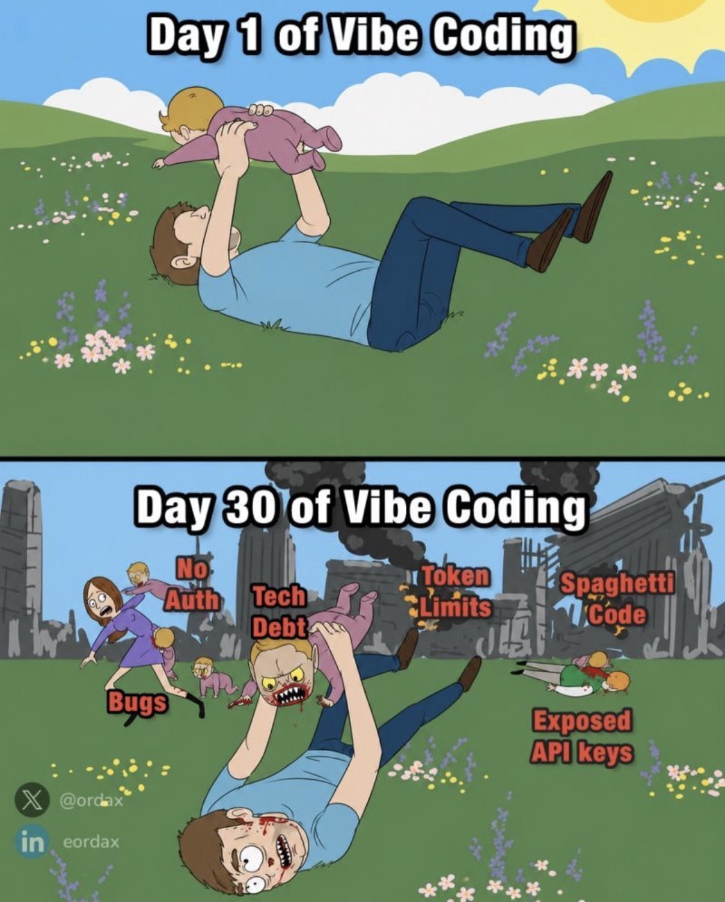
Be prepared to roll up your sleeve

Slide 32
Codes and tutorial
https://github.com/rbesenczi/my_ols

