Slide 1
SAS PROC OPTMODEL

Slide 2
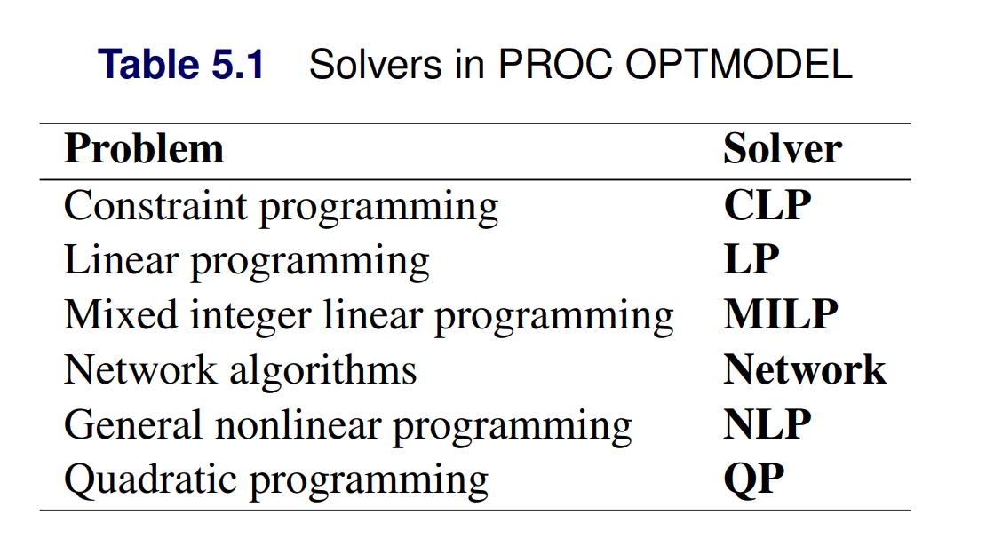

Slide 3


Slide 4

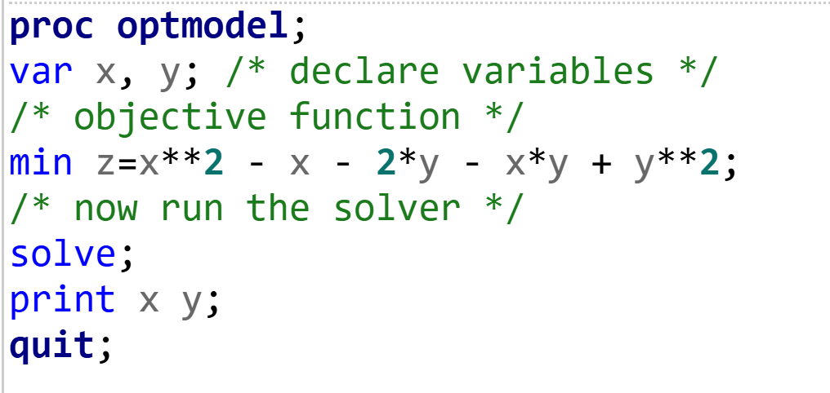

Slide 5
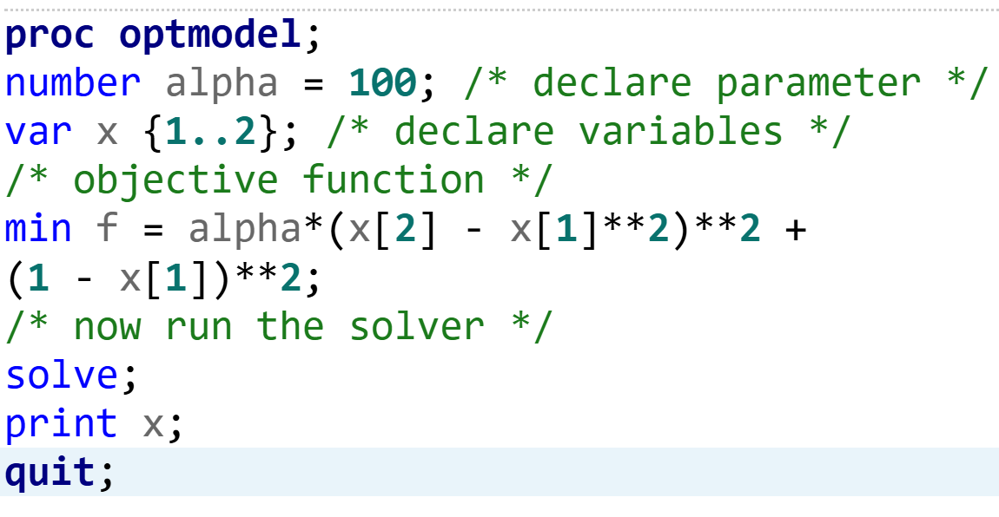

Slide 6
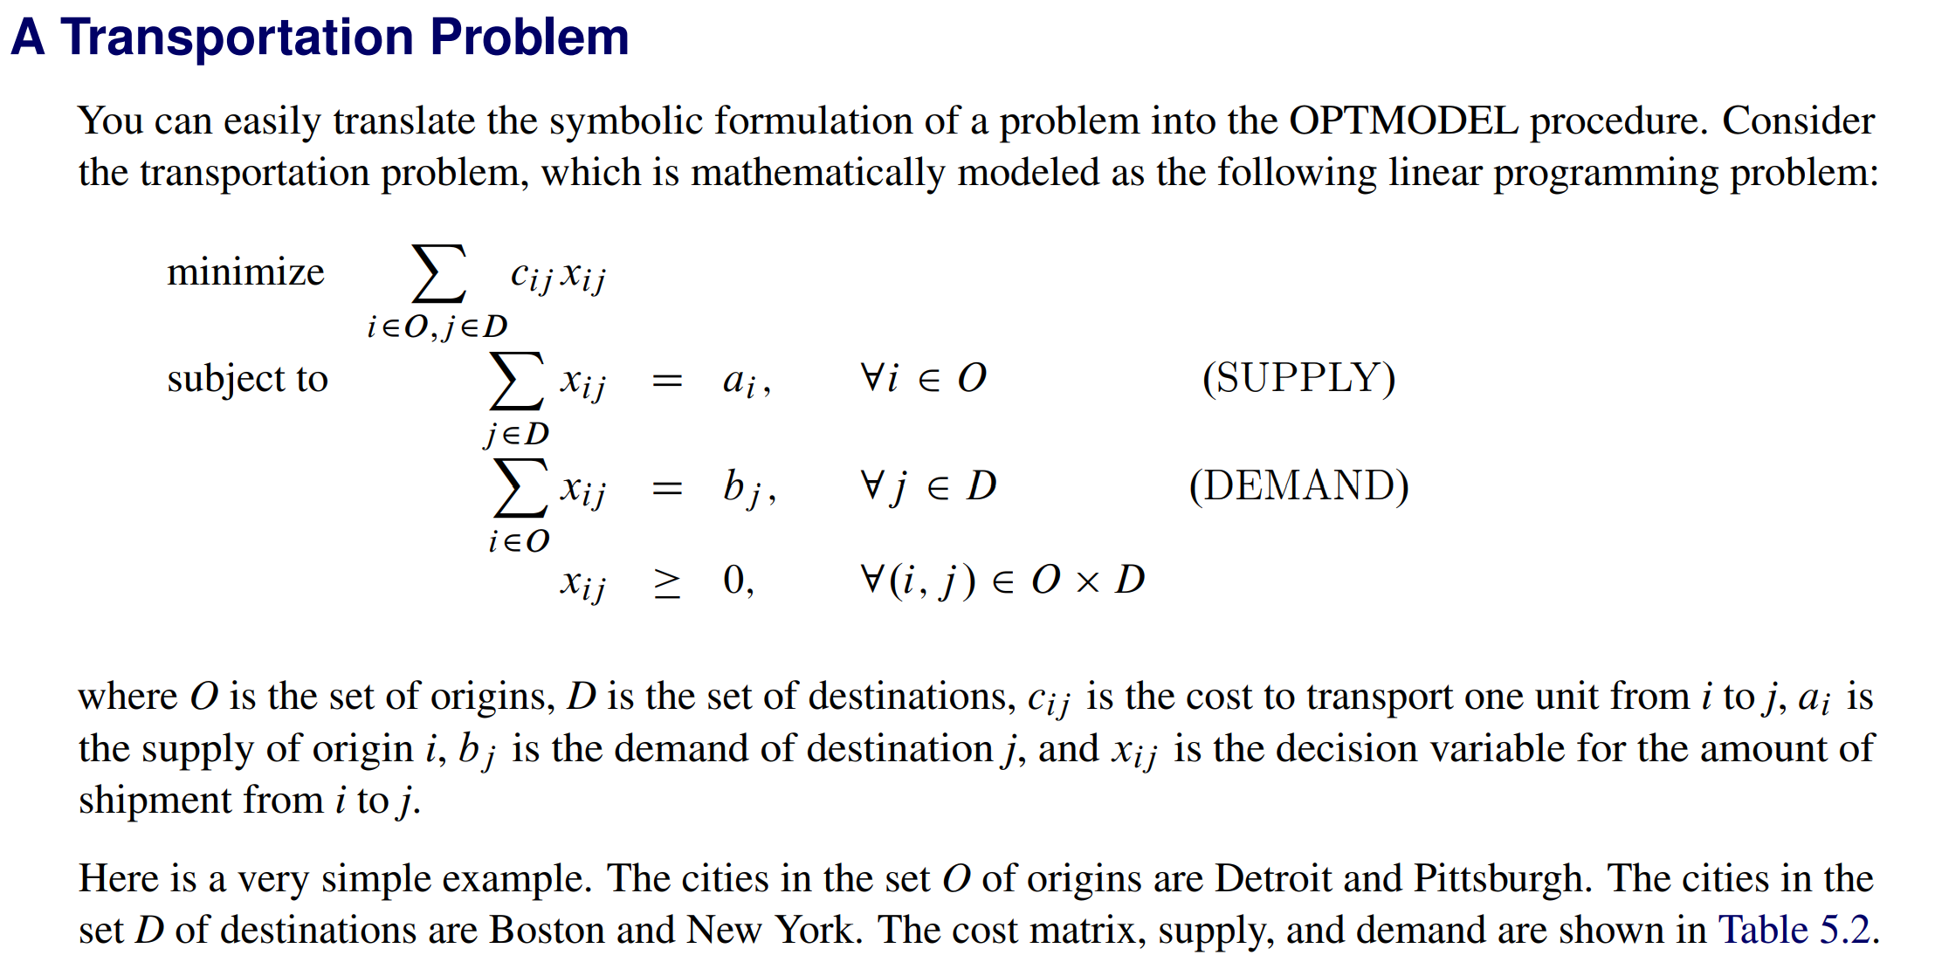

Slide 7
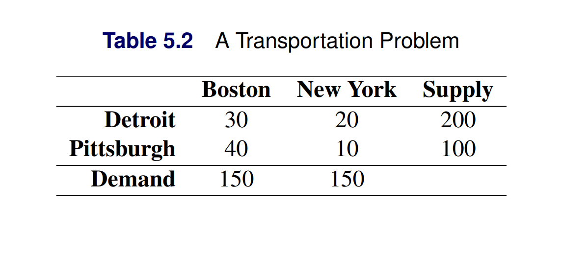

Slide 8
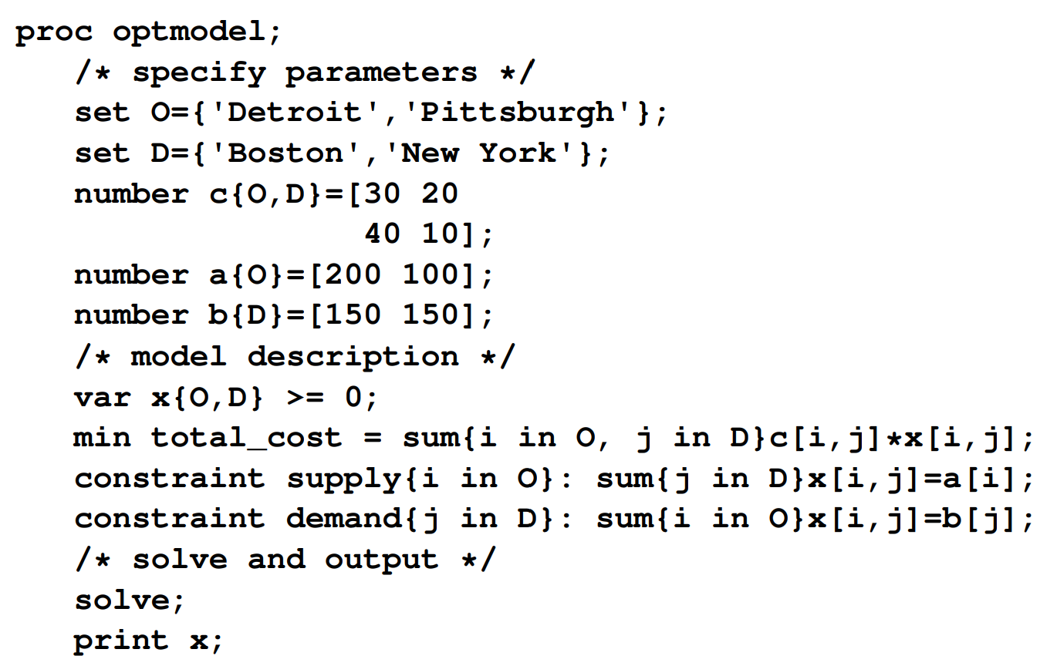
SAS processes this matrix using row-major order
Detroit is the first row read all columns form D then move to Pittsburg

Slide 9
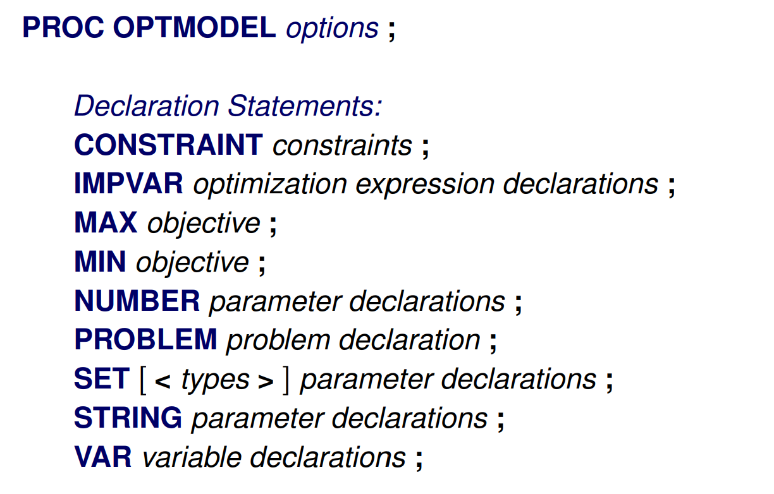

Slide 10
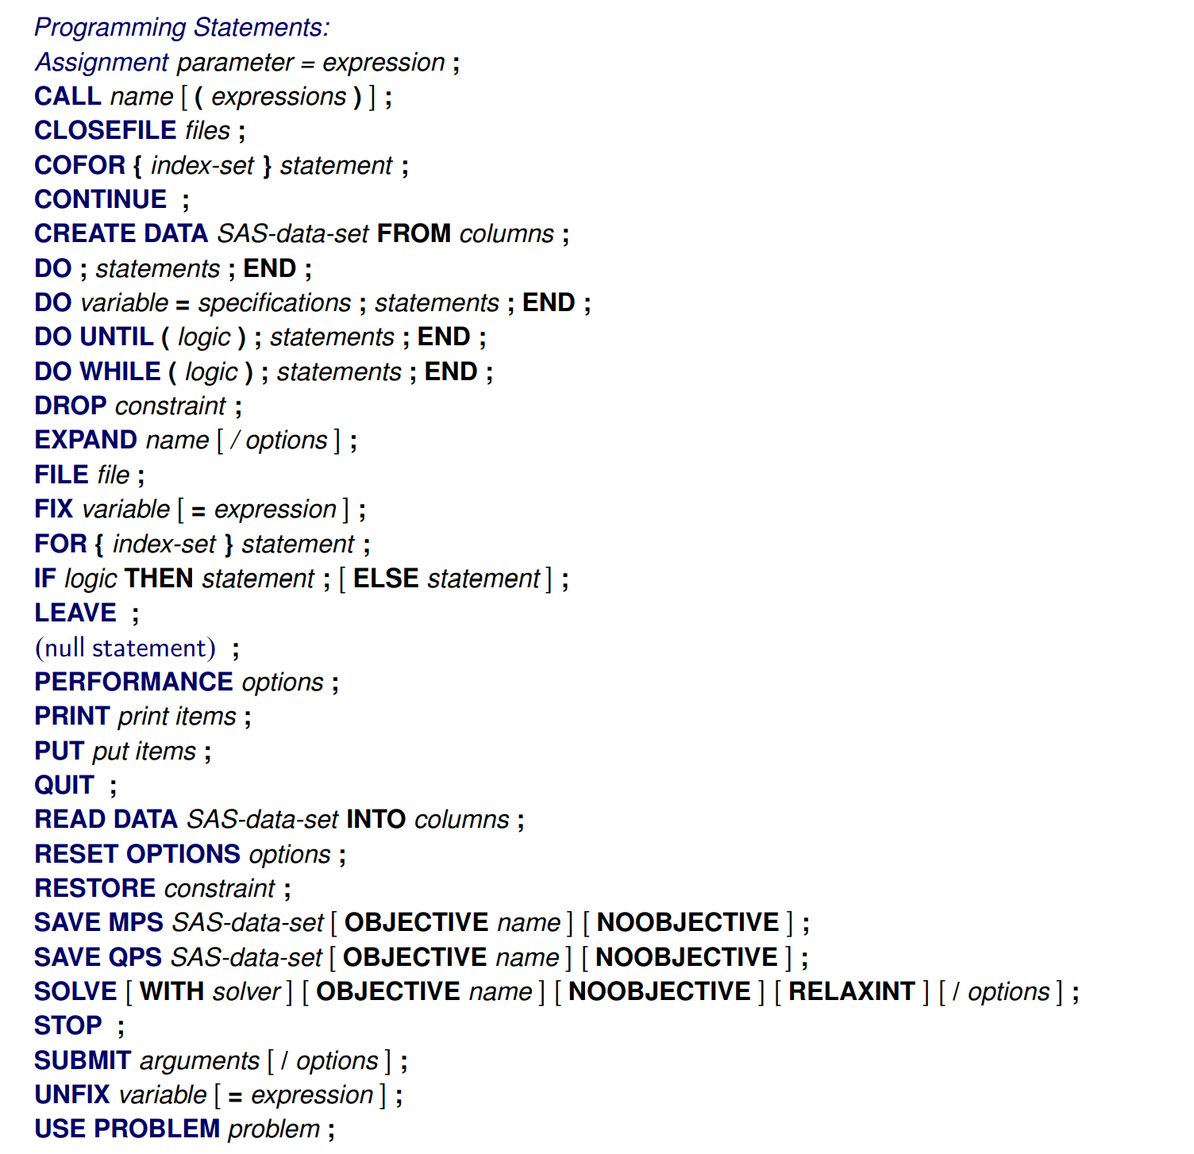

Slide 12


Slide 13


Slide 14


