Slide 1
Got Work?
Bryce Flammer, Matthew Hill, Jacob Holbrook, Aryan Osqueezadeh

Slide 2
Overview
We created a web based, database driven application that connects people willing to work jobs such as lawn mowing and snow blowing to those who need such jobs done.
Web Based
Everyone in the group has experience with HTML5, CSS, and Vue.js
Database Driven
Everyone in the group knows the basics of Django, and we have learned a lot more over the course of the project.
User Home Pages
Gives every user a personalized experience, giving them the information that they need to request or fulfil jobs.

Slide 3
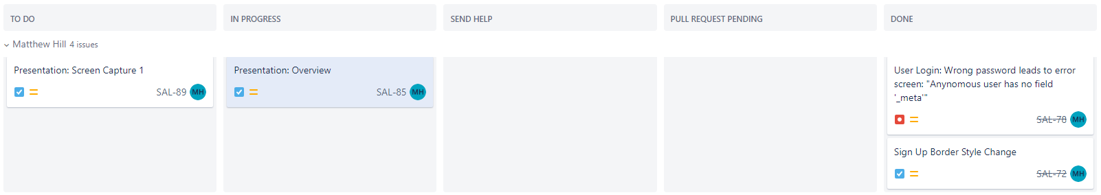
Overview: Development methods
Agile Development
Jira was used to keep track of tasks and bugs.
Breaking requirements into short tasks enabled clear communication between group members surrounding responsibilities, and made SCRUM meetings very efficient
Each of the five categories allowed all group member to quickly see the status of any given task. Alongside the standard “To do,” “In progress,” and “Done” column, we created the “Send Help” and “Pull Request Pending”
Send Help: Used when difficulties arose that needed to be discussed as a group
Pull Request Pending: Any task that had been completed but was had a pending pull request went here, allowing other members to compare the task and the GitHub pull request and provide feedback before merging the code and placing the task in the “done” column

Slide 4
Overview: Testing
Unit Testing
In an effort to hold to the MVC model, we create a file, ‘utility.py,’ to take the ‘controller’ portion of MVC, which contains much of the interaction with the database.
Each function within ‘utility.py’ has an associated unit test, all of which can be easily run from the command line.
System Testing
Perform a series of actions as a user, document what happens.
When something went wrong, it was documented and discussed as a team. If time allowed and the severity of the bug warranted attention so late in the project, the bug would be resolved.
Go through our use case diagrams and activity diagrams in our app, make sure everything is up to snuff

Slide 5
User Profile Features
Main Goal: User accounts that can be signed into in order to make a unique experience for all
To achieve this goal, all user profiles:
Must Have
Saved info including a monetary balance
Name, Zip Code, Email, Password
Differences between the three user types
Should Have:
A way to increase/decrease their balance
Could Have:
A customizable home page
Custom profile photos
Won’t Have:
Real currency used for their balance

Slide 6
User Profile Features
Workers
Customers
Owners
Can customize the type of jobs and the time they want to work
Can customize a radius in which they want to work
Can receive and begin work on available jobs
Get paid 90% when jobs are complete
Can review finished jobs
Can create new jobs
Pays for completed jobs with their balance
Can see the completion status of their jobs
Can review workers after a job
Can blacklist workers
Can request a refund
Can create new job types (snow shoveling, etc.)
Get paid 10% when a job is completed
Can accept or deny refund requests sent by customers

Slide 7
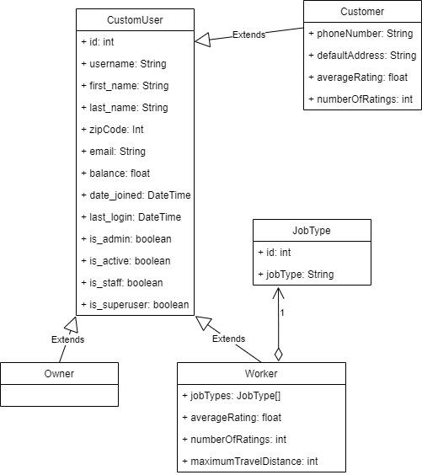
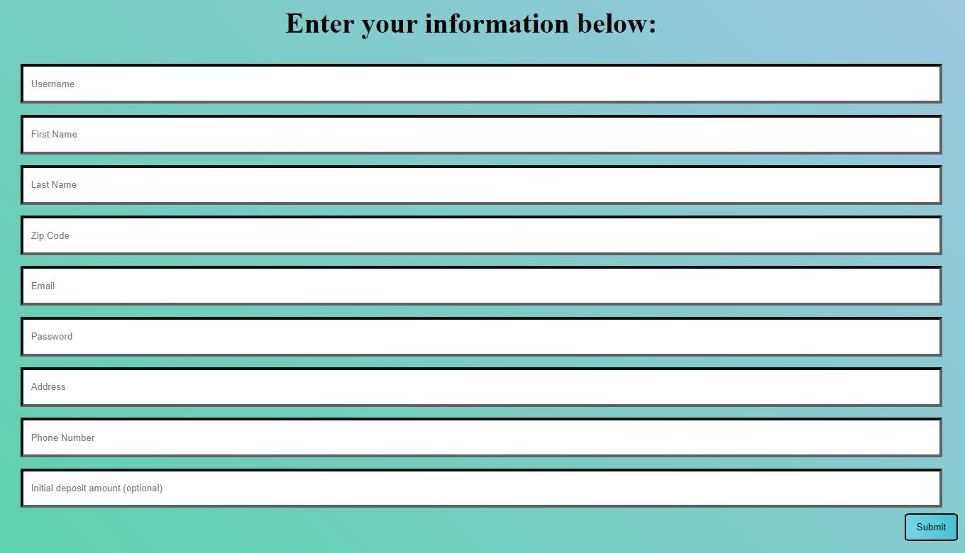
User Profile Features
UML Diagram For All Users
All users are mostly the same
Owners have no unique properties
Both workers and customers have a rating created by reviews left for them
Customer Sign Up Page

Slide 8
User Authentication and Access
Main Goal: Users to be able to login to account with protected data
To achieve this goal:
Must Have
An encrypted password
An unique username
An unique email
Should Have:
A strong original password
Could Have:
A feature to stay logged in even when the browser window is closed
An automatic timeout log out
Won’t Have:
Real credit card information security

Slide 9
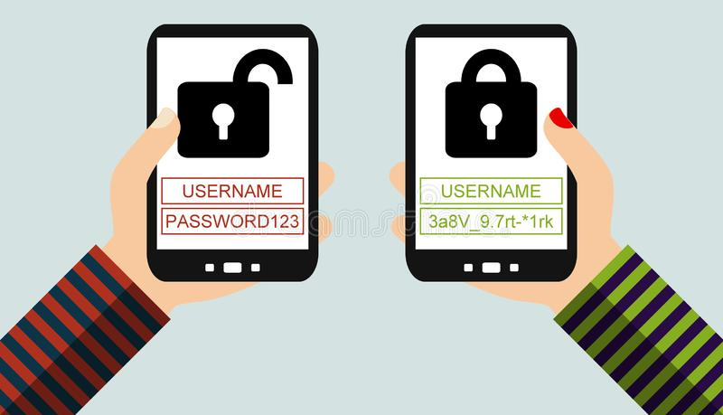
User Authentication and Access
The user is allowed to create their own personalized password and username. Through the django framework the password is encrypted in the database. When a user attempts to use the login page, the system searches the database to ensure that the username exists. If it does, they are logged in with their original username and the encrypted password for safety. Afterwards, they are directed to their individual pages with options tailored to the user type. Each page contains a logout button at the top of the page to exit their account.

Slide 10
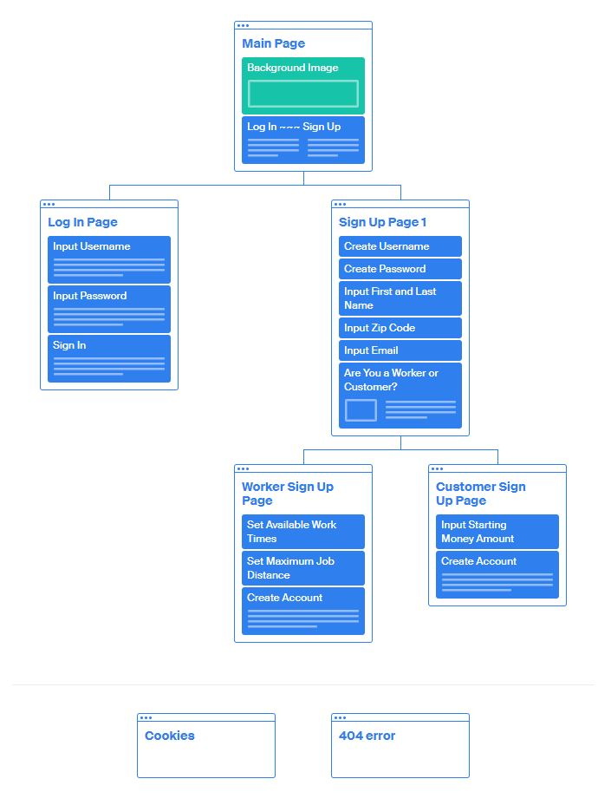
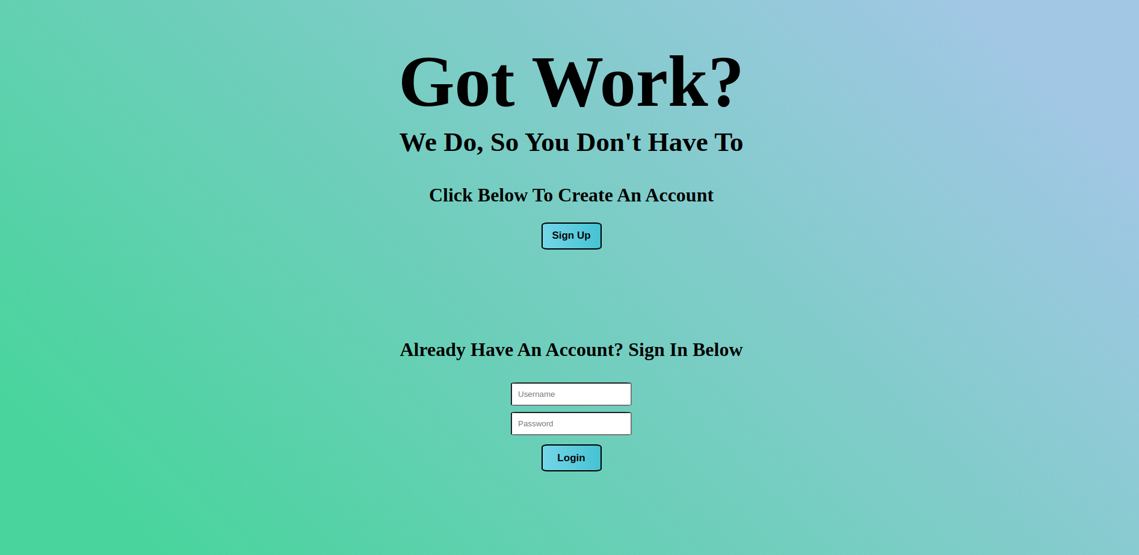
User Authentication and Access
Access Diagram
User main page

Slide 11
Job Features
Main Goal: Allow Customers to create a job, and Workers to accept and complete a job
To Achieve this Goal:
Must Have
Data Relevant to the Job
For example, a reference to the Customer
The Ability for a Customer to Create a New Job
The Ability for a Worker to Accept a Job
Should Have
A Job Status
Could Have
A Recurring Feature
Won’t Have
Sensitive User Information

Slide 12
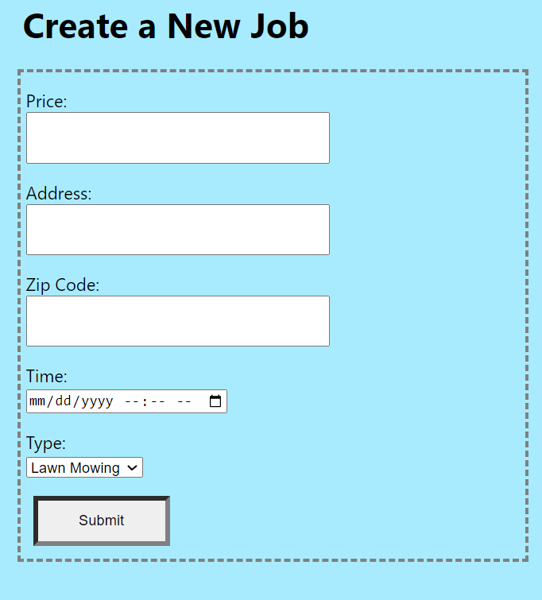
Job Features
Customers are able to create a request for a job that they need completed. They simply need to input the data necessary for the job, then click submit. When the job is created, Workers who are willing to work at that time, in that area, doing that type of job, will be able to accept the job. Once the job is completed, the worker will be able to mark the job as finished. Once finished, the Worker and the website Owner will be paid, and the funds will be removed from the Customer’s account. Upon completion, Workers are able to rate how a job went. Customers are able to review how the worker did, and if needed, send a refund request to the Owner, which they may accept or decline.

Slide 13

Use Case: Figure 4 – Worker creating an account

Slide 14
Use Case: Figure 3 – Customer creating an account

Slide 15
Use Case: Figure 2 – Customer looking for a worker to do a job

Slide 16
Use Case: Figure 6 – Worker getting a job

Slide 17
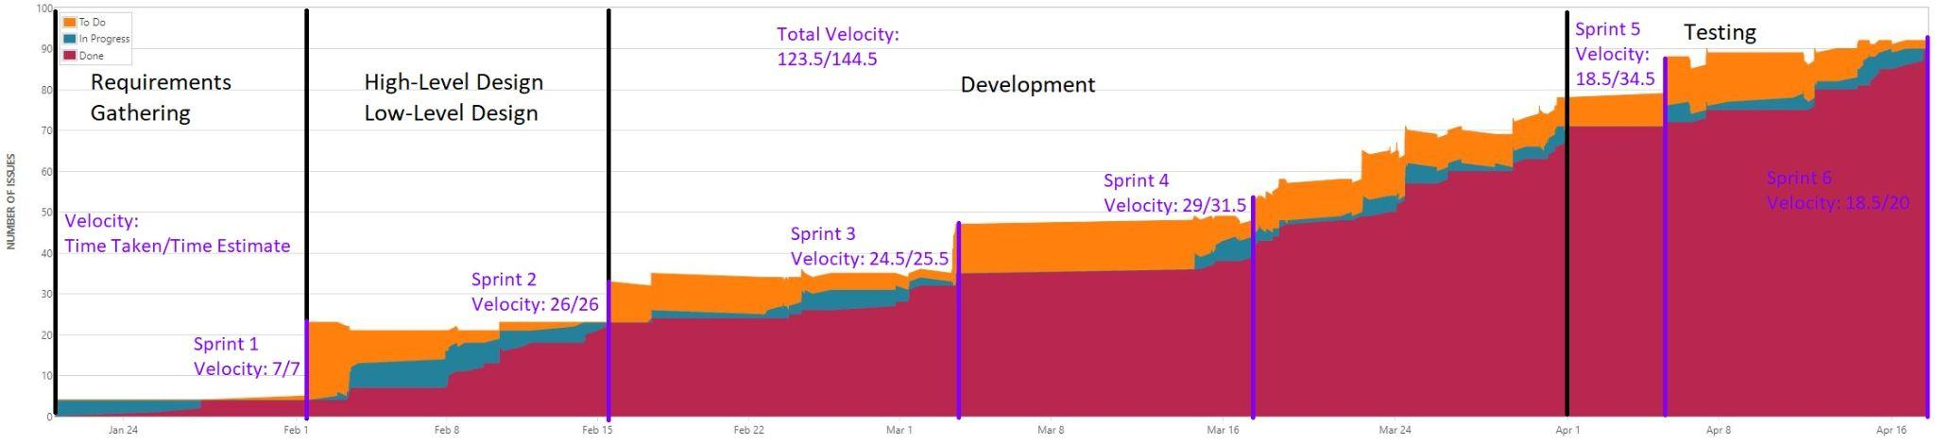
Burndown Chart

Slide 18
Resources
Django Documentation. Django. (n.d.). Retrieved April 17, 2022, from https://docs.djangoproject.com/en/4.0/
YouTube. (n.d.). CodingWithMitch. YouTube. Retrieved April 17, 2022, from https://www.youtube.com/channel/UCoNZZLhPuuRteu02rh7bzsw
Stack Overflow. (n.d.). Retrieved April 17, 2022, from https://stackoverflow.com/
Super Fast Visual sitemap tool. Super Fast Visual Sitemap Tool | Octopus.do. (n.d.). Retrieved April 17, 2022, from https://octopus.do/
Your favicon.ico source. Free Favicon. (n.d.). Retrieved April 17, 2022, from https://freefavicon.com/
Class resources, including powerpoint slides and example uml diagrams.
CS2610 Assignments and Lecture Notes

Slide 19
Questions?

