Slide 1
NYC Yellow Taxi Dataset Analysis (January 2024)
Uncovering Insights, Trends, and Predictive Models for Urban Transportation
By
Arth Patel
Nand Patel
Dhruv Diyora
Rishabh Gada

Slide 2
ABSTRACT
This study explores taxi trip patterns in New York City using the January 2024 Yellow Taxi dataset. By analyzing trip durations, distances, and fare structures, we aim to uncover trends and anomalies in urban transportation. Additionally, we leverage machine learning models to predict trip fares and durations, providing valuable insights for optimizing city-wide transit operations.

Slide 3
INTRODUCTION
Taxi services are a critical component of New York City’s transportation network. This analysis investigates taxi trip data, examining metrics such as trip duration, fare, and passenger count.
The objectives include
Identifying travel patterns.
Detecting anomalies in fare structures and trip durations.
Developing predictive models for fares and durations.
The results inform stakeholders such as policymakers, urban planners, and transportation companies.

Slide 4
DATASET OVERVIEW
The dataset comprises detailed trip records with below fields
Temporal: Pickup and drop-off times.
Spatial: Location IDs for origin and destination.
Trip Info: Distance, fare, passenger count.
Payment Details: Mode of payment, additional charges.
Key Stats:
Trips: 99,999 entries.
Average Duration: 16.45 minutes.
Average Fare: $21.27.
Average Distance: 4.2 miles.

Slide 5
DATASET CLASSIFICATION
The NYC Yellow Taxi dataset contains detailed trip records with the following columns:
VendorID: Identifier for the taxi vendor.
tpep_pickup_datetime & tpep_dropoff_datetime: Pickup and drop-off timestamps.
passenger_count: Number of passengers.
trip_distance: Distance traveled during the trip.
RatecodeID: Code indicating the rate of the trip.s
tore_and_fwd_flag: Indicates if the trip data was stored before being forwarded to the server.
PULocationID & DOLocationID: IDs representing pickup and drop-off locations.
payment_type: Payment method used (e.g., card, cash)
fare_amount, extra, mta_tax, tip_amount, tolls_amount, total_amount, congestion_surcharge, and Airport_fee: Financial details related to the trip, including base fare, surcharges, taxes, and total cost.

Slide 6
PREPROCESSING
Steps performed
Converted pickup and drop-off timestamps to datetime objects.
Created a derived feature for trip duration in minutes.
Removed extreme outliers in distance and fare to improve data quality.
Addressed anomalies like negative fares.

Slide 7
LITERATURE REVIEW
Research on urban mobility highlights the significance of
Fare prediction models for pricing transparency.
Duration predictions for improved scheduling.
Prior works, like NYC Taxi Trip Dataset analysis, demonstrate ML's effectiveness in optimizing transportation.

Slide 8
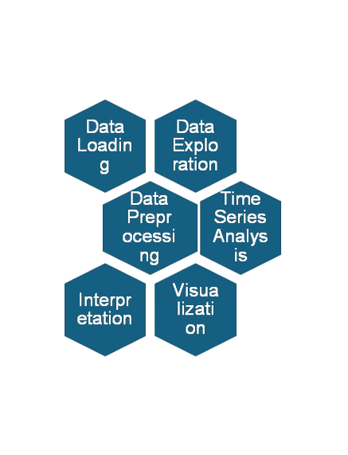
ARCHITECTURE & METHODOLOGY

Slide 9
EXPLORATORY DATA ANALYSIS
.

Slide 10
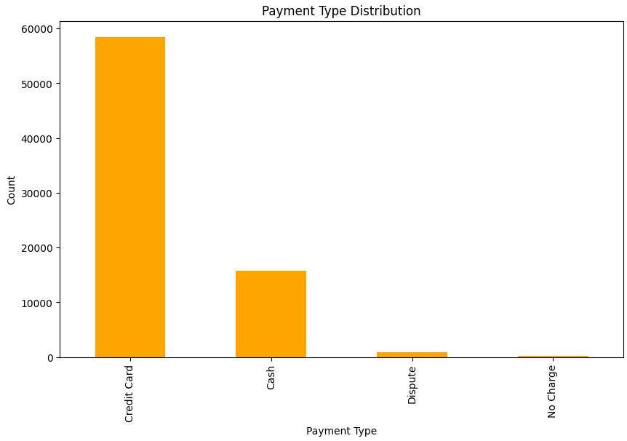
KEY INSIGHTS
Credit card is the dominant payment method.
Cash payments are second most common, while others are rare.
Observation: Rare payment types might indicate edge cases or special circumstances.
Recommendation: Focus on optimizing systems for credit card and cash users.
Use Case: Identifies the need to prioritize infrastructure for the top payment methods.

Slide 11
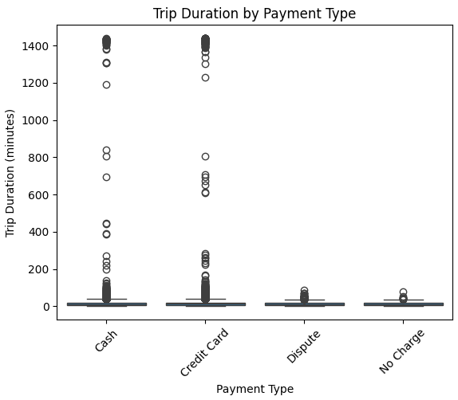
KEY INSIGHTS
Cash trips have slightly higher median durations.
Dispute payments show greater variability in duration.
Observation: Variability in dispute durations suggests inefficiencies.
Recommendation: Address operational inefficiencies for disputed trips.
Use Case: Optimize service processes for diverse payment types.

Slide 12
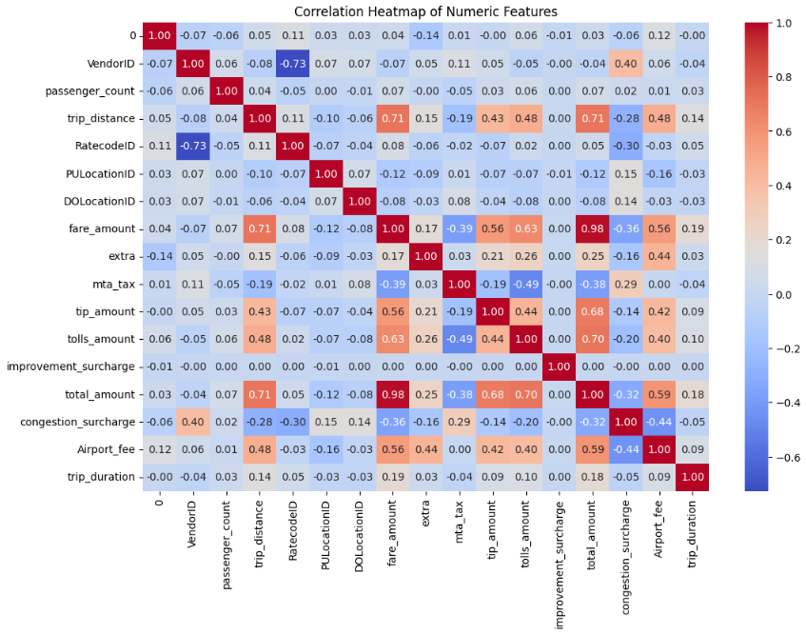
KEY INSIGHTS
Strong positive correlation between fare amount and trip distance.
Weak correlation for passenger count with other variables.
Observation: Distance is a significant predictor for fare.
Recommendation: Build predictive models using strongly correlated features.
Use Case: Basis for fare estimation algorithms.

Slide 13
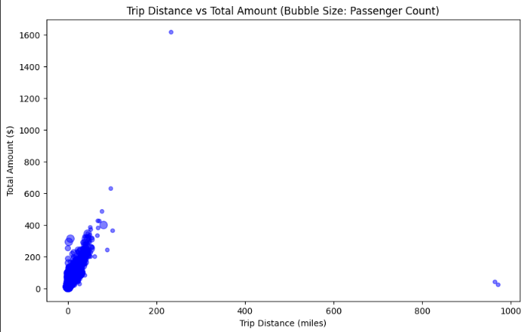
KEY INSIGHTS
Higher passenger counts often correspond to higher total fares.
Outliers suggest additional fees for short trips.
Observation: Some trips with large bubbles (many passengers) have unusually high fares.
Recommendation: Review pricing structure for multi-passenger trips.
Use Case: Visualizes combined impacts of passenger count, distance, and fare.

Slide 14
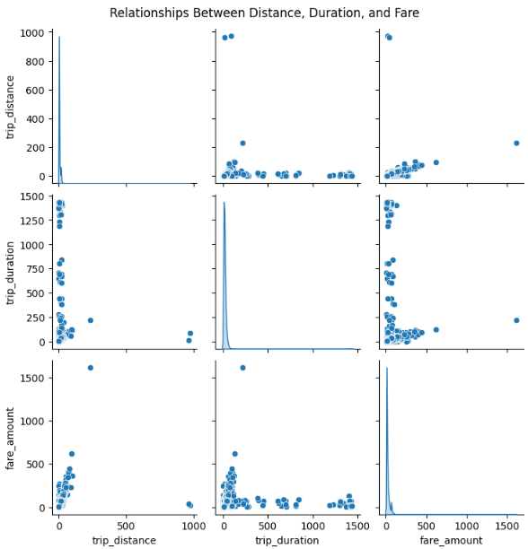
KEY INSIGHTS
Longer trips generally have higher fares and durations.
Variability in medium trips might be influenced by traffic or stops.
Observation: Medium trips show a wider range of durations and fares.
Recommendation: Investigate variability to improve pricing accuracy.
Use Case: Demonstrates complex interdependencies for strategic planning.

Slide 15
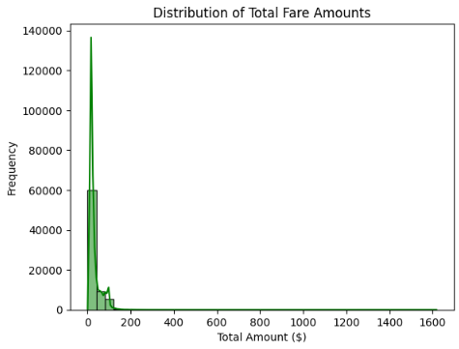
KEY INSIGHTS
Most trips have fares between $10-$50.Right-skewed distribution shows fewer high-value trips.
Observation: High fares contribute disproportionately to revenue.
Recommendation: Target high-value customers for personalized services.
Use Case: Revenue segmentation analysis..

Slide 16
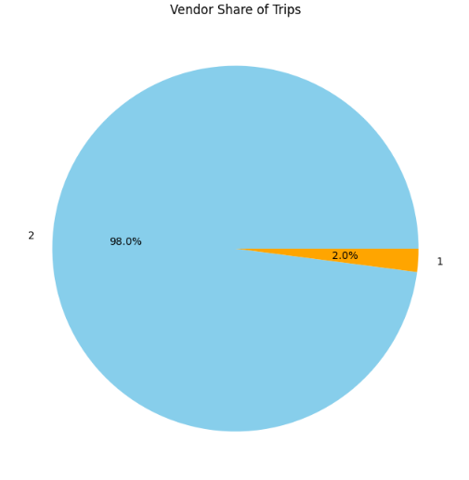
KEY INSIGHTS
One vendor dominates the market.Smaller vendors have room to grow.
Observation: High concentration of trips by a single vendor.
Recommendation: Encourage competition for service diversity.
Use Case: Industry analysis and strategic partnerships.

Slide 17
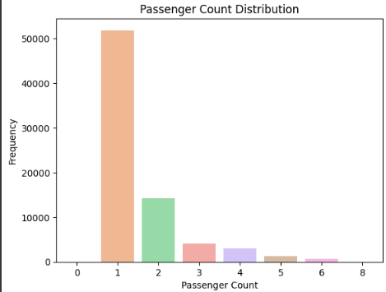
KEY INSIGHTS
Single-passenger trips are most common.Trips with more than five passengers are rare.
Observation: Majority trips do not require high-capacity vehicles.
Recommendation: Align fleet size with passenger distribution.
Use Case: Optimizing vehicle allocation.

Slide 18
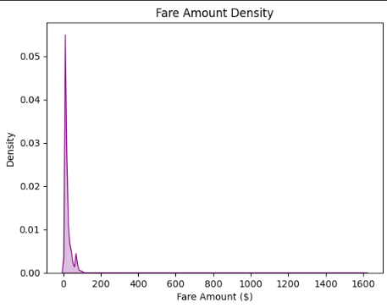
KEY INSIGHTS
Peak fare density lies between $10-$25.Secondary peaks suggest specific pricing tiers or zones.
Observation: Pricing policies affect fare distribution.
Recommendation: Refine tiered pricing models for consistency.
Use Case: Pricing strategy evaluation.

Slide 19
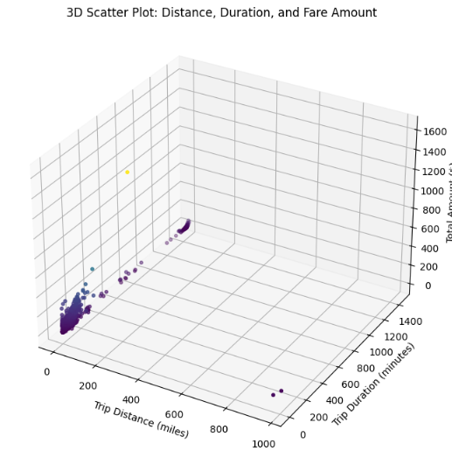
KEY INSIGHTS
High fares are associated with long distances and durations.
Clusters reflect common trip patterns and pricing caps.
Observation: Clear trends support predictable pricing strategies.
Recommendation: Address anomalies for policy and pricing improvements.
Use Case: Comprehensive trip analysis.

Slide 20
MACHINE LEARNING MODELS
.

Slide 21
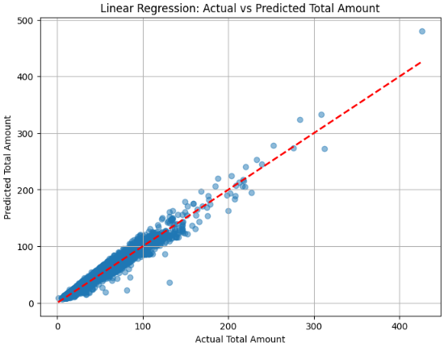
LINEAR REGRESSION
Key Insight: Linear regression was used to predict total_amount based on features like trip_distance, fare_amount, extra, and mta_tax. The Root Mean Square Error (RMSE) was computed to evaluate the model's performance.
Visual Observation: The scatterplot of predicted vs. actual total_amount shows some deviations, indicating that the model struggles with some predictions, especially for extreme values.The diagonal red line represents perfect predictions. Points further from this line indicate higher errors.
Conclusion: While linear regression captures general trends, it may not adequately handle non-linear relationships or outliers in the data, leading to higher prediction errors for certain trips..

Slide 22
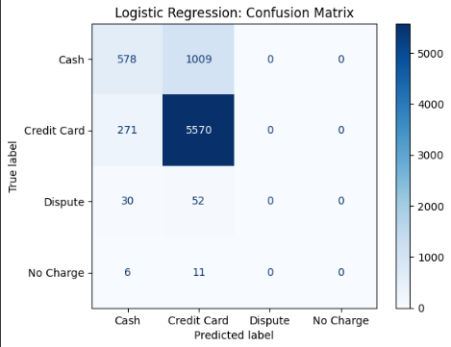
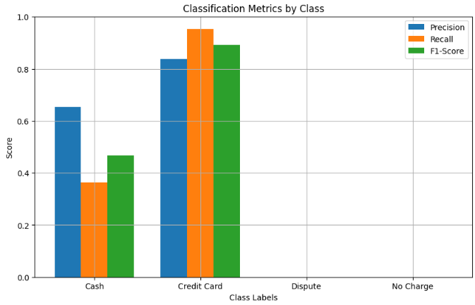
LOGISTIC REGRESSION
Key Insight: Logistic regression was trained to classify payment_type using features like trip_distance, fare_amount, and others. The confusion matrix and classification metrics (precision, recall, and F1-score) were used to evaluate the model.
Visual Observations:The confusion matrix indicates a high imbalance in prediction performance across classes, with "Credit Card" being the most accurately predicted class.Precision, recall, and F1-score are significantly lower for "Cash" and other classes, showing the model's struggle to differentiate them.
Conclusion: Logistic regression performs well for the dominant class ("Credit Card") but fails to generalize across other payment types due to class imbalance and potentially overlapping feature distributions.

Slide 23
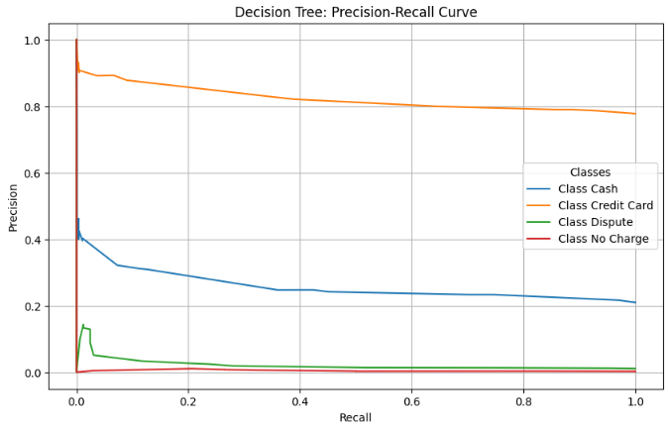
DECISION TREE
Key Insight: A decision tree with a maximum depth of 5 was trained. The precision-recall curve shows how well the model handles classification across classes.
Visual Observations:The precision-recall curve shows poor performance for minority classes like "Dispute" and "No Charge".The accuracy score indicates overall performance, but detailed metrics highlight challenges in minority class predictions.
Conclusion: The decision tree captures more nuanced patterns than logistic regression but still struggles with class imbalance and overfitting on certain features.

Slide 24
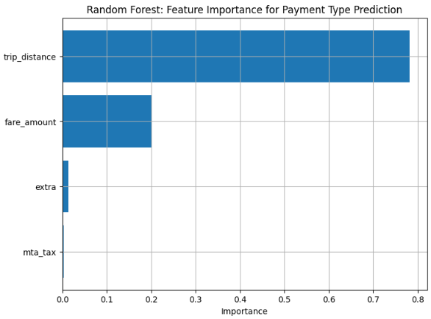
RANDOM FOREST
Key Insight: Random Forest was used to classify payment_type and identify feature importances.
Visual Observations:Feature importance visualization reveals trip_distance and fare_amount as the most influential features for predicting payment type.The random forest model likely performs better than individual models like decision trees due to ensemble learning.
Conclusion: Random Forest provides a balanced trade-off between accuracy and robustness. However, it may still face challenges with class imbalance, and its complexity can increase computational cost.

Slide 25
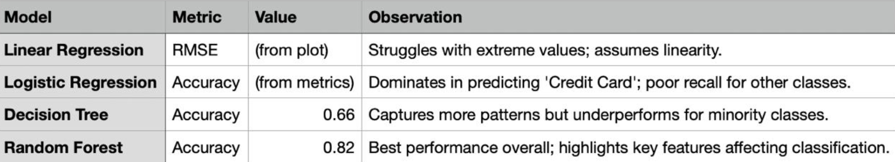
SUMMARY

Slide 26

CONCLUSION
The models show varying performance levels:
Linear Regression: Effective for linear trends but struggles with outliers and non-linear relationships.
Logistic Regression: Performs well for the majority class but struggles with class imbalance.
Decision Tree: Captures patterns better than logistic regression but underperforms for minority classes.
Random Forest: Best overall performance, highlighting key predictors like trip_distance and fare_amount.

Slide 27
REFERENCES
https://www.ibm.com/topics/linear-regression
https://www.simplilearn.com/10-algorithms-machine-learning-engineers-need-to-know-article
https://www.nyc.gov/site/tlc/about/tlc-trip-record-data.page

Slide 28
THANKYOU
.

