Slide 1

Variational Inference for Bayesian Nonnegative Matrix Factorisation Gyu Hwan Park Supervised by Heejung Shim University of Melbourne
Vacation Research Scholarships are funded jointly by

Slide 2


Nonnegative Matrix Factorisation (NMF)
Decompose data matrix (X) as a product of two nonnegative matrices of factor loadings (W) and activations (H)
Nonnegativity constraint for interpretation
samples
factors
samples
data
X
activations
H
factors
features
$$≈$$
features
loadings
W
Notes:
Nonnegative matrix factorisation (NMF) is a dimension reduction technique, which decomposes data matrix X into a product of 2 nonnegative matrices of factor loadings W and activations H.
Here, matrix H in pink represents the lower-dimensional intrinsic features of data.
The loadings matrix W relates the high-dimensional matrix X to activations matrix H.
The nonnegativity constraint on the entries of these two matrices allow intuitive interpretation when analysing the meaning of the two matrices.

Slide 3
Example: single-cell RNA-seq data
Identify underlying biological processes (factors) in gene expression data
How can we form meaningful interpretation?
cells
factors
cells
X
W
H
factors
genes
$$≈$$
genes
Notes:
For example, in my research project, I will use NMF in single-cell RNA-seq data, where the matrix X represents gene expression counts, with rows corresponding to genes and columns representing cells.
Here, we want to identify the underlying biological processes (factors) by factorizing X.
Now, the question is, how can we form physically meaningful interpretation with NMF? How is it exactly going to help?

Slide 4





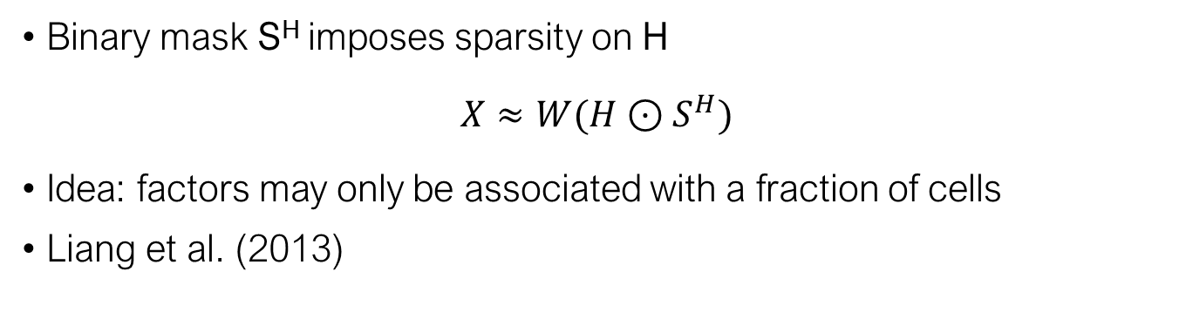

Sparse NMF (S-NMF)
Binary mask S^{H} imposes sparsity on H
$$X≈W(H⊙S^{H})$$
Idea: factors may only be associated with a fraction of cells
Liang et al. (2013)
samples
factors
samples
factors
$$H⊙S^{H}$$
$$H⊙S^{H}$$
features
X
$$≈$$
features
$$W⊙S^{W}$$
Notes:
Explain H and S^H
Say we give gamma priors, and Bernoulli prior for S, and pi_k beta

Slide 5



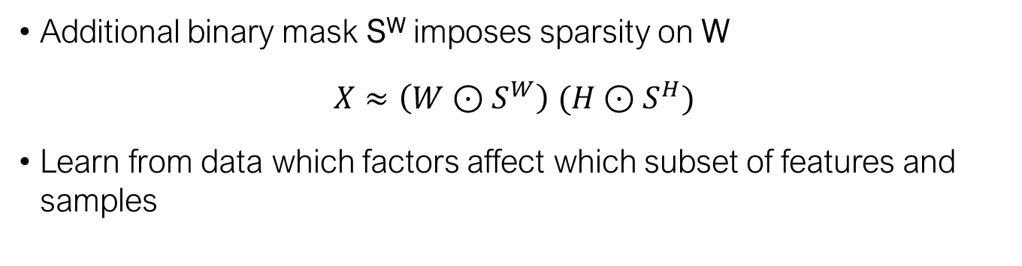
Doubly Sparse NMF (DS-NMF)
Additional binary mask S^{W} imposes sparsity on W
$$X≈\left(W⊙S^{W}\right) (H⊙S^{H})$$
Learn from data which factors affect which subset of features and samples
samples
factors
samples
factors
$$H⊙S^{H}$$
$$H⊙S^{H}$$
features
X
$$≈$$
features
$$W⊙S^{W}$$
$$W⊙S^{W}$$
Notes:
Doubly Sparse NMF is an existing model as well
For single cell data, it is possible that underlying biological processes (or factors) are associated with only a subset of genes and cells
Hence it is natural to put sparsity constraint in the loading matrix as well
Mention similar to previous S-NMF model, here we learn the pi_i for W as well, so that we can silence insignificant factors in both matrices simultaneously

Slide 6
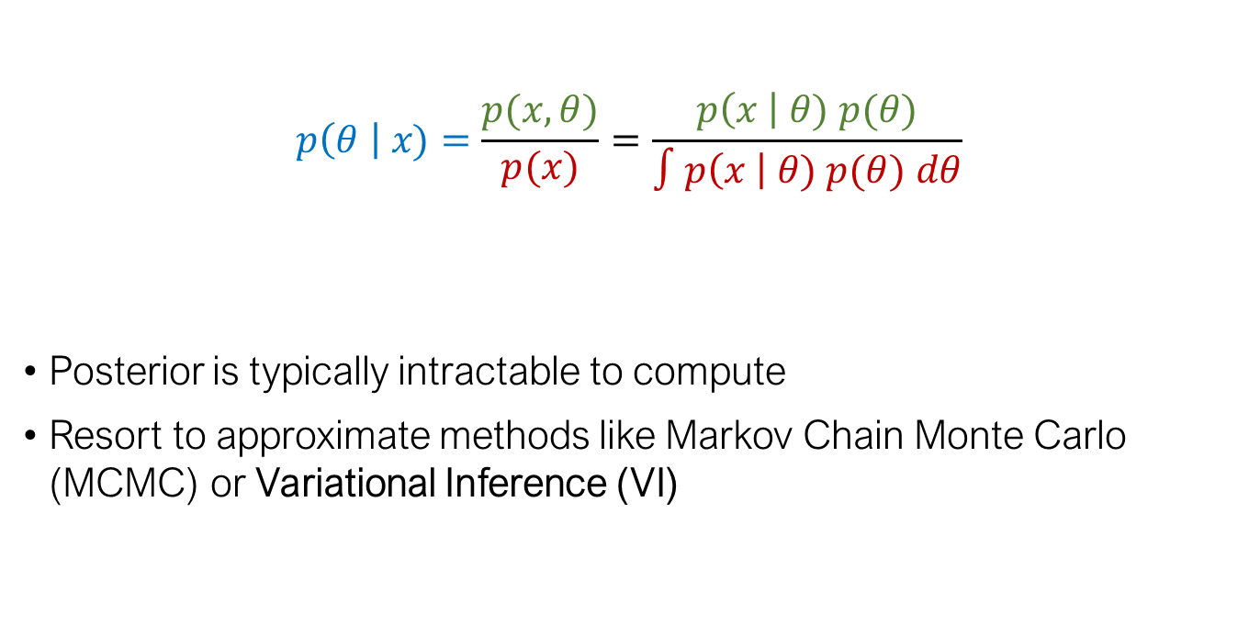
Bayesian inference
$$p\left(θ \right| x)=\frac{p(x, θ)}{p(x)}=\frac{p\left(x \right| θ) p(θ)}{∫p\left(x \right| θ) p(θ) dθ}$$
Posterior is typically intractable to compute
Resort to approximate methods like Markov Chain Monte Carlo (MCMC) or Variational Inference (VI)
Joint probability likelihood prior
posterior
distribution
marginal probability
Notes:
Mention theta is the parameter, x is the data collected to learn about theta
Model specifies joint probability, but posterior cannot be computed directly since the marginal is intractable in complex high-dimensional problems
Particularly, we will focus on VI in this project

Slide 7
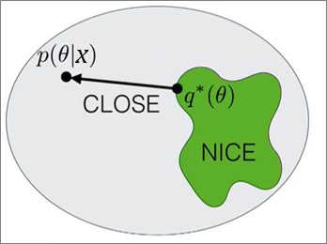
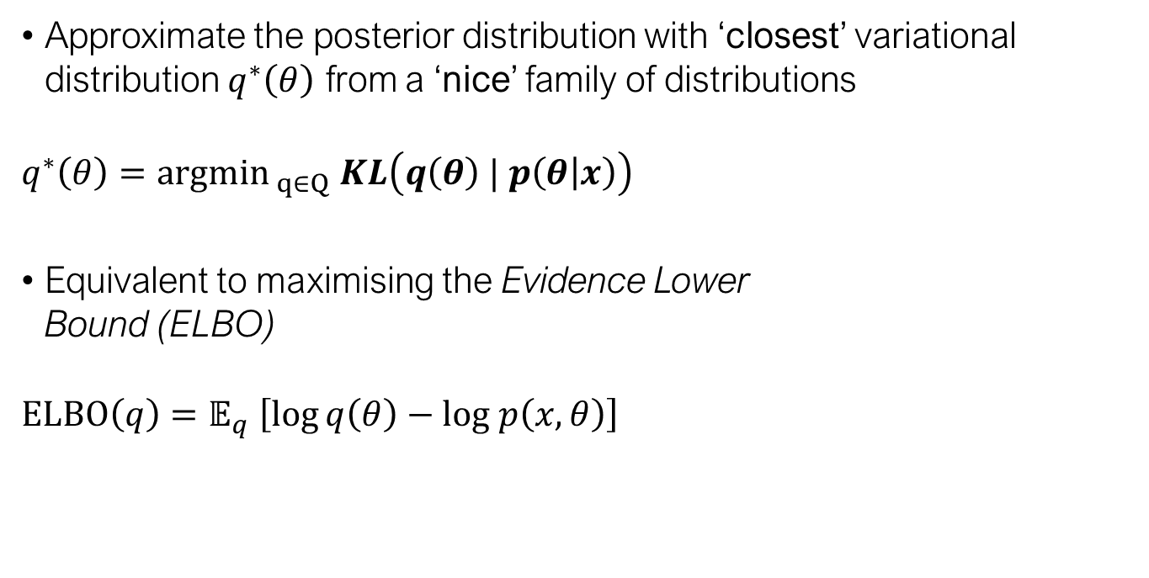
Variational Inference (VI)
Approximate the posterior distribution with ‘closest’ variational distribution $q^{∗}\left(θ\right)$ from a ‘nice’ family of distributions
$$q^{∗}\left(θ\right)={argmin}_{ q∈Q} KL\left(q\left(θ\right) | p\left(θ | x\right)\right)$$
Equivalent to maximising the Evidence Lower Bound (ELBO)
$$ELBO\left(q\right)=𝔼_{q} \left[\log{q\left(θ\right)−log p\left(x,θ\right)}\right]$$
Source: Broderick
Notes:
Acknowledge blei et al. 2017
Say q(theta), theta is a vector of parameters not just one

Slide 8
Variational Inference (VI)
Common choice for family Q: mean-field variational family
Assumption: independence of parameters in variational distribution
Enables tractable, often closed-form iterative optimisation
Source: Broderick
Notes:
The independence assumption simplifies the optimisation procedure,
enables tractable, …

Slide 9






DS-NMF with VI
$$X≈\left(W⊙S^{W}\right) (H⊙S^{H})$$
Independence assumed between W and S^{W}, H and S^{H}
samples
$$H⊙S^{H}$$
$$H⊙S^{H}$$
features
X
$$≈$$
$$W⊙S^{W}$$
$$W⊙S^{W}$$
Notes:
In the context of gene expression data, it makes more sense to apply the SSVI inference technique on DS-NMF model.
My contribution during the AMSI vacation research program was deriving and implementing SSVI technique for the DS-NMF model.
I derived and implemented SSVI inference technique for DS-NMF model.
Binary masks allow enhanced interpretation for ‘sparse’ processes that involve a small subset of genes and/or cells

Slide 10





DS-NMF with Structured Stochastic VI (DSSVI)
Inference: Structured Stochastic Variational Inference
$$X≈\left(W⊙S^{W}\right) (H⊙S^{H})$$
Dependencies restored between W and S^{W}, H and S^{H}
samples
$$H⊙S^{H}$$
$$H⊙S^{H}$$
features
X
$$≈$$
$$W⊙S^{W}$$
$$W⊙S^{W}$$
Liang et al. (2014)
Notes:
In the context of gene expression data, it makes more sense to apply the SSVI inference technique on DS-NMF model.
My contribution during the AMSI vacation research program was deriving and implementing SSVI technique for the DS-NMF model.
I derived and implemented SSVI inference technique for DS-NMF model.
Binary masks allow enhanced interpretation for ‘sparse’ processes that involve a small subset of genes and/or cells

Slide 11




Simulation study
Assess performance of DSSVI on estimating sparse S^{W}
Compare DSSVI vs SSVI on estimating:
Factor loadings $W⊙S^{W}$
Sparse binary mask $S^{H}$
Activations $H⊙S^{H}$
samples
factors
samples
factors
$$H⊙S^{H}$$
features
X
$$≈$$
features
$$W⊙S^{W}$$
Notes:
Goal of simulation study is to assess how well DSSVI can capture the sparsity structure in W, and to compare other parts with SSVI.
Comparison: DSSVI vs SSVI when sparsity structure is present in both true matrices of factor loadings and activations
Sparsity is in both loadings and activations, to see if DSSVI can capture additional sparsity, and capture the existing sparsity as good as existing SSVI method.

Slide 12
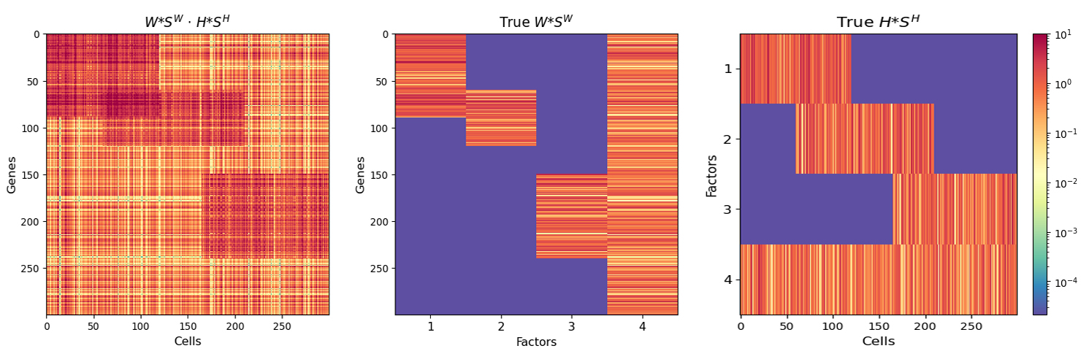
Simulated dataset
300 genes (features)
300 cells (samples)
4 factors
$$E\left(X\right) = \left(W⊙S^{W}\right) (H⊙S^{H})$$
Notes:
Say 10 independent samples X were drawn
(30 runs in total)
Best run (according to log ll) for each independent sample was chosen take part
Rightmost matrix is the true mean of data that samples are drawn from

Slide 13
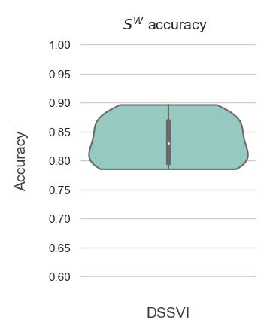
DSSVI: Capturing sparsity in S^{W}
Use posterior mean for evaluation
Accuracy of binary mask S^{W}: proportion of correctly inferred 0’s and 1’s
Notes:
Posterior mean of S^W is obtained from DSSVI algorithm. Entries are [0,1] and rounded off to nearest whole number for accuracy calculation.
Median is around 0.8

Slide 14
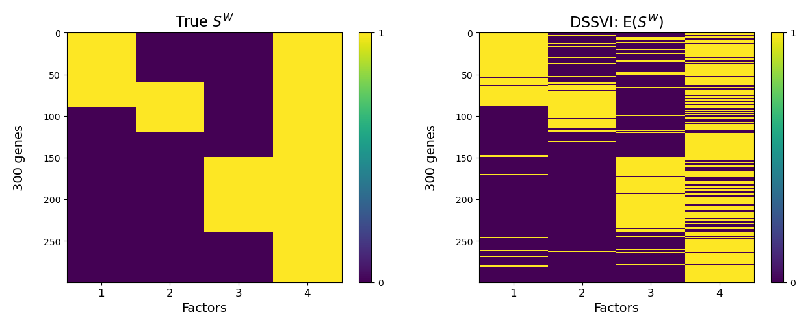
DSSVI: Estimated S^{W}
Notes:
This is the run with highest accuracy 0.8967

Slide 15
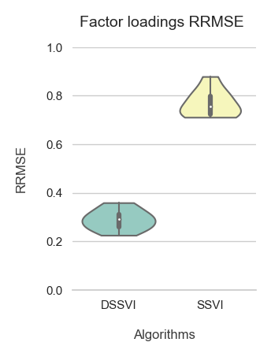
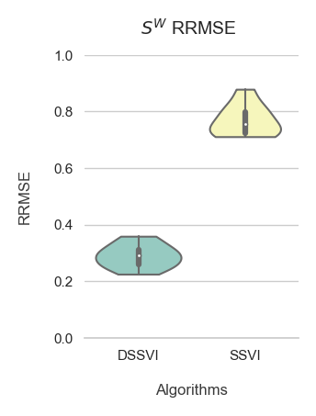
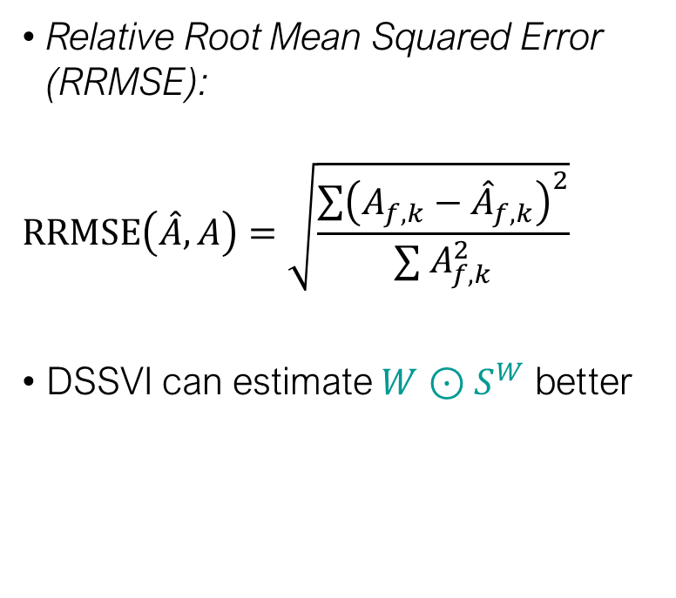
Estimation of sparse factor loadings
Relative Root Mean Squared Error (RRMSE):
$$RRMSE\left(\hat{A},A\right)=\sqrt{\frac{{\sum{\left(A_{f,k}−{\hat{A}}_{f,k}\right)}}^{2}}{∑{ A}_{f,k}^{2}}}$$
DSSVI can estimate $W⊙S^{W}$ better
Notes:
Briefly introduce what RRMSE means, why RRMSE

Slide 16
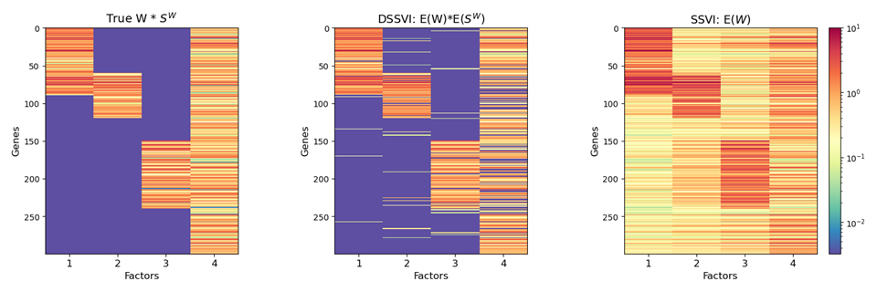
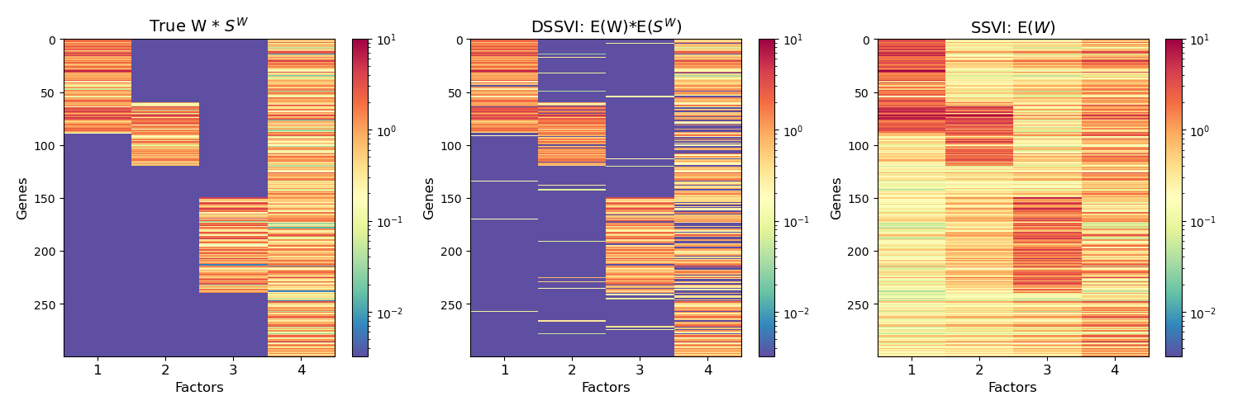
Estimation of sparse factor loadings
SSVI fails to capture the sparse structure of factor loadings
DSSVI can identify which fraction of genes are affected by which factors
Notes:
Visual comparison of estimated factor loadings for DSSVI and SSVI
SSVI roughly captures overall structure, however cannot capture sparsity (instead gives little values around 0.1~)
DSSVI gives much better interpretation in the context of single cell data
Can know which factors affect which genes

Slide 17
Discussion
DSSVI can capture sparsity in S^{H} as good as SSVI
DSSVI performs better in estimating mean of observations
DSSVI can flexibly learn whether or not sparsity is present in true data

Slide 18
Next steps
Apply to real data
Single cell RNA-seq data
Implement log-predictive likelihood metric for evaluation

Slide 19
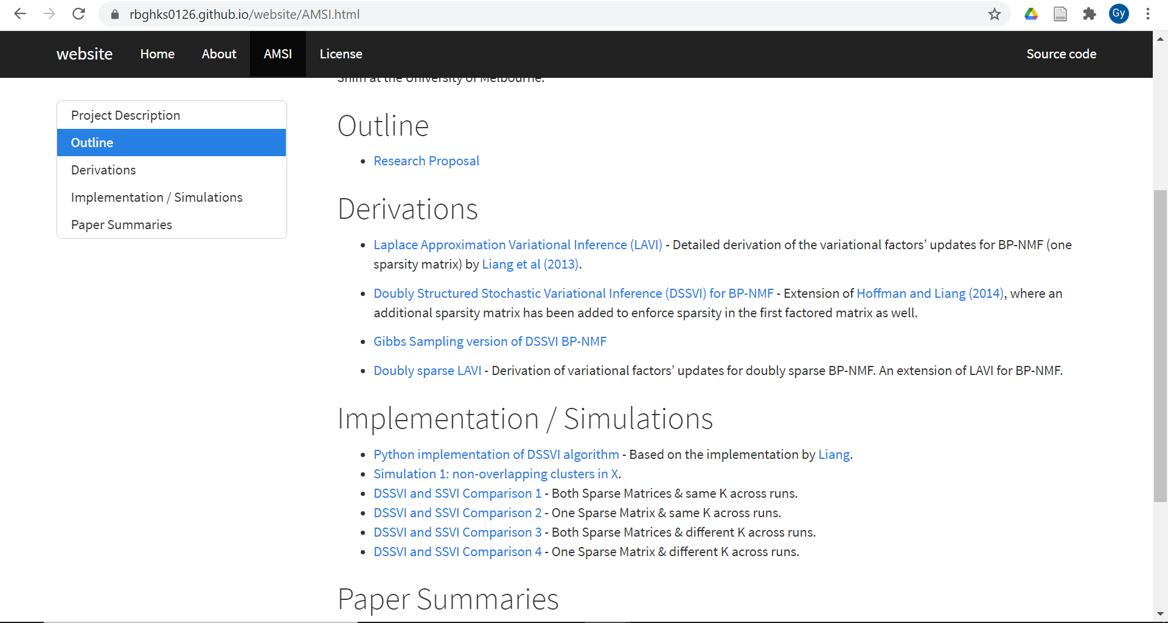
Conclusion
DSSVI enhances performance and interpretation
Can capture sparsity in factor loadings well
Can capture sparsity in activations as good as SSVI
More details: https://rbghks0126.github.io/website/AMSI.html

Slide 20
References
D. Blei, A. Kucukelbir, and J. McAuliffe (2017). Variational Inference: A Review for Statisticians. Journal of the American Statistical Association.
D. Liang, M. D. Hoffman and D. Ellis (2013). Beta Process Sparse Nonnegative Matrix Factorization for Music. ISMIR.
D. Liang and M. D. Hoffman (2014). Beta process non-negative matrix factorization with stochastic structured mean-field variational inference. [online] Available: https://arxiv.org/abs/1411.1804.
Tamara Broderick: Variational Bayes and Beyond: Bayesian Inference for Big Data (ICML 2018 tutorial) (2018). YouTube video, added by Steven Van Vaerenbergh [online]. Available: https://www.youtube.com/watch?v=Moo4-KR5qNg&t=1502s&ab_channel=StevenVanVaerenbergh

