Slide 1

PRE-IDEATHON TEMPLATE
GENESIS
IDEATHON
TEAM & DOMAIN
Team Name – YUKTHI
Team Members - BHALASUBRAMANIYAN RAMAKRISHNAN CB.EN.U4ECE26009
NIRANJAN S - CB.EN.U4ECE26037
SHAGARIKA P – CB.EN.U4CCE26135
POOJA S – CB.EN.U4CCE26137
Selected Domain – 1 Intelligent Systems & Digital Futures
Problem Statement – Migrant workers often lose access to government benefits after migration because they do not know which schemes they qualify for, what documents they need, or how to apply in a new state and also an language barrier.

Slide 2


Bridging the Gap Between Workers and Welfare
TEAM
YUKTHI
Internal migrant workers frequently lose access to ration benefits, health records, school admission support, and legal protections when they move between states. Documents exist, but workers do not know which scheme applies, where to apply, or how to prove eligibility. Language barriers and intermediary exploitation worsen exclusion.
What exactly needs to be solved?
We need to bridge the gap between a worker being eligible for a benefit and actually claiming it. Workers need a simple way to discover eligible schemes, understand them in their own language, identify missing documents, know where to apply, and get help when they are stuck.
Why is it important right now?
India’s digital public infrastructure is expanding, but last-mile benefit delivery remains fragmented . Migrant workers frequently cross state boundaries for employment while welfare information remains fragmented across schemes, portals, languages, and departments. A simple voice-first system can make essential benefits easier to discover, understand, and access.

Slide 3
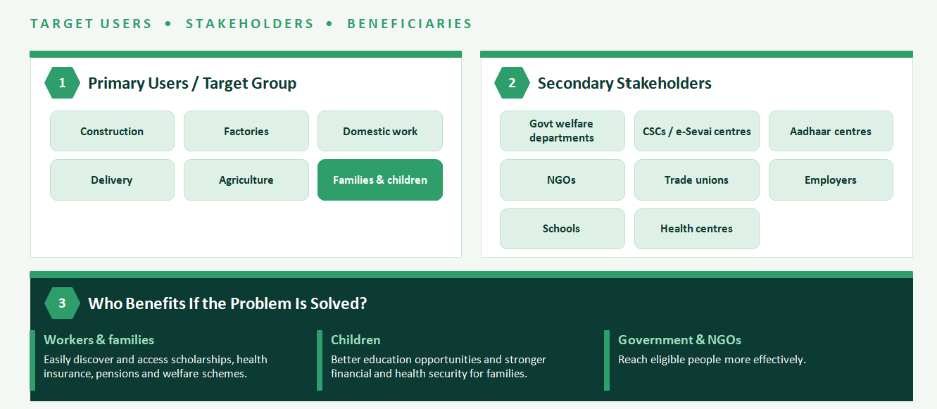
WHO IS AFFECTED?
TEAM
YUKTHI

Slide 4
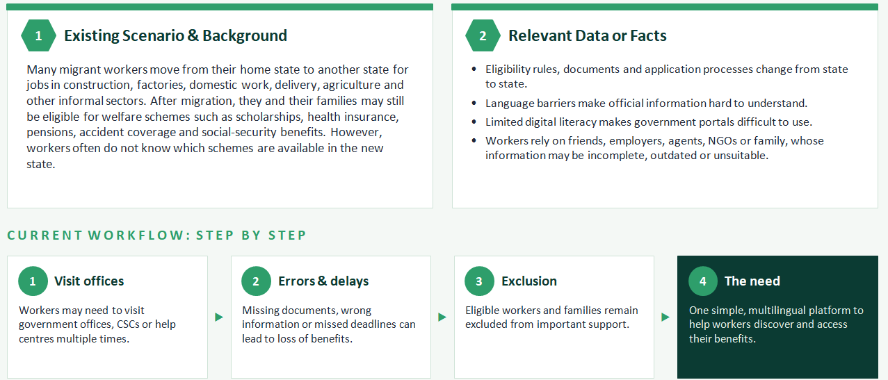
CURRENT SITUATION & CONTEXT
TEAM
YUKTHI

Slide 5
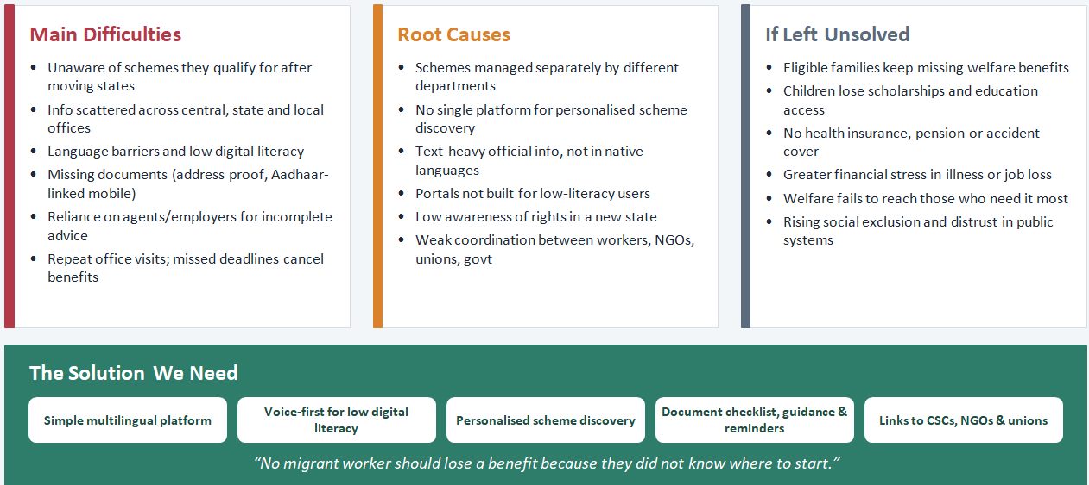
KEY CHALLENGES
TEAM
YUKTHI
Main difficulties, bottlenecks, root causes and consequences

Slide 6
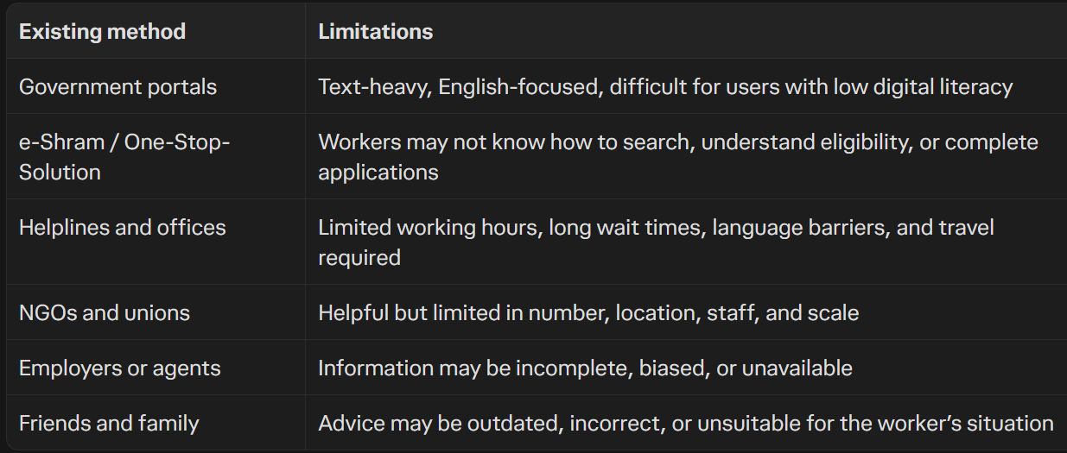
EXISTING SOLUTIONS / APPROACHES
TEAM
YUKTHI
What is already being done, and where it falls short
Key gap: Migrant workers lack one simple, multilingual system to discover eligible schemes, understand documents, and apply with confidence.

Slide 7
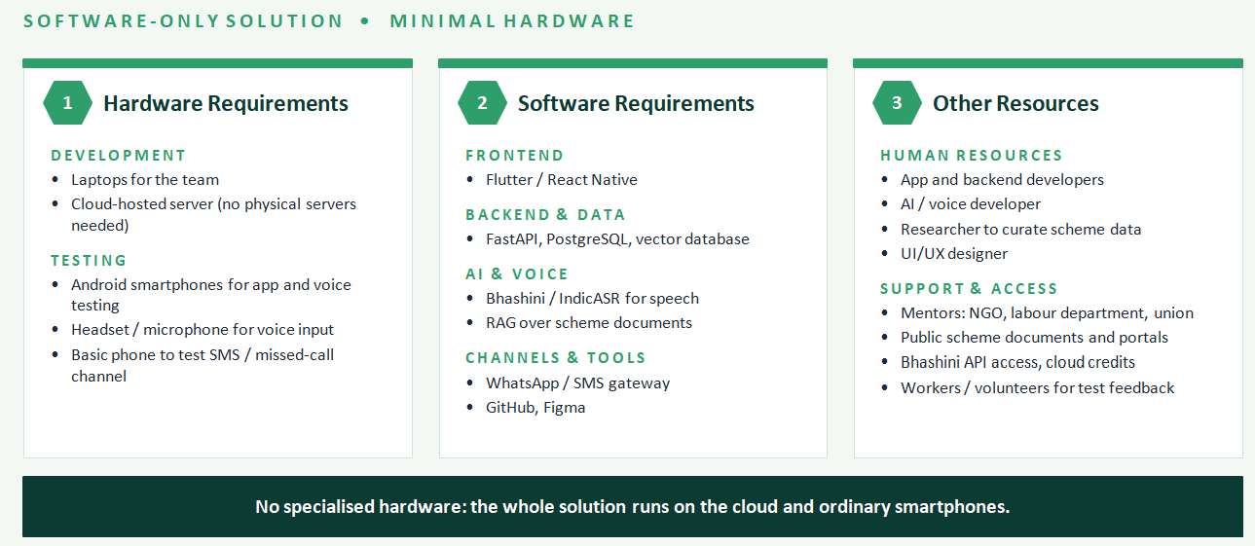
PROBLEM INSIGHTS & OPPORTUNITY AREAS
TEAM
YUKTHI

Slide 8
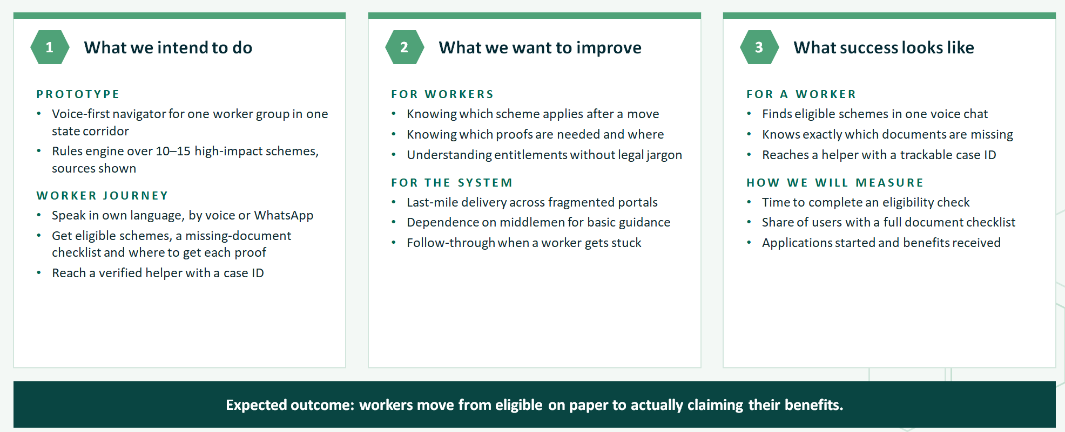
INITIAL DIRECTION & EXPECTED OUTCOME
TEAM
YUKTHI

