Slide 1
Predict. ..

Slide 2
kept:
TrafficType str: site/app
PublisherId str: brand value of publisher
AppSiteId str : brand value of app/site
AppSiteCategory str: arts,travel: genre
Position str: top/bottom
OS str
OSVersion str
DeviceType str
DeviceIP str (perhaps!!)
Country str
CampaignId int
CreativeId int
CreativeType int
CreativeCategory str
ExchangeBid float

Slide 3
removed
BidId str unique
BidFloor int same
Timestamp int ignored
Age int not enuf data
Gender str --do--
Carrier str
DeviceId str all 0
Latitude str
Longitude str
Zipcode int
GeoType str

Slide 4
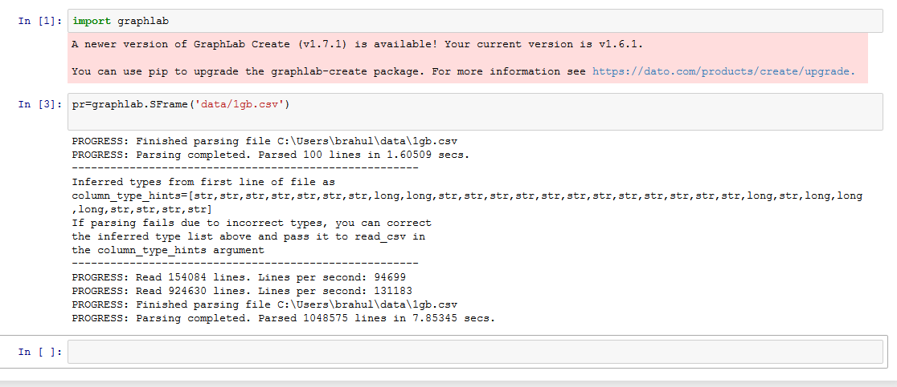

Slide 5
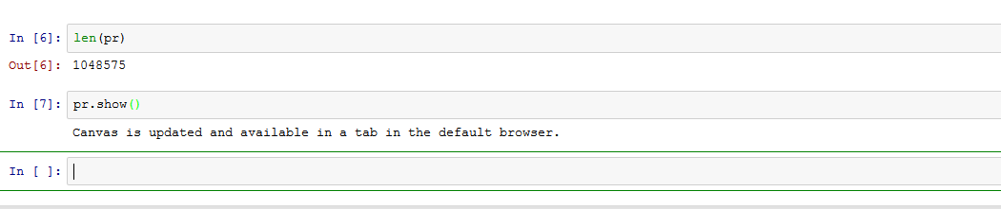
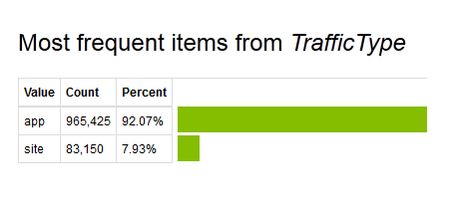
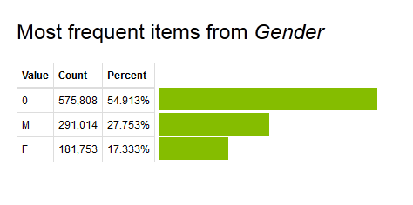
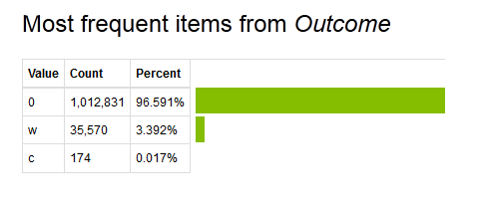

Slide 6
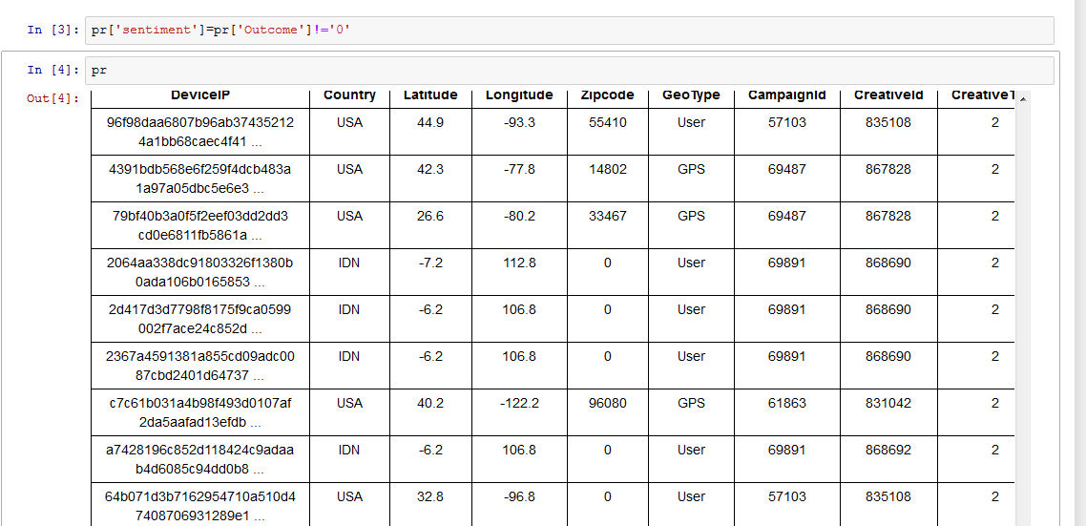
Filtering…
Finding sentiment

Slide 7
A popular approach towards solving class imbalance problems is to bias the classifier so that it pays more attention to the positive instances.
This can be done, for instance, by increasing the penalty associated with misclassifying the positive class relative to the negative class.
Another approach is to preprocess the data by oversampling the majority class or undersampling the minority class in order to create a balanced dataset.

Slide 8
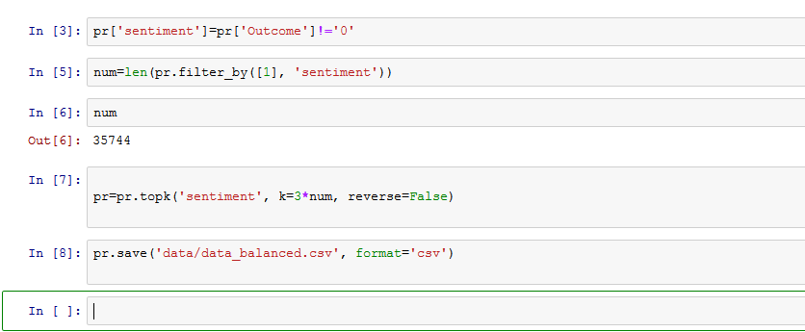
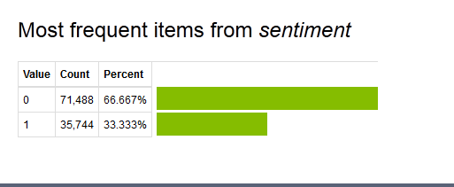

Slide 9
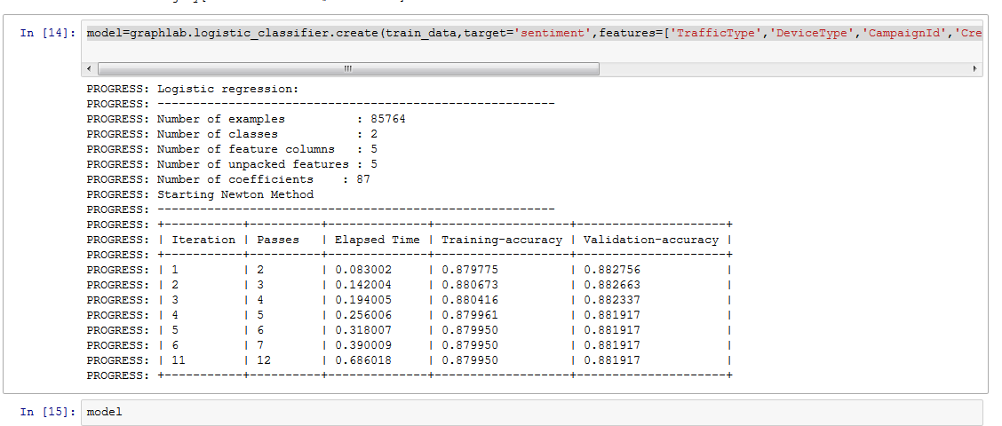
learn
model=graphlab.logistic_classifier.create(train_data,target='sentiment',features=['TrafficType','DeviceType','CampaignId','CreativeCategory','ExchangeBid'],validation_set=test_data,max_iterations=500)

Slide 10
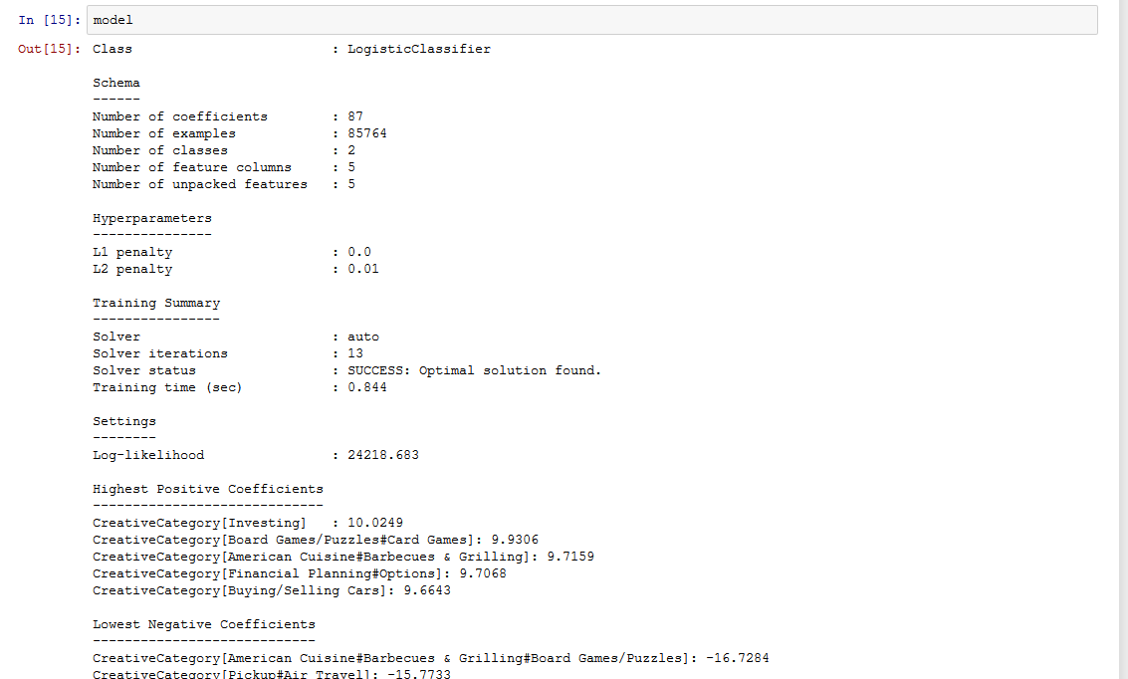

Slide 11
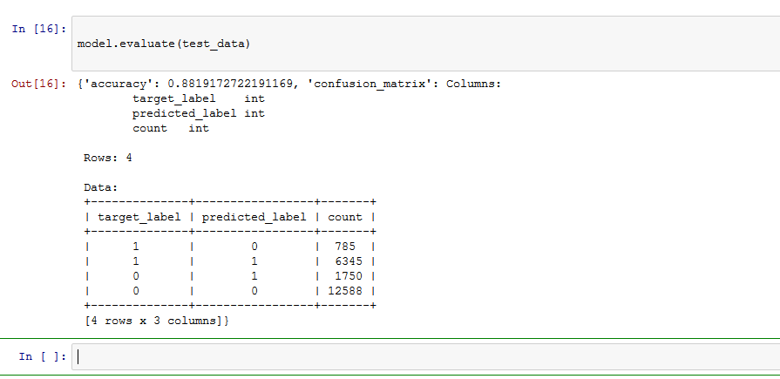
Evaluate..
model.evaluate(test_data)

Slide 12
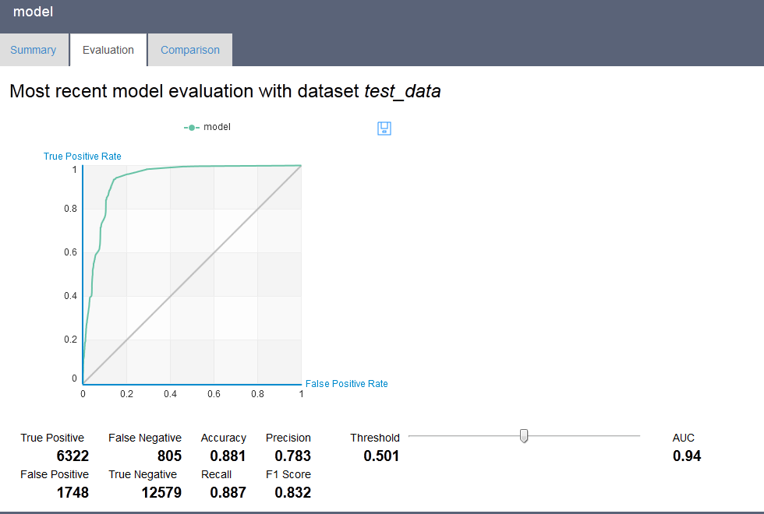

Slide 13
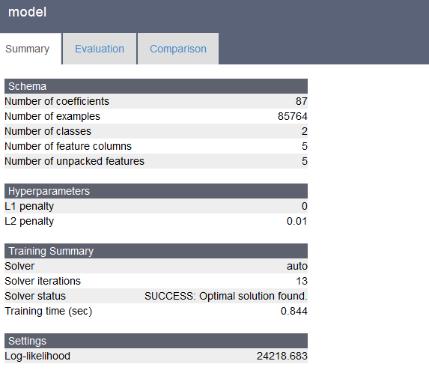

Slide 14
