Slide 1
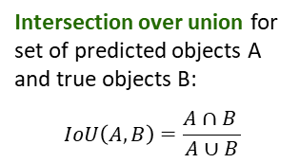
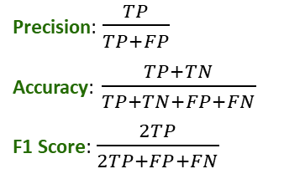
1: Normalize images
2: Identify objects
3: Separate into cells
4. Maximize precision
1
2
3
4
5
6
7
Intersection over union for set of predicted objects A and true objects B:
$$IoU\left(A, B\right)=\frac{A∩B }{A∪B}$$
14 21 28 35 42 49
“True objects”
?
Precision: $\frac{TP}{TP+FP}$
Accuracy: $\frac{TP+TN}{TP+TN+FP+FN}$
F1 Score: $\frac{2TP}{2TP+FP+FN}$

Slide 2
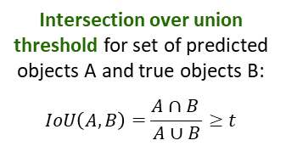
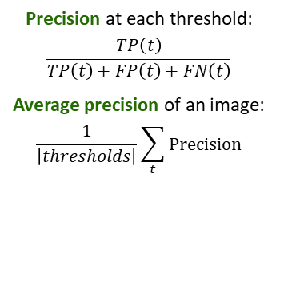
1: Normalize images
2: Identify objects
3: Separate into cells
4. Maximize precision
1
2
3
4
5
6
7
Intersection over union threshold for set of predicted objects A and true objects B:
$$IoU\left(A, B\right)=\frac{A∩B }{A∪B}≥t$$
14 21 28 35 42 49
“True objects”
?
Precision at each threshold:
$$\frac{TP\left(t\right)}{TP\left(t\right)+FP\left(t\right)+FN\left(t\right)}$$
Average precision of an image:
$$\frac{1}{\left|thresholds\right|}\sum_{t}{Precision}$$

Slide 3
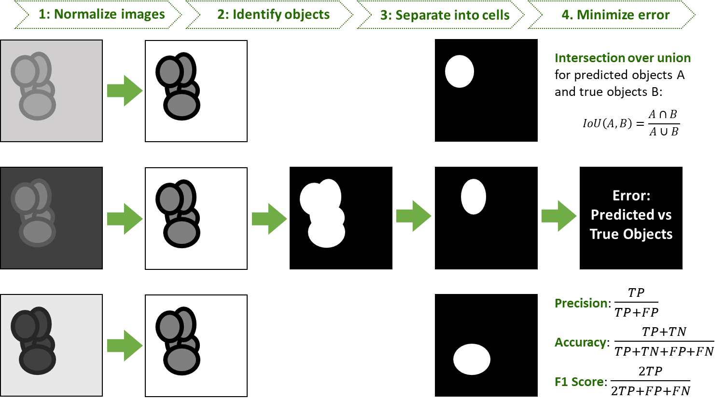
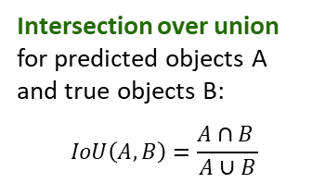

1: Normalize images
2: Identify objects
3: Separate into cells
4. Minimize error
Intersection over union for predicted objects A and true objects B:
$$IoU\left(A, B\right)=\frac{A∩B }{A∪B}$$
Error:
Predicted vs True Objects
Precision: $\frac{TP}{TP+FP}$
Accuracy: $\frac{TP+TN}{TP+TN+FP+FN}$
F1 Score: $\frac{2TP}{2TP+FP+FN}$

Slide 4
