Slide 1
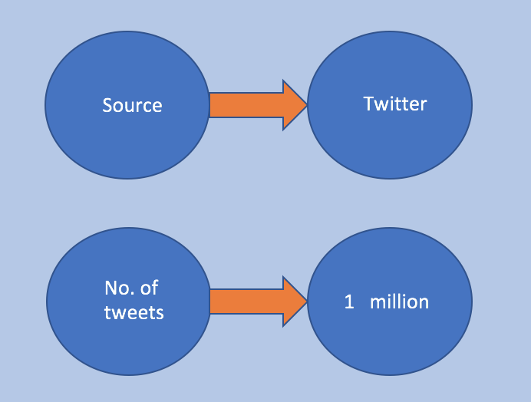
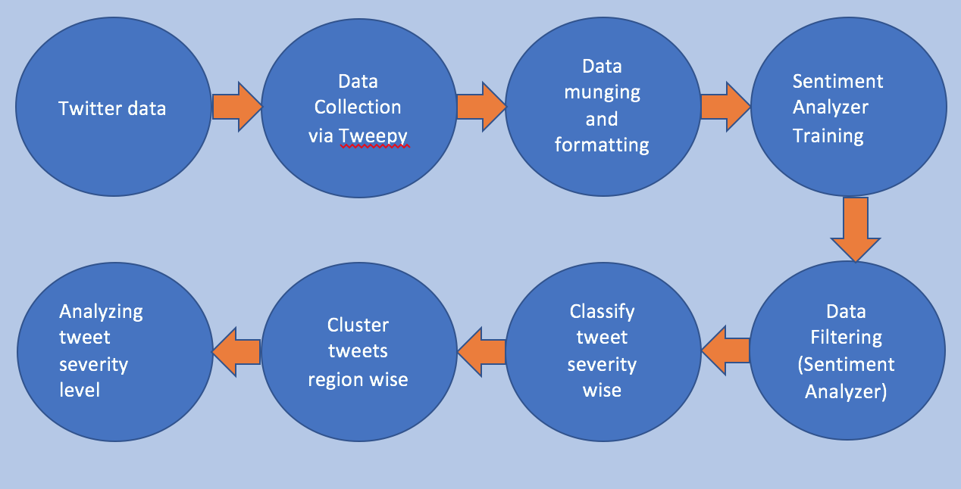
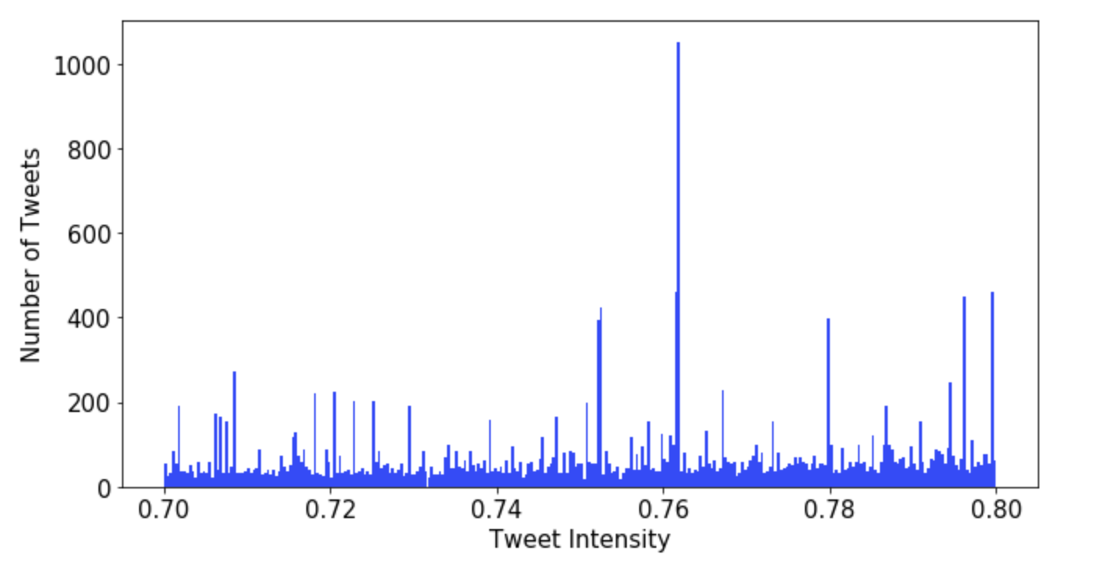
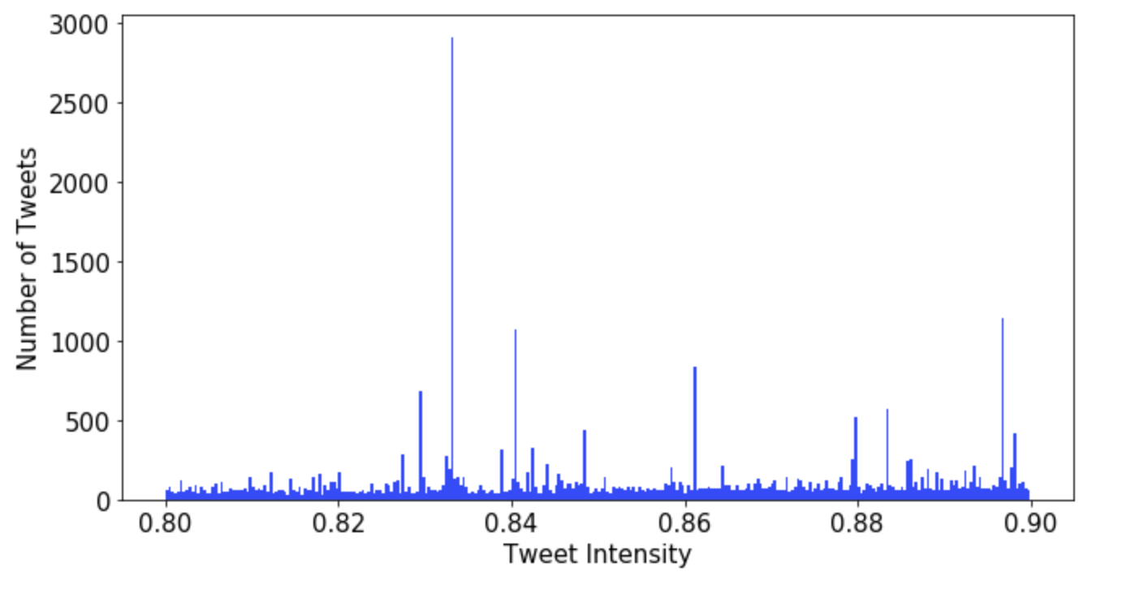
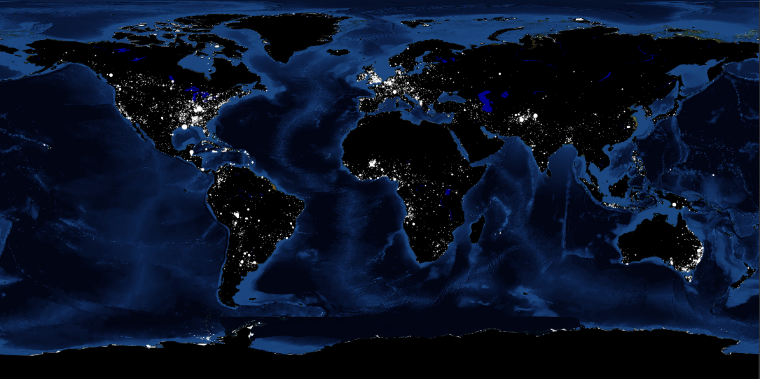
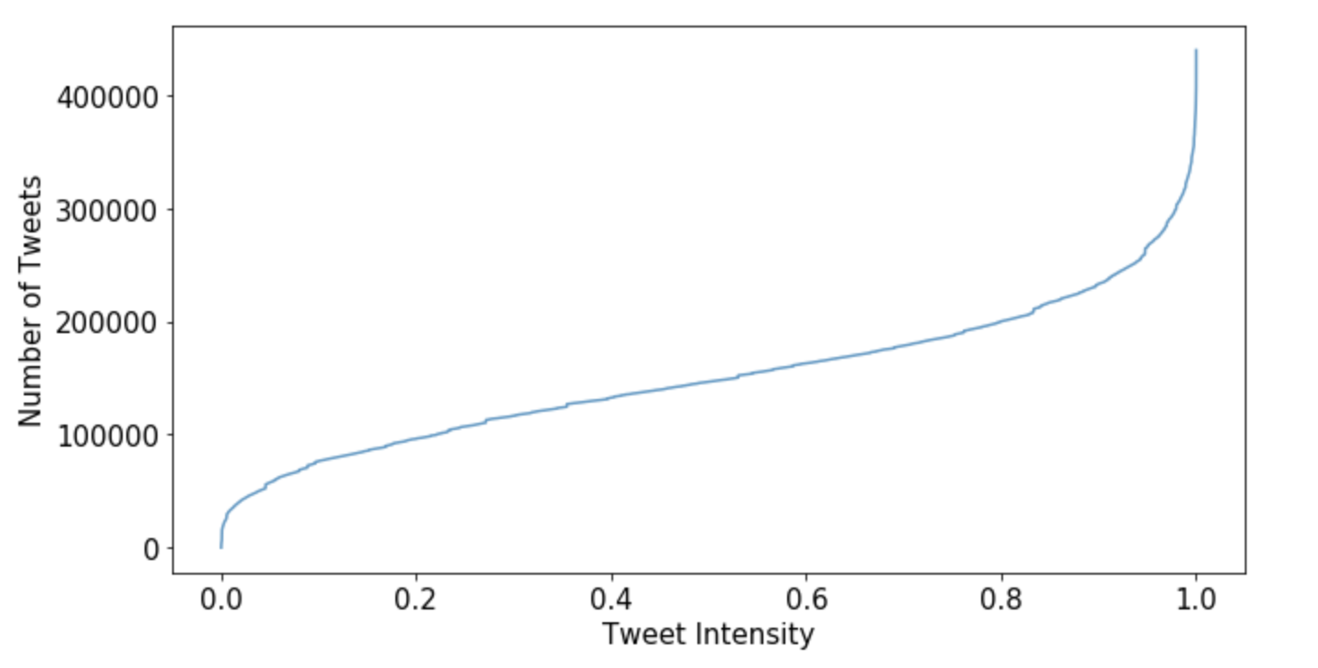
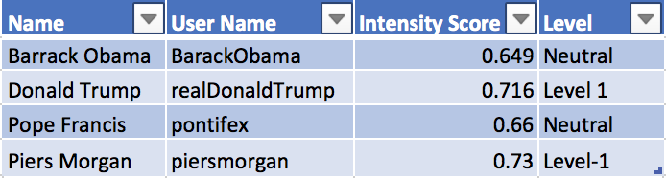
Analysis of Cyberbullying against women
Shweta Bharti, Rahul Bhansali, Jatin Garg, Aditya Tomer
Graduate School SBU
Introduction
In this project, we examine and explore violence and abuse faced by women in social media, specifically, on Twitter. The motivation for the project is primarily driven by United Nations’ Sustainable Development Goals(SDGs) #5 which is Achieving Gender Equality and Empowering All Women and Girls.
Data
Method
Graph (Level 1 Intensity)
Results
Total Number of Violent Tweets against women: 123,112
Total Number of Tweets Analyzed: 439,686
Percentage of Violent Tweets against women: 28%
Percentage of Violent Tweets against women of category:
Mildly Severe: 4.91%, Moderately Severe: 7.49%, Extremely Severe: 15.9%
Graph (Level 2 Intensity)
Region-wise violent tweets
Graph (Distribution)
Conclusion
Curbing online violence against women is necessary
Sentiment Analyzer was created to classify tweets
In total, 1 million tweets were used to train and test the sentiment analyzer
Organizations and countries can make use of the world maps to concentrate on specific regions
Discussion
The world map of distribution of violent tweets against women according to regions can be used by various countries or organizations to figure out the places or regions that need specific focus to curb online violence against women in those regions
Interesting results

