Slide 1

Yolanda AI Assistant Project:
Domain Knowledge Improvement & Video Integration
Project Mentors:
1. Rost Genevich
2. Ray Washington
Group Members: 1. Netifatu Abdulmumin-Butali 2. Rakshit Bhardwaj 3. Sai Anirudh Gandham (L) 4. Nishitha Keelamur Ravichandar 5. Guna Sekhar Chowdary Kollu 6. Sahana Ramakrishnan 7. Rishitha Vejella

Slide 2
Approach for Yolanda AI Assistant Project – Proof of Concept Code
Enhancing Yolanda’s Domain Knowledge and Improving Client Engagement with AI-driven Video Integration – Phase II (Refining prompts)

Slide 3
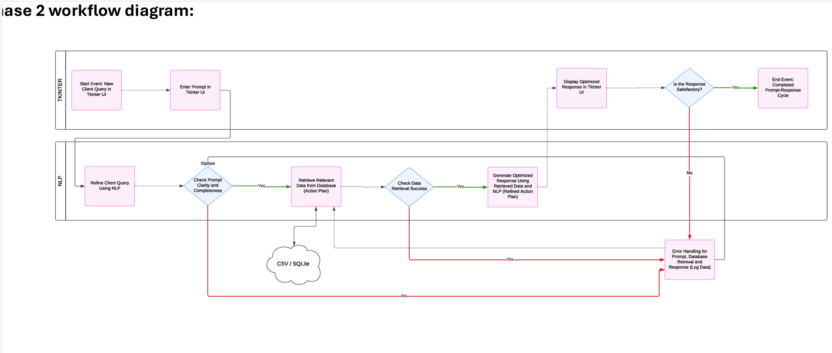

Slide 4
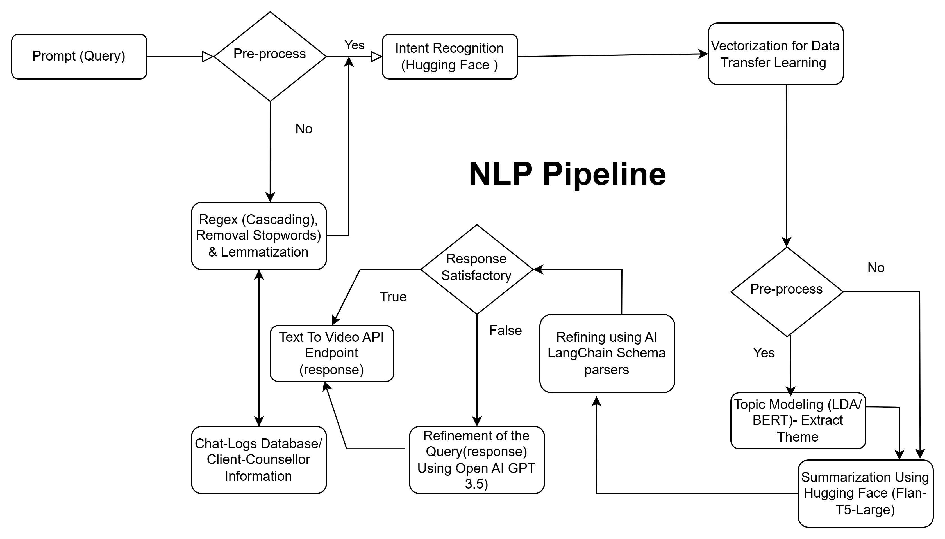

Slide 5
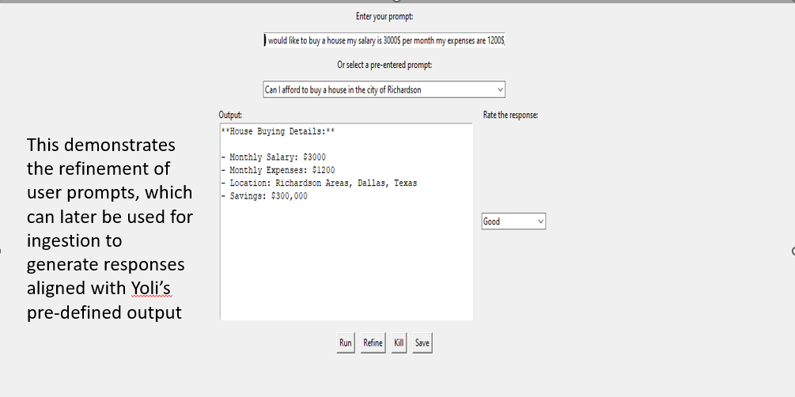
UI/UX Front End

Slide 6
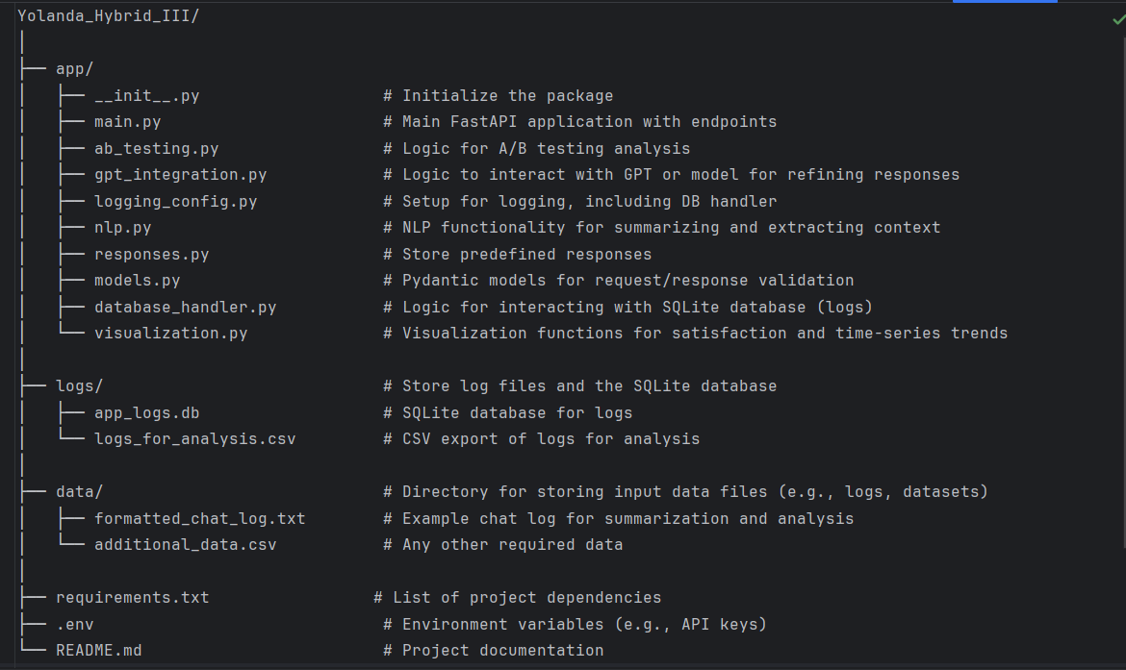
Project Tree Structure

Slide 7
Project Overview
Objective:
Provide a system for generating and refining action plans using AI models.
Enable dynamic, personalized responses based on user feedback (e.g., financial action plans).
Core Features:
Predefined Action Plans: Automatically provide a set of predefined, relevant action plans.
Refinement with AI: Use AI (GPT-based models) to refine action plans based on counsellor feedback.

Slide 8
Key Components
Fast API Service: Handles requests to generate and refine action plans.
AI Integration (LangChain + Hugging Face): Uses AI models to refine and personalize responses based on user feedback.
Endpoints:
/query: Retrieves the predefined action plan.
/feedback: Refines the action plan using AI if the user is not satisfied.

Slide 9
Business Value
Enhanced Customer Experience:
Offers tailored, real-time responses that meet customer needs.
Improves decision-making through AI-powered recommendations and Statistical A/B testing.
Scalable Solution:
API-based architecture allows for easy integration with existing systems (like Yolanda Chatbot).
Provides personalized responses without manual intervention.
Increased Efficiency:
Automated action plan generation and refinement leads to faster and more accurate responses.
Reduces the burden on customer service teams by providing instant, personalized suggestions.

Slide 10

Business Value A/B Testing
A/B Testing for Customer Satisfaction Analysis
Objective:
To perform A/B testing to assess customer satisfaction based on different client segments and interaction times. This will help improve the overall user experience and optimize service delivery.
a) Satisfaction Rate by Client Segment (New vs. Returning Users)
b) Impact of Time of Interaction on Satisfaction

Slide 11
Satisfaction Rate by Client Segment (New vs. Returning Users)
Hypothesis: New users may have a different satisfaction rate compared to returning clients.
Segmentation:
New users are identified by client_id = 0.
Returning clients are those with client_id > 0.
Test:
Group A: New users (client_id = 0)
Group B: Returning clients (client_id > 0)
Purpose: To determine if new user onboarding methods or targeted services can improve satisfaction among first-time users.

Slide 12
Impact of Time of Interaction on Satisfaction
Impact of Time of Interaction on Satisfaction
Segmentation:
The data is divided into time slots: morning (6 AM - 12 PM), afternoon (12 PM - 6 PM), and evening (6 PM - 12 AM).
Test:
Group A: Morning interactions
Group B: Afternoon interactions
Group C: Evening interactions
Purpose: To understand if certain times of the day correspond with higher satisfaction, helping to optimize customer support or service hours.

Slide 13
Integration Overview with Yolanda Chatbot
Objective: Integrate FastAPI-based Action Plan System into Yolanda Chatbot for seamless customer interaction.
How It Works:
User Query: Yolanda Chatbot makes a request to /query endpoint.
AI Refinement: If feedback is provided (via /feedback endpoint), Yolanda requests a refined plan from the AI system.
Example Workflow:
User asks: "Create an action plan."
API responds with a predefined plan.
User feedback: "Refine the plan."
API refines the response using AI and returns a tailored plan.

Slide 14
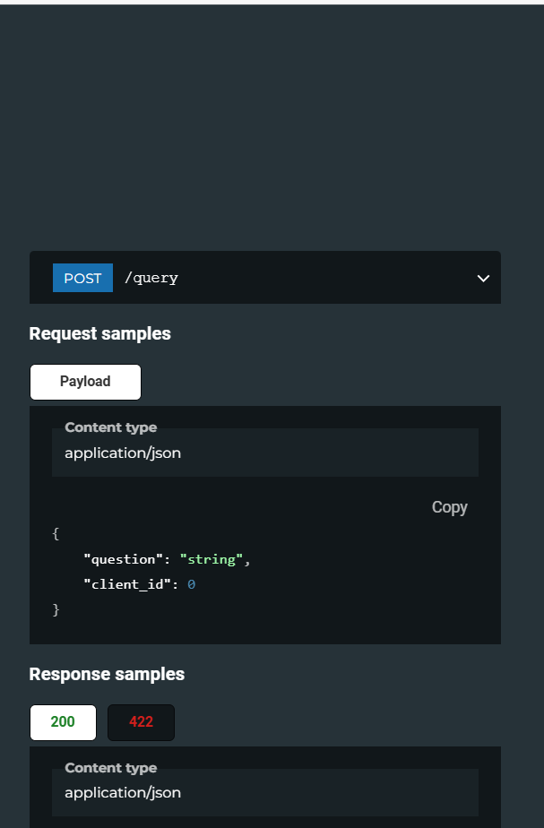
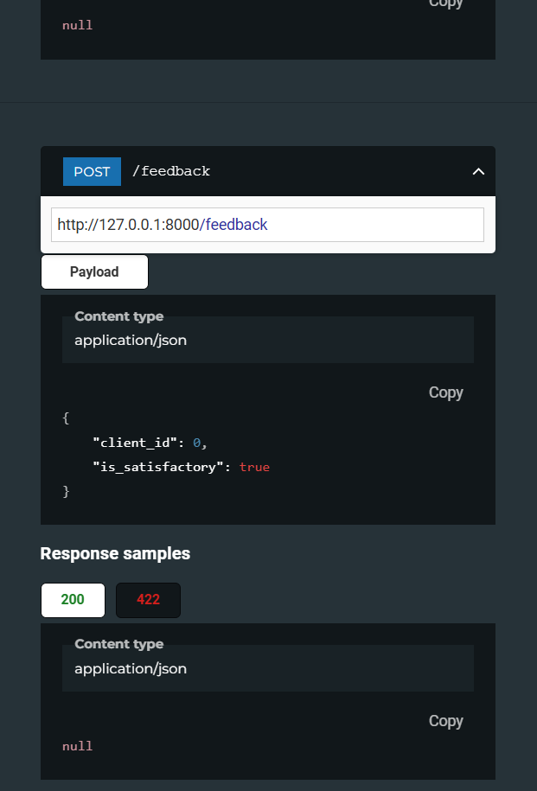
API Documentation using Fast API ReDoc

Slide 15
Integration Steps
Step 1: Expose the Fast API Service
Host Fast API service with the /query and /feedback endpoints publicly (via cloud).
Step 2: Yolanda Chatbot Integration
Yolanda Chatbot's backend will call the /query API to retrieve the action plan.
On feedback, Yolanda will call /feedback for refinement.
Step 3: Testing and Deployment
Test the integration between Yolanda and Fast API to ensure smooth API interactions.
Ensure both endpoints work seamlessly for user feedback.

Slide 16
CORS Configuration (for Chatbot Integration)
CORS (Cross-Origin Resource Sharing):
Purpose: Allows the Yolanda Chatbot (from a different domain) to interact with the Fast API service.
Configuration: Set allowed origins (e.g., Yolanda Chatbot's domain) for secure cross-origin requests.
Benefit: Ensures security and enables real-time communication between the systems. Personalized services for premium users.

Slide 17
Next Steps
API Deployment: Host the Fast API service in a production environment.
1
Integration Testing: Test the integration between Yolanda and the Fast API service.
2
Monitoring: Set up logging and monitoring to track API usage and response performance.
3
User Feedback Loop: Implement further AI enhancements as more feedback is received.
4

