Slide 1
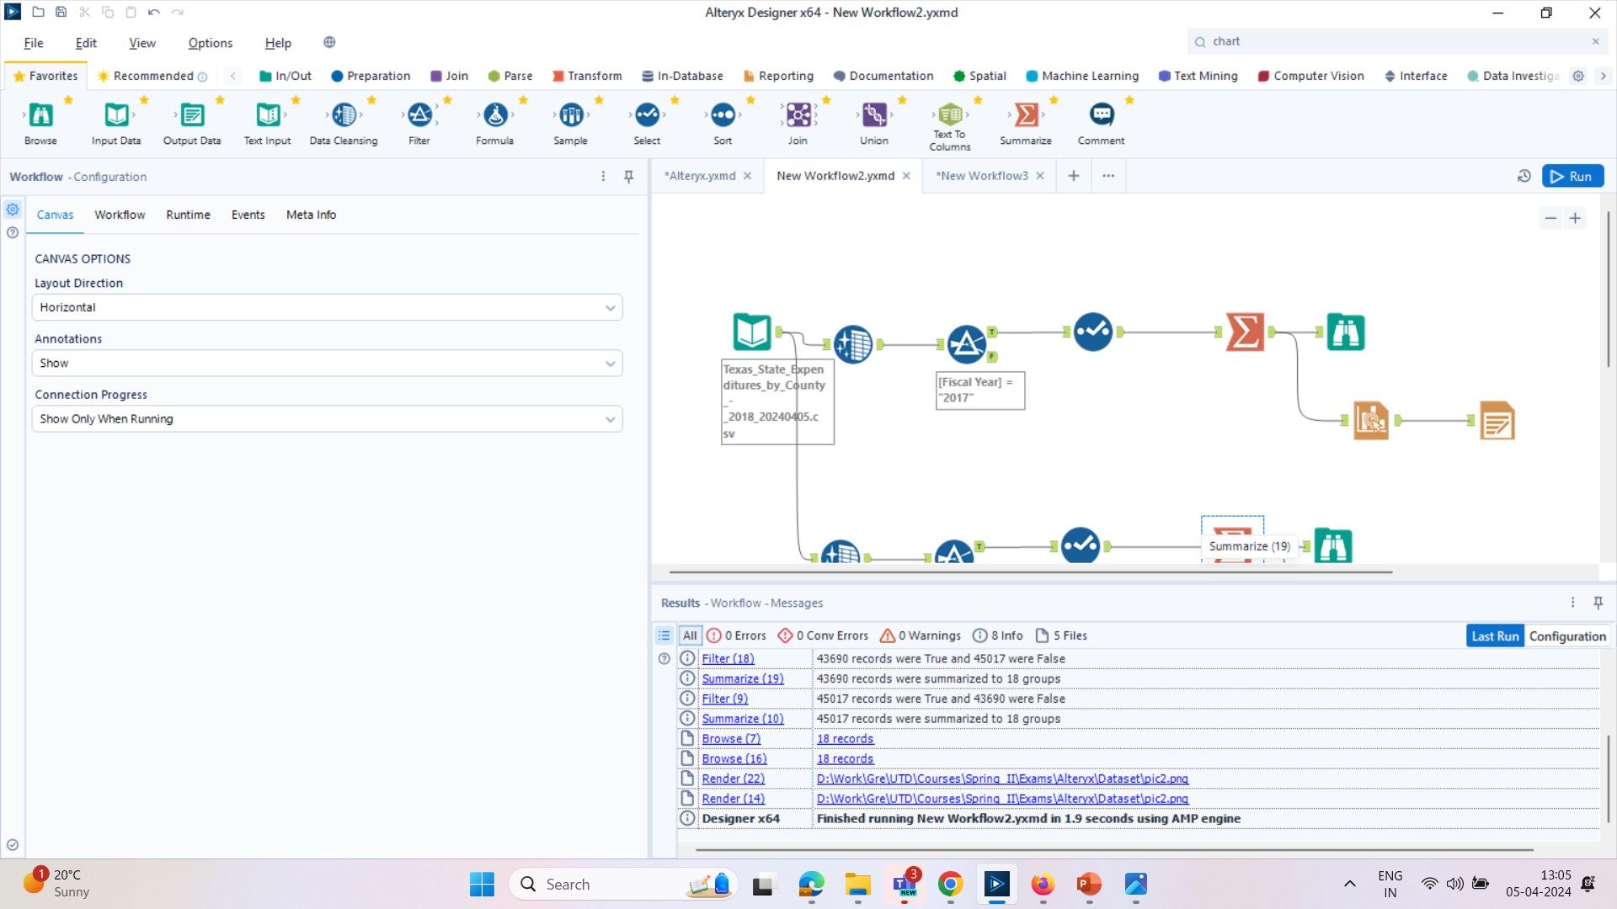
Sales Tax Allocation in Texas on different Utilities
ALTERYX WORKFLOW

Slide 2
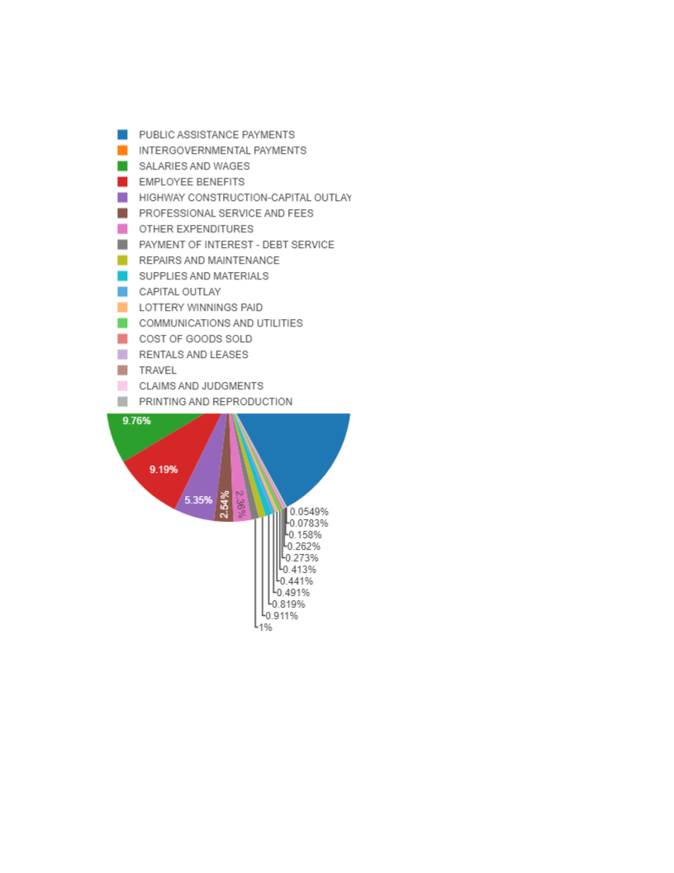
Tax State Expenditure On Different Utilities in Texas
We see that Public Assistance Payments has increased in expenditure. Which is a Warning Sign!!
Cost of Goods Sold is Low which is a Boon and we Texans! Should be proud and leverage it in future!

Slide 3
High State Expenditure on Public Assistance Payments is a Warning Sign WHY??
1) ECONOMIC CONDITION: Majority of the Population is struggling. Due to perhaps Financial constraints, unemployment or low wages
2) EFFECTIVITY OF THE EXISTING PROGRAM: We need improvement on the current program, probably change the system of operation of function of the existing program
3) DEMOGRAPHIC: High expenditure on Public assistance payments could mean that we have more elderly people staying after retirement, which is a good thing, but we are losing young work force, who may be liking to work else where, which is not a good sign

Slide 4
Low Expenditure on Cost of Goods Sold a POSITIVE SIGN!
1) EFFICIENCY IN PRODUCTION: This could mean that companies in Texas are efficient in managing production of goods
2) QUALITY CONTROL : Lower COGS means there is a focus on quality control. The companies are progressive reducing waste, improvement in production processes, leading to higher customer satisfaction
3) COMPETTIVE PRICING: Low COGS means more competitive pricing, attracting more customers and increasing the market share

Slide 5
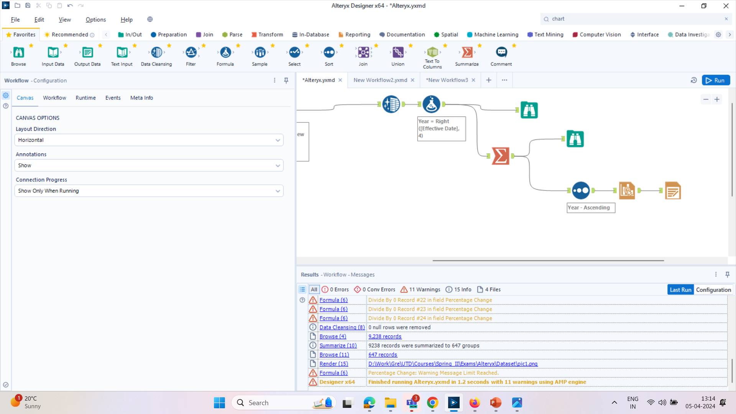
Alteryx Workflow

Slide 6
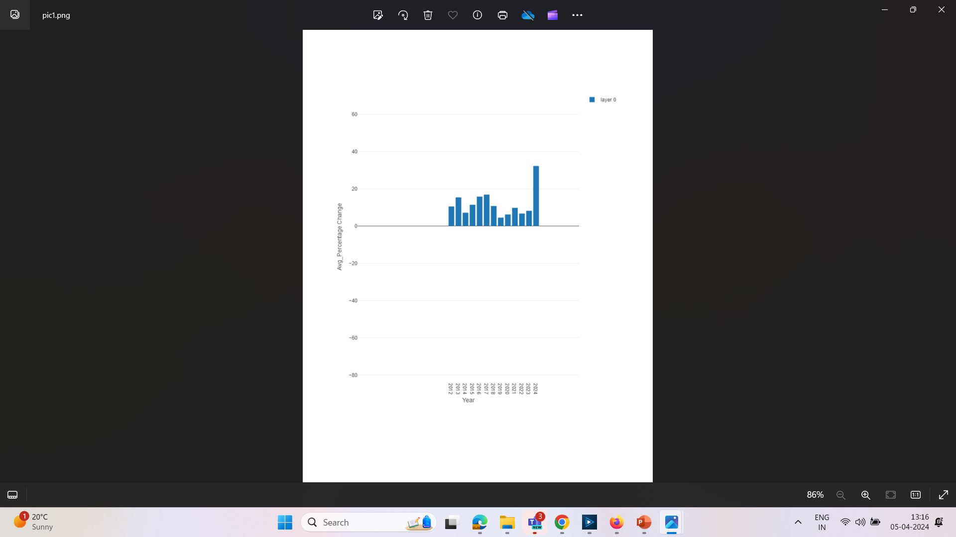

Slide 7
Average Percentage Increase in Sales Tax Allocation
As we can there is a trend of high and low percentage of sales tax rate from 2012 to 2018.
But as we move forward from 2022 16% , we see a spike in increment in rate return in 2024 to 34%. Which a good sign
Increased Government Revenue
Reduced Budget Deficit
Investing in Public good health

