Slide 1

FINAL PROJECT MIS 6382 GROUP 2 PRESENTATION
Vacation Rental Properties Dataset Analysis
By:
Rakshit Bhardwaj
Vishal Mulukutla
Ku Tzu Yen
Victor Lopez

Slide 2
This dataset contains data on vacation rental properties, encompassing specifics like the date, property name, category (for instance, BeachHouse), property type, rating, price, and average revenue. The information provided facilitates the analysis of trends, comparisons, and gaining insights into the vacation rental market.
Vacation Rental Properties Dataset Analysis

Slide 3
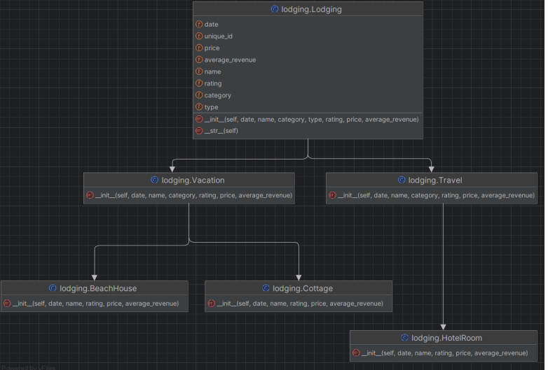
CLASS DIAGRAM HIERARCHY

Slide 4
OOPS CONCEPTS UTILIZED
CLASS DEFINITION –
* ‘__init__’ method initializes instances with attributes like date, name, category, type, rating, price, average revenue, and unique ID.
* ‘__str__’ method provides string representation of the object.

Slide 5
OOPS CONCEPTS UTILIZED
2. INHERITANCE-
* (Travel, Vacation, HotelRoom, Cottage, BeachHouse). These classes inherit from the ‘Lodging’ class.
* Each subclass inherits attributes and methods from the parent class and can have additional attributes or methods specific to their class as well.

Slide 6
OOPS CONCEPTS UTILIZED
3. CONSTRUCTOR OVERRIDE-
* Each subclass defines its own ‘__init__’ method, which calls the parent classes ‘__init__’ method using ‘super().__init__()’.
* This process is termed as overriding, providing own implementation in addition to taking leverage form the parent class.

Slide 7
OOPS CONCEPTS UTILIZED
4. POLYMORPHISM-
* This concept is demonstrated when instances of different classes can be treated as instance of their parent class.
* This process calls for the ease and flexibility in handling different types of parent class objects interchangably

Slide 8
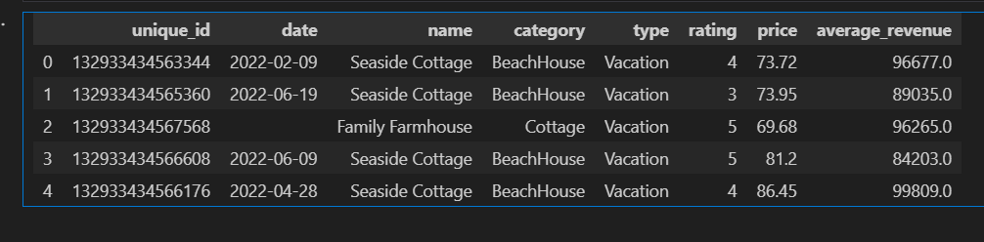
GIVEN DATA SET

Slide 9
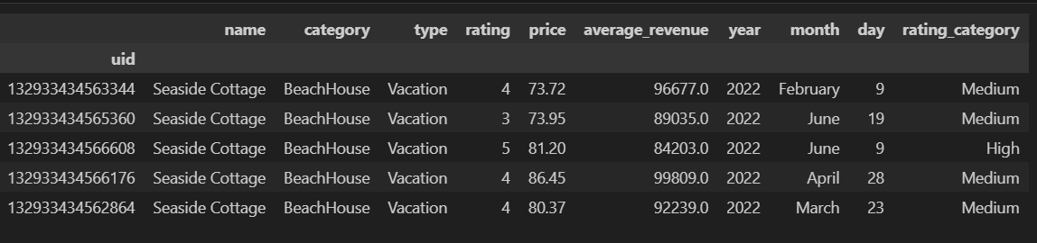
CLEANED DATA SET

Slide 10
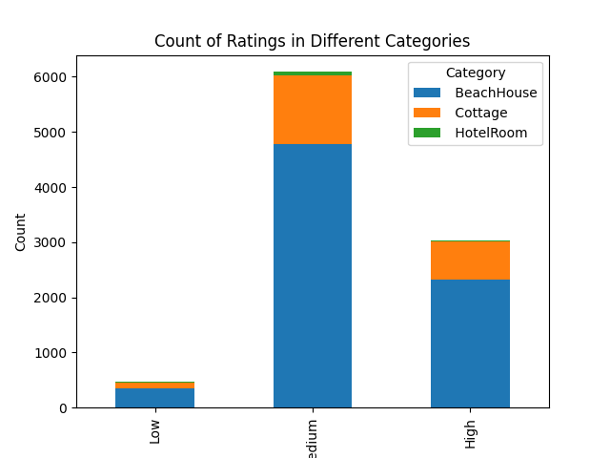
VISUALIZATION
BAR CHART

Slide 11
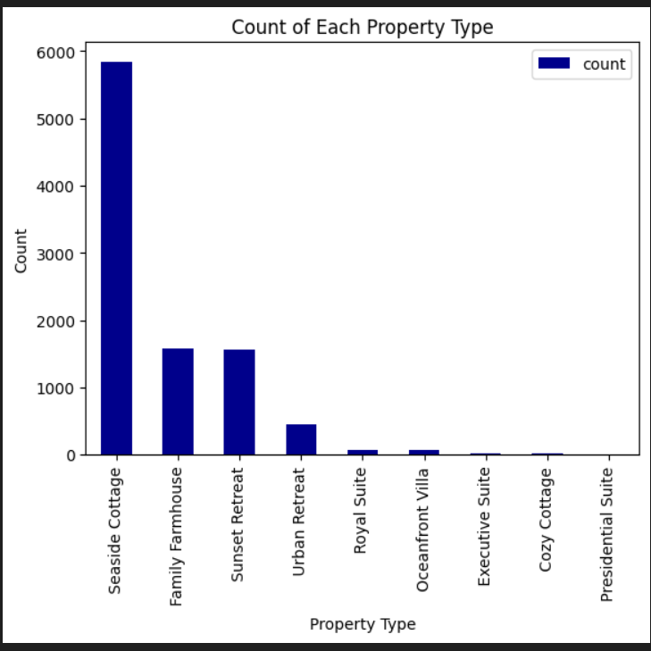
VISUALIZATION
BAR CHART

Slide 12
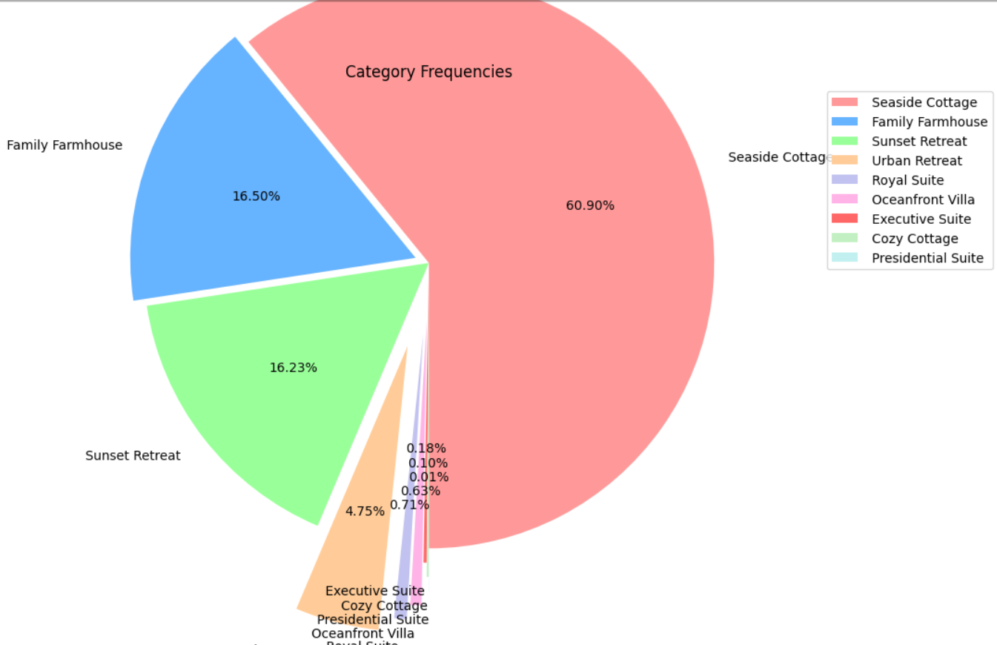
VISUALIZATION
PIE CHART

Slide 13
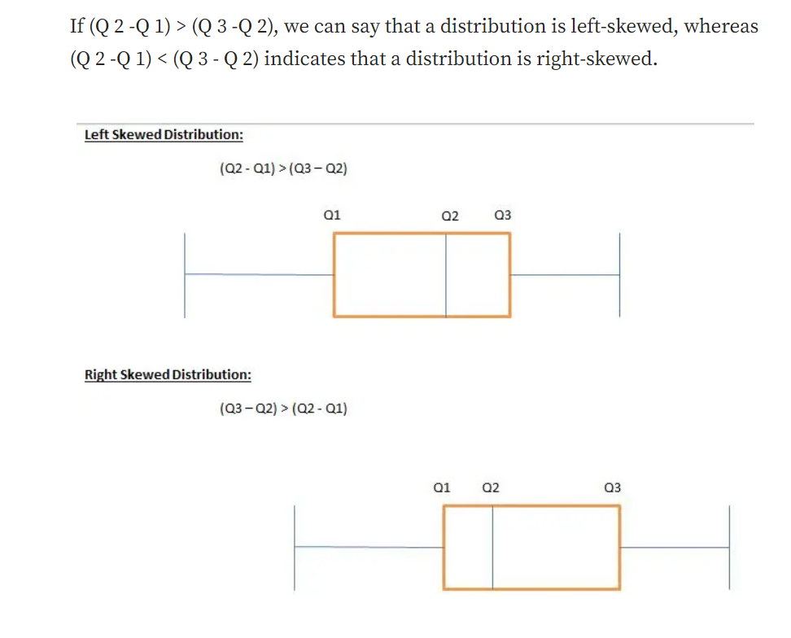
VISUALIZATION
BOX-PLOT CHART

Slide 14
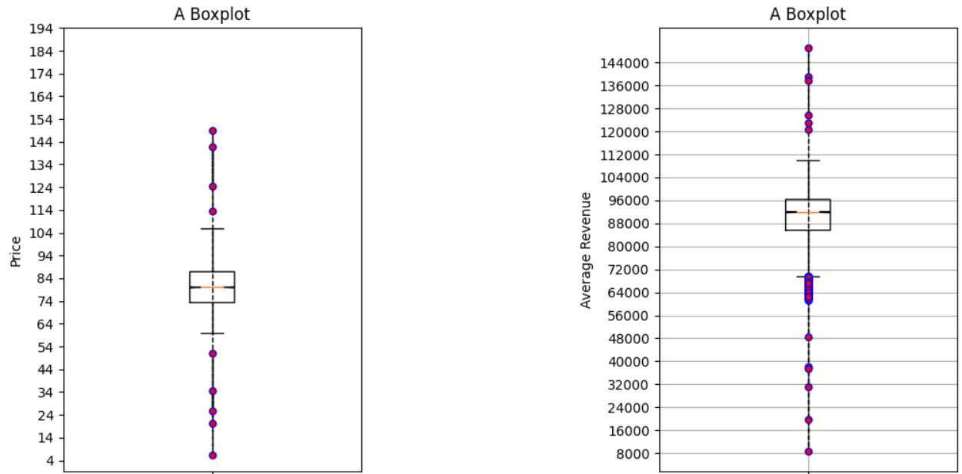
VISUALIZATION
BOX-PLOT CHART

Slide 15
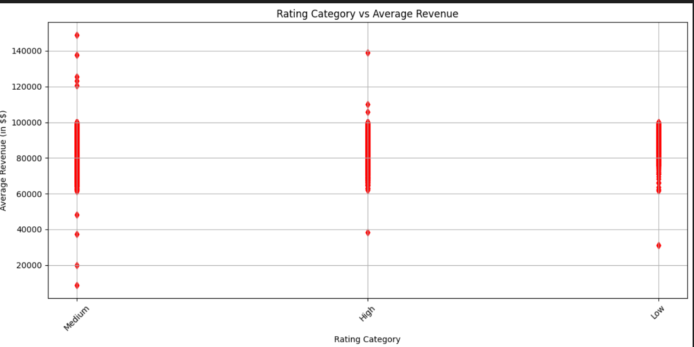
VISUALIZATION
SCATTER-PLOT CHART

Slide 16
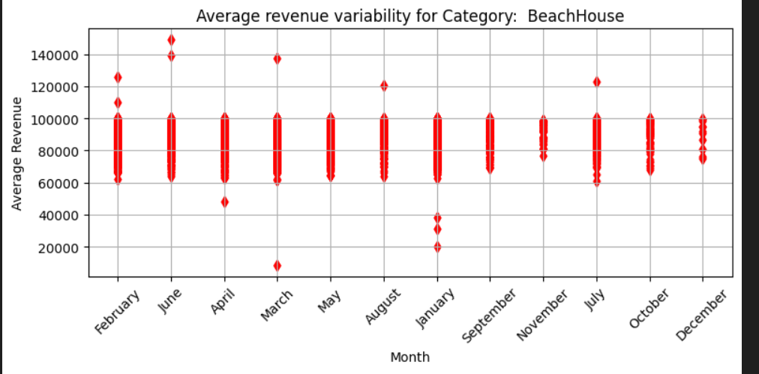
VISUALIZATION
SCATTER-PLOT CHART

Slide 17
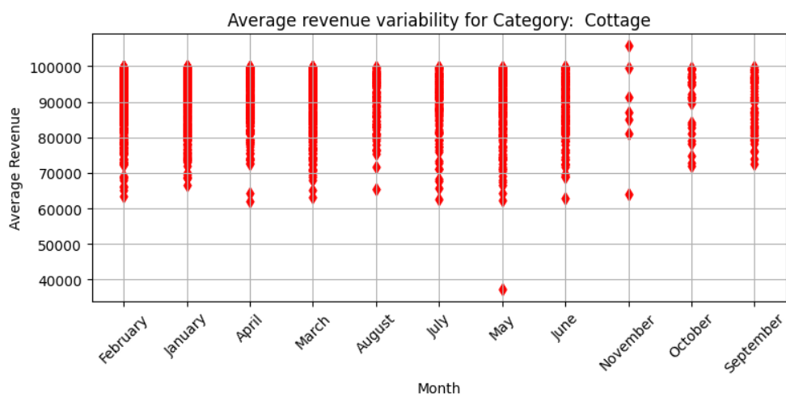
VISUALIZATION
SCATTER-PLOT CHART

Slide 18
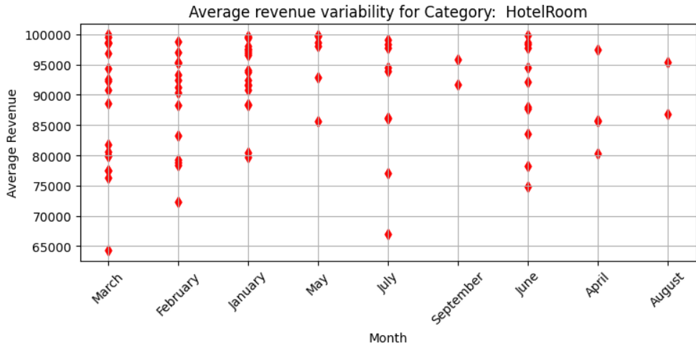
VISUALIZATION
SCATTER-PLOT CHART

Slide 19
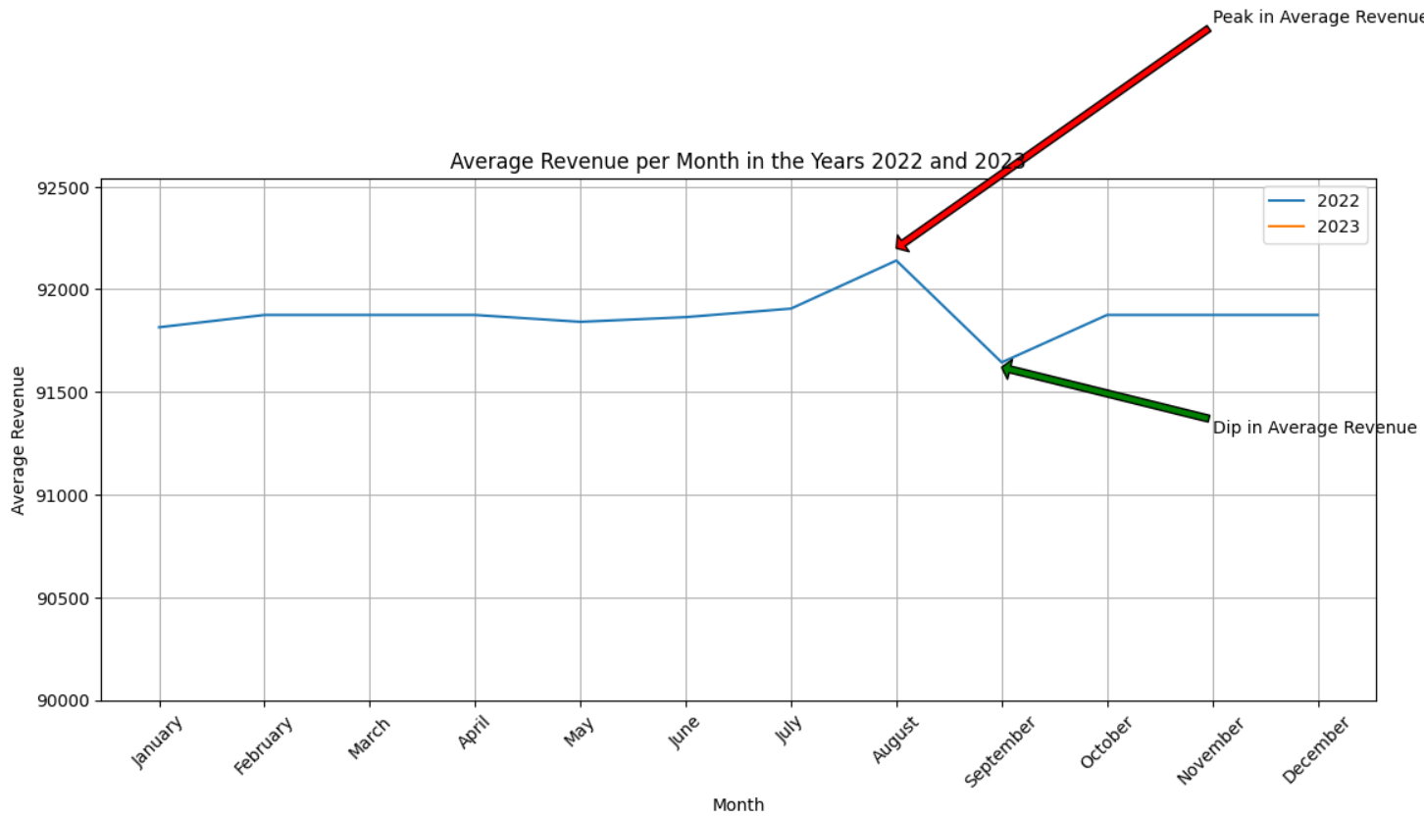
VISUALIZATION
LINE CHART

Slide 20
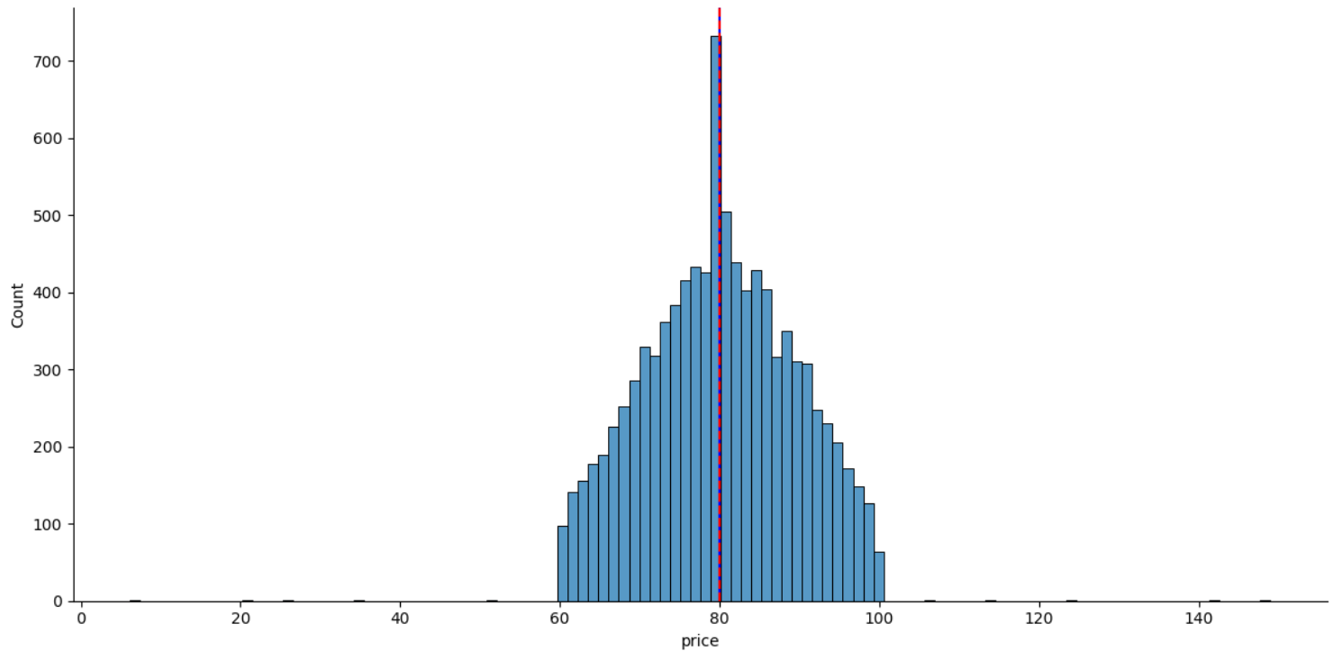
VISUALIZATION
HISTOGRAM CHART

Slide 21
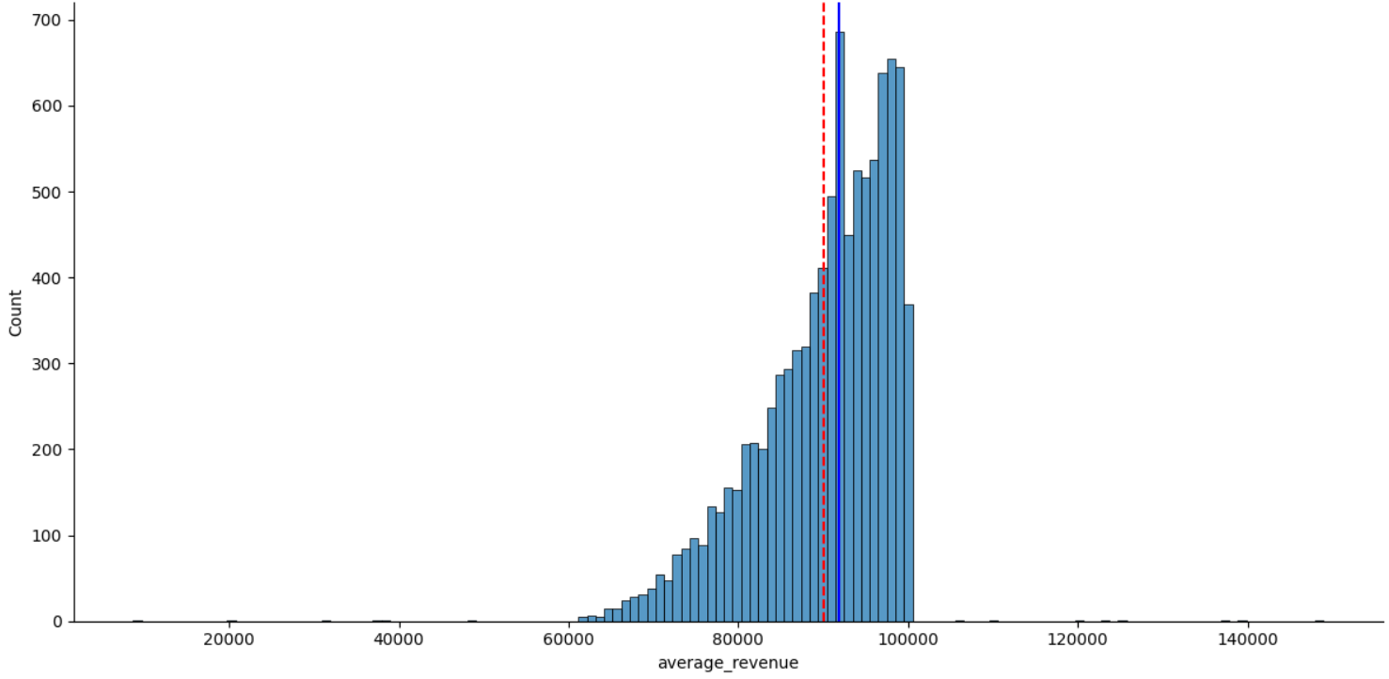
VISUALIZATION
HISTOGRAM CHART

Slide 22
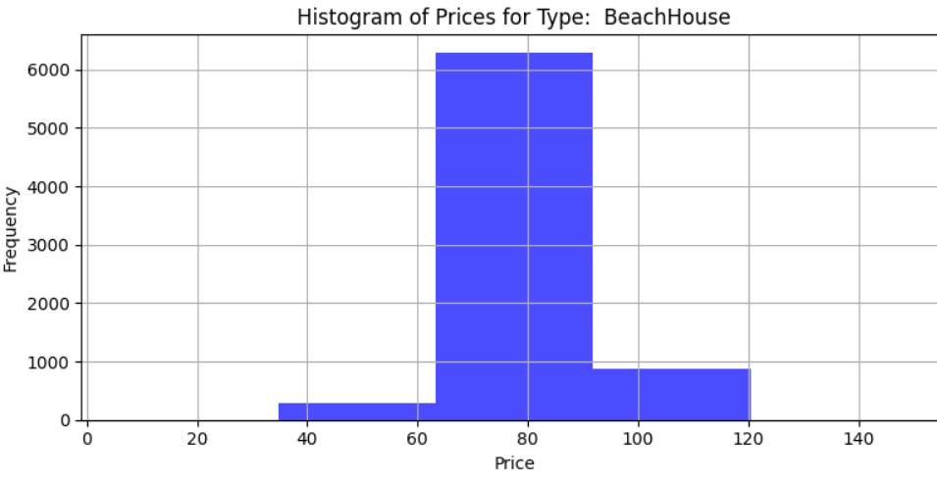
VISUALIZATION
HISTOGRAM CHART

Slide 23
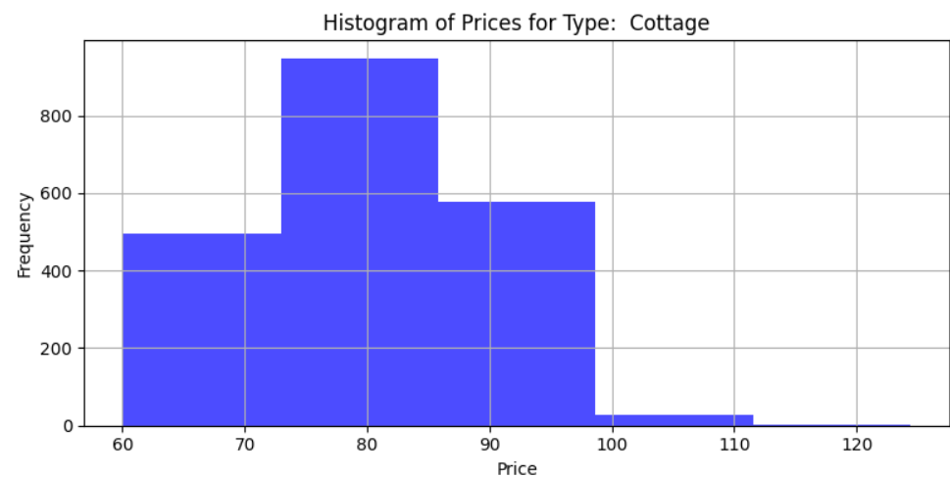
VISUALIZATION
HISTOGRAM CHART

Slide 24
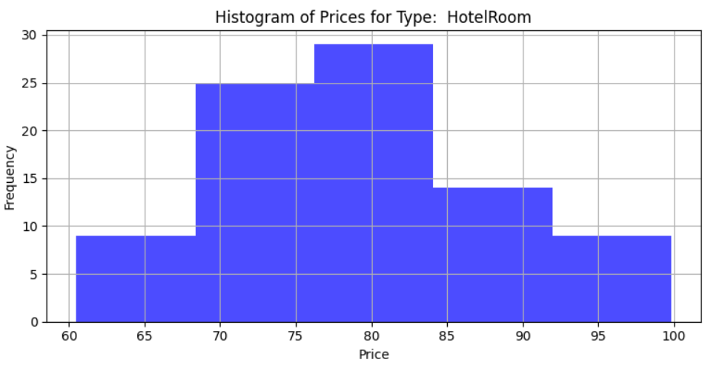
VISUALIZATION
HISTOGRAM CHART

Slide 25
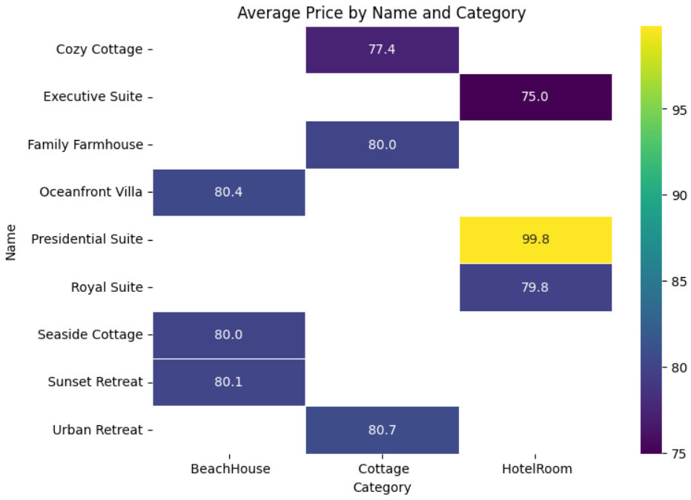
VISUALIZATION
HEAT-MAP CHART

Slide 26
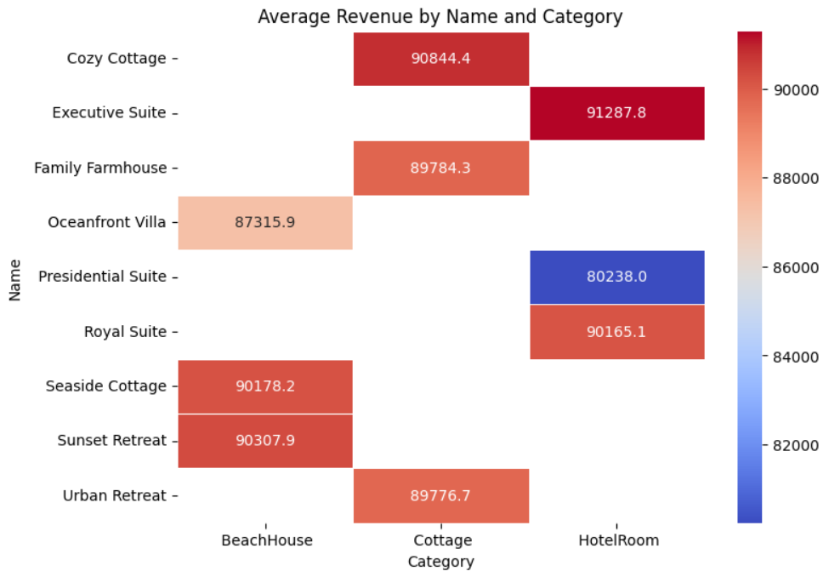
VISUALIZATION
HEAT-MAP CHART

Slide 27
CONCLUSION
1. The average revenue goes at its highest in August and at the same time attains its lowest value in September in the year 2022
2. the count of prices for booking Categories of the likes BeachHouse and Hotelroom tend to follow a Gaussian (Normal) Distribution and Cottage industry is slightly left skewed as it is confirmed from both Histogram’s as well as Box-plot.
3. he most transactional industry is represented by the Beach category industries and it accounts for total (Seaside + Sunset Retreat + Ocean Front Villa) = (60.9 + 16.23 + 0.63 )% = 77.76% of the total industries
4. Family farm house of Cottage industry is trying to compete with the Seaside cottage of the beachHouse industry as we can see it is slowly making an impact, with this trend it may exceed the former.
5. As we can see from the Heat map chart the average price for Presidential Suite is the highest, implying not many customers can afford it as such average revenue goes down. Inverse relationship between average price and average revenue, and vice versa for Executive suite.

Slide 28
INDIVIDUAL CONTRIBUTIONS
Vishal – Datasets, Bar Chart, and Pie Chart
Ku – Introduction, Title, Oops Concepts
Lopez – Box Plot, and Scatter Plot
Rakshit – Line, Histogram, and Heat-map Charts
3.

Slide 29
THE END
THANKS AUDIENCE KEEP SMILING!!
The joy of coding Python should be in seeing short, concise, readable classes that express a lot of action in a small amount of clear code -- not in reams of trivial code that bores the reader to death. - Guido van Rossum

