Slide 1
Intel’s Strategic Decision: Selecting the Optimal Location for a New Assembly and Test Plant
An Analysis Based on Financial, Logistics, and Supply Chain Costs Utilizing a Decision Matrix Approach

Slide 2
Introduction
Intel is evaluating several potential locations for its next assembly and test (AT) plant for semiconductor wafers.
Key decision criteria include operational costs, logistics efficiency, government incentives, market access, and labor availability.
This presentation explores financial performance, supply chain transportation costs, and a decision matrix to assess the optimal location.

Slide 3
Financial Terminologies
Dupoint Framework has three components to measure the efficacy of ROE (Return of Equity):
Profitability = Net income/ Sales (Profit Margin)
Efficiency = Total sales / Total Assets (Asset Turnover)
Leverage ratio = Total Assests / Stockholder’s equity. (Equity Multiplier)
ROE = Net Income / Equity
ROE = Profitability x Efficiency x Leverage
Notes:
Return on Equity
ROE = Net Income / Equity
Measure of overall profitability of shareholders investment.
Where Net Income is the net amount of assets generated by a business through operations
ROE at one point in time does not give us the right analysis. We need to look at the trends over time and compare across financial timeline
a) Profitability Ratio - The more sales we have, the higher our income is going to be , which gives profitability ratio
How much income is generated from sales
Net income / Sales
b)Efficiency ratio - Measures how much sales are generated from the company’s assets
Total Sales / Total Assets
c)Leverage ratio - How much money has been borrowed to purchase the asset
How many assets were acquired via equity that has been put in the business
Leverage ratio = Total asset / Stockholder’s equity

Slide 4
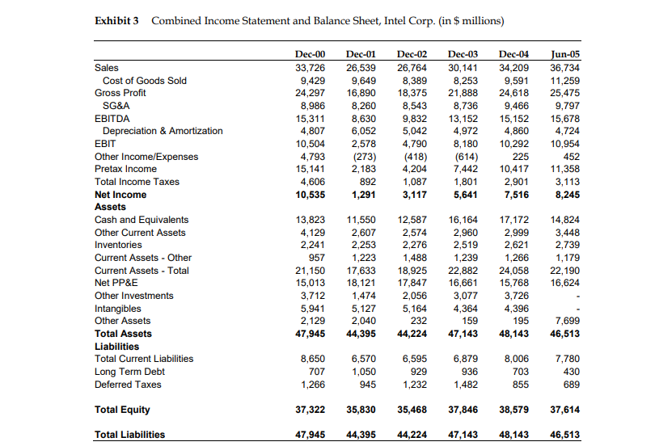
Financial Statement

Slide 5
Financial Overview
Competitor: AMD
Financial Overview (2000-2005)
Key Metrics for Intel:
Sales: $33.7B (2000) → $36.7B (2005)
Net Income: $10.5B (2000) → $8.2B (2005)
Total Assets: $47.9B (2000) → $46.5B (2005)
Trend: Profitability dipped in 2001 but recovered steadily by 2005.
Key Financial Ratios Over Time:
Profitability: 2000: 31.2%, 2001: 4.9%, 2002: 11.6%, 2005: 22.4%
Efficiency: 2000: 0.70, 2001: 0.60, 2005: 0.79
Leverage: 2000: 1.28, 2001: 1.24, 2005: 1.24
Return on Equity(ROE): 2000: 28.2%, 2001: 3.6%, 2005: 21.9%

Slide 6
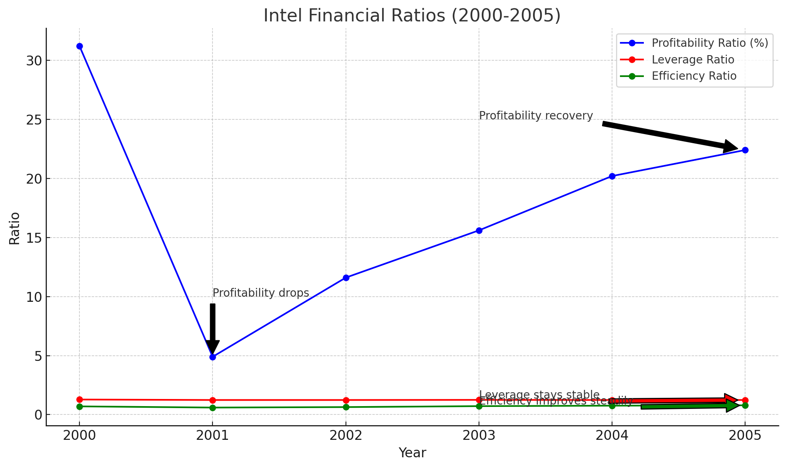
Financial Overview
Competitor: AMD
Financial Overview (2000-2005)
Key Metrics for Intel:
Sales: $33.7B (2000) → $36.7B (2005)
Net Income: $10.5B (2000) → $8.2B (2005)
Total Assets: $47.9B (2000) → $46.5B (2005)
Trend: Profitability dipped in 2001 but recovered steadily by 2005.
Key Financial Ratios Over Time:
Profitability: 2000: 31.2%, 2001: 4.9%, 2002: 11.6%, 2005: 22.4%
Efficiency: 2000: 0.70, 2001: 0.60, 2005: 0.79
Leverage: 2000: 1.28, 2001: 1.24, 2005: 1.24
Return on Equity(ROE): 2000: 28.2%, 2001: 3.6%, 2005: 21.9%

Slide 7
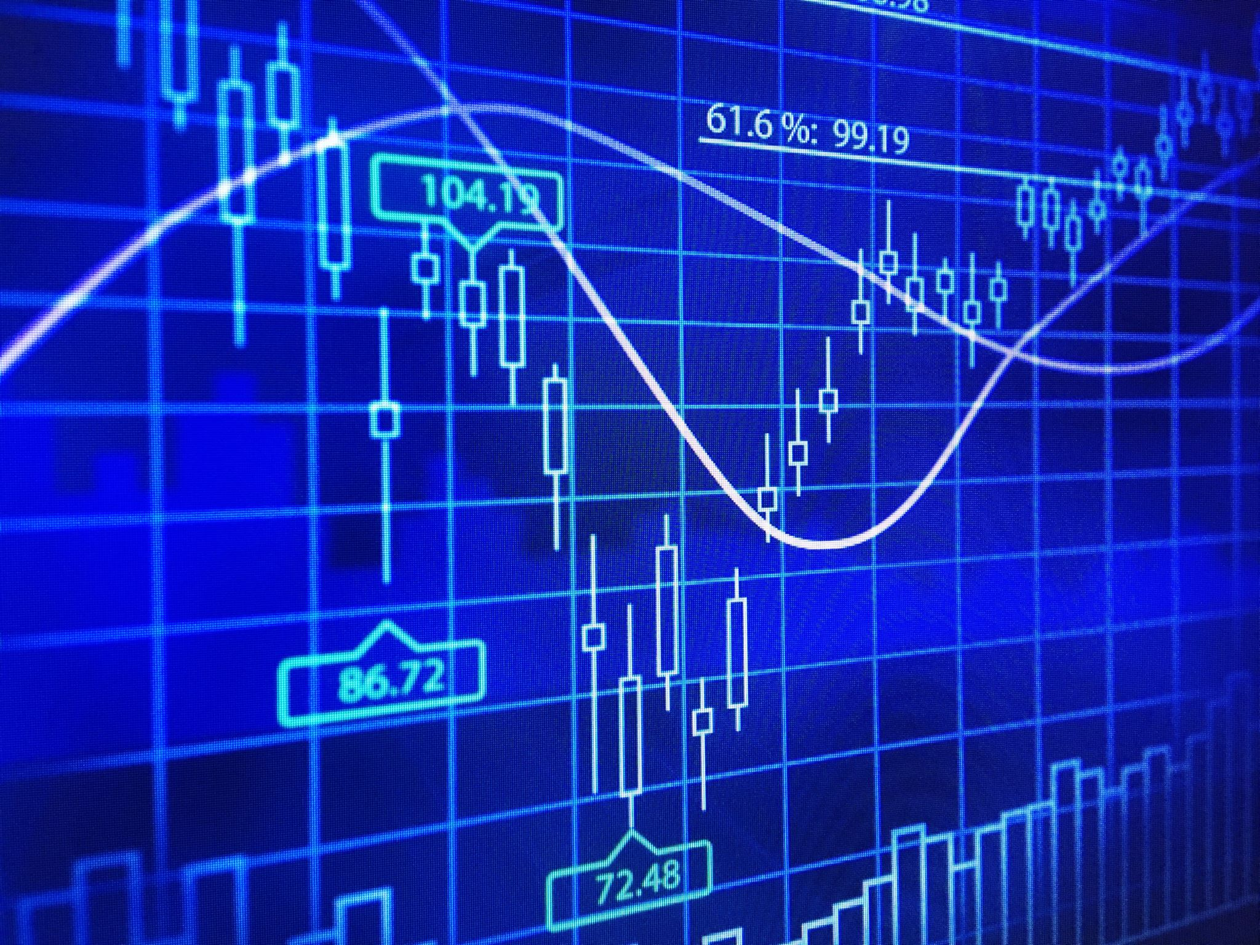
Effect of Profitability Ratio
2000 to 2001: Profitability dropped from 31.2% to 4.9%, a significant decline. This could be explained by the economic downturn (the dot-com bubble burst) and external factors such as reduced demand for Intel's products.
2002 to 2005: Profitability consistently improved from 11.6% in 2002 to 22.4% in 2005. This suggests Intel became more efficient, potentially from operational improvements, cost reductions, or recovering market conditions.

Slide 8
Effect of Efficiency Ratio
2000 to 2001: Intel's efficiency ratio dropped from 0.70 in 2000 to 0.60 in 2001. This decline in efficiency is in line with the drop in profitability and reflects Intel's struggle to generate sales from its assets during the dot-com bubble burst.
The reduced demand for Intel's products and the overall economic downturn likely led to this lower efficiency, as Intel's assets were not being fully utilized to generate revenue.
2002 to 2005: Efficiency consistently improved from 0.60 in 2001 to 0.79 in 2005, reflecting Intel’s recovery. This improvement suggests that Intel became more efficient in utilizing its assets to generate sales, likely due to operational improvements, recovering market conditions, and strategic investments in new technologies or processes. This period of growth highlights Intel's ability to maximize returns from its existing assets, contributing to the overall increase in profitability during this time.

Slide 9
Effect of Leverage Ratio
2000 to 2001: Intel's leverage ratio remained fairly stable, going from 1.28 in 2000 to 1.24 in 2001. This slight decrease in leverage indicates that Intel was relying slightly less on borrowed funds relative to its equity during this period. The dot-com bubble burst in 2000-2001 may have influenced Intel's decision to manage its leverage cautiously, avoiding higher debt in uncertain market conditions. By maintaining a stable leverage ratio, Intel reduced the risk of financial distress during a period of reduced profitability.
2002 to 2005: Leverage stayed relatively consistent, holding at 1.24 in 2005. This indicates that while Intel experienced improved profitability during this period, it chose not to significantly increase its debt levels. Instead, Intel likely focused on operational improvements and cost reductions, rather than leveraging its assets to take on more debt. By maintaining stable leverage, Intel ensured that its capital structure remained sound, benefiting from its equity base without over-reliance on borrowed funds.

Slide 10
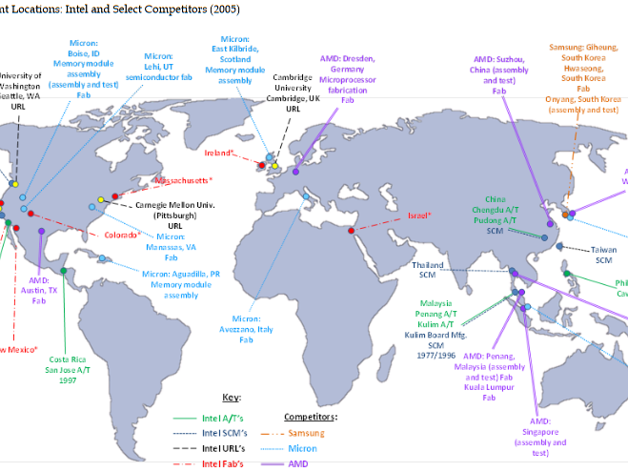

Slide 11
Timeline for Semiconductor Wafers Transportation
1. Sample Preparation: 7 days
2. Sample Shipping (by AIR): 7 days
3. Sample Assessment: 7 days
4. Negotiation: 0 days
5. Production / Manufacturing: 30 days
6. Quality Inspection: 1 day
7. Revisions: 3 days
8. Buffer Time: 10 days
9. Local Transportation to Sea Port: 2 days
10. Documentation, Customs Clearance: 2 days
11. Carrier Loading at the Port: 2 days
12. Transportation (by Sea): 30 days
13. Unloading at Port / Airport: 2 days
14. Customs Clearance: 2 days
15. Domestic Transport: 1 day
Total Time (including samples & production): 106 days

Slide 12
Cost Breakdown for Semiconductor Wafers Transportation
Sample Outsourcing Costs (Imaginary Values):
- Item Price (500 units): $100,000
- Palletization: $50/pallet = $500
- Air Freight (Port-to-Port): $2,500
- Air Surcharge: $300
- Certificate of Origin: $100
- Insurance: $500
- Customs Duty (5%): $5,000
- Import VAT (15%): $15,750
- Final Delivery: $1,500
- Total Estimated Costs: $126,420

Slide 13
Key Criteria for Plant Location Decision
1. Operational Costs (Profitability) – 20%
2. Infrastructure and Logistics (Efficiency) – 15%
3. Government Incentives (Leverage) – 15%
4. Market Access (ROE) – 15%
5. Political and Economic Stability – 10%
6. Labor Availability and Costs – 10%
7. Logistics and Transportation – 15%
Rationale: Balancing Intel's profitability and operational efficiency.
Notes:
Operational Cost (Profitability) – 20%
Intel's operational costs significantly impact profitability. To maintain competitiveness in the semiconductor market, minimizing labor, utilities, and overhead costs is essential when locating the AT plant, as highlighted in the case study and supply chain document.
Infrastructure and Logistics (Efficiency) – 15%
Logistics efficiency, including transportation and port access, is vital for timely delivery. As the supply chain document highlights, logistics impacts timelines and customs clearance. I prioritized logistics due to Intel's need for customer proximity and swift market deployment.
Government Incentives (Leverage) – 15%
The availability of government incentives, such as tax breaks and subsidies, directly influences Intel’s decision-making. Incentives help reduce capital expenditures and operating costs, improving Intel's financial leverage.
In the case study, several countries offered favorable government incentives, which makes this a key factor in deciding where to locate the new plant, hence the 15% weighting.
Market Access (ROE/Strategic Advantage) - 15%
Being closer to key markets is crucial for Intel to achieve faster delivery times and increase market penetration. This is particularly important for serving high-growth regions such as China and Southeast Asia.
As highlighted in the case study, strategic advantage through market access can significantly impact Intel's return on equity (ROE) by allowing them to generate better returns from their investments. For this reason, market access carries a significant 15% weight.
Political and Economic Stability - 10%
A stable political and economic environment ensures fewer disruptions in the long-term operation of the AT plant. While this is important, it doesn’t directly affect the day-to-day costs or efficiency of the plant, so I assigned it a moderate weight
The case study suggests political and economic stability as a factor, but it’s not the top consideration when balanced against cost and logistical concerns.
Logistics and Transportation - 15%
The supply chain document highlights the critical role of logistics and transportation in determining shipment timelines, costs, and overall supply chain efficiency. It emphasized factors like transportation mode (air vs. sea), handling, customs, and shipment timelines, which all have a direct impact on Intel’s ability to move products efficiently.
Efficient logistics also reduce costs and ensure timely delivery to Intel's customers, making this a key criterion, particularly given the importance of timely product launches in the technology sector.
Labor Availability and Costs - 10% Having access to a skilled labor force at competitive rates is essential for Intel's operations. The supply chain document underlines how labor impacts both production and operational costs, which in turn affects profitability.
However, since Intel's assembly and test operations are not as labor-intensive as their fabrication plants, I gave this a lower weight (10%) compared to more direct factors like operational costs and logistics.

Slide 14
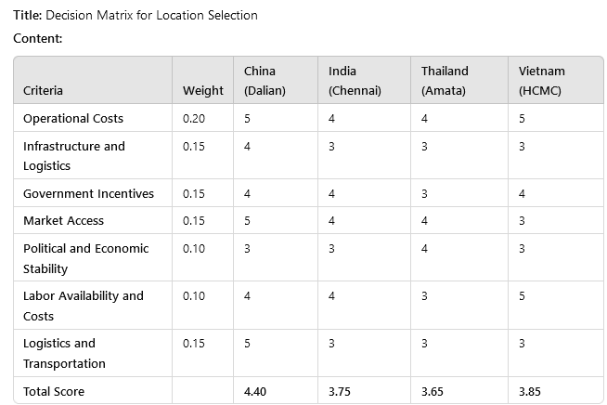
Decision Matrix for Location Selection

Slide 15
Recommended Location
CHINA (Dalian)
Total Score: 4.40
Strong infrastructure and logistics
Competitive operational costs
Favorable government incentives
Proximity to key Asian markets
Conclusion:
China’s Dalian location offers the best balance of cost, efficiency, and strategic market access.

Slide 16
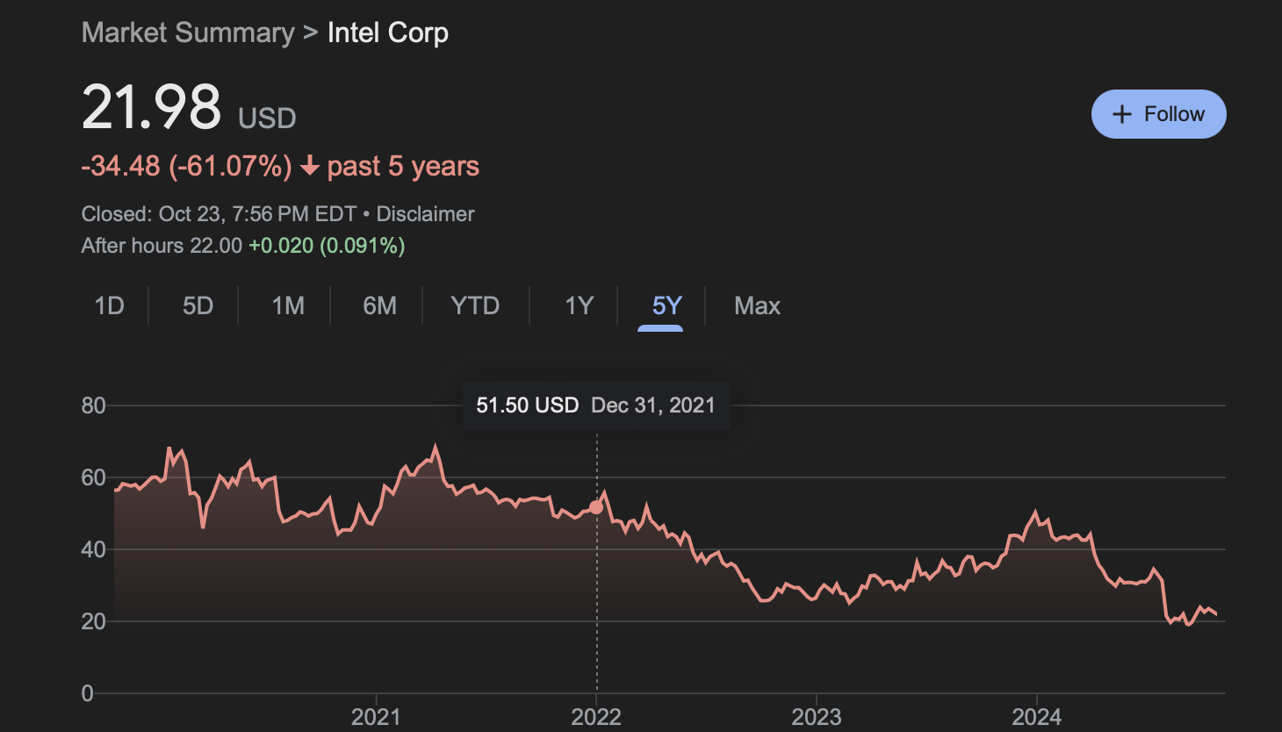
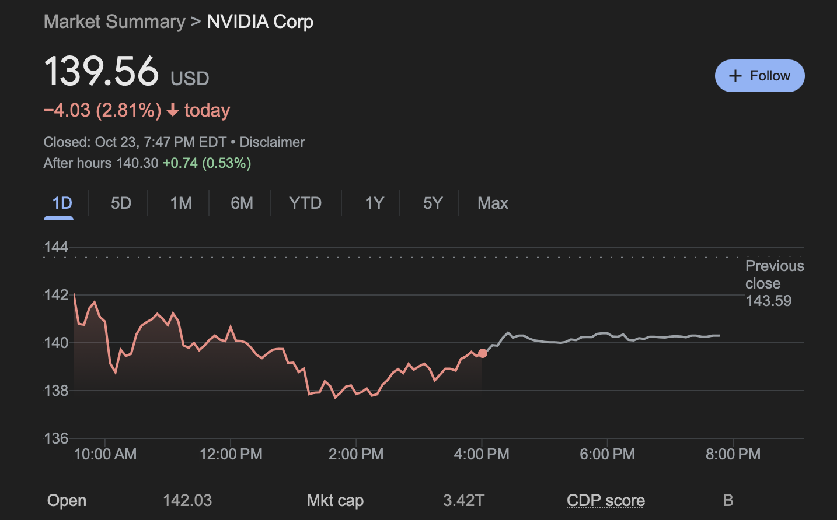
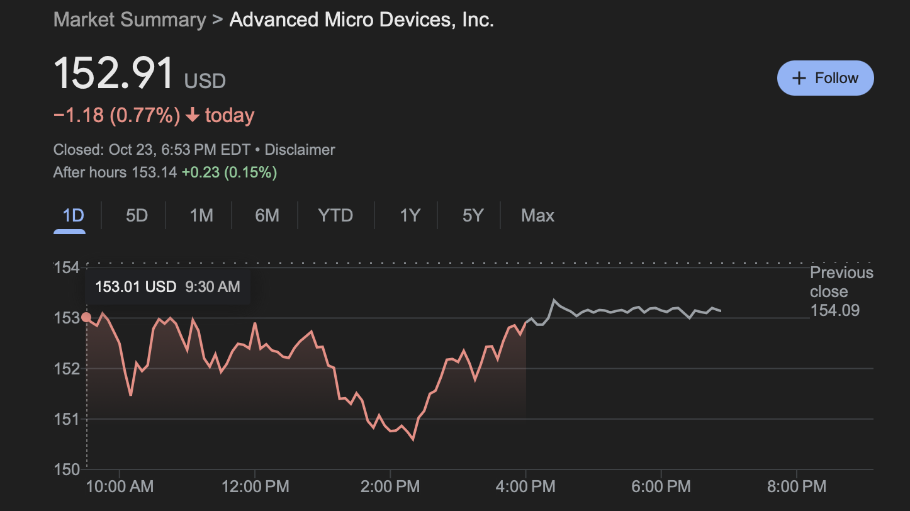
Summary and Conclusion
Intel’s financial ratios and transportation cost analysis support choosing China (Dalian).
The decision matrix indicates that Dalian combines cost-efficiency, logistics, and market access.
This location will support Intel's growth and supply chain optimization for semiconductor wafers.
Thank you
Ready for Q&A!
Interesting Caveat and Reflection

