Slide 1


Smart Invoice AI – Automated Text Detection System
University of San Diego
Applied Computer Vision for AI (AAI-521-IN2)
Group 5:
Anusha S. L. Bandaru, Rakesh R. Bhatija, Nikhil Bembi

Slide 2
Project Team
Anusha S. L. Bandaru | Rakesh R. Bhatija | Nikhil Bembi
Team Lead | Team Member | Team Member

Slide 3

Dataset Selection
We chose the Invoices-and-Receipts dataset from hugging face.
This is a public dataset which belongs to the general “Receipts & Invoices” collection. This dataset is meant fro OCT extraction tasks: to extract text from invoices/receipt images.
Dataset: https://huggingface.co/datasets/mychen76/invoices-and-receipts_ocr_v1
GitHub: https://github.com/rbhatija

Slide 4








Agenda
Introduction
Problem & Motivation
FRAMEWORK & Literature Review
Methodology & Training
Results
Discussion
Future Work
Conclusion

Slide 5





Introduction & Problem Statement
Background: Detect text regions to automate OCR workflow
Dataset: ”Invoices & Receipts” from Hugging face (2,238 total records ~ 282 MB of data).
Problem: Identify text regions in invoice & receipt images
Real-world motivation: Companies process millions of invoices ; manual data entry is slow, costly and error-prone!
Challenges: High-variability in data, unbalanced text density, Tight spacings, Language, class imbalance.

Slide 6
Project Objectives & Motivation
Objectives:
  Perform data exploration to understand invoice/receipt variability, text distribution & mask annotations.
  Preprocess dataset (image resizing, polygon scaling, mask generation, noise handling).
  Implement DBNet-based segmentation using ResNet-18 backbone for text region detection.
  Integrate OCR on segmented regions to extract readable structured text as far as possible.
  Achieve high segmentation accuracy for real-world invoice automation.
  Analyze model threshold sensitivity & evaluate precision-recall trade-off for business deployment.
Motivation:
  Manual invoice processing is slow, costly, error-prone & non-scalable.
  Businesses need automatic extraction of totals, vendor names, line-items & tax fields for accounts payable.
  AI-driven invoice understanding accelerates billing, audits, reimbursement & compliance workflows.
  Enables high-volume document automation → reduced human effort, increased accuracy, faster financial decisions.

Slide 7
Framework
Frameworks:
DBNet (Bai et al., 2020) introduces a Differentiable Binarization mechanism enabling pixel-level text segmentation — ideal for irregular invoice layouts
ResNet-18 backbone (He et al., 2016) enables deep residual feature extraction, preserving gradient flow and improving detection of small, dense text regions
OCR Pipeline Integration — segmentation masks isolate text zones → OCR extracts structured words with higher accuracy and less noise.
Image
Probability Map
Binary Map
Text Region Extraction
Image
Convolution Layers
Residual Blocks
Feature Maps(Sent to DBNet Head)
Image
Text Mask(From DBNet)
Region Cropping
OCR Recognition
Structured Text Output

Slide 8
Methodology - Model & Training
PyTorch Lightning training workflow
  Automated training loops, logging & checkpointing
  GPU-optimized batching + mixed-precision support
  Validation runs triggered periodically during training
Pixel-level segmentation metrics
  Precision, Recall, F1-Score, IoU for text-mask accuracy
  Evaluated on 409 invoice/receipt images
  Binary mask comparison against polygon-derived ground truth
Threshold sweep for Precision-Recall trade-offs
  Thresholds tested from 0.10 → 0.90
  Best performance in 0.5 range (F1 ≈ 0.8274)
  enables tuning for high-recall or high-precision business usage

Slide 9
Methodology – Model Performance
Best F1 Range: 0.30-0.40; F1 ~ ____
Standard Threshold performance at 0.5:
  Precision : 0.84
  Recall: 0.82
  F1: 0.83
  IoU: 0.71
The above values shows a strong balance between false positive and false negatives
 | Example Result
Threshold | IoU | Precision | Recall | F1 Score
0.10 | 0.6669 | 0.6790 | 0.9741 | 0.8002
0.30 | 0.7261 | 0.7805 | 0.9125 | 0.8413
0.50 | 0.7056 | 0.8401 | 0.8150 | 0.8274
0.85 | 0.4250 | 0.9049 | 0.4421 | 0.5965

Slide 10
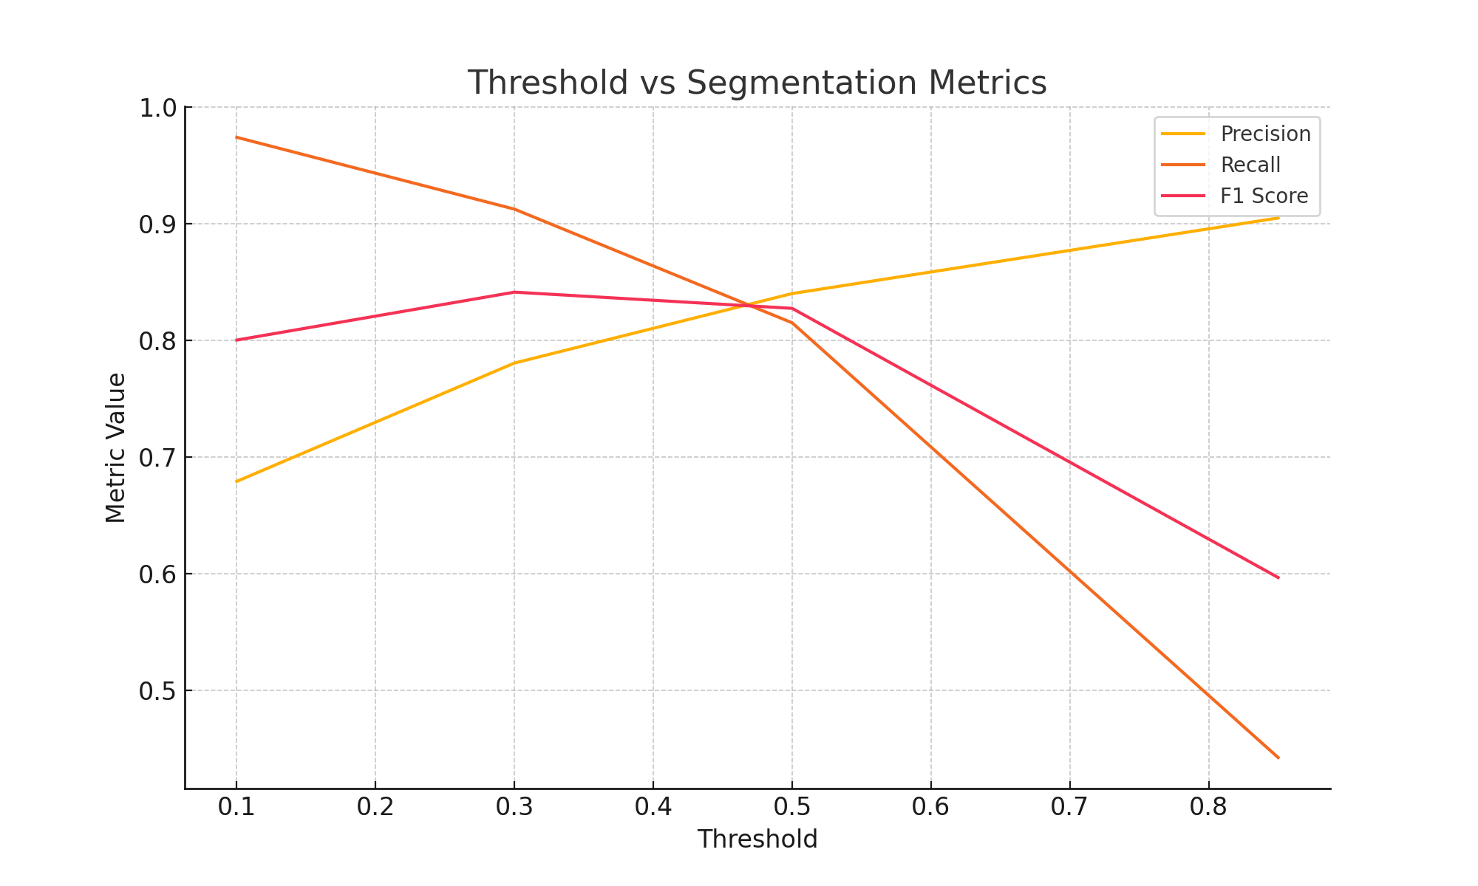
Model Performance - Visualization
Insight:
As the threshold increases, precision improves but recall drops. The model performs best at a 0.30–0.40 threshold, where precision and recall are balanced — giving the highest F1 score and most reliable text segmentation for invoices.

Slide 11
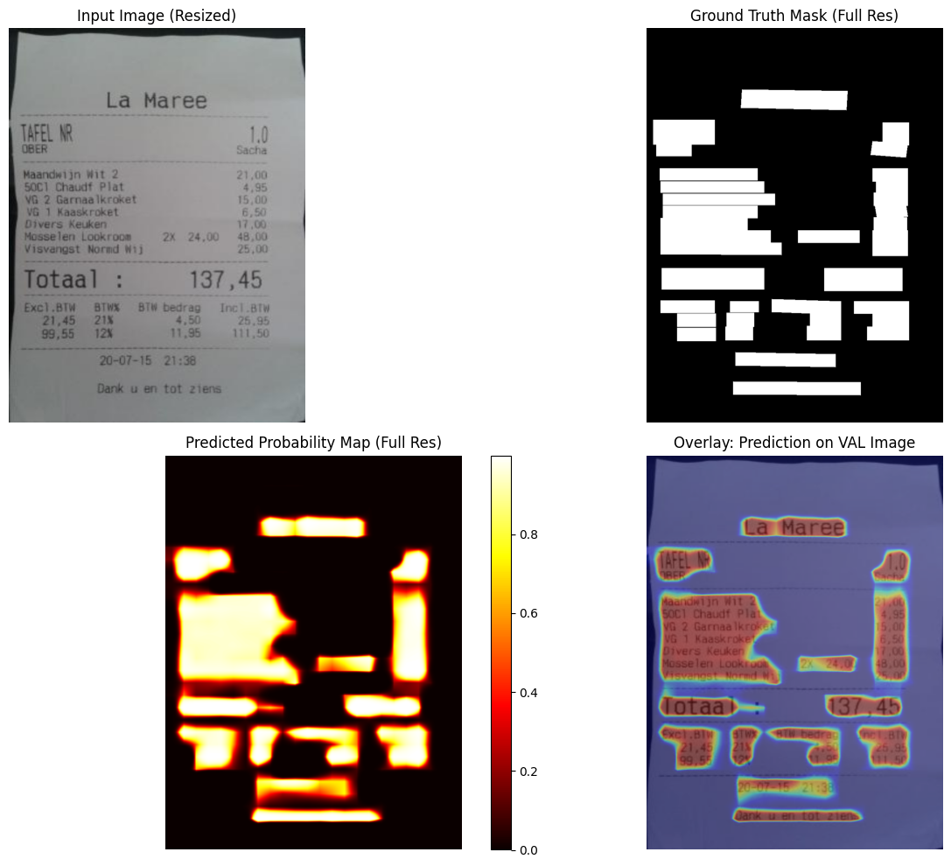
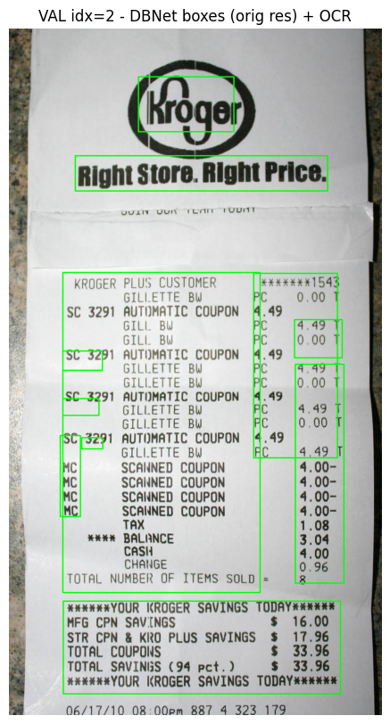
Results
Prediction Heatmaps and Overlays
Bounding-Box Visualization with OCR
Results demonstrate that segmentation-based text detection significantly outperforms bounding-box approaches for invoices and receipts. The model achieved strong IoU and F1 scores despite noise and inconsistent OCR polygons. Threshold sweep analysis confirms robustness and adaptability for operational deployment.
A validation sample showing input image (top-left), ground-truth mask (top-right), predicted probability map (bottom-left), and final prediction overlay (bottom-right). The model correctly highlights major text blocks and fine-grained text areas.

Slide 12
Discussion & Insights
Recommendations: Use Threshold ~ 0.50 for optimal recall + precision
F1 ≈ 0.83 and IoU ≈ 0.71 show the model is production-feasible.
Models learns text structure well!

Slide 13
Future work
Feed detected text regions into an OCR engine to convert masks into actual English text for NLP engine
Extract Key fields from the text such as “vendor name, invoice number, date, line items, tax, total amount”
Semantic understanding using NLP models

Slide 14
Conclusion
Smart Invoice AI successfully implements a DBNet-style segmentation approach for invoice text region detection and achieves strong performance across quantitative and qualitative evaluations. The system is fairly suitable for integration into real-world OCR pipelines and lays the groundwork for future improvements, such as adaptive binarization modules and transformer-based OCR integration.

Slide 15

The End

