Slide 1
Data Science and AI for Finance DA6701
Module – Integrating MPT, CAL, CAPM, and HRP
Nandan Sudarsanam,
Department of Data Science and AI,
Wadhwani School of Data Science and AI,
Indian Institute of Technology Madras

Slide 2
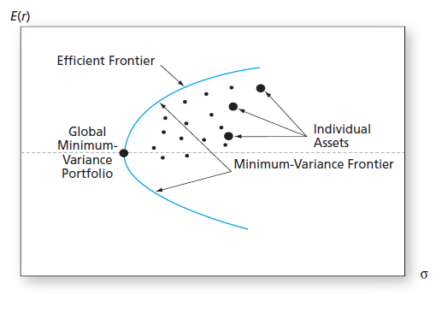
Integrating MPT, CAL, CAPM
Markowitz’s MPT teaches us that of the many ways we can combine risky assets to create portfolios, there should be an efficient frontier on the risk-reward graph.

Slide 3
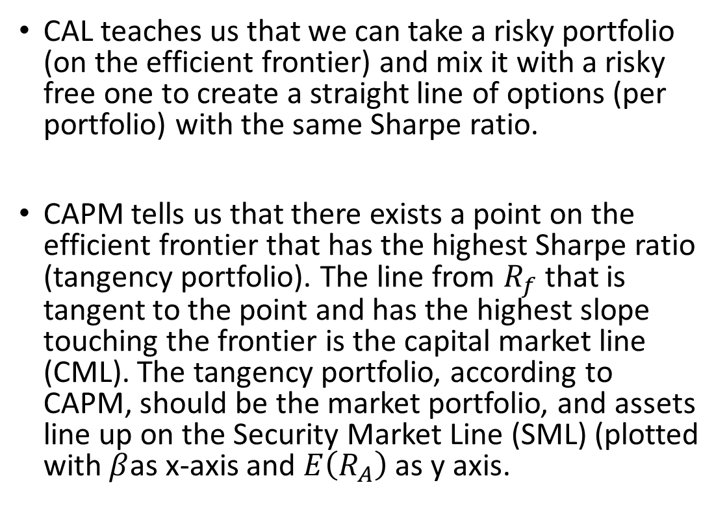
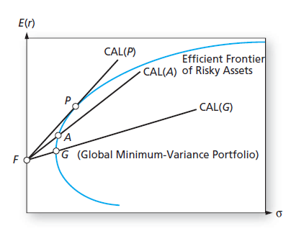

Integrating MPT, CAL, CAPM
CML
Bodie, Zvi, Alex Kane, and Alan Marcus. Ebook: Essentials of investments: Global edition. McGraw Hill, 2013.

Slide 4
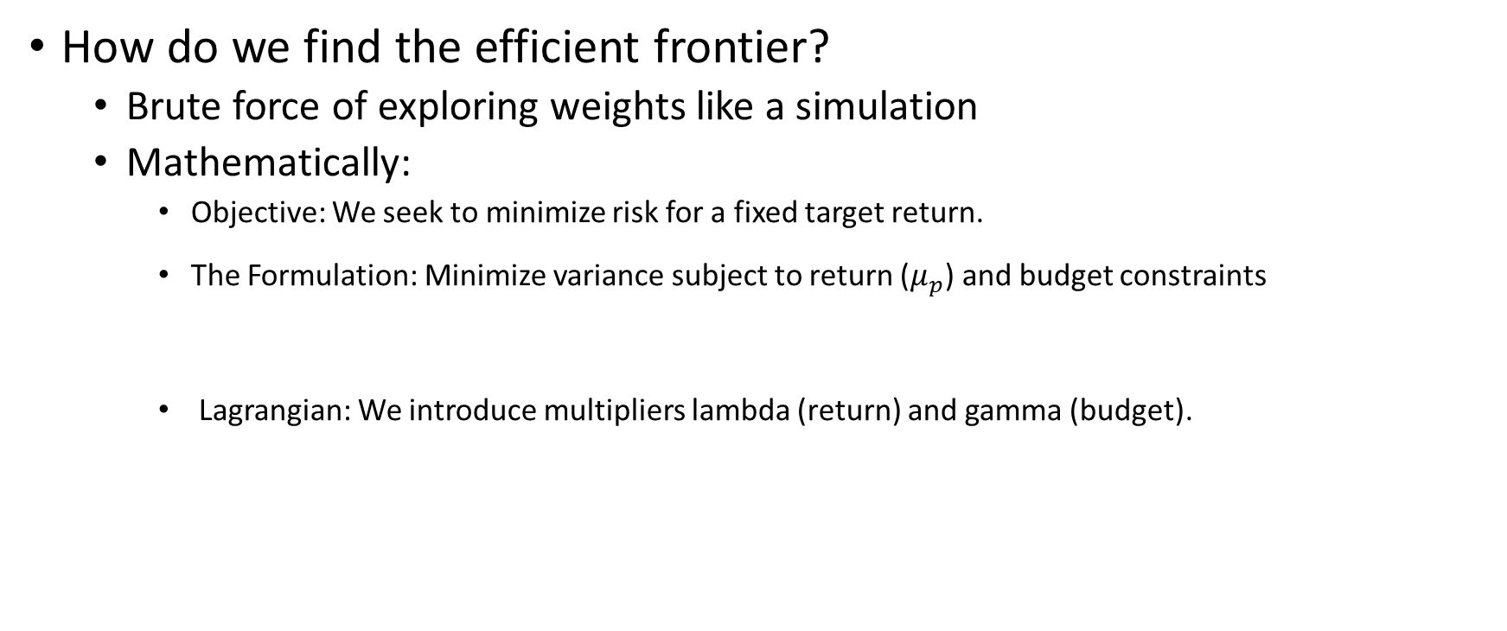
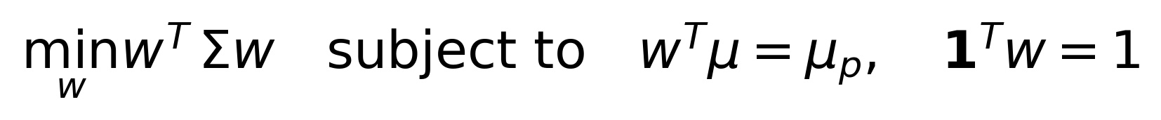
Nuts and bolts of portfolio selection

Slide 5
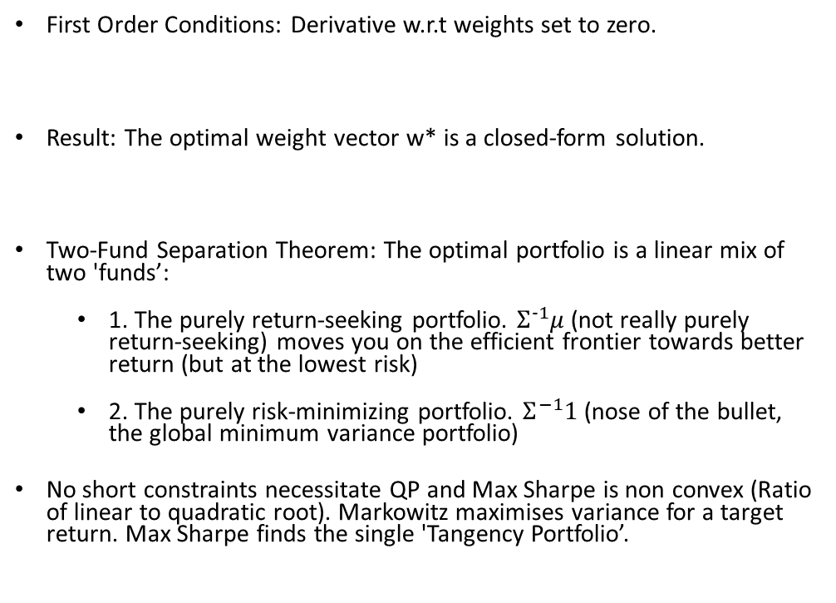

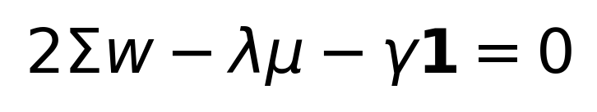
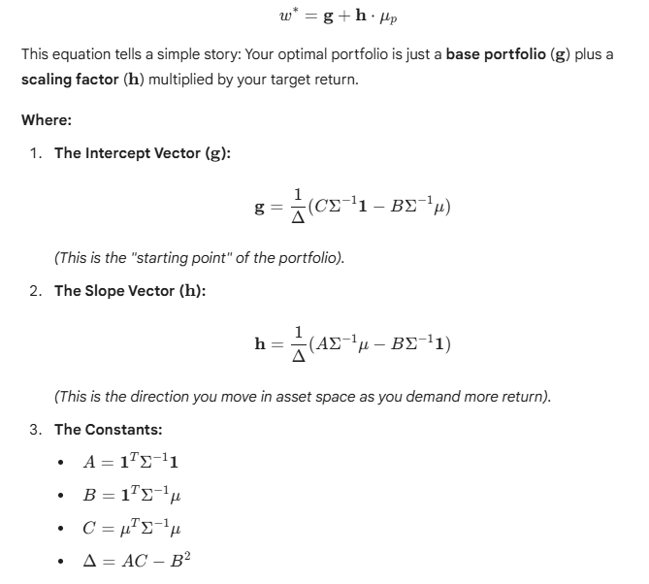
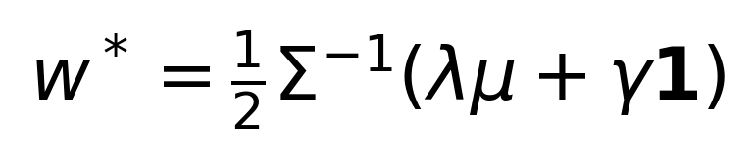
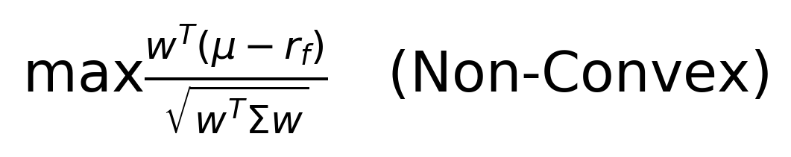
Nuts and bolts of portfolio selection

Slide 6
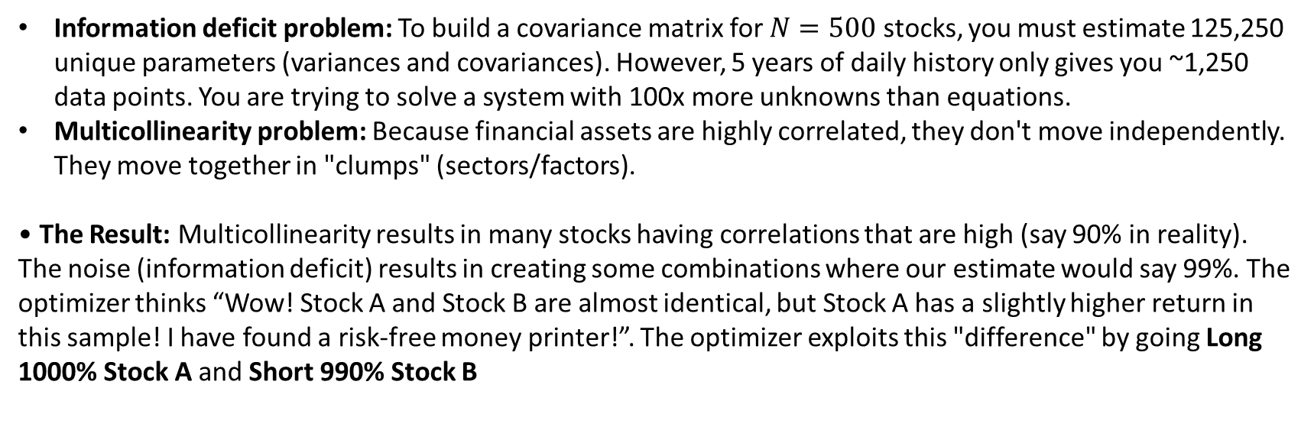
Where does Markowitz fail?
The Quote: "Mean-variance optimization is an error-maximization machine." (Richard Michaud).

Slide 7
What are some alternate approaches to ex-post optimal portfolio using ML
There are two broad approaches to solving this problem: Ex-post and Ex-Ante
Ex-post approaches Regularization (Ledoit Wolf), Hierarchical Risk Parity (HRP)
Ex-Ante approaches: forecast returns and provide expected returns to the optimizer (RFs, XGBoost, LSTMs, Transformers), Reinforcement Learning for end-to-end

Slide 8
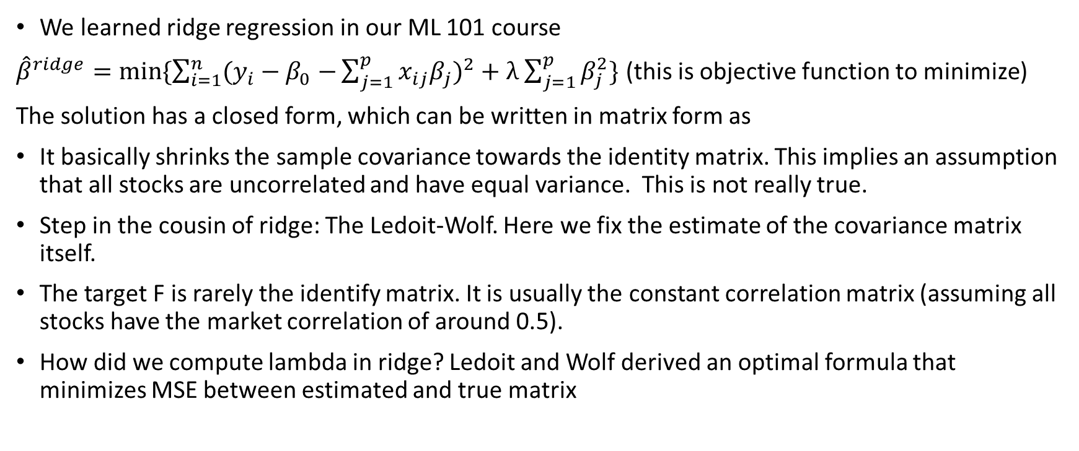


Regularization

Slide 9
Hierarchical Risk Parity
Hierarchical Risk Parity (HRP) does away with the need to invert a covariance matrix entirely. Instead, it uses machine learning techniques (hierarchical clustering) to build a robust portfolio that is far less sensitive to noise in the data, aiming for genuine diversification across different sources of risk.
Risk Management algorithm not return maximizer. Comparable to minimum variance portfolio (MVP)
However, MVP tries to find a global perfect portfolio through optimization which requires us to invert the covariance matrix which (thanks to information deficit and multicollinearity) results in haywire opposing weights that are merely the result of noise and don’t have any generalization.
HRP is structurally forced to diversify in a top-down manner.

Slide 10
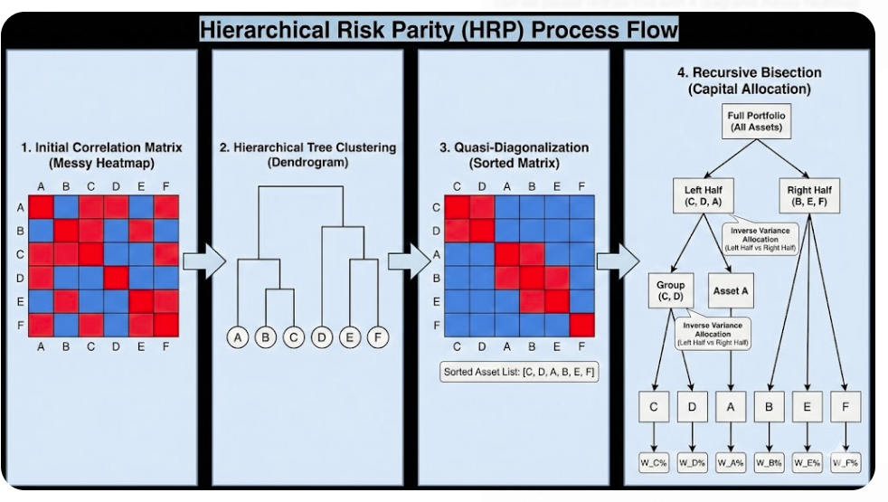
Hierarchical Risk Parity
Steps:
Hierarchical cluster
Optional step: clustering based asset allocation
Quasi-diagonalisation
Recursive bisection

Slide 11
Hierarchical Risk Parity
Hierarchical Clustering (quick revision)
Does not require a fixed number of clusters
Creates nested clusters
Types:
Agglomerative (Bottom-up)
Divisive (Top-down)
Requires defining some measure of dissimilarity between clusters
Single Linkage (why does HRP take single linkage?)
Complete Linkage
Group Average
Ward’s method, increase in SSE from a merger

Slide 12
Hierarchical Risk Parity
Agglomerative Hierarchical Clustering
Points to note:
Graphical representation through Dendrogram
Monotonicity
What is the optimal number of clusters
Optimal leaf ordering (OLO)
Hard constraint (nothing comes between a merger)
Soft constraint (order elements inside a cluster to be close to neigbhors). This soft constraint will play an important role in the quasi diagonal matrix
Dissimilarity metric (single linkage)
Why do Hierarchical clustering for HRP?:
Hierarchical clustering-based asset allocation: replace clusters with single prototypical stocks
The stock with the highest correlation to the cluster or most liquid
We don’t care about the clustering we care about the ordering!
a
b
c
d
e
f
g
OLO ordering (a,b,c just for convenience)

Slide 13
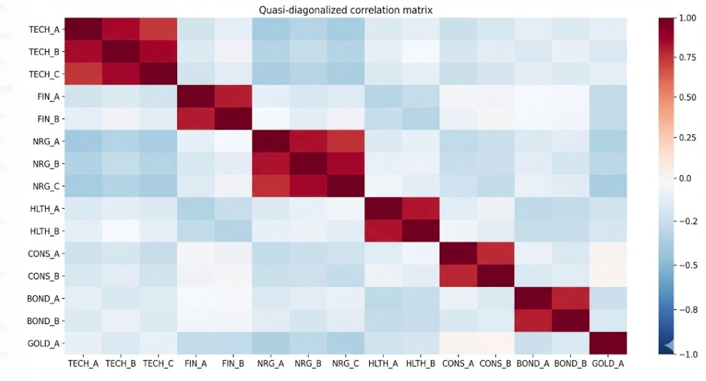


Hierarchical Risk Parity
Quasi diagonalization – the sorted matrix is a visual verification of the clustering algorithms effect on ordered covariance.
We take the output from the dendrogram (a list of indices) and shuffle the columns of the covariance matrix to match the order.
Recursive Bisection
Split the universe into two (left side vs right side)
Calculate cluster variance
Assign weights as per inverse variance parity
Combined cluster variance
Calculate split factor
Repeat the steps for next split till we have each stock weight. Why do we need quasi diagonlization for this to work?

Slide 14
What are some ex-ante approaches to optimal portfolios using ML

Slide 15
The problem of the replicating portfolio: Some ML approaches

