Slide 1

INDIAN INSTITUTE OF TECHNOLOGY MADRAS
Learning from
Comparison Data
M.Tech Project · Phase I Viva
Nitesh Kumar Shah · ID25M806
Supervisor Prof. Suryanarayana Sankagiri
Department of Data Science and Artificial Intelligence · November 2026
Notes:
Introduce the project and the Phase I scope.
Source: Phase I report, title page.

Slide 2
Choice sets and IIA
Travel from IIT Madras to the airport
Original choice set
Expanded choice set
Car, taxi, bike, bus
Car, taxi, bike, bus, walking
Independence of Irrelevant Alternatives (IIA)
The relative odds of choosing car over taxi stay the same when walking is added. A context effect occurs when the available alternatives change those relative odds.
IIT Madras / Phase I Viva
02
Notes:
Use the IIT Madras to airport example. Walking illustrates an irrelevant option. The example explains IIA. The experiments later use simulated choices. Seshadri et al. (2019), Discovering Context Effects from Raw Choice Data.
Source: Phase I report, §§1.1 and 2.2.

Slide 3
Bradley–Terry estimation
Pairwise win probability
P(i beats j) = exp(θᵢ) / [exp(θᵢ) + exp(θⱼ)]
Fit the scores by minimising the average negative log-likelihood.
Centre the scores so their sum is zero.
A finite MLE exists when the directed win graph is strongly connected.
IIT Madras / Phase I Viva
03
Notes:
Bradley and Terry (1952). The probabilities depend only on score differences. Centring selects a zero-sum representation. The finite-MLE condition is strong connectivity of the directed win graph, as discussed in the report.
Source: Phase I report, §2.4.

Slide 4
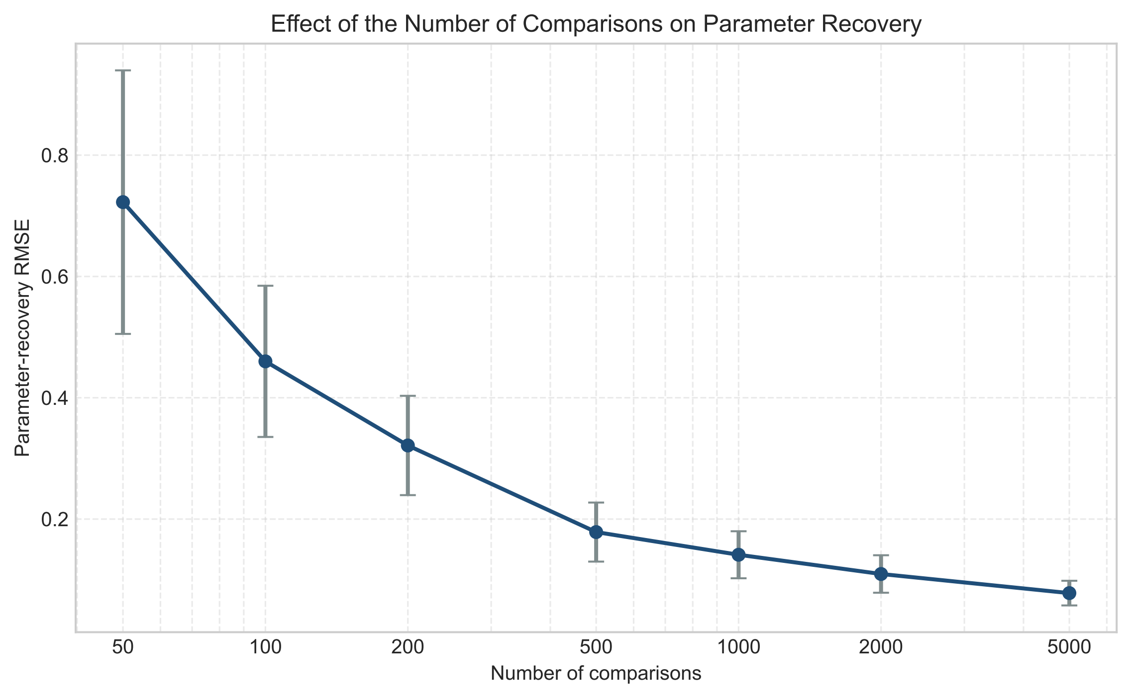
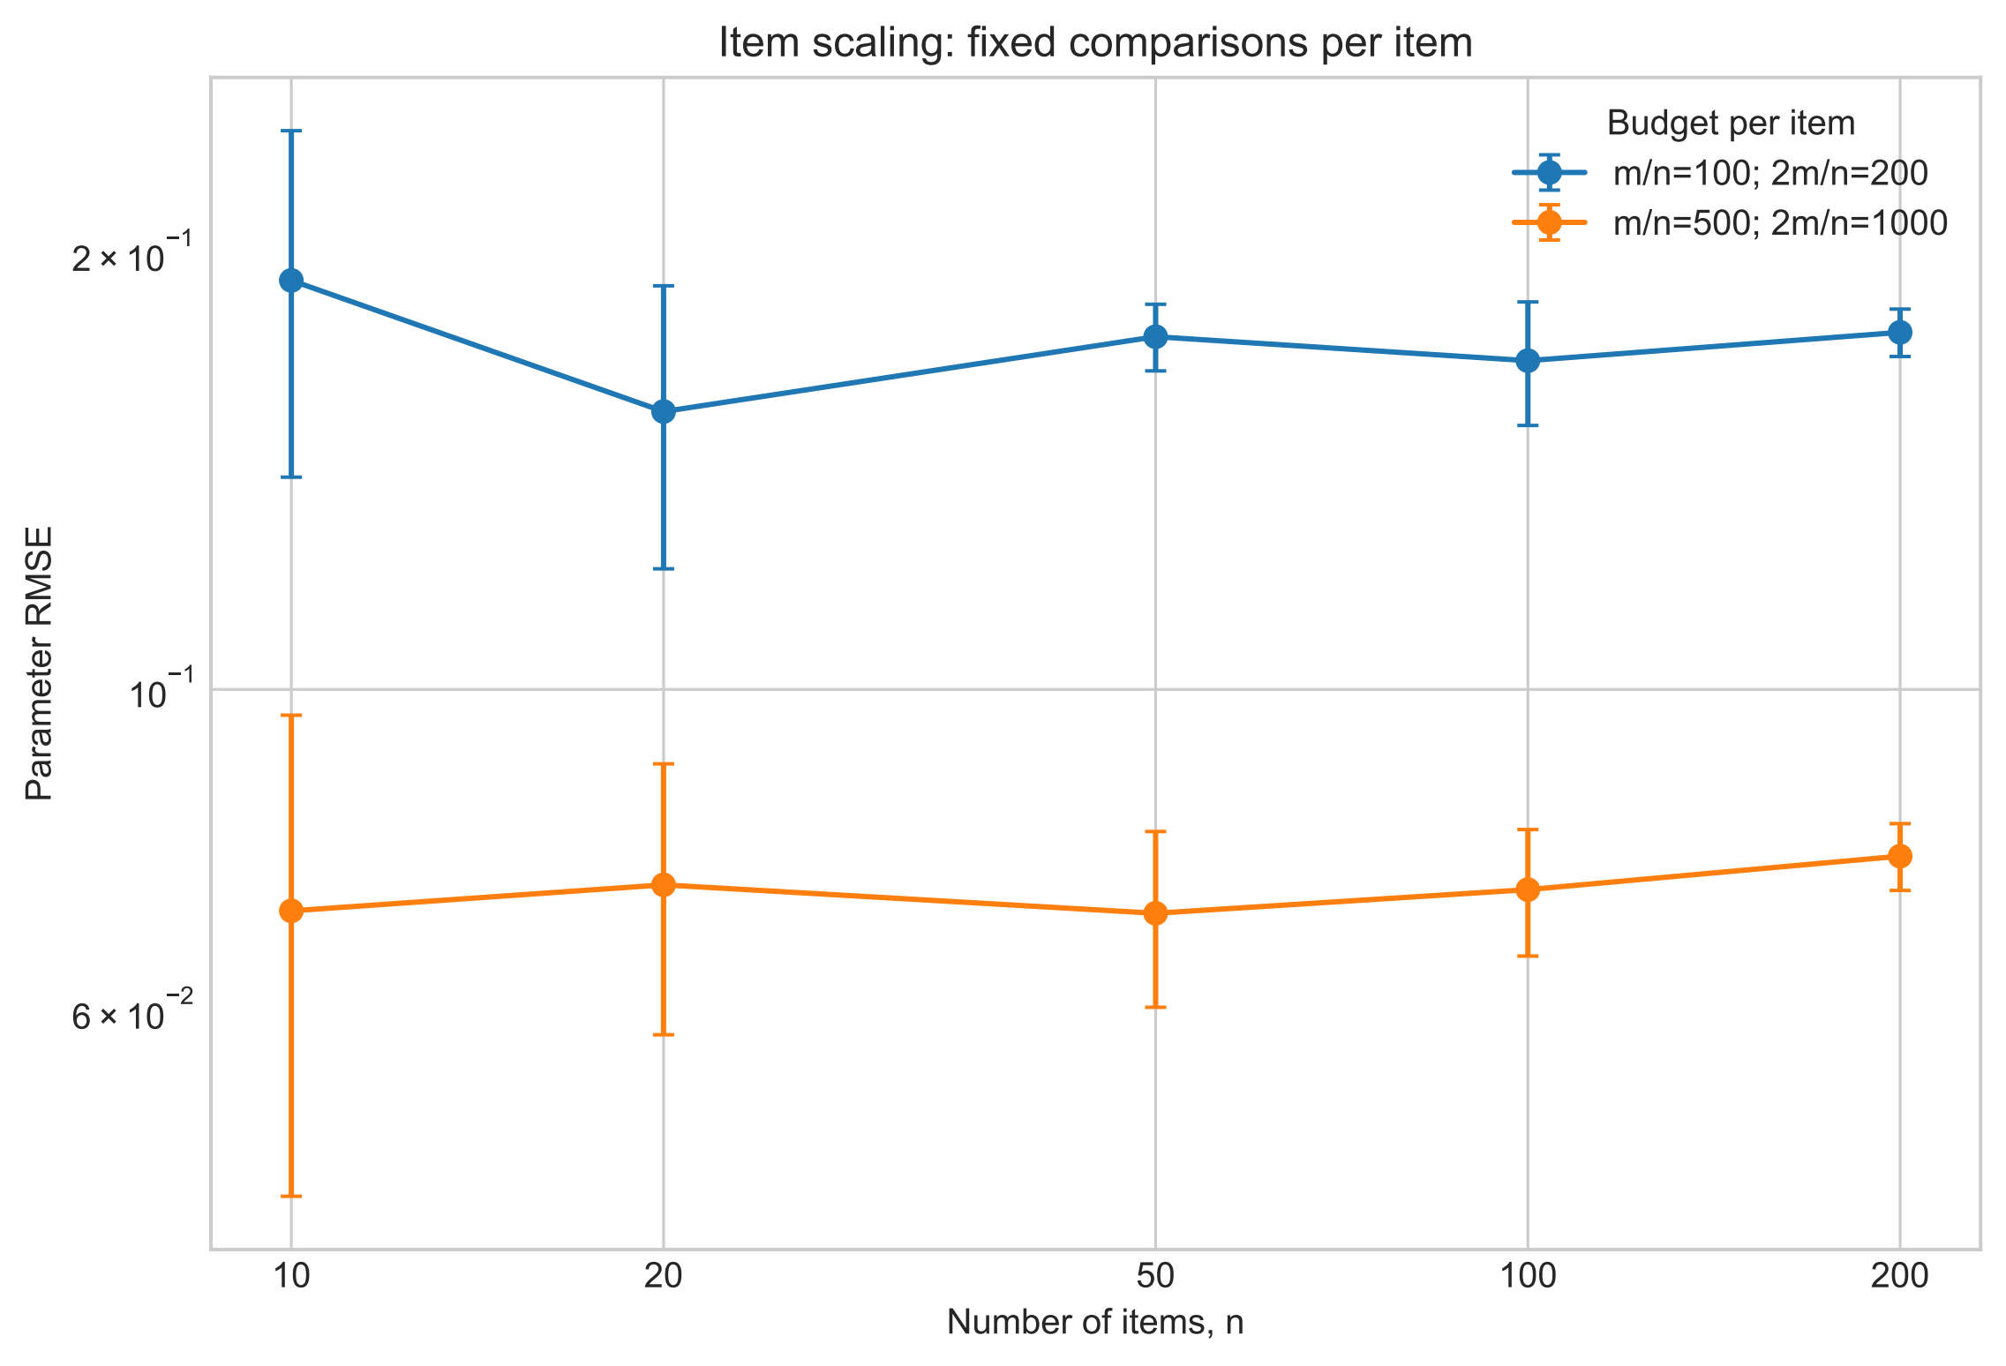
Bradley–Terry parameter recovery
More comparisons with 10 items
More items at fixed comparisons per item
RMSE falls as comparisons increase. At fixed m/n, it stays roughly stable as the number of items grows.
IIT Madras / Phase I Viva
04
Notes:
Baseline: 10 items, 1,000 comparisons, RMSE 0.1224. The left experiment repeats each comparison count 20 times. For the Choix study, each setting has five attempted runs and only finite, converged fits enter the summaries. At fixed total comparisons, recovery generally worsens as the item count grows. See 01_BradleyTerry_recovery.ipynb and 00_BTL_recovery_noofitems.ipynb.
Source: Phase I report, §§3.1.1–3.1.2.
Source notebook: https://github.com/rbhdsks/Learning-from-Comparison-Data-Master-Thesis-Project-/blob/cc7a5ab5ccf2ef462020f26919576bf275fa4105/notebooks/experiments/Bradley_Terry_Model/From%20Scratch/01_BradleyTerry_recovery.ipynb

Slide 5
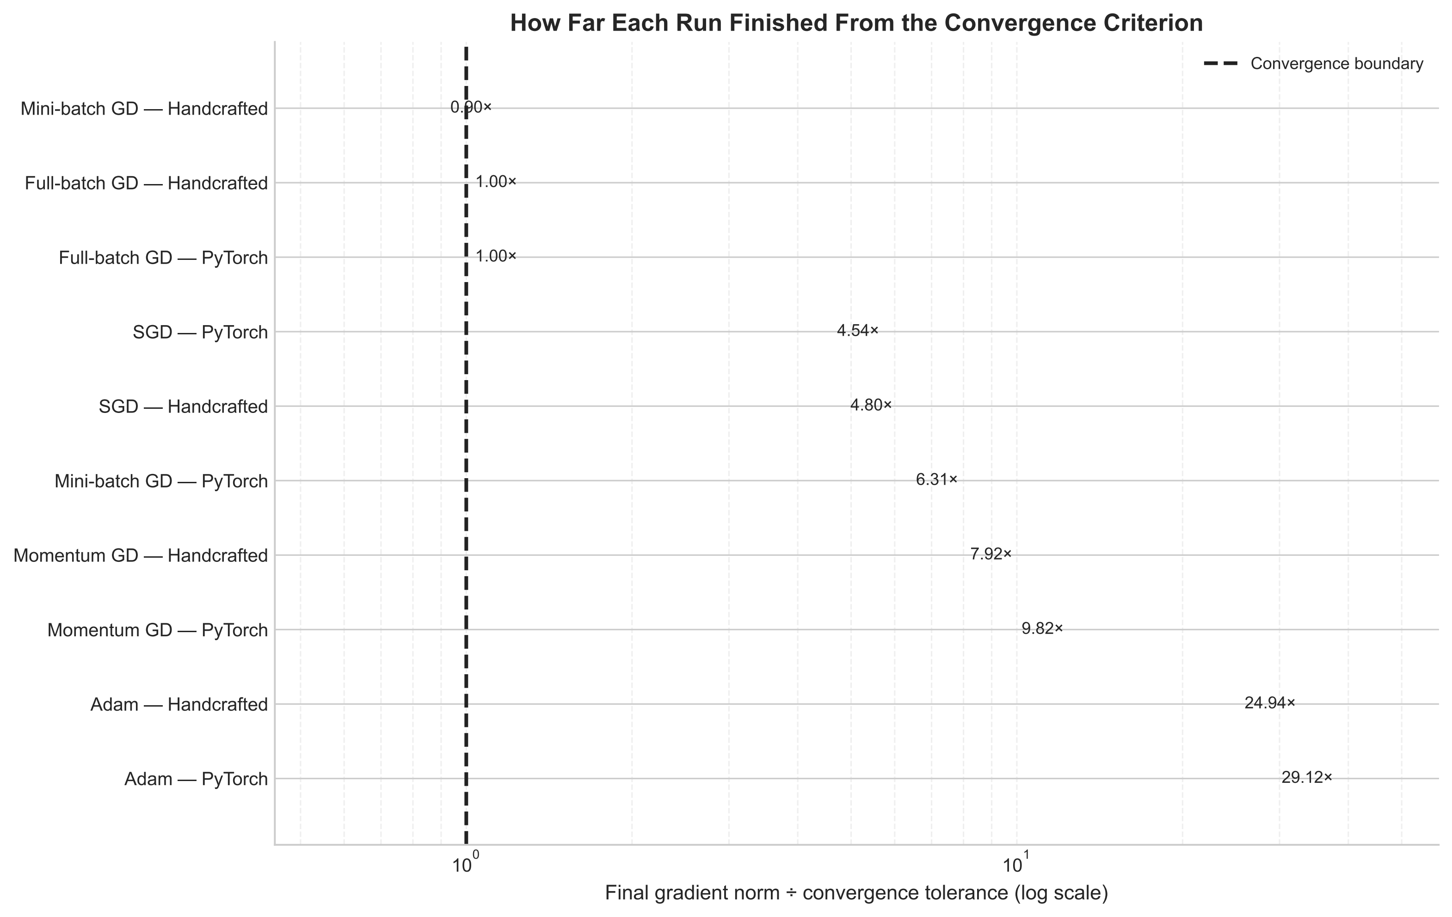
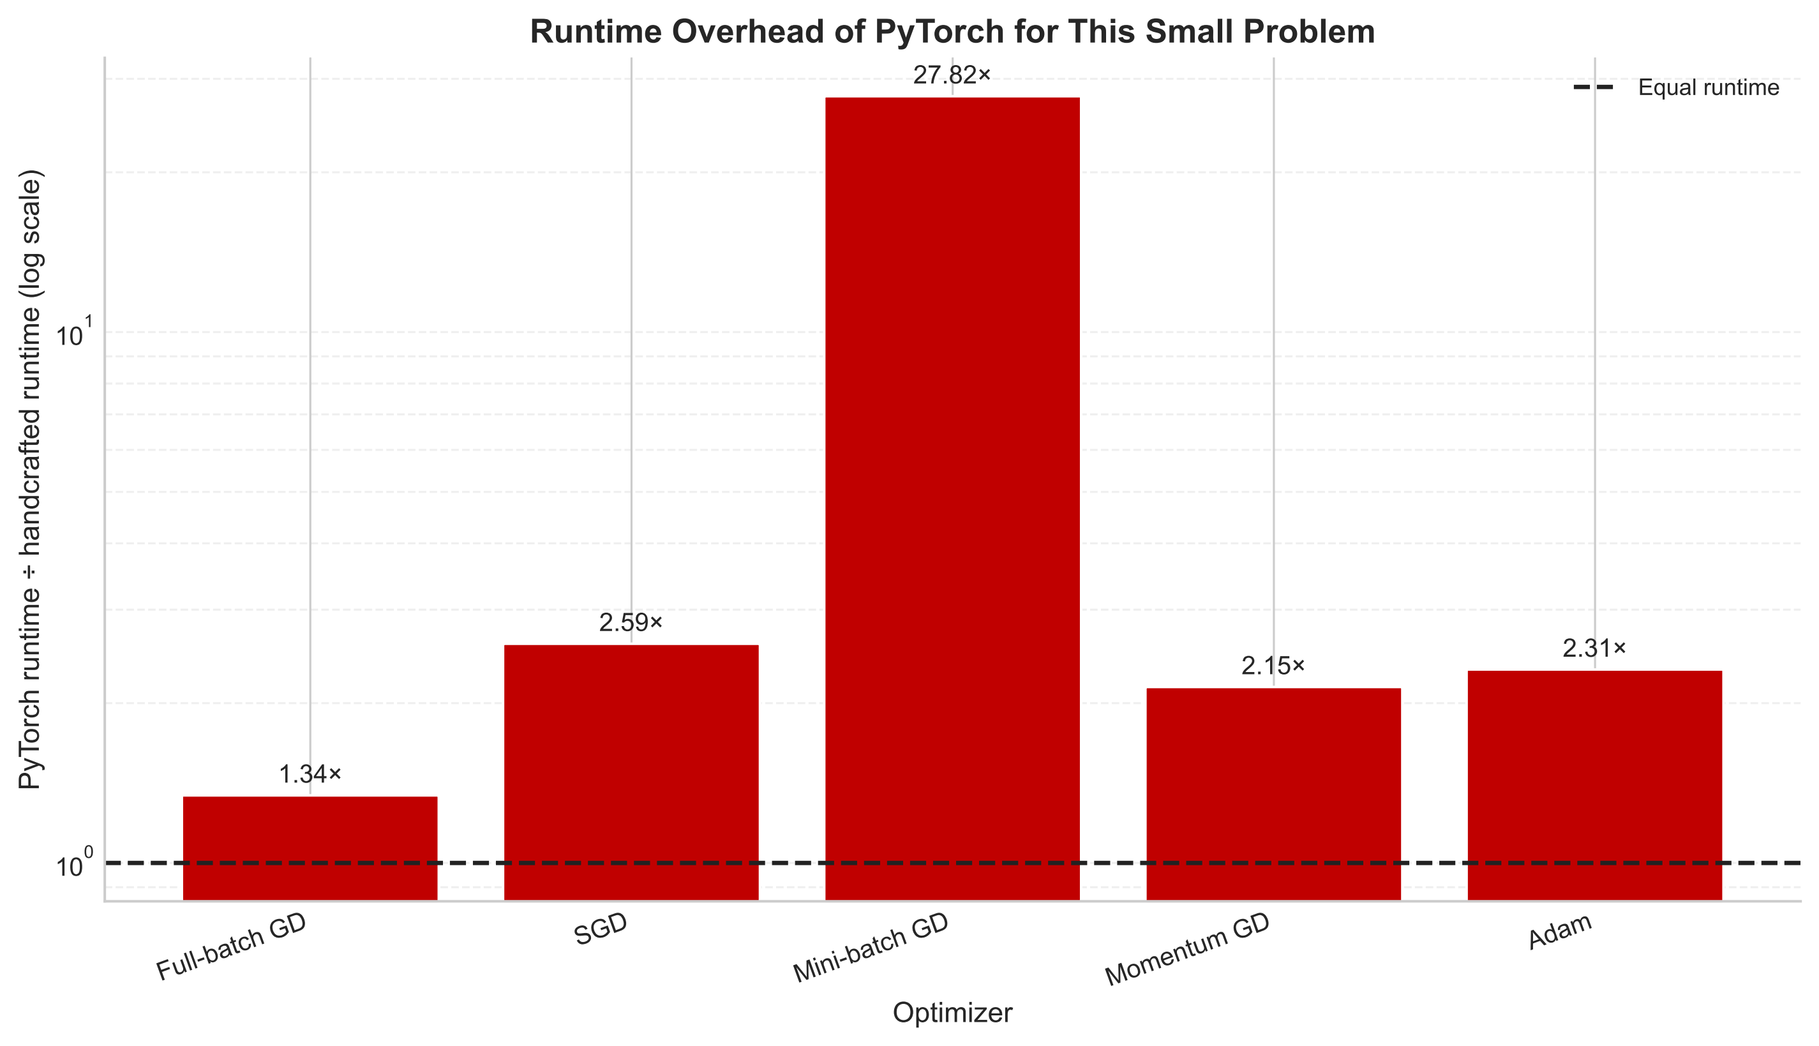
Comparison of optimisation methods
Final gradient norm ÷ convergence tolerance
PyTorch runtime ÷ handcrafted runtime
Recovery errors were similar, but convergence and runtime differed across methods.
IIT Madras / Phase I Viva
05
Notes:
The run budget is 10,000 epochs. A ratio at or below one satisfies the convergence criterion. Full-batch GD converged in both implementations, and handcrafted mini-batch GD also converged. Results apply to this small CPU experiment.
Source: Phase I report, §3.1.3.
Source notebook: https://github.com/rbhdsks/Learning-from-Comparison-Data-Master-Thesis-Project-/blob/cc7a5ab5ccf2ef462020f26919576bf275fa4105/notebooks/experiments/Bradley_Terry_Model/From%20Scratch/04_BradleyTerry_MLE_Optimizations.ipynb

Slide 6
Context-Dependent Model
Utility of item x in choice set C
u(x | C) = sum of u(x, z) over the other items z in C
Full CDM
Low-rank CDM
Estimate a separate parameter for each ordered pair. The centred model has n(n−1)−1 free parameters.
Represent u(x, z) by the dot product of two r-dimensional vectors. The implementation stores 2nr trainable entries.
IIT Madras / Phase I Viva
06
Notes:
For each target x and context item z, u(x, z) is the contribution of z to x. The choice probability is obtained by applying softmax to the utilities in the set. A common shift in off-diagonal parameters can be removed by centring. Seshadri et al. (2019).
Source: Phase I report, §§2.5.4–2.5.5.

Slide 7
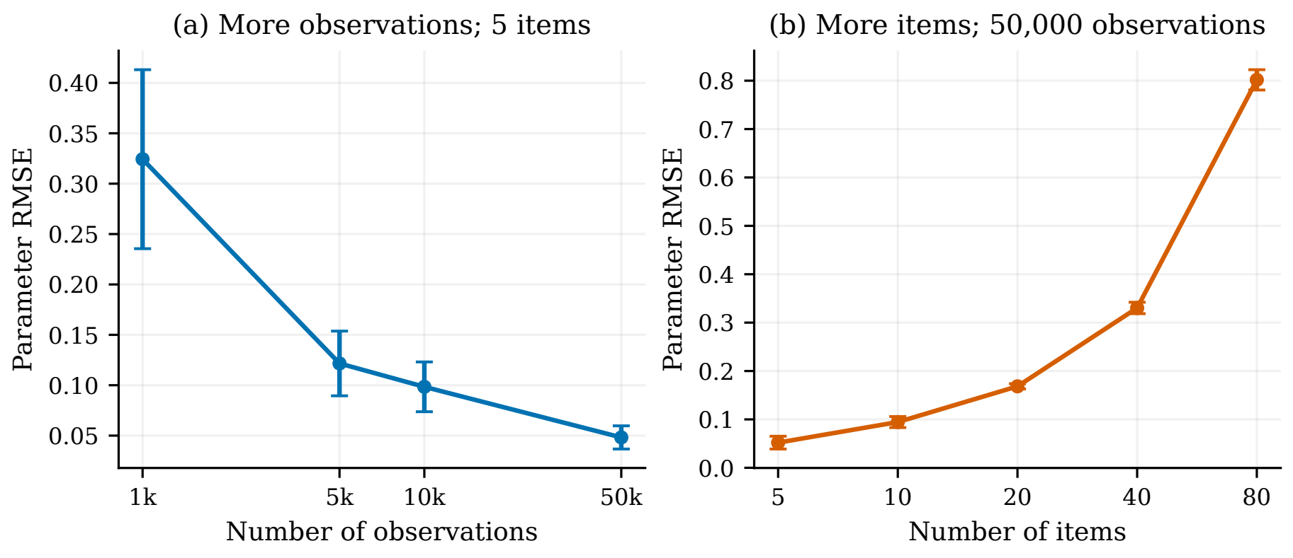
Full CDM parameter recovery
Synthetic choices from pairs and triples. The model is fitted on 80% of the observations.
More observations improve recovery for five items. With 50,000 observations fixed, recovery worsens as the number of items increases.
IIT Madras / Phase I Viva
07
Notes:
The left panel averages ten runs per setting. The right averages five. Error bars show one standard deviation. Each run generates new observations, splits the data, fits the model and records results.
Source: Phase I report, §3.2.1.
Source notebook: https://github.com/rbhdsks/Learning-from-Comparison-Data-Master-Thesis-Project-/blob/cc7a5ab5ccf2ef462020f26919576bf275fa4105/notebooks/experiments/Context_Dependent_Model/Full%20CDM/01_CDM-CDM.ipynb

Slide 8
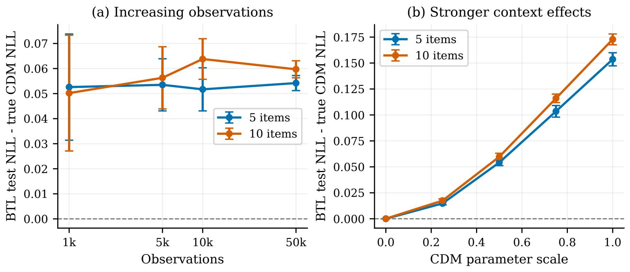
BTL/Luce fitted to CDM-generated choices
Prediction gap = fitted BTL test NLL − generating CDM test NLL.
More observations do not remove the gap in these experiments. The gap grows as the CDM parameter scale increases.
IIT Madras / Phase I Viva
08
Notes:
Each setting uses ten runs with 80/20 train/test splits. A positive gap means fitted BTL assigns worse predictive likelihood to held-out choices. The right panel fixes 50,000 observations.
Source: Phase I report, §3.2.2.
Source notebook: https://github.com/rbhdsks/Learning-from-Comparison-Data-Master-Thesis-Project-/blob/cc7a5ab5ccf2ef462020f26919576bf275fa4105/notebooks/experiments/Context_Dependent_Model/Full%20CDM/02_CDM-BTL.ipynb

Slide 9
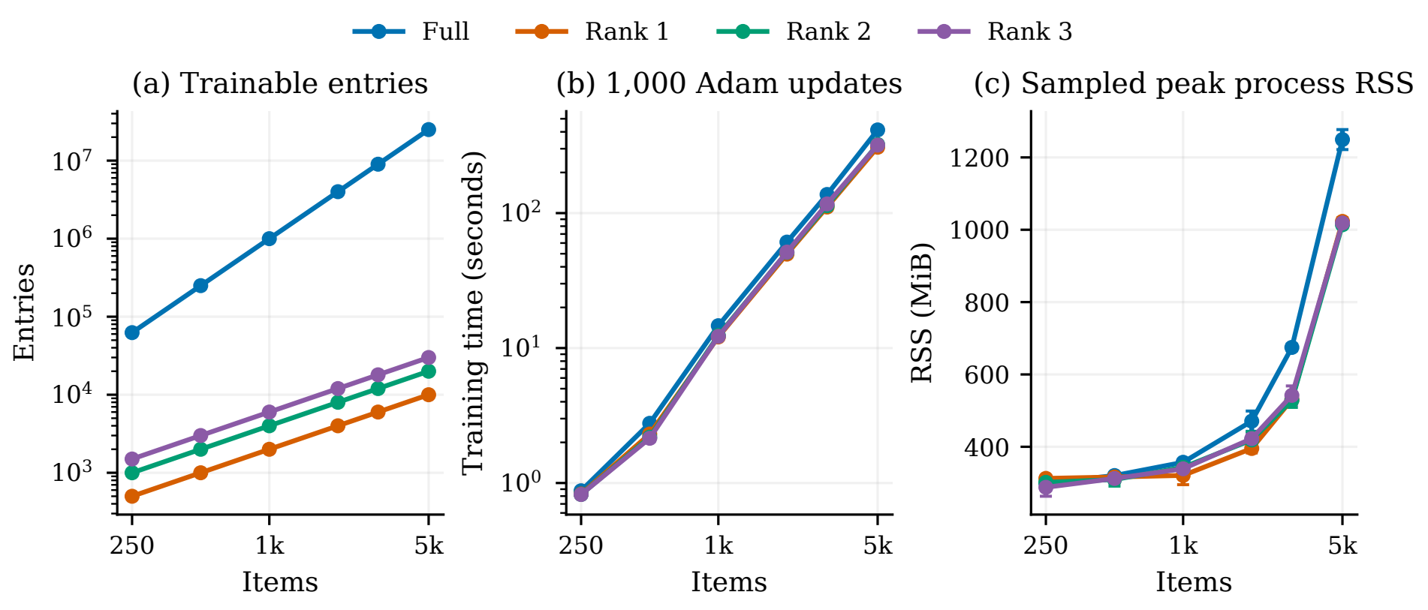
Computational scaling of full and low-rank CDM
250–5,000 items. Each fit uses 1,000 observations and 1,000 Adam updates on the CPU.
Low-rank CDM stores fewer parameters, but fitting time remains similar in this implementation.
IIT Madras / Phase I Viva
09
Notes:
Five repeats. RSS is resident set size, the RAM used by the whole process. The plotted measure is the mean of each fit’s maximum sampled RSS. The low-rank implementation still forms the full array of CDM parameters. The time is for a fixed number of updates.
Source: Phase I report, §3.2.3.
Source notebook: https://github.com/rbhdsks/Learning-from-Comparison-Data-Master-Thesis-Project-/blob/cc7a5ab5ccf2ef462020f26919576bf275fa4105/notebooks/experiments/Context_Dependent_Model/Low%20Rank%20CDM/01-FullvsLowrankResourceScaling.ipynb

Slide 10
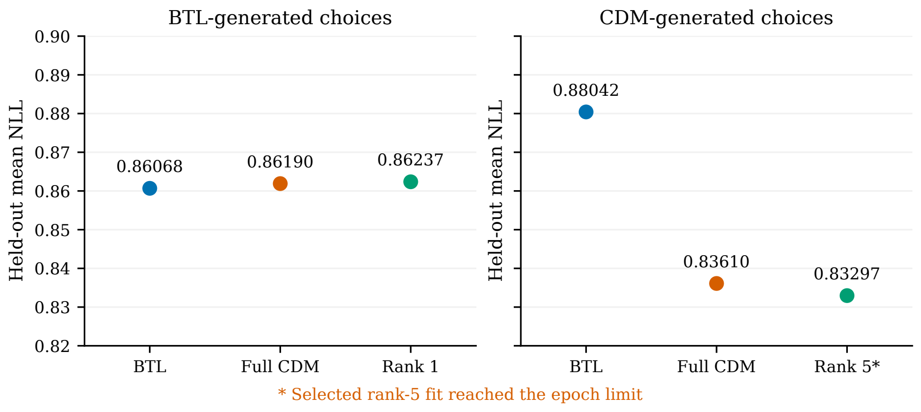
Unified comparison on held-out choices
10 items, 10,000 observations per generator, 70/15/15 split. Lower test NLL is better.
The models perform similarly on BTL-generated choices. Both CDM fits have lower test NLL on CDM-generated choices.
IIT Madras / Phase I Viva
10
Notes:
Rank and restart are selected by validation NLL. Rank one is selected for BTL data and rank five for CDM data. The selected rank-five fit reached 5,000 epochs without meeting the gradient criterion. Results are from one synthetic setup.
Source: Phase I report, §3.2.4.
Source notebook: https://github.com/rbhdsks/Learning-from-Comparison-Data-Master-Thesis-Project-/blob/cc7a5ab5ccf2ef462020f26919576bf275fa4105/notebooks/experiments/Context_Dependent_Model/Low%20Rank%20CDM/04-Unifiednotebook.ipynb

Slide 11
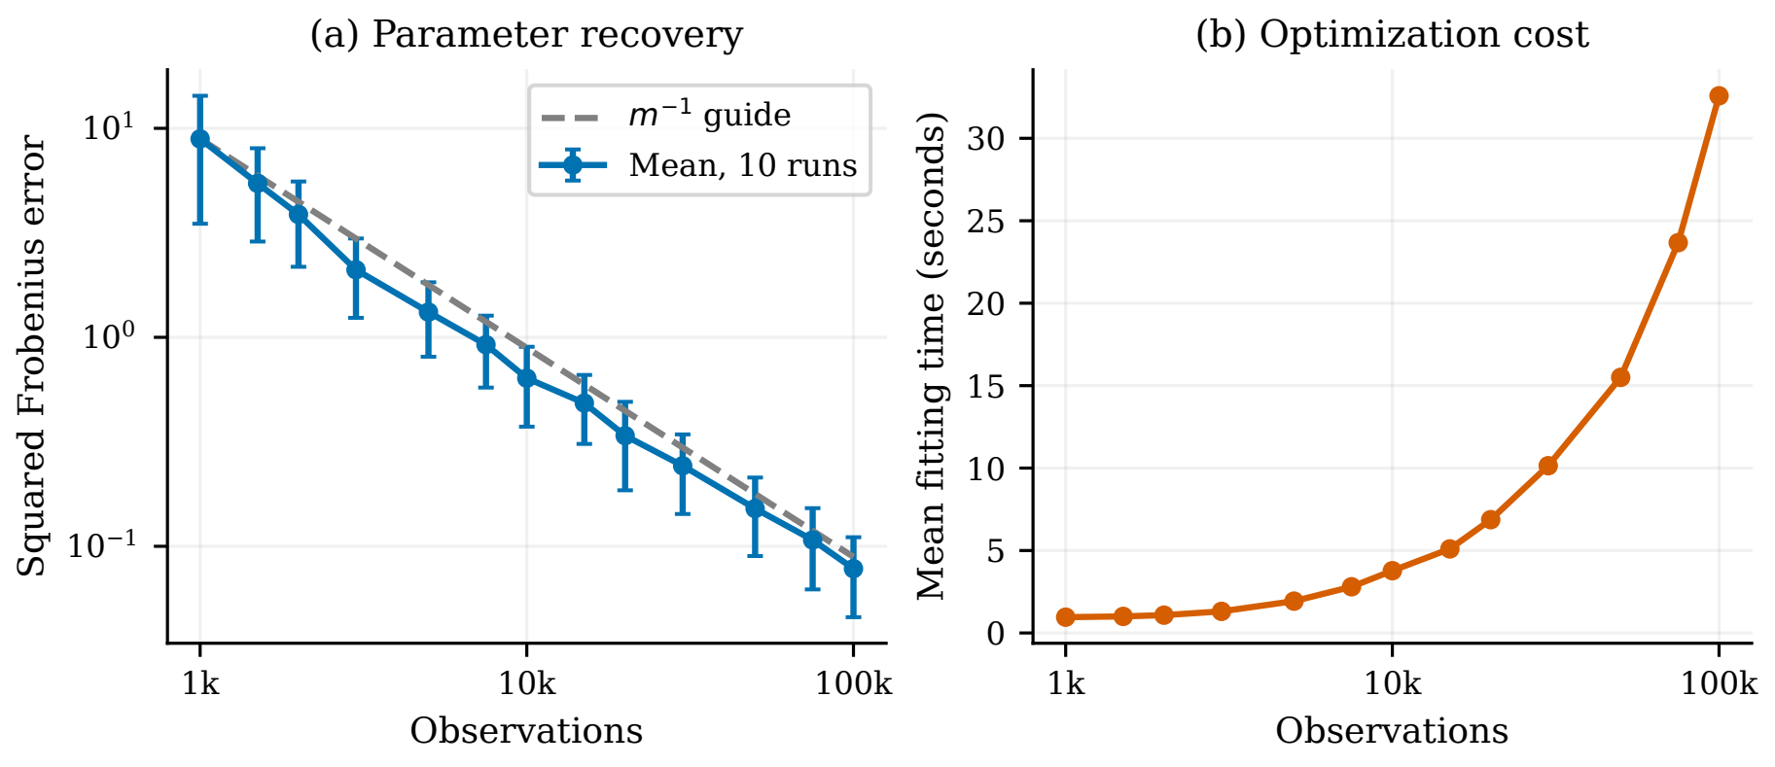
Six-item CDM parameter recovery
Choice sets contain two to six items. Results average ten runs at each observation count.
The sum of squared parameter errors decreases as observations increase, while fitting time rises.
IIT Madras / Phase I Viva
11
Notes:
Following Seshadri et al. (2019), the generating parameters are fixed and smaller datasets are nested in each simulated run. Squared Frobenius distance sums the squared differences over all 30 off-diagonal entries after centring. The dashed inverse-count curve is a reference.
Source: Phase I report, §3.2.5.
Source notebook: https://github.com/rbhdsks/Learning-from-Comparison-Data-Master-Thesis-Project-/blob/cc7a5ab5ccf2ef462020f26919576bf275fa4105/notebooks/experiments/Context_Dependent_Model/CDM_Paper_Reproduction/01_synthetic_recovery.ipynb

Slide 12
Conclusion
Parameter recovery
More observations improved recovery. Increasing the number of items under a fixed data budget made estimation more difficult.
Context effects
Fitting BTL/Luce to the tested CDM-generated choices left a predictive gap.
Low-rank CDM
Fewer stored parameters did not translate into the same reduction in runtime or total process memory.
Further work will repeat the comparisons across independent datasets and improve optimisation.
IIT Madras / Phase I Viva
12
Notes:
Summarise the findings within the tested synthetic settings. Discuss further checks across independent datasets and improvements to low-rank optimisation.
Source: Phase I report, §4.

