Slide 1
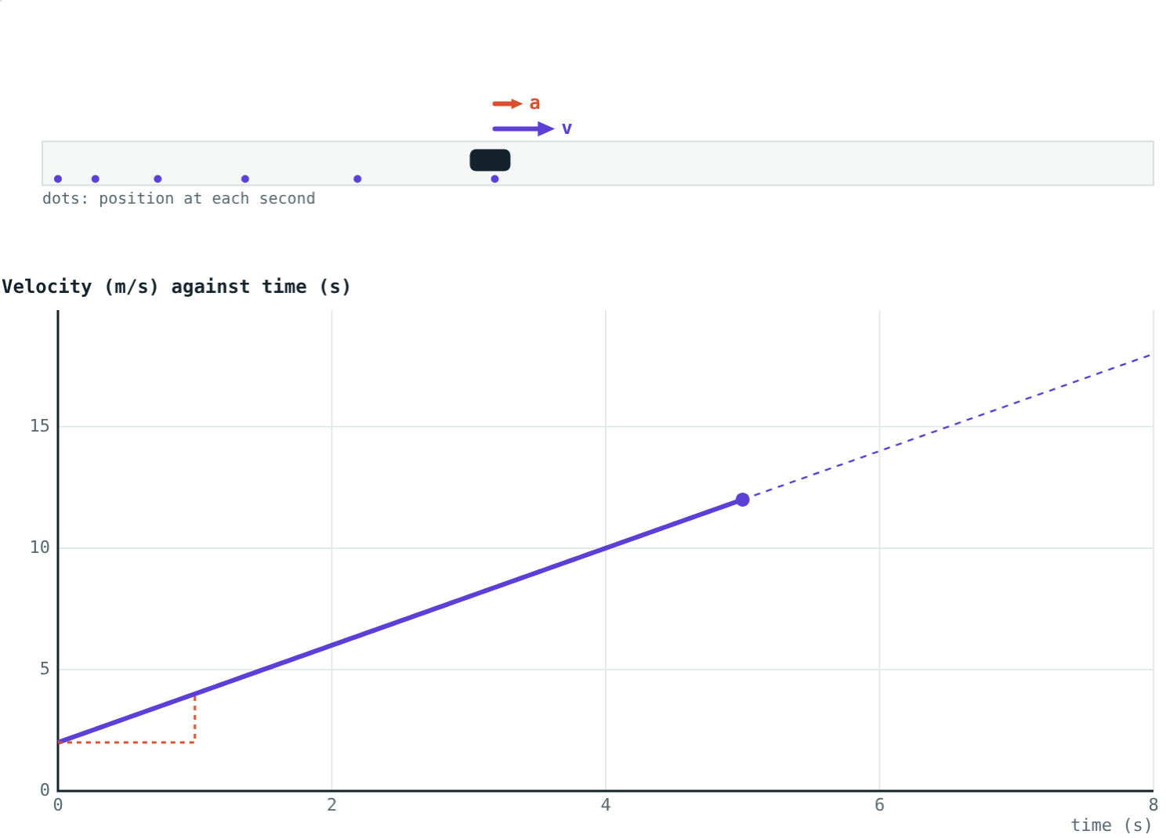
Acceleration
STD 9 SCIENCE · CH. 1 LAWS OF MOTION
Lesson 4 · Visual Science & Maths
Notes:
Goal: students can calculate acceleration from a = (v − u)/t, use the unit m/s², and classify positive, negative and zero acceleration.

Slide 2
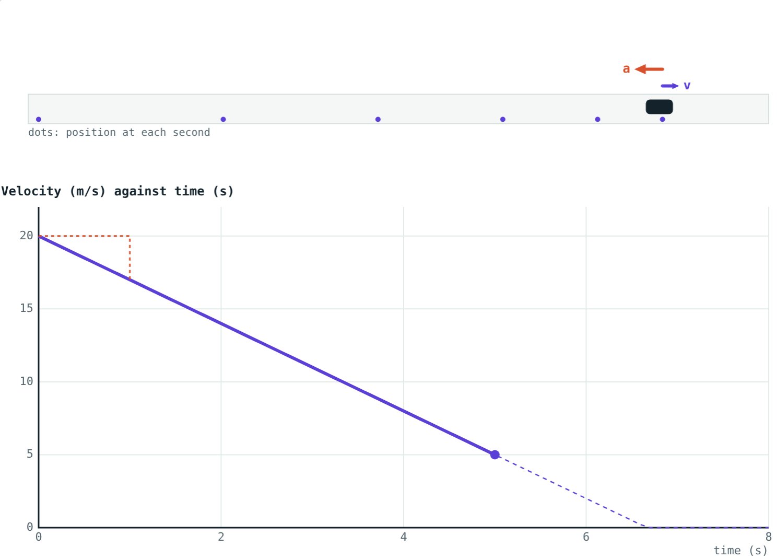
How quickly does velocity change?
A scooter pulls away from a green light. A bus slows down as it reaches a stop. Both velocities are changing.
Which changes faster, and how can we measure it?
A bus braking from 20 m/s: the dots bunch up
Notes:
Introduce the idea that 'how fast velocity changes' is a quantity in its own right.

Slide 3
Acceleration
a = (v − u) ÷ t
The rate of change of velocity
u = initial velocity, v = final velocity, t = time taken
SI unit: m/s² (metres per second per second)
2 m/s² means velocity grows by 2 m/s every second
Violet arrow: velocity. Coral arrow: acceleration
Notes:
Write the units out in full once: (m/s) ÷ s = m/s². Students often write m/s by mistake.

Slide 4



Three kinds of acceleration
Positive
Negative
Zero
Velocity increases. Acceleration points the same way as the motion.
Velocity decreases. Also called deceleration or retardation.
Velocity stays the same: uniform motion or at rest.
Notes:
Ask for an example of each: a ball rolling down a slope, a car braking, a train cruising.

Slide 5
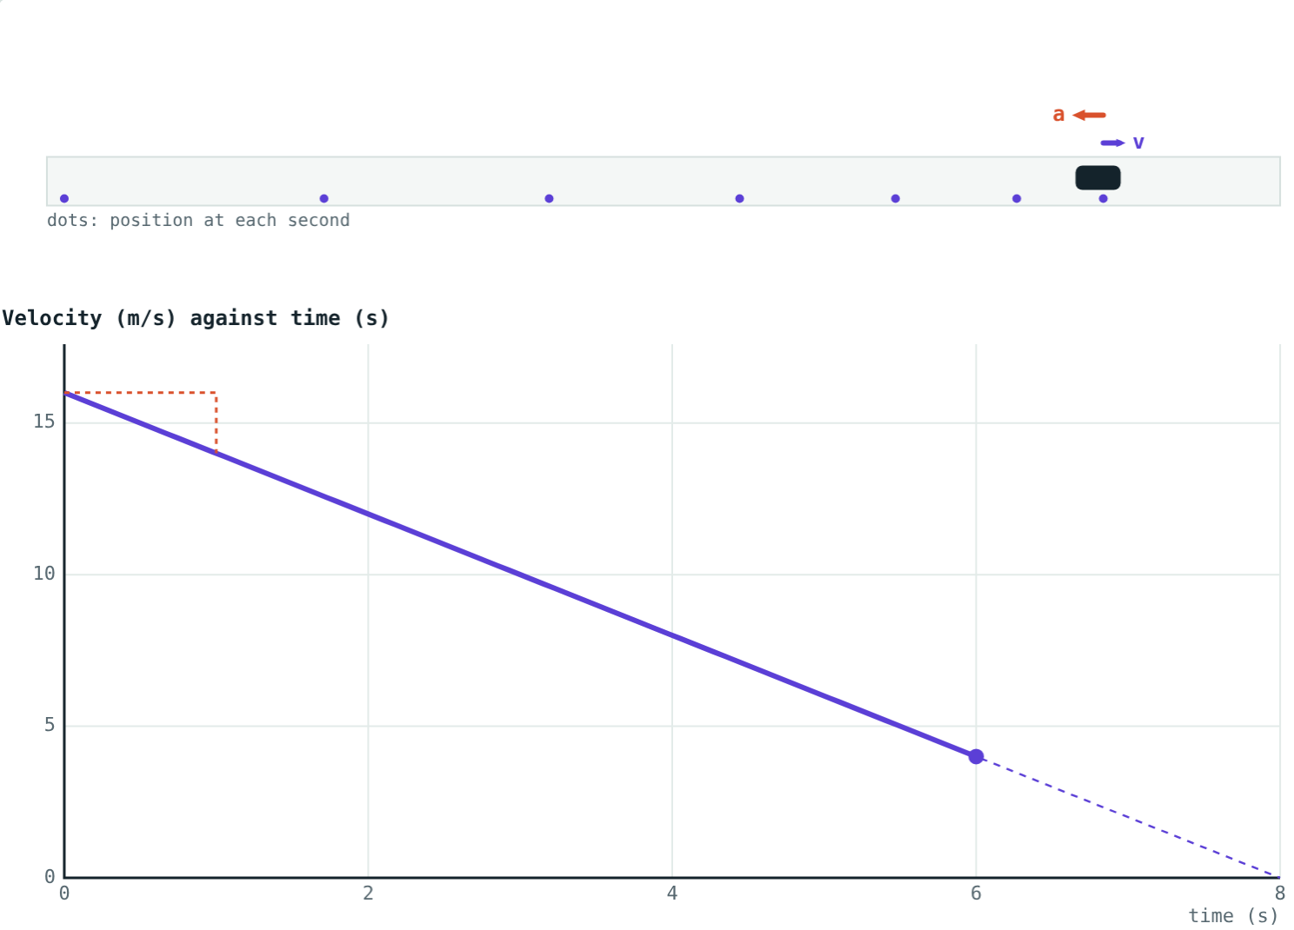
Speeding up and slowing down
u = 2 m/s, a = +2 m/s²: dots spread out, graph rises.
u = 16 m/s, a = −2 m/s²: dots bunch up, graph falls.
The slope of the velocity–time graph is the acceleration.
Notes:
Point at the dashed step on each graph: the change in velocity in one second is the acceleration.

Slide 6
Equal changes in equal times
Time (s) | 0 | 1 | 2 | 3 | 4
Scooter's velocity (m/s) | 0 | 3 | 6 | 9 | 12
Change each second (m/s) | – | +3 | +3 | +3 | +3
Notes:
Equal changes of velocity in equal times is uniform acceleration, here 3 m/s². A ball rolling down a smooth slope behaves like this.

Slide 7
Worked examples
A scooter at a green light
A bus pulling in
A scooter starts from rest and reaches 12 m/s in 4 s. Find its acceleration.
A bus slows from 20 m/s to 5 m/s in 5 s. Find its acceleration.
u = 0, v = 12 m/s, t = 4 s
a = (12 − 0) ÷ 4 = 3 m/s²
u = 20, v = 5, t = 5
a = (5 − 20) ÷ 5 = −3 m/s²
Notes:
The minus sign in the second answer is the physics: it says the bus is decelerating.

Slide 8
Worked example: units first
A car speeds up from 18 km/h to 54 km/h in 5 s. Find its acceleration in m/s².
u = 18 × 5/18 = 5 m/s
v = 54 × 5/18 = 15 m/s
a = (15 − 5) ÷ 5 = 2 m/s²
Same idea in the simulation: steady positive acceleration
Notes:
Always convert to m/s before dividing by time in seconds.

Slide 9
Braking to a stop
A bus at 20 m/s brakes with a deceleration of 3 m/s².
−3 m/s²
acceleration
6.7 s
time to stop
It loses 3 m/s every second, so it stops after 20 ÷ 3 ≈ 6.7 s.
u = 20 m/s, a = −3 m/s², shown at 5 s
Notes:
Use v = u + at with v = 0 as a preview of the equations of motion (Lesson 6).

Slide 10

Common mistakes
v − u the wrong way round
Wrong unit
Always final minus initial, or the sign flips.
Acceleration is m/s², not m/s.
Mixing km/h and seconds
“At rest means no acceleration”
Convert velocities to m/s before dividing.
A ball at the top of its throw is at rest for an instant but still accelerating.
Notes:
The last point is a good discussion question for stronger students.

Slide 11
Quick check
1
A cyclist goes from 2 m/s to 8 m/s in 3 s. Find her acceleration.
2
A train runs at a steady 72 km/h on a straight track. What is its acceleration?
3
What does negative acceleration tell you about the velocity?
4
What is the SI unit of acceleration?
Notes:
Answers: 1) 2 m/s². 2) Zero. 3) The velocity is decreasing (deceleration). 4) m/s².

Slide 12
Drive it yourself
Open the Acceleration lesson on the Visual Science & Maths website. Set the starting velocity and acceleration, and watch the velocity–time graph.
Next lesson: Distance–time and velocity–time graphs
Notes:
Homework idea: list five situations at home or on the road and classify each acceleration as positive, negative or zero.

