Slide 1
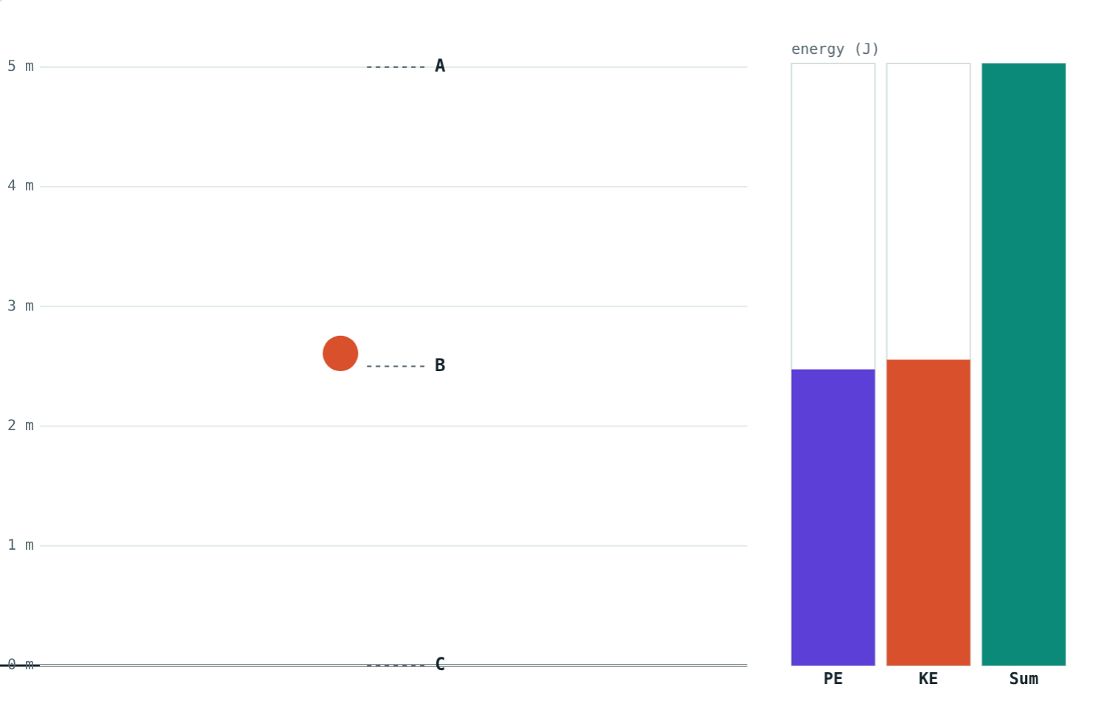
Conservation of Energy
STD 9 SCIENCE · CH. 2 WORK AND ENERGY
Lesson 3 · Visual Science & Maths
Notes:
Goal: students can state the law of conservation of energy, follow P.E. and K.E. through free fall, and use v = √(2gh).

Slide 2




Energy changes form
Solar panel
Battery and fan
Hydroelectric dam
Green plants
Light energy becomes electrical energy.
Chemical → electrical → kinetic energy.
Potential → kinetic → electrical energy.
Light energy becomes chemical energy in food.
Notes:
Ask students to trace the energy changes in a torch, a pressure cooker and a bicycle dynamo.

Slide 3
The law of conservation of energy
Energy can neither be created nor destroyed. It can only be converted from one form into another.
The total energy stays the same
Energy that seems “lost” has changed into heat or sound
Falling ball: the green total bar never changes
Notes:
This is one of the most important ideas in all of science.

Slide 4
Free fall: points A, B and C
Point | P.E. | K.E. | Total
A: top, at rest | mgh | 0 | mgh
B: fallen a distance x | mg(h − x) | mgx (v² = 2gx) | mgh
C: just before landing | 0 | mgh (v² = 2gh) | mgh
Notes:
At B, v² = 2gx from the third equation of motion, so K.E. = ½m(2gx) = mgx.

Slide 5
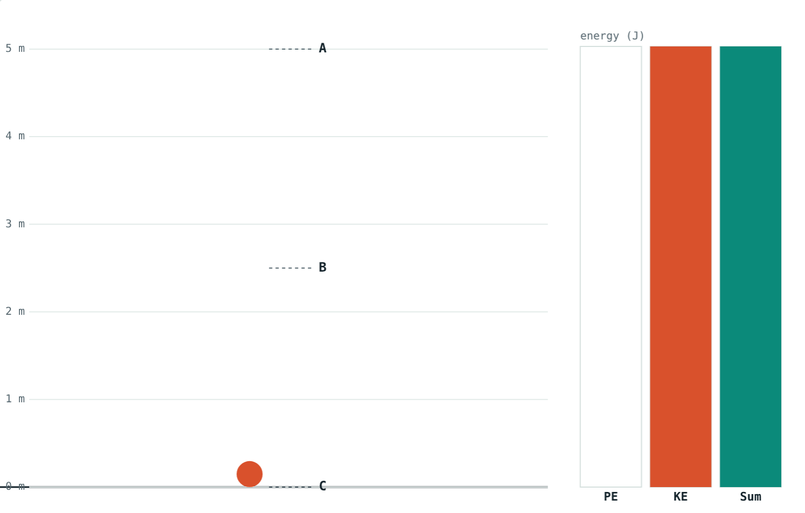
Halfway and at the bottom
P.E. and K.E. about equal; total 98 J.
All kinetic: 98 J at about 9.9 m/s.
Potential energy lost = kinetic energy gained.
Notes:
Both pictures show a 2 kg ball dropped from 5 m.

Slide 6
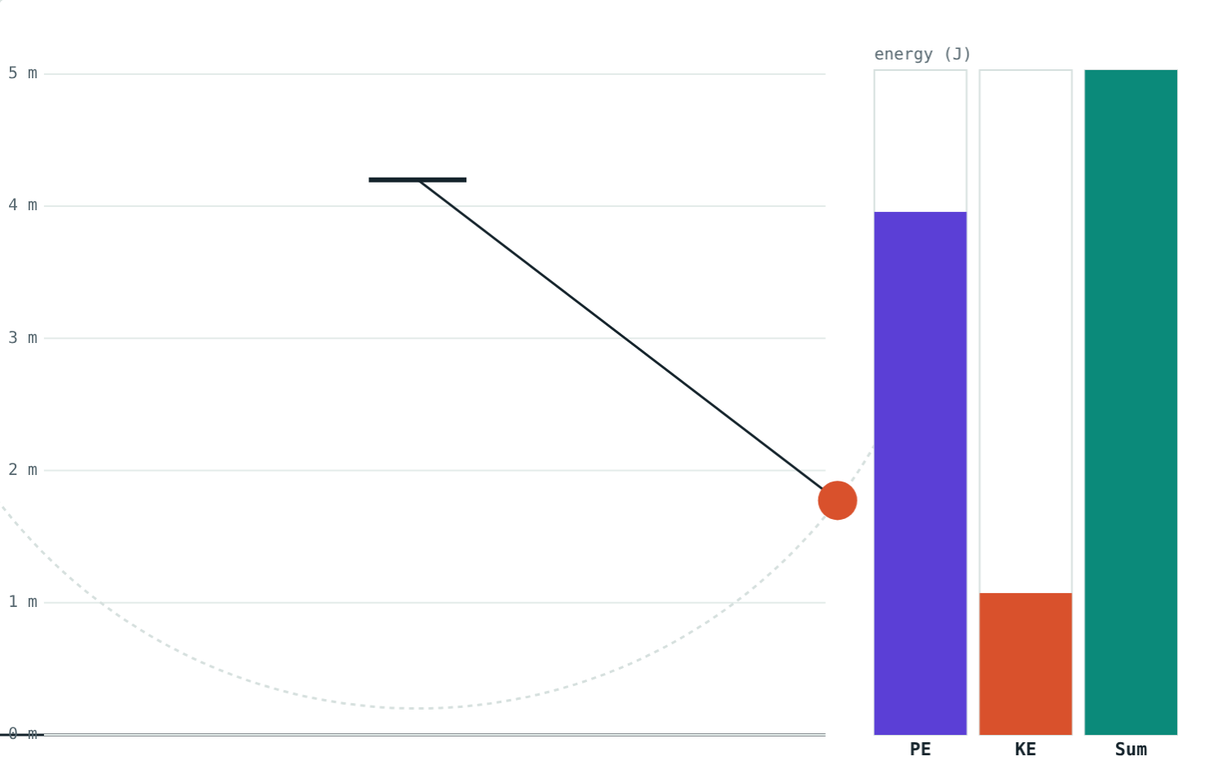
Pendulums and slides
v = √(2gh)
Pendulum: all P.E. at the ends, all K.E. at the bottom
Smooth slide: speed at the bottom = √(2gh)
Mass cancels: heavy and light reach the same speed
Shape of the slide does not matter
The bars swap as the pendulum swings
Notes:
From mgh = ½mv², the m cancels, leaving v = √(2gh).

Slide 7
Worked example: free fall
A 2 kg ball is dropped from 5 m. Find its energies at the top, halfway and just before landing.
Top: P.E. = 98 J, K.E. = 0, total = 98 J
Halfway: P.E. = 49 J, K.E. = 49 J
Bottom: K.E. = 98 J, v = 9.9 m/s
Just before landing: all kinetic energy
Notes:
v = √(2 × 98 ÷ 2) = √98 ≈ 9.9 m/s.

Slide 8
Worked examples
A playground slide
A pendulum
A child slides from rest down a smooth slide 2.5 m high. Find her speed at the bottom.
A bob is released 0.2 m above its lowest point. Find its speed at the bottom.
v = √(2 × 9.8 × 2.5) = √49 = 7 m/s
v = √(2 × 9.8 × 0.2) = √3.92 ≈ 1.98 m/s
Notes:
Neither answer depends on the mass.

Slide 9
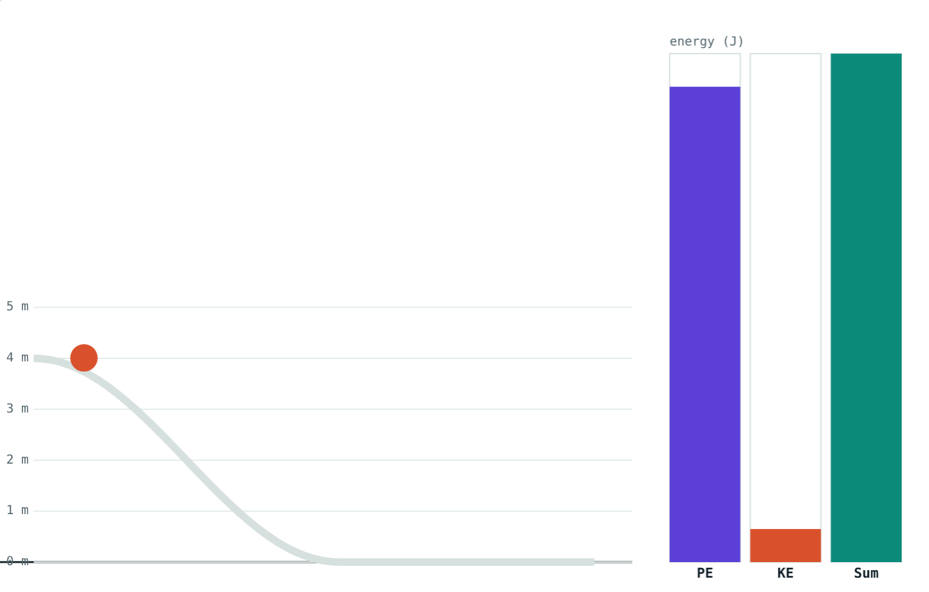
Heavy or light, same speed
From 4 m on a smooth slide:
8.85 m/s
1 kg child at the bottom
8.85 m/s
5 kg child at the bottom
The heavier child has five times the energy, but the same speed.
A ball on a smooth slide from 4 m
Notes:
Energies: 39.2 J for 1 kg, 196 J for 5 kg.

Slide 10

Common mistakes
“Energy gets used up”
Heavier slides faster
It changes form, often into heat.
Without friction, v = √(2gh) for any mass.
Counting energy twice
Height in cm
At any point, P.E. + K.E. = starting energy.
Use metres: 50 cm = 0.5 m.
Notes:
The first is worth a class discussion: where does a stopped pendulum's energy go?

Slide 11
Quick check
1
Just before a dropped ball lands, what form is most of its energy in?
2
At the top of its swing, what kind of energy does a pendulum bob have?
3
A 1 kg ball falls from 10 m. Find its K.E. just before landing.
4
A real pendulum slowly stops. Where did its energy go?
Notes:
Answers: 1) Kinetic. 2) Potential (K.E. is zero for an instant). 3) 98 J. 4) Heat and sound, through air resistance and friction.

Slide 12
Watch the bars yourself
Open the Conservation of Energy lesson on the Visual Science & Maths website. Drop a ball, swing a pendulum and race down a slide.
Next lesson: Power
Notes:
Homework idea: trace the energy changes from the Sun to a cup of tea.

