Slide 1
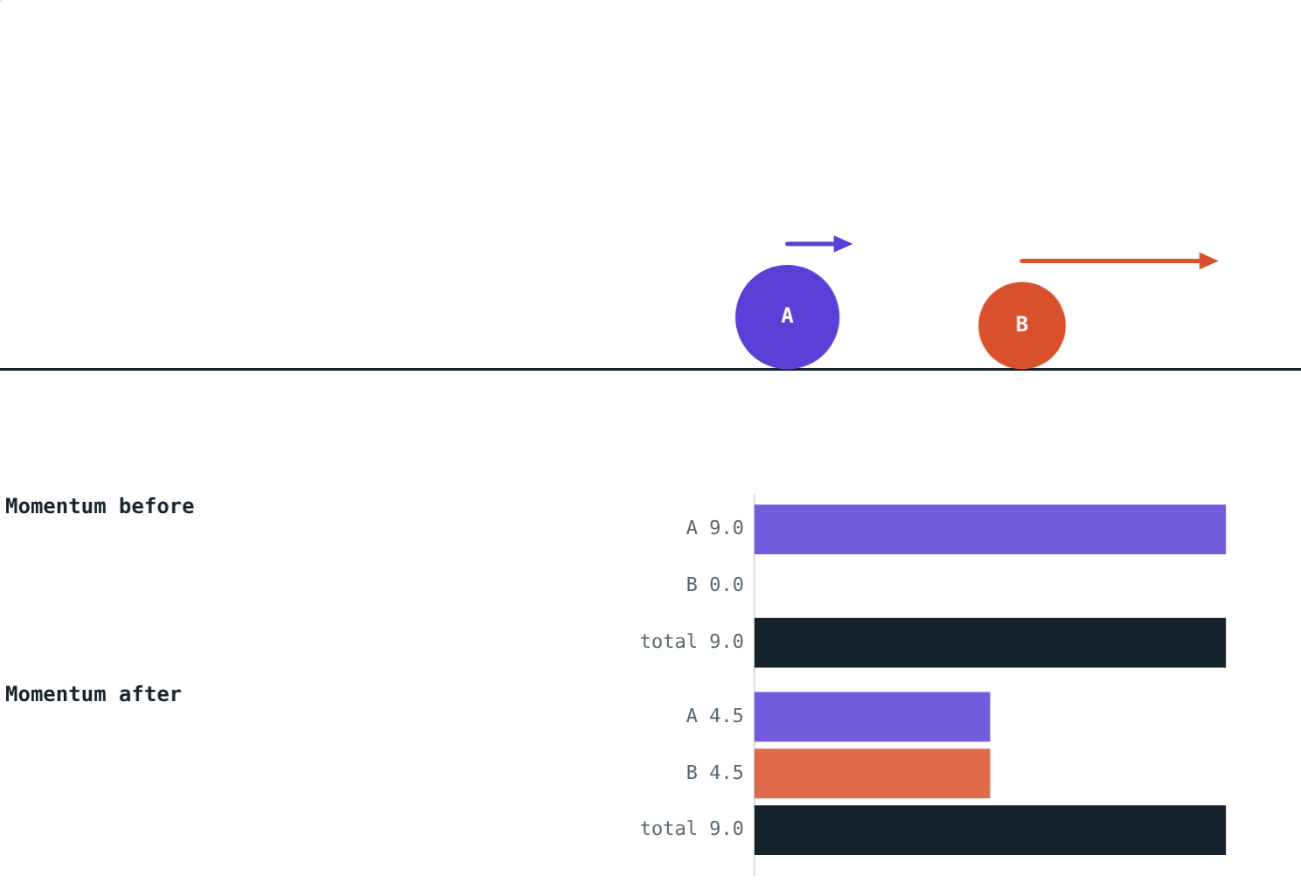
Conservation of Momentum
STD 9 SCIENCE · CH. 1 LAWS OF MOTION
Lesson 9 · Visual Science & Maths
Notes:
Goal: students can state the law of conservation of momentum, explain it using the third law, and solve collision and recoil problems.

Slide 2
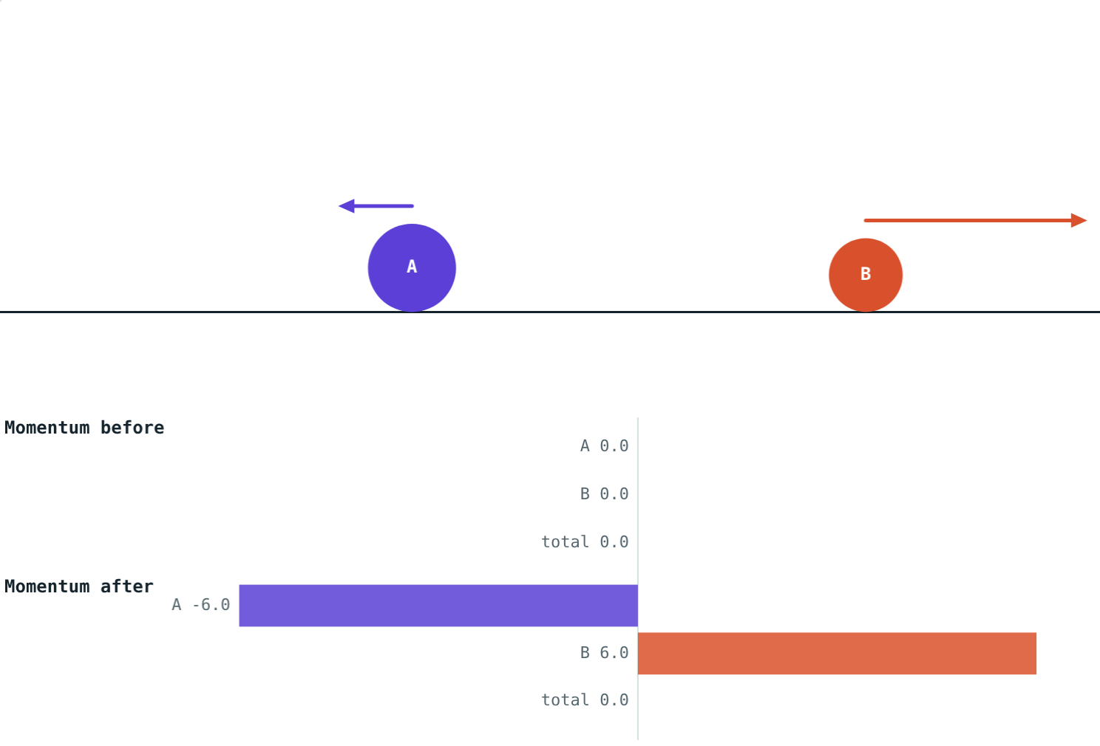
Before and after
Two marbles collide. A gun recoils. A rocket lifts off. Each time, objects push on each other.
What stays the same before and after?
Two balls pushing apart from rest
Notes:
Let students guess: speed? energy? The answer is total momentum.

Slide 3
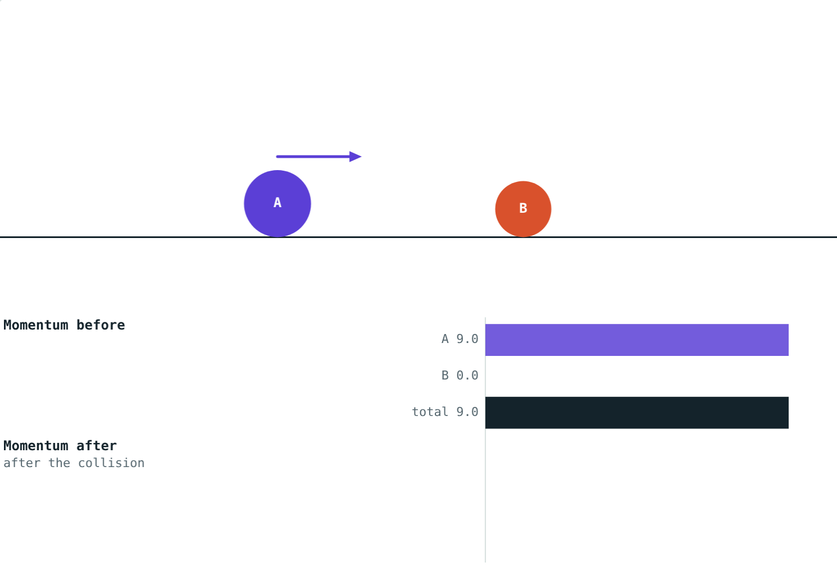
The law
m₁u₁ + m₂u₂ = m₁v₁ + m₂v₂
With no external force, the total momentum of interacting objects stays constant.
Momentum P = mv, in kg·m/s
It has a direction: right +, left −
Before the collision: A carries all 9 kg·m/s
Notes:
Choose one direction as positive at the start of every problem.

Slide 4
Heavy ball hits light ball
A: 3 × 3 = 9 kg·m/s. B: 0. Total 9.
A: 3 × 1.5 = 4.5. B: 1 × 4.5 = 4.5. Total 9.
The momentum is shared out differently, but the total does not change.
Notes:
Compare the black total bars in both pictures: they are the same length.

Slide 5
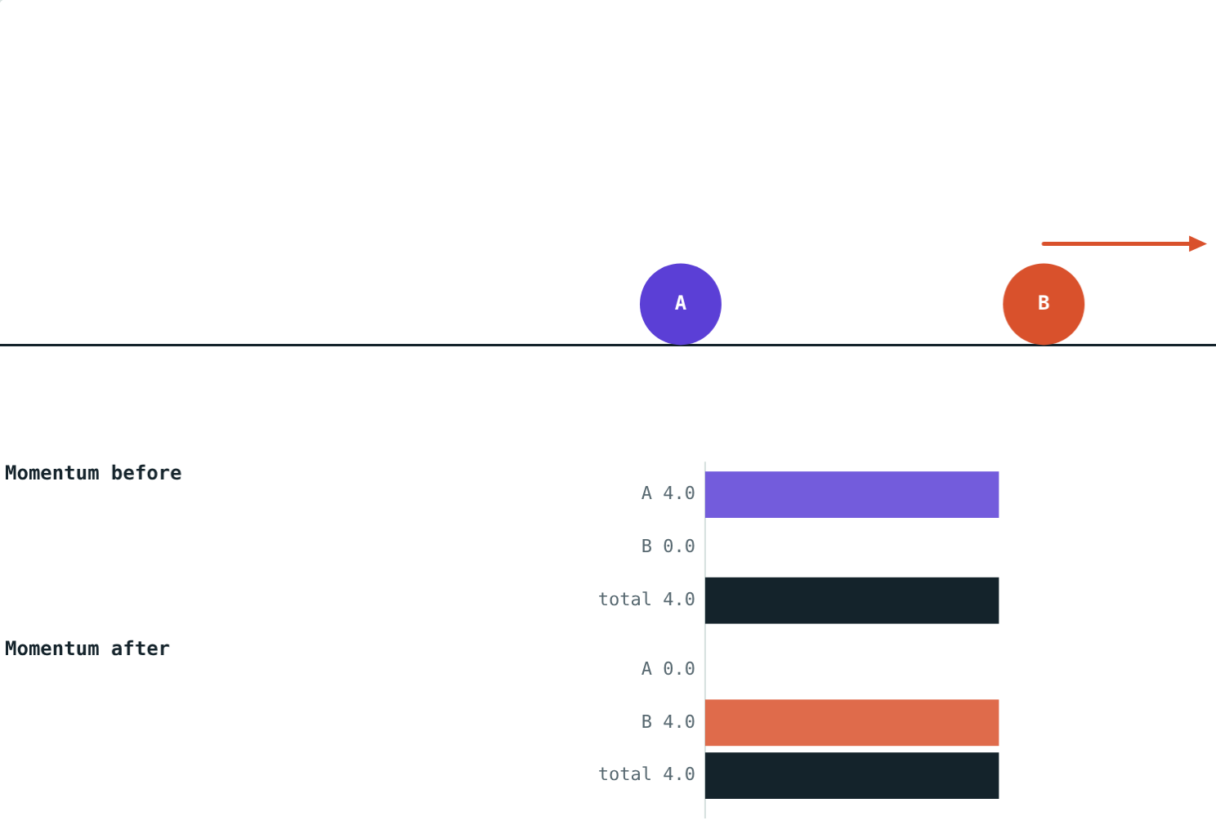
Why it works
It follows from Newton's third law:
A pushes B and B pushes A, equally and oppositely
Both forces act for the same time
So B gains exactly the momentum A loses
The total cannot change
Equal masses: A stops, B carries all the momentum
Notes:
Change in momentum = force × time. Equal and opposite forces for equal times give equal and opposite changes.

Slide 6
Recoil
Total momentum is 0 before, so it must be 0 after:
−6
heavy ball (kg·m/s)
+6
light ball (kg·m/s)
The heavy ball moves back slowly; the light one moves off fast. Guns and rockets work the same way.
3 kg and 1 kg balls push apart from rest
Notes:
Heavy ball: −6 ÷ 3 = −2 m/s. Light ball: 6 ÷ 1 = 6 m/s.

Slide 7
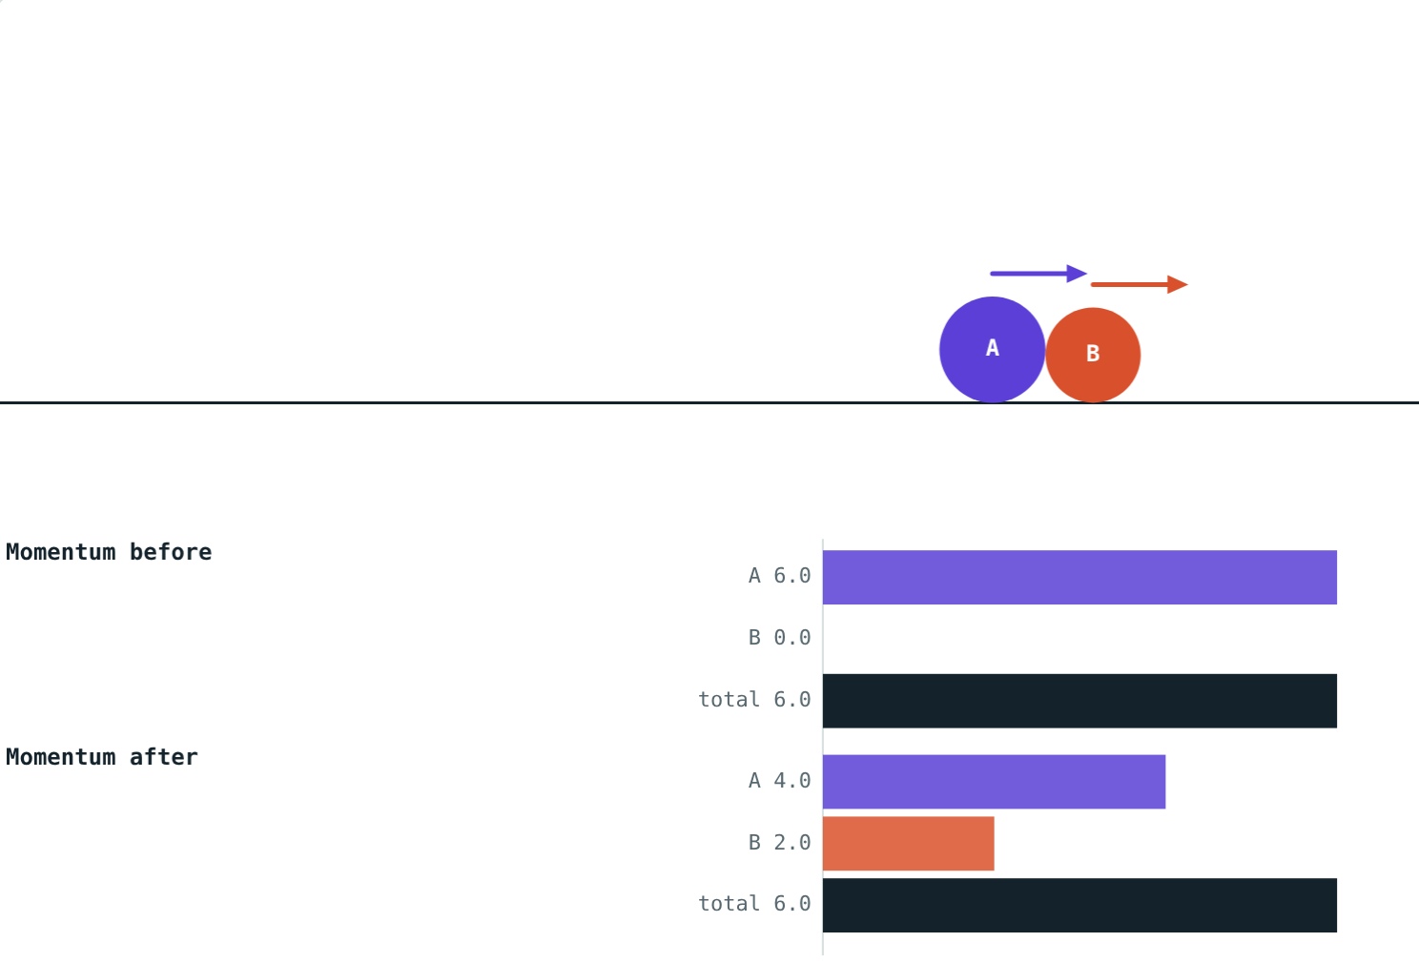
Sticking together
Before: 2 × 3 = 6 kg·m/s. After, both move together:
6
total after (kg·m/s)
2 m/s
common velocity
Energy is lost as heat and sound, but momentum is still conserved.
2 kg at 3 m/s hits 1 kg at rest, and they stick
Notes:
v = 6 ÷ (2 + 1) = 2 m/s.

Slide 8
Worked examples
Gun recoil
Trolleys that stick
A 4 kg gun fires a 20 g bullet at 400 m/s. Find the gun's recoil velocity.
A 2 kg trolley at 3 m/s hits a 1 kg trolley at rest, and they stick. Find their velocity.
0 = 0.02 × 400 + 4v
4v = −8, so v = −2 m/s
Before: 2 × 3 = 6 kg·m/s
3v = 6, so v = 2 m/s
Notes:
The minus sign in the first answer means the gun moves backwards.

Slide 9
Worked example: a missing velocity
A 3 kg ball at 3 m/s hits a 1 kg ball at rest. Afterwards the 3 kg ball moves at 1.5 m/s. Find the velocity of the 1 kg ball.
Before: 3 × 3 + 0 = 9 kg·m/s
After: 3 × 1.5 + 1 × v₂ = 4.5 + v₂
4.5 + v₂ = 9, so v₂ = 4.5 m/s
Total before = total after = 9 kg·m/s
Notes:
Set up 'total before = total after' and solve for the unknown.

Slide 10

Common mistakes
Forgetting signs
Adding speeds
Velocities in the opposite direction are negative.
Add momenta (m × v), not speeds.
“Sticking loses momentum”
Ignoring outside forces
Energy is lost; momentum is not.
The law needs no external force, such as friction.
Notes:
Sign errors in head-on collision problems are the most common mistake.

Slide 11
Quick check
1
Find the momentum of a 0.5 kg ball moving at 6 m/s.
2
Why does a cannon move backwards when it fires?
3
A 1 kg ball at 4 m/s hits an identical ball at rest and stops. How fast does the second ball move?
4
When is total momentum conserved?
Notes:
Answers: 1) 3 kg·m/s. 2) Total momentum must stay zero, so the cannon's backward momentum balances the shell's forward momentum. 3) 4 m/s. 4) When no external force acts.

Slide 12
Collide them yourself
Open the Conservation of Momentum lesson on the Visual Science & Maths website. Change the masses and velocities, and check the totals.
That completes Chapter 1: Laws of Motion
Notes:
Homework idea: explain how a rocket can accelerate in space, where there is no air to push against.

